Slide 1
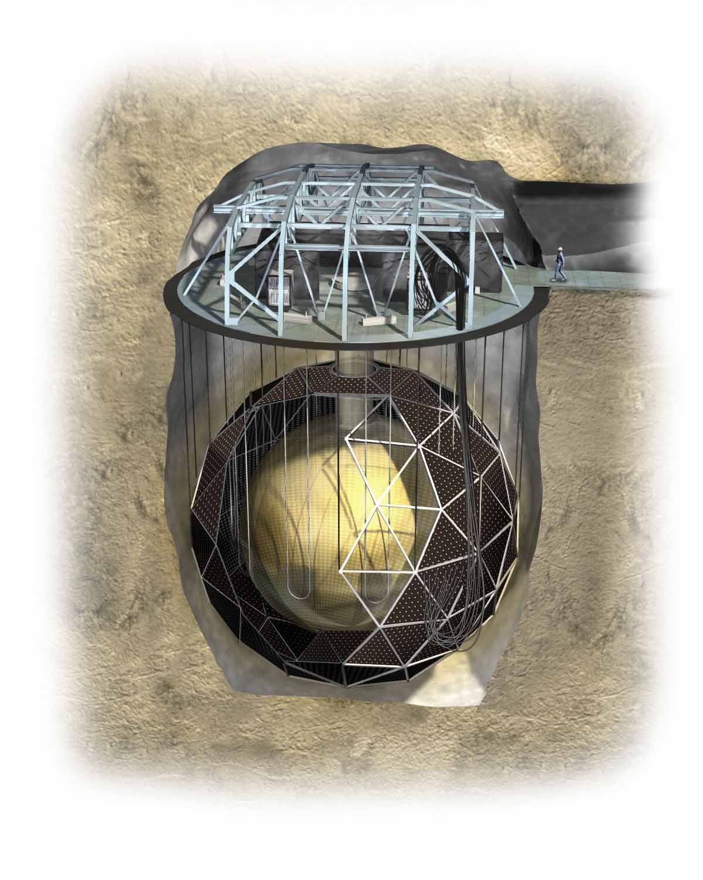
Neutrino Physics from SNO
Aksel Hallin
University of Alberta
Erice, 2009

Slide 2
Neutrino Physics from SNO/SNO+
SNO+ will be discussed by Christine Kraus and Simon Peeters; also Art McDonald.
SNO 3 Phase analysis by N. de Barros

Slide 3
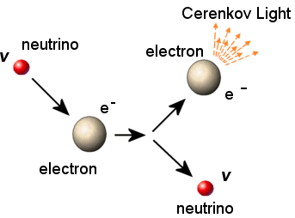
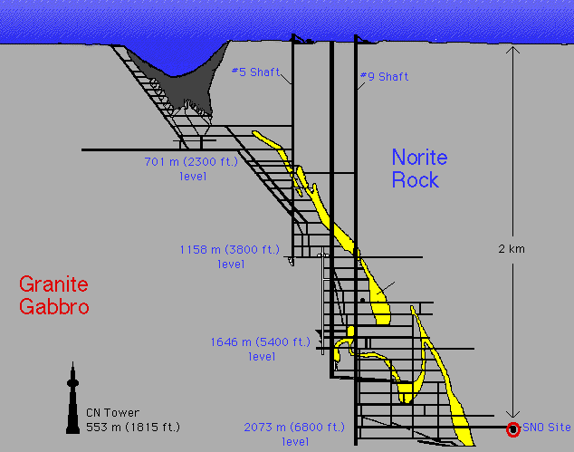
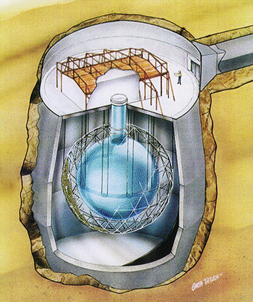
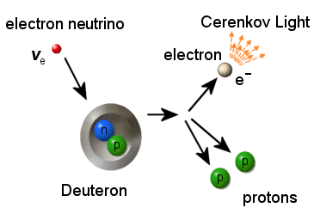
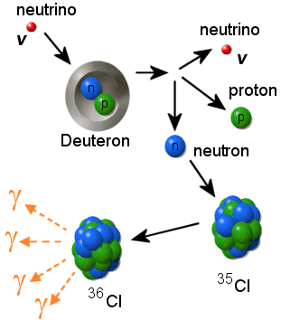
Sudbury Neutrino Observatory
Neutrino-Electron Scattering (ES)
Charged Current (CC)
1000 tonnes D₂O
Support Structure for 9500 PMTs, 60% coverage
12 m Diameter Acrylic Vessel
1700 tonnes Inner
Shielding H₂O
Neutral Current (NC)
5300 tonnes Outer
Shield H₂O
Urylon Liner and
Radon Seal

Slide 4
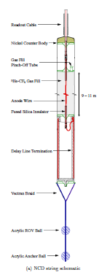
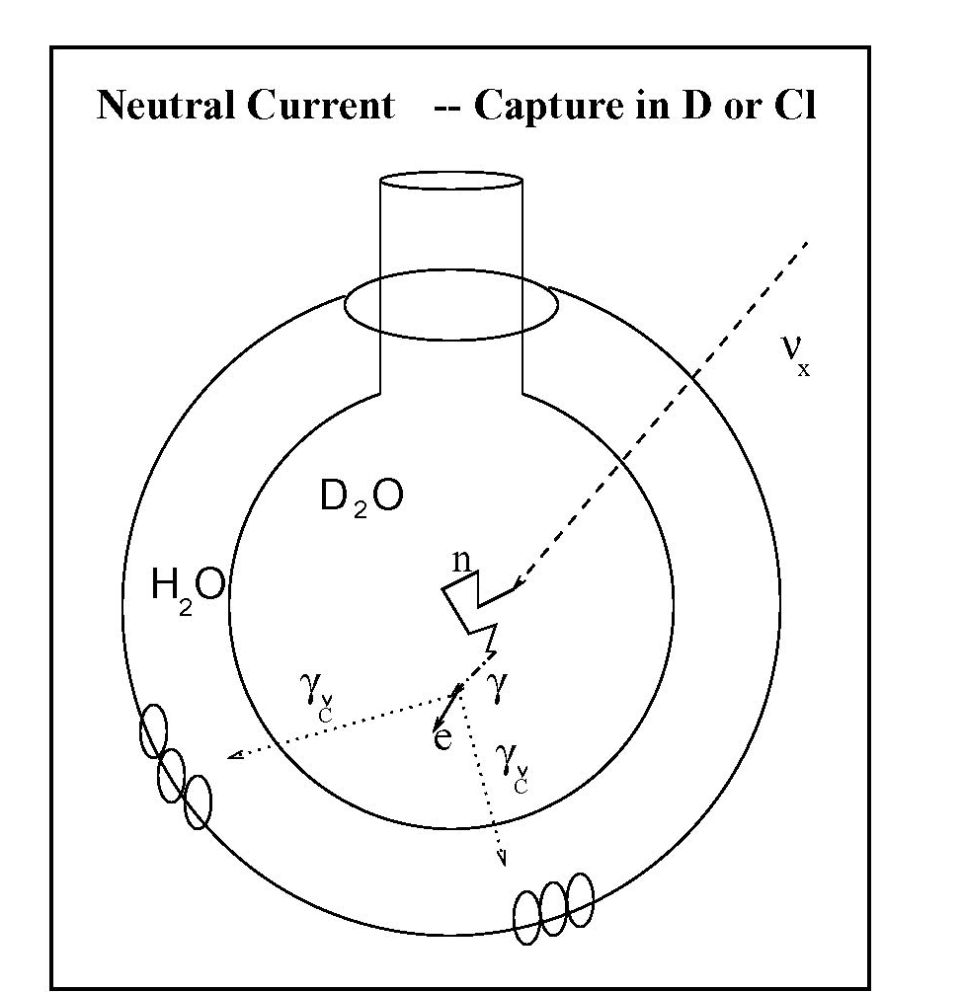
Three Phases of SNO: 3 NC reactions
Phase I: Just D₂O: neutron capture on deuterium
Simple detector configuration, clean measurement
Low neutron sensitivity
Poor discrimination between neutrons and electrons
Phase II: D₂O + NaCl: neutron capture on Chlorine
Very good neutron sensitivity
Better neutron electron separation
Phase III: D₂O + ³He Proportional Counters
Good neutron sensitivity
Great neutron/electron separation

Slide 5
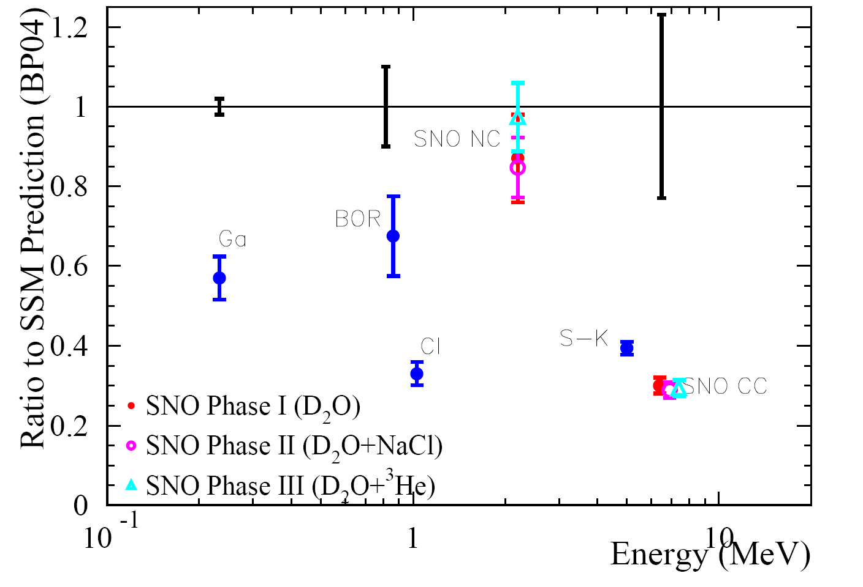
Solar ν Measurements
Global Summary

Slide 6
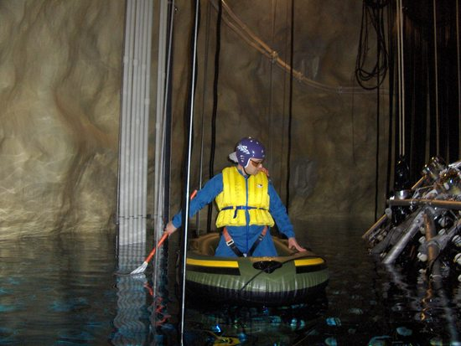
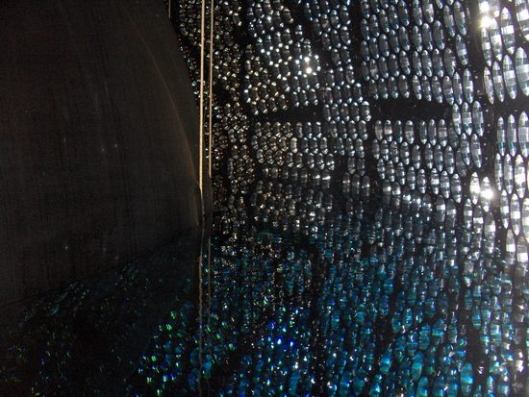
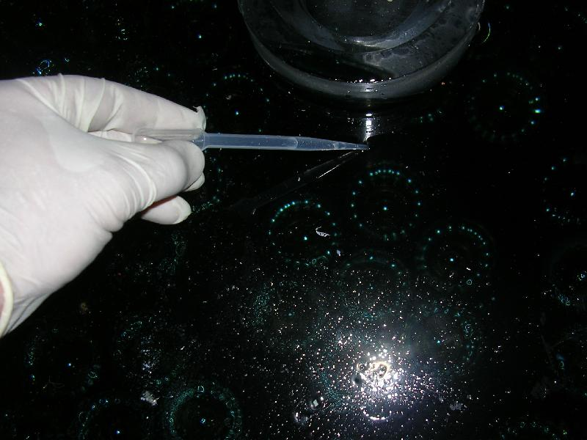
SNO
Ended data taking 28 Nov 2006
Most heavy water returned June 2007
Finish decommissioning end of 2007
TRIUMF Town Meeting 1-3 August 2007

Slide 7
Current SNO Efforts
High frequency periodicity studies (solar g-modes)
Burst searches
Exotics (e.g., n-nbar oscillation)
3-Phase analysis including NCD pulse shape analysis and hep analysis
Low Energy Threshold Analysis (LETA)
Joint Phase I+II down to T_{eff}>3.5 MeV
Significantly reduced systematics
Direct ν_{e} survival probability fit
(Borexino and Super-K also working in this regime)
SNO trigger threshold <~2.0 MeV for all phases
Previous SNO analysis thresholds:
T>5.0 MeV/5.5 MeV/6.0 MeV Phase I/II/III

Slide 8
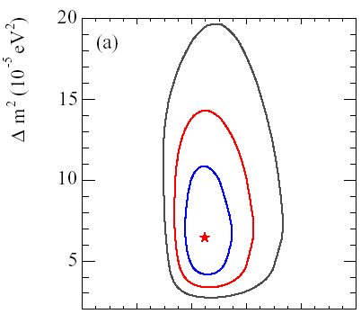
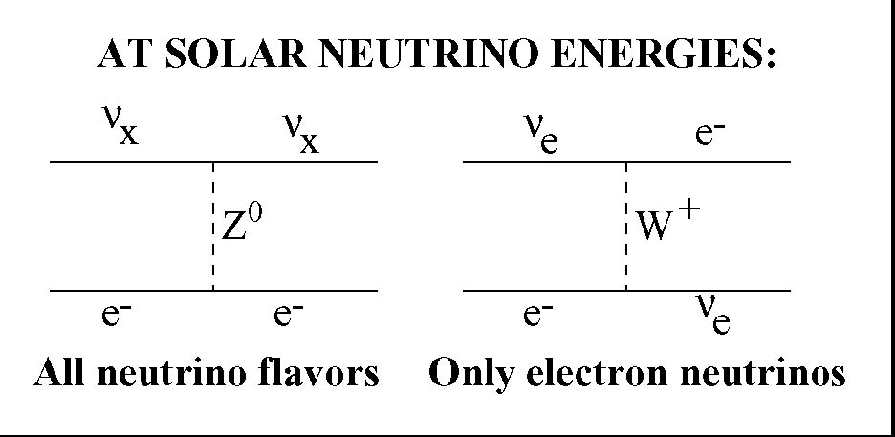
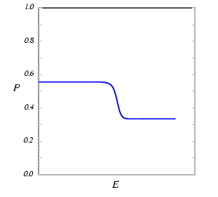
Physics Motivations for Low Threshold Analysis
MSW (Matter Effect) Phenomenology
`Unlucky’ Parameters
σ(ν_{μ,τ}) = 0.155σ(ν_{e})
Large spectral distortion
Large Day/Night effect
P_{ee}
Rise of survival probability at low T_{ν}
as we approach vacuum-average value of 1-(1/2)sin²2θ
E_{υ}
hep-ph/0305159

Slide 9
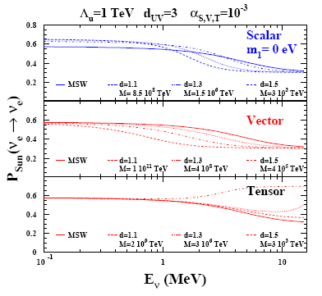
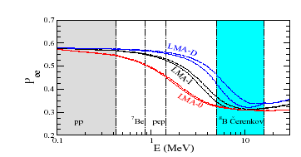
Physics Motivations for Low Threshold Analysis ( also SNO+ )
Nonstandard effects can be enhanced by MSW-like resonance
Miranda, Tortola, Valle, hep-ph/0406289 (2005)
M. C. Gonzalez-Garcia, P. C. de Holanda,
E. Masso and
R. Zukanovich Funchalc,
hep-ph/0803.1180
Friedland, Lunardini, Peña-Garay, PLB 594, (2004)
Barger, Huber, Marfatia, PRL95, (2005)

Slide 10
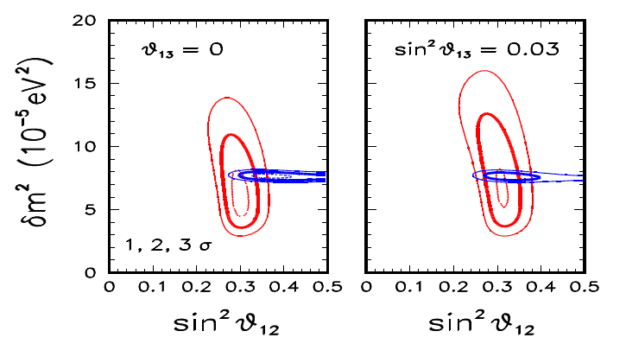
Physics Motivations for Low Threshold Analysis
Test the model of massive neutrino mixing
KamLAND+Solar provides (weak) handle on θ₁₃

Slide 11
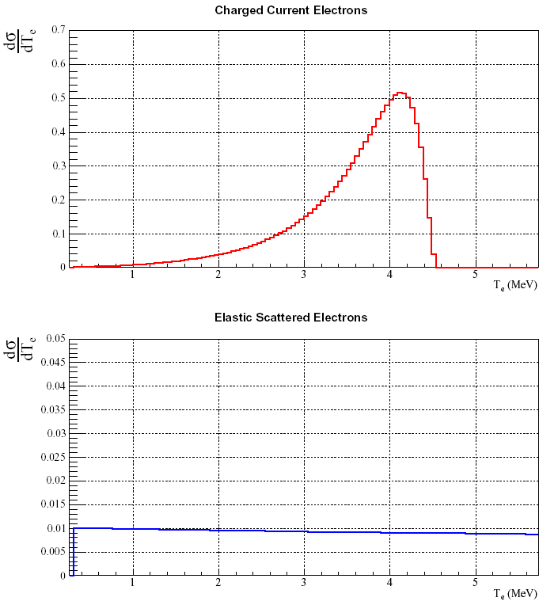
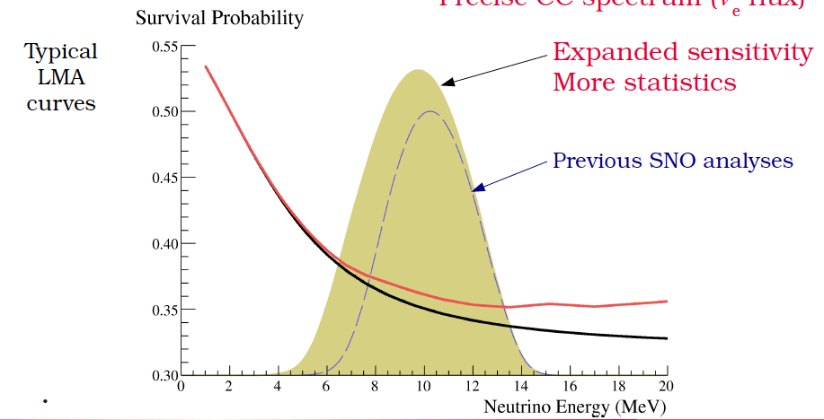
Advantages of Low Threshold Analysis
ν_{e} Statistics
E_{ν}=6 MeV
E_{ν}=6 MeV

Slide 12
Advantages of Low Threshold Analysis
ν_{x} (NC) Statistics
Phase I (D₂O)
NC
+74%
Phase II
(D₂O+NaCl)
NC
+68%

Slide 13
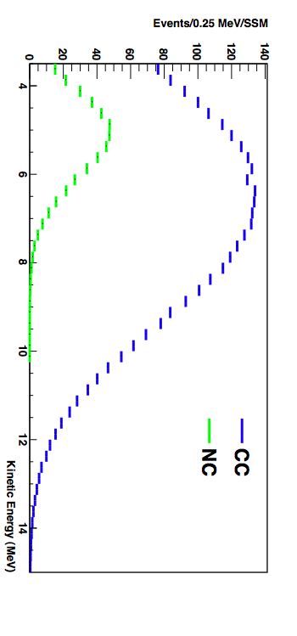
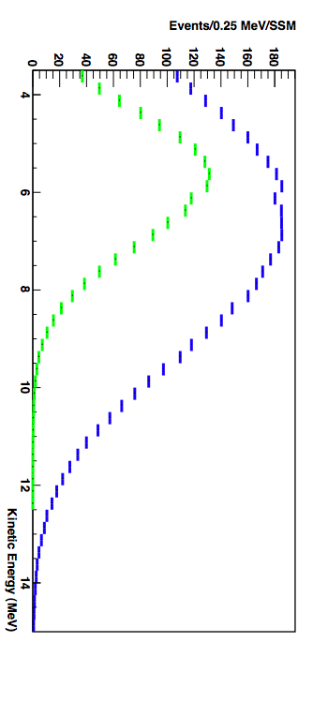
Advantages of (2-Phase) Low Threshold Analysis
Breaking NC/CC Covariance
Phase I
(D₂O)
“Beam Off”
Phase II
(D₂O+Salt)
“Beam On”

Slide 14
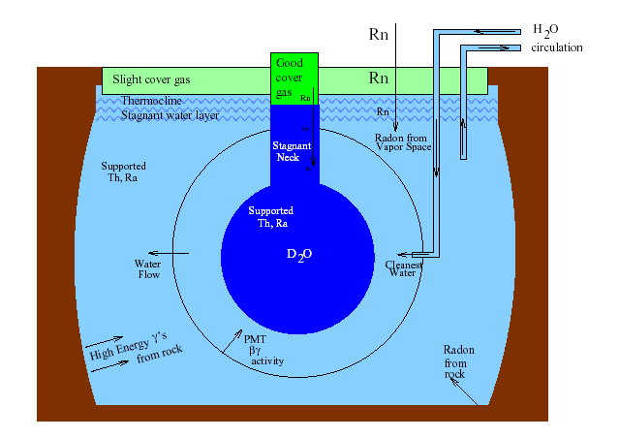
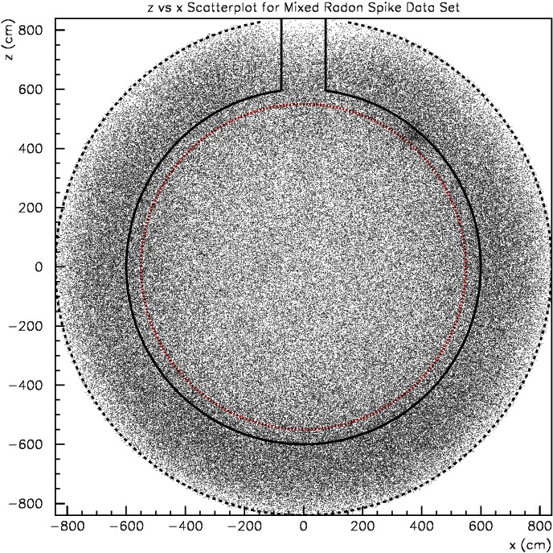
Challenges of a Low Threshold Measurement
Low Energy Backgrounds
Cosmic rays < 3/hour
T_{eff}>3.5 MeV
All events
(before background reduction);
~5000 νs

Slide 15
Challenges of a Low Threshold Measurement
Low Energy Backgrounds
Kinetic Energy Spectrum
PMT β−γs
3 neutrino signals
+ 17 backgrounds
MC
Old threshold
NC+CC+ES (Phase II)
internal (D₂O)
external (AV + H₂O)
New Threshold = 3.5 MeV
Notes:
ALL MC!!

Slide 16
How Do We Make a Low Threshold Measurement?
To make a meaningful measurement, we:
Reduced backgrounds
Reduced systematic uncertainties
Fit for all signals and remaining backgrounds
Entire analysis chain re-done, from charge pedestals to simulation upgrades to final `signal extraction’ fits
Primary reasons for improvement in precision:
Increased statistics
Breaking of NC/CC covariance
Reduction in systematic uncertainties

Slide 17
Low Energy Threshold Analysis
Signal Extraction Fit (Signal PDFs)
Not used
T_{eff} (MeV)
cosθ_{sun}
(R/R_{AV})³
1 D projections

Slide 18
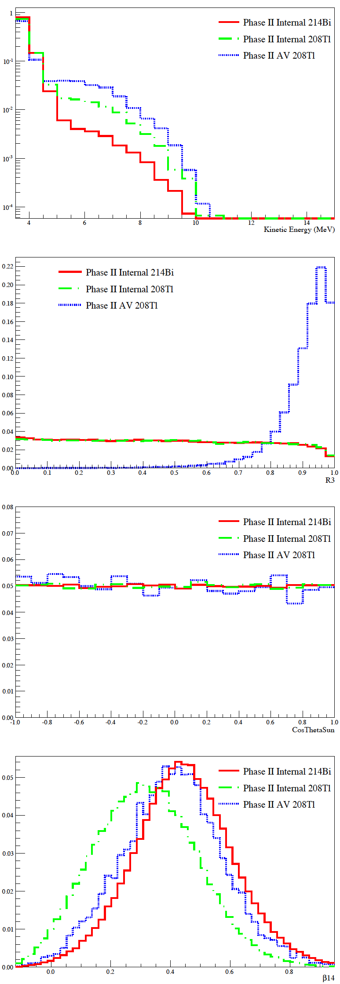
Low Energy Threshold Analysis
Signal Extraction Fit (3 Background PDFs)
T_{eff} (MeV)
cosθ_{sun}
(R/R_{AV})³
1 D projections

Slide 19
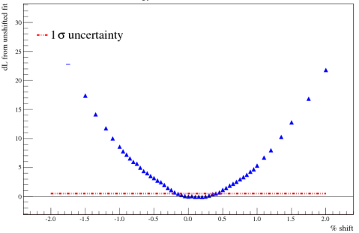
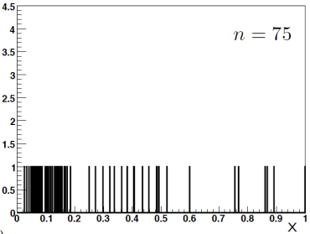
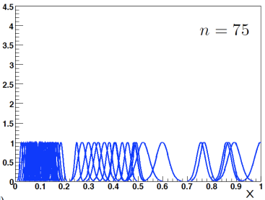
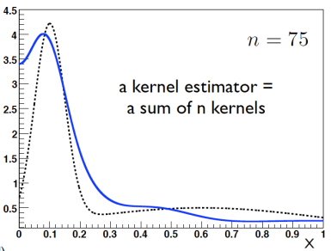
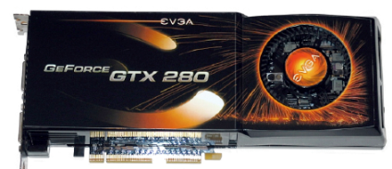
Low Energy Threshold Analysis
Signal Extraction Fit
(3 signals+17 backgrounds)x2, and pdfs are multidimensional:
ES, CC
NC, backgrounds
Two distinct methods:
1. Maximum likelihood with binned pdfs:
• Manual scan of likelihood space (iterative)
Locate best fit and +/- 1σ uncertainty
→ data helps constrain systematics
`human intensive’
2. Kernel estimation---ML with unbinned pdfs:
Allows full `floating’ of systematics, incl. resolutions
CPU intensive---use graphics card!
Notes:
Further improve syst meast by using data to constrain values of syst pars

Slide 20
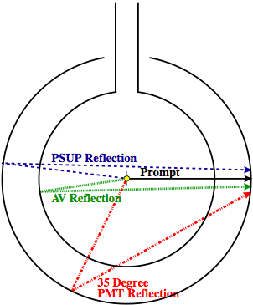
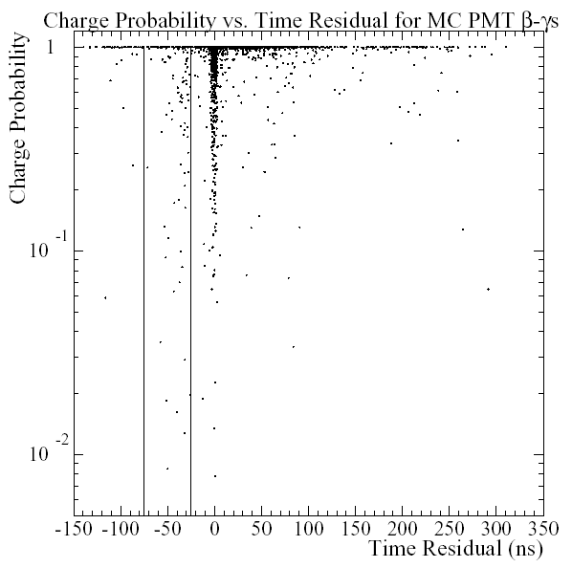
Low Energy Threshold Analysis
Background Reduction
New energy estimator includes both `prompt’ and `late’ light
Rayleigh Scatter
12% more hits≈6% narrowing of resolution
~60% reduction of internal backgrounds
New Cuts help reduce external backgrounds by ~80%
Example:
High charge early in time
Fiducial Volume
γ
β
β
(it was good we fixed our pedestals…)

Slide 21
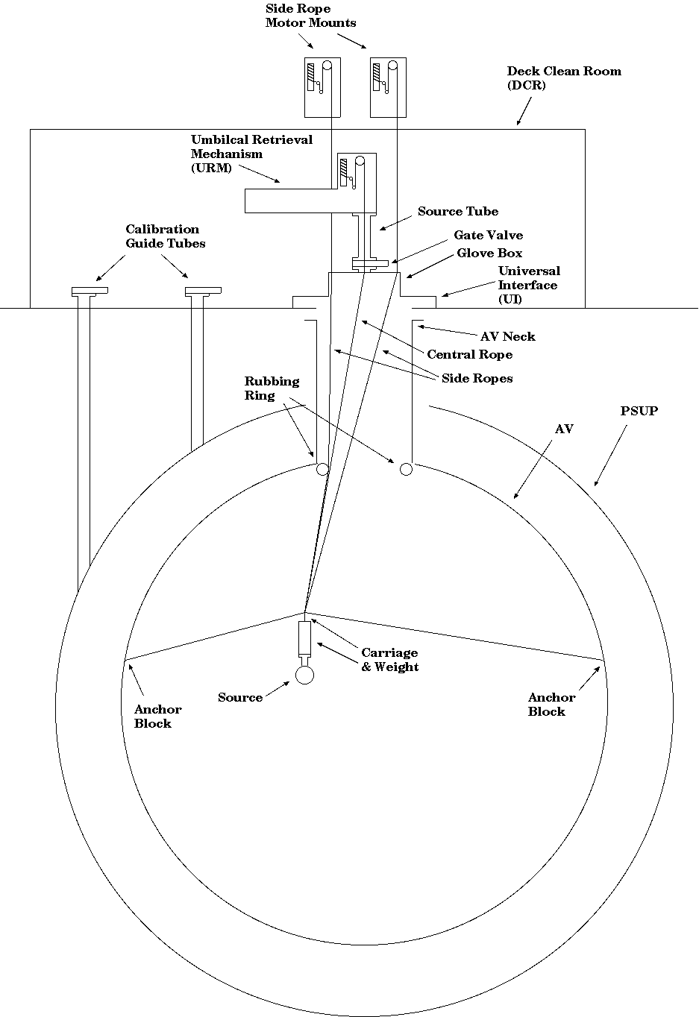
Low Energy Threshold Analysis
Systematic Uncertainties
Nearly all systematic uncertainties from calibration data-MC
Upgrades to MC simulation yielded many reductions
Residual offsets used as corrections w/ add`l uncertainties
All uncertainties verified with multiple calibration sources

Slide 22
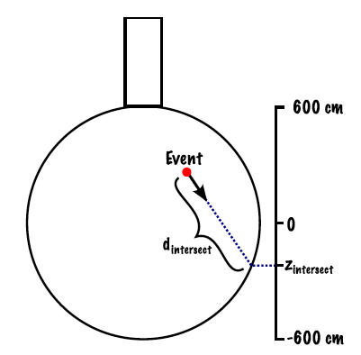
Low Energy Threshold Analysis
Systematic Uncertainties—Energy Scale
No correction
With correction
¹⁶N calibration source
6.13 MeV γs
Volume-weighted uncertainties:
Old: Phase I = ±1.2% Phase II = ±1.1%
New: Phase I = ±0.6% Phase II = ±0.5% (about half Phase-correlated)
Tested with: Independent ¹⁶N data, n capture events, Rn `spike’ events…

Slide 23
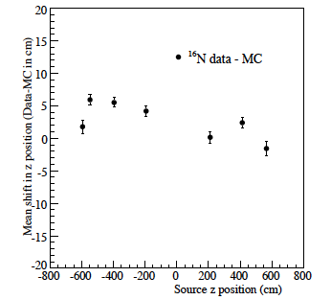
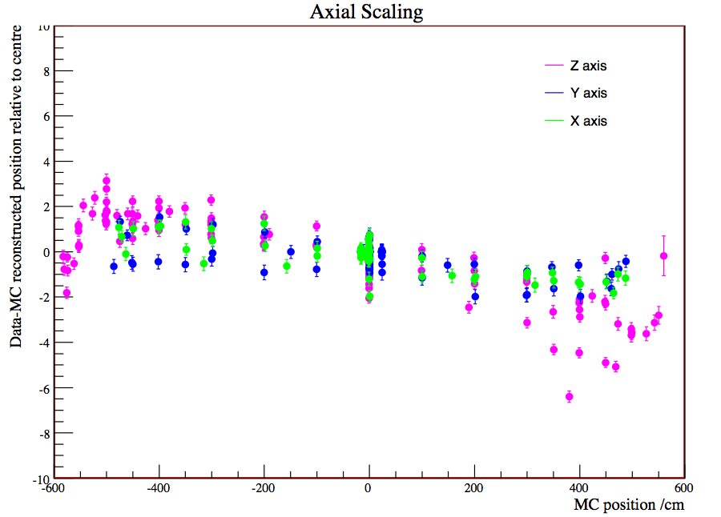
Low Energy Threshold Analysis
Systematic Uncertainties—Position
Old
New
Central runs remove source positioning offsets,
MC upgrades reduce shifts
Fiducial volume uncertainties:
Old: Phase I ~ ±3% Phase II ~ ±3%
New: Phase I ~ ±1% Phase II ~ ±0.6%
Tested with: neutron captures, ⁸Li, outside-signal-box νs

Slide 24
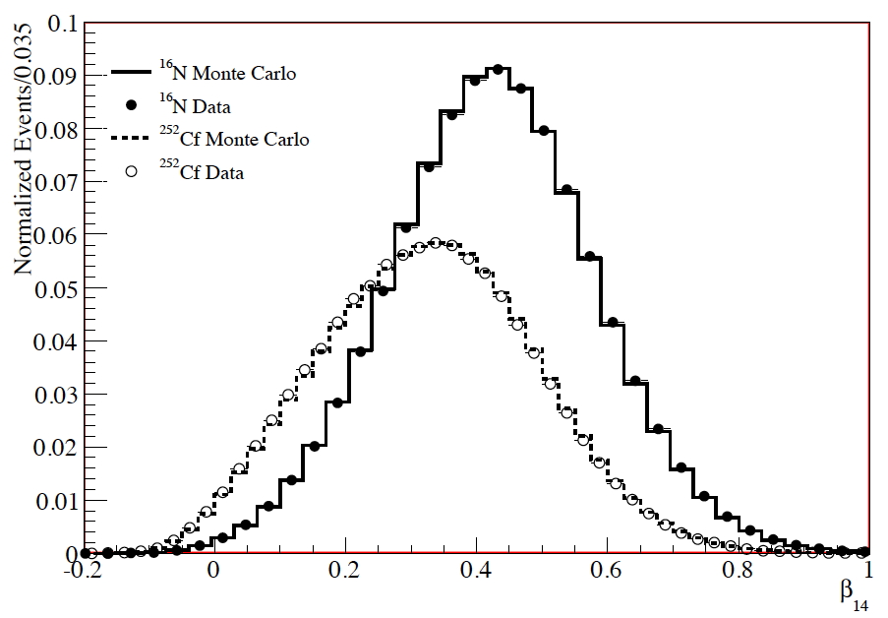
Low Energy Threshold Analysis
Systematic Uncertainties—Isotropy (β₁₄)
MC simulation upgrades provide biggest source of improvement
Tests with muon `followers’, Am-Be source, Rn spike
β₁₄ Scale uncertainties:
Old: Phase I --- , Phase II = ±0.85% electrons, ±0.48% neutrons
New: Phase I ±0.42%, Phase II =±0.24% electrons,^{+0.38%}_{-0.22%} neutrons

Slide 25
Low Energy Threshold Analysis
PMT β−γ PDFs
Not enough CPUs to simulate sample of events→ Use data instead
PassFail
PassPass
Early charge probability
Early charge probability
FailPass
FailFail
In-time ratio
In-time ratio
`Bifurcated’ analysis
N_{PF} = ε₁(1-ε₂)N_{b}
N_{FP} = (1-ε₁) ε₂N_{b}
N_{FF} = (1-ε₁)(1-ε₂)N_{b}
N_{PP} = ε₁ε₂N_{b} + N_{s}
N_{PMT}= N_{PP} – N_{s}
= N_{FP} * N_{PF} / N_{FF}
(so fixing pedestals gave us a handle on these bkds…)

Slide 26
Low Energy Threshold Analysis
Analysis Summary
Fits are maximum likelihood in multiple dimensions (two methods)
Most PDFs generated with simulation
Systematics from data-MC comparisons
In some cases, corrections applied to MC PDFS based on comps.
Tested on multiple independent data sets
PMT pdf generated from bifurcated analysis of data
Tested on MC and with independent analysis using direction vs. R³
Dominant systematics (6/20) allowed to vary in fit
Constrained by calib.
Note: many backgrounds look alike! But very few look like signal
Some backgrounds have ex-situ constraints from radiochm. assays
²⁰⁸Tl

Slide 27
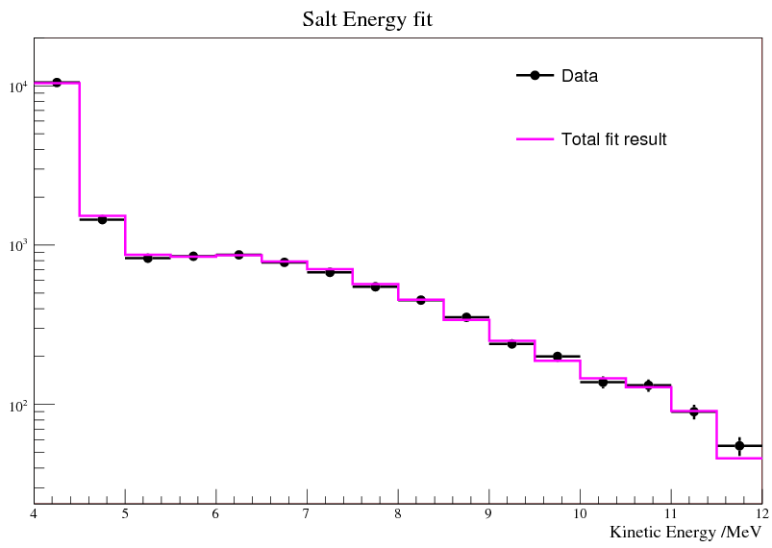
Low Energy Threshold Analysis
Full Fit to Data (1D projection, binned)
Phase II fit
χ² = 13.5 / 15
PRELIMINARY
Notes:
Result of fit to full data: very good chi2

Slide 28
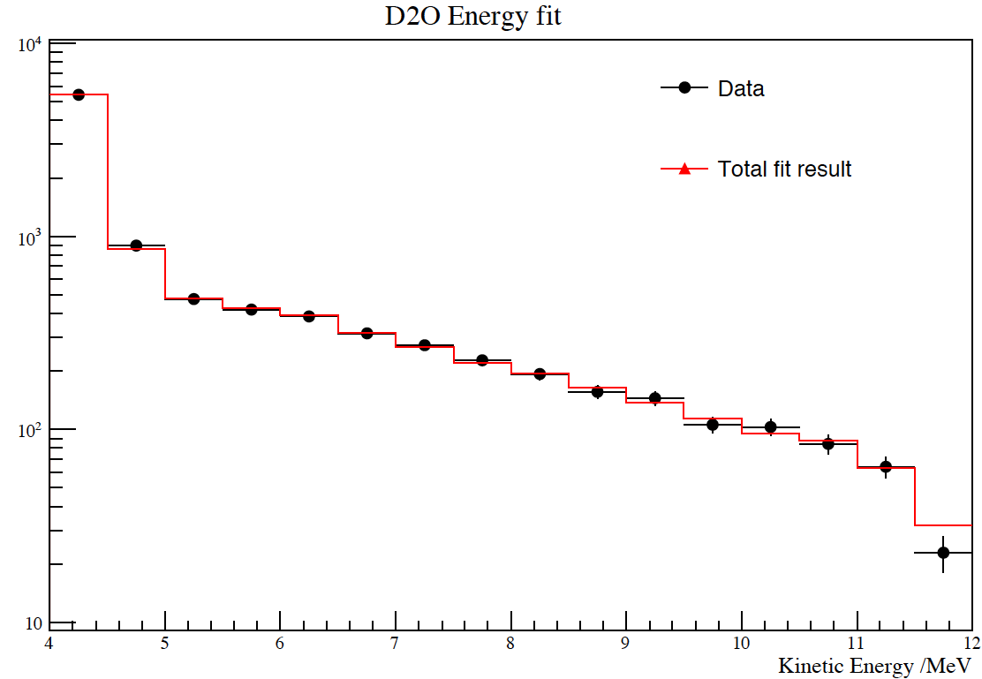
Low Energy Threshold Analysis
Full Fit to Data (1D projection, binned)
Phase I fit
Phase II fit
PRELIMINARY
Notes:
Result of fit to full data: very good chi2

Slide 29
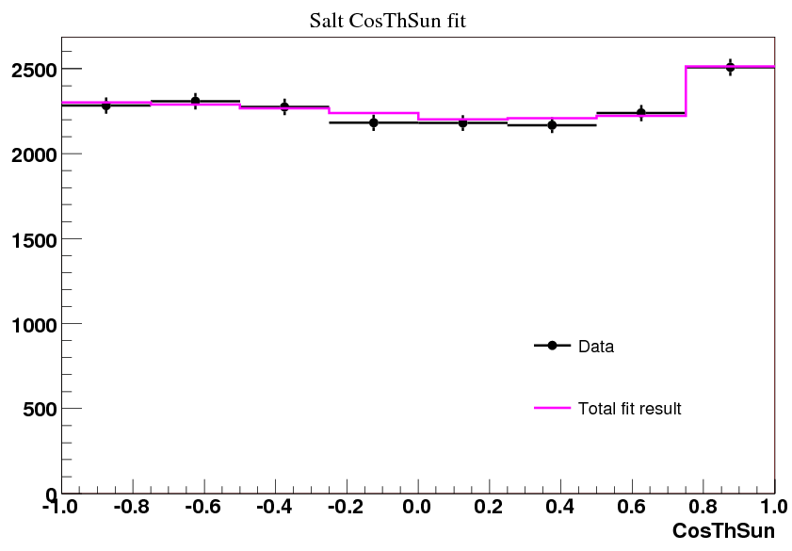
Low Energy Threshold Analysis
Full Fit to Data (1D projection, binned)
Phase II cosθ_{sun}
ES signal visible even at 3.5MeV threshold
χ² = 3.0 / 7
PRELIMINARY
Notes:
And shows clear ES peak, even at 3.5MeV threshold

Slide 30
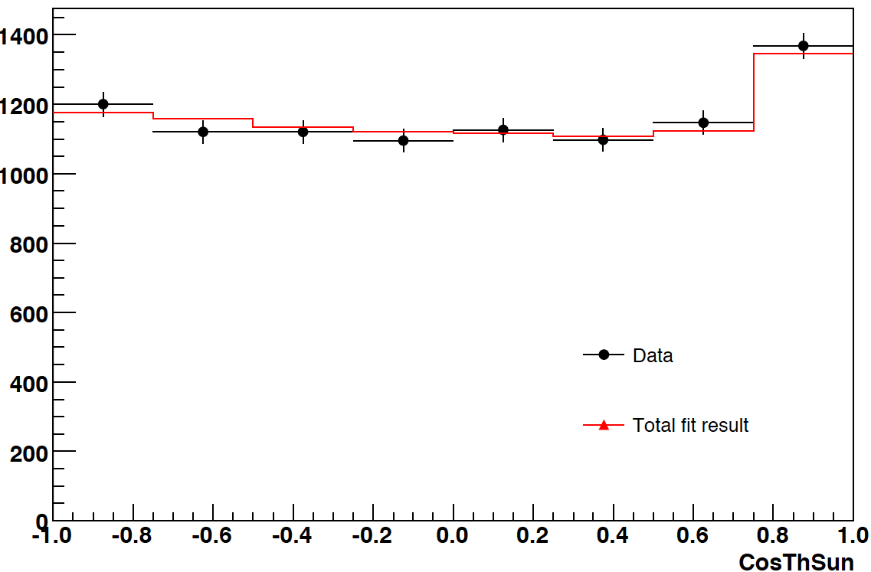
Low Energy Threshold Analysis
Full Fit to Data (1D projection, binned)
Phase I cosθ_{sun}
PRELIMINARY
Notes:
And shows clear ES peak, even at 3.5MeV threshold

Slide 31
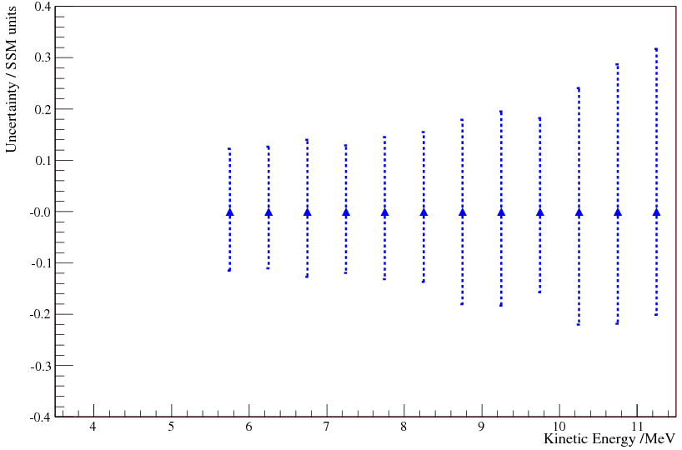
Low Energy Threshold Analysis
Uncertainties on ES Electron Recoil Spectrum
Salt phase spectrum
PRELIMINARY
Notes:
Spectrum from previous analysis

Slide 32
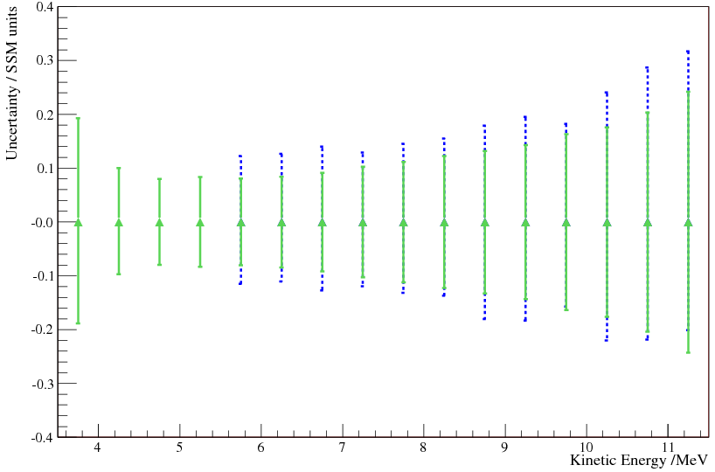
Low Energy Threshold Analysis
Uncertainties on ES Electron Recoil Spectrum
Salt phase spectrum
LETA spectrum
PRELIMINARY
Notes:
Lower E + reduced uncerts

Slide 33
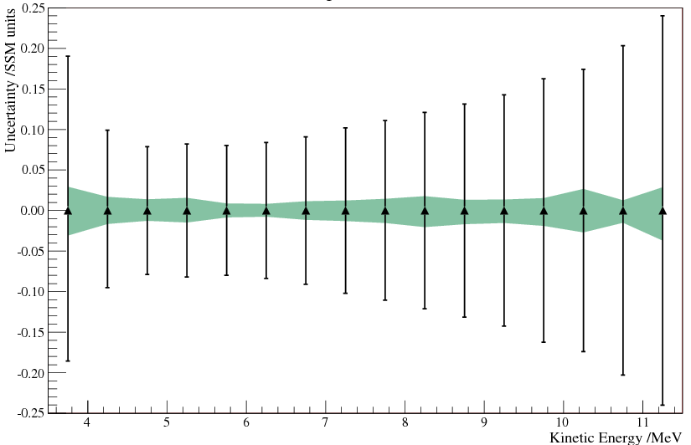
Low Energy Threshold Analysis
Uncertainties on ES Electron Recoil Spectrum
Statistics (+ bkg correlations)
Detector systematics
PRELIMINARY
Notes:
Not showing shape of extracted spectra, but you can see the magnitude of the uncerts
Dominated by stats

Slide 34
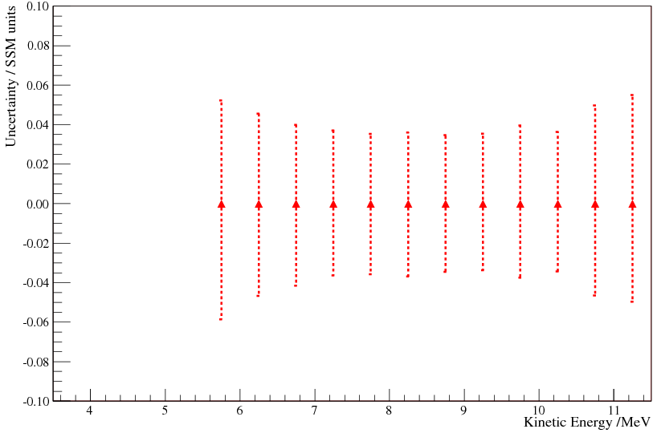
Low Energy Threshold Analysis
Uncertainties on CC Electron Recoil Spectrum
Salt phase spectrum
PRELIMINARY
Notes:
NSP uncerts

Slide 35
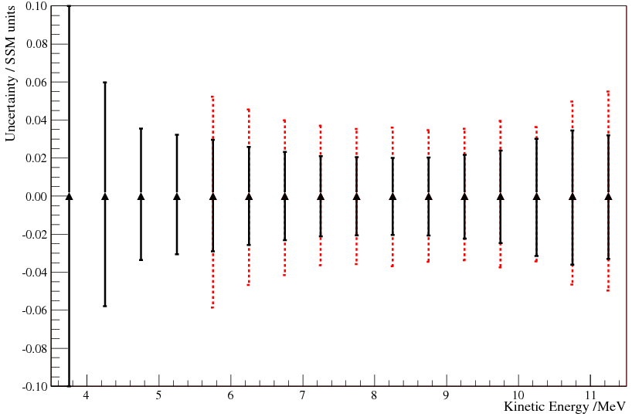
Low Energy Threshold Analysis
Uncertainties on CC Electron Recoil Spectrum
Salt phase spectrum
LETA spectrum
PRELIMINARY
Notes:
New bins + reduced uncerts

Slide 36
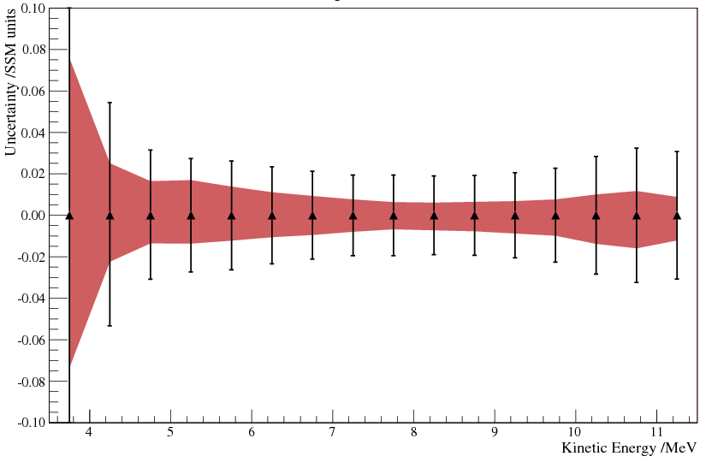
Low Energy Threshold Analysis
Uncertainties on CC Electron Recoil Spectrum
Statistics (+ bkg correlations)
Detector systematics
PRELIMINARY
Notes:
Real interest: CC
No info from bin0, but normalise bkg

Slide 37
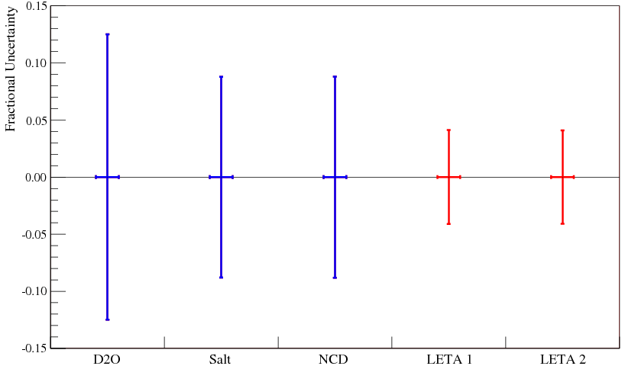
Low Energy Threshold Analysis
Uncertainties on CC Electron Recoil Spectrum
Phase I
Phase II
PRELIMINARY
Phase III
Phase I+II
Phase I+II
Notes:
Damn that’s good

Slide 38
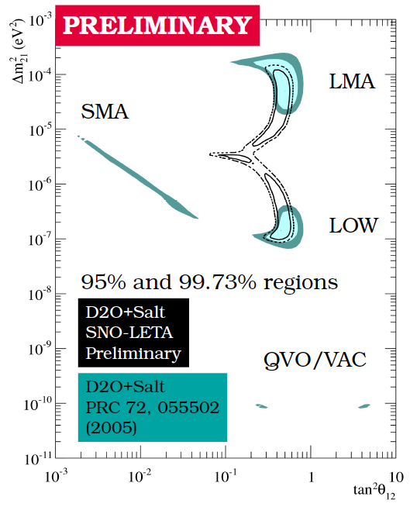
Low Energy Threshold Analysis
SNO-Only Mixing Parameters
(Without
Day/Night)

Slide 39
Low Energy Threshold Analysis
Results to Look for in Upcoming Paper
CC & ES binned recoil spectra
NC-measured total flux
Direct extraction of survival probability P_{ee}:
Solar+KamLAND two-flavor contours
Solar+KamLAND three-flavor contours
P_{avg}
P_{asym}
E_{ν}
E_{ν}

Slide 40
Summary
Low Energy Threshold Analysis nearly complete
Expect significant improvements in precision
Many other SNO analyses also finishing up

