Slide 1
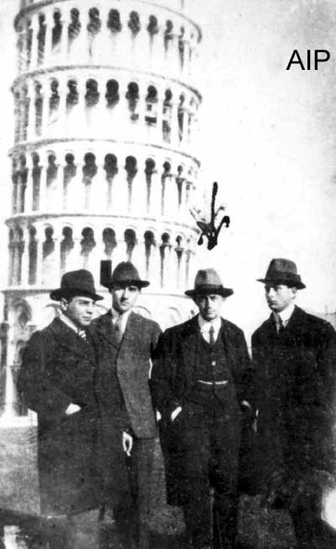
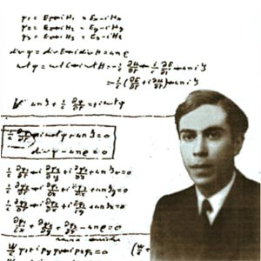
Physics with underwater neutrino telescopes
Vincenzo Flaminio for the ANTARES Collaboration
(Physics Dept. & INFN-Pisa)
V. Flaminio Erice 2009

Slide 2



ν^{s} from space: the long march
Solar neutrinos (MeV energies)
→ Davis et al. 1955 – 1978 Koshiba et al., 1987-1988
Riccardo Giacconi,
Masatoshi Koshiba
Raymond Davis Jr.
Stockholm, 12 December 2002.

Slide 3

ν^{s} from space: the long march
Later → observation of ν^{s} from SN1987a ➔ help clarify mechanism of SNs
(Energies around 10 MeV)

Slide 4
From MeV ν^{s} to PeV ν^{s}
Detectors of High Energy (GeV→ PeV Energy) Cosmic ν^{s}
Why ?
- Understand production mechanism of HE cosmic rays
- Disantangle Synchrotron-Inverse Compton from Hadronic production in SNRs
- Study Binary systems, μQuasars
- Investigate the very high energy processes occurring in GRBs
Search for Dark matter
New probe → new observations

Slide 5
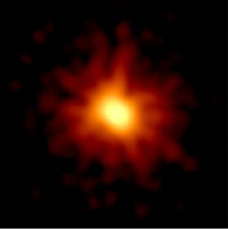
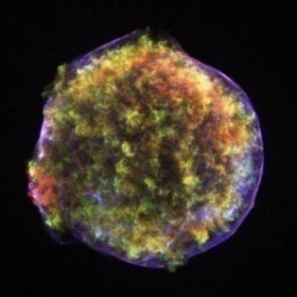
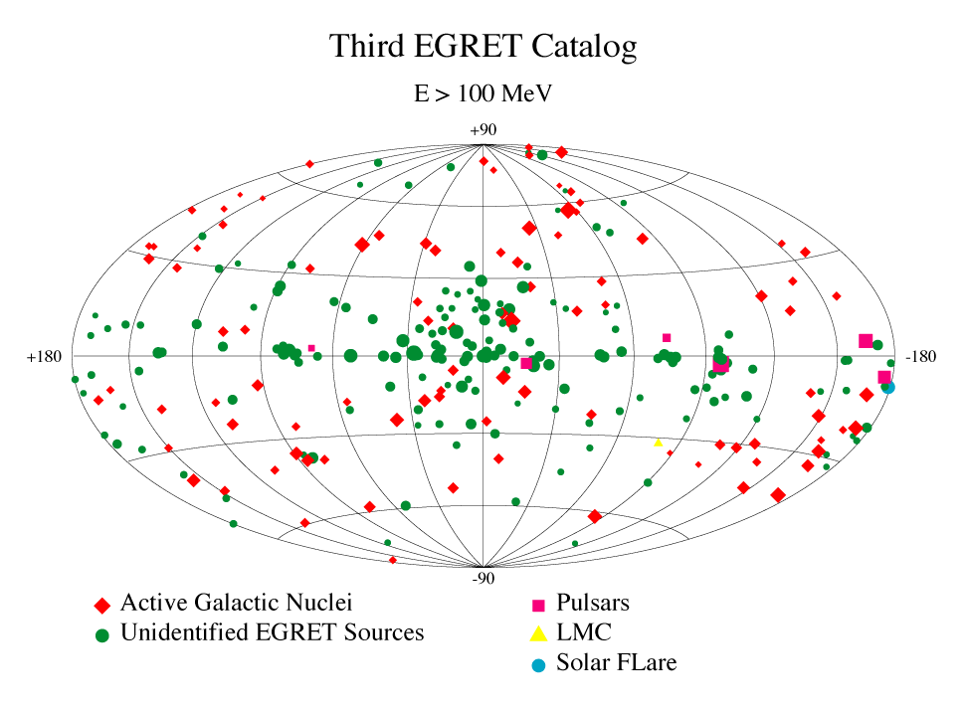
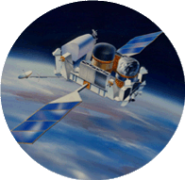
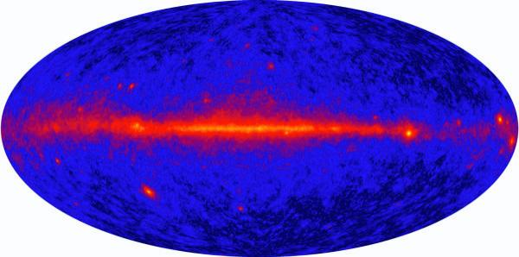
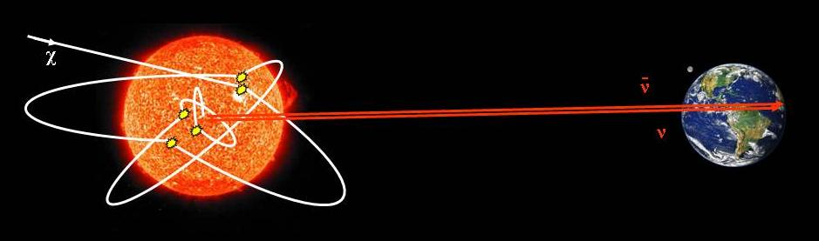
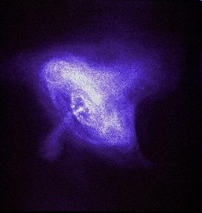
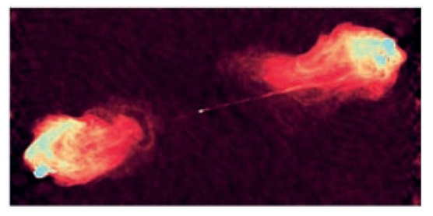
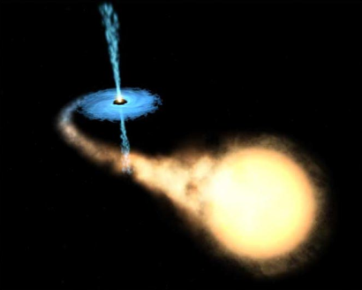
Potential sources
GALACTIC
EXTRAGALACTIC
Fermi-Glast γ−ray skymap
Indirect dark matter search
Supernova remnants
GRBs
Pulsars
AGNs
Microquasars

Slide 6
Cross Sections & Interaction Lengths
Particle | σ (mb) | σ (cm²) | Interaction length λ (m of H₂O)
H.E. Proton | 50 | 5 x 10⁻²⁶ | 0.3
H.E. γ | 0.4 | 4 x 10⁻²⁸ | 42.0
H.E. ν | 0.7 x 10⁻¹¹ x E_{ν} (GeV) | 0.7 x 10⁻³⁵ (at 1 TeV) | 2 x 10⁹
“ “ | 0.7 x 10⁻¹¹ x E_{ν} (GeV) | 0.7 x 10⁻³² (at 1 PeV) | 2 x 10⁶
D_{Earth} = 12.8 x 10⁶ m → λ = D_{Earth} at E_{ν} = 190 TeV
Remember → 1 GeV = 1000 MeV, 1 TeV = 1000 GeV, 1 PeV = 1000 TeV

Slide 7
Cross Sections & Interaction Lengths
D_{Galaxy} = 10¹⁹ m => nr of Galaxies crossed in one λ
Particle | Galactic Interaction length λ_{G} (m) | Nr Galaxies
Proton | 2 x 10²³ | 2 x 10⁴
γ | 3 x 10²⁵ | 10⁷
ν (1 TeV) | 1.5 x 10³³ | 10¹⁴
ν (1 PeV) | 1.5 x 10³⁰ | 10¹¹

Slide 8
Neutrino Telescopes
Neutral particle → points back to source (undeflected by B fields)
Weak interaction → no absorption
Tiny cross section
➔ need huge detector
ν_{μ} + N → μ + hadrons
μ measures ν direction
ν_{μ}
μ
N
X

Slide 9
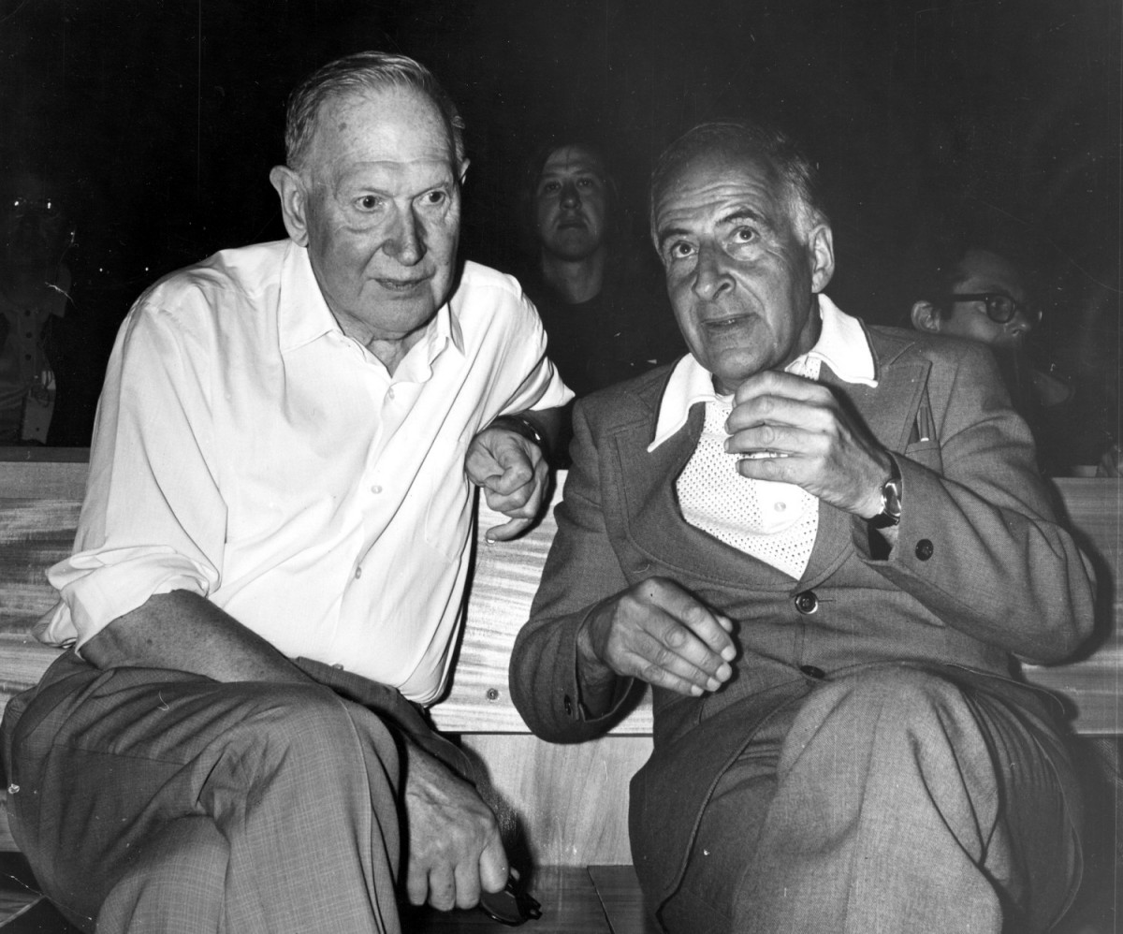
A little bit of history
Moisej Markov
Bruno Pontecorvo
Detection technique
M.Markov,1960:
We propose to install detectors
deep in a lake or in the sea and
to determine the direction of
charged particles with the help
of Cherenkov radiation

Slide 10
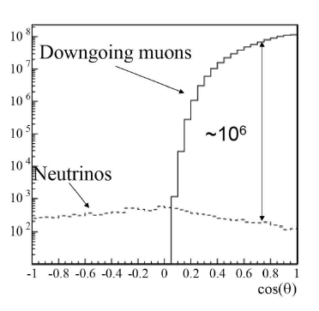
Atmospheric muon background
Reduced background
if only events from
the other side of the
Earth selected
Price to pay → cutoff due to absorption by the Earth

Slide 11
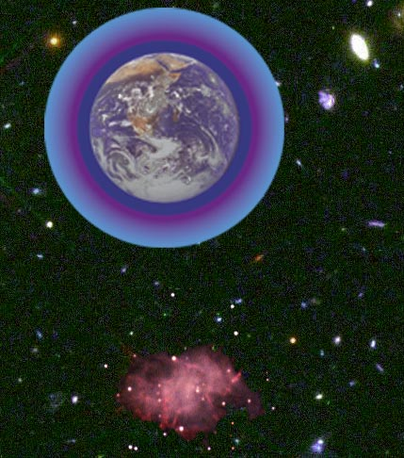
Neutrino detection principle
ANTARES detection principle
3D PMT
array
ν_{μ}
p, α
μ
p
Cherenkov
light from μ
γ_{č}
ν_{μ}
γ
2500 m
depth
43°
Measurement :
Time & position
of hits
μ
interaction
ν
μ (~ ν) trajectory

Slide 12
Pioneering development
Dumand (Hawaii 1978-1992), depth 4500 m phased out
Roberts, RMP 64, 1, 1992
Later experiments
Baikal (Baikal lake, Russia, 1983 → present) depth 1100 m running
I.A. Belolaptikov et al., Astr. Ph. 7, 263, 1997
Nestor (Pylos, Greece → 1996 - 2003) depth 4000 m prototype ran in 2003
G. Aggouras et al., Astr. Ph. 23, 377, 2005
NEMO (Capo Passero, Sicily 2001→ present) depth 3500 m construction +
Capone et al., N.I.M. A 602, 47, 2009 prototype ran in 2007
ANTARES (Toulon, France → 2001 → present) depth 2500 m running since 2006
E. Aslanides et al. Preprint astroph/9907432, 1999
V. Flaminio, XIII Int. Works. on ν Telescopes, Venice, 2009
KM3NET (European Project: Antares+Nemo+Nestor) FP6 → Design Study
http://www.km3net.org FP7 → Prep. Phase
(Mediterranean: site to be decided)

Slide 13

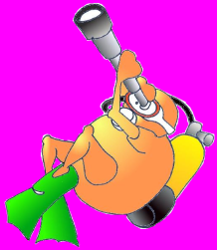
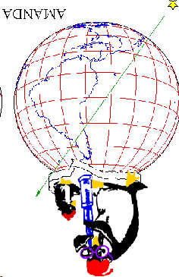
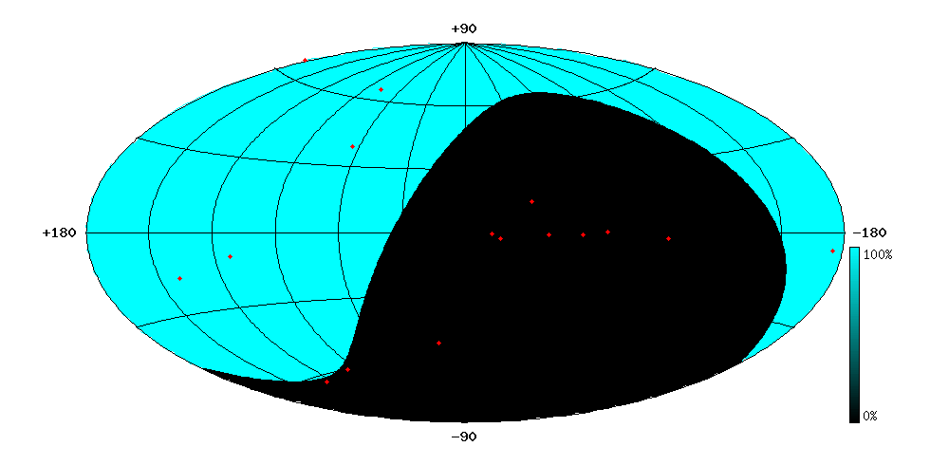
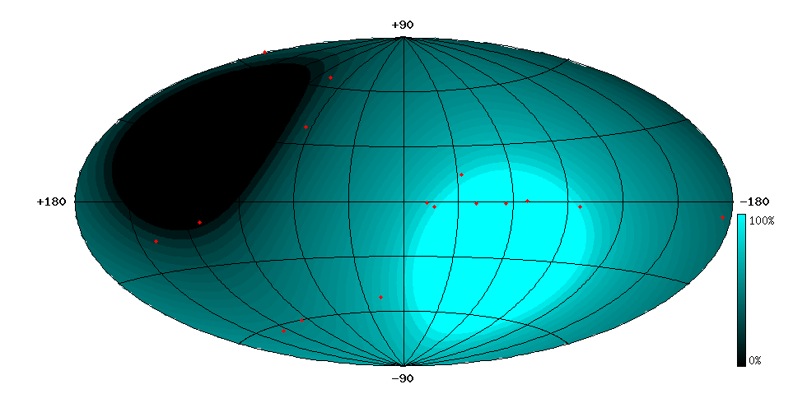
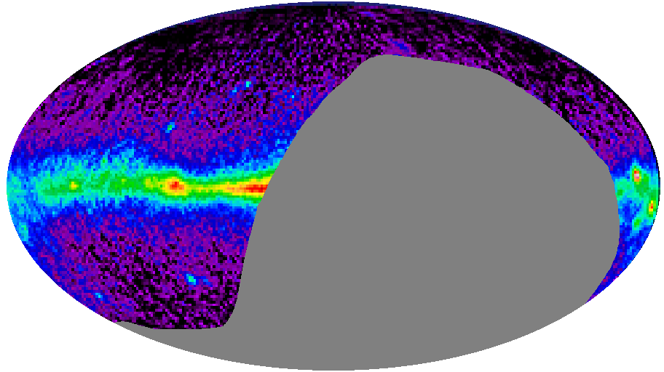
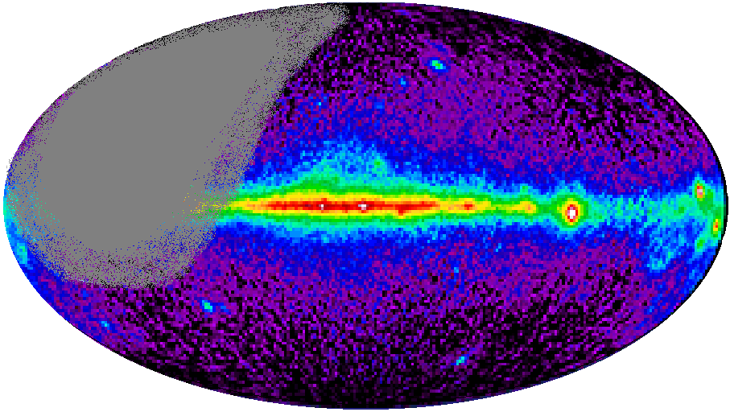
Mediterranean Sea ν Telescopes →
Complementary to South Pole
AMANDA/IceCube (South Pole)
(Ice: ~2°/0.6°)
ANTARES/KM3 (43° North)
(water: ~0.2°/0.1°)
Mkn 421
Mkn 501
Mkn 501
CRAB
RX J1713.7-39
CRAB
SS433
SS433
GX339-4
VELA
Galactic
Centre

Slide 14


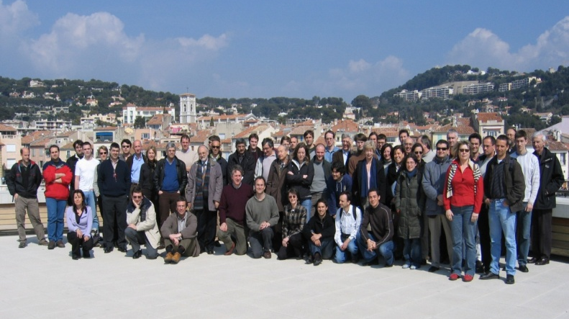
The ANTARES Collaboration
NIKHEF,
Amsterdam
Utrecht
KVI Groningen
NIOZ Texel
University of Erlangen
Bamberg Observatory
ITEP,Moscow
Moscow State Univ
ISS, Bucarest
IFIC, Valencia
UPV, Valencia
UPC, Barcelona
7 countries
29 institutes
~150 scientists+engineers
CPPM, Marseille
DSM/IRFU/CEA, Saclay
APC, Paris
LPC, Clermont-Ferrand
IPHC (IReS), Strasbourg
Univ. de H.-A., Mulhouse
IFREMER, Toulon/Brest
C.O.M. Marseille
LAM, Marseille
GeoAzur Villefranche
University/INFN of Bari
University/INFN of Bologna
University/INFN of Catania
LNS – Catania
University/INFN of Pisa
University/INFN of Rome
University/INFN of Genova
14

Slide 15
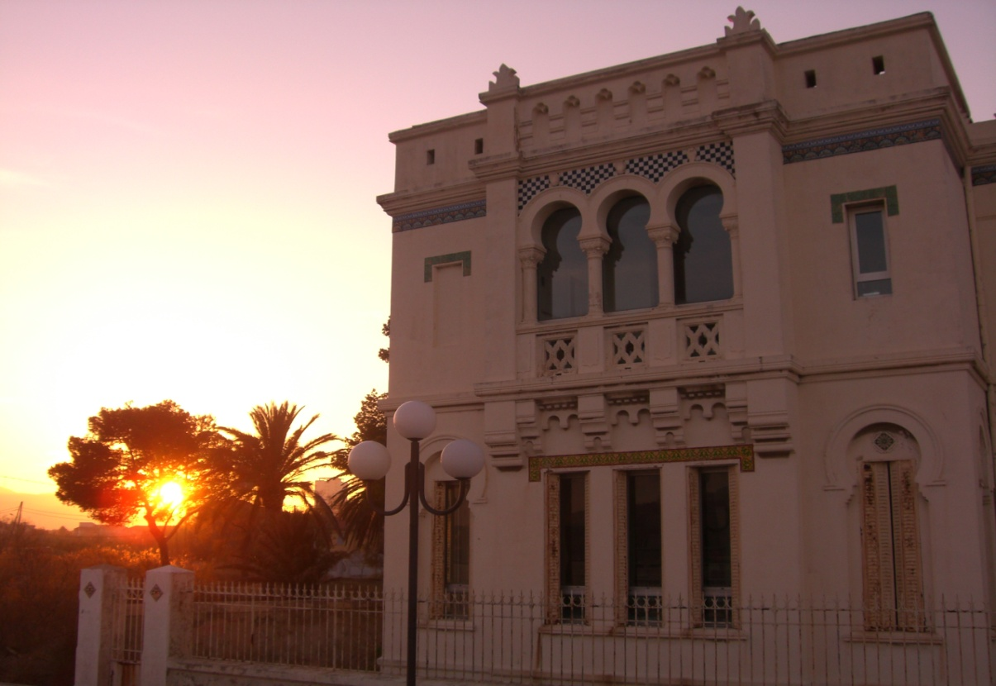
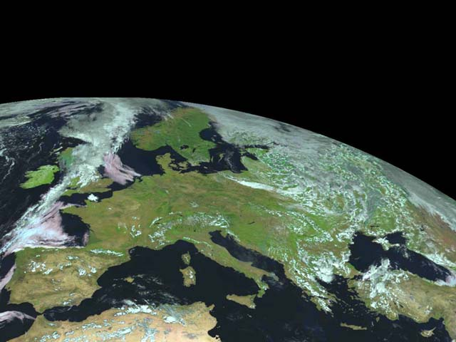
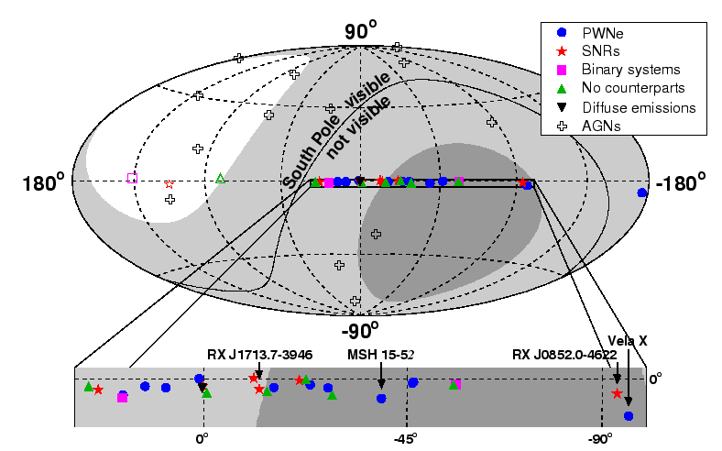
The ANTARES site
42°50’ latitude Nord
6°10’ longitude Est
The Michel Pacha Building
Galactic Center visible 75% of the
day
(Marius Michel)
Galactic coordinates

Slide 16
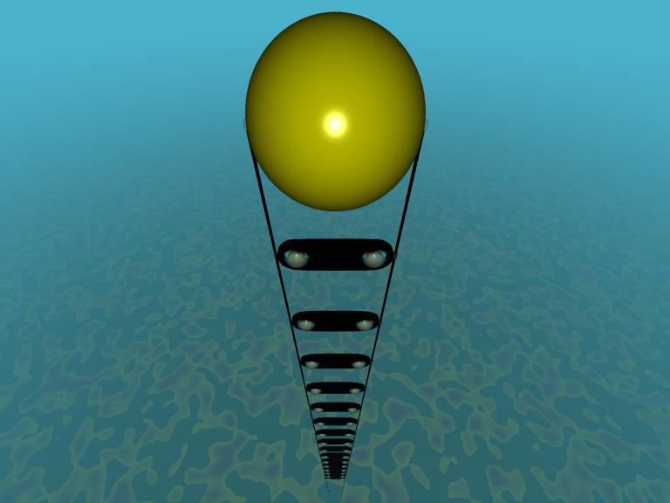
Antares « Demonstrator » deployed end 1999 (1100 m depth)
A. Kouchner PhD Thesis
Atm. μ^{s}
angular distribution
compared to MC

Slide 17
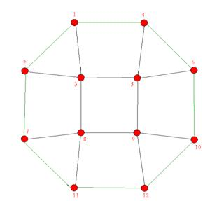
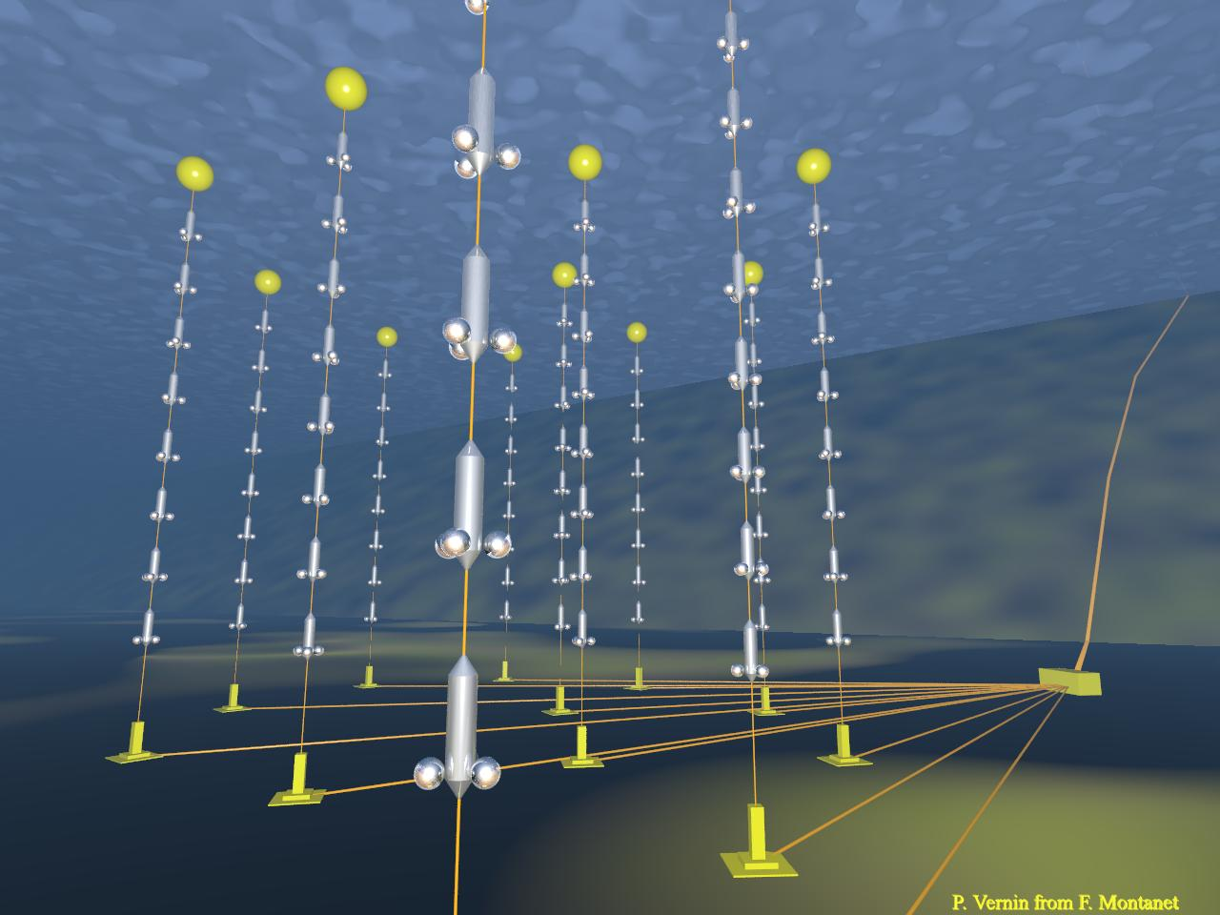
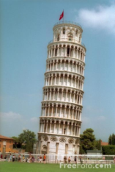
The ANTARES detector
2500m depth
350 m
14.5 m
Cable to
shore
57 m
100 m
Junction
Box
~60 m
Link cable

Slide 18
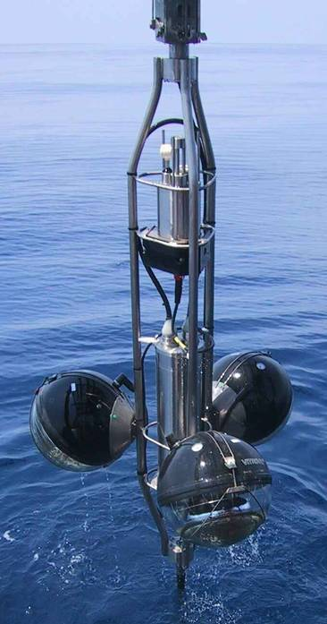
The ANTARES detector
Storey
45°

Slide 19
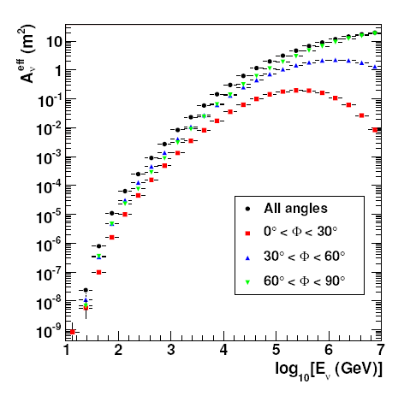
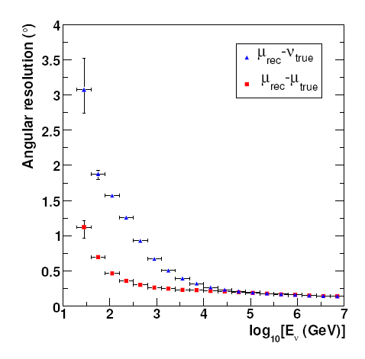
Expected Performance (12 lines detector)
Neutrino effective area
Angular resolution
For E_{ν}<10 PeV, A_{eff} grows with energy due to the increase of σ_{ν} and the muon range.
For E_{ν}>10 PeV the Earth becomes opaque to neutrinos.
For E_{ν} < 10 TeV, the angular resolution is dominated by the ν-μ angle.
For E_{ν} > 10 TeV, the resolution is limited by track reconstruction errors.
N_{det}=A_{eff} × Time × Flux

Slide 20
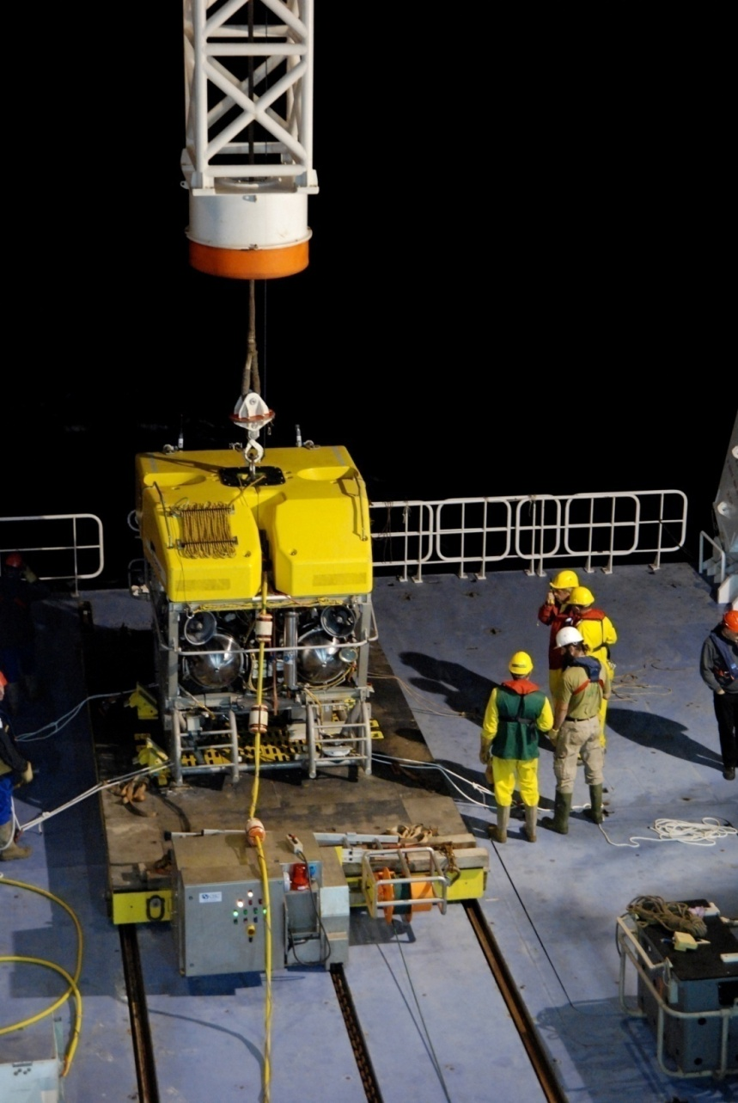
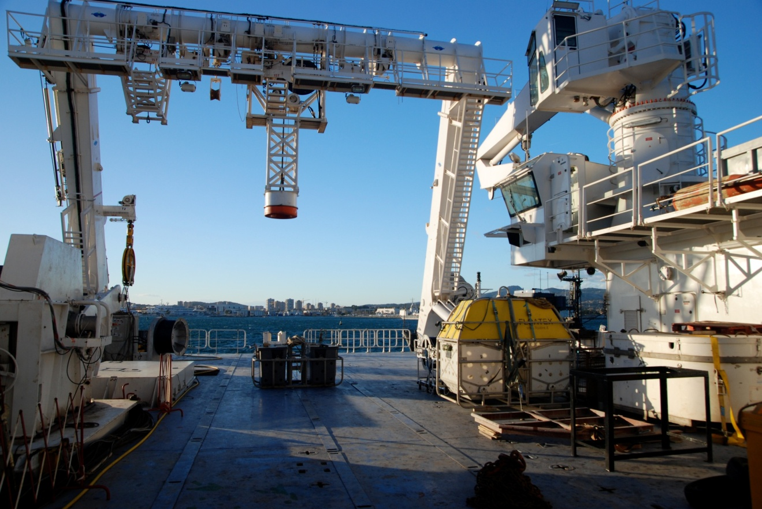
Detector operations

Slide 21
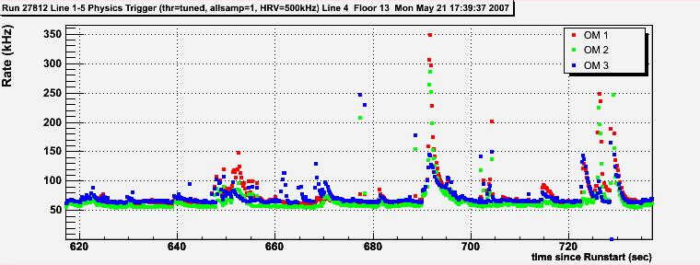
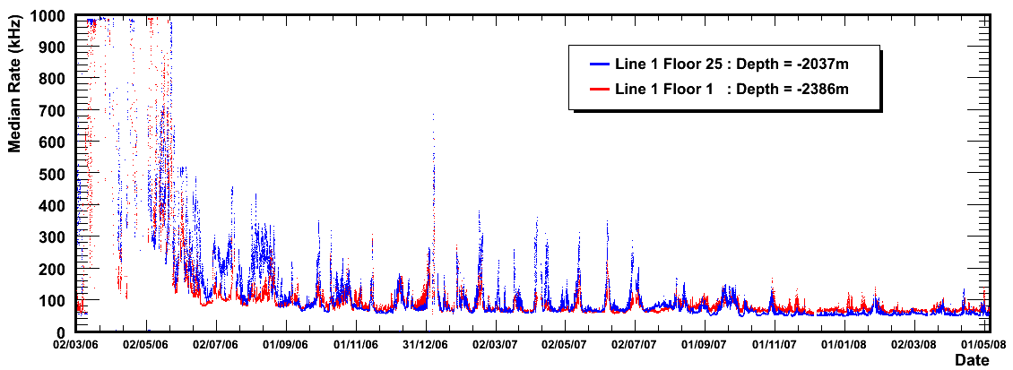
The detected signal
Muon (Cherenkov)
2 µs crossing time
2 min
Bioluminescence
Continuous background
∼ 60 kHz *
Occasional bursts ~MHz
792 days
  * 10’’ PMT, 0.3 p.e. threshold

Slide 22
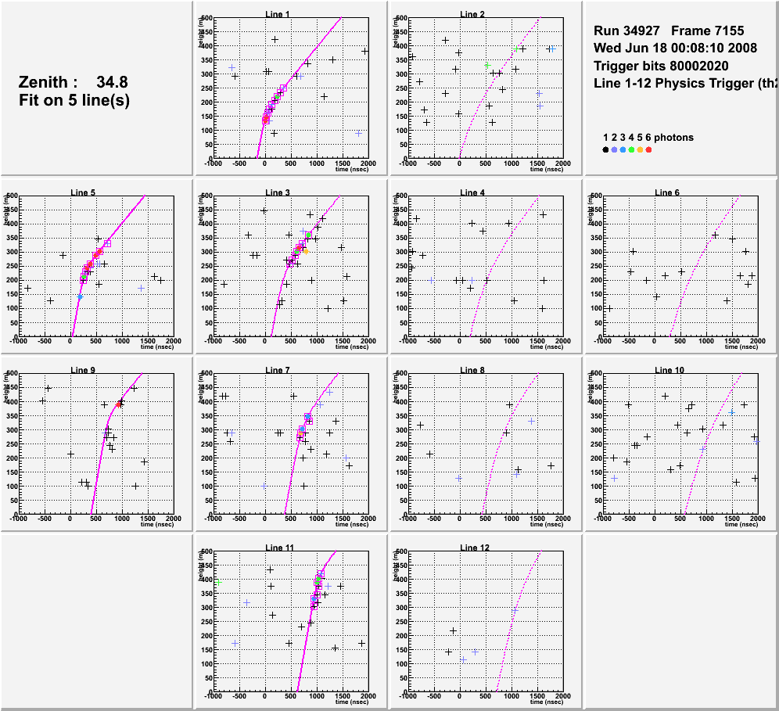
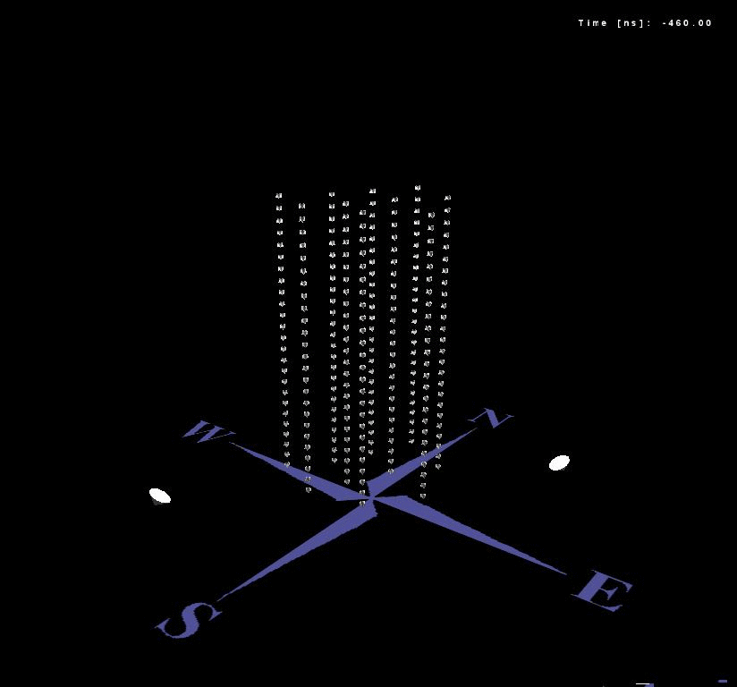
Neutrino-induced muon
PMT z
Example of a reconstructed up-going muon (i.e. a neutrino candidate) detected in 6/12 detector lines:
Hit time

Slide 23
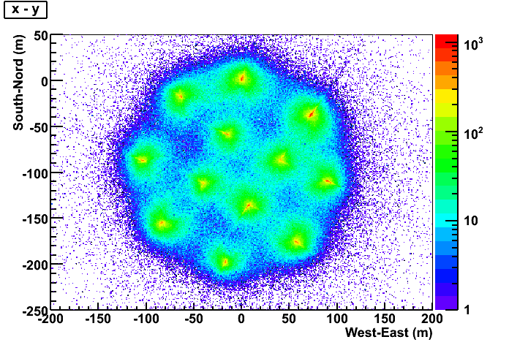
Detector footprint
Detector as seen by atmospheric muons: reconstructed position of the muon at the time of the first triggered hit

Slide 24
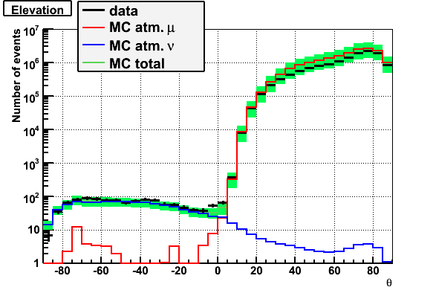
Zenith angle distribution
June 2007 – Dec 2008
5+10+12 lines
341 active day
1062 upward neutrino candidates
neutrinos
upgoing
downgoing
Good agreement with “standard” neutrino oscillations:
sin² 2θ = 1; Δm² = 2.4 · 10⁻³ eV²

Slide 25
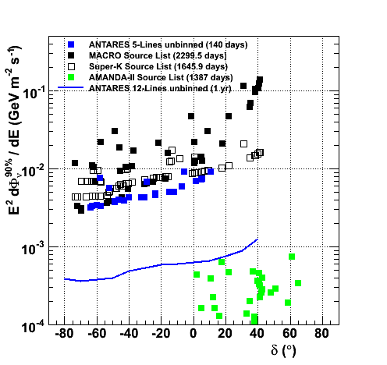
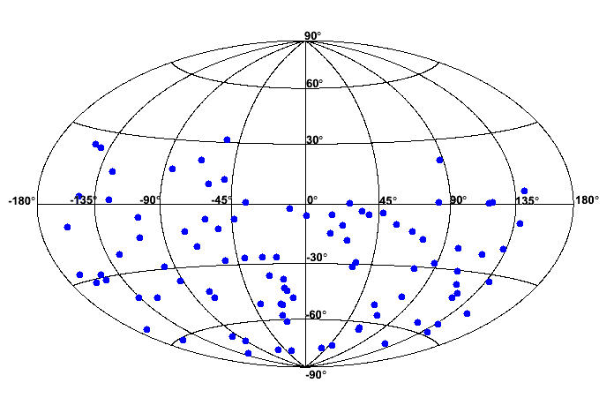
2007 data → neutrino sky map (all sky search)
No significant excess found
Equatorial coordinates
Effective live time: 140 days – 5 lines
94 upgoing neutrinos
Upper limits obtained with 2007 data compared with 1 year of complete detector and other experiments
Analysis of full detector data ongoing

Slide 26
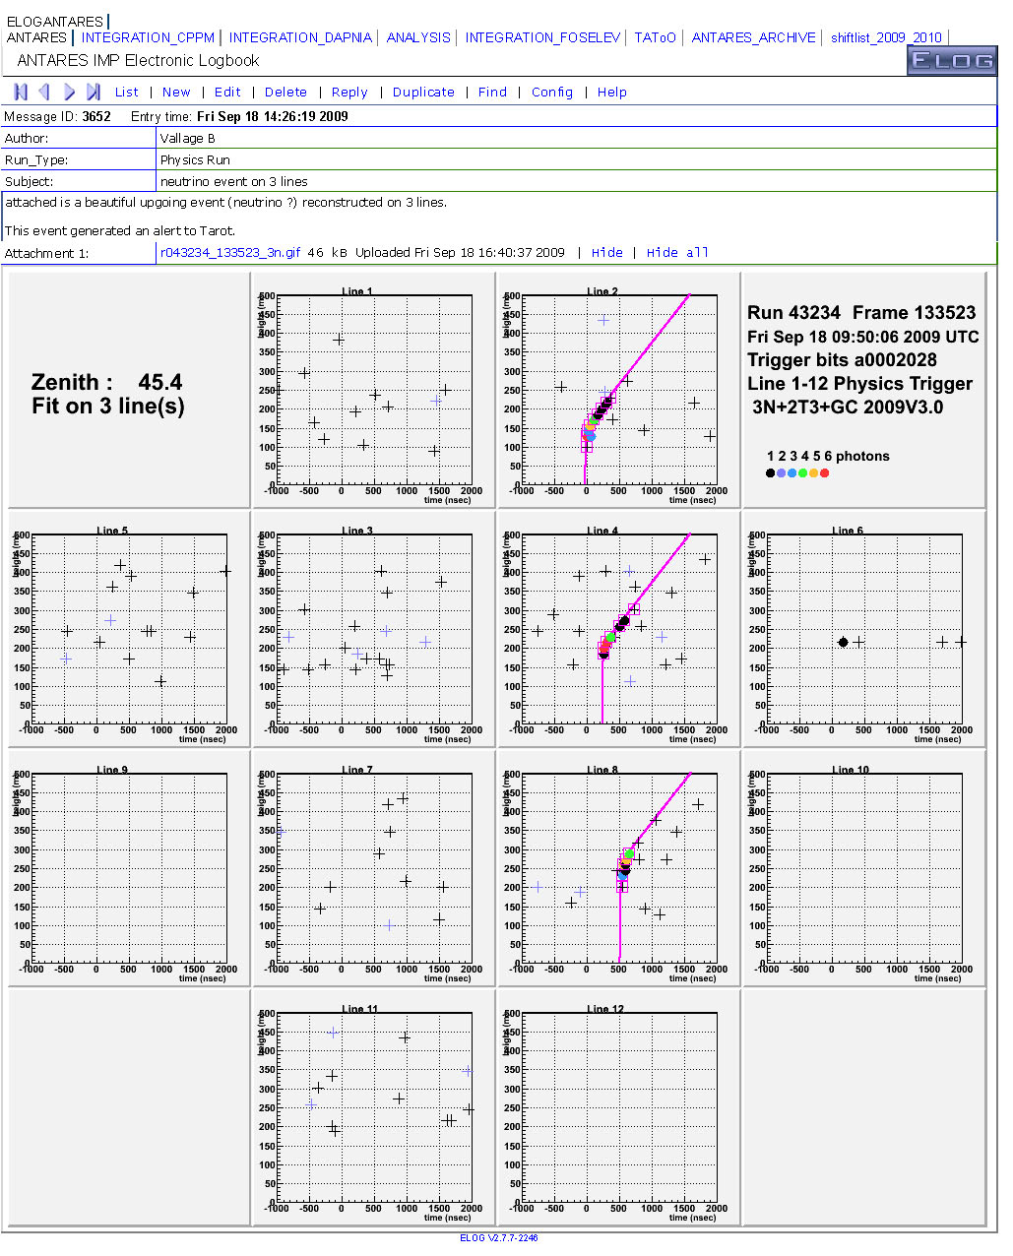
Additional initiatives in ANTARES
Antares-Virgo-Ligo agreeement (common trigger)
Antares Alerts to Optical Tescopes (Tarot)
September 18, 2009
observed neutrino and alert
sent to TAROT

Slide 27
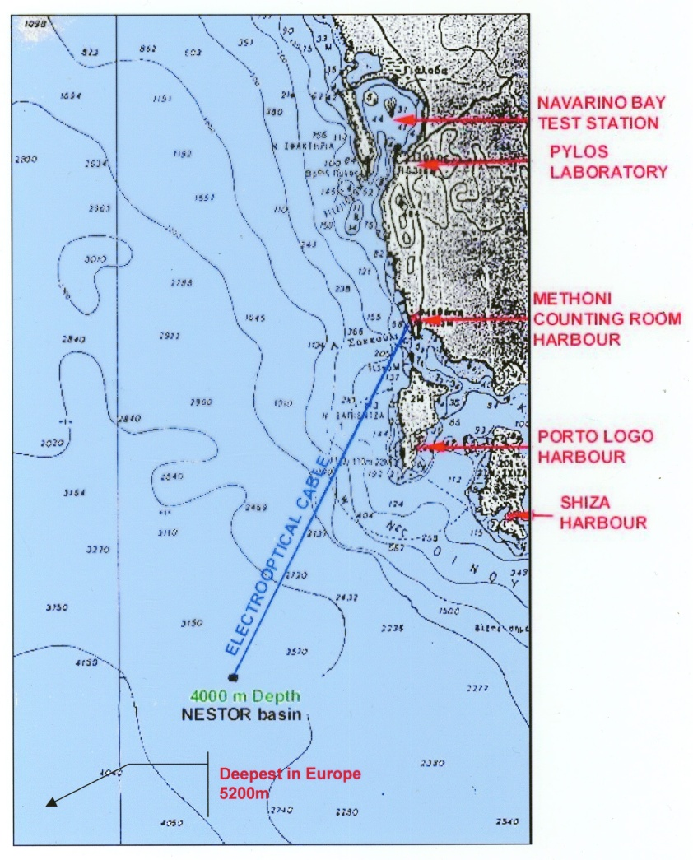
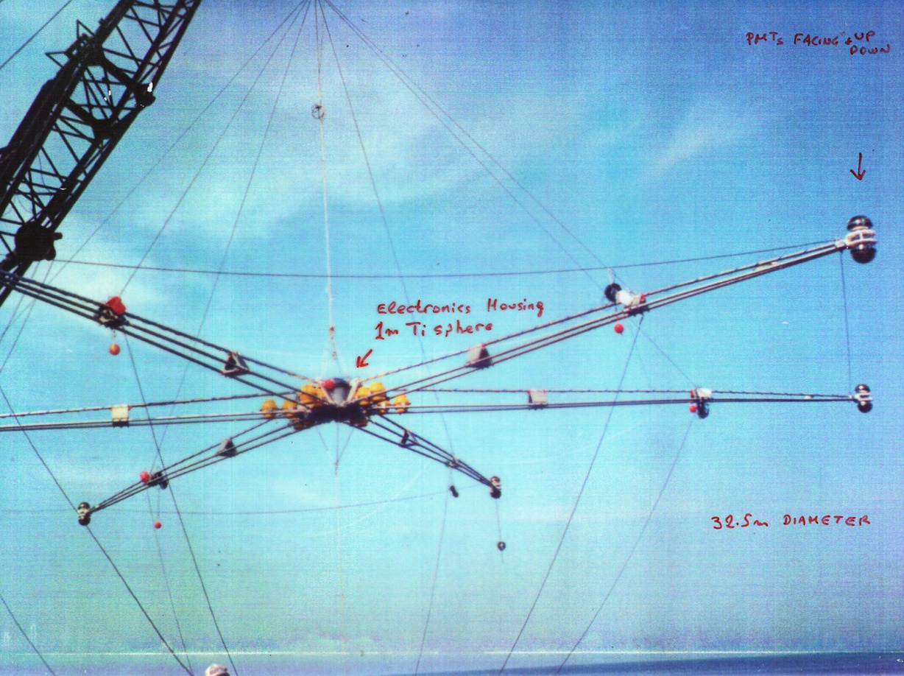
NESTOR→ Prototype deployed in the Mediterranean (2003)
Avoid underwater connections → no use of ROV
Implications: have to recover entire detector in
case of repairs
(not recommended after DUMAND experience)
32 m diameter floor (6 floors)
30 m between floors
144 15” PMTs
At the center of each floor a Ti sphere
Houses the floor electronics

Slide 28
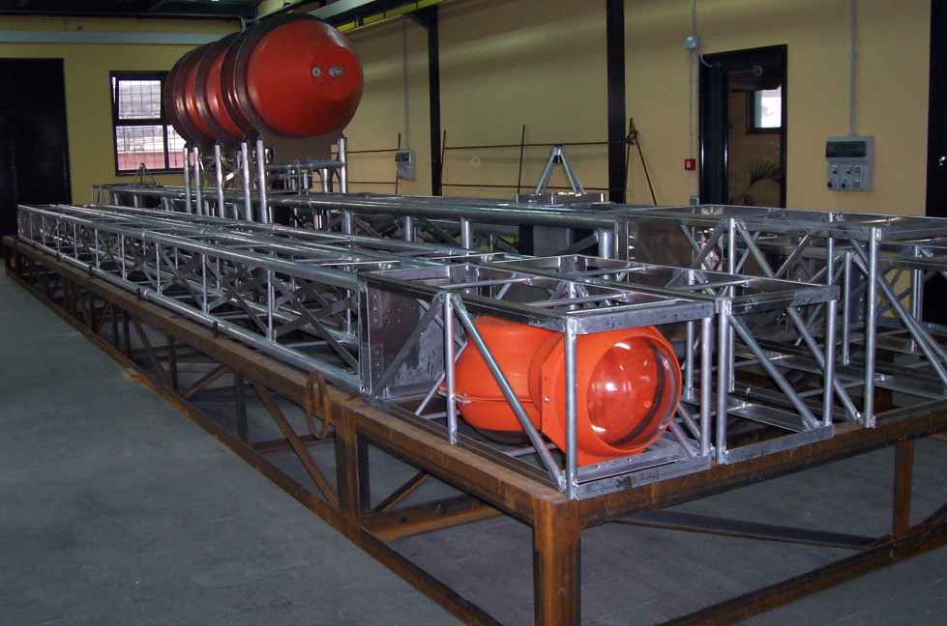
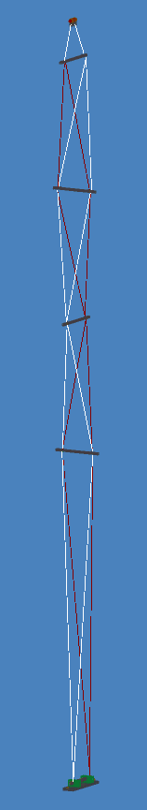
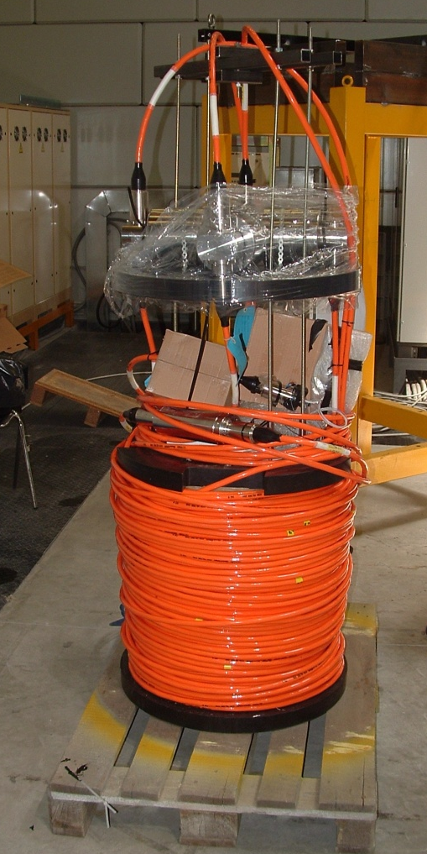
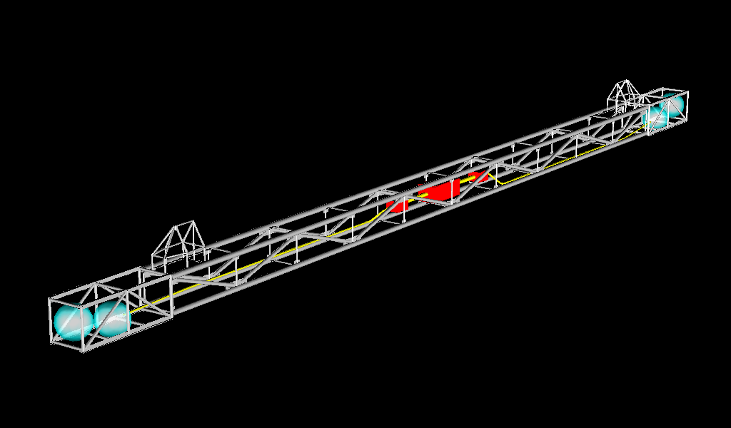
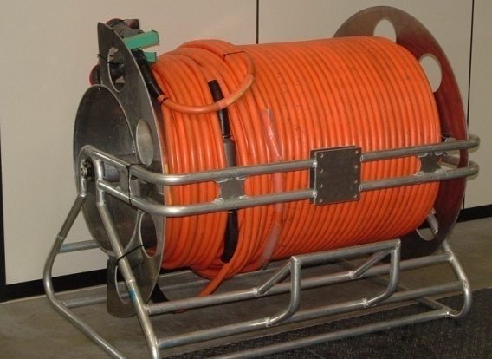
The Mini Tower for NEMO Phase-1
Floor 4
Floor 3
Tensioning ropes
Floor 2
Optical modules
Floor control module
Break-out
Floor 1
Tensioning ropes
Backbone cable
(electro-optical) Nexans-D0330
Backbone e.o. cable
Mechanical stresses are applied only to the tensioning ropes
e.o. Jumper cable
Tower base - JB
Tower Base Module

Slide 29



KM3NeT
A research facility in the Mediterranean Sea
  A next generation neutrino telescope
  Cabled observatory for Earth and Marine sciences
+
+
+…
38 institutes from 10 European countries

Slide 30
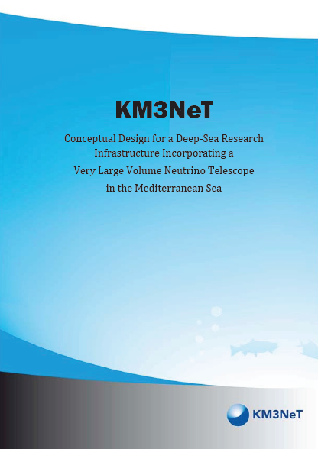
Km3Net Design Study
Design study → funded by EU FP6 in February 2006
Development of a cost-effective design for a cubic km sized
deep-sea infrastructure housing a neutrino telescope….
Conceptual Design Report
released in April 2008
(www.km3net.org)
Includes:
  Science case
  Site studies
  Design goals
  Technical implementation

Slide 31

Km3Net Preparatory Phase
Funded by the EU FP7 framework in March 2008
Primary objective → pave the path to political and scientific
convergence on the legal, governance, financial engineering and siting aspects of the infrastructure…..
Km3net timeline

Slide 32
Conclusions
Long march towards underwater cosmic neutrino detection has undergone an acceleration
Nestor → first serious attempt in the Mediterranean → results published
ANTARES made a major step forward during 2006-2007 and the 12-lines detector with 875 OMs was completed in 2008.
NEMO → big effort towards Capo Passero site (3500 m)
Construction of detector for NEMO PhaseI completed. Results being published.
The 100 km electro-optical cable for NEMO PhaseII installed and
shore-station building ready
Joint European effort towards a km3 detector in the Mediterranean
well advanced (Km3NeT DS+PP)

Slide 33
The End

Slide 34
Background Material

Slide 35

Detector positioning
Acoustic system:
  One emitter-receiver at the bottom of each line
  Five receivers along each line
  Four autonomous transponders on pyramidal basis
Additional devices provide independent sound velocity measurements
Measure every 2 min
-Distance line bases
to 5 storeys/line and
transponders
-Headings and tilts

Slide 36



































Deployment
Data taking periods:
MILOM : Mar ’05 – Mar ‘06
Line 1 : Mar ’06 - Sep ’06
Line 1-2 : Sep ’06 - Jan ’07
Line 1-5 : Jan ’07 - Dec ’07
Line 1-10 : Dec ’07 - May ’08
Complete : May’08 onwards
La Seyne-sur-Mer
(40 km)
(2.5 km depth)

Slide 37


Detector layout
Acoustic storey
… and several instruments for environment studies with the ANTARES infrastructure

Slide 38


Atmospheric muons
PMT z
Example of a reconstructed down-going muon, detected in all 12 detector lines:
Hit time

Slide 39
Design goals
Substantially better sensitivity than IceCube
Volume > 1 km³
Core process: ν_{μ}+N → μ+X above 100 GeV
Construction and deployment < 4 years
Data taking period > 10 year
Optimized for energy range 1 TeV – 1 PeV
Angular resolution < 0.1º
Zenith angle:
  Full acceptance for neutrinos originating from directions up to at least 10° above the horizon
  For energies > 100 TeV angular acceptance limited only by the absorption of the Earth

Slide 40

Km3Net Design Study

