Slide 1


The OPERA experiment
A direct search of the muon-neutrino to tau-neutrino oscillations
Stefano Dusini - INFN Padova
on behalf of OPERA collaboration

Slide 2







The OPERA collaboration
ULB Brussels
Bern
ETH Zurich
Hamburg
Münster
Rostock
IRB Zagreb
Sofia
INR, LPI, ITEP, SINP Moscow
JINR Dubna
INPE Obninsk
LAPP Annecy
IPNL Lyon
IPHC Strasbourg
Jinju
Bari
Bologna
L’Aquila
LNF Frascati
LNGS
Napoli
Padova
Roma
Salerno
34 Institutions
~200 physicist
Aichi
Toho
Kobe
Nagoya
Utsunomiya
METU Ankara
Technion Haifa

Slide 3
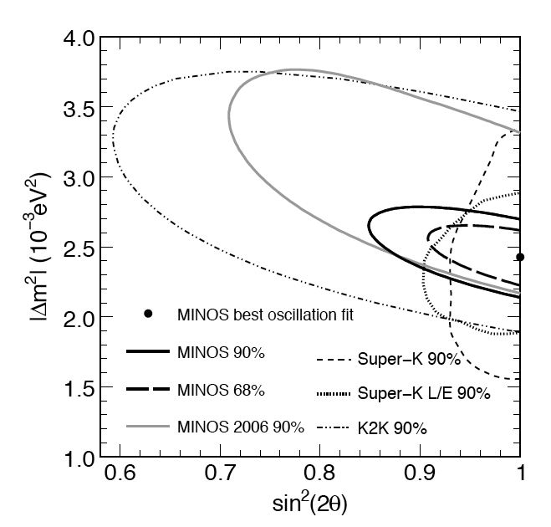
Physical motivations
The OPERA experiment is designed to provide an unambiguous evidence for ν_{μ}→ν_{τ} oscillation in the region of atmospheric neutrinos by looking for ν_{τ} appearance, event by event not statistical, in a ν_{μ} beam
Super-K (1998): atmospheric neutrino anomaly can be explained in terms of neutrino oscillations
CHOOZ: ν_{μ} → ν_{e} oscillations excluded as dominant process responsible for atmospheric neutrino disappearance
Super-K ν_{μ} disappearance signal confirmed by K2K and MINOS
Is ν_{μ} → ν_{τ} the leading process in the atmospheric sector?

Slide 4
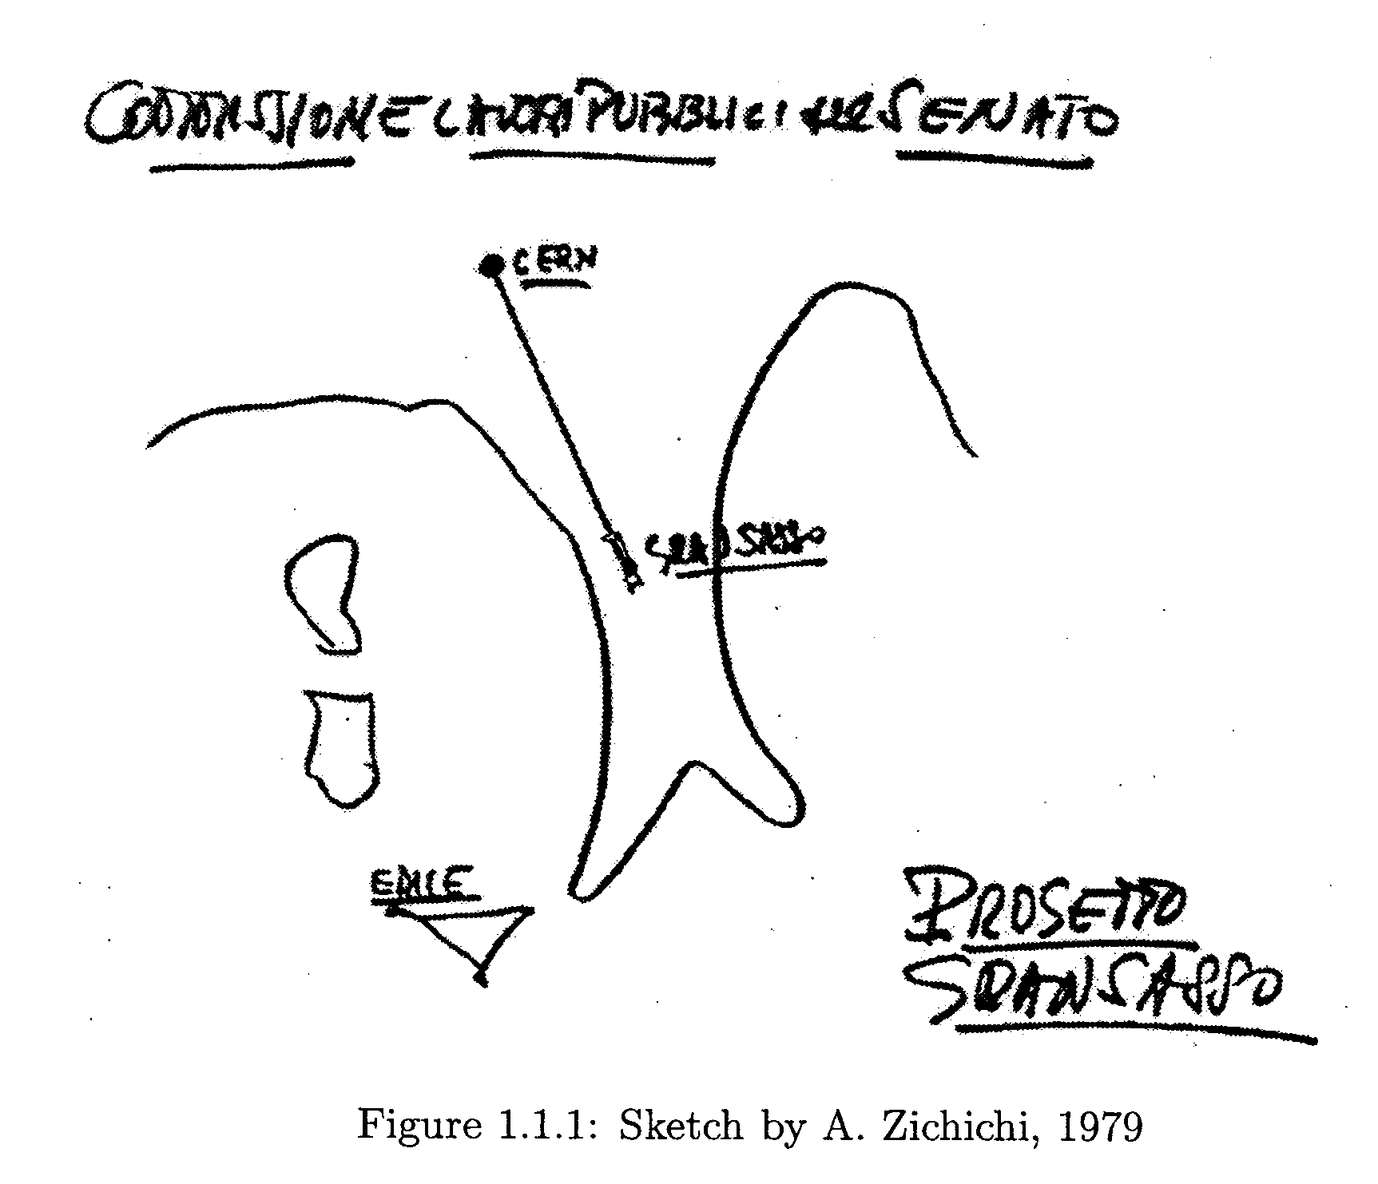
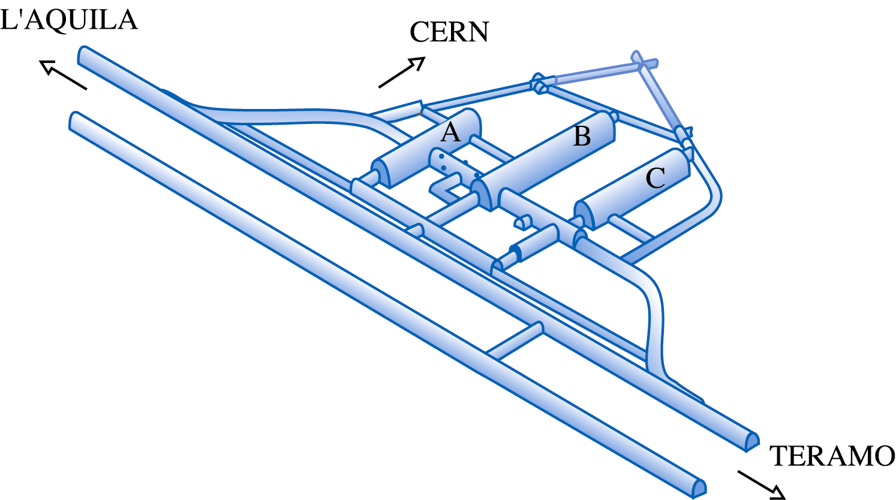
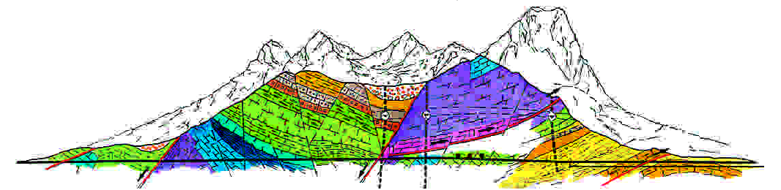
CNGS beam
CNGS is a high energy ν_{μ} beam from CERN to Laboratori Nazionali del Gran Sasso (LNGS).
ν
OPERA
Largest underground laboratory for astro-particle physics.
underground area: 18 000 m²
1400 m rock coverage
cosmic µ reduction= 10^{–6} (1/m²h)

Slide 5
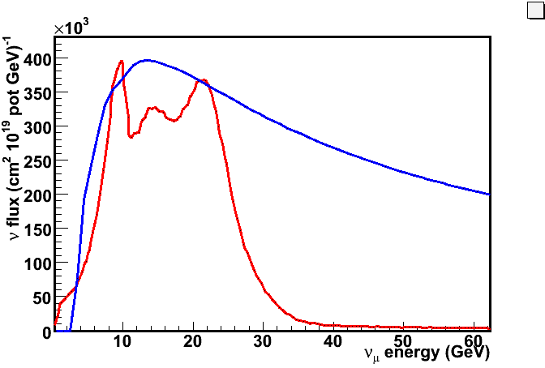
CNGS beam
Target mass
SPS 400 GeV/c protons on
graphite target
Cycle length 6 s
2 extractions, 10.5 μs long, separated by 50 ms
Beam intensity 2.4 10¹³ pot/extr.
Expected performance 4.5 10¹⁹ pot/year
Beam main features
L | 730 km
<E_{ν}> | 17 GeV
L/ <E_{ν}> | 43 km/GeV
(ν_{e}+ν_{e})/ν_{μ} | 0.87%
ν_{μ} / ν_{μ} | 4%
ν_{τ} prompt | negligible
Arbitrary units
The expected interactions in OPERA target (M_{D}=1.25kton) for 4.5 10¹⁹ pot/year
~4400 ν_{μ} CC + NC per year
~22 ν_{τ} CC per year for Δm² = 2.5 10⁻³ eV²

Slide 6
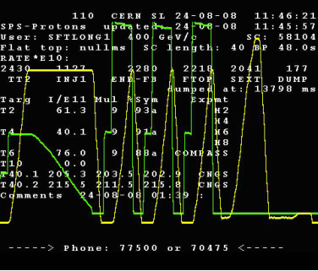
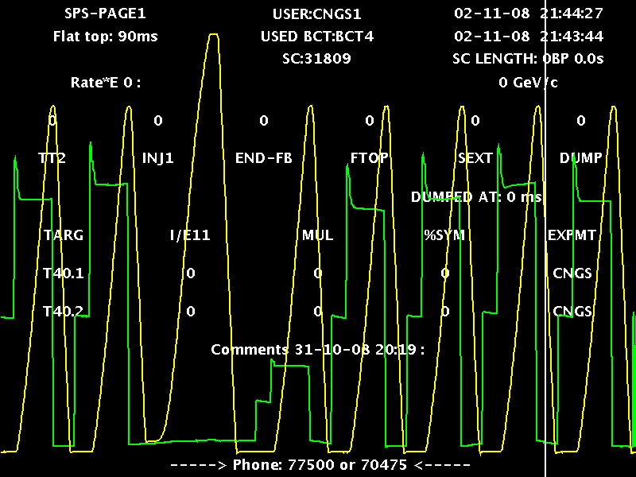
CNGS runs
2006: Pilot run after commissioning in Aug, no follow-up in October due to a problem in the cooling of one horn. Moreover, empty target
2007: Major problems in the radiation shielding of the ventilation system. Only 8·10¹⁷ pot. Significant interventions during winter shutdown
2008 OPERA fully operational. Total 1.78 10¹⁹ pot.
Performance of the CERN injection complex poor at beginning but steadily improving. After the LHC accident, further increase of the integrated intensity for OPERA (duty cycle 37.5% →83%).
LHC
2xCNGS
MTE/CNGS
4x CNGS
Typical SPS Supercycle
After LHC accident
SFTPRO
3xCNGS
LHC
MD

Slide 7
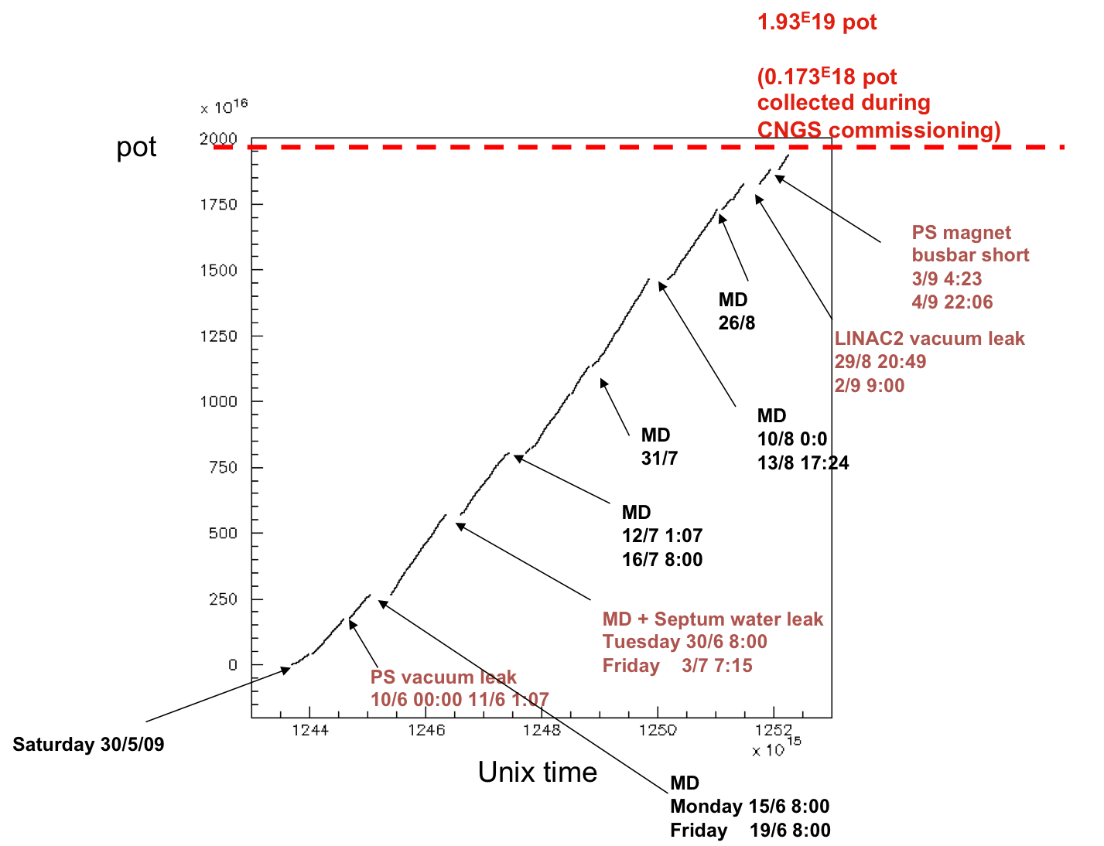
2009 CNGS run
run start was delayed by a quake that occurred in L'Aquila region on April the 6th (306 killed, 1600 injured)
the effect in the underground lab.
was dumped by a factor of 5
so no damage occurred to
the OPERA detector.
run “officially” started the 1st of
June and will last 153 days
Extrapolating to the end of run we
will get 3.5 10¹⁹ pot < 4.5 10¹⁹ pot
nominal run.
to reach quickly its physics goal
OPERA relies on CERN support
to have soon the CNGS running
at nominal intensity

Slide 8
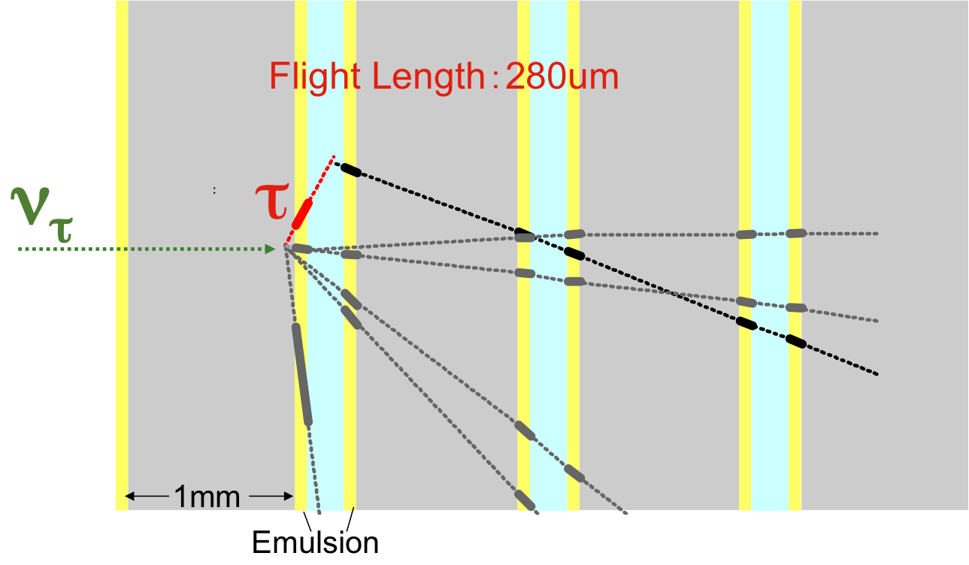
How to detect a tau
The separation of the ν_{τ} CC from the dominant ν_{μ} interactions is based on the identification, event-by-event, of the peculiar decay topology of the τ.
[cτ ~ 87 μm]
BR 17.4 %
BR 17.8 %
BR 48.7 %
BR 14.6 %
oscillation
ν_{μ} → ν_{τ} + N → τ⁻ + X
3D tracking:
32 grains/100μ
(35% of Non-Scaling QE and 65% DIS)
ν_{μ}
Decay “kink”
τ⁻
μ⁻
ν_{τ}
DONUT ν_{τ} event
(11% of Non-Scaling QE and 89% DIS)
ν_{μ}
μ⁻
ν_{μ}
Successful
application in DONUT with discovery of ν_{τ} (2000)
no-oscillation
μm resol. ↔ large mass “dilemma” solved bringing the technology of the
lead – nuclear emulsion sandwich to an immense size (1.25kton) needed by the small ν_{τ} cross section.

Slide 9
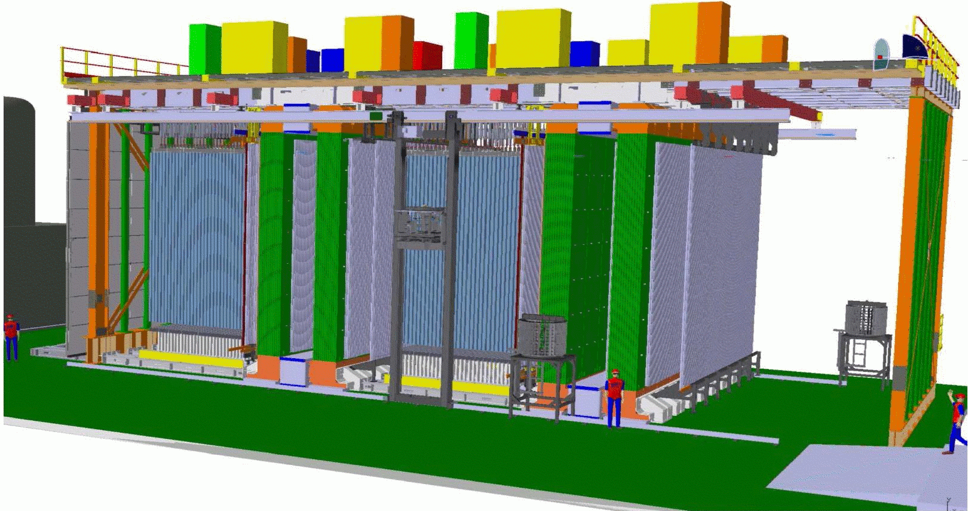
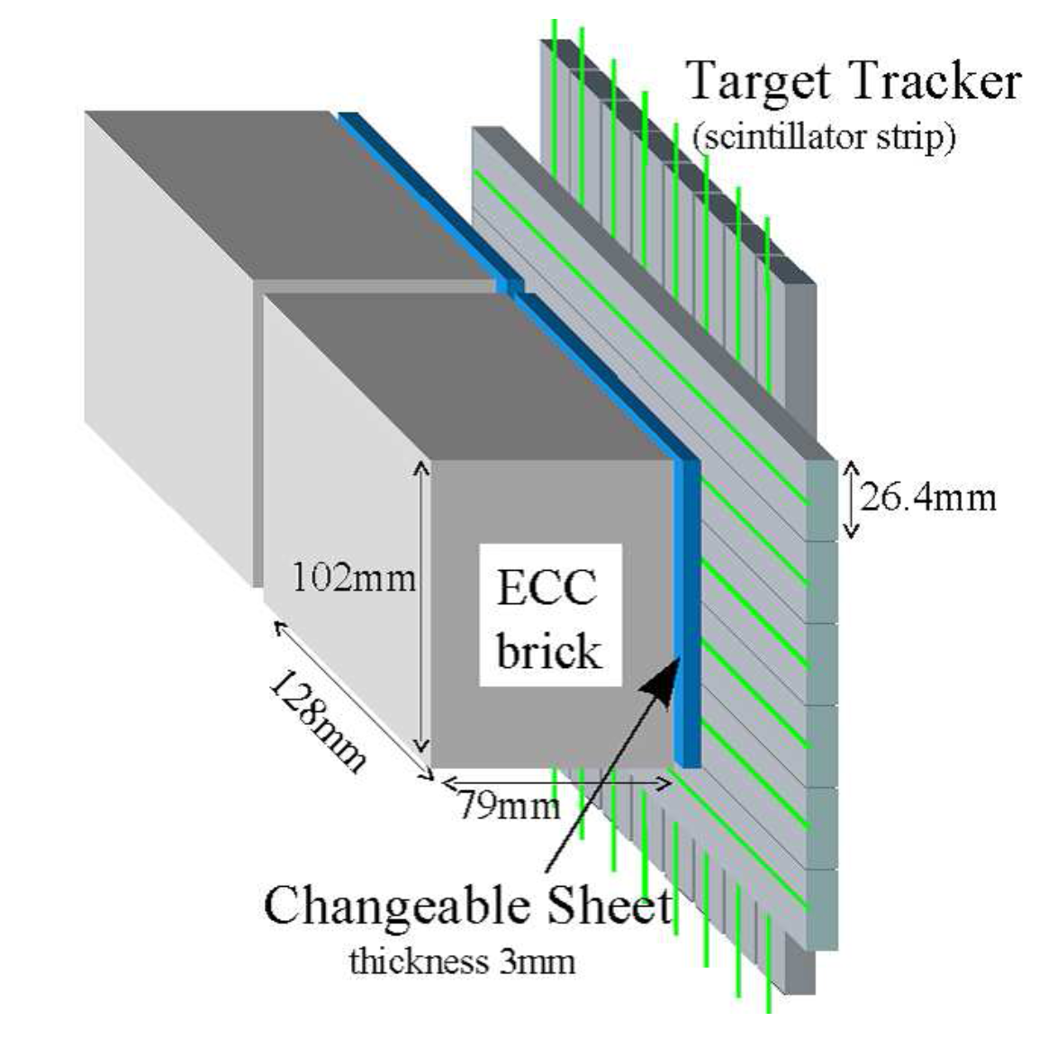
Oscillation Project with Emulsion tRacking Apparatus
Super Module 1
Super Module 2
RPC
Detector
supermodules construction:
Sept. 2003 - spring 2007
Veto
ECCs
scint. strips
Target
Muon
Spectrometer
Drift
tubes
10 m
20 m
10 m
BRICK WALLS
2850 bricks/wall
53 walls
BMS
Brick Manipulator system
HIGH PRECISION TRACKERS
6 drift-tube layers/spectrometer
spatial resolution < 0.5 mm
TARGET TRACKERS
2x31 scintill. strips walls
256+256 X-Y strips/wall
WLS fiber readout
64-channel PMTs
63488 channels
0.8 cm resol., ε 99%
rate 20 Hz/pixel @1 p.e.
INNER TRACKERS
990-ton dipole magnets
(B= 1.55 T) instrumented with 22 RPC planes
3050 m², ~1.3 cm res.
RPC + drift tubes in spectrometers:
muon ID,
momentum,
charge
Target Trackers
neutrino trigger
brick localization

Slide 10
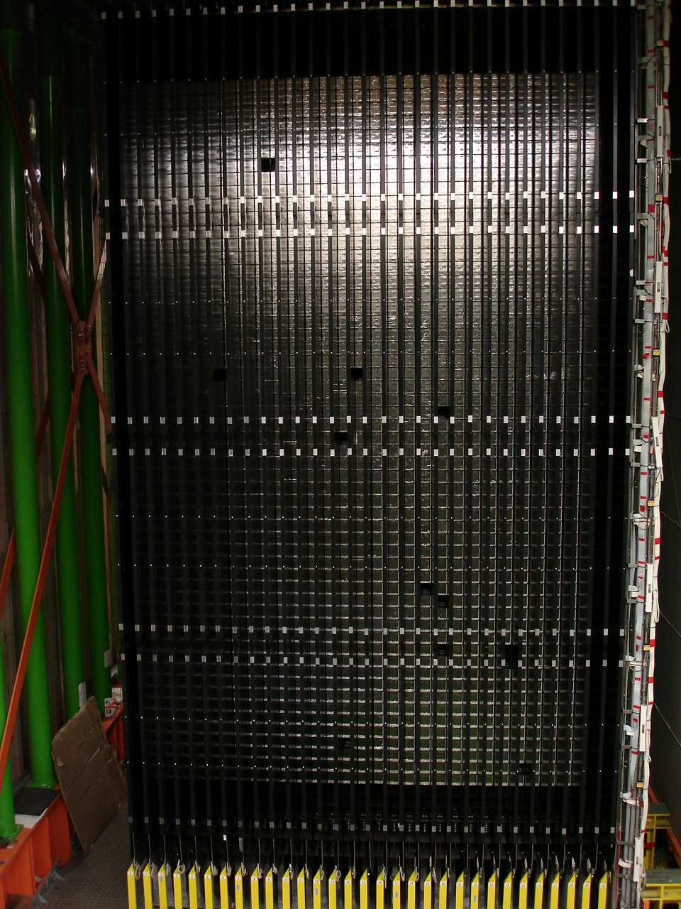
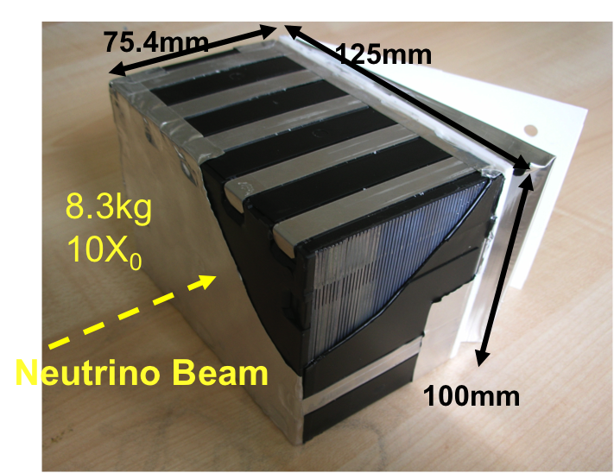
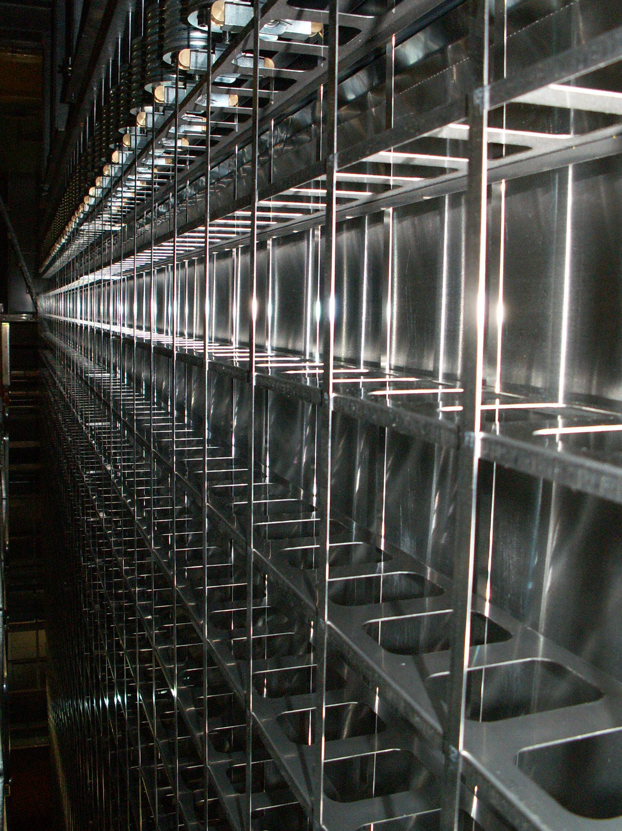
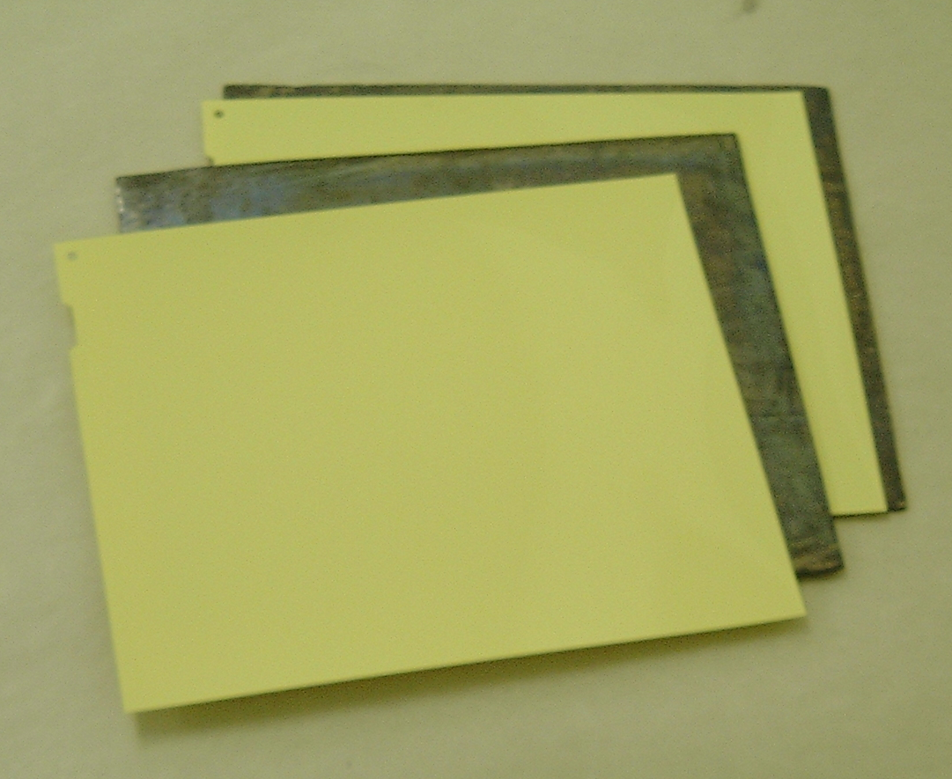
OPERA target
Changeable Sheet Doublet
(CS) in separate envelope
Mechanical structure
Brick trays
6 m
Brick: 57 nuclear emulsion films interleaved with 56 lead plates (1mm thick)
~150,000 bricks
(total target mass ~ 1.25 kt)
arranged in 54 walls
10.2cm
12.5cm

Slide 11
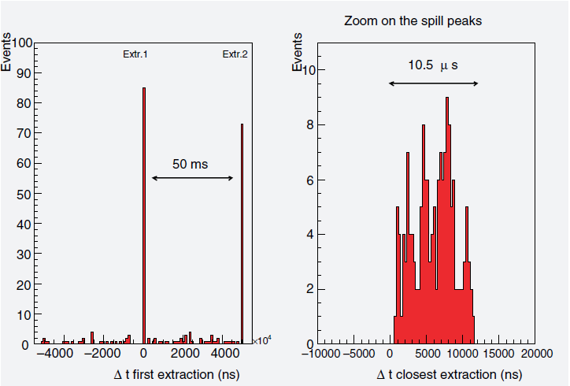
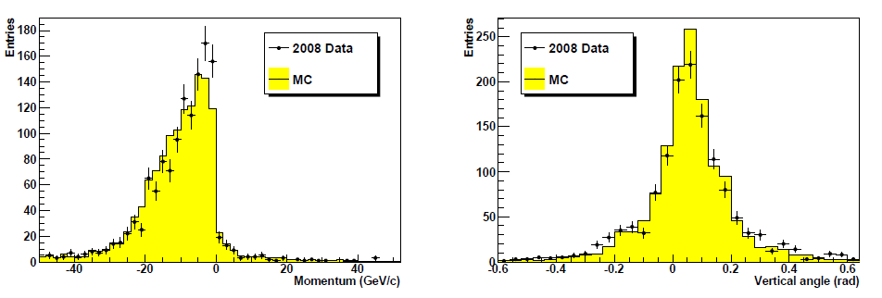
OPERA as real time experiment
R. Acquafredda et al.,
New J. Phys. 8 (2006) 303
CNGS events are selected on a delayed time coincidence between proton extraction from SPS and the events in OPERA.
The synchronization is based on GPS with
precision of ~100 ns.
DAQ livetime during CNGS is 98.8%
Real time detection of neutrino interaction in target and in the rock surrounding OPERA
Beam tilt due
earth curvature
μ⁺ from anti-ν_{μ} contamination

Slide 12
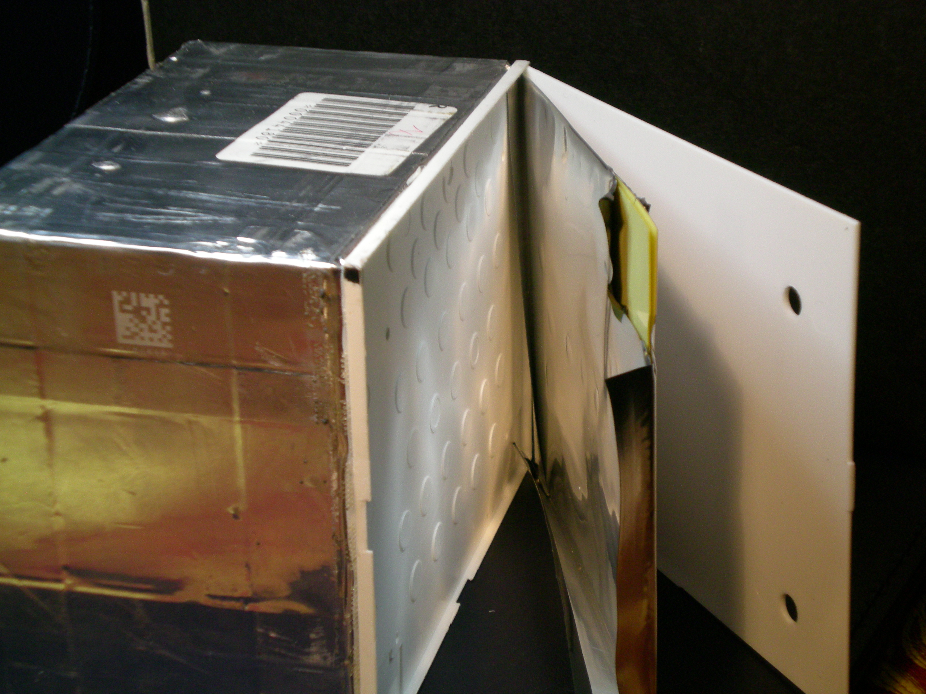
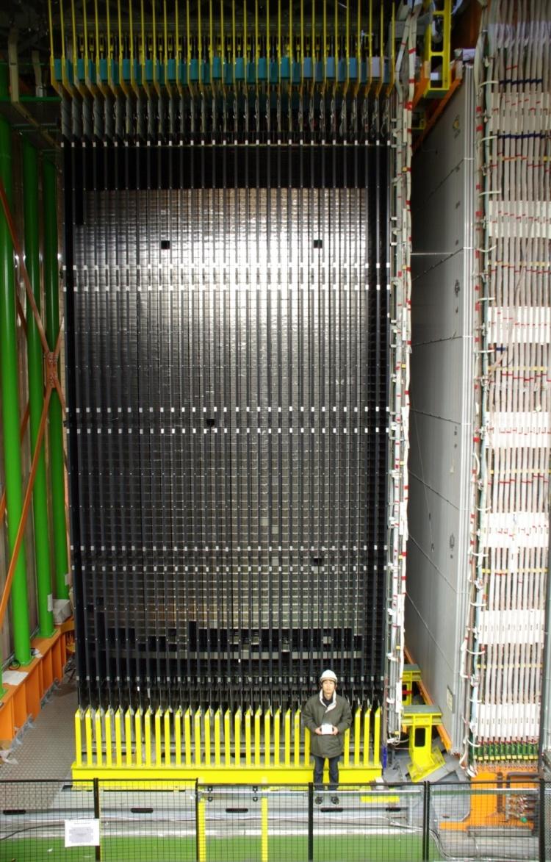
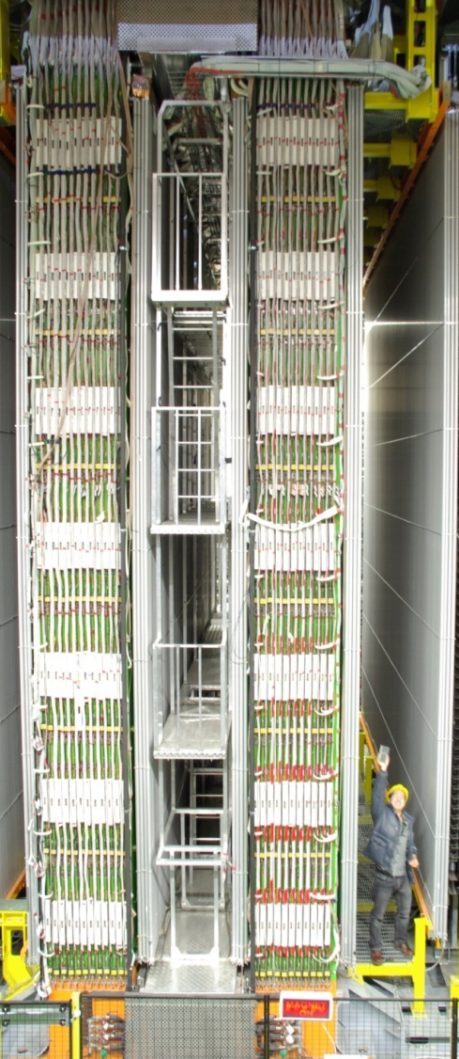
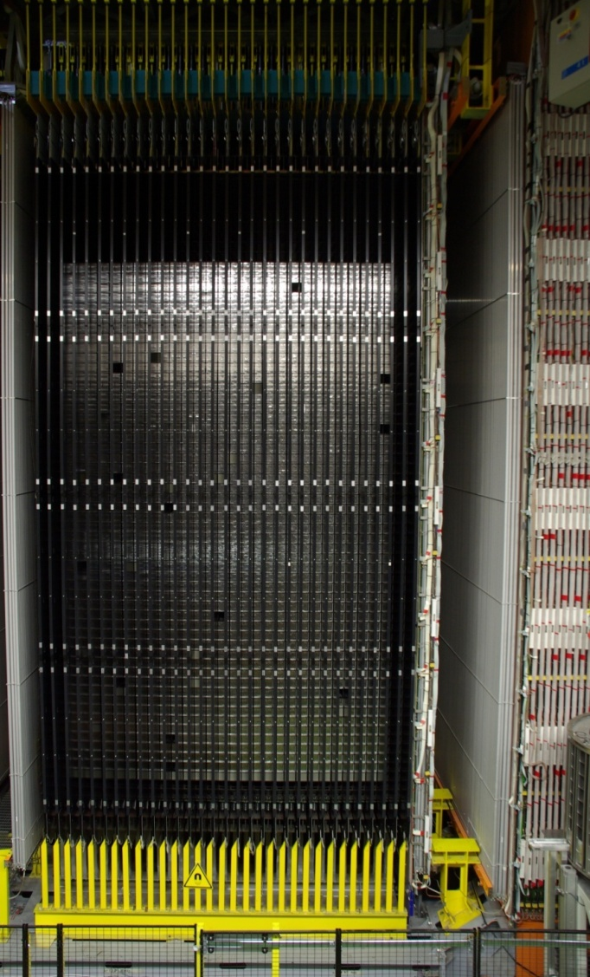
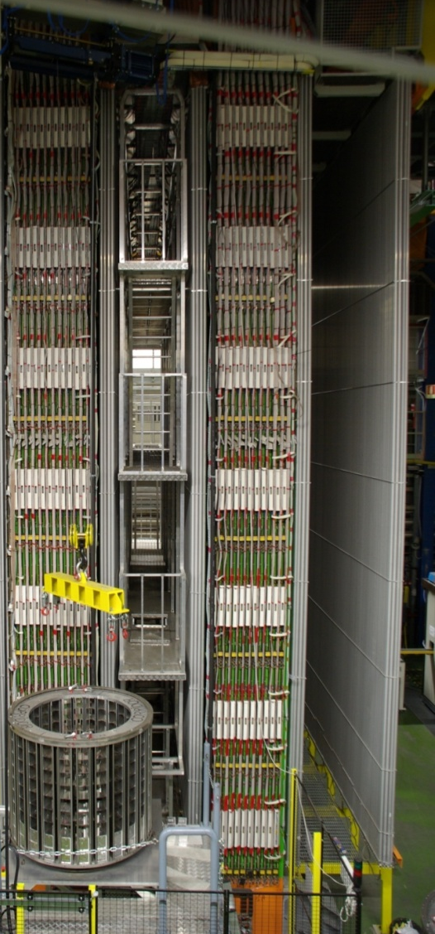

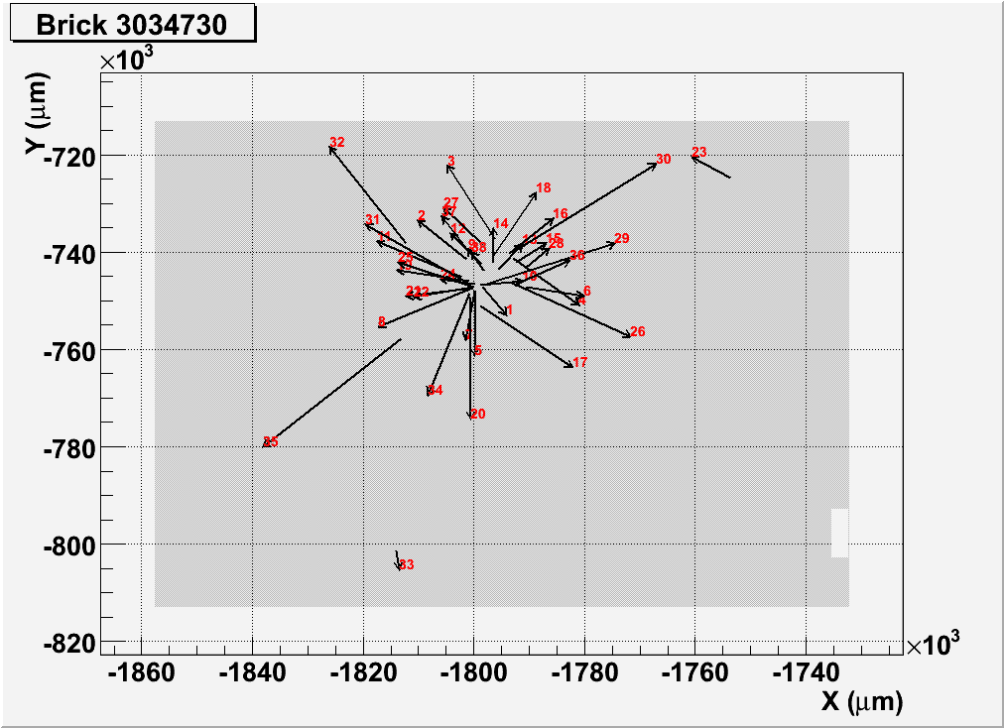
OPERA as hybrid detector
SM1
SM2
Extract Brick and CS, scan CS.
Confirm the event in the ECC brick.
Develop brick and send to scanning labs.
Brick finding eff. on 2008 Data
1st brick: 72%
After 2nd brick extraction > 80%
Preliminary
Target area (ECC + CS + TT)
Muon spectrometer (Magnet+RPC+PT)
Brick Manipulator System

Slide 13
OPERA hybrid det.: vertex location
● Scan-back: Connected tracks are followed up to their stopping points
(interaction vertex hints).
● Volume scan: a zone of ~ 1 cm² in several films is measured around
track disappearance point(s) to confirm the presence of the interaction
and reconstruct the vertex topology
CS prediction
ν_{μ}
Scan-Back
start from CS
prediction
Volume Scan
5 up-stream
10 down-stream
2
1
2
…
48
49
50
51
52
53
54
55
56
57
1

Slide 14
Status of 2008 vertex location
In 2008 Run we record about 1600 events in the target,
0.7 τ expected after analysis selection
 | with muon | without muon | Total
Events extracted | 1242 | 356 | 1598
Bricks developed | 993 | 249 | 1242
Vertices located in ECC | 738 | 135 | 873
Vertices located in the dead material | 16 | 6 | 22
The vertex location of 2008 events will
be completed by September 2009.
Analysis of 2008 events (decay search)
by end of 2009.

Slide 15
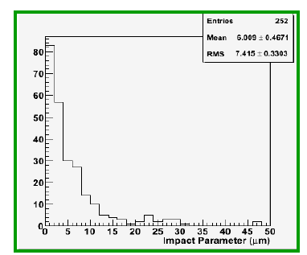
Decay search: work in progress….
Decay topologies are searched looking to long flight decay or tracks with large
impact parameter. The procedure is under optimization.
microtrack
Before
Track (basetrack) loss can be recovered if we can use the “microtracks” level
“basetrack”
After

Slide 16
Decay search
Preliminary
Micro-tracks @ the vertex
plate made clear the
separation between the two
vertices.
Momentum reconstruction of
hadron tracks by mean of
Multiple Coulomb Scattering
allows to reconstruct the
kinematic of the event and
thus suppresses the
background
Preliminary

Slide 17
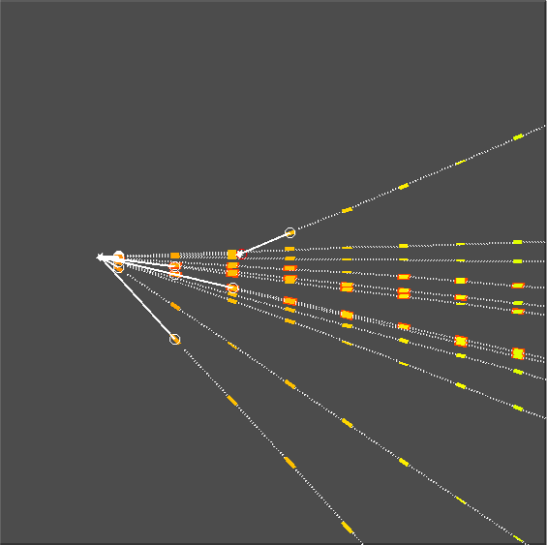
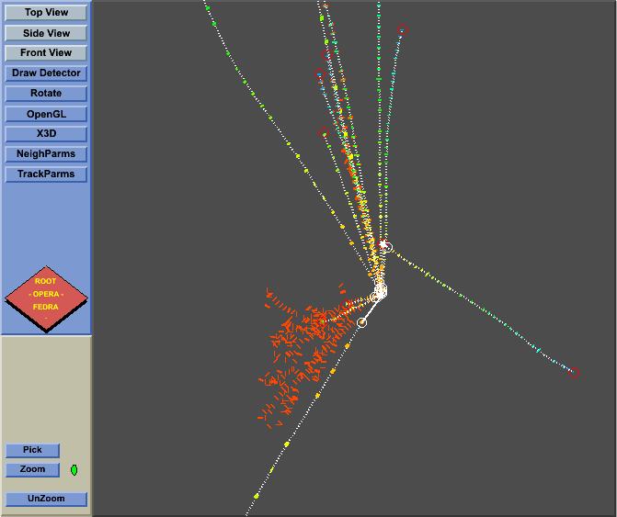
Long charm decay
2009 JINST 4 P06020
Kink
Kink
μ
e.m. shower
Flight length = 3247 μm
Θ_{kink} = 0.204 rad
P_{daughter} = 3.9^{+1.7}_{-0.9} GeV from MCS
610 < P_{t} < 1140 MeV @ 90% CL
Δφ in transverse plane = 165º
Two e. m. showers pointing to vertex

Slide 18
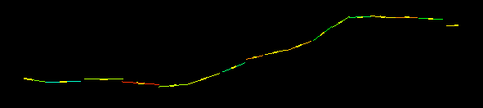
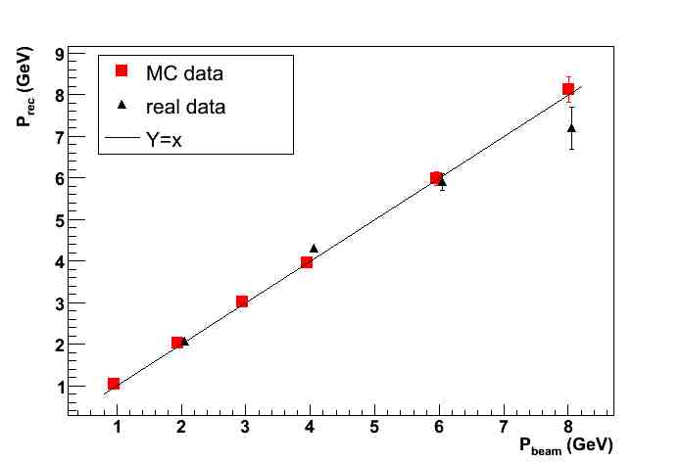
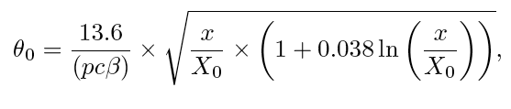
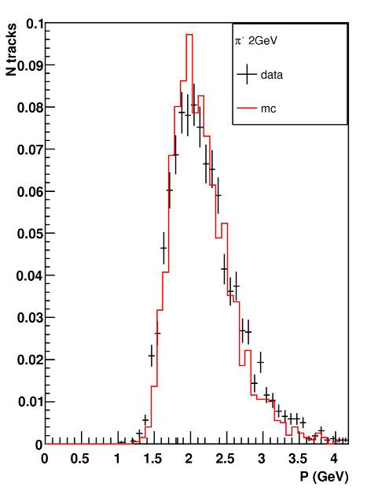
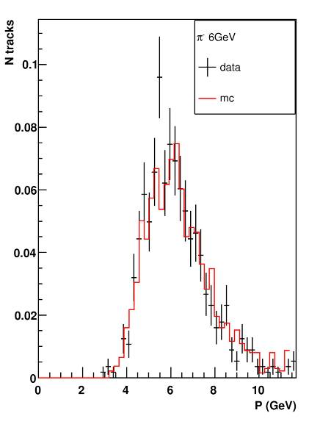
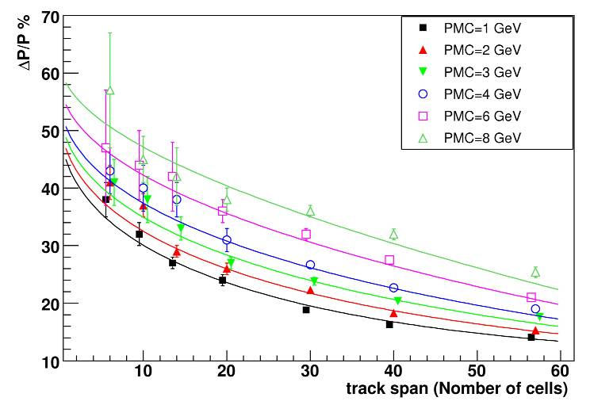
Momentum reconstruction by Multiple Coulomb scattering
Evaluate scattering of particles
P MCS (GeV)
π test beam
Pion 2 GeV
Pion 6 GeV
P beam (GeV)
Data from Test exposure to pion beam

Slide 19
Multi prong charm decay
3 prongs secondary, 4 prongs primary vertex
secondary 1150 μm away from the primary
charmed parent seen in 1 emulsion layer !
Δφ (charm,μ) ≈ 150°
p1=2.4 ^{+1.3}_{−0.6} , p2=1.3 ^{+0.4}_{−0.3} , p3=1.2 ^{+1.7}_{-0.4} GeV/c
μ⁻
top
side
front

Slide 20
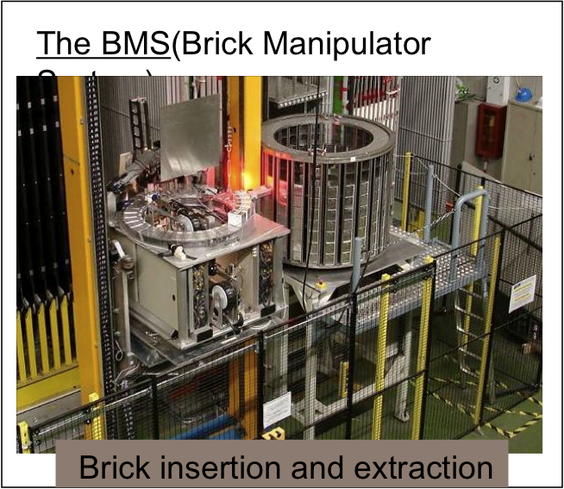
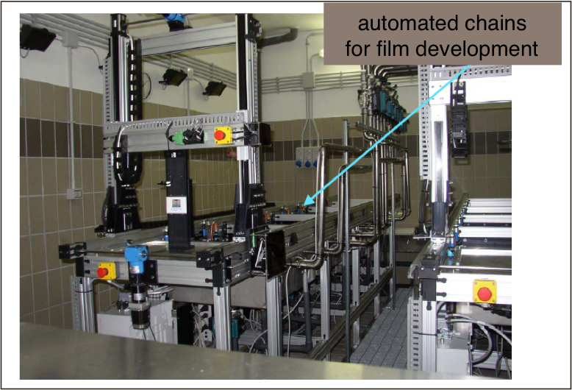
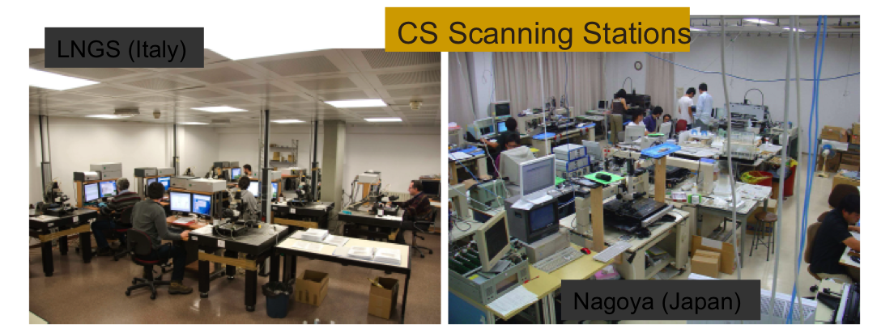
2008 CNGS run: summary
2008 run has been used to validate the several steps of the running of OPERA
  Alignment and development of Changeable Sheets
  Scanning of Changeable Sheets
  Extraction development of the Bricks @ CNGS rate
  Vertex location in the different Labs.
  Decay search
  Kinematical analysis
Fully validated
CS alignment
In progress

Slide 21
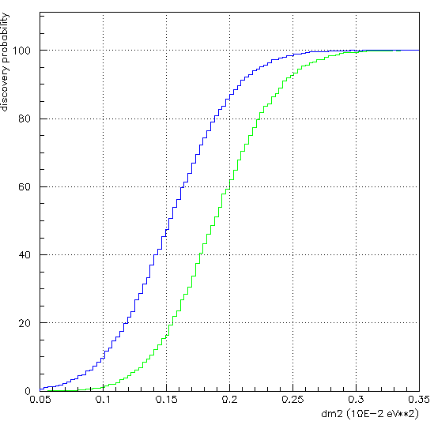
OPERA signal and background
We are revaluating and optimizing the tau search analysis based on the experience gained with 2008 data.
The analysis of a minimum bias sample of 2008 data fully kinematically reconstructed is in progress.
This will allow us to better estimate the backgrounds from OPERA data (hadronic interaction length, impact parameter, missing p_{t} …) and to tune the emulsion MC to get a more reliable evaluation of signal efficiency and backgrounds.
τ decay channel | B.R. (%) | Signal Δm² = 2.5 x 10-3 eV² | Background
τ → μ | 17.7 | 2.9 | 0.17
τ → e | 17.8 | 3.5 | 0.17
τ → h | 49.5 | 3.1 | 0.24
τ → 3h | 15.0 | 0.9 | 0.17
Total |  | 10.4 | 0.75
4-σ evidence
3-σ evidence
Discovery probability (%)
Full mixing, 5 years run, 4.5x10¹⁹ pot / year
Δm² (eV²)
Main background sources:
Production and decay of charmed particles
Hadron re-interactions in lead
Large angle muon scattering

Slide 22
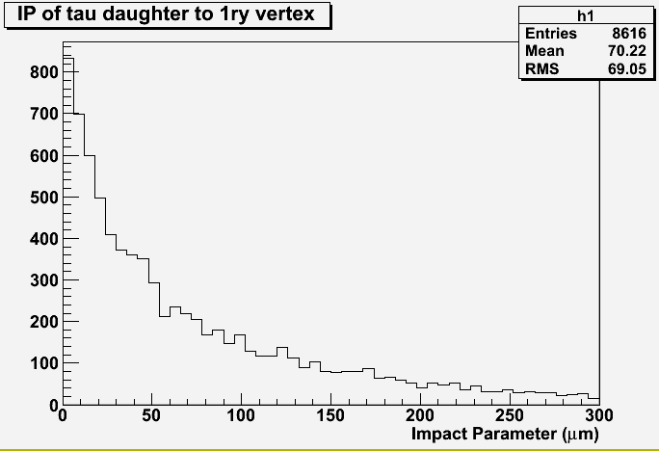
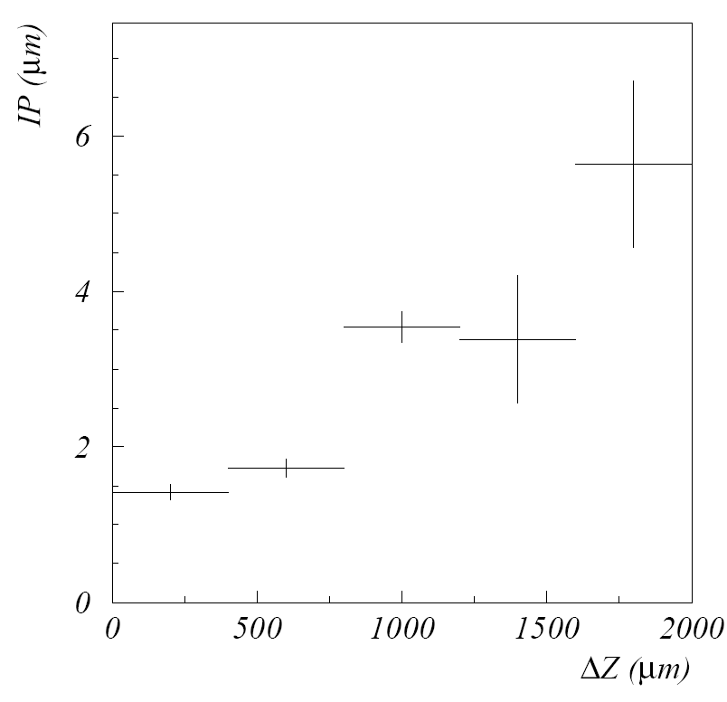
Impact parameter study
lead
emulsion
MC
IP
ΔZ
IP = Distance from the reconstructed vertex
ΔZ profile plot
Data
Data
<IP>
Preliminary

Slide 23
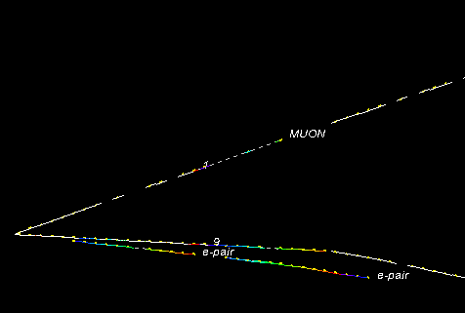
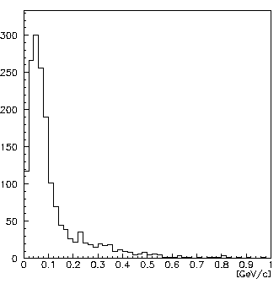
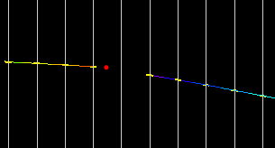
Hadronic reinteraction
Hadron reinteraction is the second important BG source
MC validation studying all the
hadron tracks produced at the primary vertex far away from the vertex
MC
Kink angle (-0.079, -0.120) = 0.041 rad
Pt
Pt = 0.265 GeV/c
27

Slide 24
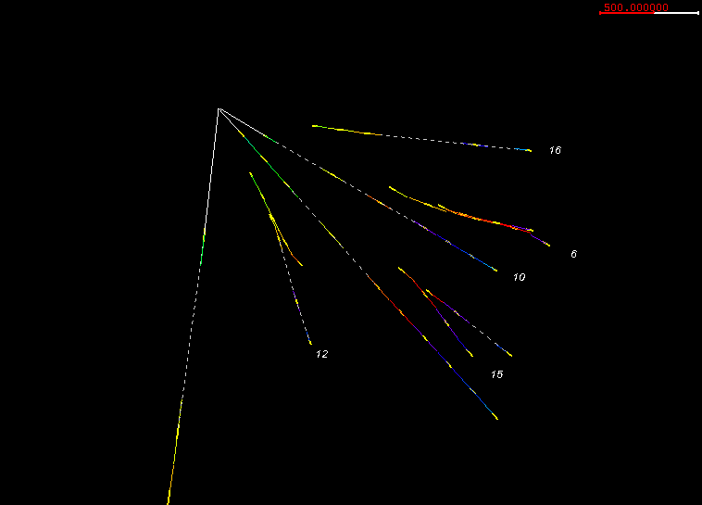
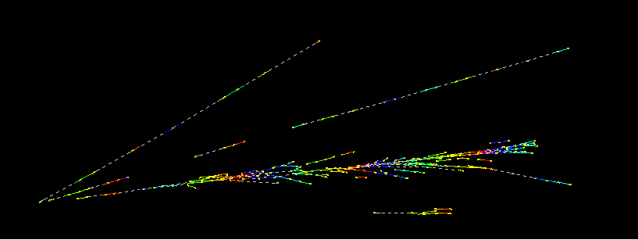
γ detection and π⁰ reconstruction
70% of 1-prong hadronic tau decays include one or more π⁰. Important to detect gamma from tau decay to improve S/N.
Gamma detection
detection of shower
detection e-pair at start point
π⁰ reconstruction is in progress.
2 e-showers give a reconstructed mass ~ 160 MeV/c²
e+
e-
γ → e-pair
γ
E ~8.1 GeV
E ~0.5 GeV

Slide 25
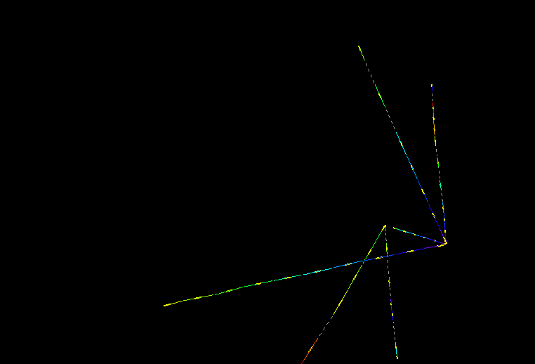
Example of γ to vertex attachment
ν_{μ} CC interaction with hadronic re-interaction
2.2 cm
Secondary vertex
7 mm
ν
Primary vertex
muon

Slide 26
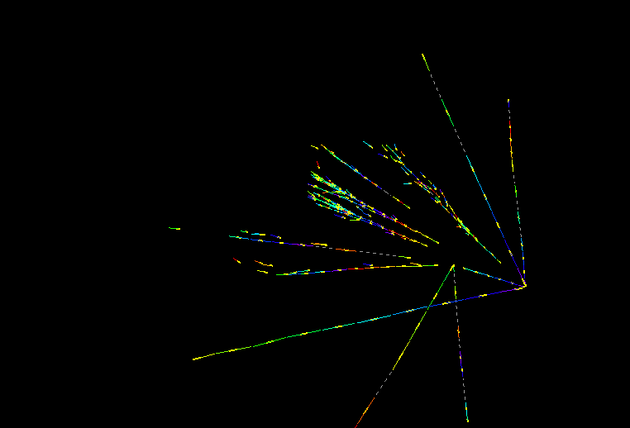
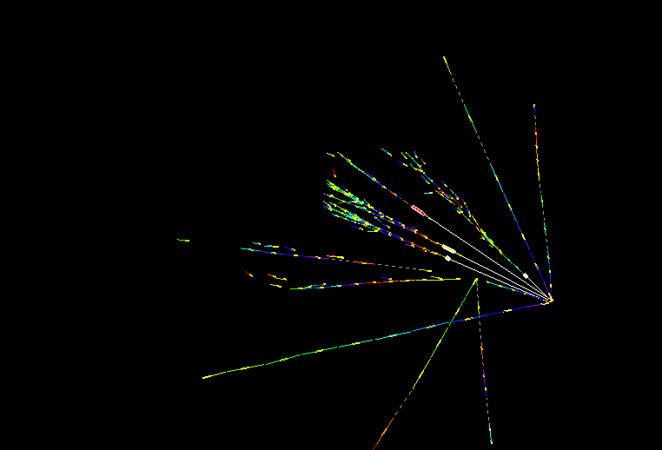
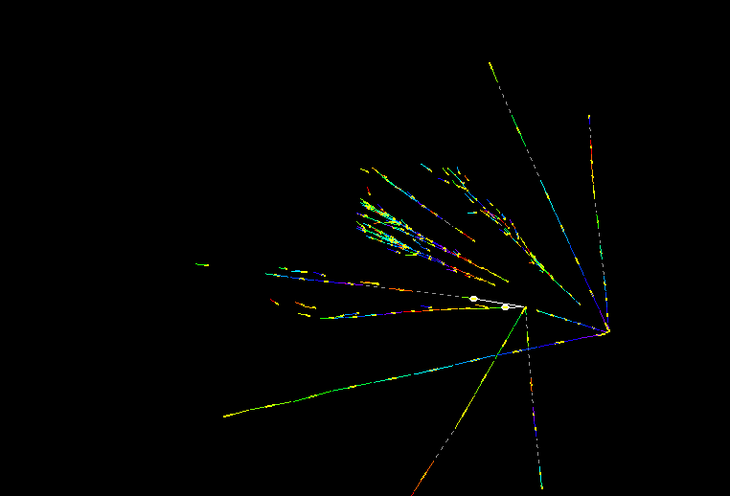
Example of γ to vertex attachment
6 γ reconstructed around the vertex
6 γ reconstructed around the vertex
6 γ reconstructed around the vertex
Work in progress
4 γ attached to primary vtx and well separated from secondary vtx:
- IP at 1ry vtx: 27 - 31 - 119 - 3.5 μm
- IP at 2ry vtx: 260 -158 - 500 - 700 μm
2 γ attached to secondary vtx and well separated from primary vtx:
- IP at 2ry vtx: 8 - 10 μm
- IP at 1ry vtx: 1216 - 806 μm
7 mm
ν
ν
ν
Not only detection, but also pointing of vertex
muon
muon
muon
2.2 cm

Slide 27
Conclusions
OPERA is taking data with all ancillary facilities, Brick extraction, development, CS & Brick scanning.., operative at full nominal speed.
1.78 10¹⁹ pot collected during 2008 run which was the first real physics.
  ~1600 events in the target, ~800 located in the bricks
  Vertex location to be finish this month
2008 data analysis (decay search, kinematical rec.) in progress.
  Optimization of the tau search and evaluation of signal efficiency and expected background on the basis of 2008 data in progress.
  No tau signal yet, expected 0.7 for 2008, analysis in progress.
  Several charm event found as expected, analysis in progress.
2009 run, 1.93 10¹⁹ pot collected
  4.5 10^{19 pot} requested (nominal CNGS run), extrapolating the present performance of CNGS we will get 3.5 10¹⁹
  as statistic is a key point in order to reach the OPERA physics goal, OPERA relies on the CERN support to have soon the CNGS running at nominal intensity.

