Slide 1
Lepton pair production
at RHIC and LHC energies
Cem Güçlü
İstanbul Technical University
Physics Department

Slide 2
Particle production from EM Fields
* Lepton-pair production
* Beam Lifetime (electron capture)
* Detector background
* Non-perturbative and perturbative approach
* Impact parameter dependence
* Multi-pair production
* Test of QED at high fields

Slide 3
Particle production from EM Fields
INTRODUCTION
FREE LEPTON PAIR PRODUCTION
BOUND FREE LEPTON PAIR PRODUCTION
ELECTRON-POSITRON PAIR PRODUCTION
WITH NUCLEAR DISASSOCIATION
5. LASER ASSISTED PAIR CREATION IN ION-ION COLLISION
6. CONCLUSION

Slide 4
Particle production from EM Fields
Central Collision
QCD (Quantum Chromo Dynamics)
Peripheral Collision
QED (Quantum Electro Dynamics)
b

Slide 5
Collisions of Heavy Ions
E
E

Slide 6
Collision Parameters :

Slide 7
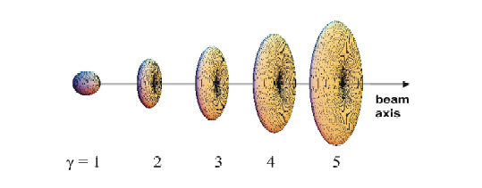
Dependence of the electric radial field strengths for a point charge
on the Lorentz factor γ

Slide 8
Relativistic Colliders
 | 200 | 100 | 120 | 12 | 1.6
 |  | 10⁴ | 1.2x10⁴ | 1.2x10³ | 160
 |  | 10⁷ | 1.2x10⁷ | 1.2x10⁶ | 1.6x10⁵
SPS
RHIC
LHC

Slide 9
QED Lagrangian
Dirac wave-function of electrons/positrons
Electromagnetic vector potential
Electromagnetic field tensor
Semiclassical coupling of electrons to the electromagnetic field

Slide 10
The four-vector potential in the rest frame of a charge point Z,
centered at the coordinates ( 0, b/2, 0 )
b

Slide 11
İn momentum space:

Slide 12
Lorentz transform this potential to the moving frame:

Slide 13
Equation of motion:
1. We construct a semiclassical action in terms of a time-dependent many electron state
2. We assume that the initial state vector corresponds to a single Slater determinant |0>
Single particle and anti-particle states

Slide 14
3. We assume the dynamics governing the time evolution of the states is unitery:
Therefore, the equation of motion can be cast into the form

Slide 15
With the above assumptions, all orders processes can be obtained. In particular, those
solutions which are perturbative in potential can ve expressed as the series
Where in above equation, the lowest-order terms is simply

Slide 16

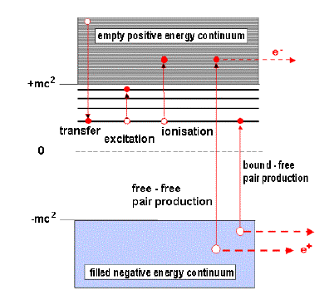

Energy diagram of the single-particle Dirac equation and basic atomic processes
which occur in ion-atom collisons

Slide 17
Second-order Feynman diagram
Ion 1
Ion 2
time
Pair Production
Emits photon
Emits photon

Slide 18
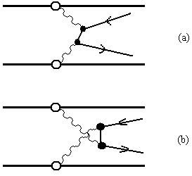
Direct and exchange diagrams :

Slide 19
Total Cross Section of free pair production

Slide 20
Scalar part of EM Fields in momentum space of moving heavy ions

Slide 21
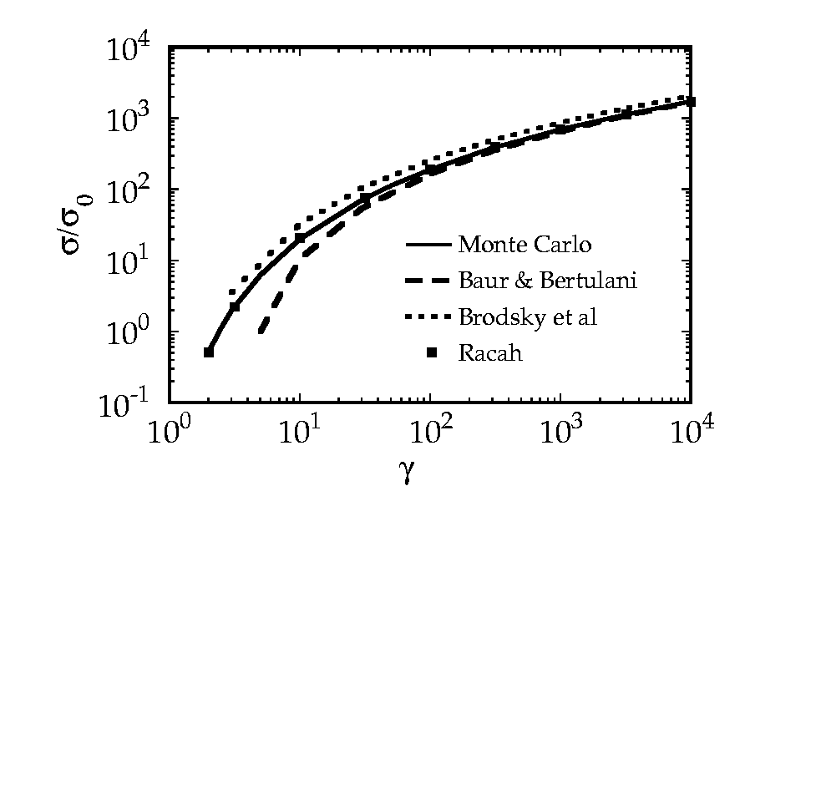

Slide 22
Free electron-positron pair production
SPS , γ=10, Au + Au , σ=140 barn
RHIC, γ=100, Au + Au , σ=36 kbarn
LHC, γ=3400, Pb + Pb , σ=227 kbarn

Slide 23
Two Photon Method :
Equivalent Photon Method:
M. C. Güçlü, Nucl. Phys. A, Vol. 668, 207-217 (2000)

Slide 24
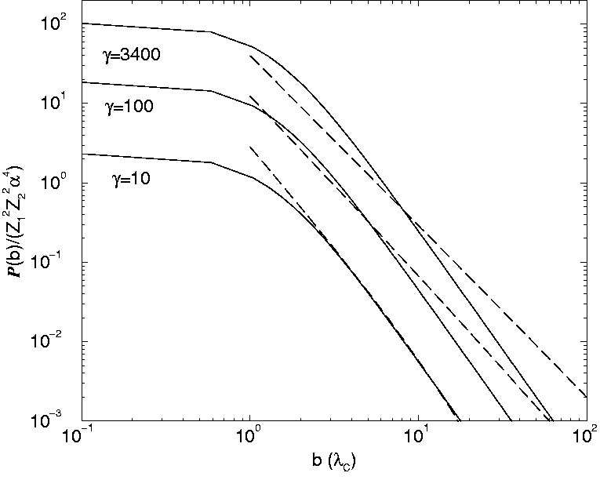

Slide 27
Electron Capture Process
In the bound-free pair-production, the
electron is captured by one of the
colliding ions
and leads to the loss of the (one
electron) ion from the beam.

Slide 28
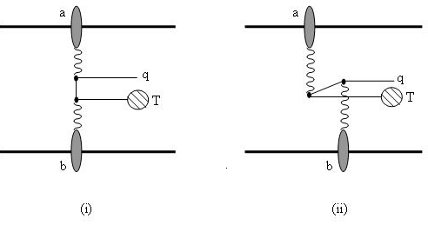
Particle production from EM Fields
Bound-free electron – positron pair production)

Slide 29
Distorted wave-function for the captured-electron

Slide 30
Positron Wave-Function
is the distortion (correction term)
due to the large charge of the ion.

Slide 31
RESULTS
TABLE I: Bound-free pair production cross sections (in barn)
for selected collision systems and cross sections as accessible
at RHIC and LHC collider facilities.

Slide 32
FIG. 2: BFPP cross sections for two different systems as functions of the
nuclear charge Z.

Slide 33
FIG. 3: BFPP cross sections for two different systems (Au+Au-dashed line and
Pb+Pb-solid line) as functions of the .

Slide 34
FIG. 4: The differential cross section as function of the transverse
momentum of the produced positrons.

Slide 35
FIG. 5: The differential cross section as function of the longitudinal
momentum of the produced positrons.

Slide 36
FIG. 6: The differential cross section as function of the energy of the
produced positrons .

Slide 37
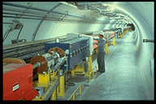
Experiments
at
CERN Super Proton Synchroton SPS

Slide 38
Energy = 200 A GeV at fixed target frame
Measured Cross Section for 1-17 MeV /c positron yield
with 25% error
for 1-17 MeV /c positron
For all positron momenta
Vane CR at al. Phys. Rev. A 50:2313 (1994).

Slide 40
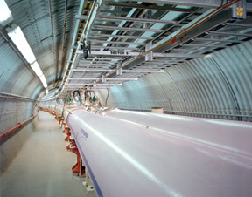
What about experiments
at
SOLENOIDAL TRACKER ( STAR ) ?
RHIC: Relativistic Heavy Ion Collider
Energy =100 GeV/nucleon
Au + Au collisions
Circumference = 2.4 miles

Slide 41
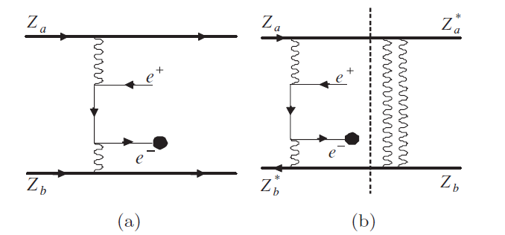
Particle production from EM Fields
Nuclear disassociation (Giant Dipole Resonance)
Electron-positron pair production (on the left) with a mutual Coulomb excitation (on the
right) being mainly giant dipole resonance (GDR). These two processes are independent
of each other.

Slide 42
Cross Section of electron-positron pairs
accompanied by nuclear dissociation
Giant Dipole Resonance

Slide 43
No hadronic probability, computed with Woods-Saxon nuclear form factor

Slide 44
Probability of mutual Coulomb nuclear excitation with breakup
as a function of impact parameter
G. Baur at al. Nuclear Physics A 729 (2003) 787-808

Slide 45
Kinematic restrictions at STAR experiment
Rapidity:
Invariant mass:
Transverse momentum :
Adams J. At al. Phys. Rev. A 63:031902 (2004)

Slide 46
Results:

Slide 47
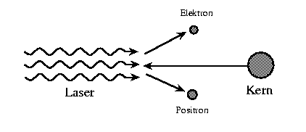
LASER ASSISTED PAIR CREATION IN ION-ION COLLISION
nonlinear Bethe-Heitler process
Carsten Müller
lab frame: ħω ≈ 100 eV , E ≈ 10^12 V/cm
rest frame: ħ ω ' and E' enhanced by 2γ

Slide 48
LASER ASSISTED PAIR CREATION IN ION-ION COLLISION
A lepton pair is produced in the Coulomb fields of the heavy-ions ( Z ) with the simultaneous absorption of N photons from the background laser field.
We aim to combine the pair creation in ion-ion collisions with the pair creation in strong laser fields by investigating pair creation in ion-ion collisions occuring in the presence of an intense laser field.

Slide 49
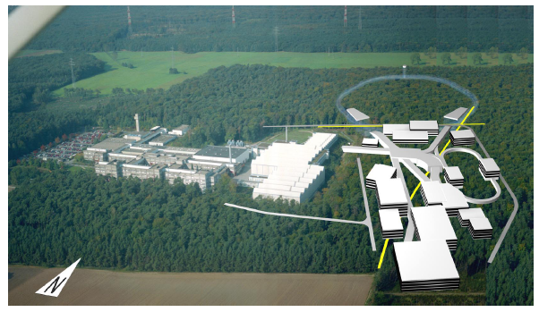
FAIR - Facility for Antiproton and Ion Research
Completed in 2018
Cost : 1.2 billion Euro
QED
Strong Fields
Ion -Matter Interactions

Slide 50
CONCLUSIONS:
1. We have obtained free-free and bound-free electron-positron pair
production cross section by using the semi-classical two photon
method.
2. Our calculations agree well with the other calculations shown at references.
3. We have also obtained cross sections as a function of rapidity, transverse momentum and longitudinal momentum of produced positrons.
4. We can repeat the similar calculation for the FAIR energies.
5. Can we use this method to calculate the production of other particles
such as mesons, heavy leptons, may be Higgs particles ?
6. Laser assisted pair creation in ion-ion collisons

Slide 51
REFERENCES:
C.A. Bertulani and G. Baur, Phys. Rep. 163, 299 (1988).
A.J. Baltz, M.J. Rhoades-Brown and J. Weneser, Phys. Rev. A 50, 4842 (1994).
C.A. Bertulani and D. Dolci, Nucl. Phys. A 683, 635(2001).
J. Eichler and W.E. Meyerhof, Relativistic Atomic Collisions (Academic Press, California, 1995).
H. Meier, Z. Halabuka, K. Hencken, D. Trautmann and G. Baur, Phys. Rev. A 63, 032713 (2001).
Şengül, M. Y., Güçlü, M. C., and Fritzsche, S., 2009, Phys. Rev. A 80, 042711.
K. Hencken, G. Baur, D. Trautmann, Phys. Rev. C 69, 054902 (2004).
M.C. Güçlü, M.Y. Şengül, Progress in Part. and Nucl. Phys. 59, 383 (2007).
Şengul, M. Y., and Güçlü, M. C., 2011, Phys. Rev. C ,83,014902.
C. Müller, A. B. Voitkiv and N. Grün, Phys. Rev. A 67, 063407 (2003).

