Slide 1
Concluding remarks on NA60 (and beyond)
Hans J. Specht
Physikalisches Institut Universität Heidelberg
Erice, 20 September 2012

Slide 2
Outline
- Planck-like radiation and deconfinement
- The ρ spectral function and chiral restoration
- Radial expansion and the EoS close to T_{c}
- Hadron results
- Remarks on other dilepton experiments

Slide 3
Measuring dimuons in NA60: concept
2.5 T dipole magnet
muon trigger and tracking (NA50)
beam tracker
Si-pixel tracker
magnetic field
targets
hadron absorber
<1m
>10m
Track matching in coordinate and momentum space
Improved dimuon mass resolution
Distinguish prompt from decay dimuons
Additional bend by the dipole field
Dimuon coverage extended to low p_{T}
Radiation-hard silicon pixel detectors (LHC development)
High luminosity of dimuon experiments maintained

Slide 4
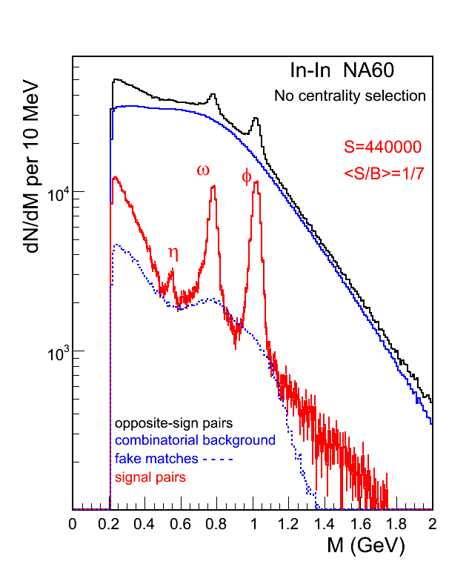
Data sample for 158A GeV In-In
subtraction of
combinatorial background
- fake matches between the two spectrometers
S/B highest of all experiments, past and present (see below)
net sample: 440 000 events
effective statistics also highest of all experiments
mass resolution: 20 MeV at the ω position
2m_{μμ}
η, ω, φ completely resolved

Slide 5
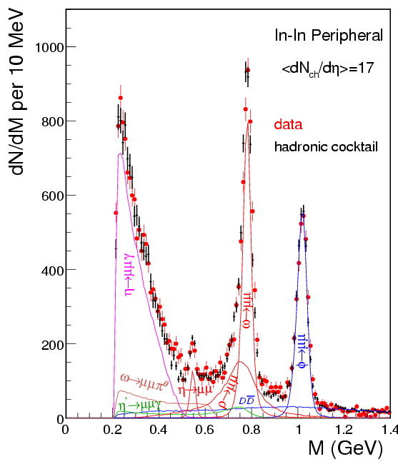
Understanding the peripheral data
Monte Carlo simulation of the expected dilepton sources:
electromagnetic decays:
2-body: η, ρ, ω, φ → μ⁺μ⁻ Dalitz : η, η′ → μ⁺μ⁻ γ ω →μ⁺μ⁻π⁰
EM transition form factors of the η and ω Dalitz decays remeasured here
_
semileptonic decays: uncorr. μ⁺μ⁻ from DD
_
fit with free parameters: η/ω, ρ/ω, φ/ω, DD
‘perfect’ description of the data

Slide 6
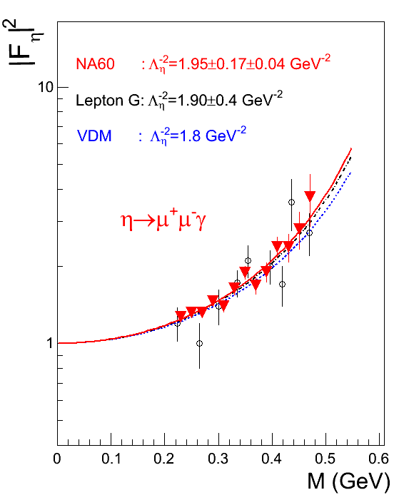
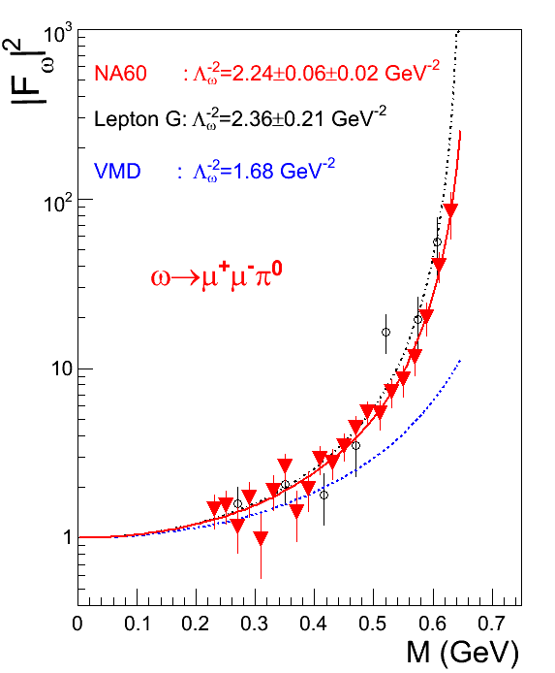
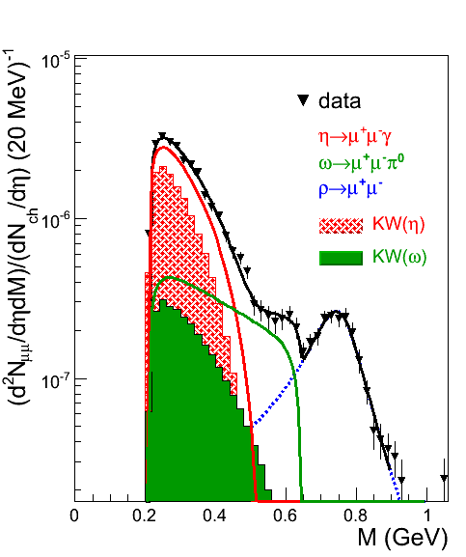
Results on Electromagnetic Transition Form Factors
Phys. Lett. B 677 (2009) 260
data corrected for acceptance
Perfect agreement of NA60 and Lepton G, confirming ω anomaly
Large improvement in accuracy; for ω, deviation from VMD 3 → 10 σ
NA60 p-A data: complete agreement, still higher accuracy (to be published)

Slide 7
NA60 results in the new edition of the PDG
PDG 2008
PDG 2010
First result from a heavy-ion experiment in the PDG ever

Slide 8
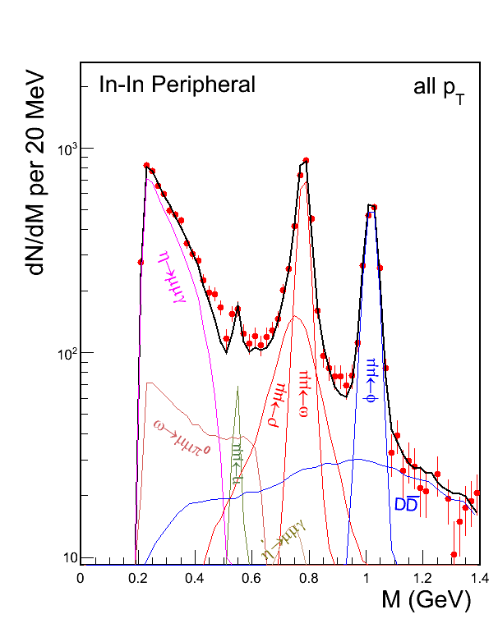
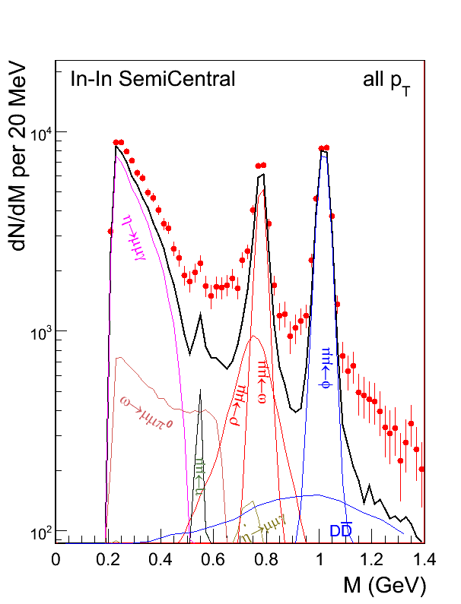
Moving to higher centralities
Peripheral data well described by meson decay cocktail (η, η’, ρ, ω, φ) and DD
More central data clear excess of data above decay cocktail; spectral shape ???
_

Slide 9
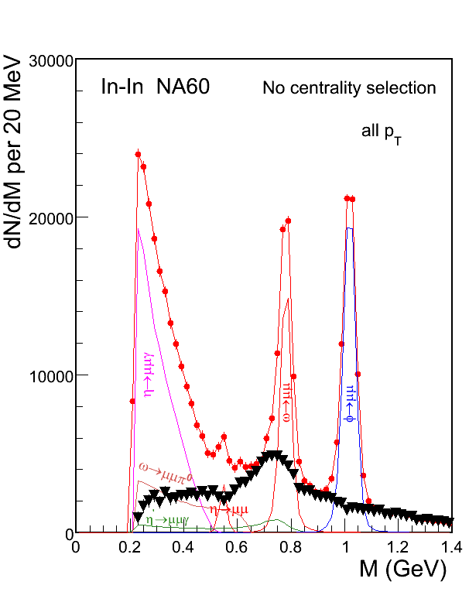
LMR (M<1 GeV) - isolation of excess dimuons
Phys. Rev. Lett. 96 (2006) 162302
isolation of excess by subtraction of measured decay cocktail (without ρ), based solely on local criteria for the major sources η, ω and φ
ω and φ : fix yields such as to get,
after subtraction, a smooth
underlying continuum
η : fix yield at p_{T} >1 GeV, based on
the very high sensitivity to the
spectral shape of the Dalitz decay
accuracy 2-3%, but results robust to mistakes even at the 10% level
keep information on subtracted hadrons and process separately

Slide 10
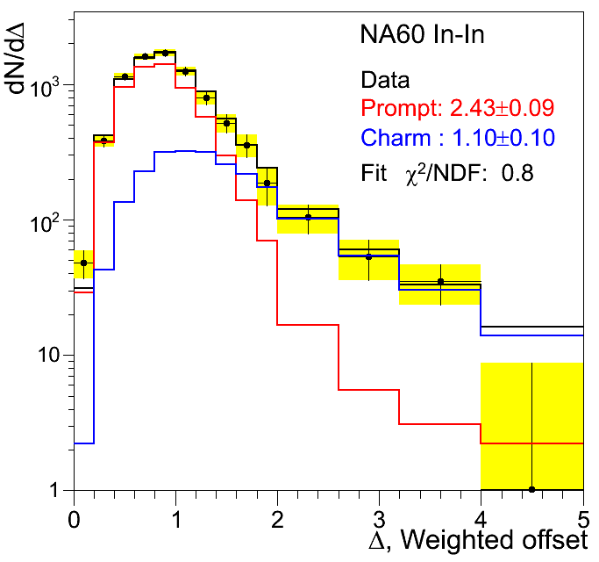
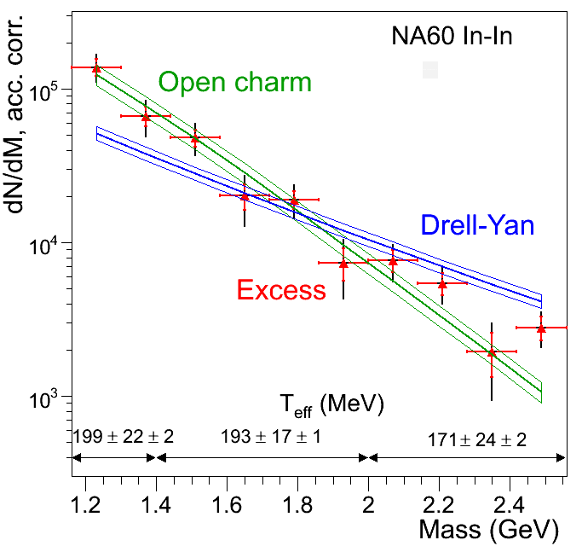
IMR (M>1GeV) – isolation of excess dimuons
Eur.Phys.J. C 59 (2009) 607
measurement of muon offsets Δμ: distance between interaction vertex and track impact point
isolation of excess by subtraction of measured open charm and Drell-Yan
~50μm
~1 mm
charm not enhanced
excess similar to open charm steeper than Drell-Yan
excess prompt; 2.4 × DY

Slide 11
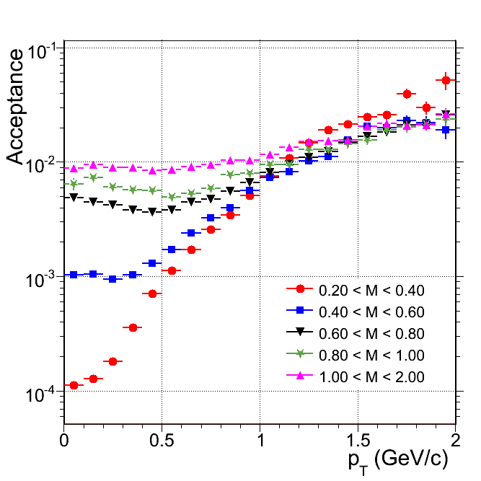
Acceptance correction
reduce 4-dimensional acceptance correction in M-p_{T} -y-cosΘ_{CS} to (mostly) 2-dimensional corrections in pairs of variables. Example M-p_{T}, using measured y distributions and measured cosΘ_{CS} distributions as an input; same for other pairs (iteration) requires separate treatment of the excess and the other sources, due to differences in the y and the cosΘ_{CS} distributions acceptance vs. M, p_{T}, y, and cosΘ understood to within <10%, based on a detailed study of the peripheral data

Slide 12
Thermal Radiation

Slide 13
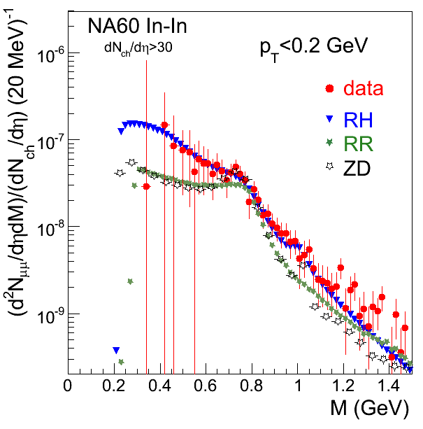
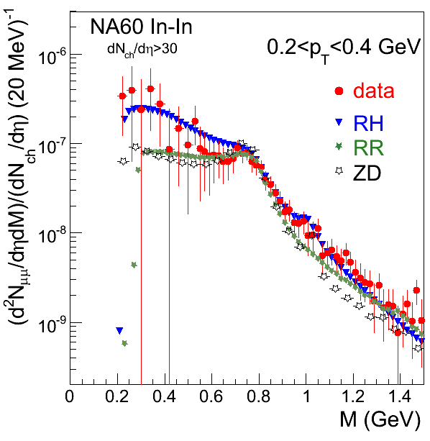
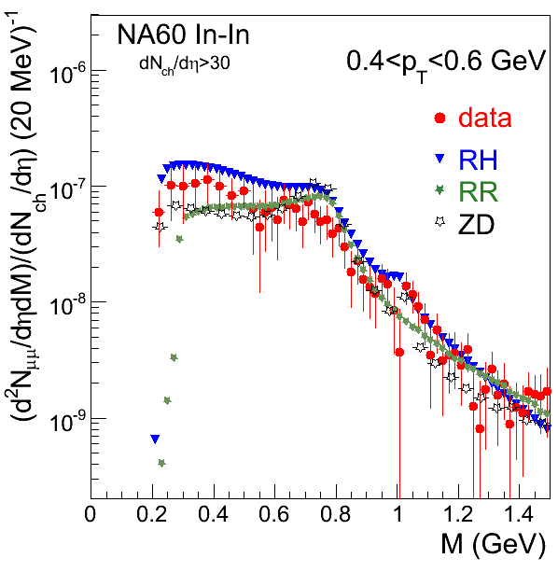
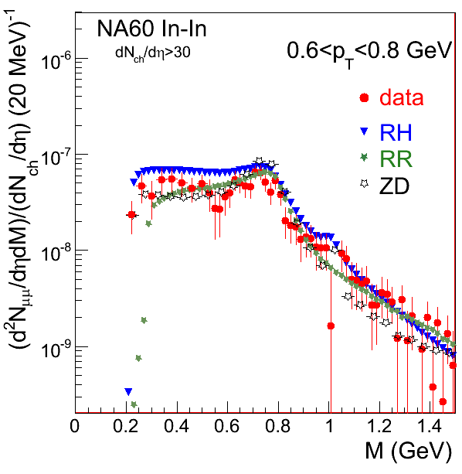
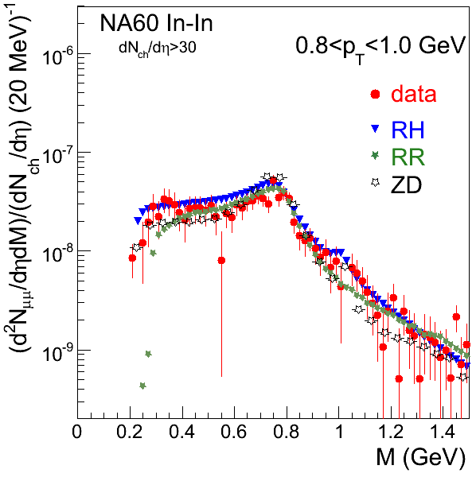
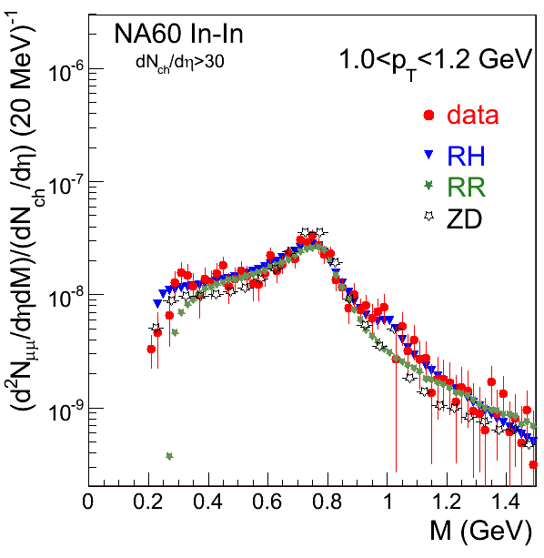
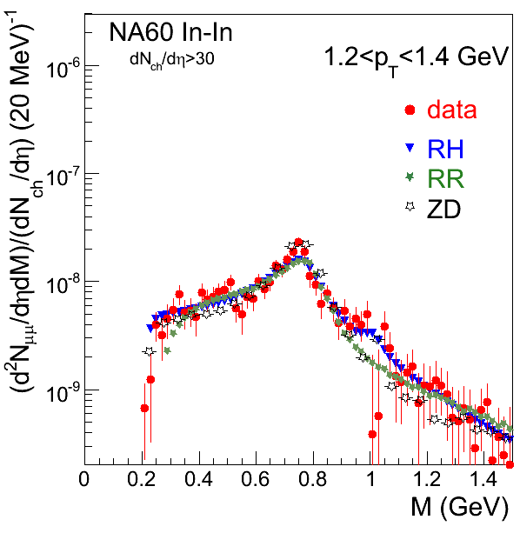
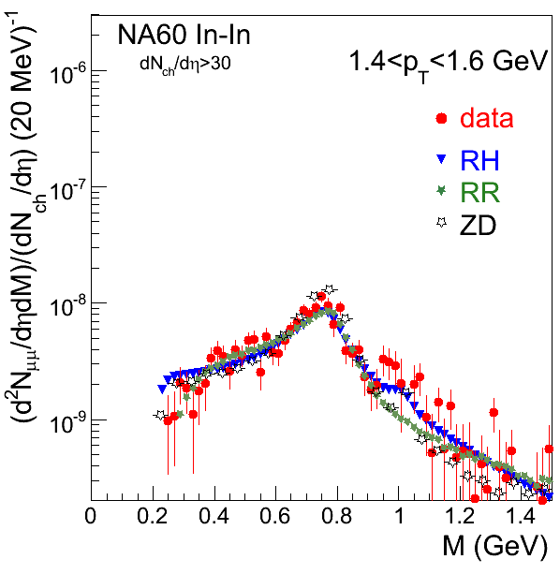
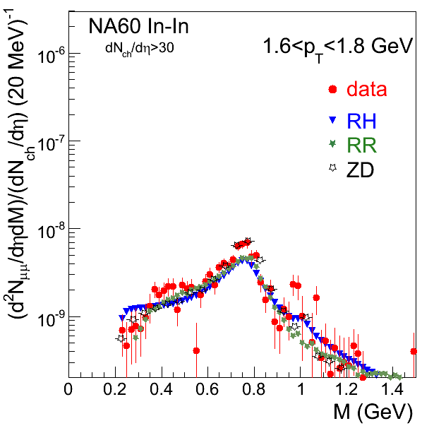
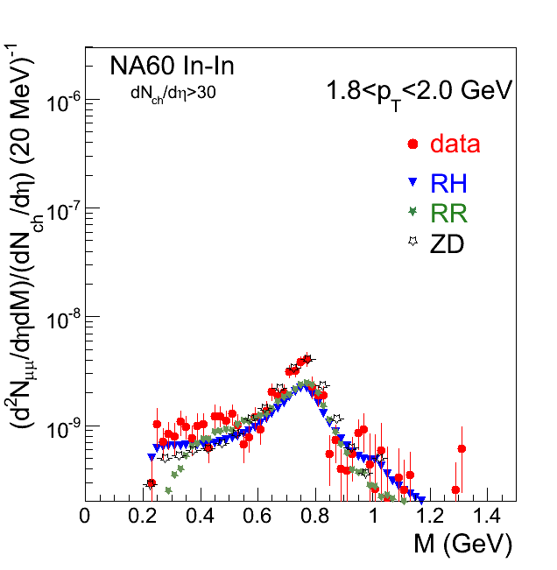
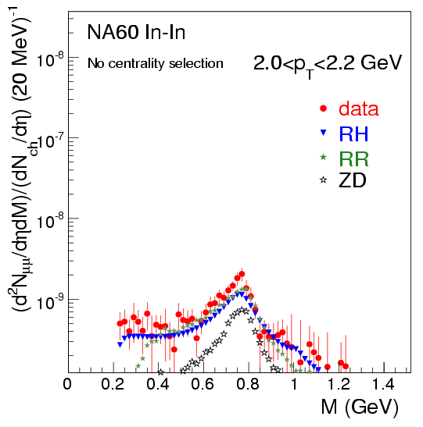
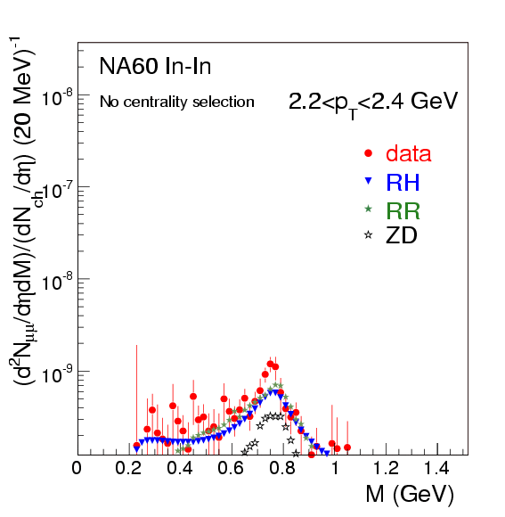
Acceptance-corrected M-p_{T} matrix of excess

Slide 14
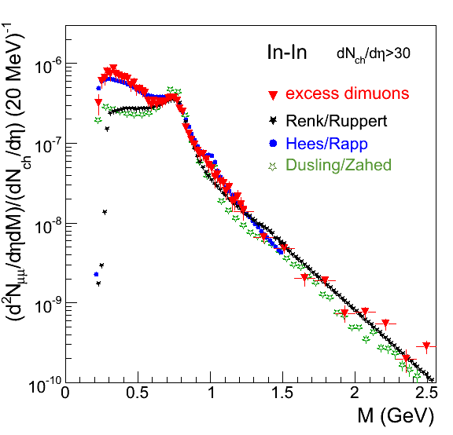
Inclusive excess mass spectrum
[Eur. Phys. J. C 59 (2009) 607-623] CERN Courier 11/ 2009, 31-35 Chiral 2010 , AIP Conf.Proc. 1322 (2010) 1-10
all known sources subtracted
integrated over p_{T}
fully corrected for acceptance
absolutely normalized to dN_{ch}/dη
M<1 GeV
ρ dominates, ‘melts’ close to T_{c}
best described by H/R model
M>1 GeV
~ exponential fall-off → ‘Planck-like’
fit to
range 1.1-2.0 GeV: T=205±12 MeV
1.1-2.4 GeV: T=230±10 MeV
T>T_{c}: partons dominate
only described by R/R and D/Z models

Slide 15
Electromagnetic Probes: the case for lepton pairs
photons: 1 variable: p_{T}
γ
lepton pairs: 2 variables: M, p_{T}
ℓ ⁺
ℓ ⁻
γ*
relevant for thermal radiation:
p_{T} sensitive to temperature and expansion velocity
M only sensitive to temperature (Lorentz invariant)
approximate mass spectrum (for flat spectral function, and interpreting T as the average temperature over the space-time evolution)
→ ‘Planck-like’
the only true (Lorentz invariant) thermometer of the field
systematic uncertainties:
theory, from fits to RR and DZ: T =215 MeV; T_{1.2 GeV}=205, T_{2.5 GeV} = 225
data: oversubtraction of DY by 20/30% → ΔT= -10/-20 MeV

Slide 16
Rho Spectral Function

Slide 17
Unfolding the convoluted mass spectrum?
- Pure spectral function completely masked by the required convolution steps towards observable thermal radiation
- Strict unfolding impossible
- Realistic way: project out space-time averaged ρ-spectral function by use of a suitable correction function
By pure chance

Slide 18
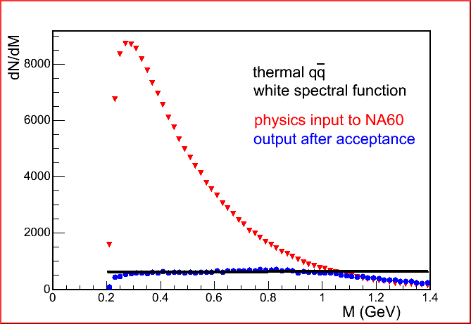
Acceptance filtering by the NA60 set-up
(Eur.Phys.J.C 49 (2007) 235)
all p_{T}
input:
thermal radiation based on a white spectral function
output:
white spectrum !
By pure chance, for the M-p_{T} characteristics of thermal radiation, without p_{T} selection, the NA60 acceptance roughly compensates for the phase-space factors and directly ‘measures’ the <spectral function>

Slide 19
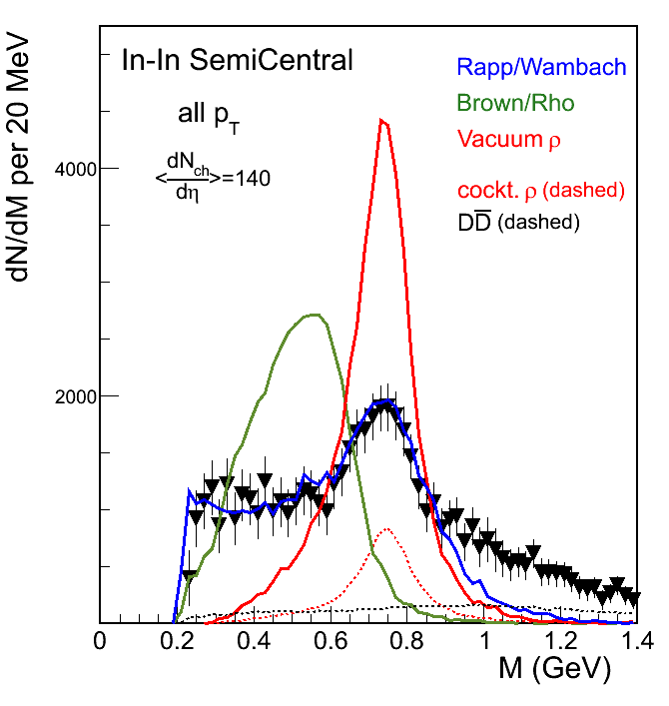
Comparison of data to RW, BR and Vacuum ρ
Phys. Rev. Lett. 96 (2006) 162302
Predictions by Rapp (2003) for all scenarios
Theoretical yields normalized to data for M<0.9 GeV
Data and predictions as shown, after acceptance filtering, roughly mirror the ρ spectral function, averaged over space-time and momenta.
Only broadening of ρ (RW) observed, no mass shift (BR)

Slide 20
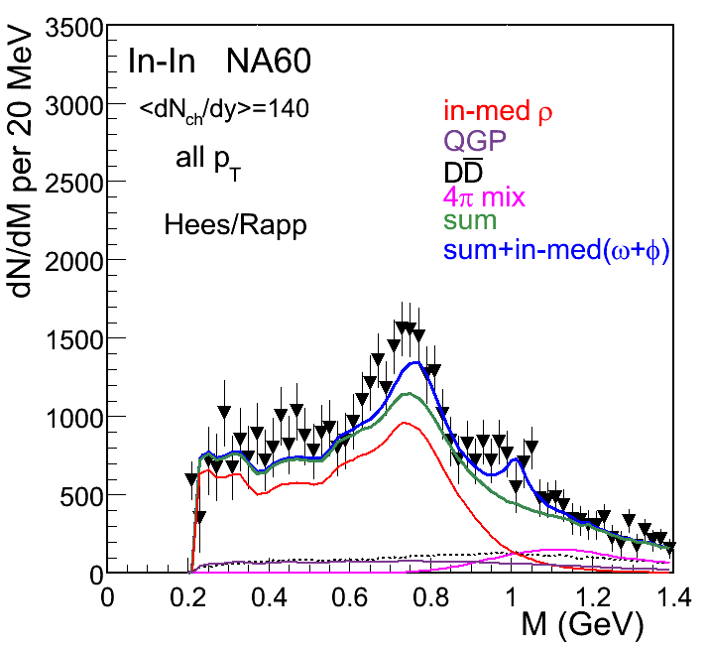
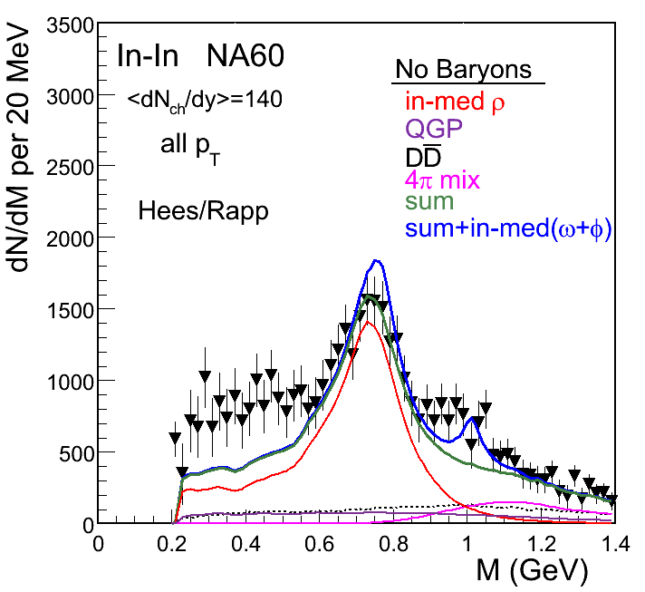
Role of baryons in broadening the ρ
van Hees and Rapp, Phys.Rev.Lett. 97 (2006) 102301
Whole spectrum reasonably well described, even in absolute terms
In this model, low-mass tail requires baryon interactions

Slide 21
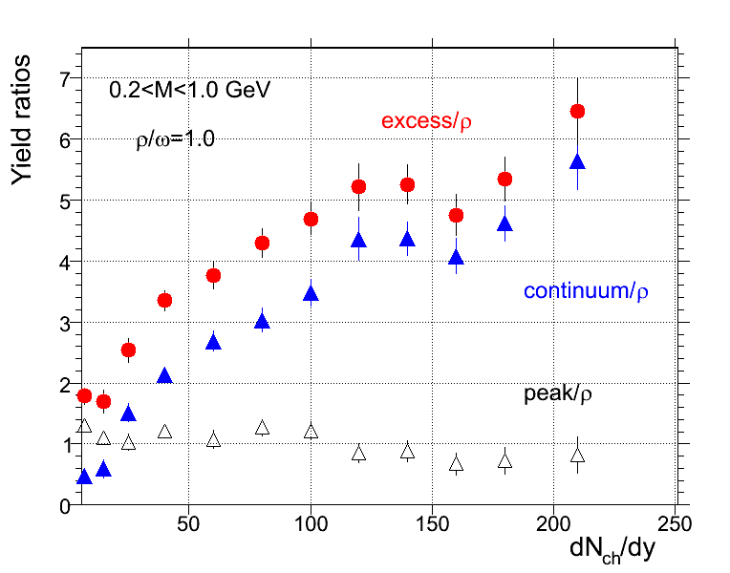
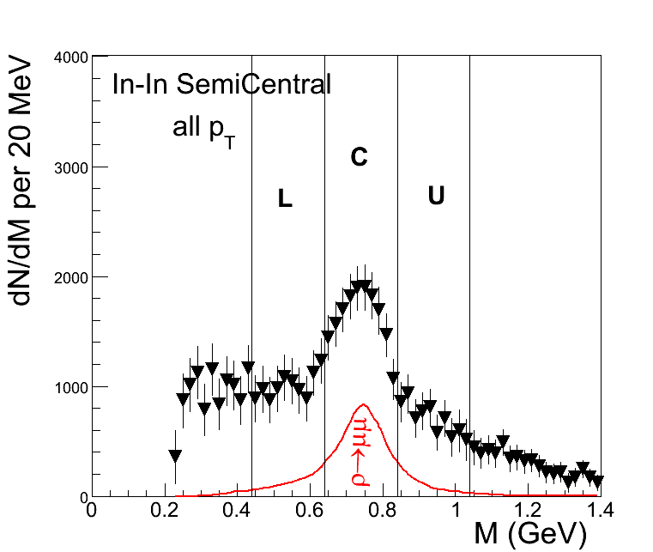
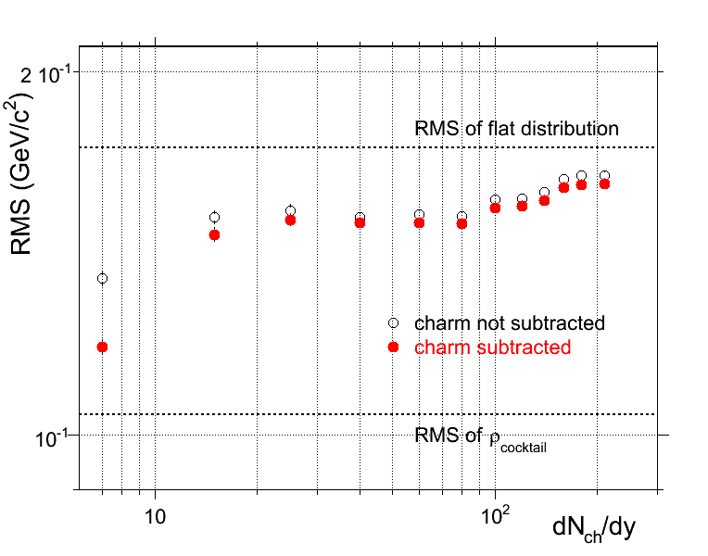
Centrality dependence of spectral shape
peak: R=C-1/2(L+U) continuum: 3/2(L+U)
rapid increase of relative yield
reflects the number of ρ‘s regenerated in π⁺π⁻ → ρ* → μ⁺μ⁻
→ ‘ρ clock’
- near divergence of the width
→ ‘melting’ of the ρ

Slide 22
Radial expansion and the
EoS close to T_{c}

Slide 23
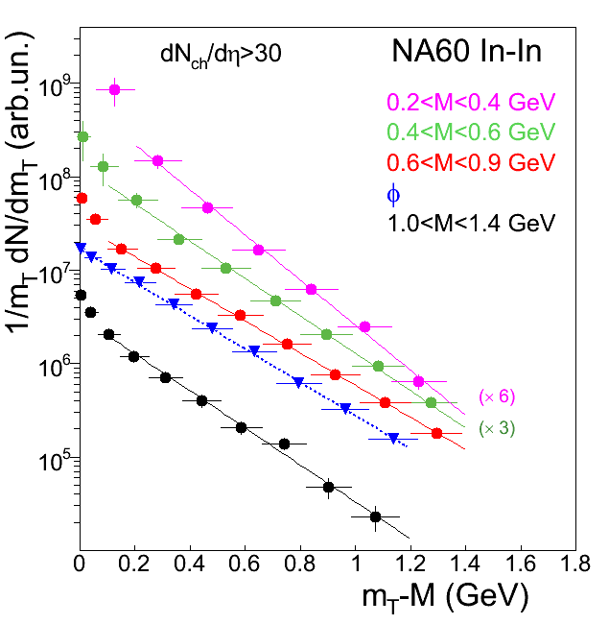
Transverse mass distributions of excess dimuons
transverse mass: m_{T} = (p_{T}² + M²)^{1/2}
Phys. Rev. Lett. 100 (2008) 022302
Eur. Phys. J. C 59 (2009) 607
all m_{T} spectra exponential for m_{T}-M > 0.1 GeV; <0.1 GeV ??
LMR
IMR
fit with 1/m_{T} dN/m_{T} ~ exp(-m_{T}/T_{eff});
T_{eff} – ‘effective temperature’

Slide 24
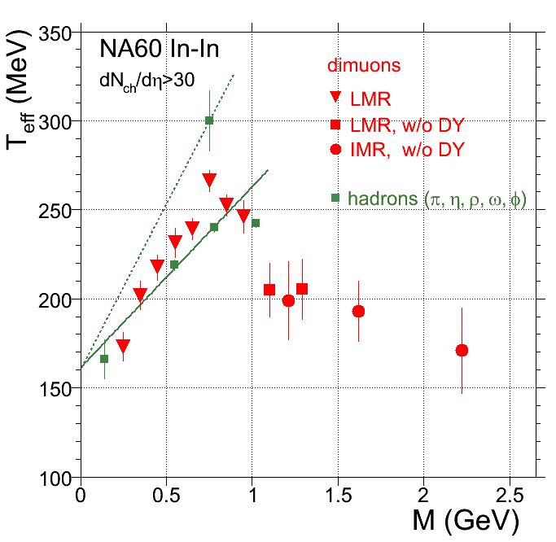
The rise and fall of radial flow of thermal dimuons
Phys. Rev. Lett. 100 (2008) 022302
Strong rise of T_{eff} with dimuon mass, followed by a sudden drop for M>1 GeV
Rise consistent with radial flow of a hadronic source (here π⁺π⁻→ρ→μ⁺μ⁻), taking the freeze-out ρ as the reference ( from a separate analysis of the ρ peak and the continuum)
Drop signals sudden transition to a low-flow, i.e. an early source → partonic origin (here qq→μ⁺μ⁻)
Dominance of partons for M>1 GeV also from p_{T} spectra

Slide 25
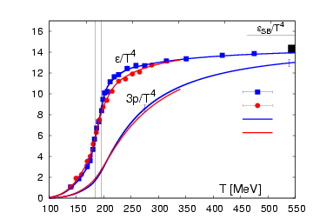
Combined conclusions from mass and p_{T} spectra
SPS
RHIC
LHC
rapid rise of energy density ε, slow rise of pressure p (not ideal gas)
Lattice QCD
→ EoS above T_{c} very soft initially (c_{S} minimal)
M >1 GeV
- T_{eff} independent of mass within errors
mass spectrum: T = 205±12 MeV
p_{T} spectra: <T_{eff}> = 190±12 MeV
- same values within errors
T = 205 MeV > T_{c} = 170 (MeV)
negligible flow → soft EoS above T_{c}
all consistent with partonic phase

Slide 26
Angular distributions

Slide 27
Angular distributions
λ, μ, ν : structure functions related to helicity structure functions and the spin density matrix elements of the virtual photon
Choice of reference frame: Collins-Soper (CS)
y
x
In rest frame of virtual photon:
θ : angle between the positive
muon p_{μ+} and the z-axis.
z axis : bisector between p_{proj} and - p_{target}
p_{µ+}
ϕ
ϑ_{CS}
z axis
p_{projectile}
p_{target}
Viewed from dimuon rest frame
Expectation: completely random orientation of annihilating particles (pions or quarks) in 3 dimensions would lead to λ, μ, ν = 0
27
Notes:
27

Slide 28
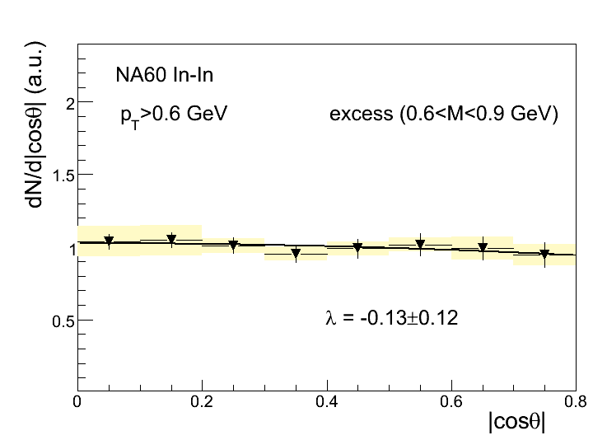
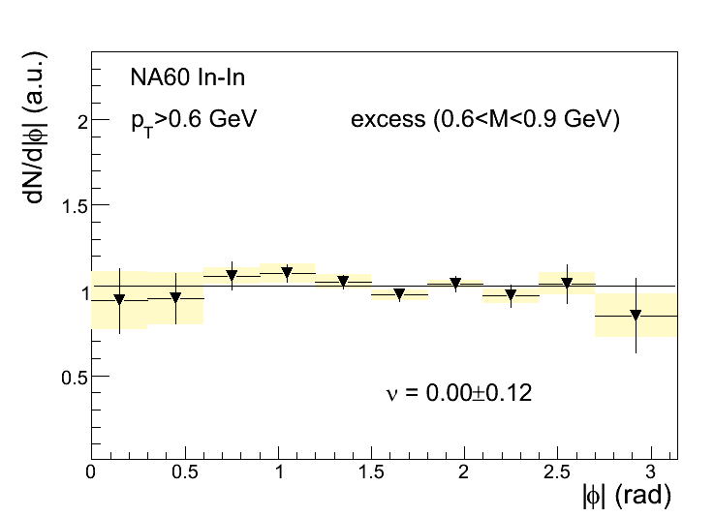
Results on structure coefficients λ, μ, ν
Phys. Rev. Lett. 102 (2009) 222301
example:
excess 0.6<M<0.9 GeV
μ = 0.05 ± 0.03 (~0 as expected)
set μ = 0 and fit projections
λ=-0.13±0.12
fit function for polar angle
fit function for azimuth angle
ν=0.00±0.12
Zero polarization within errors
28
Notes:
28

Slide 29
Hadron results

Slide 30
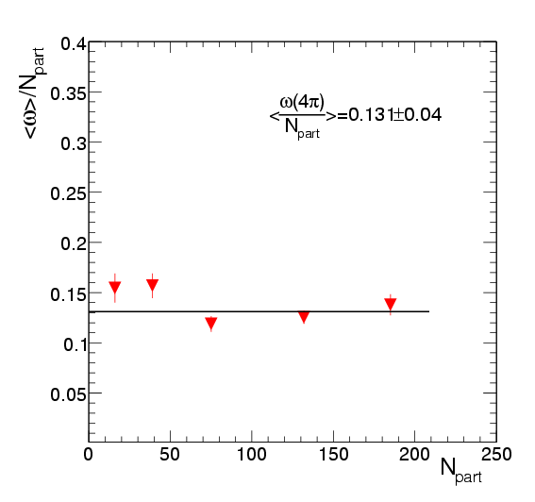
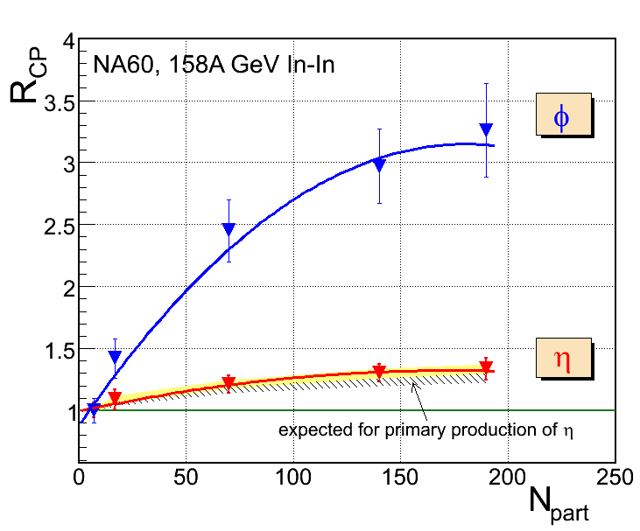
Centrality dependence of hadron yields
φ
yield scales with N_{part}
yields of hadrons with strangeness (η, φ) increase with N_{part}
no nuclear enhancement
difference between η and φ consistent with wave function content of ssbar

Slide 31
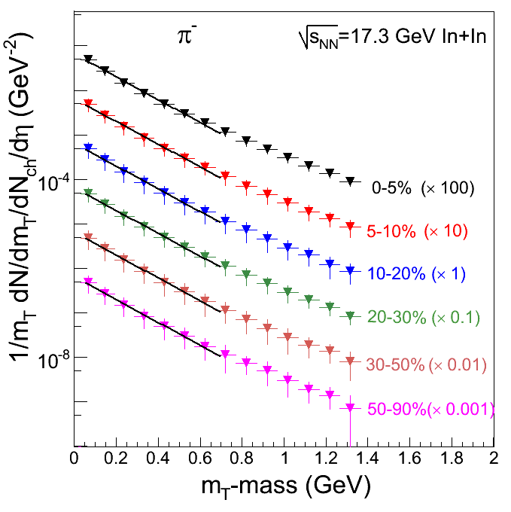
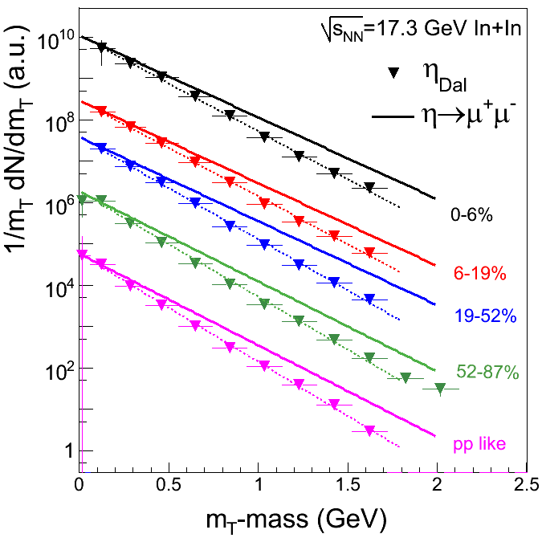
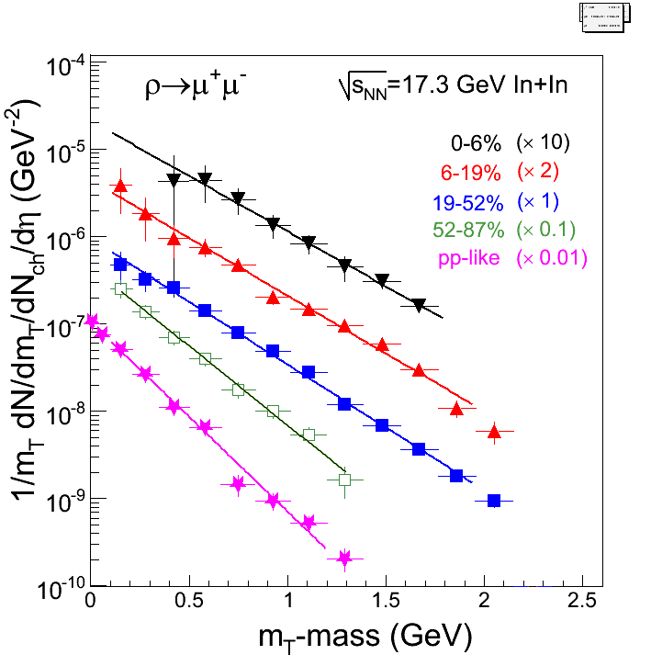
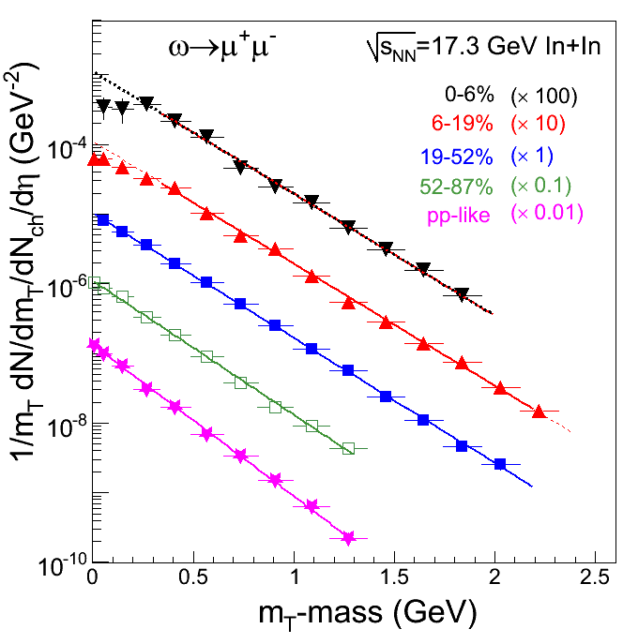
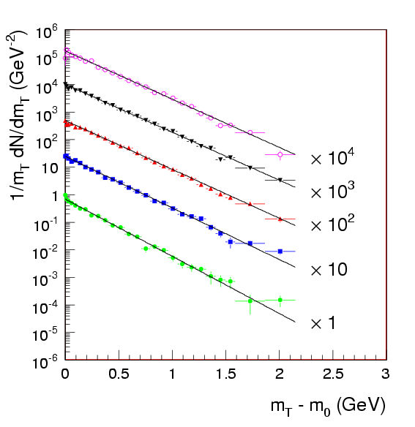
Light-flavoured hadrons in NA60
freeze-out ρ
a.u.
√s_{NN}=17.3 GeV In-In
φ → μ⁺μ⁻

Slide 32
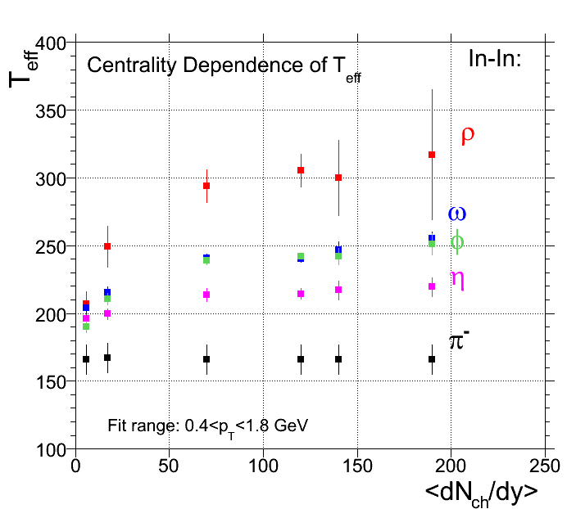
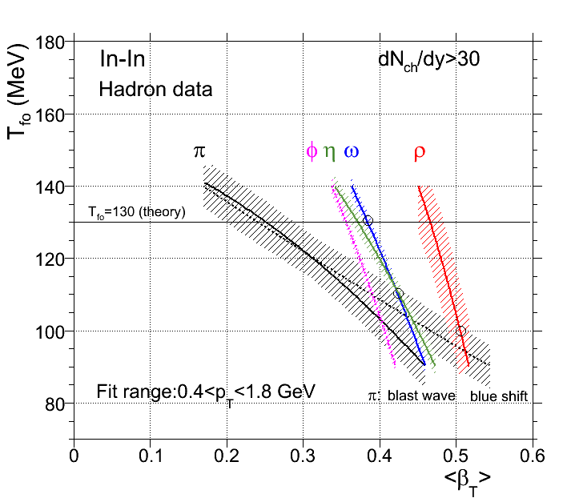
Hierarchy in hadron freeze-out
crossing of hadrons with π defines T_{f}, v_{T} max reached at respective hadron freeze-out
different hadrons have different coupling to pions (ρ maximal) → clear hierarchy of freeze-out (also for light-flavored hadrons)
use of Blast wave code
for a given hadron M, the measured T_{eff} defines a line in the T_{fo}-v_{T} plane
large difference between ρ and ω (same mass)

Slide 33
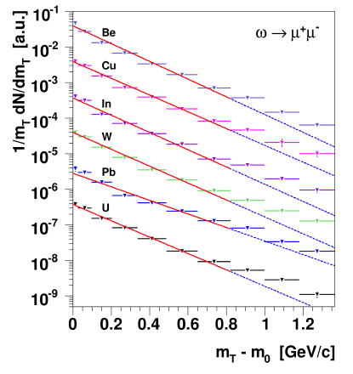
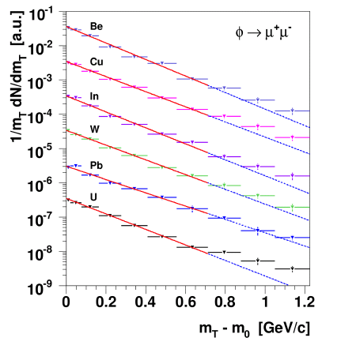
Light-flavoured hadrons in NA60
a.u.
√s_{NN}=17.3 GeV In-In
In-In at 158A GeV
φ → μ⁺μ⁻
low mass sample size 440 000
(peripheral alone < 10%)
pure exponential m_{T} spectra
p-A 400 GeV
p-A 400 GeV
p-A at 400 GeV
ω/ρ → μ⁺μ⁻
φ → μ⁺μ⁻
low mass sample size 180 000
(NA27: insufficient statistics for ρ/ω and φ ◊ no p_{T} spectra)
upward bend of m_{T} spectra
→ hard scattering components
no hard scattering components at 158A GeV

Slide 34
Conclusions
Planck-like exponential mass spectra, exponential m_{T} spectra, zero polarization and general agreement with thermal models consistent with interpretation of excess dimuons as thermal radiation
Emission sources of thermal dileptons mostly hadronic (π⁺π⁻ annihilation) for M<1 GeV, and mostly partonic (qq annihilation) for M>1 GeV; associated temperatures quantified; hints at soft EoS close to T_{c}; direct connection to deconfinement at the SPS
_
In-medium ρ spectral function identified; no significant mass shift of the intermediate ρ, only broadening; (indirect) connection to chiral symmetry restoration

Slide 35
The NA60 experiment
http://cern.ch/na60
CERN
Heidelberg
~ 60 people
13 institutes 8 countries
Palaiseau
Bern
BNL
Riken
Stony Brook
Yerevan
Lisbon
Torino
Clermont
Cagliari
Lyon
R. Arnaldi, K. Banicz, K. Borer, J. Buytaert, J. Castor, B. Chaurand, W. Chen,B. Cheynis, C. Cicalò, A. Colla, P. Cortese, S. Damjanovic, A. David, A. de Falco, N. de Marco, A. Devaux, A. Drees, L. Ducroux, H. En’yo, A. Ferretti, M. Floris, A. Förster, P. Force, A. Grigorian, J.Y. Grossiord, N. Guettet, A. Guichard, H. Gulkanian, J. Heuser, M. Keil, L. Kluberg, Z. Li, C. Lourenço, J. Lozano, F. Manso, P. Martins, A. Masoni, A. Neves, H. Ohnishi, C. Oppedisano, P. Parracho, P. Pillot, G. Puddu, E. Radermacher, P. Ramalhete, P. Rosinsky, E. Scomparin, J. Seixas, S. Serci, R. Shahoyan, P. Sonderegger, H.J. Specht, R. Tieulent, E. Tveiten, G. Usai, H. Vardanyan, R. Veenhof and H. Wöhri

Slide 36
Remarks on other dilepton experiments

Slide 37
Dilepton experiments beyond NA60
The high energy frontier
Relevance
- RHIC PHENIX, STAR
M <1 GeV → chiral restoration M >1 GeV → hadrons vs. partons (precise meas. of T)
- LHC ALICE
The low energy frontier
Dream: energy dependence from
- RHIC LE PHENIX, STAR
√s = 4 − 5500 AGeV
- SPS NA60-like
with data quality equivalent to NA60
- SIS300 CBM
Principal obstacle to reach this:
- SIS100 HADES, CBM
colliders not competitive to fixed-target
experiments in terms of interaction rate
Data quality
decisive parameters: Number of Interactions and Signal/Background
range of B/S: 20 - 1000 → B/S >>1; dynamic range 50 between exp.(!)
- effective sample size: S_{eff} ~ I × S/B reduction by factors of 20-1000
- systematics: δS_{eff}/S_{eff} = δB/B × B/S δB/B = 2…5 ×10⁻³

Slide 38
Assessment of B/S: choice of S
B
S
choose hadron cocktail in mass window 0.5-0.6 GeV for S
- free from prejudices on any excess; no ‘bootstrap’; most sensitive region
- unambiguous scaling between experiments; B/S dN_{ch}/dy

Slide 39
Combinatorial Background/Signal in Dilepton Experiments
Reference: hadron cocktail at masses of 0.5-0.6 GeV
Experiment | Centrality | Lepton flavor | B/S as meas. or simul. | B/S rescaled to dN_{ch}/dy=300 | B/S field data ×1/3 | B-field at vertex
HADES-SIS100 | semicentr | e⁺e⁻ | 20 | 60 | 60 | −
CERES DR | semicentr | e⁺e⁻ | 80 | 100 | 100 | −
CERES SR/TPC | central | e⁺e⁻ | 110 | 100 | 100 | −
PHENIX with HBD | central | e⁺e⁻ | 250 | 100 | 100 | −
PHENIX w/o HBD | central | e⁺e⁻ | 1300 | 600 | 200 | +
STAR | central | e⁺e⁻ | 400 | 200 | 70 | +
ALICE Upg ITS | central | e⁺e⁻ | 1200 | 200 | 70 | +
CBM-SIS100 | central | e⁺e⁻ | 200 | 300 | 100 | +
CBM-SIS300 | central | e⁺e⁻ | 200 | 200 | 70 | +
NA60 | semicentr | μ⁺μ⁻ | 55 | 80 | 80
CBM-SIS300 | central | μ⁺μ⁻ | 600 | 600 | 600
→ ‘penalty’ factor 3 (4) for B-field, hindering optimal rejection of low-mass pairs
→ ‘reduced’ values 80±20 (w/o red) → only small influences of experimental details

Slide 40
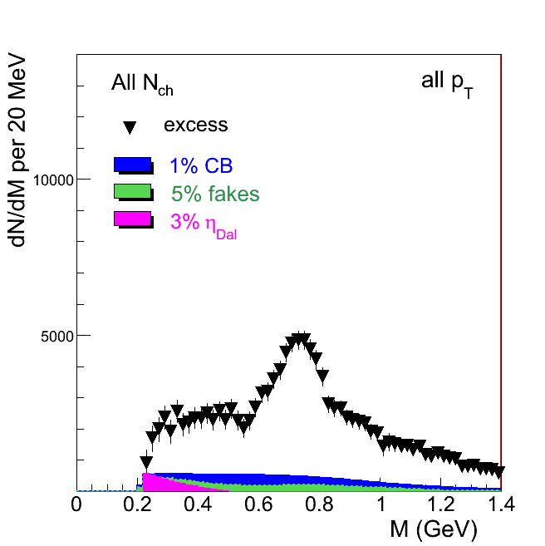
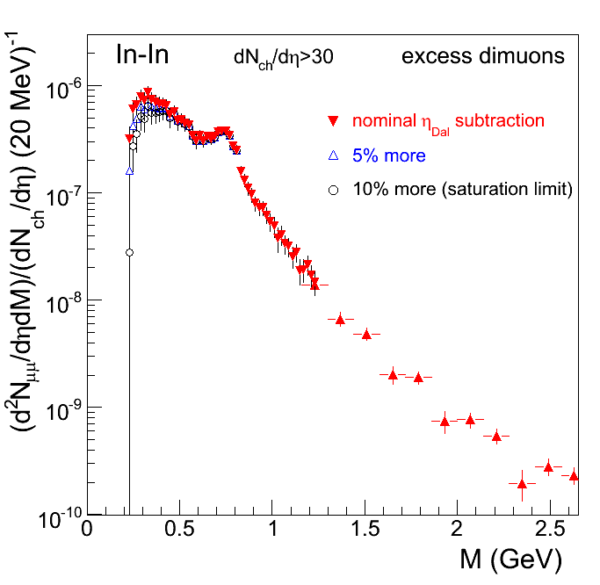
Systematic errors for dimuons in NA60

Slide 41
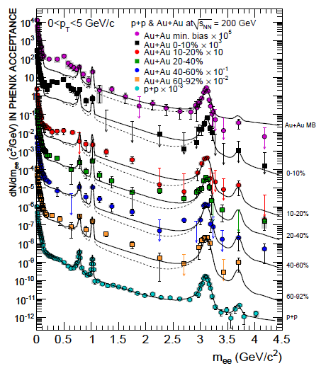
Di-electron results from PHENIX
LMR
δB/B=0.25%
--- Foreground: same evt
--- Background: mixed evt
Previous results (PRC 2010); B/S=1300 (central)
HBD results (QM2012); factor of 5 → B/S=250 (→100!)
no B-field
semi-central

Slide 42
Di-electron results from STAR (QM2012)
B/S=400 (central)
← data/cocktail <1 →
cocktail normalization?
no centrality dependence of enhancement
background problem?
oversubtraction by 0.2%?

Slide 43
Di-muons simulations for CBM-SIS300 (2009ff)
B/S=600
CBM-SIS300
Difference mostly due to the larger acceptance angles at lower energies ?
ρ/ω/φ →μ⁺μ⁻
B/S=55 → 80
×
ρ/ω=1

