Slide 1
Future options for the CERN SPS
Hans J. Specht
Physikalisches Institut Universität Heidelberg
Erice, 20 September 2012

Slide 3
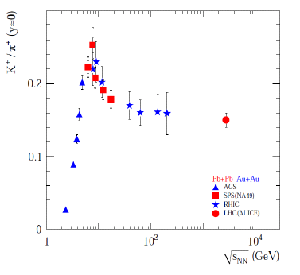
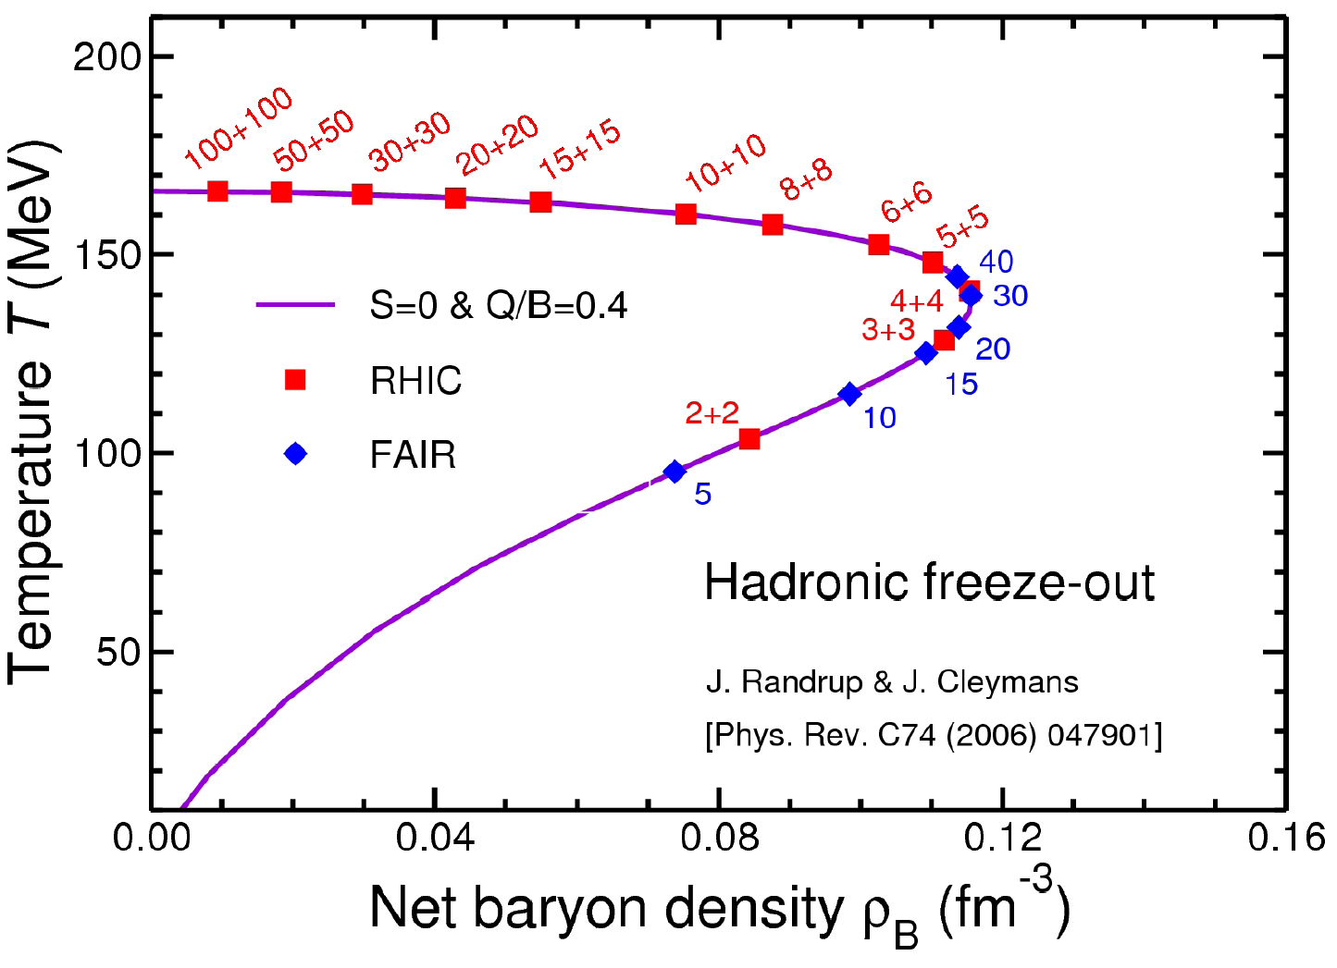
SPS Energy Range
Prime physics goal:
systematic measurement of EM radiation and charm over the full energy range from SIS-100 (11 AGeV) to top SPS (160 AGeV)
0.9
1.0 ρ_{max}
160
80
RHIC
11
SIS-300
SPS
SIS-100
Problem of SIS-300: max beam energy 35 AGeV
only low side of peak covered
miss ‘onset of deconfinement’ (and critical point?)

Slide 4
Beam conditions: CERN vs. GSI/FAIR
SPS
SIS100/300
Energy range: 10 – 158
< 11 – 35 (45)
[AGeV]
beam target interaction intensity thickness rate
interaction rate
[Hz]
[Hz]
[λ_{i} ]
[Hz]
NA60 (2003)
2.5×10⁶
20%
5×10⁵
new injection scheme
10⁸
10%
10⁷
10⁵ - 10⁷
10⁸
1%
10⁶
LHC AA
5×10⁴
Luminosity at the SPS comparable to that of SIS100/300
No losses of beam quality at lower energies except for emittance growth
RP limits at CERN in EHN1, not in (former) NA60 cave
Pb beams scheduled for the SPS in 2016-2017, 2019-2021

Slide 5
G. Usai, CERN Town Meeting 2012

Slide 6
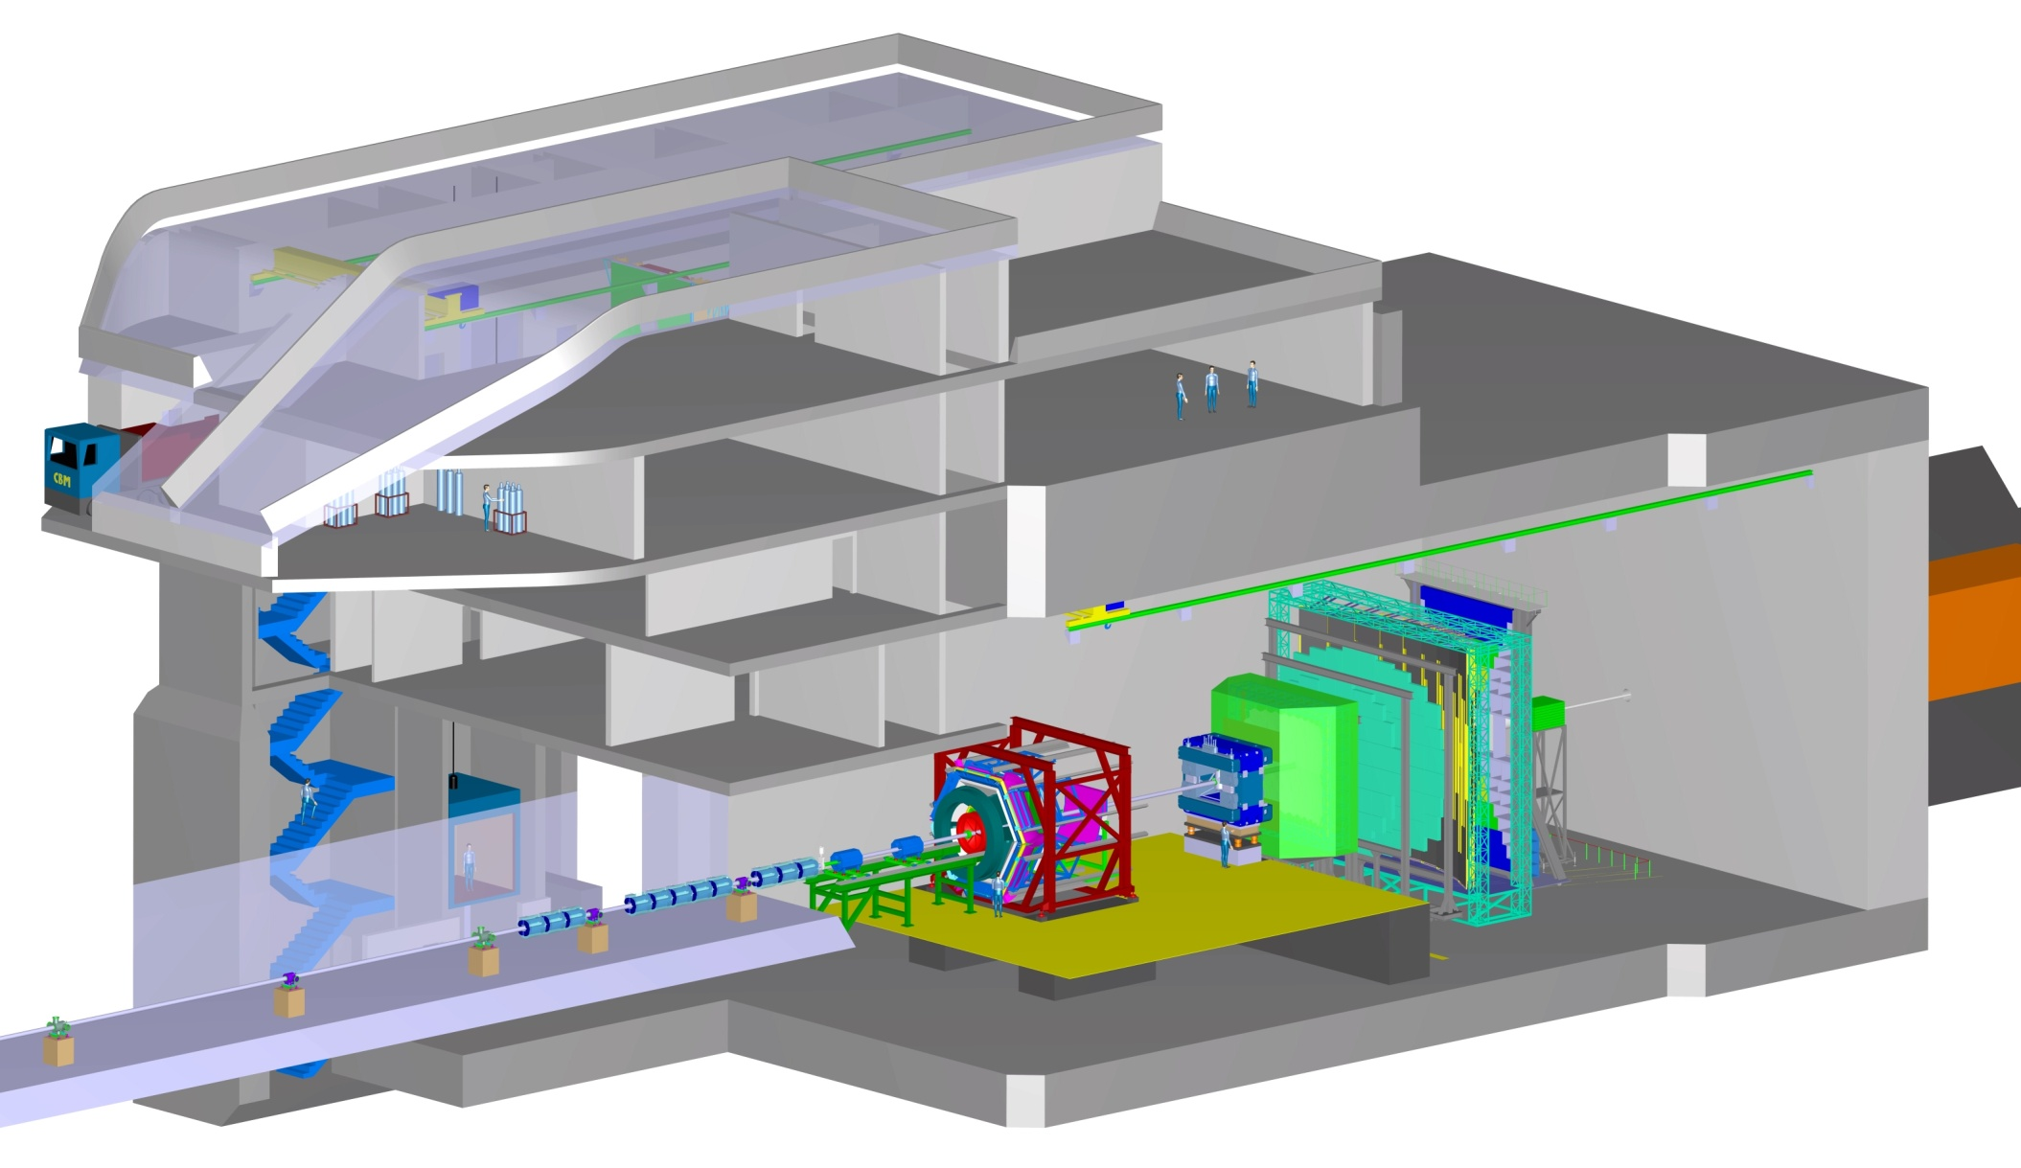
Present concept at GSI FAIR
Operation of HADES and CBM in the same cave at SIS-100

Slide 7
Combinatorial Background/Signal in Dilepton Experiments
Reference: hadron cocktail at masses of 0.5-0.6 GeV
Experiment | Centrality | Lepton flavor | B/S as meas. or simul. | B/S rescaled to dN_{ch}/dy=300 | B/S field data ×1/3 | B-field at vertex
HADES-SIS100 | semicentr | e⁺e⁻ | 20 | 60 | 60 | −
CERES DR | semicentr | e⁺e⁻ | 80 | 100 | 100 | −
CERES SR/TPC | central | e⁺e⁻ | 110 | 100 | 100 | −
PHENIX with HBD | central | e⁺e⁻ | 250 | 100 | 100 | −
PHENIX w/o HBD | central | e⁺e⁻ | 1300 | 600 | 200 | +
STAR | central | e⁺e⁻ | 400 | 200 | 70 | +
ALICE Upg ITS | central | e⁺e⁻ | 1200 | 200 | 70 | +
CBM-SIS100 | central | e⁺e⁻ | 200 | 300 | 100 | +
CBM-SIS300 | central | e⁺e⁻ | 200 | 200 | 70 | +
NA60 | semicentr | μ⁺μ⁻ | 55 | 80 | 80
CBM-SIS300 | central | μ⁺μ⁻ | 600 | 600 | 600
→ ‘penalty’ factor 3 (4) for B-field, hindering optimal rejection of low-mass pairs
→ ‘reduced’ values 80±20 (w/o red) → only small influences of experimental details

Slide 8
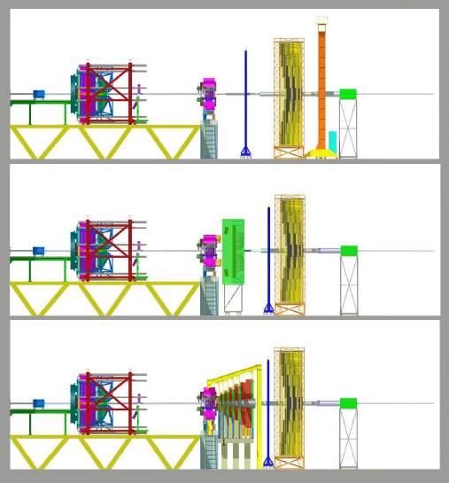
How to optimize the physics outcome for the next 10-15 y
Proposal: split HADES and CBM at SIS-100
HADES at SIS-100
CBM at SPS
Upgrade HADES, optimized for e⁺e⁻, to also cope with Au-Au (now Ni-Ni)
Modify CBM to be optimal (magnet) for either e⁺e⁻ or μ⁺μ⁻; role of hadrons?
Merge with part of personell of CBM
Merge with ‘CERN’ effort towards a NA60 successor experiment
Profit from suitable R&D of CBM
Profit from suitable R&D of CBM, in particular for Si
If SIS-300 would be approved in >2020, one could continue CBM there in >2027

