Slide 1



Nuclear effects in neutrino quasielastic interaction
Neutrino Physics:” Present and Future"
Erice,Trapani, Sicily, Italy, September 20, 2013
G. Chanfray, IPN Lyon, CNRS/IN2P3, Université Lyon 1
In collaboration with:
Magda Ericson (IPN Lyon and CERN)
Marco Martini (ULB Bruxelles)
Jacques Marteau (exp neutrino group, IPNL)
Phys. Rev. C 80 065501 (2009)
Phys. Rev. C 81 045502 (2010)
Phys. Rev. C 84 055502 (2011)
Phys. Rev. D 85 093012 (2012)
Phys. Rev. D 87 013009 (2013)
arXiv:1303.7199

Slide 2



Importance of nuclear effects in neutrino physics
Neutrinos are detected by nuclei. The neutrino-nucleus interaction has to be fully understood
For neutrino in (or below) the GeV range, the dominant process is the quasi-elastic knock-out of a nucleon, but more complex processes and/or many-body effects play a very important role: many nucleon ejection not always experimentally distinguishable
The role of nuclear effects in neutrino energy reconstruction for the analysis of neutrino oscillation experiments
Theoretical tool: nuclear response-functions to excitation operators
Spin-isospin
(+ Delta)
Isospin (isovector charge)
μ
In>
TRANSVERSE RESPONSE R_{T}
ν
I0>

Slide 3
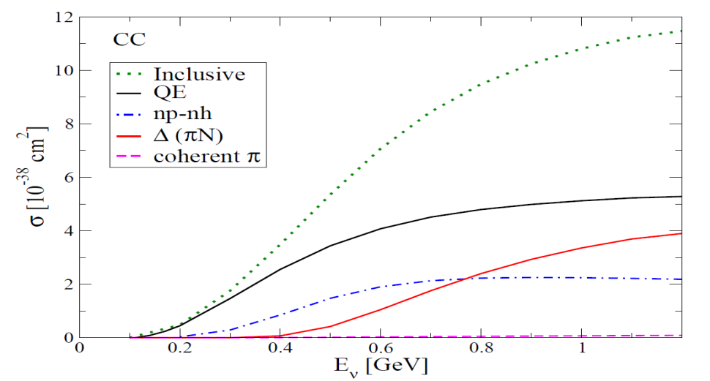
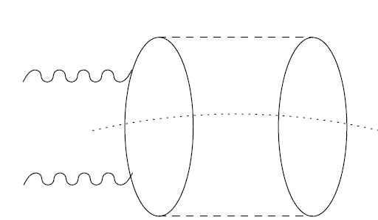
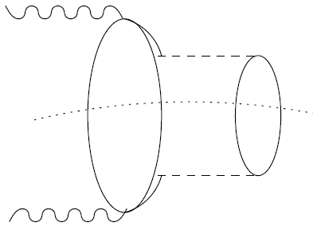
A unified description of neutrino-nucleus interaction in the GeV regime: role of 2p-2h excitations
μ
μ
μ
Ʋ
n
p
p
p
p
n
n
n
n
n
n
n
n
π
p
p
p
p
n
p
p
p
n
p
p
n
n
n
p
n
p
n
p
n
p
p
p
n
p
p
Quasi-elastic (QE)
Two-nucleon knock-out (2p-2h)
Pion production

Slide 4
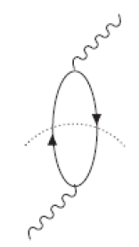
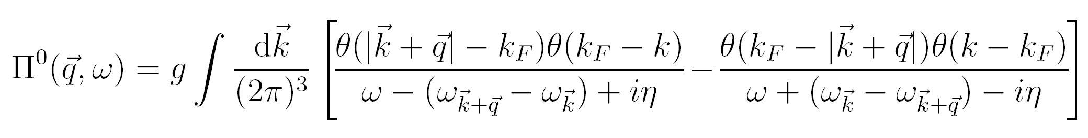
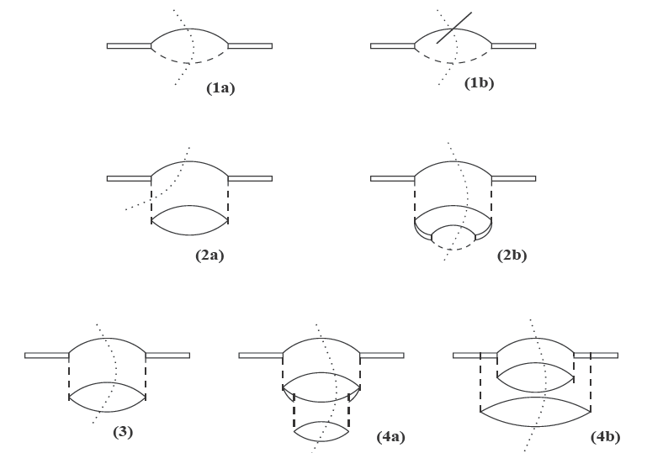
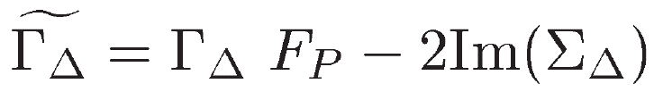
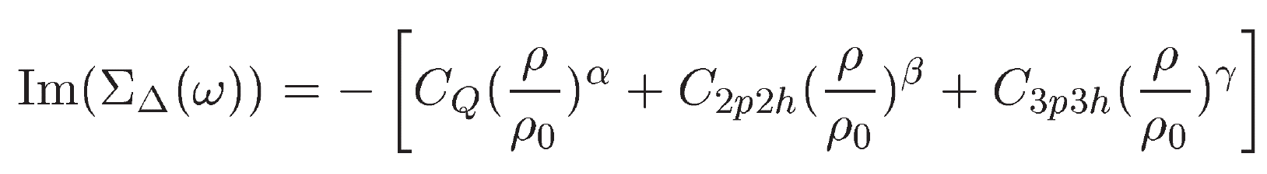
Some details on the basic processes
Quasi-elastic
Pion production
Delta in the medium:
modification of the delta width
Δ→π N
Pauli correction (F_{P})
Pion distortion (C_{Q})
2p-2h
3p-3h

Slide 5
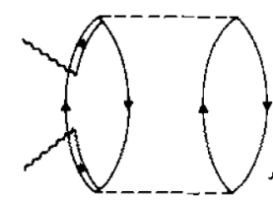
2p-2h contributions: multi nucleon ejection
Reducible to a modification of the Delta width in the medium
E. Oset and L. L. Salcedo, Nucl. Phys. A 468, 631 (1987):
2p-2h
3p-3h
Not reducible to a modification of the Delta width
Microscopic calculation of π absorption at threshold: ω=m_{π}
Shimizu, Faessler, Nucl. Phys. A 333,495 (1980), extrapolated to other energies
NN correlations and NΔ interference
From a microscopic evaluation of R_{T}
Alberico, Ericson, Molinari,
Ann. Phys. 154, 356 (1984)
Parameterization of the responses in terms of
Extrapolation to
cover ν region

Slide 6
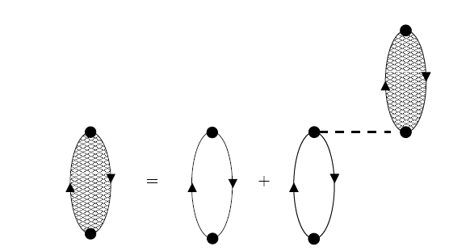
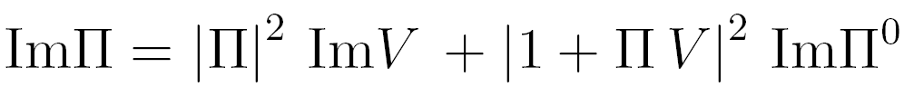
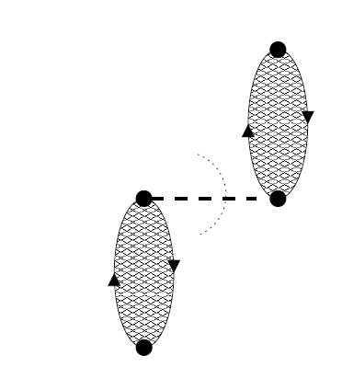
Collective nature of the responses: switching on the interaction : pion and rho exchange in presence of short-range correlations
RPA
π,ρ,g’
q=300 MeV/c
π
coherent π
production
exclusive channels:
QE, 2p-2h, Δ→πN …
Several partial components
treated in self-consistent,
coupled and coherent way

Slide 7
Where 2p-2h enter in ν-nucleus cross-section?
isospin spin-longitudinal
isovector nuclear response
]
interference V-A
isospin spin-transverse
The 2p-2h term affects the magnetic and axial responses
(terms in G_{M} , G_{A} )
(spin-isospin, στ excitation operator)

Slide 8
R_{T} of ¹²C: comparison with data and with calculations of Gil et al.
Our calculations
Gil, Nieves, Oset NPA 627, 543 (1997)
several evaluations of 2p-2h contributions to R_{T} are compatible among them and with data.
This test is important for ν cross section which is dominated by R_{T}

Slide 9
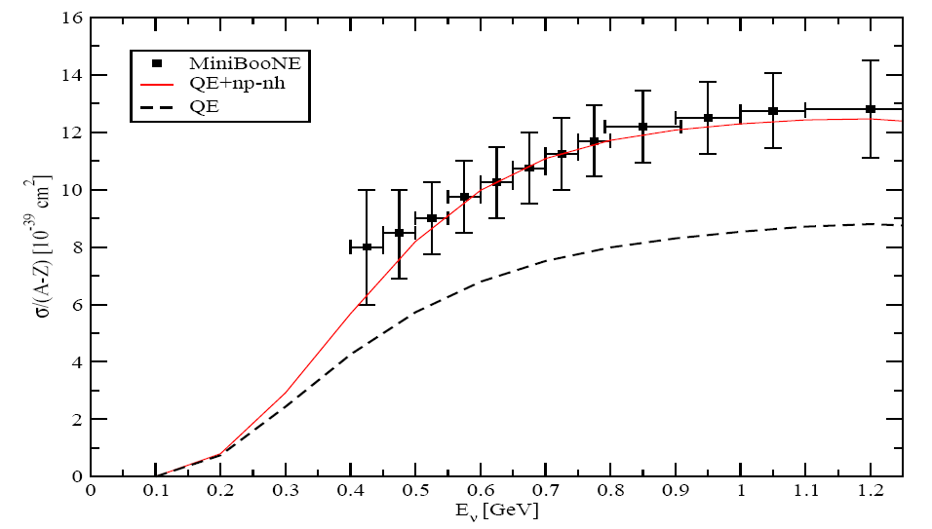
Total « quasielastic » neutrino cross-section:
the MiniBooNe puzzle
Genuine CCQE
μ
N’
p
p
n
n
n
W+
p
p
p
p
n
p
n
Ʋ
N
Cherenkov detectors measure CCQE-like which includes
np-nh contributions !
In RFG an axial mass of 1.35 GeV needed to
account for data
Two particles-two holes
(2p-2h)
μ
N’
N’
n
p
n
p
n
W+
p
n
p
p
n
p
n
Ʋ
p
p
N
N
W+ absorbed by a
pair of nucleons !
Agreement with MiniBooNE without increasing M_{A}

Slide 10
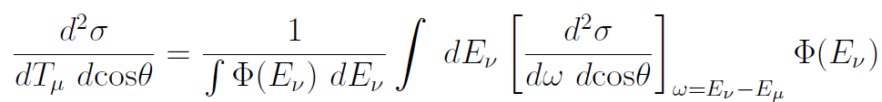
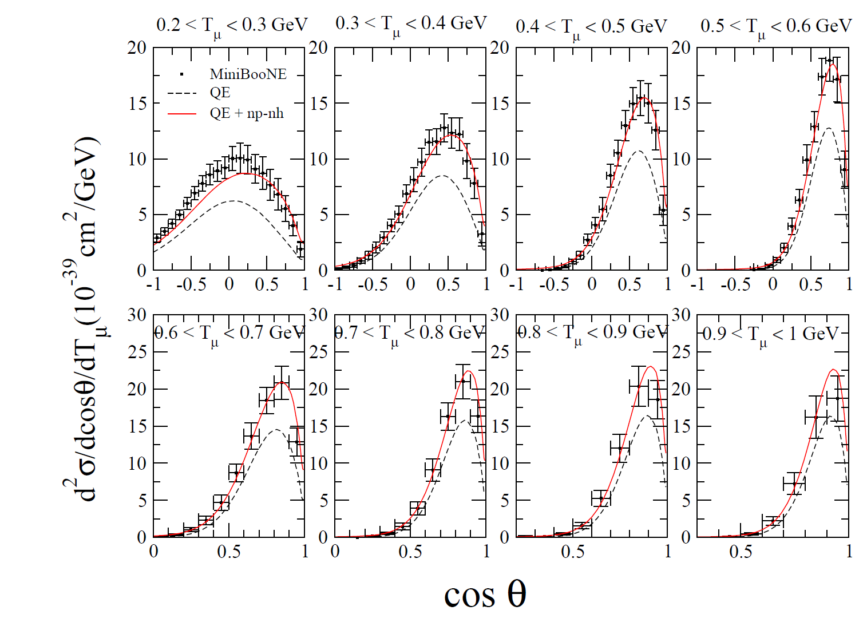
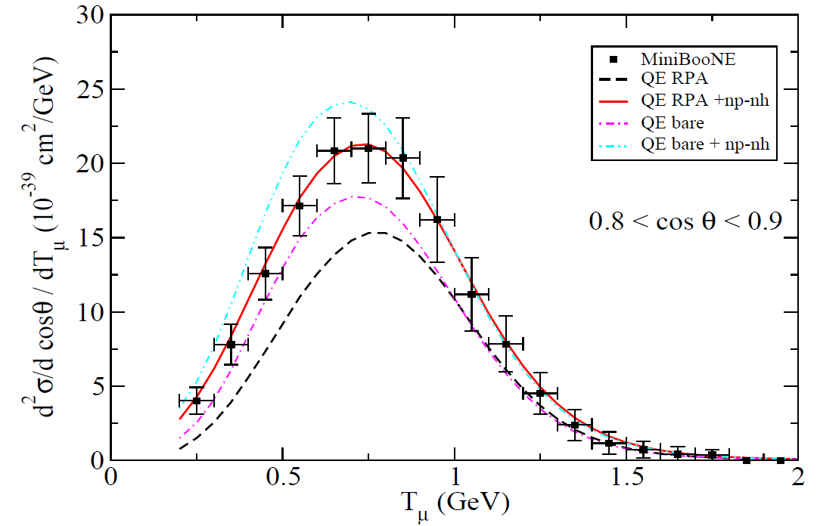
MiniBooNE CCQE-like flux-integrated double diff. X section (model independent measurement)
red: including np-nh
black: genuine QE
Important multinucleon contribution
Agreement with MiniBooNE without increasing M_{A} once np-nh is included
Similar conclusions in Nieves et al. PLB 707, 72 (2012)

Slide 11
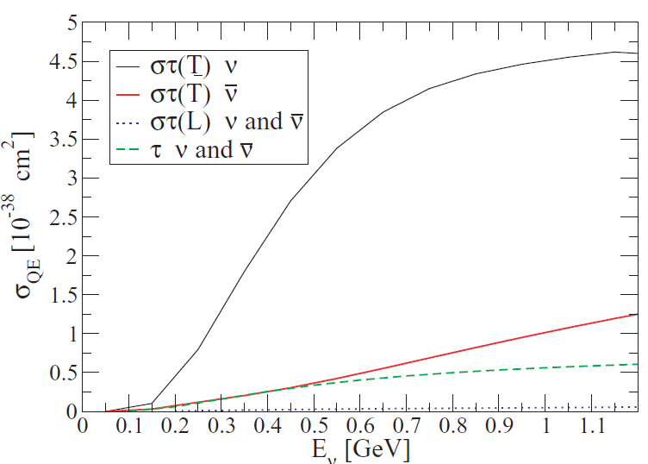
Antineutrino vs Neutrino-nucleus cross-section
isovector nuclear response
isospin spin-longitudinal
isospin spin-transverse
]
interference V-A
The 2p-2h term affects the magnetic and axial responses (terms in G_{A} ,G_{M})
The isovector response R_{τ} (term in G_{E} ) is not affected
The role of interference term (in G_{A}G_{M}) is crucial: it enhances the contribution of Rστ(T) for neutrinos.
For antineutrinos instead the destructive interference partially suppresses this contribution leaving a larger role for isovector Rτ which is insensitive to 2p-2h.
Rστ ν
Rστ ν
Rτ ν or ν
Hence the relative role of 2p-2h should be smaller for antineutrinos

Slide 12
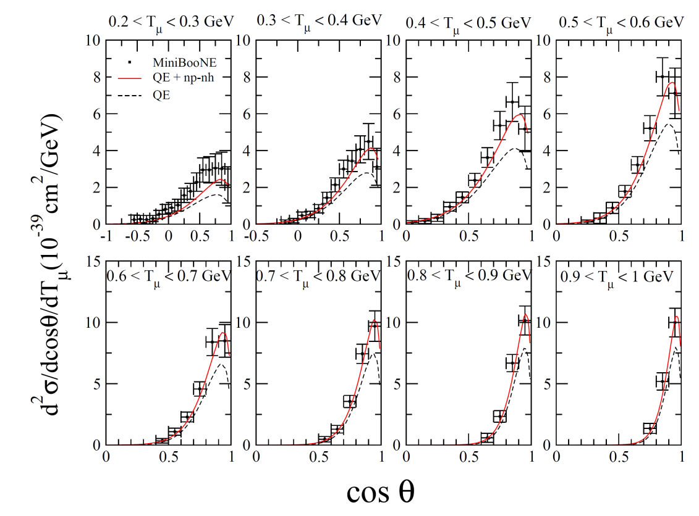
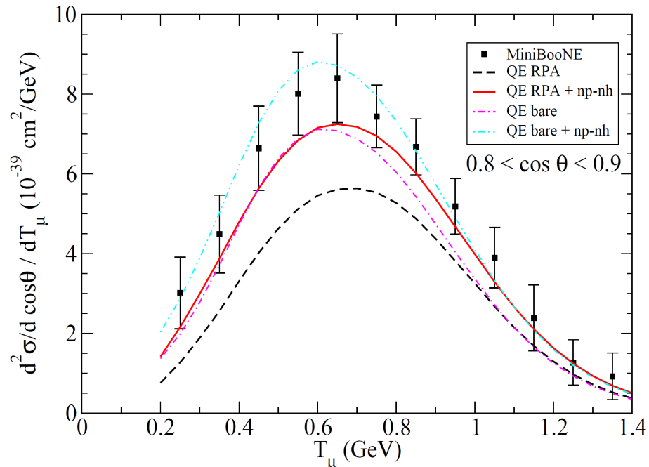
MiniBooNE CCQE-like flux-integrated double diff. X section Our Results for antineutrinos
red: including np-nh
black: genuine QE
Our results are compatible with experimental data.
Nevertheless a small but systematic underestimation shows up.
We remind the additional normalization uncertainty of 17.2% in the MiniBooNE data

Slide 13
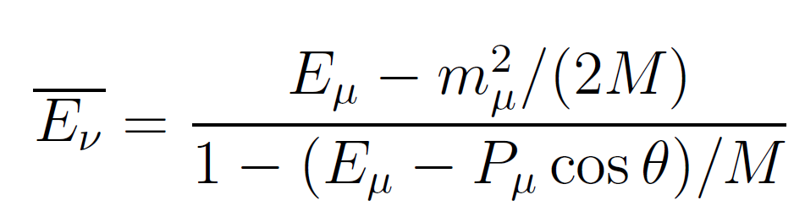
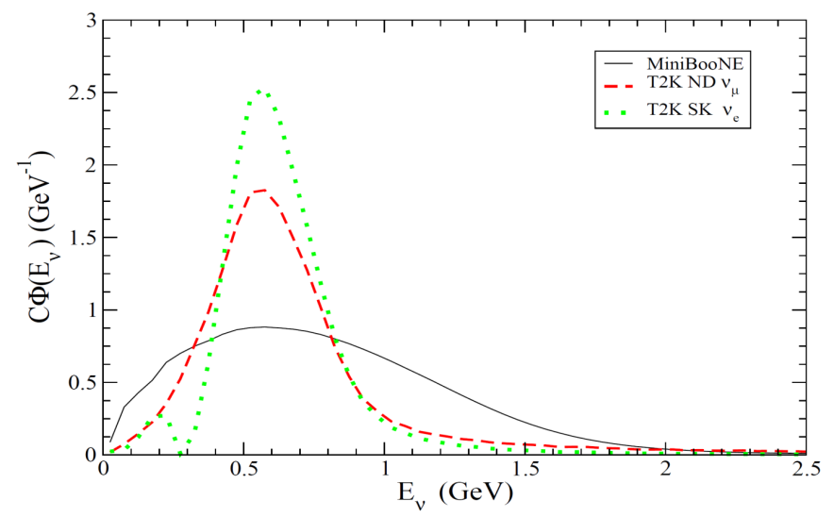
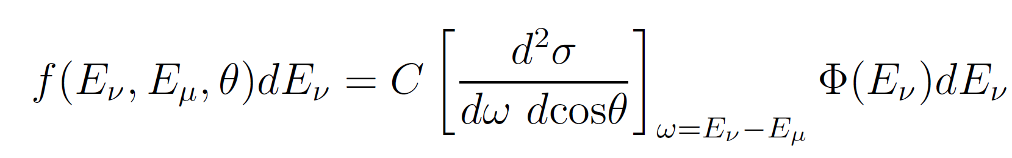
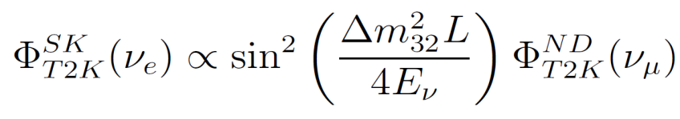
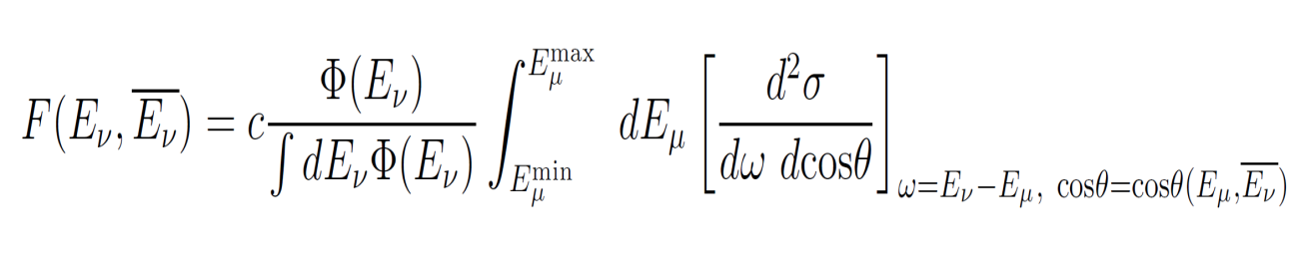
ν energy reconstruction and ν oscillation
Neutrino oscillation experiments require the determination of the neutrino energy which enters the expression of the oscillation probability. This determination is done through charged current quasielastic events.
Reconstructed neutrino energy
μ
Ʋ_{μ} beam
n
p
θ
n
n
p
n
p
p
n
p
n
p
E_{μ} and θ measured
via two-body kinematics
In reality for a given reconstructed energy, there is a distribution of true neutrino
energy which depends on the neutrino flux shape and on the cross-section
See Also U. Mosel et al , PRC86, 054606 (2012)

Slide 14
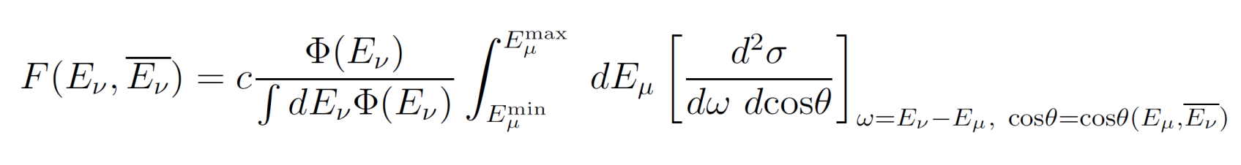
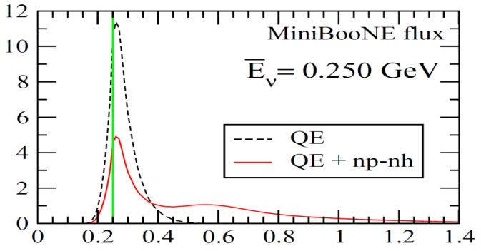
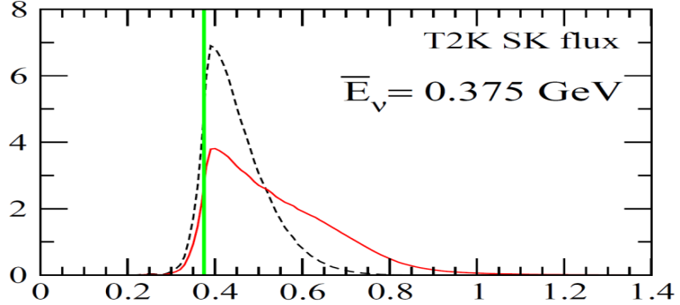


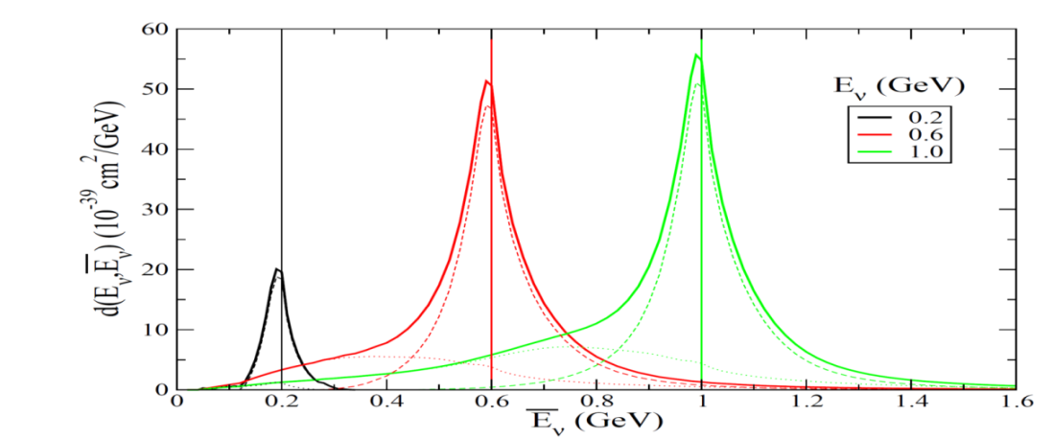
Reconstructed energy
True energy
Distribution of events
at a given reconstructed energy:
High energy tail due to np-nh
Not symmetrical
Crucial role of neutrino flux
True energy
Reconstructed energy
Distribution of events at a given
true energy:
Low energy tail due to np-nh

Slide 15
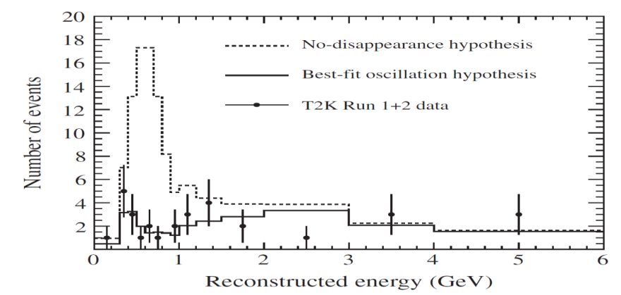
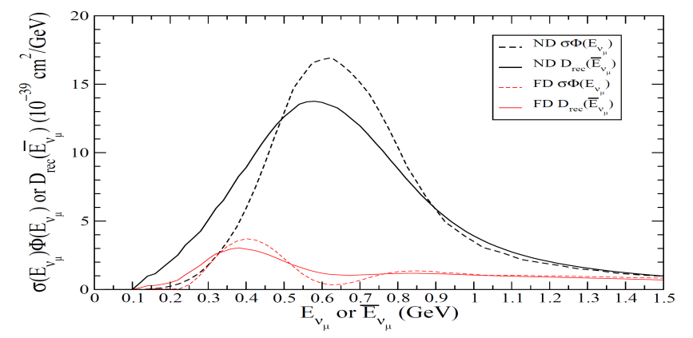
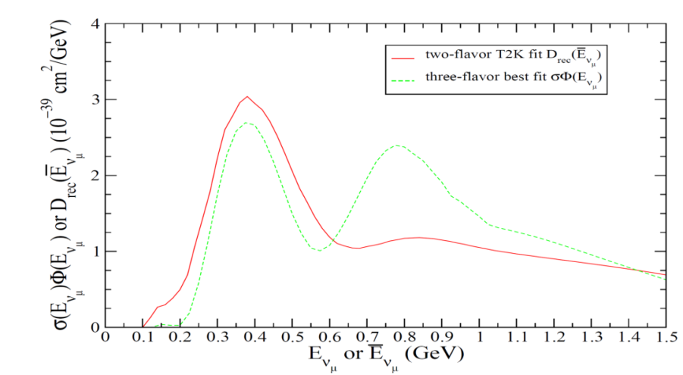
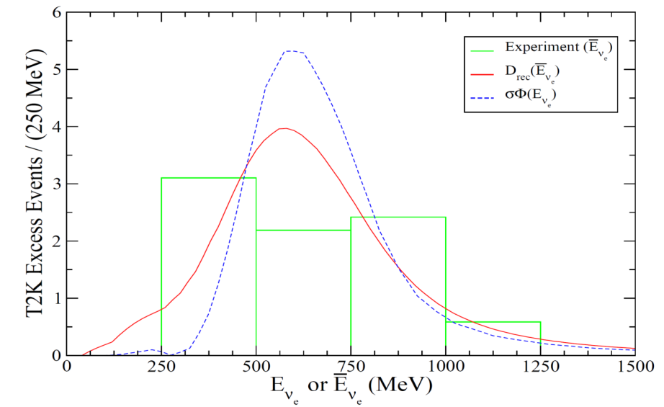
T2K ν_{μ} disappearance
T2K PRD 85, 031103 (2012)
Smeared curves: low energy tail
Far detector: middle hole largely filled
Δm²₃₂ = 2.65 10⁻³ eV²
Δm²₃₂ = 2.43 10⁻³ eV²
In the first peak region: the smeared curve can be reproduced in the unsmeared case with a lower value of the oscillation mass parameter
T2K oscillation electron events
Main origin : np-nh
ICHEP 2012
The reconstruction correction tends to
make events leak outside the high flux
region,
in agreement with the observed trend.

Slide 16
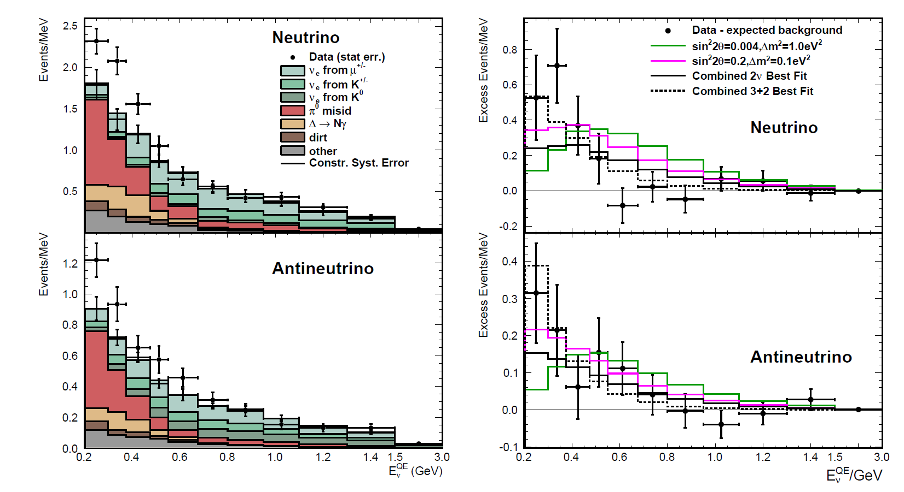
MiniBooNE νμ → νe and νμ→νe
MiniBooNE Anomaly: Excess of events at low energies

Slide 17
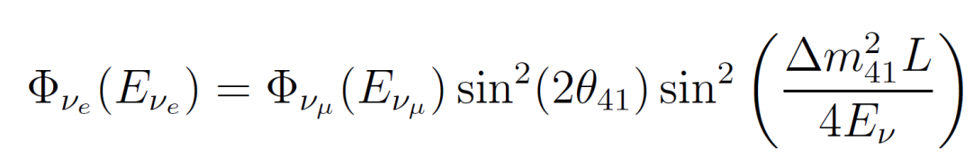
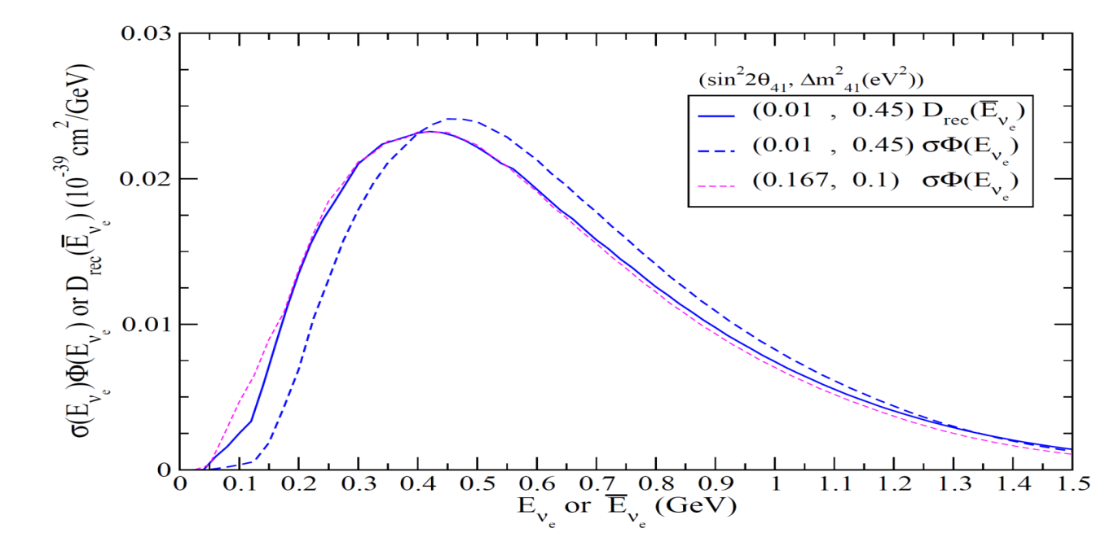
Oscillations induced by sterile neutrino; 3+1 hypothesis
The low energy behavior of the MiniBooNE data favors small values of the mass parameter which concentrate the ν flux at low energies. But small values imply, in order to have enough events, large values of sin²(2θ) which are not compatible with the constraints from other sets of data.
Taking into account our
smearing procedure
-The smeared curve is shifted at lower energies (displacement of the peak ≈ 100 MeV)
-The smeared curve with Δm²=0.45 eV² can be reproduced in the unsmeared case with Δm²=0.1 eV²
Taking into account the smearing, a large mass value allows the same quality
of fit of data than is obtained in the unsmeared case with a much smaller mass
Gain for the compatibility with the existing constraints

Slide 18
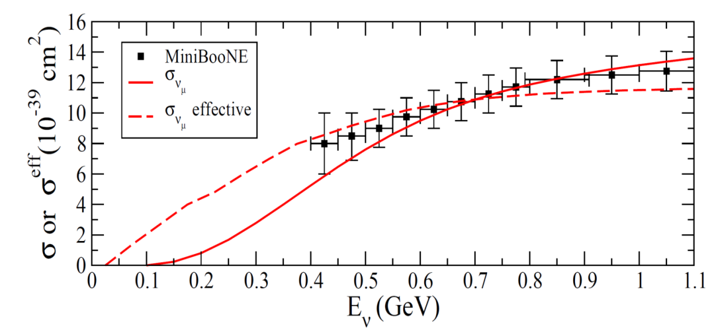
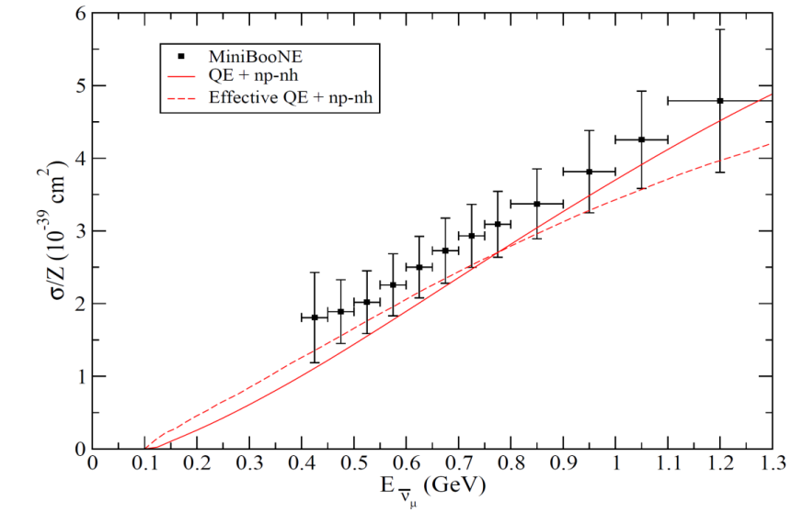
Real and effective cross sections for μ
From the smeared distribution one defines an « effective » cross-section according to
- It depends on the particular beam distribution
- To be directly compared with experimental (MiniBoone) data
ν
ν

Slide 19
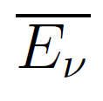
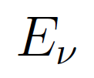
Summary
Nuclear responses treated in RPA
Unified description of several channels:
Quasielastic
Pion production
Multinucleon emission (np-nh excitations)
Comparison with experiments
Quasielastic σ , d2σ/(dTμ dcosθ) , dσ/dQ2 measured by MiniBooNE can be
explained without any modification of M_{A} when including the np-nh channel
Agreement with the recent Antineutrino MiniBooNE CCQE measurement
Neutrino energy reconstruction
T2K: agreement with ν_{e} data
T2K ν_{μ} and MiniBooNE: the energy reconstruction correction is expected to lead to
an improvment of the best fit oscillation mass parameters
MiniBooNE: our smearing procedure improves the compatibility with existing
constraints

Slide 20
