Slide 1
Status of the KATRIN experiment
Nancy Wandkowsky for the KATRIN Collaboration
September 20, 2013
KATRIN overview
STS status
SDS commissioning
Transmission studies
Background studies
Summary and Outlook

Slide 2
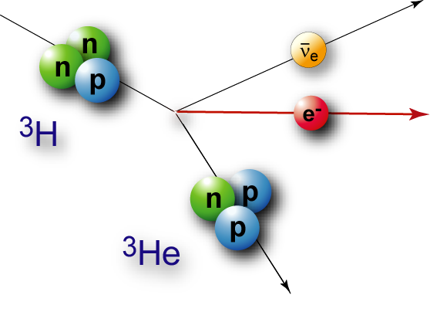
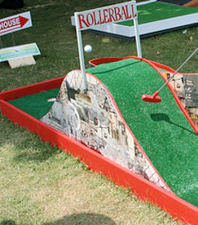
KATRIN overview
KATRIN experimental setup
source
transport
spectrometer
detector
2014: Source and
Transport Section (STS) commissioning
2013: Spectrometer and Detector Section (SDS) commissioning

Slide 3
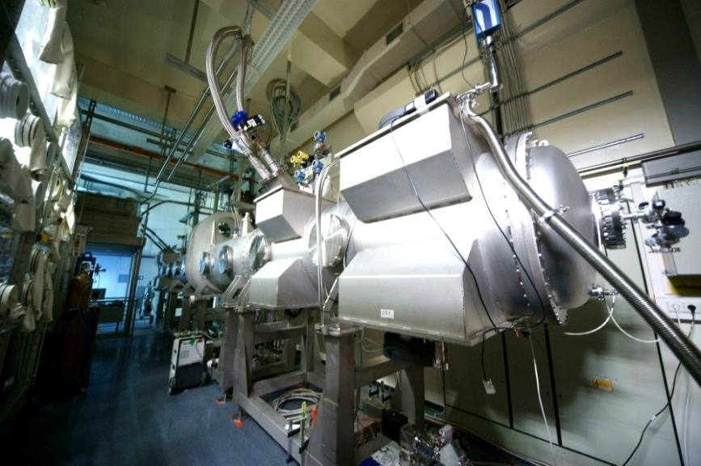
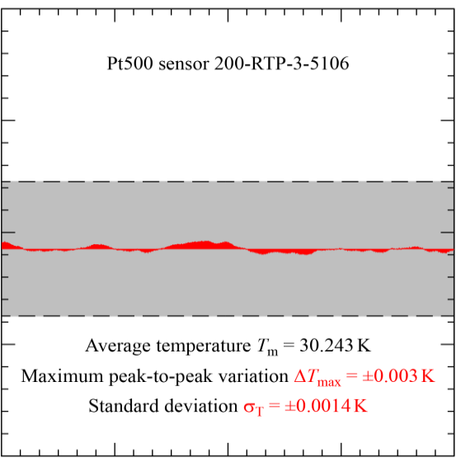
STS status
Windowless gaseous tritium source
WGTS demonstrator successfully tested in 2011/12
2013/14: upgrade to full source
magnet tests at CEA Saclay
delivery and commissioning in 2014
30.35
4h measurement
30.30
KATRIN specification
Temperature T_{BT} [K]
30.25
30.20
WGTS Demonstrator
06:00 07:00 08:00 09:00 10:00
S. Grohmann et al, Cryogenics 55, 5 (2013)

Slide 4
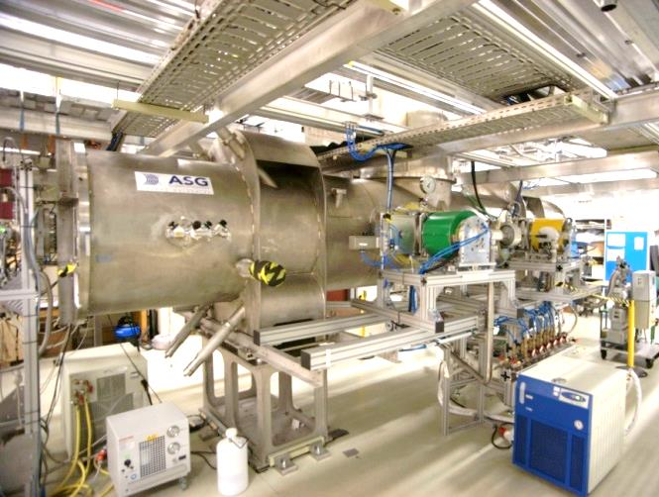
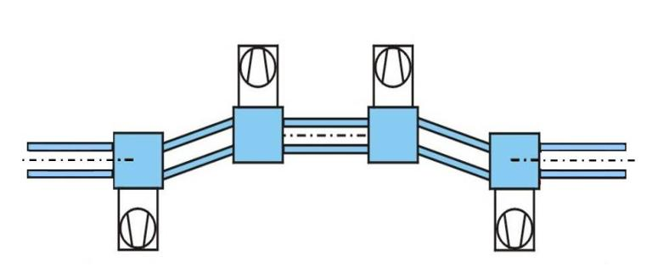
STS status
Differential pumping section
DPS pumping concept successfully tested in 2011
gas flow reduction by 2.5·10⁴ achieved
failure of protection diode → new concept worked out
delivery and commissioning in 2014
S. Lukic et al., Vacuum 86, 8 (2012)

Slide 5
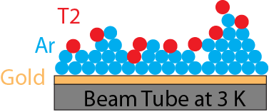
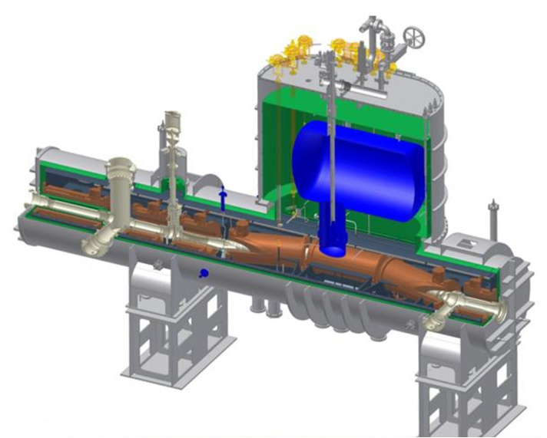
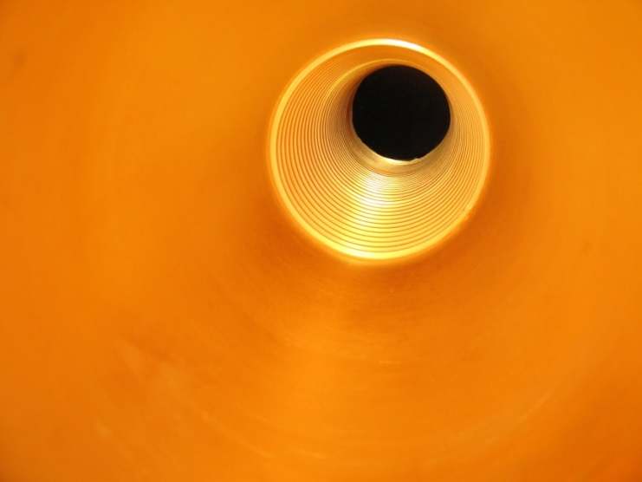
STS status
Cryogenic pumping section
CPS pumping concept demonstrated
beam tube gold coating, cold tests of magnets successfully passed
reworking of protection diodes
delivery and commissioning in 2014
F. Eichelhardt et al., Fusion Sci. Technol. 54 (2008)

Slide 6
KATRIN overview
KATRIN experimental setup
source
transport
spectrometer
detector
2014: Source and
Transport Section (STS) commissioning
2013: Spectrometer and Detector Section (SDS) commissioning

Slide 7
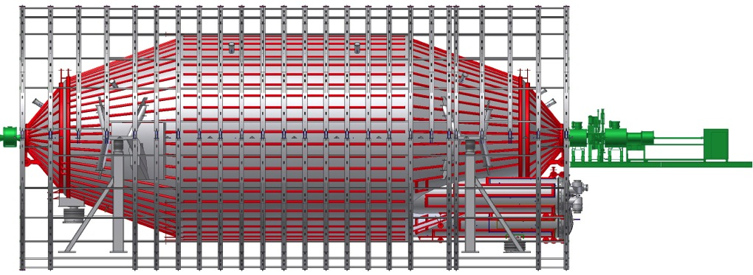
SDS commissioning - objectives
Main Spectrometer
angular
selective
E-Gun
Detector
Section
Primary objectives:
test of individual hardware, software and slow control components
provide ultra high vacuum conditions at the p ≈ 10⁻¹¹ mbar level
detailed understanding of MAC-E filter transmission properties (E = 18.6 keV with ΔE = 0.93 eV resolution)
detailed knowledge and control of background processes

Slide 8
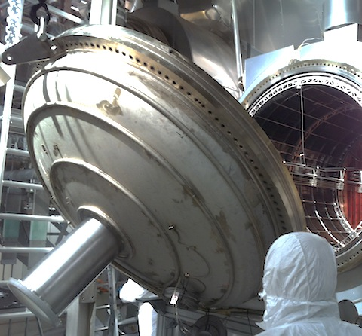
SDS commissioning – preparations
May 8, 2012
Spectrometer closed

Slide 9
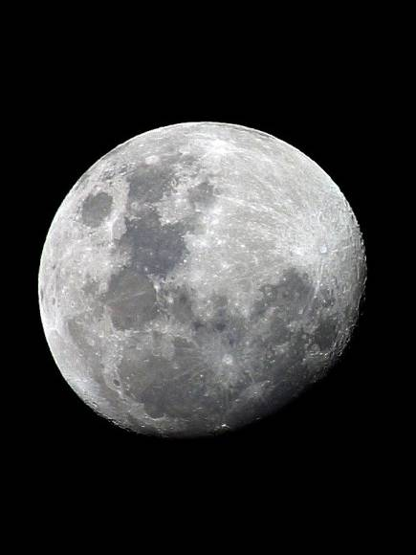
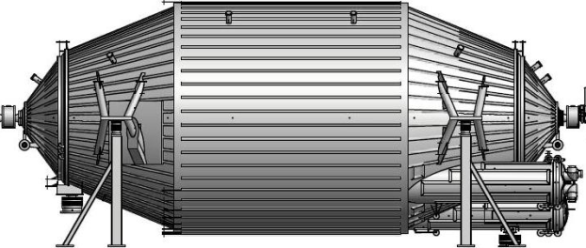
SDS commissioning – bake-out
Motivation
p = 10⁻¹¹ mbar
back at vacuum in July 2012: 10⁻⁸ mbar (water-dominated)
required pressure: 10⁻¹¹ mbar to minimize scattering on residual gas
challenge: large volume of 1240 m³

Slide 10
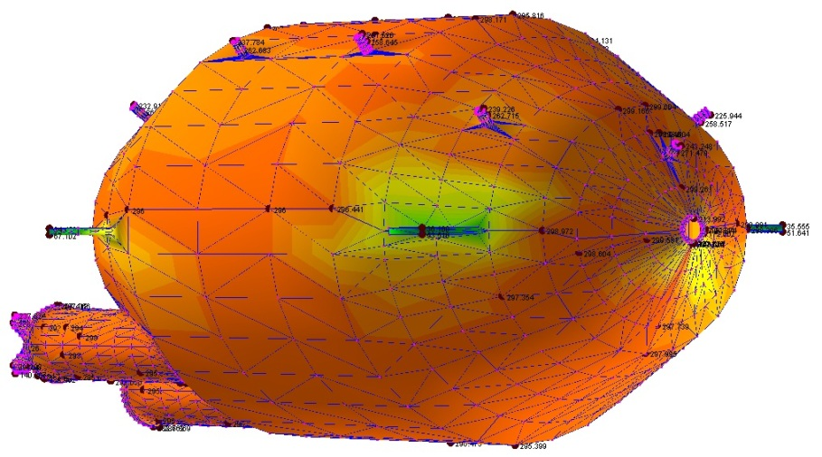
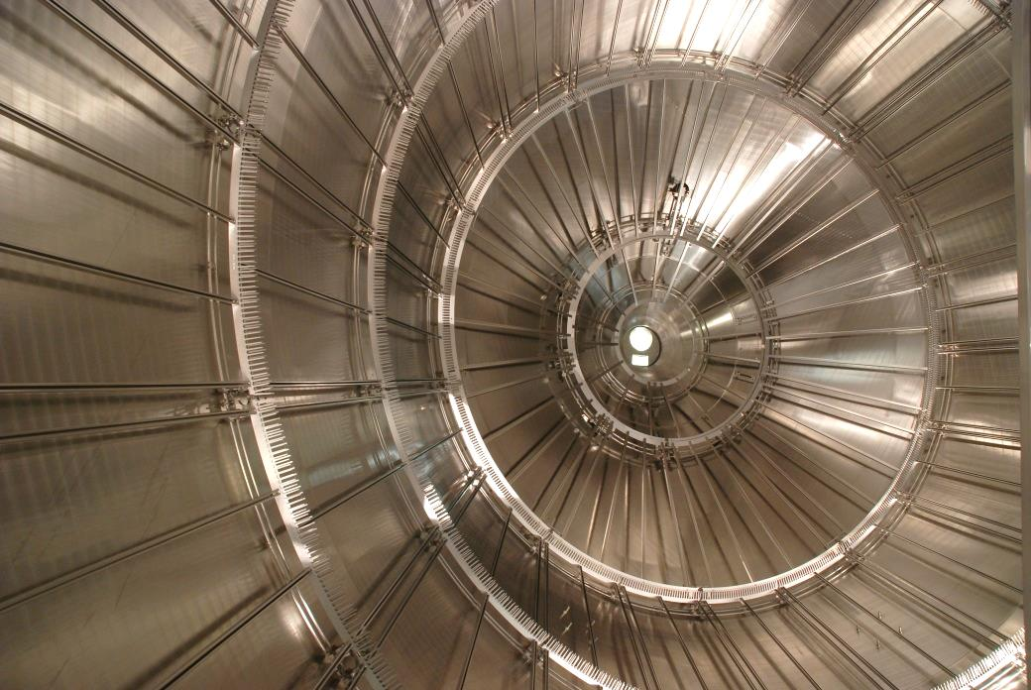
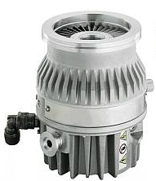
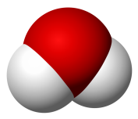
SDS commissioning – bake-out
Procedure
required temperature: 200°C
slow heating so inner electrode
can follow expansion of vessel
inner surface: 690 m²
turbomolecular
pump

Slide 11
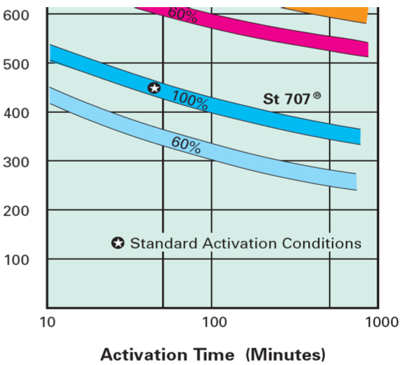
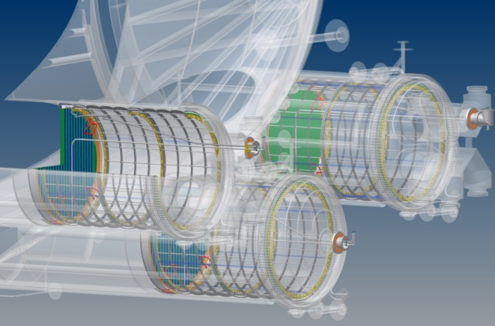
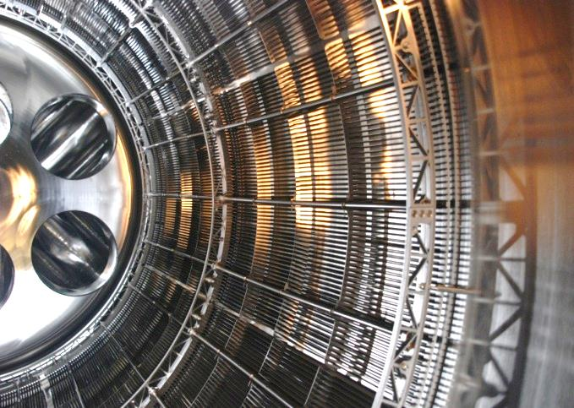
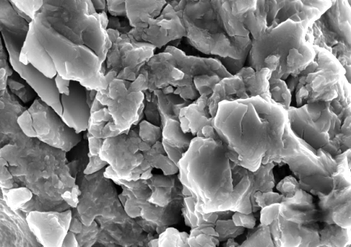
SDS commissioning – bake-out
Getter activation
back at vacuum in July 2012: 10⁻⁸ mbar
required pressure: 10⁻¹¹ mbar to minimize scattering on residual gas
(water-dominated)
challenge: large volume of 1240 m³
activation of getter material (NEG St 707)

Slide 12
SDS commissioning – bake-out
Procedure
slow heating/cooling (~1°C/h): expansion of vessel and electrode
temperature breakpoints: 200°C – water removal from vessel
300°C – activation of getter material
leak developed &
fixed immediately
back to
10⁻¹¹ mbar level
Today: 4·10⁻¹¹ mbar

Slide 13
SDS commissioning – bake-out
expansion
fix point
(video mirrored)
J. Wolf

Slide 14
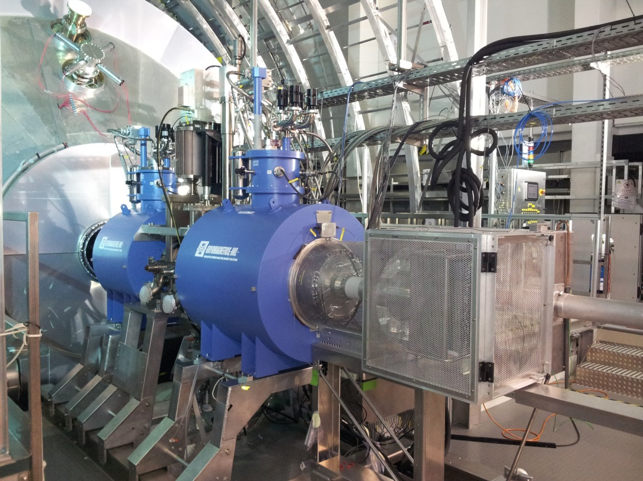
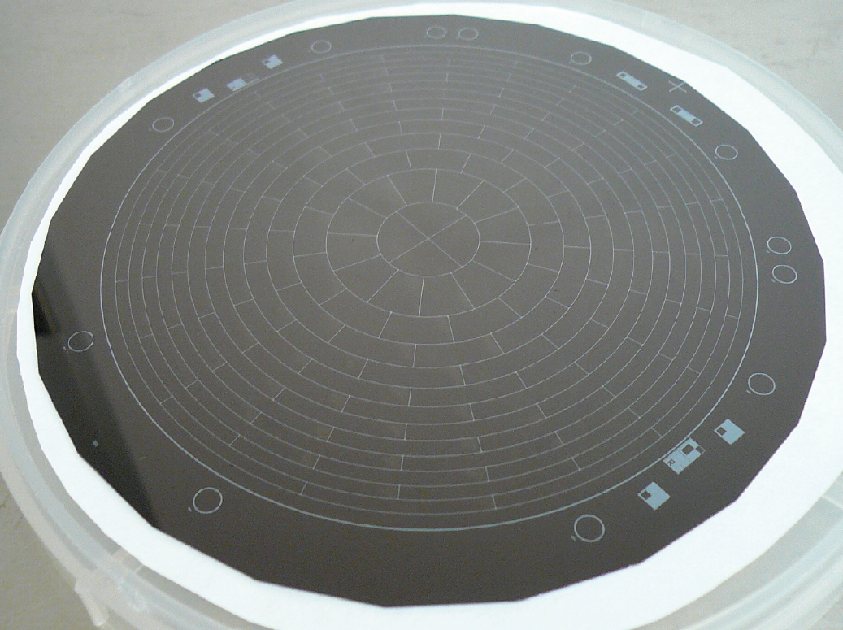
SDS commissioning - detector
Integration of detector and spectrometer
May 16, 2013: SDS connection established
May 28, 2013: opening gate valve

Slide 15
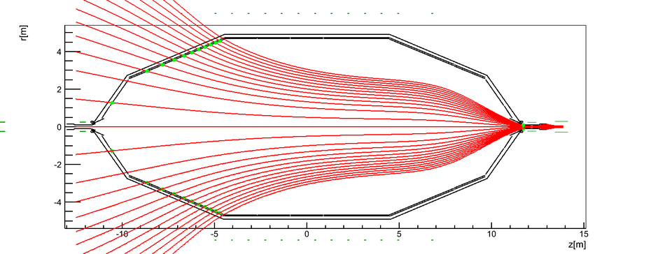
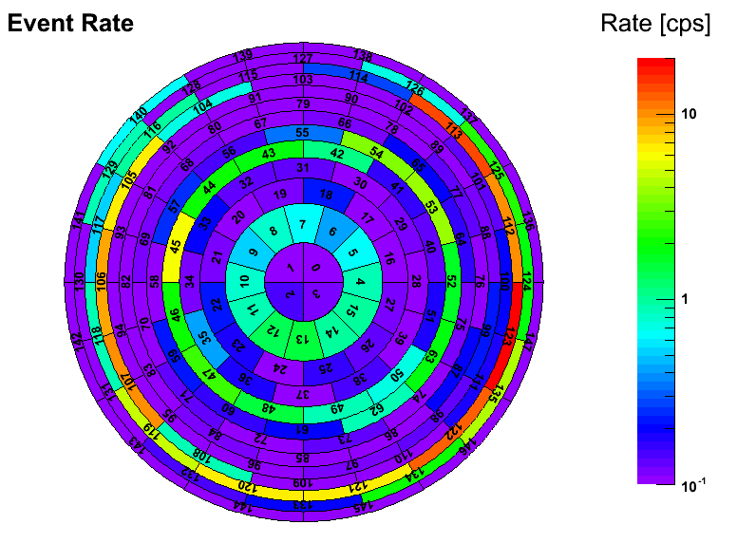
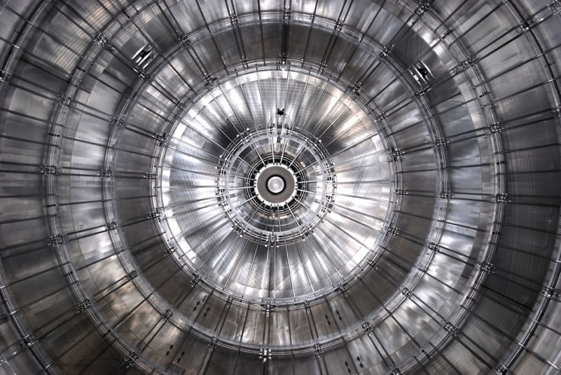
SDS commissioning – first light
May 31, 2013
asym. magnetic field
map electrode onto detector
confirmed by simulations

Slide 16
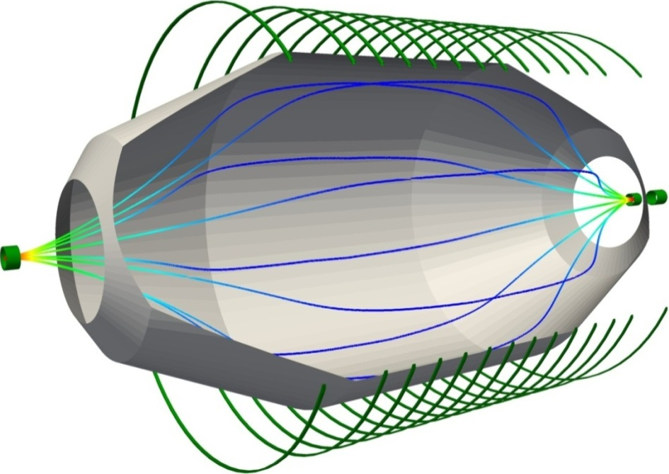
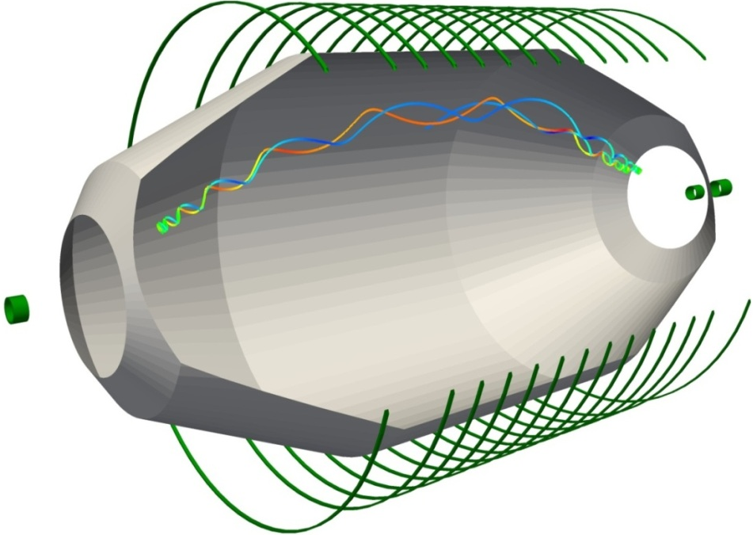
SDS commissioning – studies
B [T]
Transmission of ß-electrons
magnetic guiding
electrostatic retardation
e
e
e
θ [°]
Background: stored electrons
magnetic bottle effect
long storage (h)

Slide 17
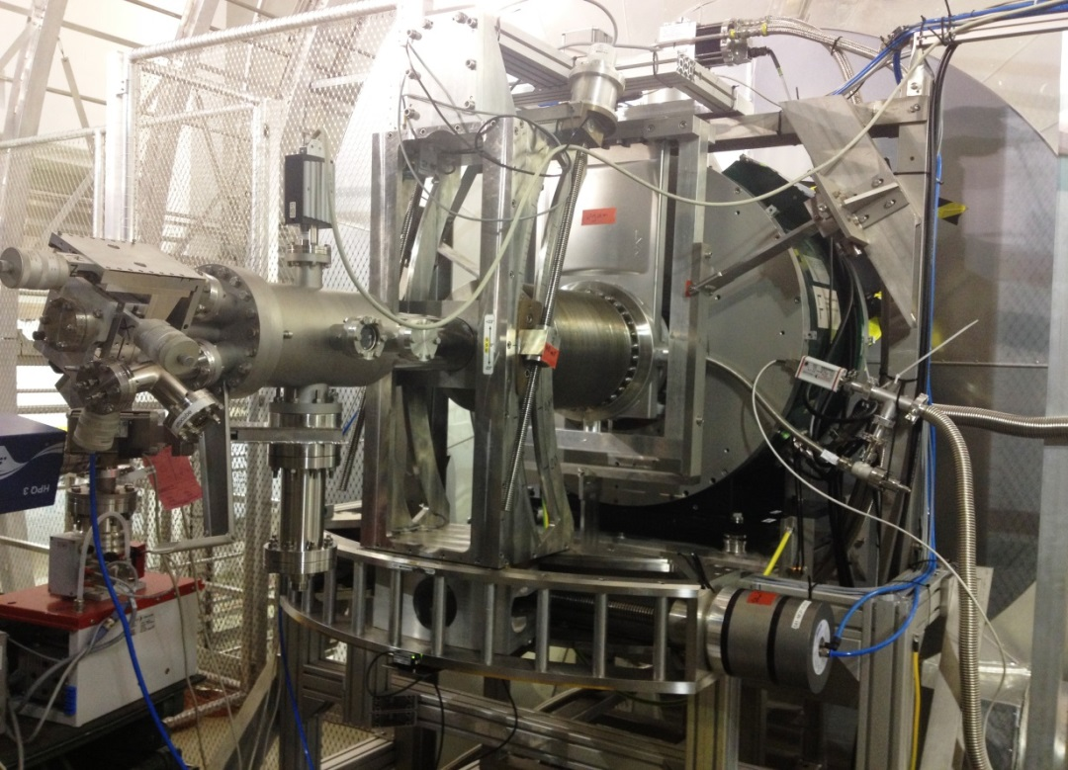
Transmission studies – e-gun
Quasi-monoenergetic, angular
selective electron gun
diagnostic tool: mapping of
analyzing plane
K. Hugenberg et al, Prog. Part. Nucl. Phys. 65, 288 (2010)

Slide 18
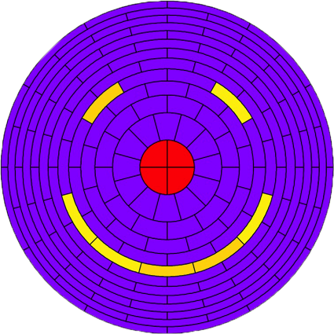
Transmission studies – mapping
Quasi-monoenergetic, angular
selective electron gun
diagnostic tool: mapping of
analyzing plane

Slide 19
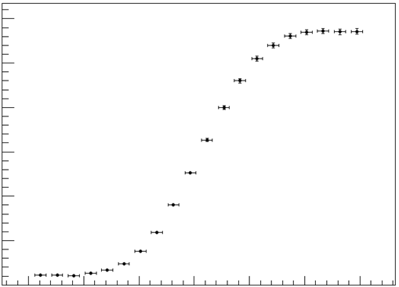
Transmission studies
Quasi-monoenergetic, angular
selective electron gun
diagnostic tool
study of electron transmission
e
e
3.0
2.5
PRELIMINARY
2.0
1.5
electron rate (kcps)
First transmission function
at high voltage (Aug. 14th)
1.0
0.5
successful transmission!
width of 100 meV
-1.1
-1.0
-0.9
-0.8
-0.7
-0.6
-0.5
U_{HV}-U_{egun} (eV)

Slide 20
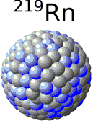
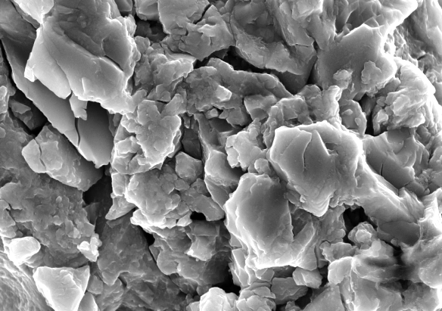
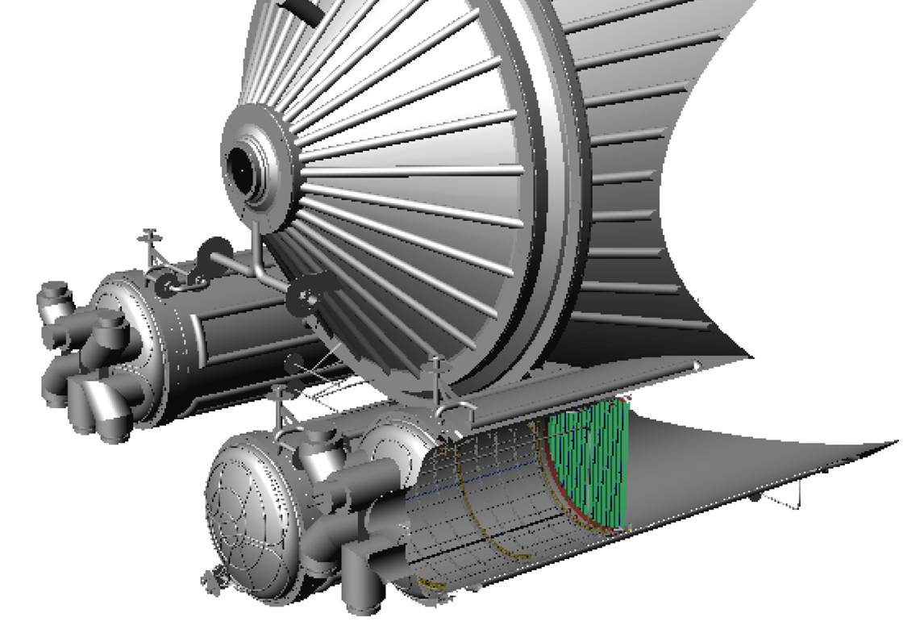
Background studies – radon
Radon sources at the KATRIN main spectrometer
getter material (St 707): ²¹⁹Rn (t_{1/2}=3.96 s)
vessel surface: ²²⁰Rn (t_{1/2}=55.6 s)

Slide 21
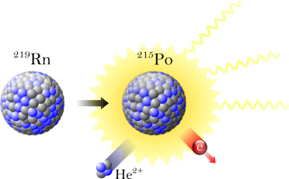
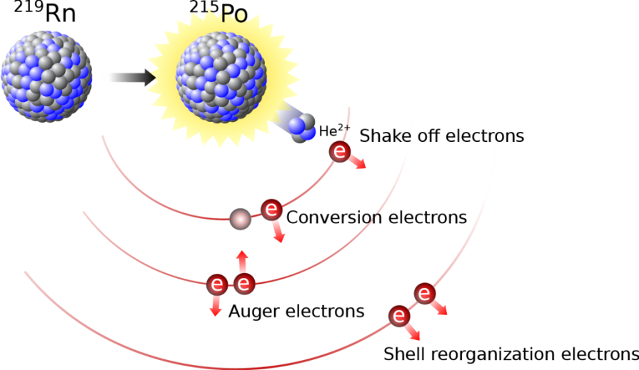
Background studies – radon
Radon decay in sensitive spectrometer volume
alpha-emission: not relevant for KATRIN
accompanying electrons: source of background

Slide 22
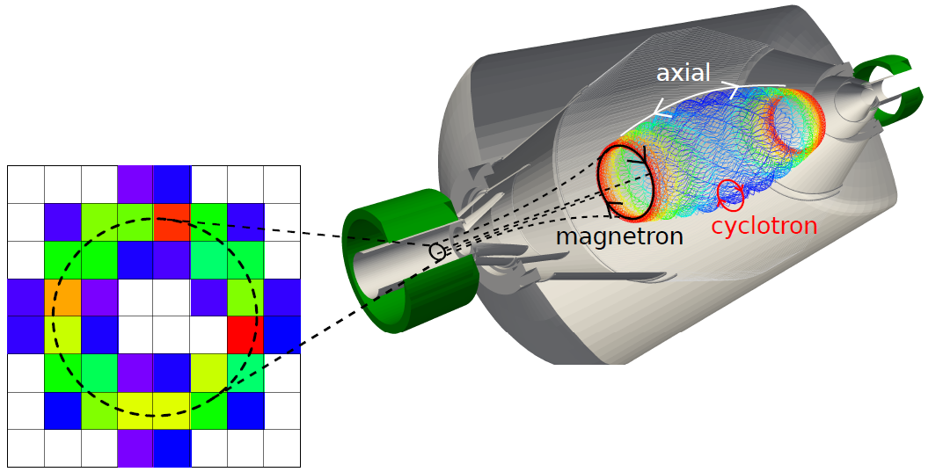
Background studies – radon model
magnetically stored electrons scatter off residual gas
→ ionization → secondary electrons
high primary energies → hundreds of secondary electrons
UHV (10-11 mbar) → storage time up to several hours
pre-spectrometer
F. Fränkle et al, Astropart. Phys. 35, 128 (2011)
S. Mertens et al, Astropart. Phys. 41, 52 (2013)
N. W. et al, J. Phys. G 40 (2013)
N. W. et al, New J. Phys. 15 (2013)

Slide 23
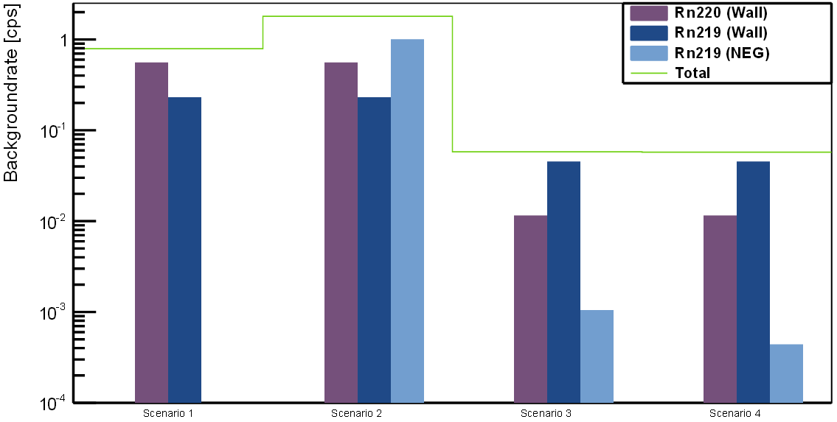
Background studies – expectations
Expectations for the main spectrometer
modeling of physics processes: KASSIOPEIA
extrapolations to main spectrometer
expectation: background on the order of 1 count per second
1
1
10⁻¹
Background rate (cps)
10⁻²
10⁻³
10⁻⁴
scenario 1
scenario 2
scenario 3
scenario 4
S. Mertens et al, Astropart. Phys. 41, 52 (2013)

Slide 24
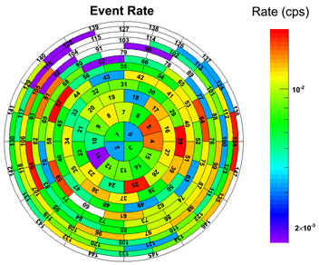
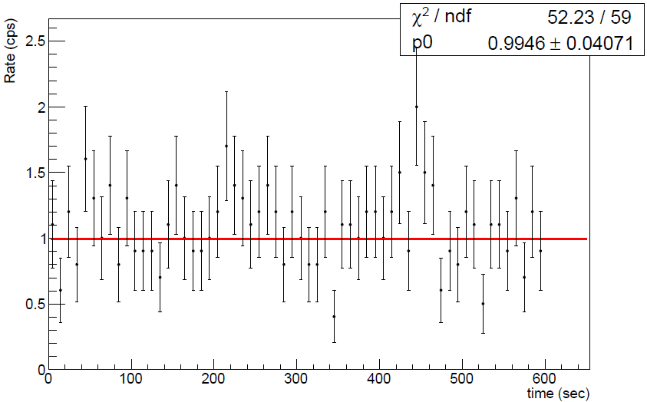
Background studies – observations
First look at background with full HV
no large Penning traps (previous MAC-E filters: >10⁵ cps initial rate)
highly effective magnetic shielding against cosmic μ-induced background
required rate: 10⁻² cps
counter measures needed: electric shielding against μ–induced background,
passive/active reduction of stored electron background
2.5
PRELIMINARY
2
10⁻²
1.5
Background rate (cps)
1
0.5
2·10⁻³
0
100
200
300
400
500
600
time (s)

Slide 25
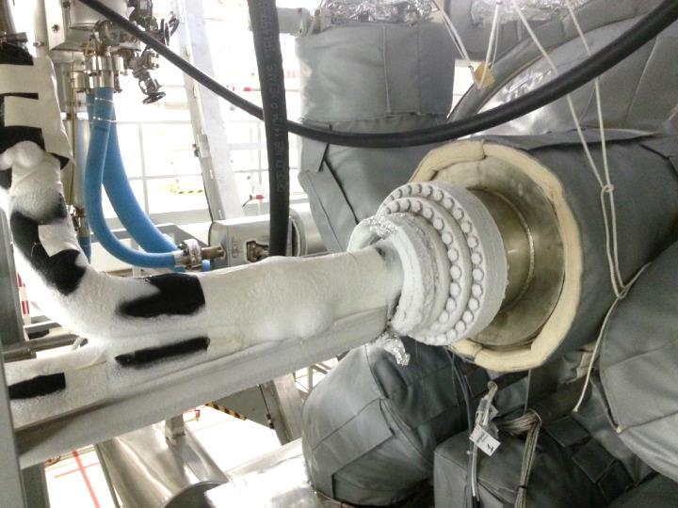
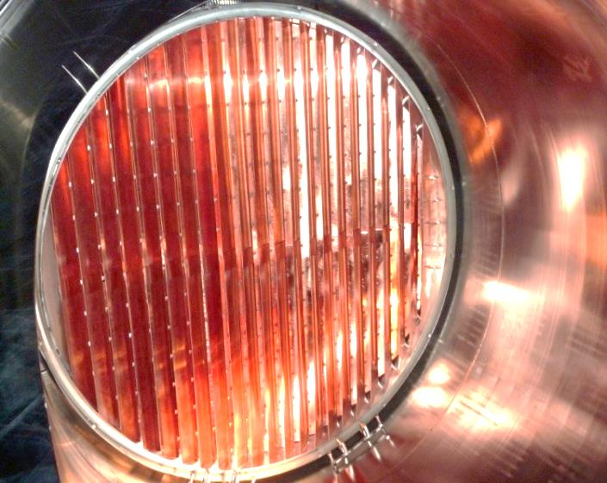
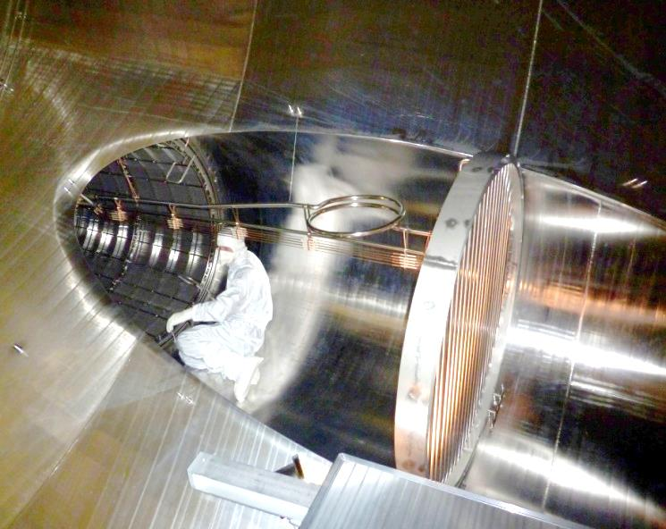
Background studies – reduction
Passive background reduction: principle
spectrometer
vessel
NEG-Pump
LN₂ cooled
baffle
²¹⁹Rn

Slide 26
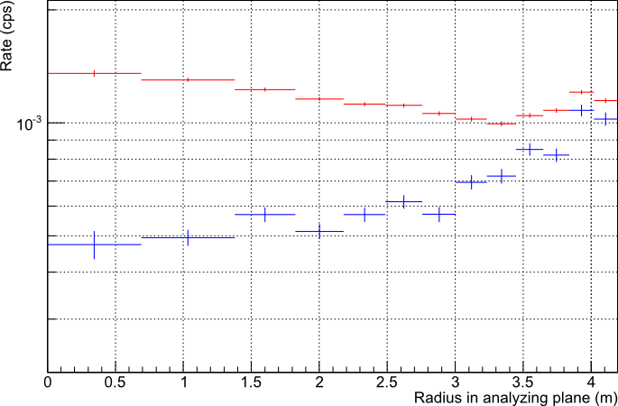
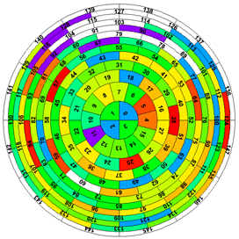
Background studies – reduction
Passive background reduction: measurement results
reduction by factor 3
PRELIMINARY
WARM BAFFLES
Background rate/unit volume (cps/m³)
COLD BAFFLES
detector rings

Slide 27
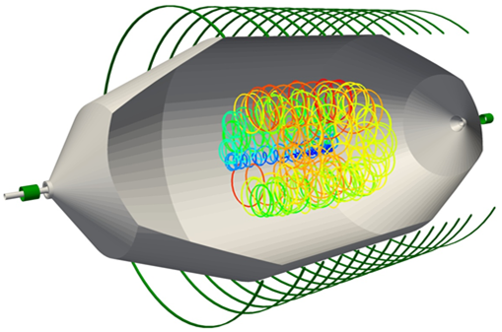
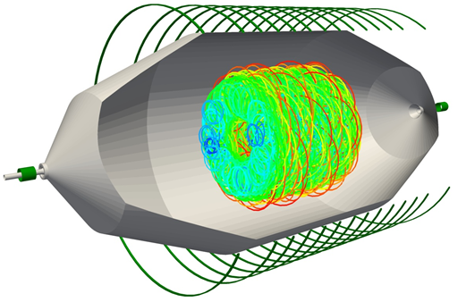
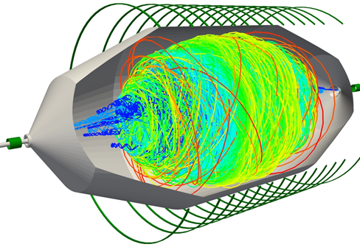
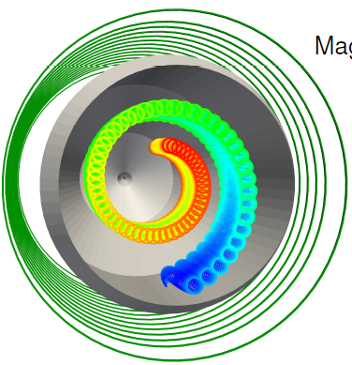
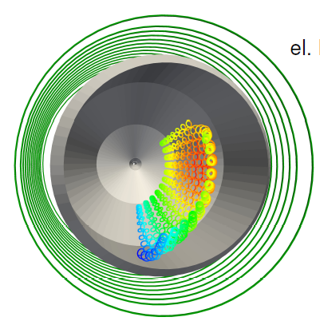
Background studies – reduction
Active background reduction: overview
breaking of electron storage condition
removal from sensitive volume
S. Mertens et al, JINST 7 P08025 (2012)
N.W., PhD thesis (2013)
Cyclotron Resonance
All electron energies
Magnetic Pulse
High energies
Electric Dipole
Low energies

Slide 28
Background studies – reduction
Active background reduction: dipole measurement
enhanced bg rate by ignition of
Penning trap between egun & spec
10³
PRELIMINARY
10²
Short application of electric dipole field
E≈1 V/m → ExB-drift
10
Background rate (cps)
1
10⁻¹
10⁻²
0 20 40 60 80 100 120
time (s)

Slide 29
Summary and Outlook
KATRIN: determination of m_{ν} <0.2 eV (90% CL)
STS components delivery and commissioning in 2014
SDS Milestones in 2013:
Jan.: bake-out of the spectrometer
May: integration of detector system (SDS)
May: first light
Aug.: application of HV
Commissioning: transmission and background studied
End of commissioning: Sept. 23rd
Detailed analysis of collected data
Prepare SDS for tritium measurements
Start of tritium measurements in 2015

