Slide 1
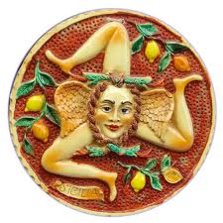
Longbaseline Neutrino Oscillations:
Status of the OPERA experiment
ν_{e}
Introduction
Experimental Setup
Data Analysis
Conclusion
ν_{μ}
ν_{τ}
Caren Hagner
Universität Hamburg
International School of Nuclear Physics, Erice, 17.9.2013

Slide 2
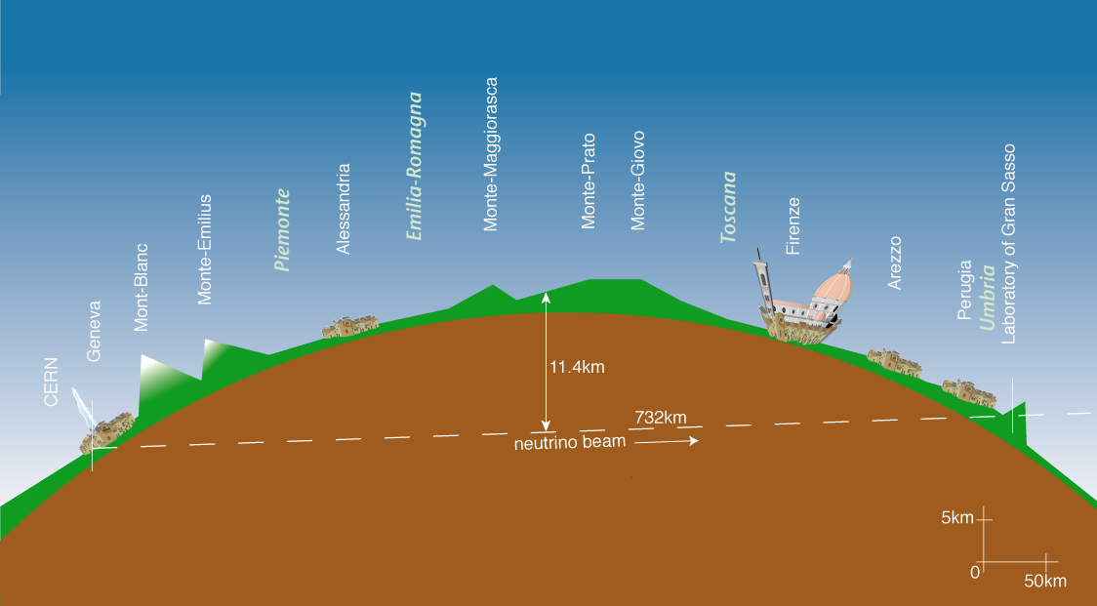
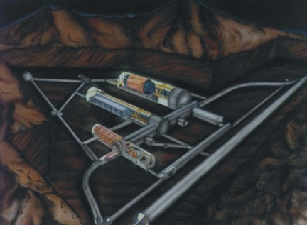
OPERA: Oscillation Project with Emulsion tRacking Apparatus
Neutrino beam (v_{μ}) from CERN to Gran Sasso Underground Lab (Italy)
Goal: Direct v_{τ} Appearance
LNGS
732 km

Slide 3
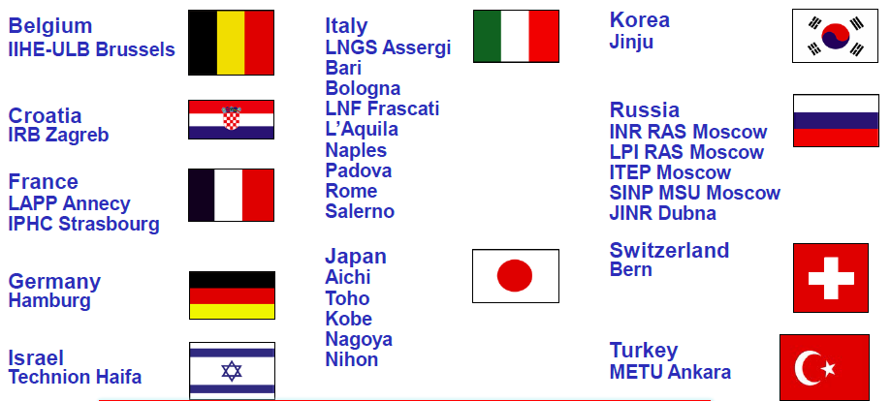
OPERA - Overview
Opera Collaboration: ~ 140 physicists, 11 countries
July 2000: Experiment proposal
May 2003: Start construction at LNGS
Summer 2006: 1st cosmics runs, CNGS beam started
Autumn 2007: 1st neutrino interactions of CNGS beam in target
July 2008: Emulsion target completed: Start of neutrino physics runs
Dec 2012: End of neutrino physics runs
Since then: scanning of emulsions ongoing

Slide 4
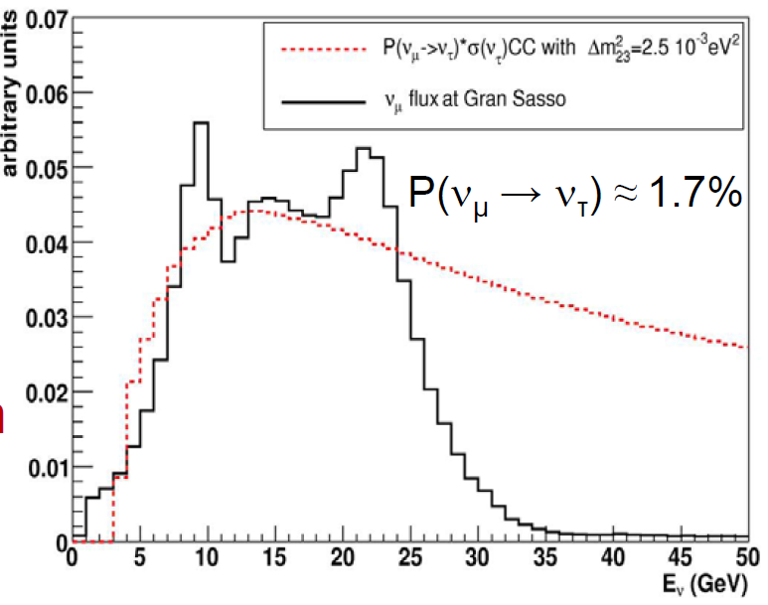
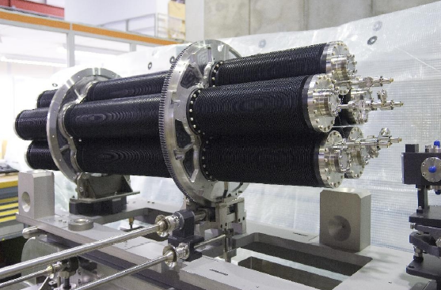
CNGS beam (“pure” v_{μ})
„conventional“ neutrino beam: 400GeV protons from SPS on graphite target
average beam power: 160 kW (peak: 480 kW)
graphite target

Slide 5
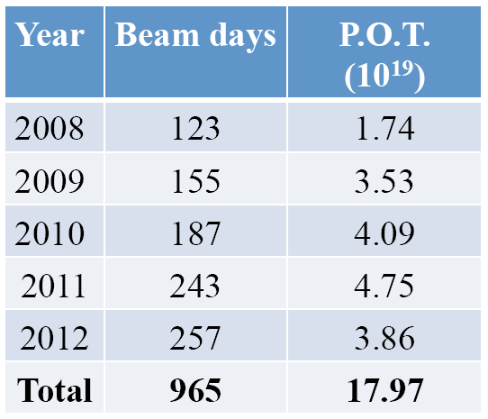
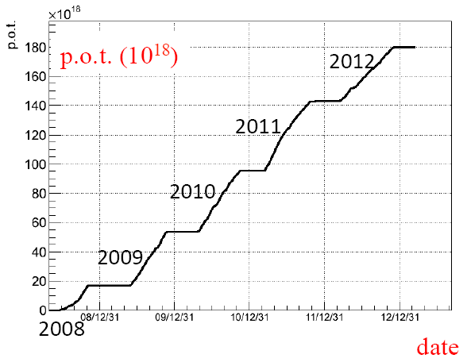
OPERA Beam Statistics:
CNGS neutrino beam operation (p.o.t. = „protons on target“)
collected intensity (total) = 17.97∙10¹⁹p.o.t.
(20% less than value in experiment proposal (22.5·10¹⁹ p.o.t.)
this corresponds to ~ 19000 neutrino interactions in the target

Slide 6
v_{τ} Detection: Direct Observation of τ Decay Topology
v_{τ}
τ-decay:
τ⁻
W
Electronic Trackers
Interface Films (CS)
p,n
hadrons
ECC brick
OPERAs challenging task:
μm tracking accuracy
over volume of ≈ 6.5×6.5×8 m³
1 mm
μ, e, π
ν_{τ}
τ⁻
OPERA principle: Hybrid Detector with modular structure
Hadrons
Pb
Emulsion layers
Notes:
T decay tabelle geaendert auf werte von G.DeLellis vom 26.3.2013 (vorher tau-mu 17.4, tau-3h 15.2)
Tau-mu mit 17.7 enthaelt noch tau-mu+gamma

Slide 7
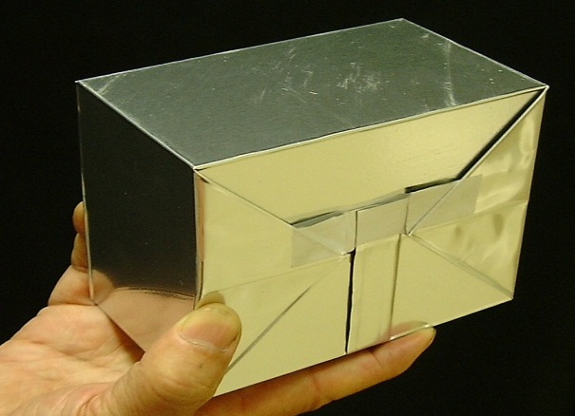
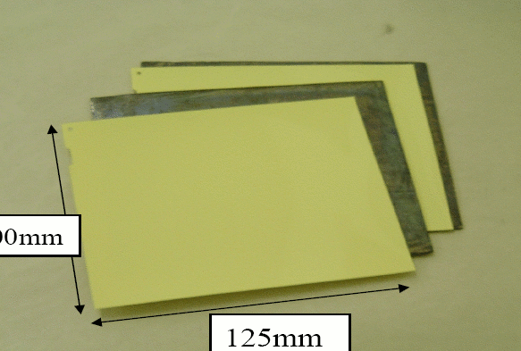
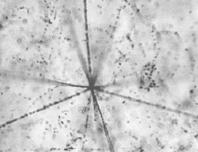
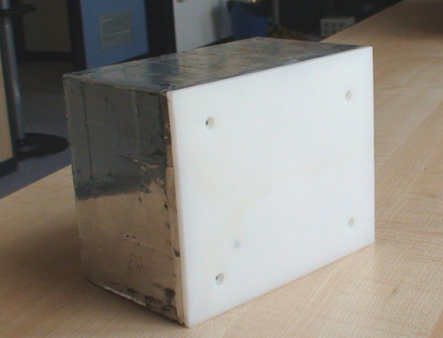
OPERA Target: Lead-Emulsion-Bricks
57 emulsion / 56 lead
10X₀
102 mm
8.3kg
Lead-Emulsion-Bricks: average number ≈ 140.000
128 mm
„Emulsion Cloud Chamber“ (ECC)
Target Mass: ≈ 1,2 kton
O(10⁵) m² of film surface
Changeable Sheet (CS)

Slide 8
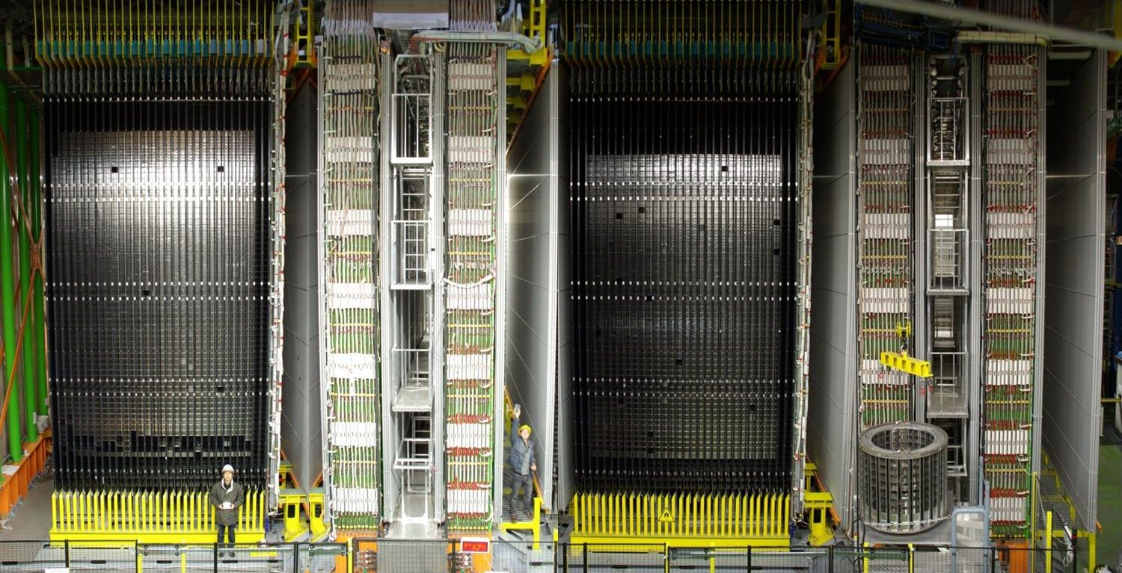
OPERA - Detector
Target 74.500 bricks
v
μ
X
B
B
Magnetic Spectrometer:
Magnet-Region: Iron & RPCs
Precision Tracker: 6 Planes of Drifttubes
BMS robot to remove bricks

Slide 9
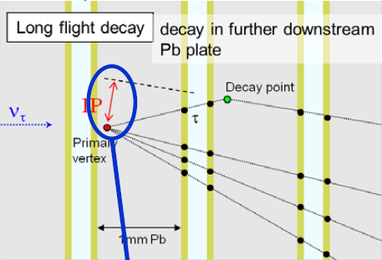
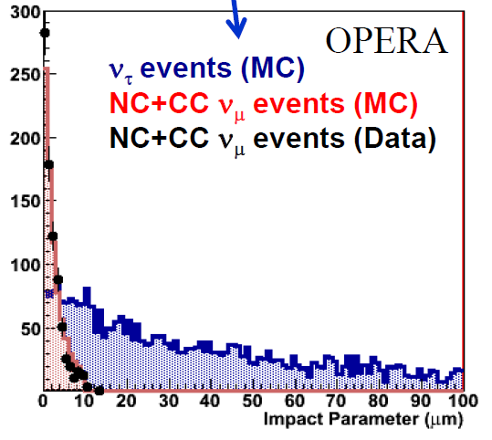
Performance of Emulsion Detector (I)
Track segment resolution: σ(angle) = 2.1 mrad
σ(position) = 0.21 μm
Vertex position resolution: ~ 1μm in transverse plane

Slide 10
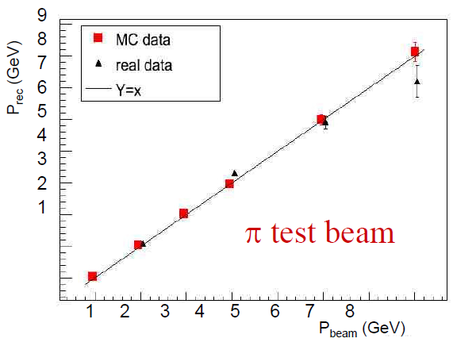
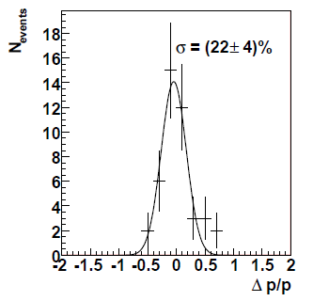
Performance of Emulsion Detector (II)
Measurement of particle momentum by Multiple Coulomb Scattering in Pb target:
NJP 14 (2012) 013026
μ (2–6 GeV)

Slide 11
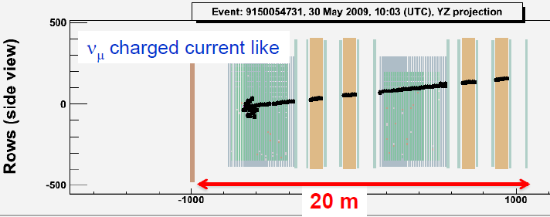
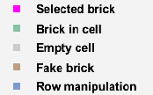
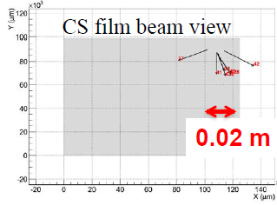
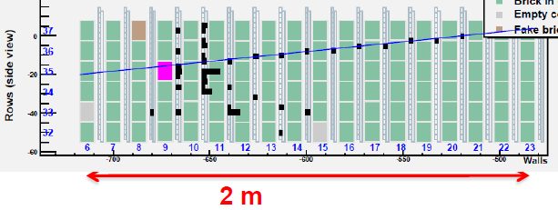
Opera Event Analysis
1. Electronic Detector Reconstruction:
2. Brick Finding:
3. CS scanning:

Slide 12
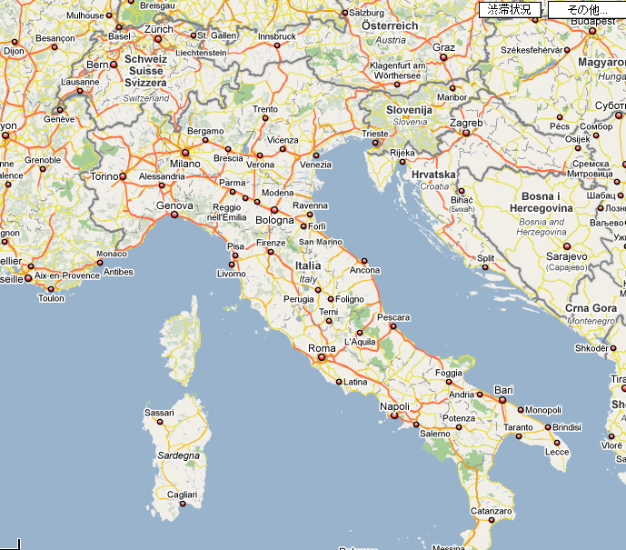
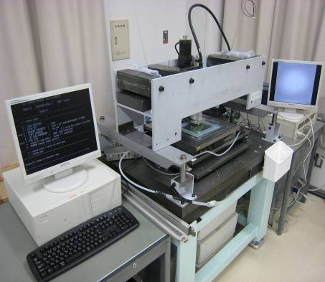
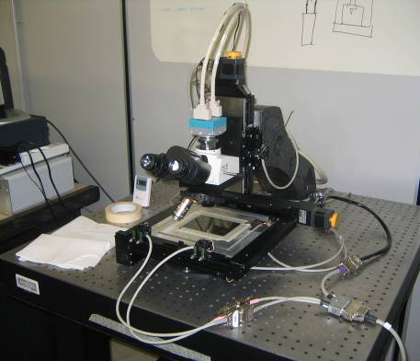
Brick Analysis
The selected bricks are sent to scanning labs
To Dubna
Bern
Japanese Scanning System
Padova
Bologna
European Scanning System
To Japan
Roma
LNGS
To Ankara
LNF
Bari
Napoli
Salerno
40 automated microscopes in Japan and Europe

Slide 13
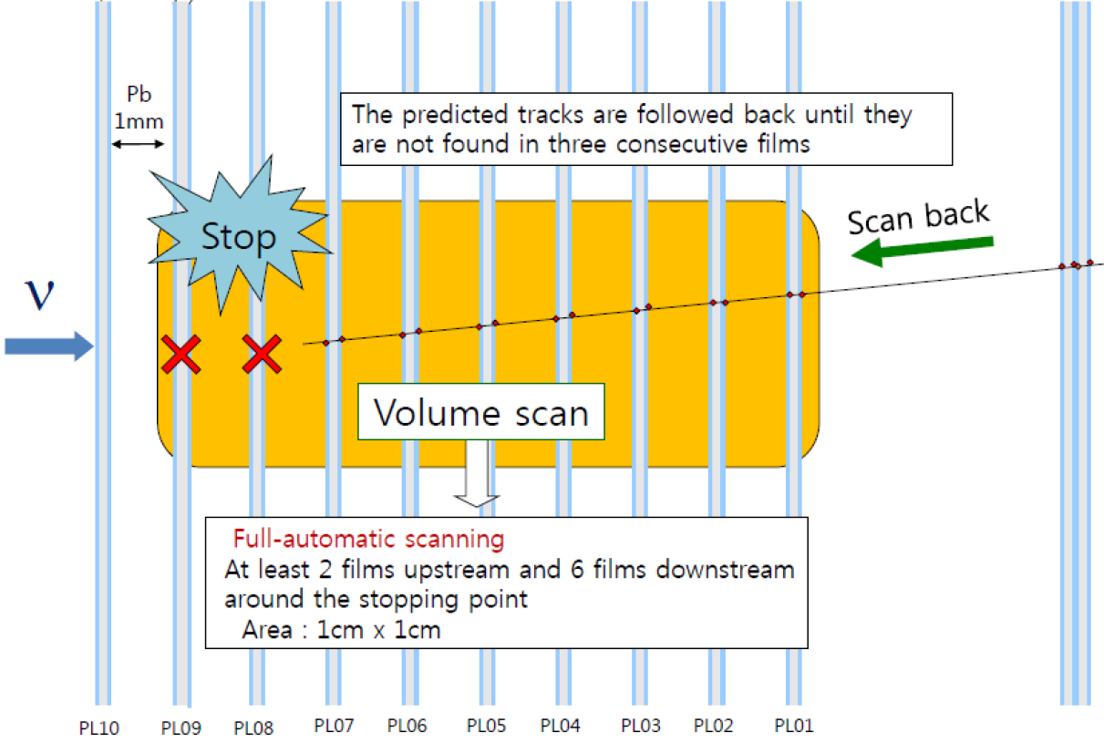
Interaction Location: „Scan Back“ Method
CS
(Improved to: 5 films upstream, 10 films downstream)

Slide 14
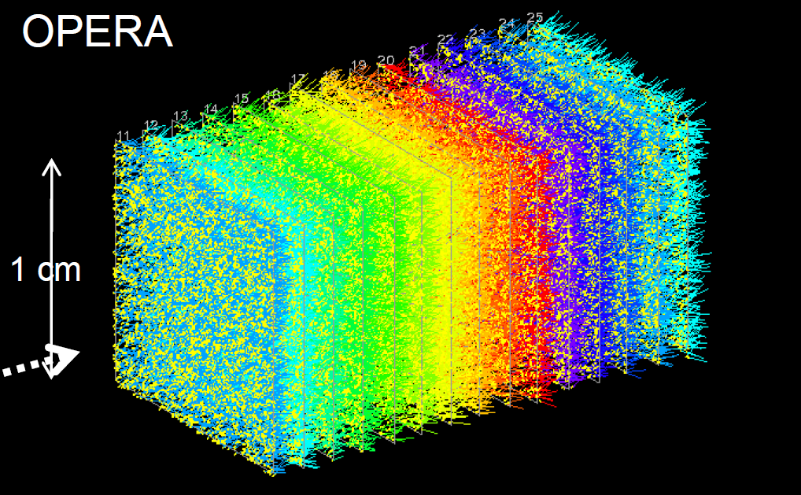
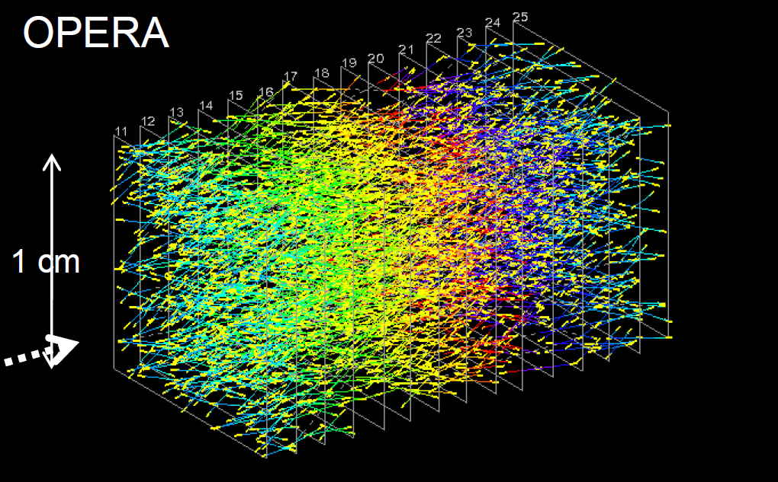
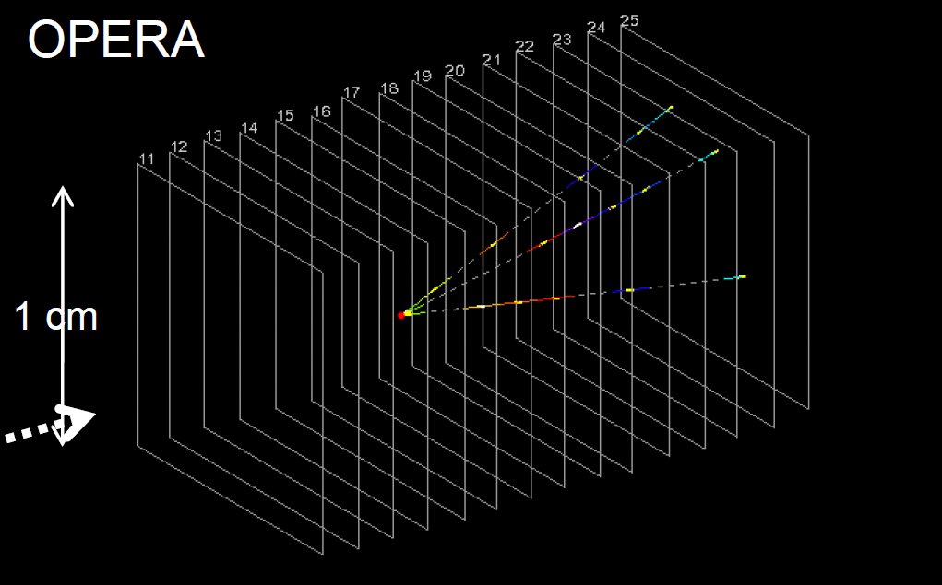
„Volume Scan“ and Vertex Reconstruction
1.) scan ~ 10 films around vertex
2.) reject passing through and short tracks
3.) search tracks pointing to an interaction vertex
Vertex Location Efficiency: 74% CC
48% NC

Slide 15
Status of Data Analysis
Interactions in:
60% external rock
20% spectrometer
arxiv:1308.2553 Opera Coll., „New results on v_{μ}→ v_{τ} appearance with the OPERA experiment in the CNGS beam“.
19505 recorded v interactions in the OPERA target (83% are reconstructed in target)
# of Events with Decay Search

Slide 16
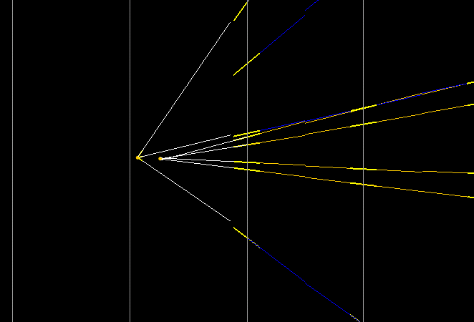
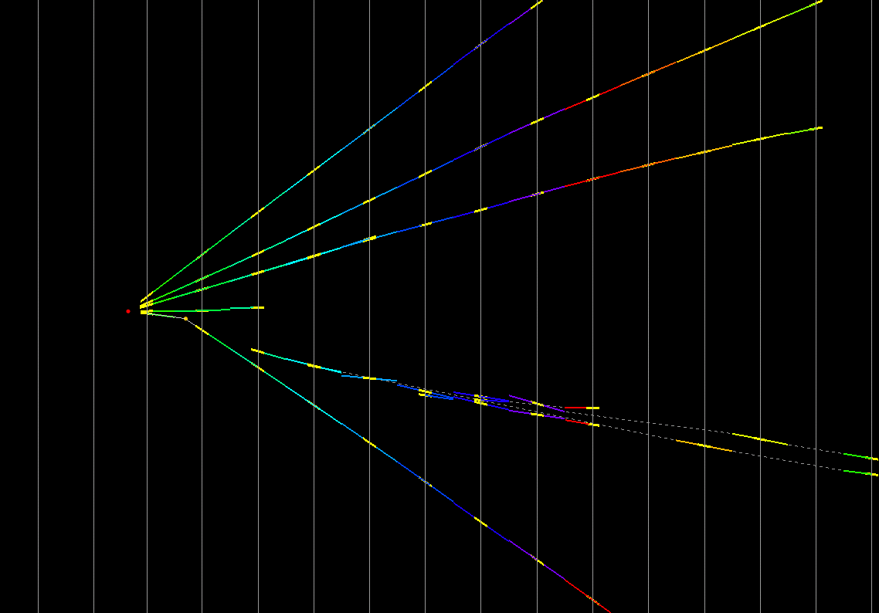
Production of Charmed Hadrons
Charm topology similar to τ (mass, decay modes & lifetime)
Background for v_{τ} search
Control sample for decay search and efficiencies
Background in the charm selection from hadronic interactions (87%) and K⁰_{S} , Λ
2 Examples of charm events found in the data:
D₀ (4 prong)
1ry muon
kink
flight length: 1330 μm
daughter muon
Notes:
D₀ hypothesis: F.L.= 313.1μm, φ = 173.2⁰, invariant mass = 1.7 GeV

Slide 17
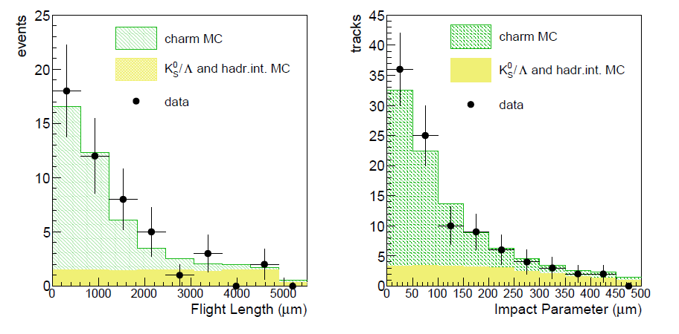
Production of Charmed Hadrons
Sample 2008-2010 (≥ 1 μ tagged 3D track): 50 charms events observed Expected: (40 ± 3) charm events and (14 ± 3) background
Good agreement!
→ systematic error of efficiency of full analysis chain < 20%

Slide 18
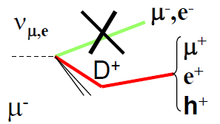
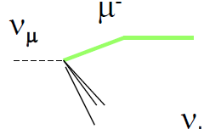
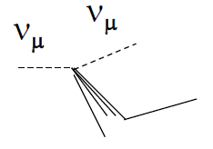
v_{μ}→ v_{τ} Oscillation Analysis
Background:
v_{μ} CC charm production (4% of CC) with misidentified μ
large angle coulomb scattering of μ
nuclear interactions of hadrons (0.2% of NC)
Kinematical Analysis:
Main variables to reduce background:
Flight length
Total p_{T} of τ daughters (wrt τ direction)
Missing p_{T} at 1ary vertex
Angle φ between τ and hadronic shower (plane transverse to beam)

Slide 19
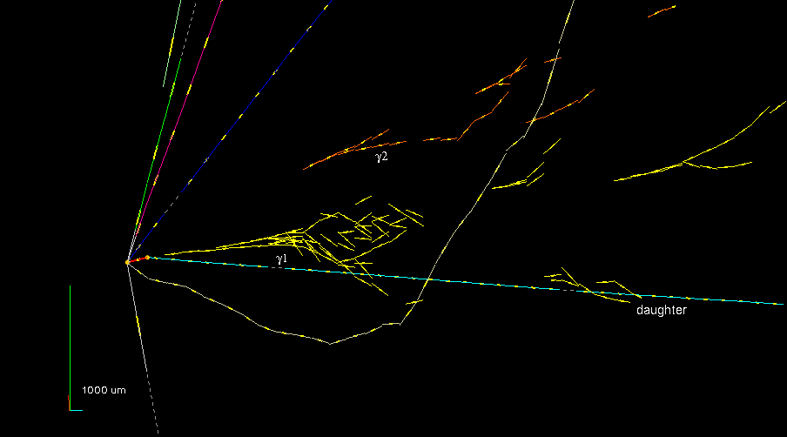
First v_{τ} Candidate (22/08/2009): event 9234119599
Opera Coll., “Observation of a first ντ candidate event in the OPERA experiment in the CNGS beam”,
Phys. Lett. B 691 (2010) 138-145
m(γγ) = 120 ± 20 ± 35 MeV
m(π⁻ γγ) = 640 ⁺¹²⁸₋₈₀⁺¹⁰⁰₋₉₀ MeV
BR(τ→ρ v_{τ}) ≈ 25%

Slide 20
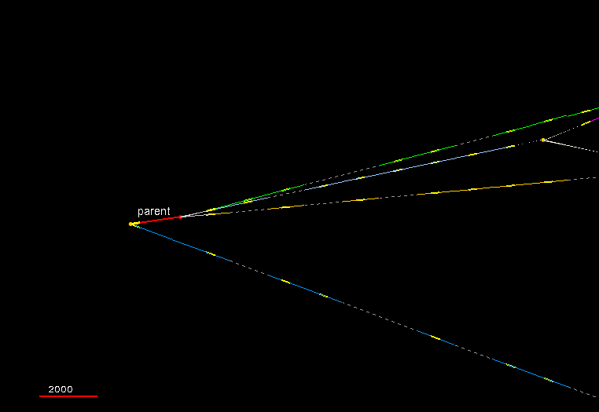
2nd v_{τ} Candidate (23/04/2011): event 11113019758
Opera Coll., “New results on v_{μ}→ v_{τ} appearance with the OPERA experiment in the CNGS beam”,
arXiv:1308.2553 submitted to JHEP

Slide 21
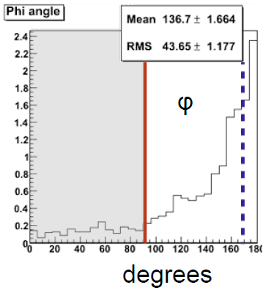
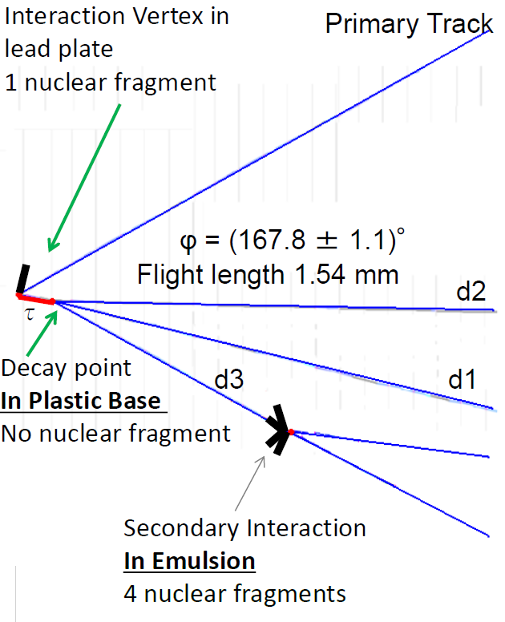
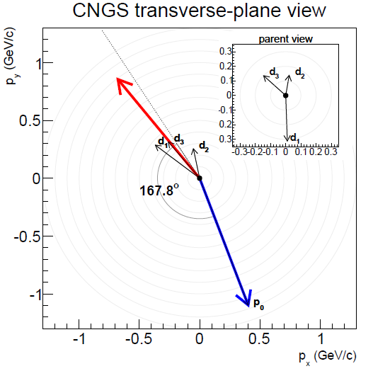
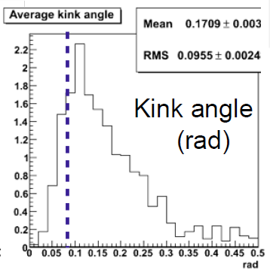
2nd v_{τ} Candidate (23/04/2011): event 11113019758

Slide 22
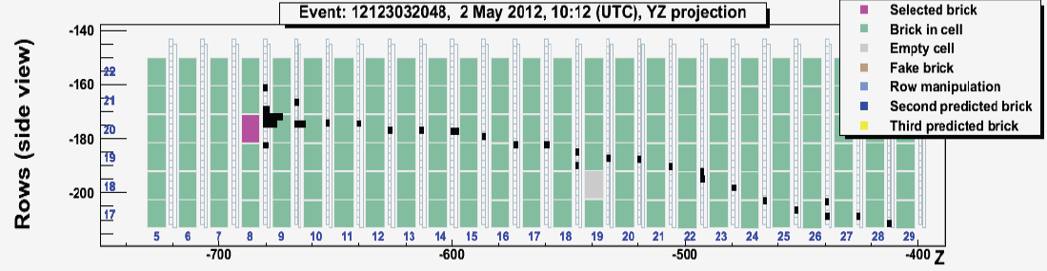
3rd v_{τ} Candidate (02/05/2012): event 12123032048
in cm
µ track
Measurement of µ momentum:
by range: 2.8 ± 0.2 GeV/c
by multiple Coulomb scattering in brick: 3.1 [2.6,4.0] GeV/c
Scanning and analysis of this brick …

Slide 23
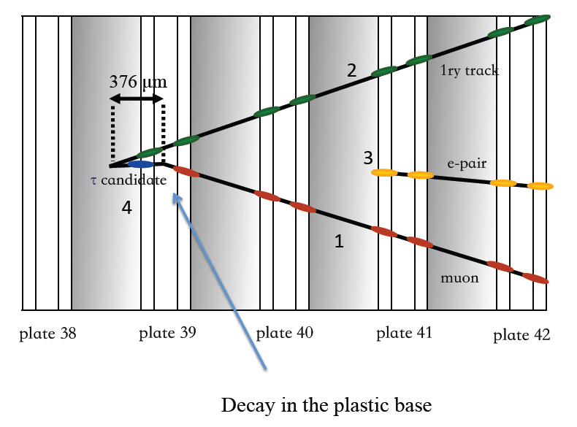
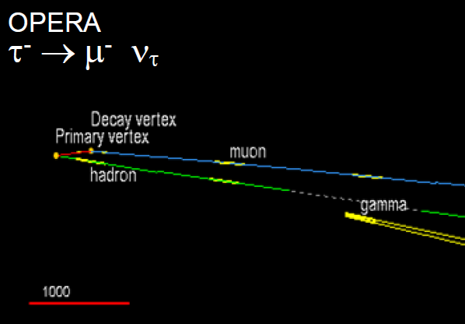
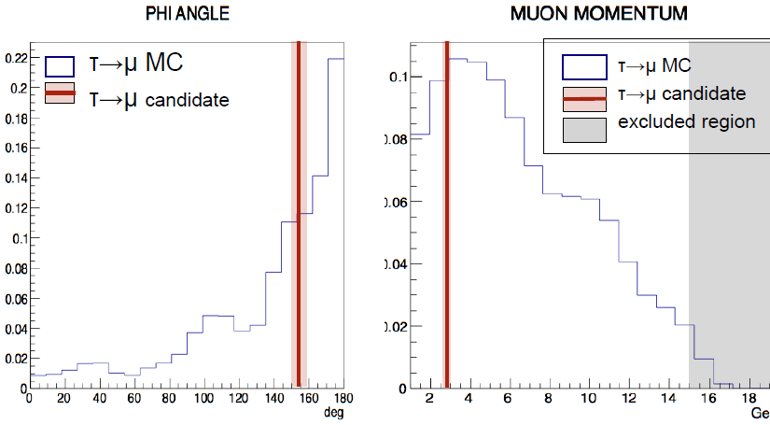
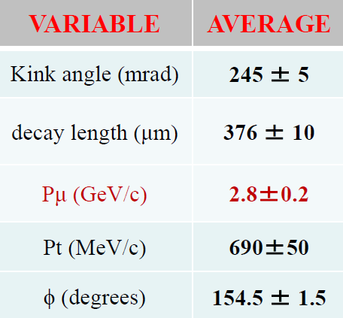
3rd v_{τ} Candidate
Publication in preparation
deg
GeV/c

Slide 24
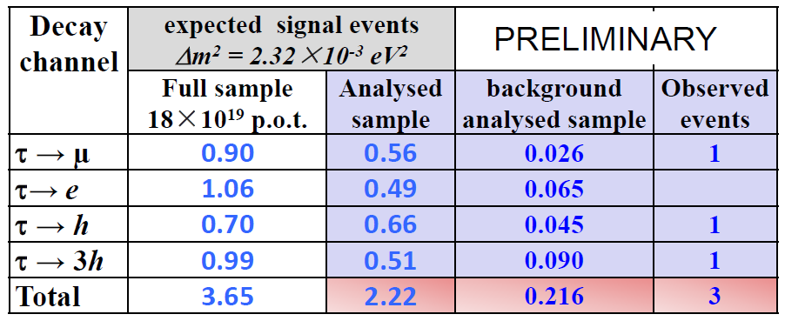
v_{μ}→ v_{τ} Oscillation Analysis: Result
Probability to be explained by background fluctuations: p = 7.3∙10⁻⁴
No oscillation hypothesis excluded at 3.2σ
Preliminary!

Slide 25
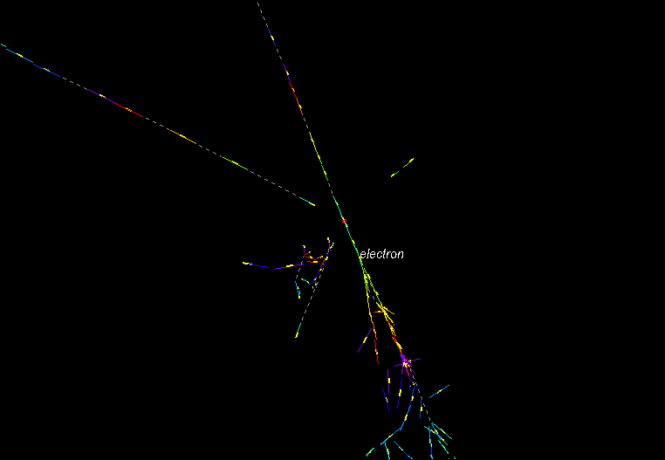
Search for ν_{μ}→ν_{e} Oscillations
Example of a v_{e} candidate event

Slide 26
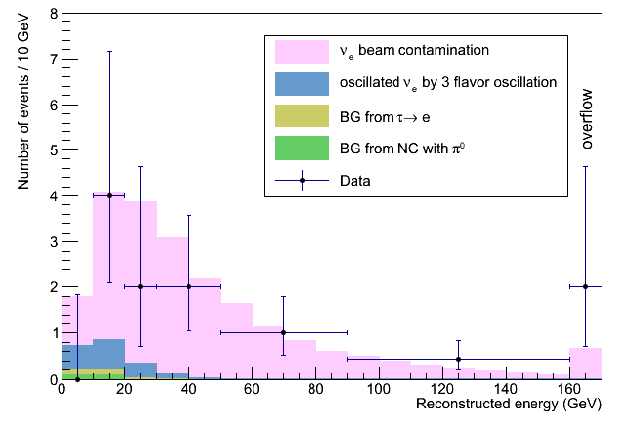
Search for ν_{μ}→ν_{e} Oscillations: Results
Opera Coll., „Search for ν_{μ} → ν_{e} oscillations with the OPERA experiment in the CNGS beam”, JHEP07 (2013) 004, arXiv1303.3953
2008+2009 Sample (5.25×10¹⁹p.o.t.): 19 v_{e} events observed
Expected v_{e} events:
v_{e} beam contamination: 19.3 ± 2.8
background from τ → ev_{τ} and misidentified π⁰: 0.5 ± 0.2
Total expected: 19.8 ± 2.8
E < 20 GeV to increase Signal/Background: 4 events observed , 4.6 expected
sin²(2θ₁₃) < 0.44 (90% C.L.)

Slide 27
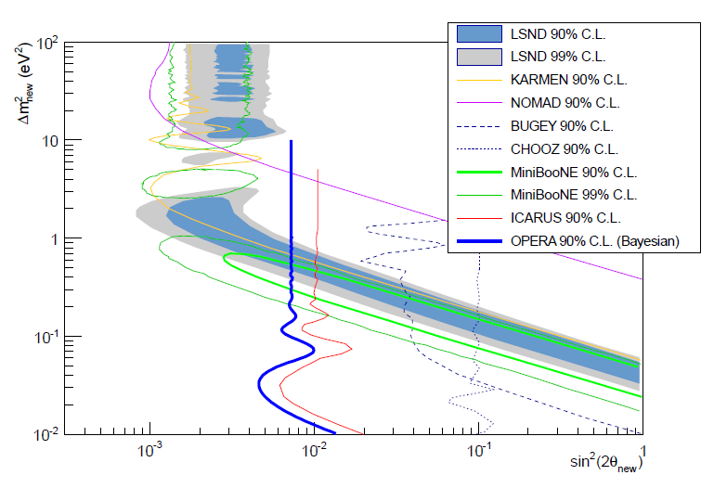
Analysis for ν_{μ}→ν_{e} non-standard oscillations
JHEP07 (2013) 004
Upper limit on non standard v oscillations sin²(2θ_{new}) < 7.2×10⁻³ (90% CL)

Slide 28
OPERA Summary
OPERA data taking from 2008-2012: CNGS delivered ≈18×10¹⁹ p.o.t. (80% of nominal)
Scanning („2nd data taking“) and analysis ongoing (≈ 64% completed).
v_{μ}→ v_{τ} analysis: 3 candidates found (expected: 2.2 signal + 0.22 background) 3.2σ significance with simple counting approach
v_{μ}→ v_{e} analysis: 19 v_{e} events observed (19.8 expected) non standard oscillation limit: sin²(2θ_{new}) < 7.2×10⁻³ (90% CL)
More statistics expected, some interesting events are under investigation…

