Slide 1
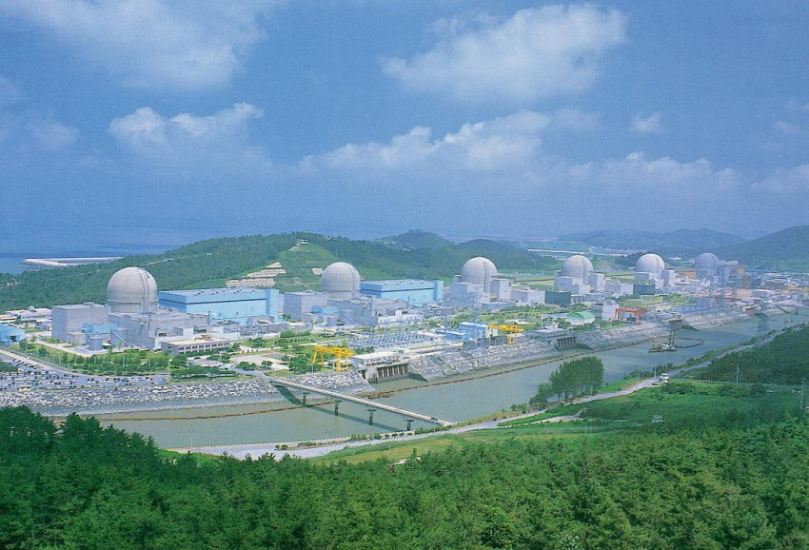

Results for the Neutrino Mixing Angle θ₁₃ from RENO
International School of Nuclear Physics, 35th Course
Neutrino Physics: Present and Future, Erice/Sicily, Sep. 16-24, 2013
Soo-Bong Kim
Seoul National University

Slide 2
Summary of RENO’s History & Status
RENO began design, tunnel excavation, and detector construction in March 2006, and was the first reactor neutrino experiment to search for θ₁₃ with both near & far detectors running, from Aug. 2011.
1st result : 220 days (April, 2012), PRL 108
( 4.9σ )
2nd result : 403 days (March, 2013), NuTel 2013
( 5.6σ )
[ ~ twice more data + improvements in energy calibration & background estimation and reduction]
Updated result : 403 days, systematic error 0.015 → 0.012
( 6.4σ )
[ Better understanding of Li/He background estimation ]

Slide 3
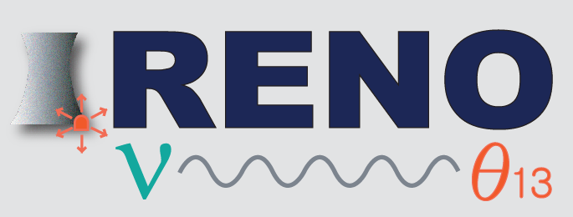
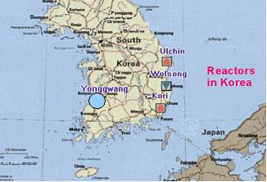
RENO Collaboration
(12 institutions and 40 physicists)
Chonbuk National University
Chonnam National University
Chung-Ang University
Dongshin University
Gyeongsang National University
Kyungpook National University
Pusan National University
Sejong University
Seokyeong University
Seoul National University
Seoyeong University
Sungkyunkwan University
Total cost : $10M
Start of project : 2006
The first experiment running with both near & far detectors from Aug. 2011
YongGwang (靈光) :

Slide 4
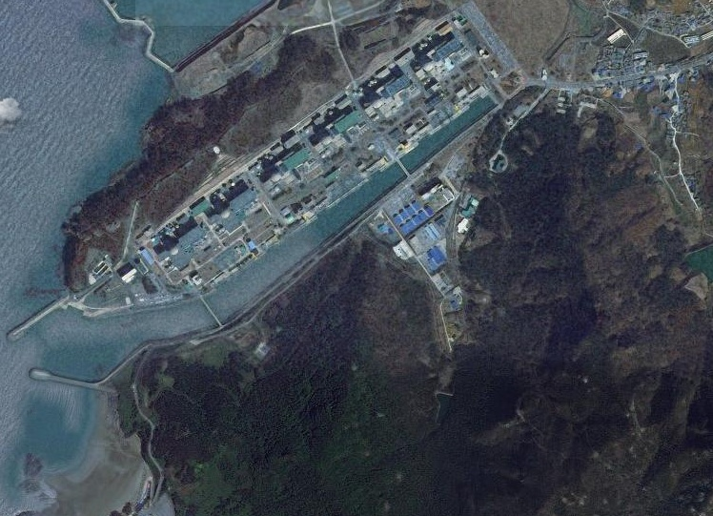

RENO Experimental Setup
110 m.w.e.
Near Detector
16.7 GW_{th}
290m
1380m
Far Detector
450 m.w.e.

Slide 5
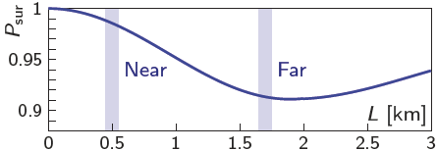
θ₁₃ Reactor Neutrino Experiments
Experiments | Location | Thermal Power (GW) | Flux Weighted Baselines Near/Far (m) | Depth Near/Far (mwe) | Target Mass (tons) | Statistics per year (GW∙ton∙yr)
Double Chooz | France | 8.5 | [410/1050] | 120/300 | 8.6/8.6 | 73
RENO | Korea | 16.7 | 409/1444 | 120/450 | 16/16 | 267
Daya Bay | China | 17.4 | 470(576)/1648 | 250/860 | 40×2/80 | 1392
Daya Bay
Far
Near
Double Chooz
Double
Chooz
Apr.
2011
Spring
2014
RENO
Aug. 2011
Aug. 2011
Daya Bay
Dec. 2011
Sep. 2011
RENO

Slide 6
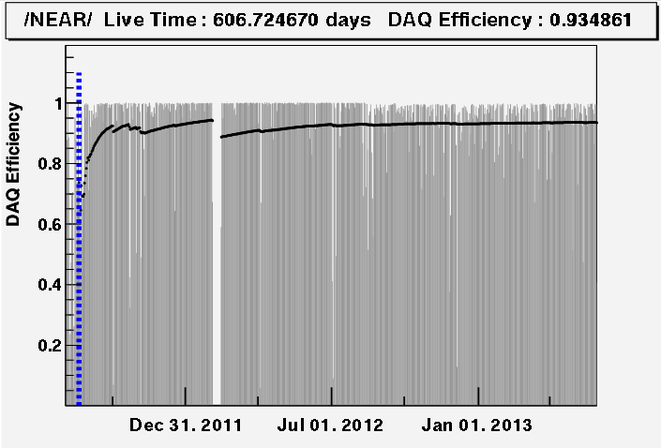
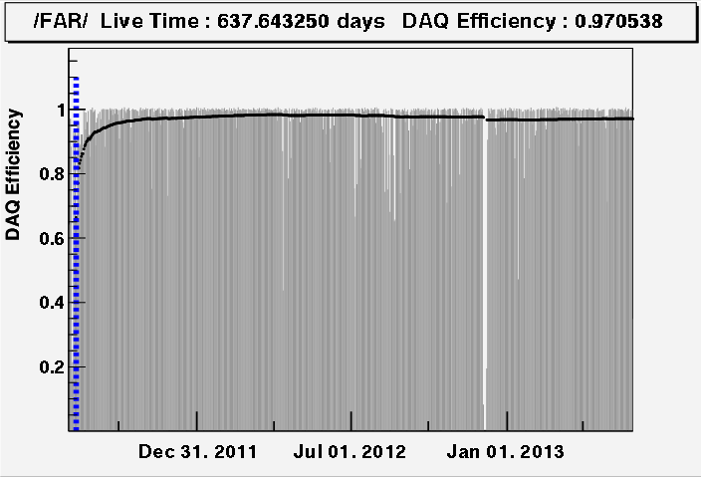
Data-Taking & Analysis Status
Data taking began on Aug. 1, 2011 with both near and far detectors.
(DAQ efficiency : ~95%)
Near
A (220 days) : First θ₁₃ result
[11 Aug, 2011~26 Mar, 2012]
PRL 108, 191802 (2012)
A
B (403 days) : Improved θ₁₃ result
[11 Aug, 2011~13 Oct, 2012]
NuTel 2013
Far
C (~700 days) : Shape+rate analysis
(in progress)
[11 Aug, 2011~31 Aug, 2013]
B
Absolute reactor neutrino flux measurement in progress
[reactor anomaly & sterile neutrinos]
C

Slide 7
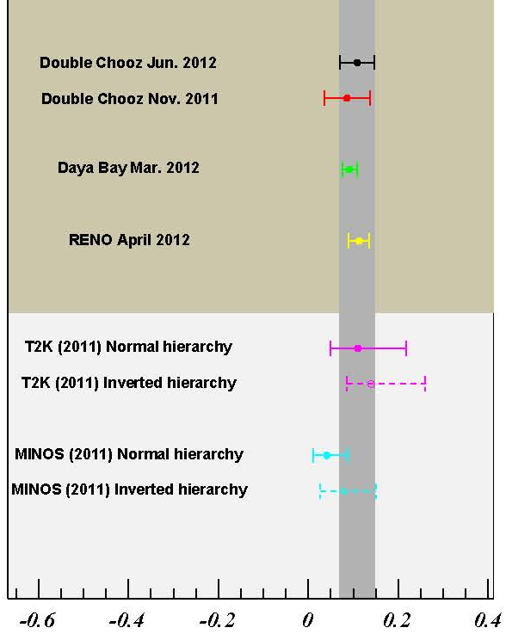
A Brief History of θ₁₃ from Reactor Experiments
Nov. 2011 (Double Chooz )
sin²(2θ₁₃) = 0.086±0.051
March 2012 (Daya Bay)
sin²(2θ₁₃) = 0.092±0.017
(5.2 σ)
April 2012 (RENO)
Daya Bay Oct. 2012
sin²(2θ₁₃) = 0.113±0.023
(4.9 σ)
RENO Mar. 2013
June 2012 (Double Chooz)
sin²(2θ₁₃) = 0.109±0.039
Oct. 2012 (Daya Bay)
sin²(2θ₁₃) = 0.089±0.011
March 2013 (RENO)
Sep. 2013 (RENO)
sin²(2θ₁₃) = 0.100±0.018
sin²(2θ₁₃) = 0.100±0.016
August 2013 (Daya Bay)
Double-CHOOZ, arXiv:1207.6632, (2012)
sin²(2θ₁₃) = 0.090±0.009
Δm²₃₁ = (2.54±0.20)×10⁻³ eV²

Slide 8
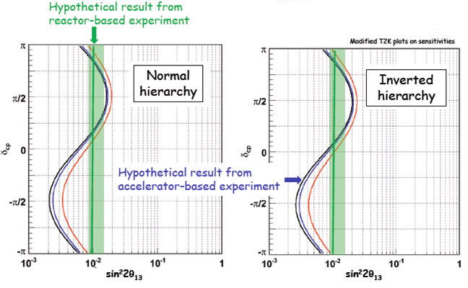
θ₁₃ from Reactor and Accelerator Experiments
* Reactor
- Clean measurement of θ₁₃ with no matter effects
* Accelerator
- mass hierarchy + CP violation + matter effects
Precise measurement of θ₁₃
(10% → 5%)
Complementary :
Combining results from accelerator and reactor based experiments could offer the first glimpse of δ_{CP.}

Slide 9
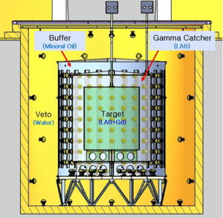
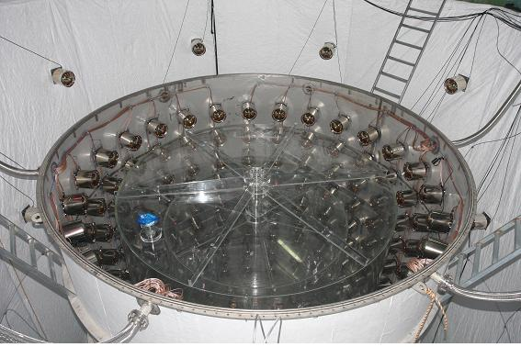
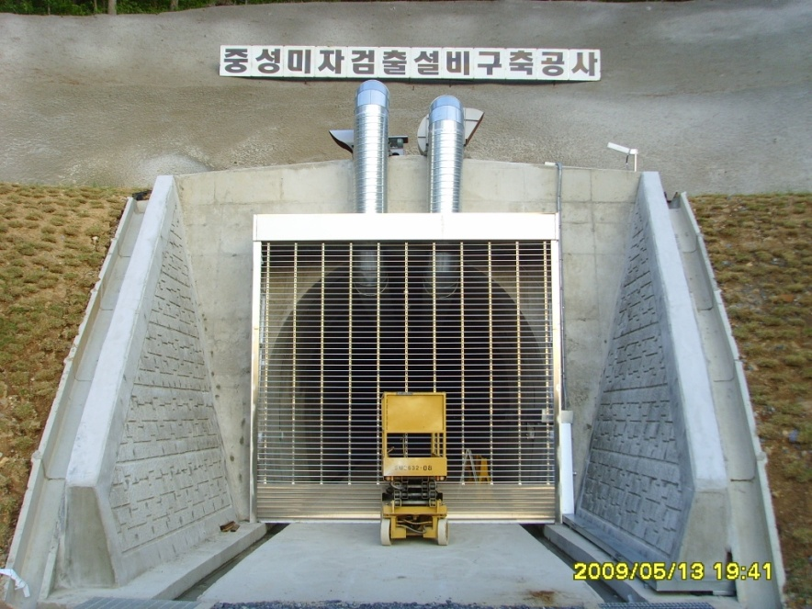
RENO Detector
354 ID +67 OD 10” PMTs
Target : 16.5 ton Gd-LS, R=1.4m, H=3.2m
Gamma Catcher : 30 ton LS, R=2.0m, H=4.4m
Buffer : 65 ton mineral oil, R=2.7m, H=5.8m
Veto : 350 ton water, R=4.2m, H=8.8m

Slide 10
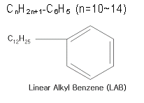

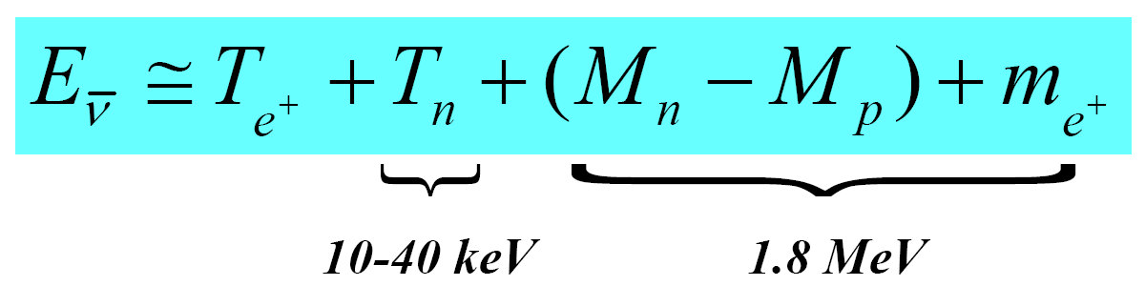
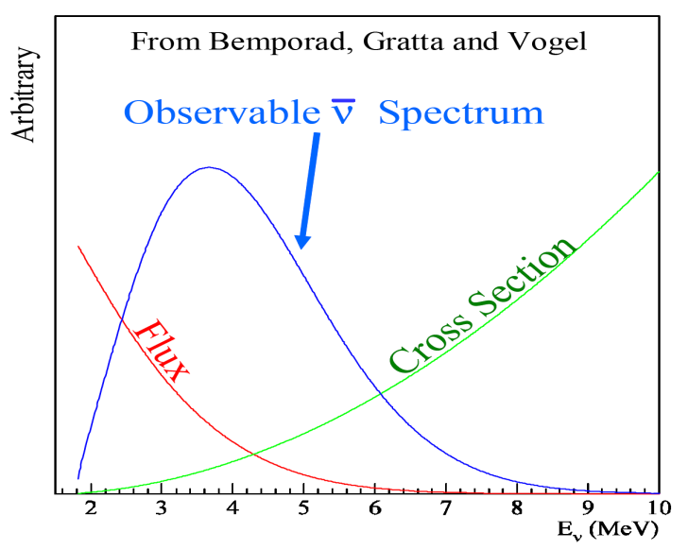
Detection of Reactor Antineutrinos
(prompt signal)
~180 μs
(delayed signal)
+ p → D + γ (2.2 MeV)
~28 μs
(0.1% Gd)
+ Gd → Gd + γ‘s (8 MeV)
Neutrino energy measurement

Slide 11
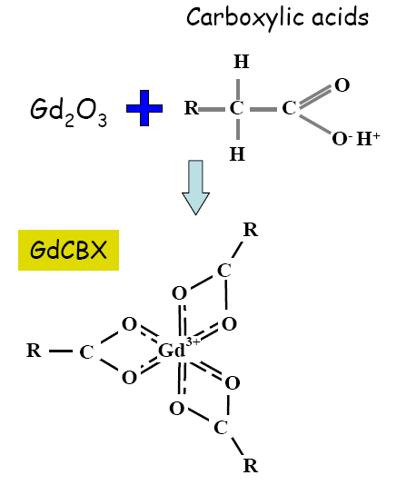
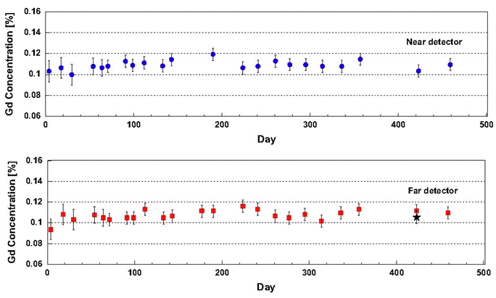
Gd Loaded Liquid Scintillator
Recipe of Liquid Scintillator
Solvent & Flour | WLS | Gd-compound
LAB | PPO + Bis-MSB | 0.1% Gd + (TMHA)³
Steady properties of Gd-LS
Stable light yield (~250 pe/MeV) , transparency & Gd concentration (0.11%)
NIM A, 707, 45-53 (2013. 4. 11)

Slide 12
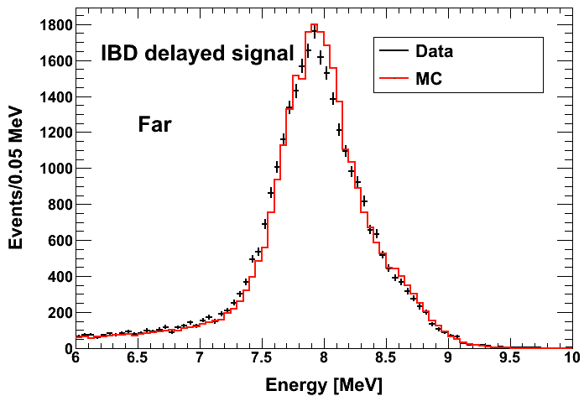
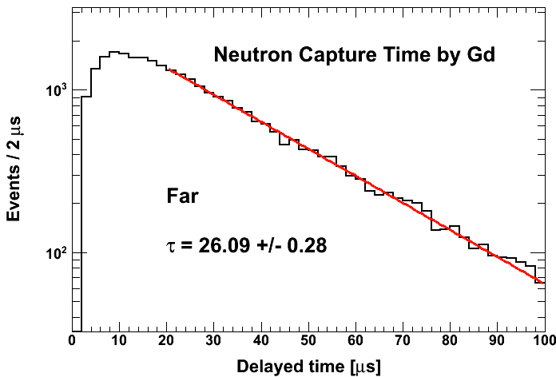
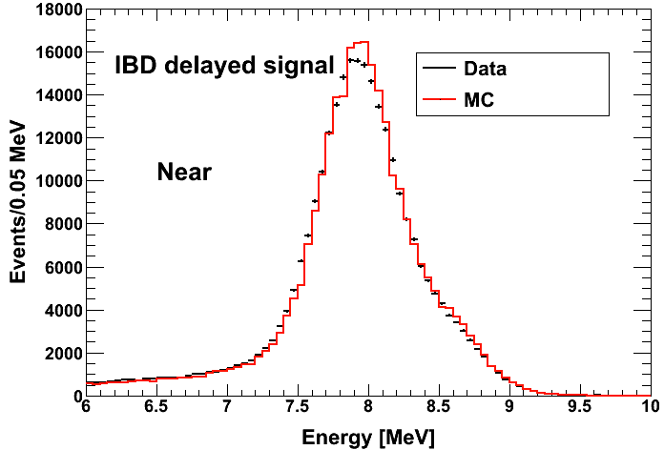
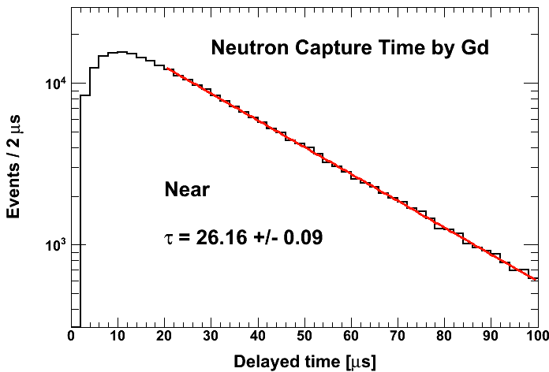
Neutron Capture by Gd

Slide 13
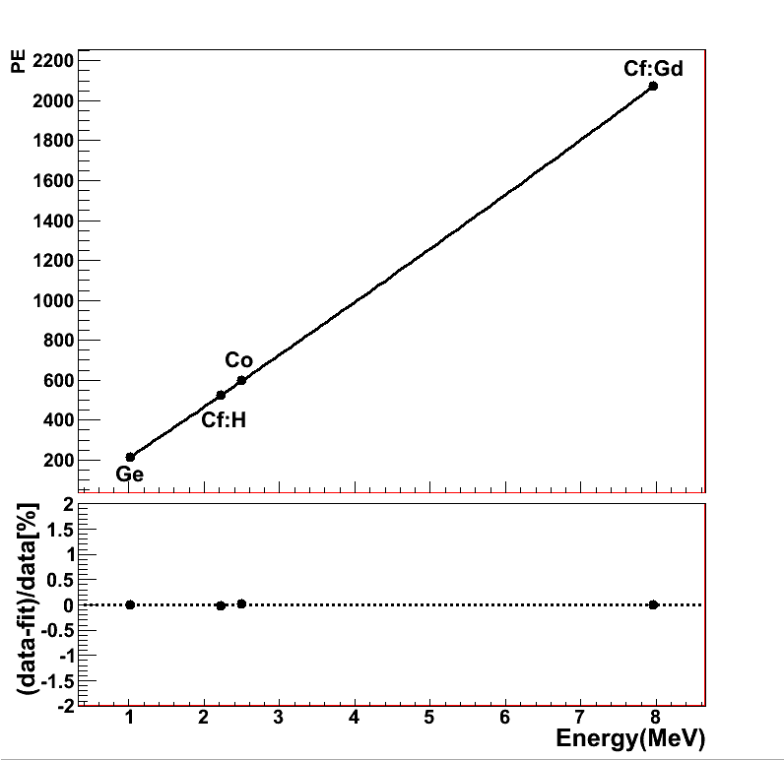
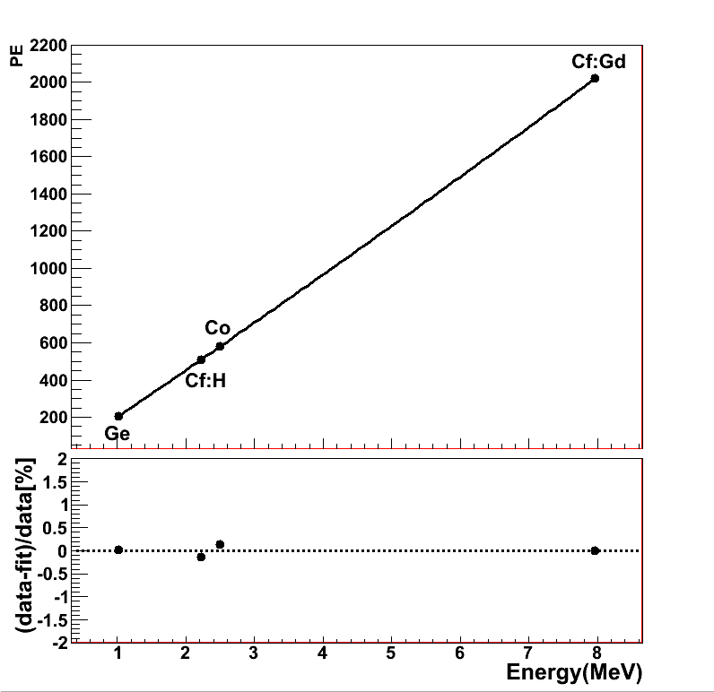
Energy Calibration
Far Detector
Near Detector

Slide 14
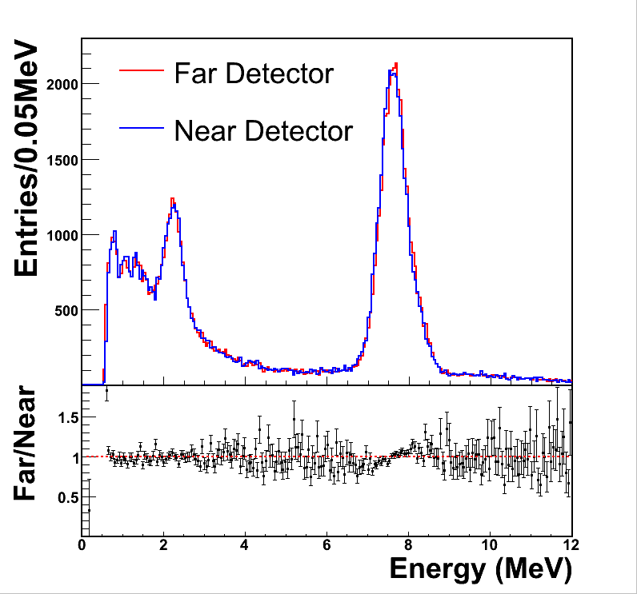
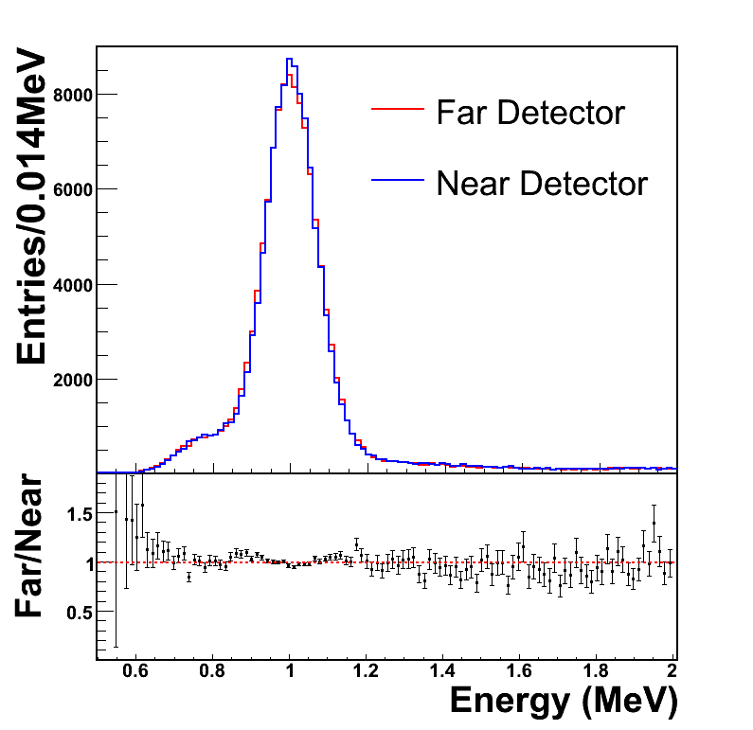
Energy Calibration
Ge 68
Cf 252
(1,022 keV)
(2.2/8.0 MeV)
Cf 252
(2.2/7.8 MeV)

Slide 15
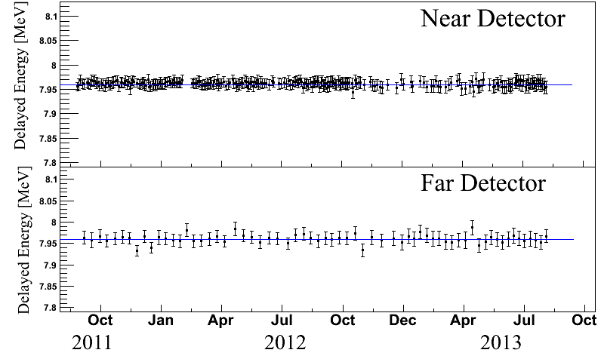
Detector Stability of Energy Scale
IBD candidate’s delayed signals (neutron capture by Gd)
preliminary

Slide 16
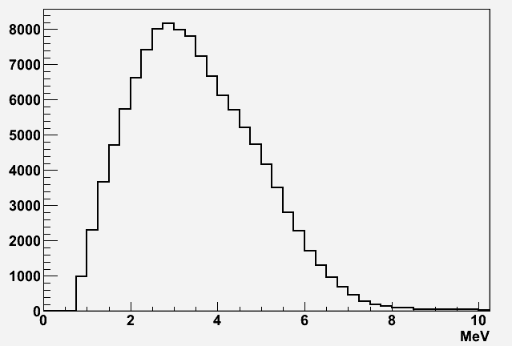
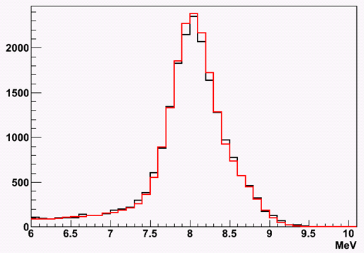
IBD Event Signature
Prompt signal (e⁺) : 1 MeV 2γ’s + e⁺ kinetic energy (E = 1~10 MeV)
Delayed signal (n) : 8 MeV γ’s from neutron’s capture by Gd
~26 μs (0.1% Gd) in LS
→
Prompt Signal
Delayed Signal

Slide 17
Backgrounds
Accidental coincidence between prompt and delayed signals
Fast neutrons produced by muons, from surrounding rocks and inside detector (n scattering : prompt, n capture : delayed)
⁹Li/⁸He β-n followers produced by cosmic muon spallation
Accidentals
Fast neutrons
⁹Li/⁸He β-n followers
μ
μ
μ
γ
p
n
n
⁹Li
e
Gd
Gd
n
Gd

Slide 18
Improved Background Estimation
Better estimation of Li/He background :
(far)
(near)

Slide 19
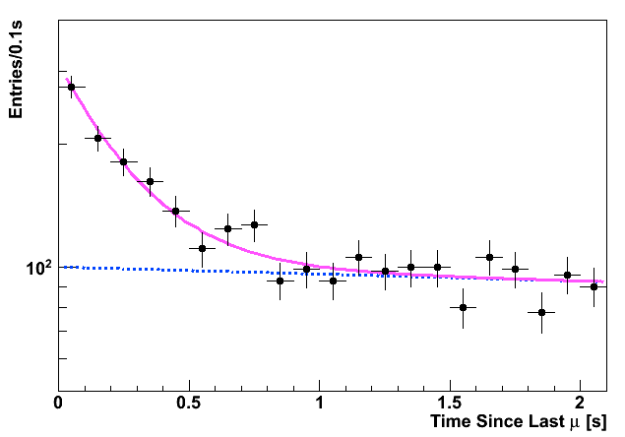
⁹Li/⁸He Background
⁹Li/⁸He are unstable isotopes emitting (β,n) followers and produced when a muon interacts with carbon in the LS.
⁹Li/⁸He
IBD

Slide 20
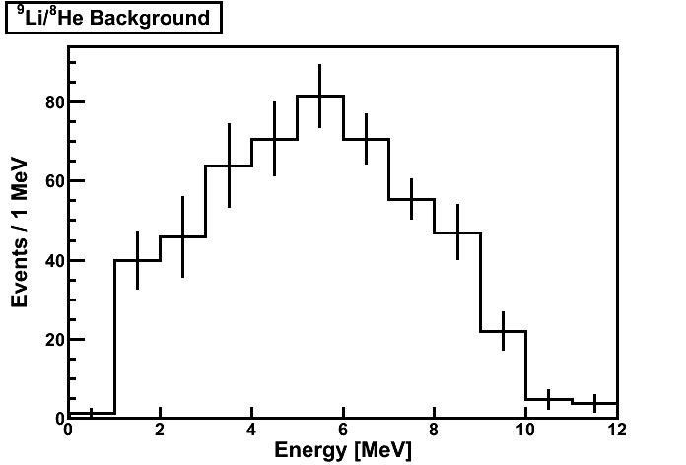
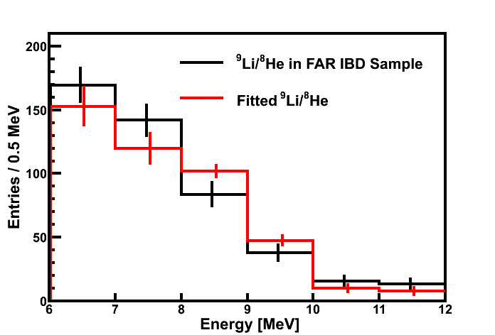
⁹Li/⁸He Background Estimation
Scaling method;
N_{LH} = α * n_{LH}
Fitted shape (from BG only sample) matches well
with the Li/He shape contained in IBD sample.
Error improvement:
1) 8 MeV → 6.5 MeV
(δα improved)
2) Increased statistics
of Li/He BG spectrum
(δn_{LH} improved)
⁹Li/⁸He

Slide 21
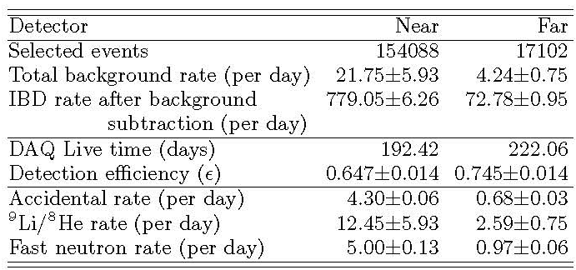
Summary of Final Data Sample
(Prompt energy < 10 MeV)
279787
30211
21.17± 1.81
4.80± 0.46
737.00± 2.31
70.22± 0.64
369.03
402.69
62.0± 0.014
71.4± 0.014
3.61± 0.05
0.60± 0.03
13.97± 1.54
3.55± 0.45
3.59± 0.95
0.65± 0.10

Slide 22
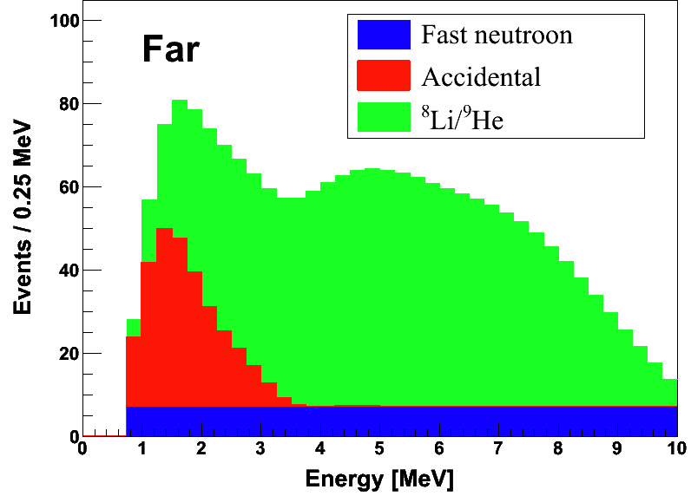
Background Spectra
Background shapes and rates are well understood
Total backgrounds : 6.4% at Far
2.8% at Near

Slide 23
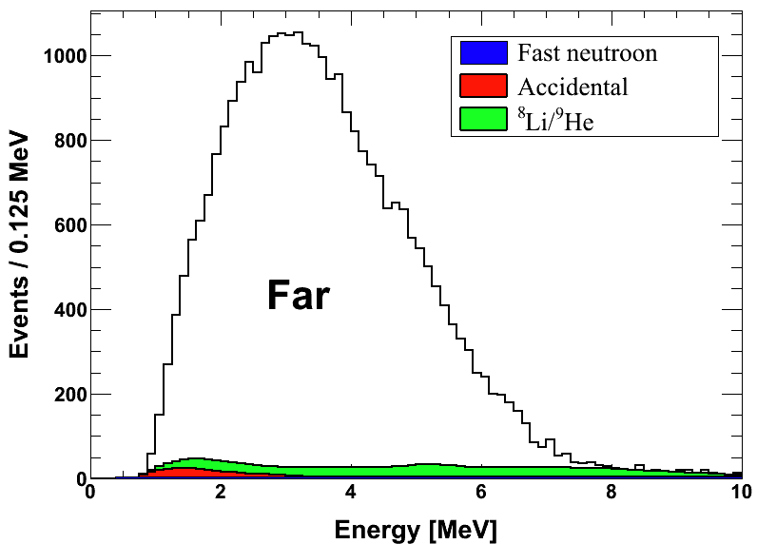
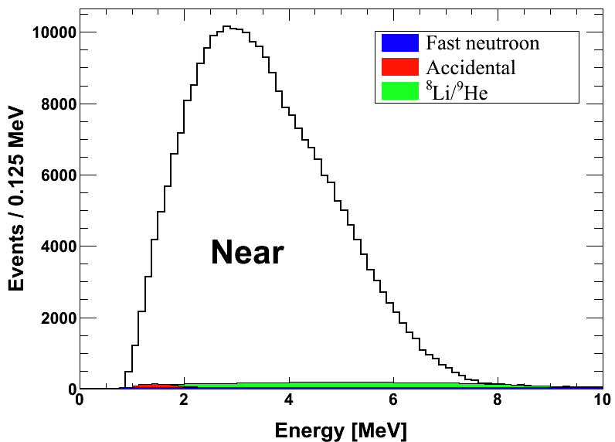
Measured Spectra of IBD Prompt Signal
Live time : 402.7 days
No. of IBD : 30,211
No. of bkg. : 1,929 (6.4%)
Live time : 369.0 days
No. of IBD : 279,787
No. of bkg. : 7,864 (2.8%)

Slide 24
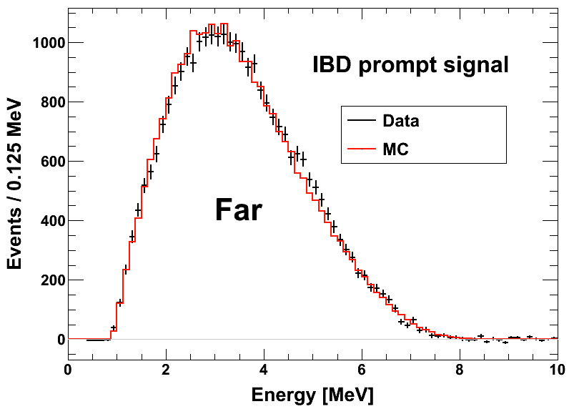
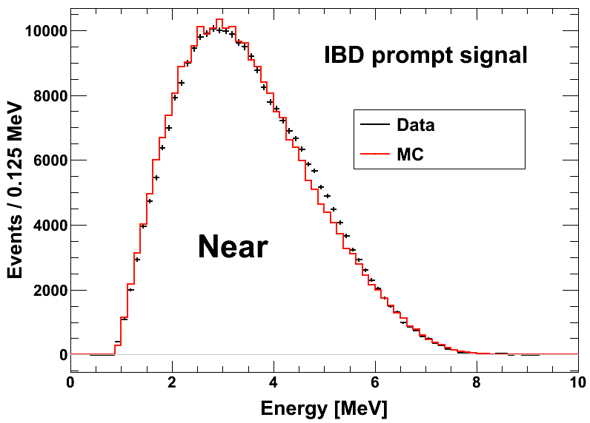
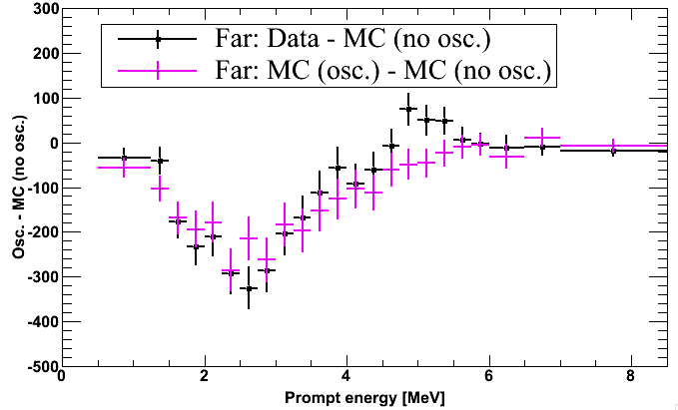
IBD Prompt Signal (Data vs. MC)
??

Slide 25
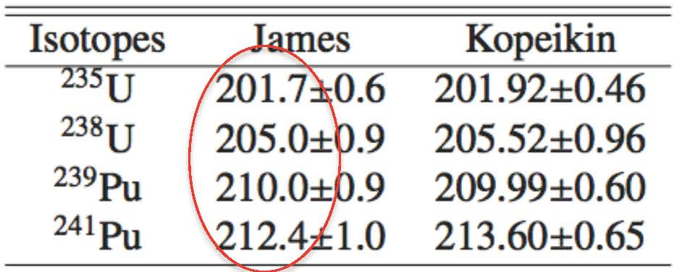
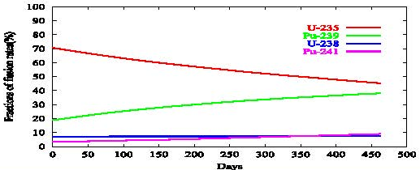
Expected Reactor Antineutrino Fluxes
Reactor neutrino flux
- P_{th} : Reactor thermal power provided by the YG nuclear power plant
- f_{i} : Fission fraction of each isotope determined by reactor core simulation of Westinghouse ANC
- φ_{i}(E_{ν}) : Neutrino spectrum of each fission isotope
[* P. Huber, Phys. Rev. C84, 024617 (2011)
T. Mueller et al., Phys. Rev. C83, 054615 (2011)]
- E_{i} : Energy released per fission
[* V. Kopeikin et al., Phys. Atom. Nucl. 67, 1982 (2004)]

Slide 26
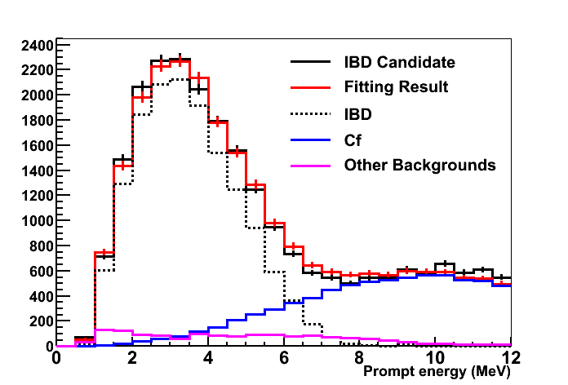
IBD Analysis of ²⁵²Cf contaminated data
IBD (/day) : 54.5094 +- 0.489393
Cf (/day): 26.2655 +- 0.361229
13th Oct. 2012 ~ 25th July. 2013

Slide 27
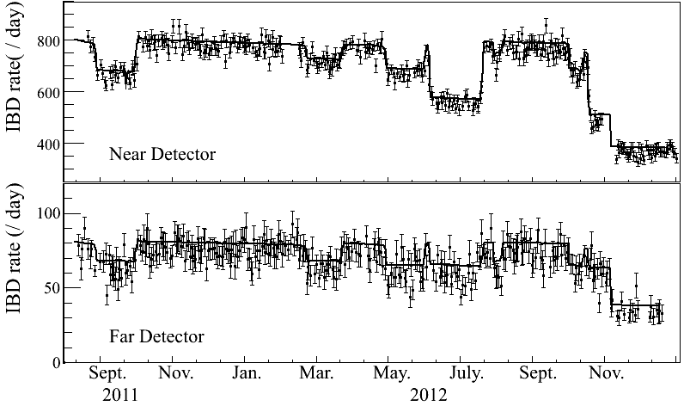
Observed Daily Averaged IBD Rate
A new way to measure the reactor thermal power remotely!!!
Cf contaminationunder control
(2013.10.13)
R2
R1
R5
R4
R6
R5
R3+R5+R6
R3

Slide 28
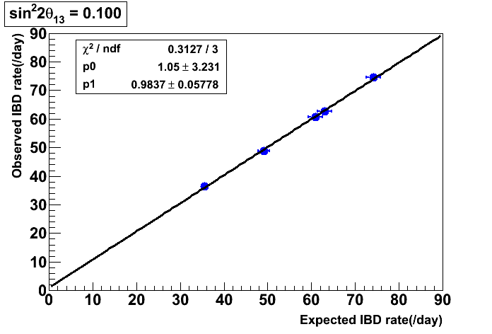
Observed vs. Expected IBD Rates
preliminary
A good agreement between observed and expected IBD rates
Correct background subtraction

Slide 29
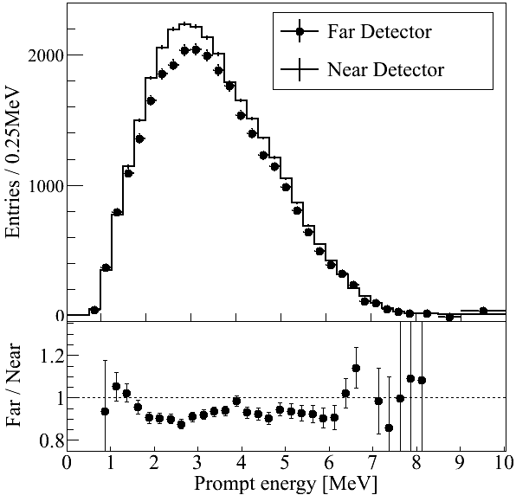
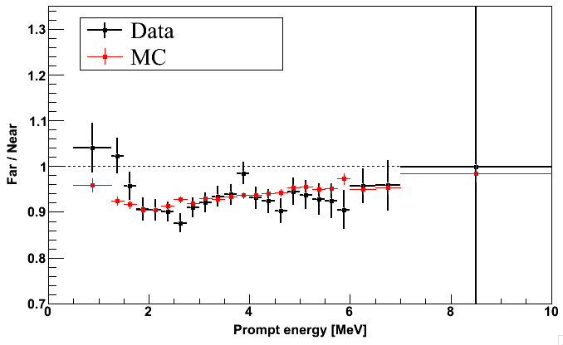
Reactor Antineutrino Disappearance
preliminary
A clear deficit in rate
( ~ 7 % reduction)
Consistent with neutrino oscillation in the spectral distortion
Reduced χ² = 1.21
Prompt energy [MeV]

Slide 30
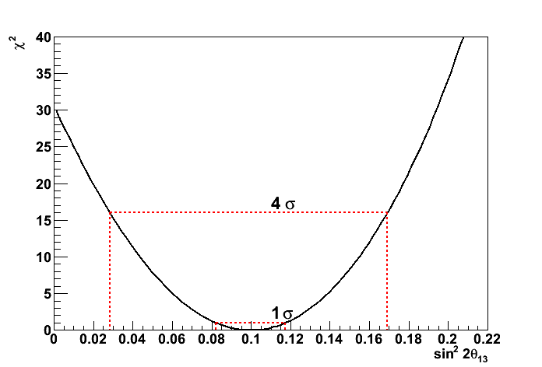
Definitive Measurement of θ₁₃
6.4 σ significant signal
preliminary

Slide 31
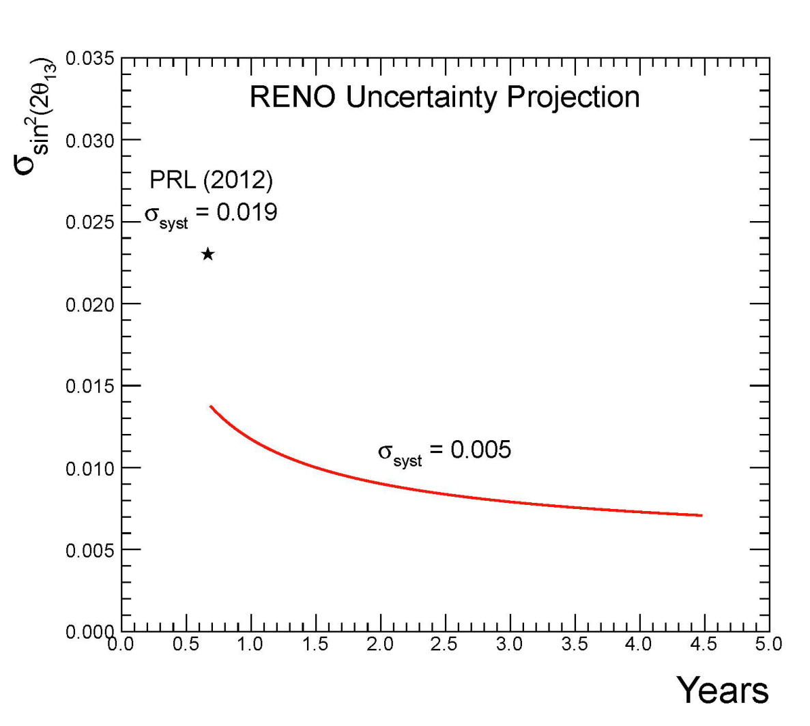
RENO’s Projected Sensitivity of θ₁₃
(402 days)
(6.4 σ)
(~ 13 σ)
(5 years)
(16 % precision)
(7 % precision)
2012. 4
5 years of data : ±0.007 (7% precision)
- statistical error : ±0.010 → ±0.005
- systematic error : ±0.012 → ±0.005
2013. 3
2013. 9
(7 % precision)

Slide 32
Expected Results from RENO
sin²(2θ₁₃) to 7% accuracy within 3 years :
→ determination of CP phase with accelerator results
Δm²₃₁ directly from reactor neutrinos :
← spectral disappearance of reactor antineutrinos
Precise measurement of reactor antineutrino flux & spectra :
→ study reactor anomaly or sterile neutrinos
Observation of reactor neutrinos based on neutron capture by Hydrogen

Slide 33
Summary
RENO has observed a clear disappearance of reactor neutrinos.
RENO has collected ~700 live days of reactor neutrino data, and improved analysis methods on energy calibration and background
estimation.
RENO has obtained a new result on the smallest mixing angle θ₁₃.
(There is a room to further reduce the systematic error…..)
(402 days)
RENO is expected to obtain new results from 700 live days of reactor neutrino data. Several analyses are under progress…..

Slide 34
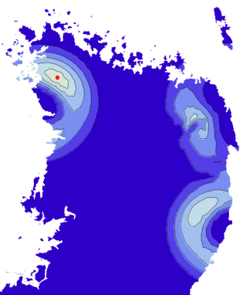
Near Detector
Far Detector
RENO-50
18 kton LS Detector ~47 km from YG reactors
Mt. Guemseong (450 m) ~900 m.w.e. overburden

