Slide 1




Dual quantum liquids and shell evolutions in exotic nuclei
INTERNATIONAL SCHOOL OF NUCLEAR PHYSICS
36th Course
Nuclei in the Laboratory and in the Cosmos
Erice, Sicily
September 21 (16-24), 2014
Takaharu Otsuka University of Tokyo / MSU
HPCI Strategic Programs for Innovative Research (SPIRE)
Field 5 “The origin of matter and the universe”

Slide 2
Outline
1. Introduction
2. (Type I) Shell Evolution
3. Computational aspect
4. Type II Shell Evolution and Dual Quantum Liquids
5. Summary

Slide 3
Difference between stable and exotic nuclei
stable nuclei
exotic nuclei
life time
infinite or long
short
number
~300
7000 ~ 10000
properties
constant inside
(density saturation)
low-density surface
(halo, skin)
density
same magic numbers
(2,8,20,28, … (1949))
shell
shell evolution
shape
?
shape phase transition (?)
shape coexistence

Slide 4
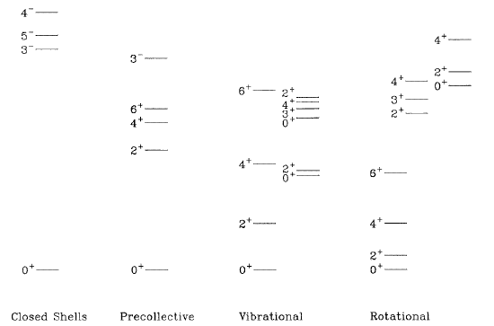
Schematic picture of shape evolution (sphere to ellipsoid)
- monotonic pattern throughout the nuclear chart –
excitation energy
Distance from the nearest closed shell in N or Z
From Nuclear Structure from a Simple Perspective, R.F. Casten (2001)

Slide 5
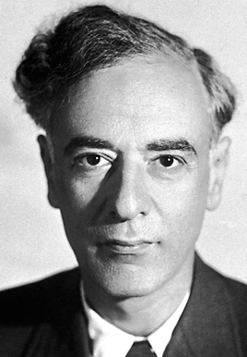
Quantum (Fermi) liquid
(of Landau)
interplay between single-particle energies and
interaction - in a way like free particles -
For shape evolution, there
may have been Ansatz that
ε₈
Spherical single
particle energies
remain basically
unchanged.
-> spherical part
of Nilsson model
Correlations,
particularly due to proton-neutron interaction, produce shape evolutions.
ε₈
ε₇
ε₆
ε₅
ε₇
ε₄
ε₆
ε₃
ε₅
ε₂
ε₄
ε₃
ε₂
ε₁
ε₁
neutron
Similar argument to
Shape coexistence
proton

Slide 6
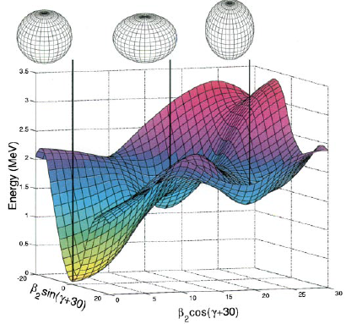

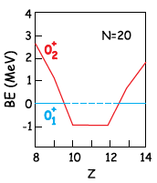
shape coexistence
¹⁶O
H. Morinaga
(1956)
Island of Inversion
(Z=10~12, N=20)
¹⁸⁶Pb
A.N. Andreyev et al.,
Nature 405, 430 (2000)

Slide 7
Outline
1. Introduction
2. (Type I) Shell Evolution
3. Computational aspect
4. Type II Shell Evolution and Dual Quantum Liquids
5. Summary

Slide 8
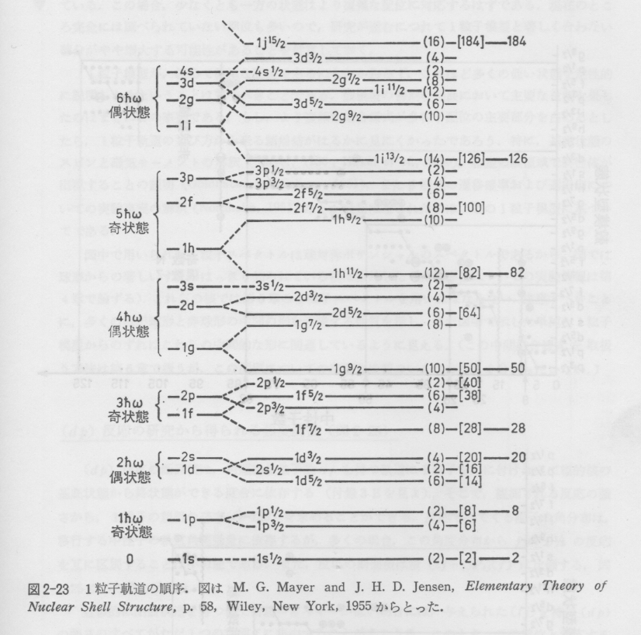
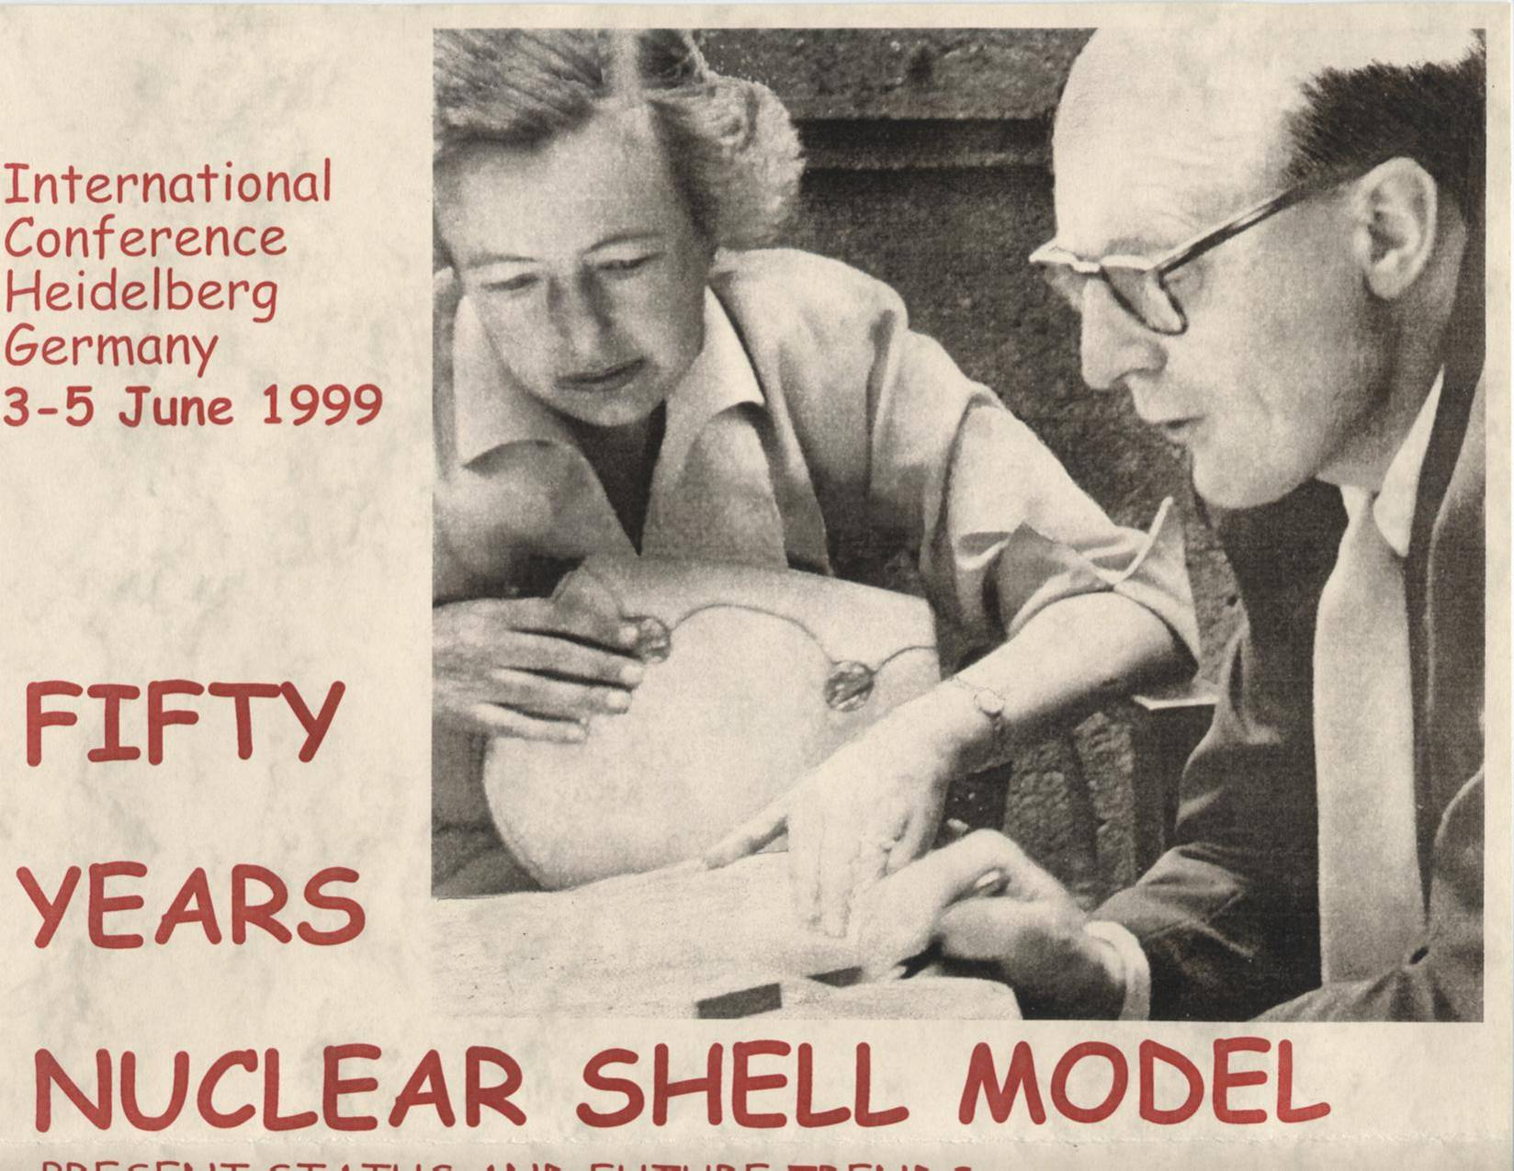
Eigenvalues of
HO potential
Magic numbers
Mayer and
Jensen (1949)
126
5hω
82
4hω
50
3hω
28
2hω
20
1hω
8
2
Spin-orbit splitting

Slide 9
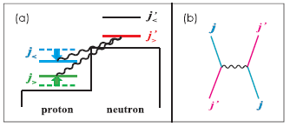
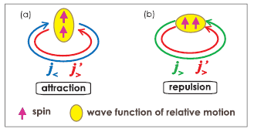
Type I Shell Evolution :
change of nuclear shell as a function of N or Z
due to nuclear forces
One of the primary origins :
change of spin-orbit splitting due to the tensor force
TO, Suzuki, et al.
PRL 95, 232502 (2005)

Slide 10
Example : N=34 and 32 (sub-) magic numbers
Normal
shell structure
for neutrons
in Ni isotopes
(proton f_{7/2}
fully occupied)
N=34 (and 32) magic number appears, if neutron f_{5/2} becomes
less bound in Ca.
f_{5/2}
34
p _{1/2}
p _{1/2}
f_{5/2}
32
byproduct
p _{3/2}
p _{3/2}
28
28
f_{7/2}
f_{7/2}
TO et al., PRL 87, 82501 (2001)

Slide 11
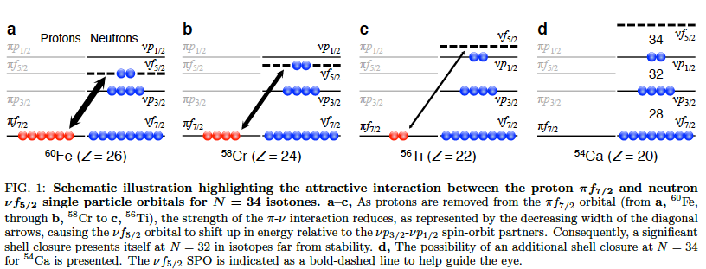
Shell evolution from Fe down to Ca
due to proton-neutron interaction
neutron f_{5/2} – p_{1/2} spacing increases by ~0.5 MeV per one-proton removal from f_{7/2}, where tensor and central forces works coherently and almost equally.
note : f_{5/2} = j < f_{7/2} = j >
Steppenbeck et al. Nature, 502, 207 (2013)

Slide 12
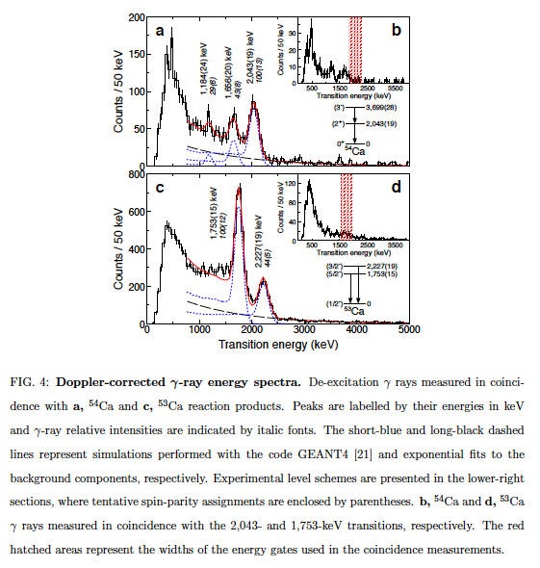
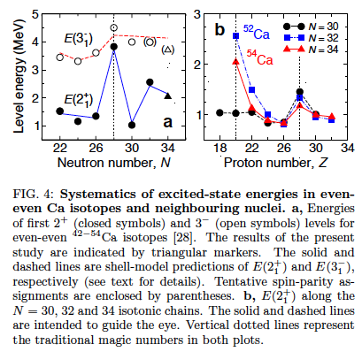
Experiment @ RIBF → Finally confirmed
new
RIBF
data
Steppenbeck et al. Nature, 502, 207 (2013)

Slide 13
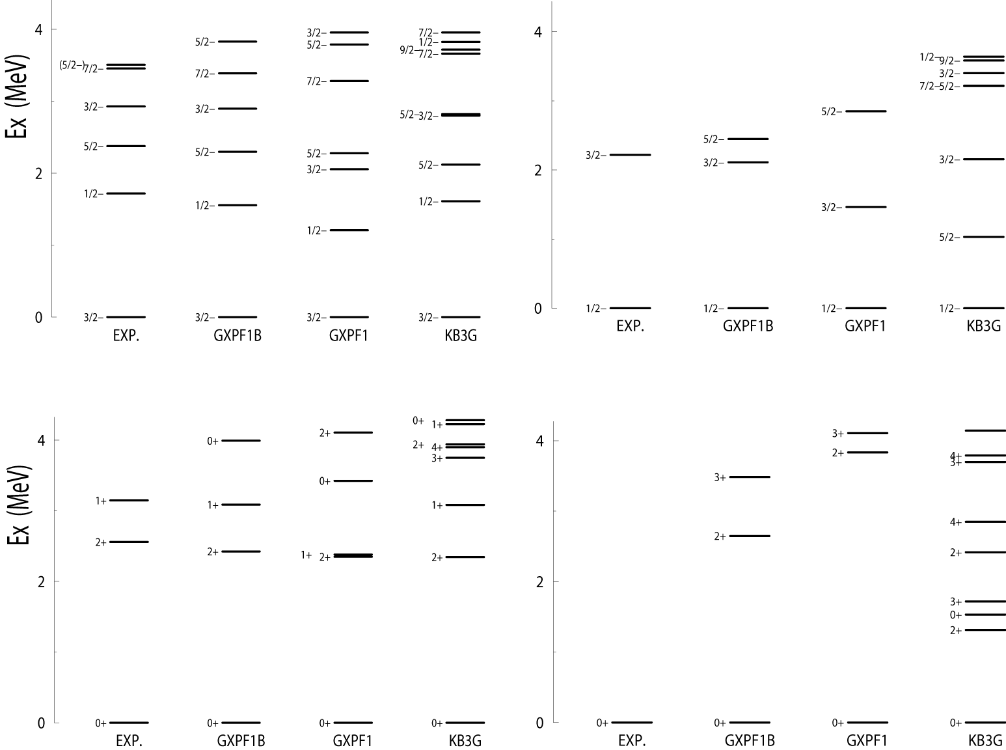
Exotic Ca Isotopes : N = 32 and 34 magic numbers ?
⁵¹Ca
⁵³Ca
GXPF1B int.:
p3/2-p1/2
part
refined
from
GXPF1 int.
(G-matrix
problem)
From my talk at Erice 2006
⁵²Ca
⁵⁴Ca
2⁺
2⁺
Some exp.
levels :
priv. com.

Slide 14
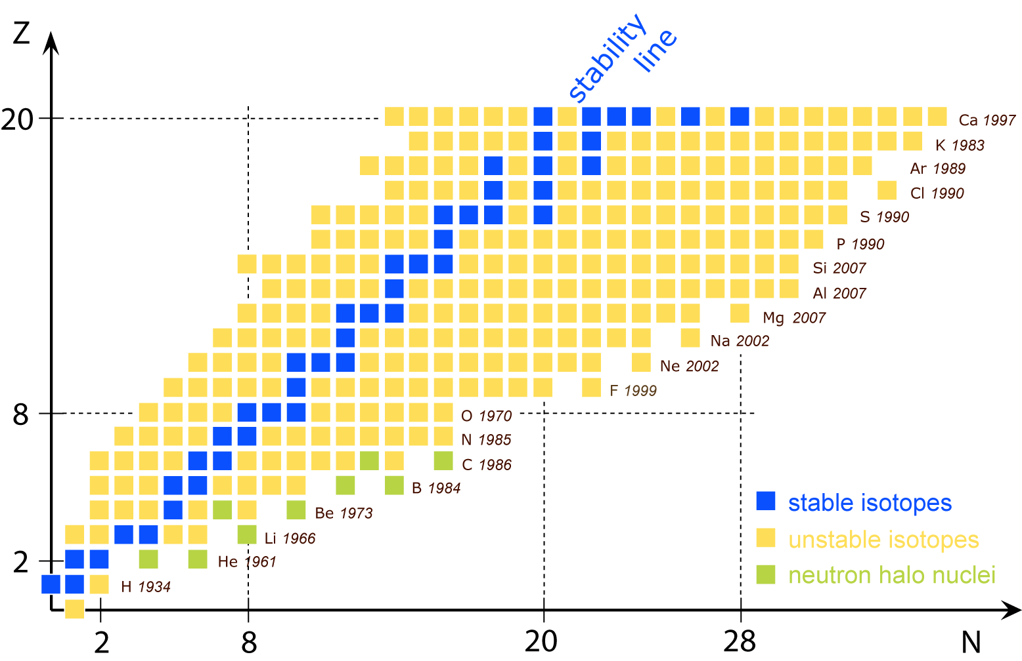
Shell evolution
in two dimensions
Evolution along isotones
driven by tensor force
Ni
Ca
Evolution along isotopes
driven by three-body force

Slide 15
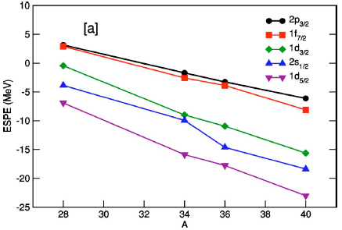
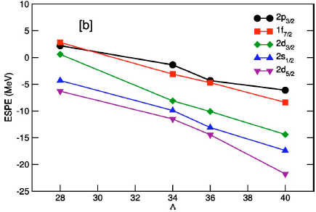
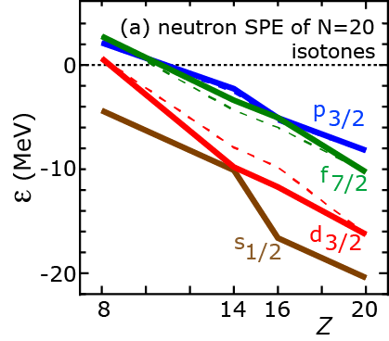
Island of Inversion (N~20 shell structure) : model independence
Shell-model interactions
Color code of lines is different from the left figure.
16
16
16
20
20
20
cv
cv
cv
cv
Strasbourg SDPF-NR
Tokyo sdpf-M
VMU interaction
central + tensor
TO et al., PRL, 104, 012501 (2010)
Based on Fig 41,
Caurier et al. RMP 77, 427 (2005)

Slide 16
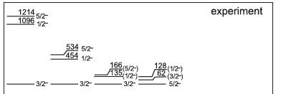
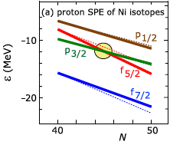
Proton f_{5/2} - p_{3/2} inversion in Cu due to
neutron occupancy of g_{9/2}
g_{9/2}
k₁
k₂
Flanagan et al., PRL 103,
142501 (2009) ISOLDE exp.
k₁
k₂
Franchoo et al., PRC 64, 054308 (2001)
“level scheme … newly established for ^{71,73}Cu”
“… unexpected and sharp lowering of the πf_{5/2} orbital”
“… ascribed to the monopole term of the residual int. ..”
th
a clean example of
tensor-force driven shell evolution
TO, Suzuki, et al.
PRL 104, 012501 (2010)

Slide 17
Outline
1. Introduction
2. (Type I) Shell Evolution
3. Computational aspect
4. Type II Shell Evolution and Dual Quantum Liquids
5. Summary

Slide 18
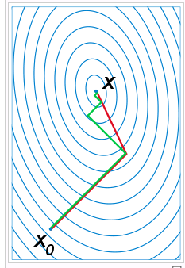
Advanced Monte Carlo Shell Model
N_{B} : number of basis vectors (dimension)
N_{p} : number of (active) particles
N_{sp} : number of single-particle states
amplitude
Projection op.
a
N-th basis vector
(Slater determinant)
Minimize E(D) as a function of D utilizing
qMC and conjugate gradient methods
Deformed single-particle state
Step 1 : quantum Monte Carlo type method
→ candidates of n-th basis vector (σ : set of random numbers)
“ σ ” can be represented by matrix D
Select the one with the lowest E(D)
steepest
descent
method
conjugate
gradient
method
Step 2 : polish D by means of the conjugate gradient method
“variationally”.

Slide 19

MCSM (Monte Carlo Shell Model -Advanced version-)
Selection of important many-body basis vectors
by quantum Monte-Carlo + diagonalization methods
basis vectors : about 100 selected Slater determinants
composed of deformed single-particle states
Variational refinement of basis vectors
conjugate gradient method
3. Variance extrapolation method -> exact eigenvalues
+ innovations in algorithm and code (=> now moving to GPU)
K computer (in Kobe) 10 peta flops machine
Projection of basis vectors
Rotation with three Euler angles
with about 50,000 mesh points
Example : 8⁺ ⁶⁸Ni 7680 core x 14 h

Slide 20
Outline
1. Introduction
2. (Type I) Shell Evolution
3. Computational aspect
4. Type II Shell Evolution and Dual Quantum Liquids
5. Summary

Slide 21
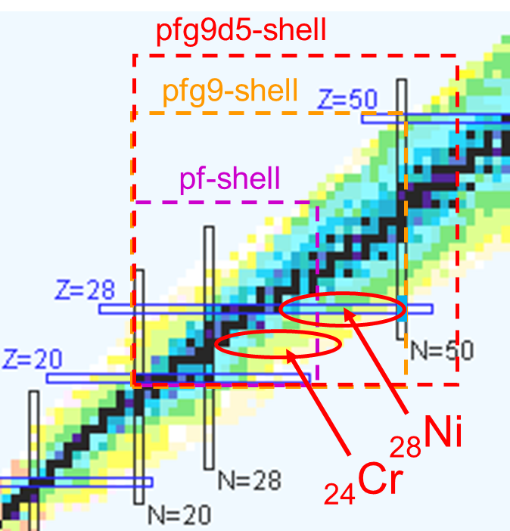
Example : Ni and neighboring nuclei
Configuration space
pfg9d5-shell (f_{7/2}, p_{3/2}, f_{5/2}, p_{1/2}, g_{9/2}, d_{5/2})
→ large Hilbert space (5 x 10¹⁵ dim. for ⁶⁸Ni) accessible by MCSM
Effective interaction : based on A3DA interaction by Honma
Two-body matrix elements (TBME)
consist of microscopic and empirical ints.
  GXPF1A (pf-shell)
  JUN45 (some of f5pg9)
  G-matrix (others)
Revision for single particle energy (SPE) and monopole part of TBME

Slide 22
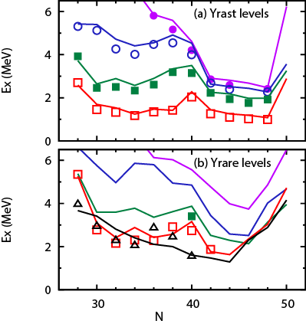
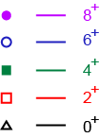
Yrast and Yrare levels of Ni isotopes
Y. Tsunoda et al.
PRC89, 030301 (R)
(2014)
exp th
fixed
Hamiltonian
-> all variations

Slide 23
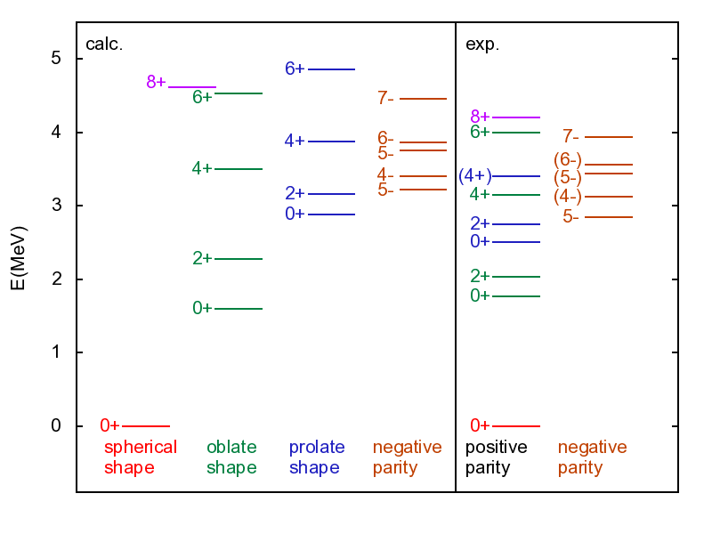
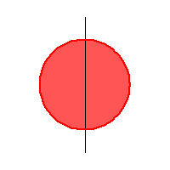
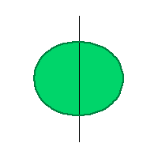
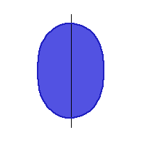
Level scheme of ⁶⁸Ni
R. Broda et al.,
PRC 86, 064312 (2012)
Recchia et al., PRC 88,
041302 (2013)
Colors are determined from the calculation

Slide 24
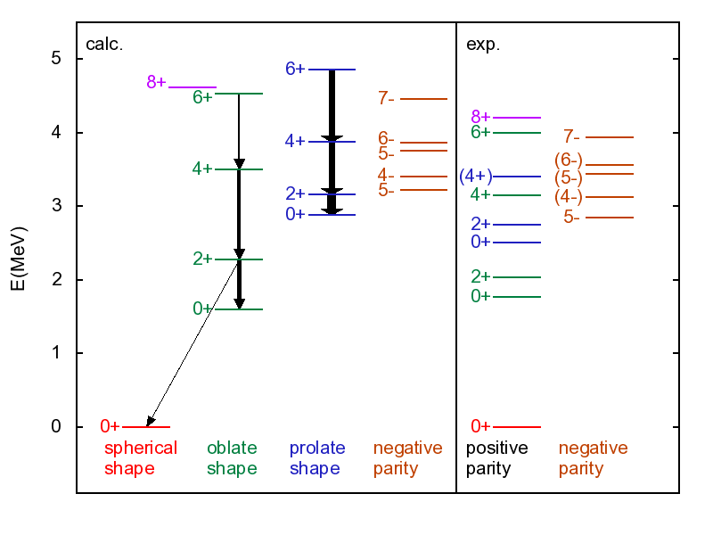
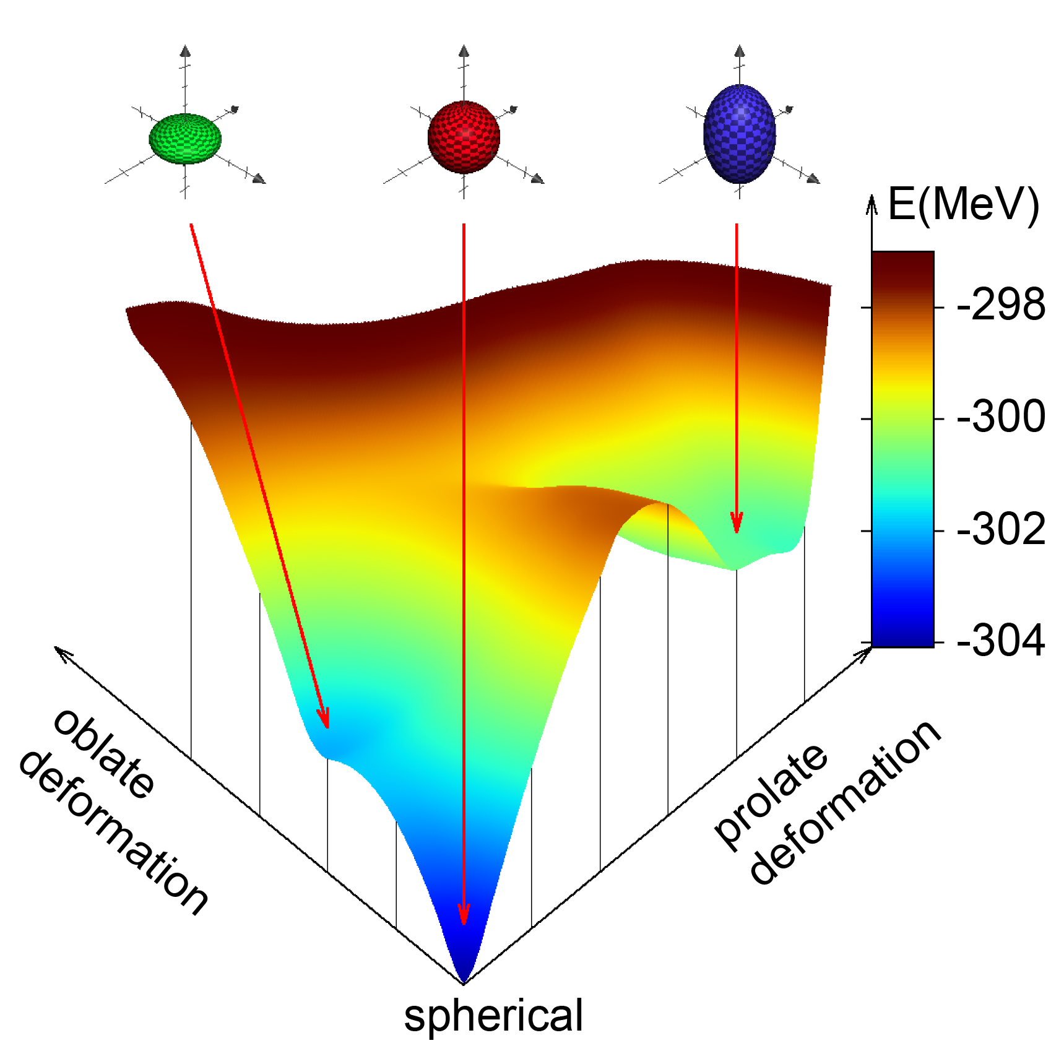
Band structure of ⁶⁸Ni
R. Broda et al.,
PRC 86, 064312 (2012)
Broad lines correspond
to large B(E2)
Taken from Suchyta, Y. Tsunoda et al.,
Phys. Rev. C89, 021301 (R) (2014) ;
Y. Tsunoda et al., Phys. Rev. C89,
031301 (R) (2014)

Slide 25

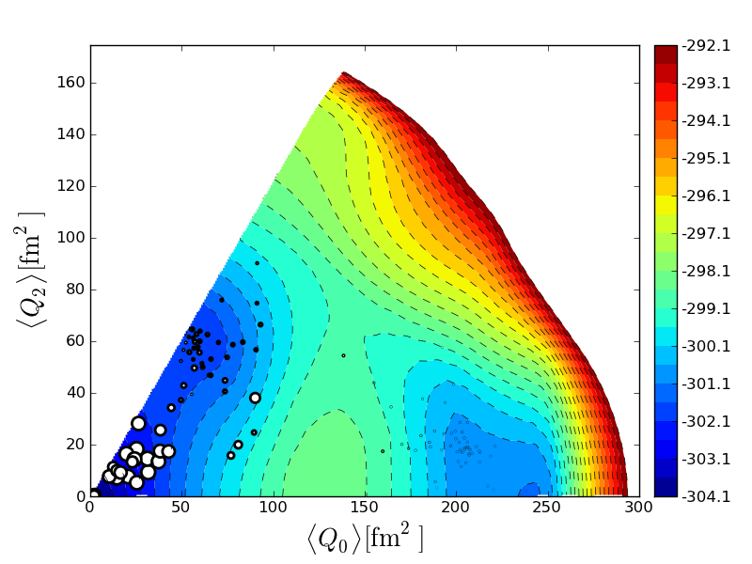
MCSM basis vectors on Potential Energy Surface
eigenstate
Slater determinant
-> intrinsic deformation
PES is calculated
by CHF
Location of circle : quadrupole deformation of unprojected MCSM basis vectors
Area of circle :
overlap probability
between each
projected basis and
eigen wave function
0⁺₁ state of ⁶⁸Ni
oblate
triaxial
spherical
prolate

Slide 26
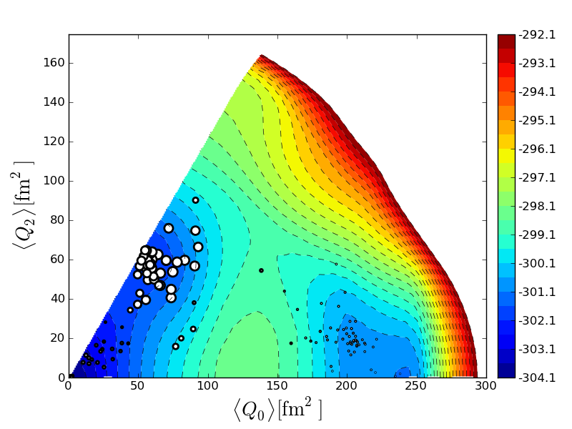
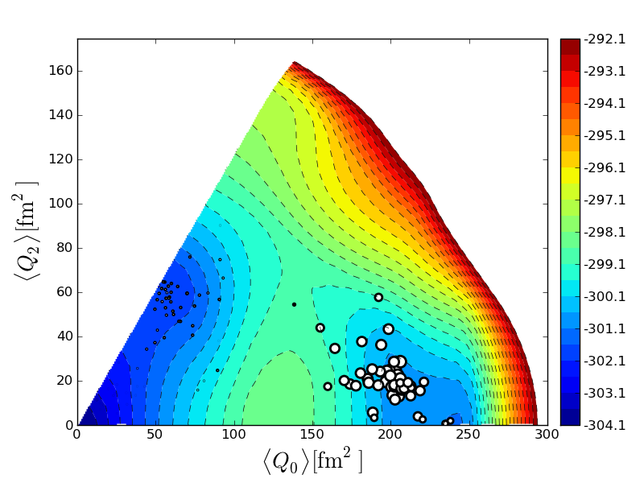
⁶⁸Ni 0⁺ wave functions ⇔ different shapes
⁶⁸Ni 0⁺₁ - 0⁺₃ states are comprised mainly of basis vectors generated in
0⁺₁ : spherical
0⁺₂ : oblate
0⁺₃ : prolate
0⁺₂ state of ⁶⁸Ni
0⁺₁ state of ⁶⁸Ni
0⁺₃ state of ⁶⁸Ni

Slide 27
Shell Evolution within a nucleus : Type II
Neutron particle-hole excitation changes proton spin-orbit
splittings, particularly f_{7/2} – f_{5/2} , crucial for deformation
→ shell ←→ deformation interconnected
normal
Type II Shell Evolution
g_{9/2}
N=40
attraction
f_{5/2}
f_{5/2}
repulsion
f_{7/2}
Z=28
closed shell
stronger excitation
i.e., more mixing
（prolate superdef.）

Slide 28
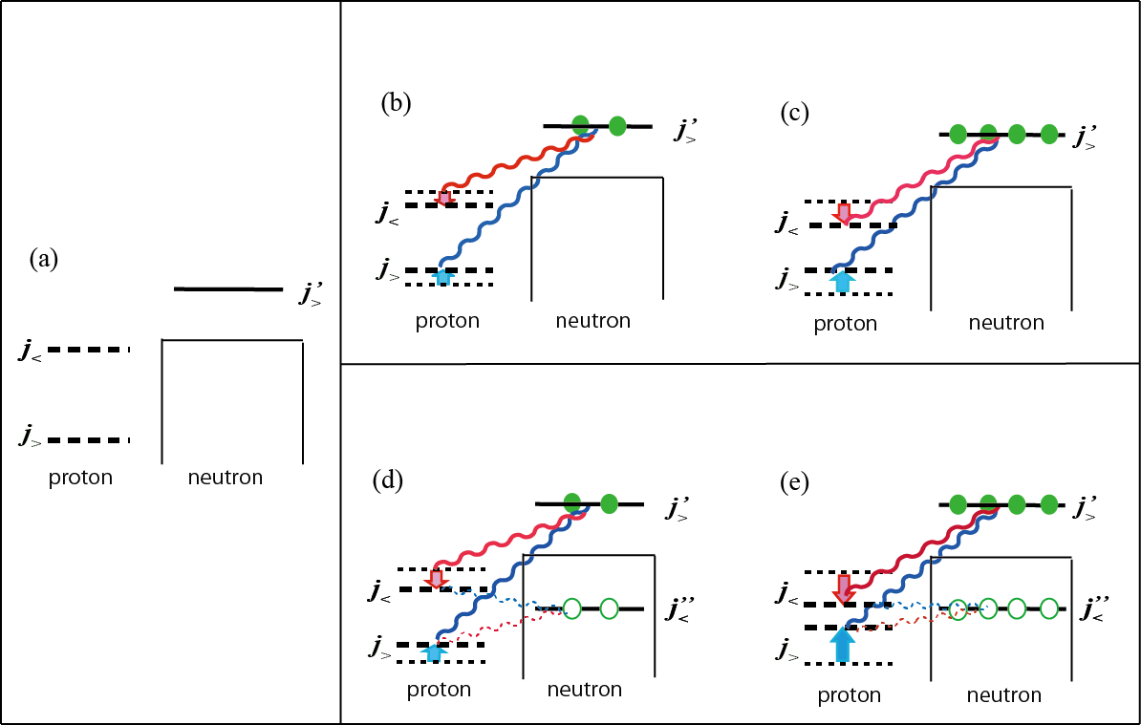
Type I Shell Evolution : different isotopes
Type II Shell Evolution : within the same nucleus
: holes

Slide 29
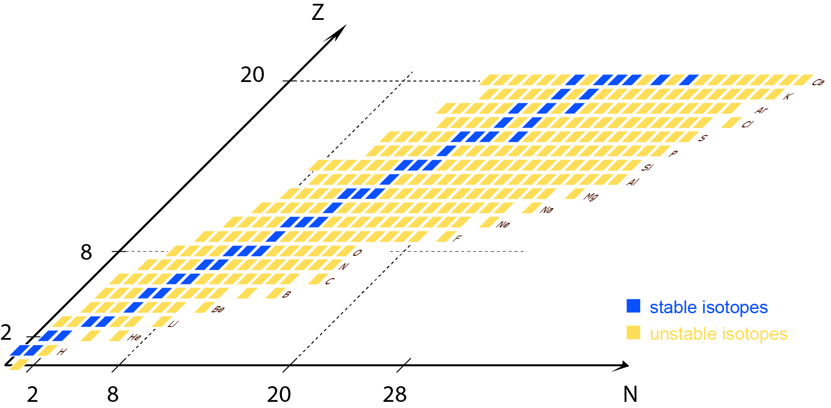
Shell evolutions in the “3D nuclear chart”
C : configuration
(particle-hole excitation)
C
Type II Shell Evolution
Type I Shell Evolution
C=0 : naïve filling configuration -> 2D nuclear chart

Slide 30
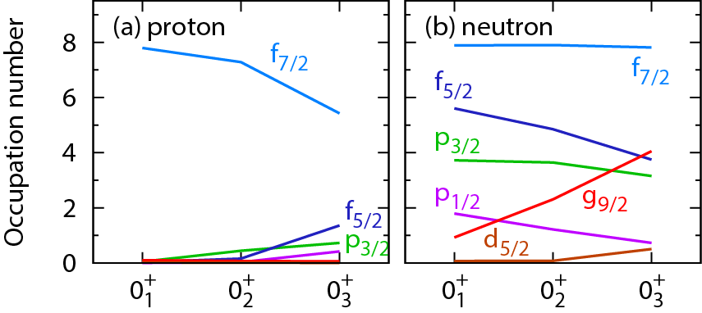
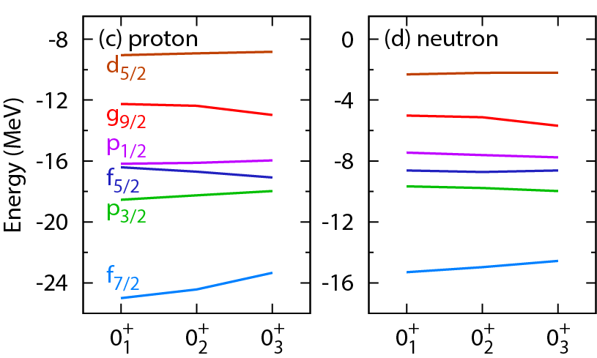
effect of
tensor force
Effective single-particle energy

Slide 31
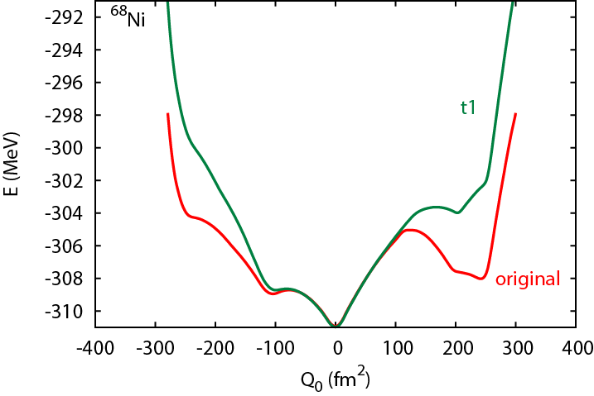
Stability of local minimum and the tensor force
The pocket
is lost.
g_{9/2}
Green line :
proton-neutron monopole interactions
f_{5/2} – g_{9/2}
f_{7/2} – g_{9/2}
so that proton f_{7/2} – f_{5/2} splitting is NOT changed due to the g_{9/2} occupation.
Same for f_{5/2} – f_{5/2} , f_{7/2} – f_{5/2}
attraction
are reset to their average
f_{5/2}
f_{5/2}
repulsion
f_{7/2}

Slide 32
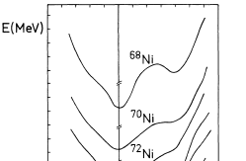
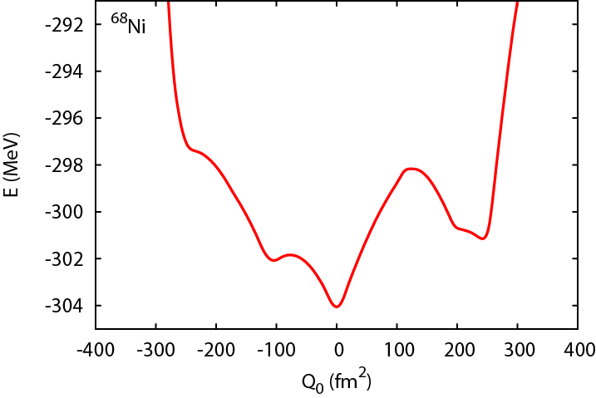
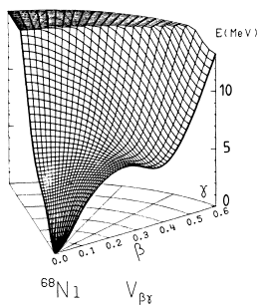


Effect of the tensor force
Bohr-model calc. by HFB with Gogny force,
Girod, Dessagne, Bernes, Langevin, Pougheon
and Roussel, PRC 37,2600 (1988)
Present
no (expicit) tensor force

Slide 33
Dual quantum liquids in the same nucleus
Certain different configurations produce different shell structures owing to (i) tensor force and (ii) proton-neutron compositions
Note : Despite almost the same density, different single-particle energies
Liquid 1
Liquid 2
leading to spherical state
leading to prolate state
core
core
core
core
proton
neutron
proton
neutron

Slide 34
Same type
Variation
Fermi energy
of ¹⁸⁶Pb
Pb
Zr
g_{7/2}
i_{13/2}
h_{9/2}
g_{9/2}
d_{5/2}
h_{9/2}
p_{1/2}
h_{11/2}
proton
neutron
proton
neutron

Slide 35
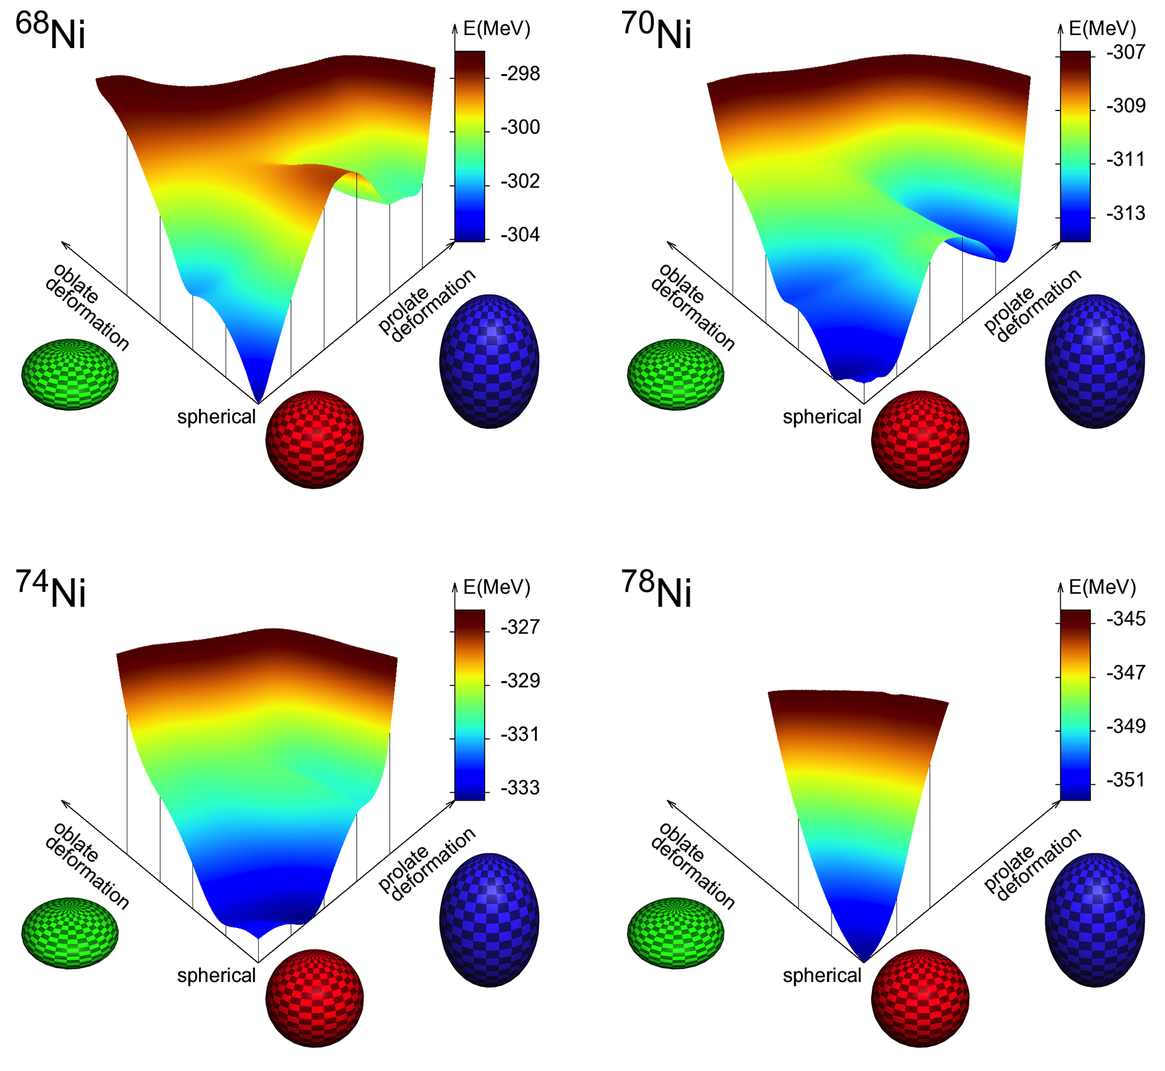
critical phenomenon :
two phases (dual quantum liquids)
nearly degenerate
large fluctuation
near critical point

Slide 36
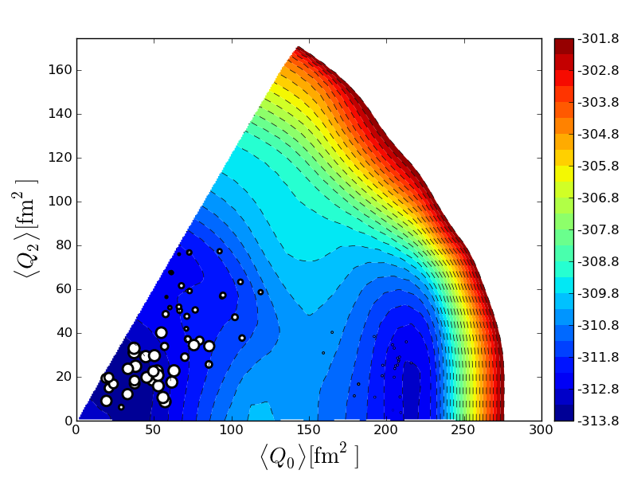
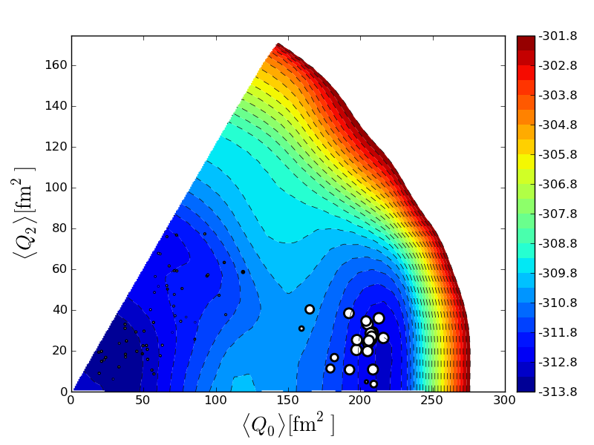


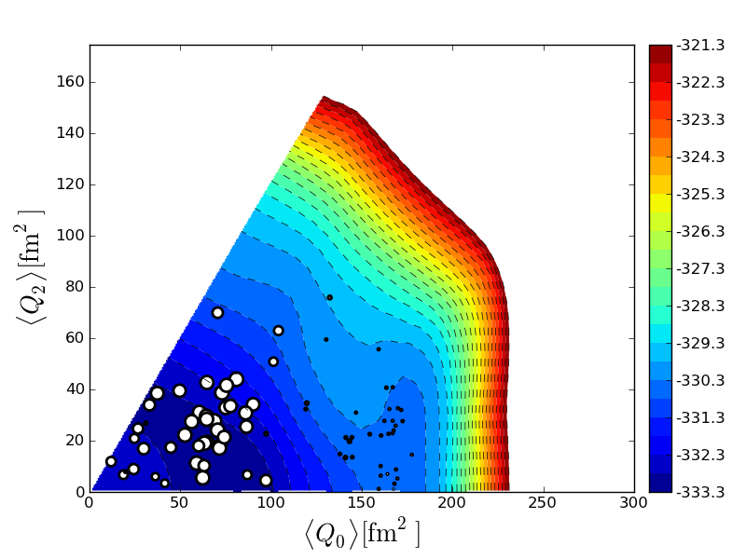



spherical
prolate
⁷⁰Ni
spherical
+
prolate, but no oblate !
0⁺₁
0⁺₂
2⁺₂
2⁺₁
⁷⁴Ni
0⁺₂
weaker prolate
by Pauli principle
0⁺₁
2⁺₁
gamma unstable
2⁺₂
Large fluctuation

Slide 37
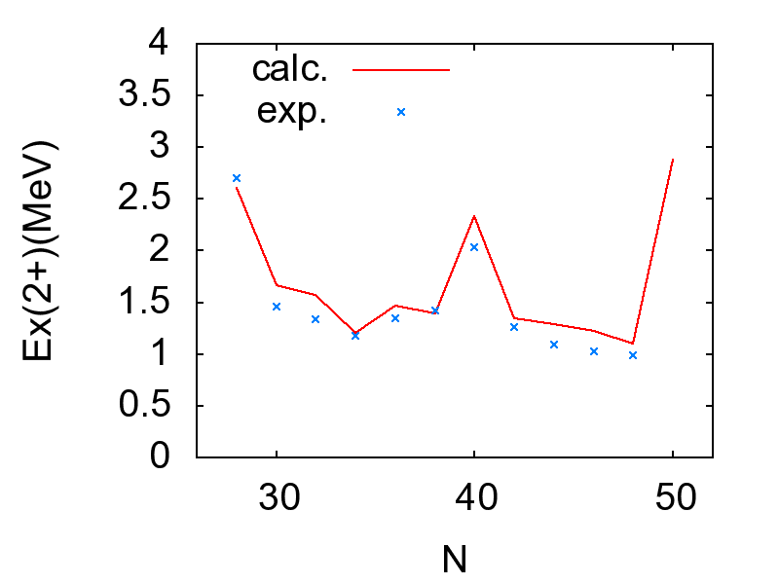
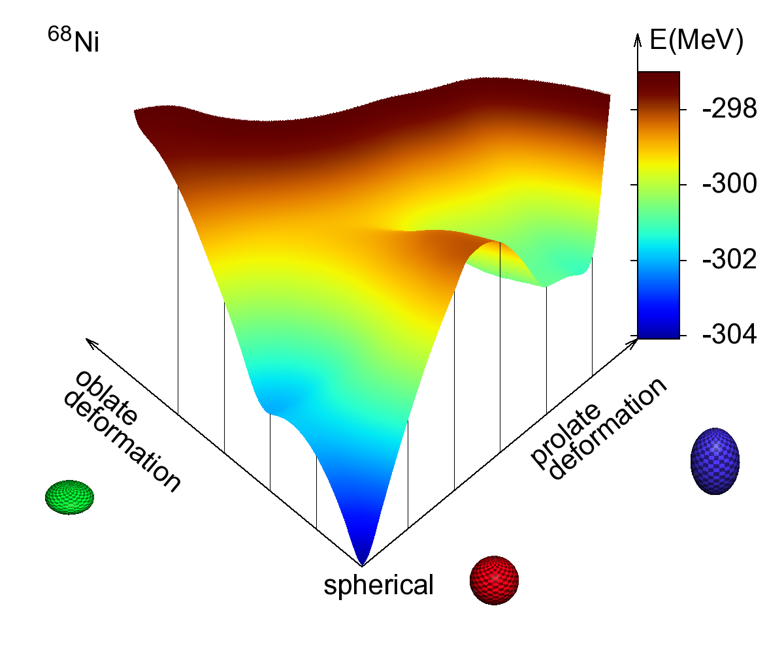
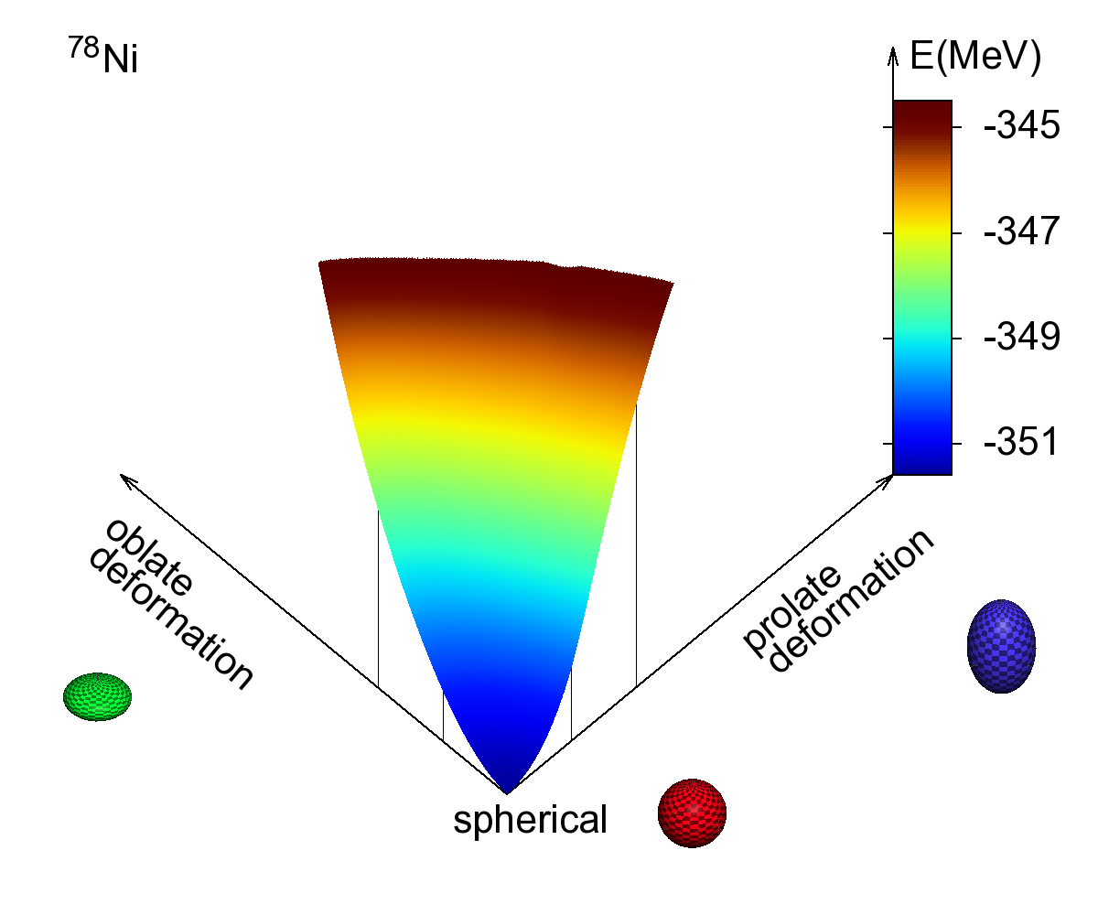
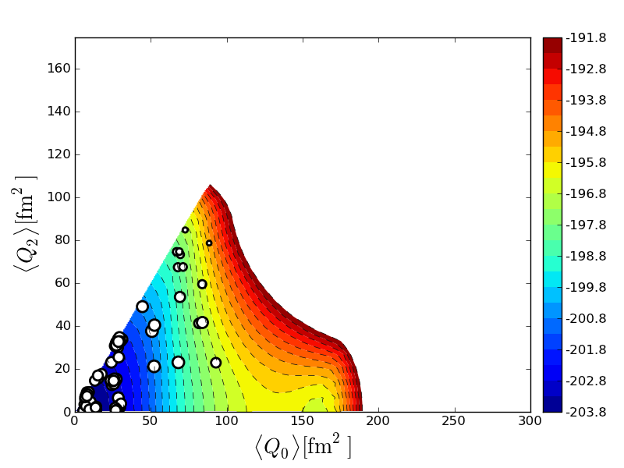
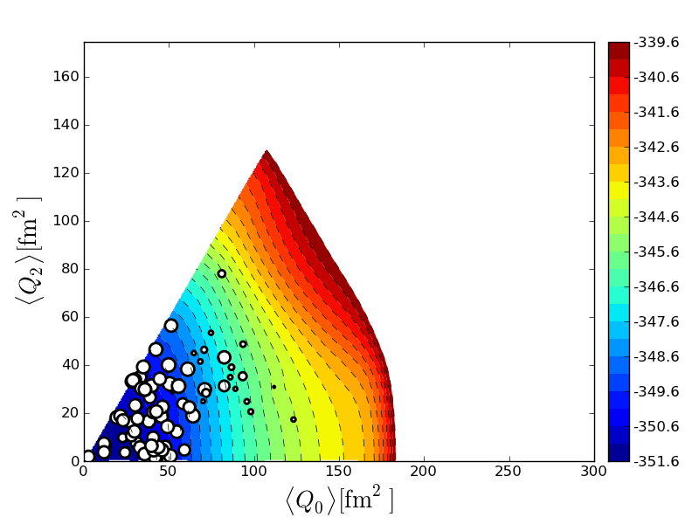
Different appearance of Double Magicity of ^{56,68,78}Ni
2⁺ Ex. Energy
⁶⁸Ni
⁷⁸Ni
Ex(2⁺) (MeV)
sharper minimum
0⁺₁ state of ⁵⁶Ni
0⁺₁ state of ⁶⁸Ni
0⁺₁ state of ⁷⁸Ni

Slide 38
Summary
Shell evolution occurs in two ways
Type I Changes of N or Z (2D) -> occupation of specific orbits
Type II Particle-hole excitation (3D)
-> occupation and vacancy of specific orbits
Tensor force, at low momentum, remains unchanged after
renormalizations (short-range and in-medium). (Tsunoda et al. PRC 2011)
It can change the shape indirectly, through Jahn-Teller mechanism.
Dual quantum liquids appear owing also to proton-neutron composition
of nuclei, giving high barrier and low minimum for shape coexistence.
Dual quantum liquids can be viewed as a critical phenomenon.
The transition from dual to normal quantum liquids results in
large (dynamical) fluctuation of the nuclear shape.
Many cases (Zr, Pb, etc.) of shape coexistence can be studied in this way, with certain perspectives to fission and island of stability.

Slide 39
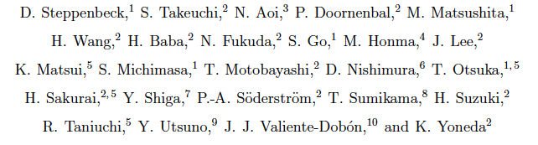

Collaborators in main slides
⁵⁴Ca magicity (RIKEN-Tokyo)
Ni calculation (an HPCI project)
Y. Tsunoda Tokyo
Y. Utsuno JAEA
N. Shimizu Tokyo
M. Honma Aizu

Slide 40
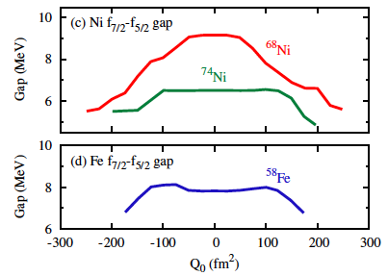
f_{7/2} – f_{5/2} spherical gap for protons
Type I
S. E.
⁷⁴Ni
shell gap (spherical)
configurations = shapes
determined self-consistently
and non-linearly
Type II Shell Evolution
shell evolution within the same nucleus
driven by the tensor force
Spherical shell gap is not changed in Nilsson model

Slide 41
Quantum (Fermi) liquid
interplay between s.p.e. and interaction
- in a way like free particles -
Liquid #1
Liquid #2
ε₈
ε₈
ε₇
ε₇
ε₆
ε₆
ε₅
ε₅
Landau
ε₄
ε₄
ε₃
ε₃
ε₂
ε₂
ε₁
ε₁
Dual quantum (Fermi) liquid -> enhancement of
shape coexistence
note: - same multipole interaction on top of this
- almost same local density

Slide 42

Evolution of neutron shell from Z=40 to 50
with tensor force
Shell structure on top of
¹⁰⁰Sn core
without tensor force
quite different
between with and w/o
tensor force
open question of the ordering
no tensor force
7/2⁺
5/2⁺
7/2⁺
full tensor force
⁹⁰Zr
¹⁰⁰Sn
Seweryniak et al., (2007)
Darby et al., (2010)
(from exp.)
g_{9/2}
(prediction)

Slide 43
Remark :
relevant feature is
not level of f _{5/2} in Ca
but its change from Ni
(+ the consequences)
As proton f_{7/2} becomes vacant
(away from stability line),
N=34 (sub)magic gap appears
(in contrast to stable nuclei with A~54),
➔ ⁵⁴Ca becomes doubly magic.
Mayer-Jensen’s scheme
(good for Fe , Ni, …)
f_{5/2}
34
p _{1/2}
32
byproduct
p _{3/2}
28
f_{7/2}

Slide 44

Type II
Shell Evolution
based on actual example of

Slide 45

TO, Suzuki, et al.
PRL 95, 232502 (2005)

Slide 46
N=34 magic number
and the shell evolution due to proton-neutron interaction
neutron f_{5/2} – p_{1/2} spacing increases by ~0.5 MeV per one-proton removal from f_{7/2}, where tensor and central forces works coherently and almost equally.
note : f_{5/2} = j < f_{7/2} = j >
Steppenbeck et al. Nature, 502, 207 (2013)

Slide 47



Ground-state energy of Ca isotopes
exp + extrap.
exp + extrap.
Phenomenological
NN
Microscopic
NN
Microscopic
NN +3NF
+ g_{9/2}

Slide 48


Shell evolution due to 3-body force
Robust consequences :
- All valence SPE’s raised
TO et al., PRL 105, 032501 (2010)
- Spacings widened
Ca isotopes
NN+3NF
34
32
NN
28
Three-body force pushes up
p_{1/2} more than f _{5/2},
reducing f _{5/2} – p _{1/2} gap
-> lowering 2⁺ level of ⁵⁴Ca
G-matrix
3rd order Q-box
24 hw int. states
3NF : Fujita-Miyazawa
TO and T. Suzuki,
Few-Body Systems, 54, 891(2013)

Slide 49
Soon we shall see …
N=20 magic
N=28 magic
Ca
N=34 magic may
holds
（prediction only）

Slide 50
Next generation of Monte Carlo Shell Model
N_{B} : number of basis vectors (dimension)
N_{p} : number of (active) particles
N_{sp} : number of single-particle states
amplitude
Projection op.
a
N-th basis vector
(Slater determinant)
Minimize E(D) as a function of D utilizing
qMC and conjugate gradient methods
Deformed single-particle state
Step 1 : quantum Monte Carlo type method
→ candidates of n-th basis vector (σ : set of random numbers)
“ σ ” can be represented by matrix D
Select the one with the lowest E(D)
steepest
descent
method
conjugate
gradient
method
Step 2 : polish D by means of the conjugate gradient method
“variationally”.

Slide 51


Extrapolation by
Energy Variance
➔ Exact solution
(no truncation)
⁶⁴Ge in pfg9-shell, 10¹⁴dim
very far
Number of basis vectors
(deformed Slater determinants)
Variance :
Conjugate gradient
finite
range
N. Shimizu, et al.,
Phys. Rev. C 82, 061305(R) (2010).
Notes:
51

Slide 52
effect of
tensor force
Effective single-particle energy

Slide 53
Yrast and Yrare levels of heavier Ni isotopes
Tsunoda et al. (2014)
γ unstable

Slide 54


spherical
prolate
⁷⁰Ni
⁶⁸Ni
0⁺₃
0⁺₁
0⁺₂
prolate
2⁺₂
2⁺₁
2⁺₂
spherical
0⁺₁
spherical and prolate still coexist, but no oblate !
⁷²Ni
oblate
0⁺₁
0⁺₂
0⁺₂

Slide 55



⁷⁴Ni
0⁺₂
prolate by
Pauli principle
⁷⁴Ni
0⁺₁
2⁺₁
gamma unstable
2⁺₂
γ-unstable and prolate w/o barrier
⁷⁶Ni
0⁺₁
0⁺₂
The situation
continues to
0⁺₂

Slide 56




⁷⁸Ni
0⁺₂
0⁺₃
0⁺₁
stronger triaxial
w/o pot. min.
weak oblate or
2⁺₂
2⁺₁
gamma-unstable or E(5)-like
strong tendency
towards
oblate,
triaxiality, or E(5)
- all “-like” -

Slide 57
E N D
collaborators in main slides

Slide 58
Summary
Shell evolution driven by nuclear forces, particularly tensor
force, produces many features -> Type I Shell Evolution
Ex. : N=32, 34 magicity
2. Type II shell evolution has been introduced;
shell evolution inside the same nucleus working coherently with
strong deformation.
It stabilizes isolated local deformed minimum on PES, enhancing shape
coexistence. Ex. Second 0+ and 2+ of ⁷⁰Ni below 2 MeV
Tensor force itself may not change the shape, but it changes
single-particle levels around Fermi surface of a given nucleus,
which may be interpreted as dual quantum liquids (different SPEs
due to nuclear forces and proton/neutron composition) .
3. Computational progress by Advanced Monte Carlo Shell Model
both in the scale of the computation but also in the insights.
4. Exotic Ni isotopes show rapid changes from spherical-deformed
shape coexistence to gamma-soft to doubly magic

Slide 59



Slide 60

Very recent paper shows
also by Suchyta et al. (2013)
Calc. by Strasbourg
theory group

Slide 61

?
Courtesy from Niikura

Slide 64
Yrast and Yrare levels of heavier Ni isotopes
γ unstable

Slide 65
⁷⁸Ni
0⁺₂
0⁺₃
0⁺₁
stronger triaxial
w/o pot. min.
weak oblate or
2⁺₂
2⁺₁
gamma-unstable or E(5)-like
strong tendency
towards
oblate,
triaxiality, or E(5)
⁷⁶Ni
0⁺₁
0⁺₂

Slide 66
Yrast and Yrare levels of Ni isotopes
Tsunoda et al. (2014)
exp th
fixed
Hamiltonian
-> all variations

Slide 67
critical point and large fluctuation
- requirement for the phase transition -
neutron part :
too rigid

Slide 68



p_{3/2}
Otsuka, Suzuki and Utsuno,
Nucl. Phys. A805, 127c (2008)
N =28
⁴²₁₄Si₂₈
Utsuno, et al., Phys. Rev. C86,
051301 (R ), (2012)
f_{7/2}
d_{3/2}
doubly
magic ?
neutron
s_{1/2}
Z =14
d_{5/2}
repulsive
proton
attractive
Potential Energy Surface
exp.
full
Tensor force removed
from cross-shell interaction
⁴²Si 2+: Bastin, Grévy et al.,
PRL 99 (2007) 022503
Strong oblate
Deformation
Other calculations (RMF, Gogny)
show oblate shape.
others: Takeuchi et al.,
PRL 109 (2012) 182502

Slide 69

Why oblate deformation in ⁴²Si ground state ?
Proton wave function of intrinsic state with axial symmetry
Spherical magic
Q₀ = 0
Oblate shape
intrinsic quadrupole moment
Q₀ = 2 { q (m=5/2) + q (m=3/2)
+ cos ² θ q (m=1/2) }
+ 4 cos θ sin θ q (mix)
{ … } < 0 for cos ² θ < 1
|Q₀| larger, if Q₀ <0 (oblate )

Slide 70

Why prolate deformation at the beginning of the shell ?
Proton wave function of intrinsic state with axial symmetry
mixing by deformed field enhanced
intrinsic quadrupole moment
Q₀ = 2 cos ² θ q (m=1/2)
+ 4 cos θ sin θ q (mix)
N=２８ isotones
Mg prolate
Si oblate
S prolate (d3/2-s1/2 mixing)

Slide 71


With tensor force
Without tensor force
Si
S
Si
S
N=22
N=24
N=26
N=28

Slide 72
Shell evolutions in the “3D nuclear chart”
C : configuration
(particle-hole excitation)
C
Z
Type II Shell Evolution
Type I Shell Evolution
N
C=0 : naïve filling configuration -> 2D nuclear chart

