Slide 1

Emergence of Exotic Phenomena in
Unstable Nuclei
–how to observe them-
H. Sakurai
RIKEN Nishina Center/Dept of Phys., Univ. of Tokyo

Slide 2
RIBF Facility
Shell Evolution and r-Process Path

Slide 3
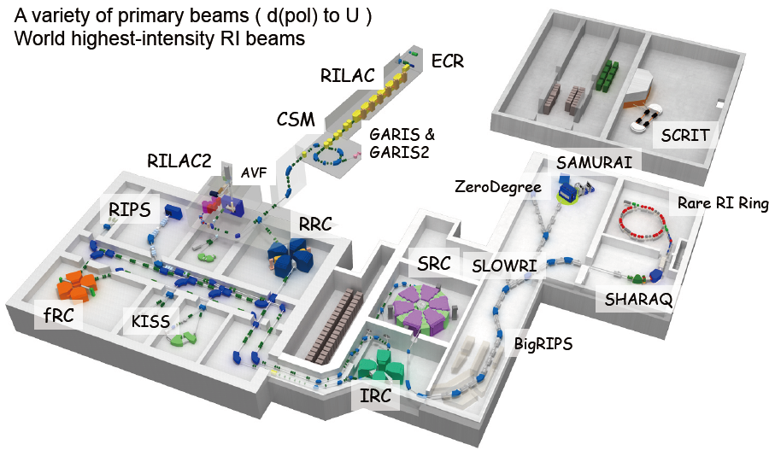
RI Beam Factory
5 cyclotrons + 2 linacs
3 inflight separators
All of experimental devices
coupled with BigRIPS
have been completed in FY13
A

Slide 4
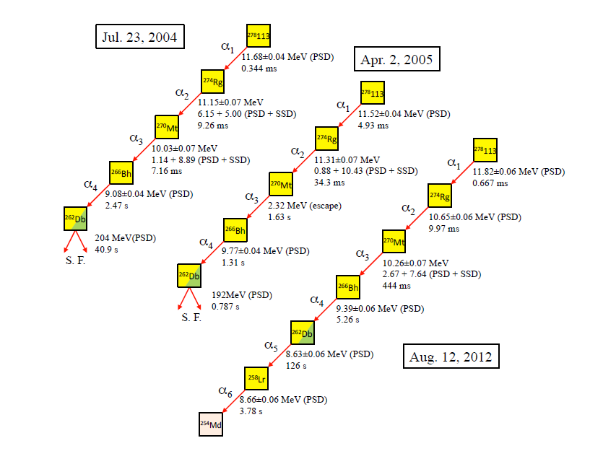
Element 113th at GARIS
Next step
Towards 119th, 120th
K. Morita et al., J. Phys. Soc. Jpn. 81 (2012) 103201

Slide 5
RI Beam Factory
5 cyclotrons + 2 linac
3 inflight separators
All of experimental devices
coupled with BigRIPS
have been completed in FY13
A
Gas-catcher

Slide 6
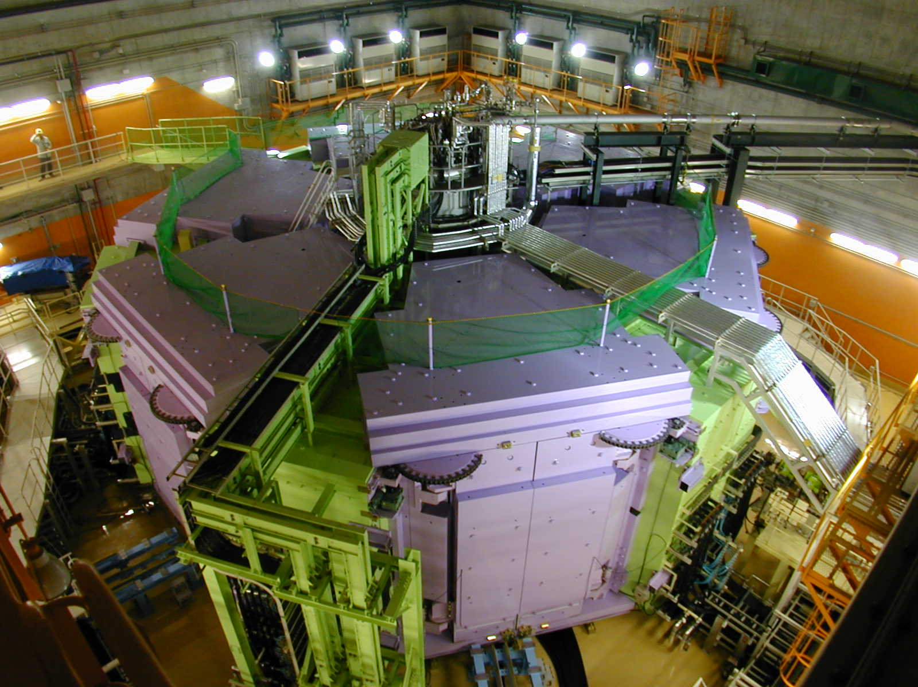
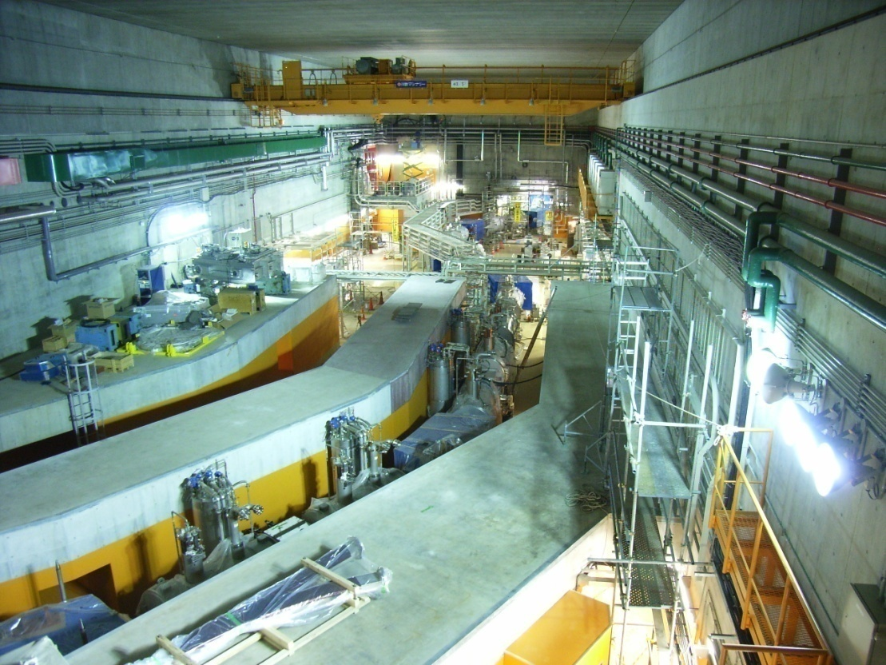
World’s First and Strongest
K2600MeV
Superconducting Ring Cyclotron
SRC
400 MeV/u Light-ion beam
345 MeV/u Uranium beam
BigRIPS
World’s Largest Acceptance
9 Tm
Superconducting RI beam Separator
~250-300 MeV/nucleon RIB
K980-MeV
Intermediate stage Ring Cyclotron (IRC)

Slide 7

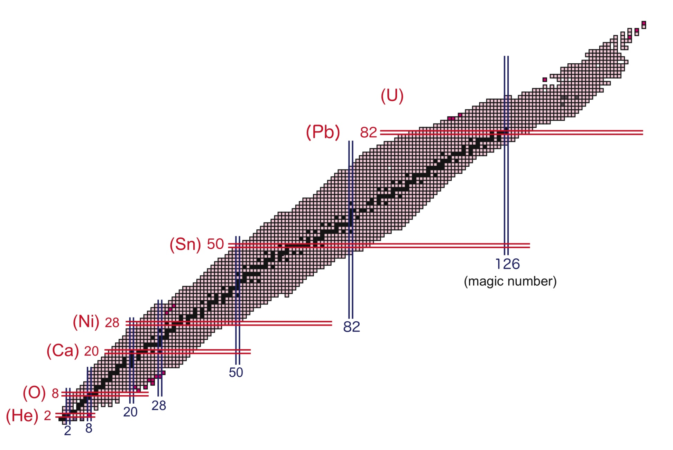
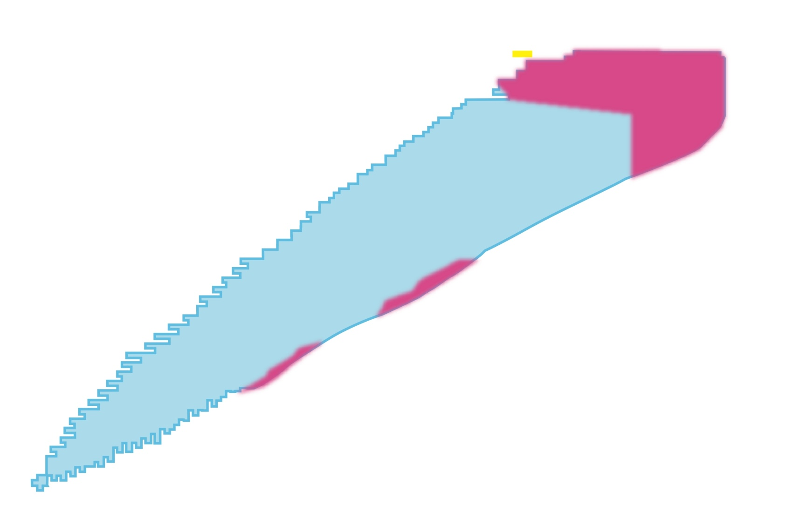
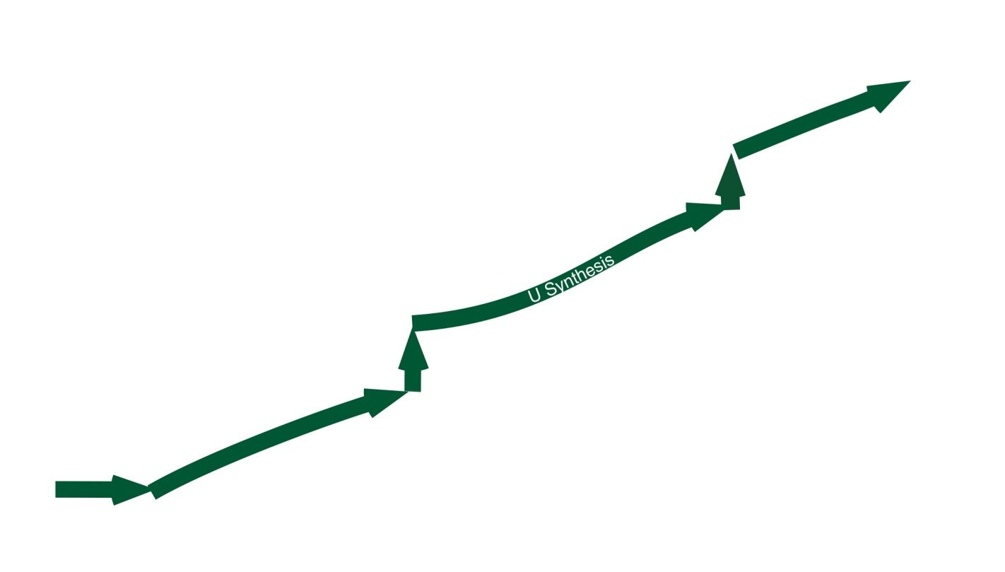
Exploration of the Limit of Existence
stable nuclei ~300 nuclei
unstable nuclei observed so far ~2700 nuclei
drip-lines (limit of existence)（theoretical predictions) ~6000 nuclei
magic numbers
4000 species to be produced
(1000 more new isotopes)
New Element
²⁷⁸113
04 July 23 18:55
57 fb
protons
R-process path
Projectile Fragmentation
In-flight U fission & P.F.
⁷⁸Ni ~0.1 particles/sec. (2007)
by 10pnA 350 MeV/u U-beam
10 particles/sec. (goal)
by 1pμA
neutrons
Notes:
7
7

Slide 8
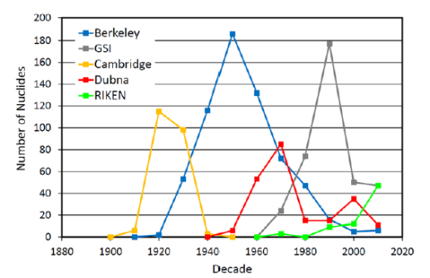
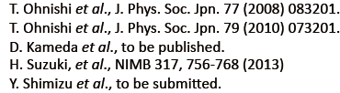
RIBF Initiatives : Isotope findings - a history -
Next decade
2010-2020
We are here
now!
RIBF started in 2007
M. Thoennessen, Nuclear Physics News, Vol.22, No.3, 2012

Slide 9
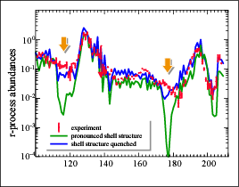
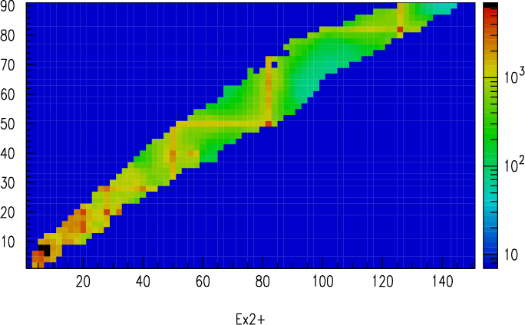
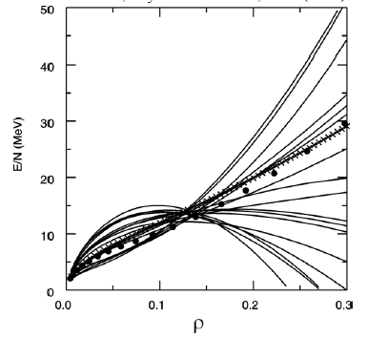
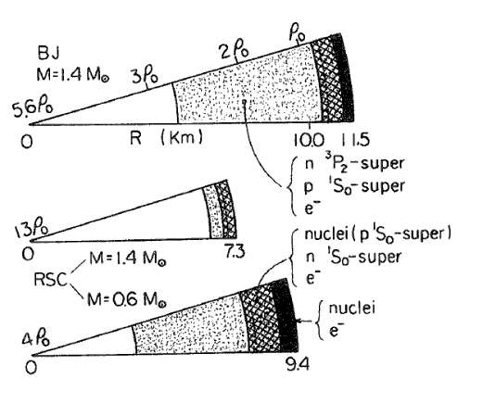
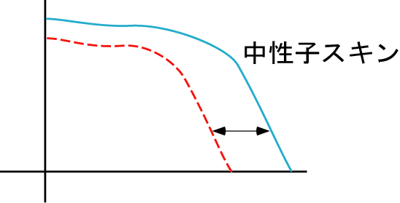
Liberation from Stable Region and
Emergence of Exotic Phenomena
Shell Evolution :
magicity loss and new magicity
R-process path: Synthesis up to U
E(2⁺)
Mass number
EOS: asymmetric nuclear matter
SN explosion, neutron-star,
gravitational wave
Dynamics of new “material” :
Neutron-skin（halo）
Density distribution
neutron skin
Neutron+
proton
proton-
neutron
matter
陽子・中性子
一様物質
r
neutrons
Notes:
9
9

Slide 10
RI Beam Factory
5 cyclotrons + 2 linac
3 inflight separators
All of experimental devices
coupled with BigRIPS
have been completed in FY13
A
large acceptance
long flight-path
e+RI scattering
Gas-catcher
mass
high resolution
spectrometer

Slide 11
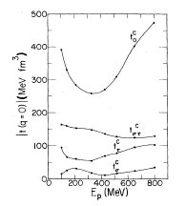
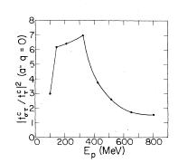
Effective Probes in RIBF: Direct Reactions
Int. E Direct reactions (150-400 A MeV)
  Weak Distortion :Minimal central force
  Effective Interaction : Spin-Isospin modes
RIBF

Slide 12
Shell evolution and r-process path
In-beam gamma spectroscopy
light mass region
medium-heavy mass region along magic
Decay spectroscopy
medium-heavy mass region

Slide 13


Nuclear Collective Motion
closed shell
open shell
at magic number
spherical nuclei
surface vibration
deformed nuclei
Quadrupole
deformation parameter β
|β|~0
|β| large
degree of collectivity
Quantum Liquid Drop Model
Even-Even Nuclei
Energy of the first excited state
E(2⁺)
E(2⁺) ∝ 1/β²
2⁺
E2 transition probability
between 2⁺ and 0⁺
B(E2)
0⁺
B(E2) ∝ β²
ground state
E(2⁺) ∝ B(E2) ⁻¹

Slide 14
Magicity and its loss through determining E(2+)
E(2⁺)
82
126
50
20
82
28
50
28
8

Slide 15
Nuclear Collective Motion
closed shell
open shell
at magic number
spherical nuclei
surface vibration
deformed nuclei
Quadrupole
deformation parameter β
|β|~0
|β| large
degree of collectivity
E(4⁺)/E(2⁺)
~ 1.8
~ 2.2
~ 3.3

Slide 16
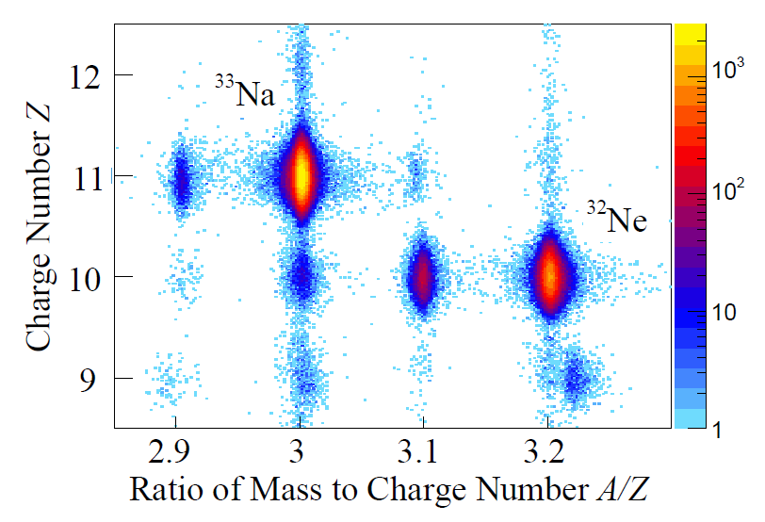
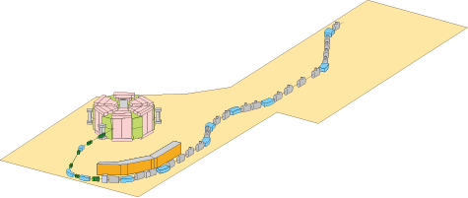
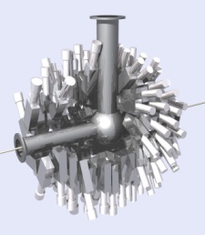
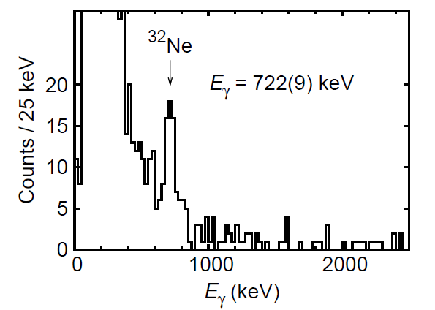
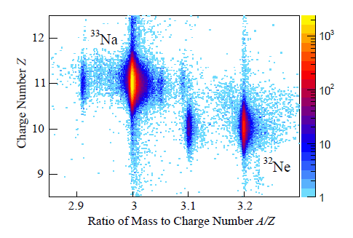
Spectroscopy via reactions
in the case of in-beam gamma
PID at ZeroDegree
Secondary target: H₂, C, Pb….
Gamma-detectors
to measure de-excited gamma rays
Ca-48 Acceleration
at Super-Conducting Cyclotron
Ca-48 beam
345A MeV
To deliver intense RI beams
PID for RI beams
Be production target
fragmentation
Doornenbal, Scheit et al. PRL 103, 032501 (2009)

Slide 17
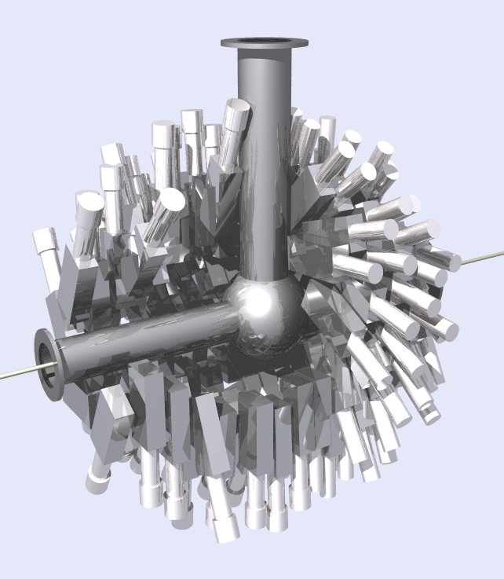
2012/9/7
-Tours 2012- Lenzkirch-Saig, Germany
DALI2 for RIBF experiments
Detector Array for Low Intensity radiation
Standard specification
Arrangement | Hedgehog like
Size (cm3) | 4.5 x 8 x 16
# of Detectors | 160
Volume | ~ 90 liter
# of Layers | 16
Angular resolution | ~ 8 degree
Energy resolution (β~0.6) | 10% @ 1MeV
Efficiency (β~0.6) | 20% @1MeV (24%@1MeV (β~0.3))
Timing resolution | ~ 2.5ns (FWHM)
γ-ray energy
Emission angle of γ ray
→ For Doppler-shift corrections
S.Takeuchi et al., NIM A 763, 596-603 (2014)
Notes:
17

Slide 18
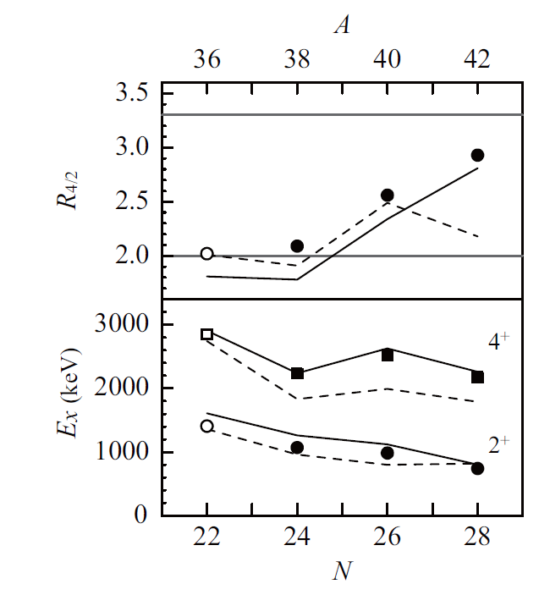
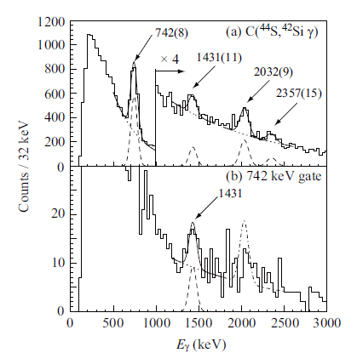
Well developed deformation of ⁴²Si
S. Takeuchi et al., PRL109, 182501 (2012)
Confirmation of 2+ energy observed at GANIL
High statistic data allows gamma-gamma
Coincidence
E(4+)/E(2+)~3 for Si-42
⁴⁴S + C -> ⁴²Si +X
Otsuka, Utsuno
Nowaki, Poves

Slide 19
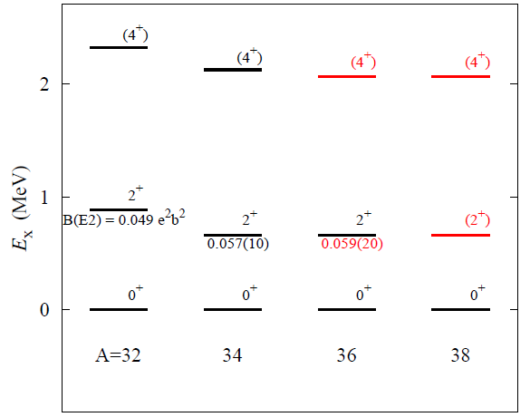
Collectivity of the neutron-rich Mg isotopes
P. Doornenbal, H. Scheit et al. PRL111 212502 (2013)
Excitation Energy of 2⁺ and 4⁺ in Mg
^{A}Al + C -> ^{A-1}Mg
For A=34 to 38
E(2⁺)~700 keV
E(4⁺)/E(2⁺)~3.1
At N=22, 24, 26 the nuclei
are well deformed
No increase of E(2⁺) at N=26
N=28 for Mg is not magic?
B(E2)?
Mn/Mp?
E(2⁺), E(4⁺) in ⁴⁰Mg?
Energy of single particle states?
N=20
22
24
26
N=20
22
24
26

Slide 20
Extension of the deformation region up to the drip-line
³²Mg
20
³⁴Mg
³²Mg
20
³⁴Mg
RIBF
Island?
Peninsula!!
³⁰Ne
³⁰Ne
28
28
8
³¹F
8
³¹F
Stability enhancement
Stability enhancement
A large deformation at Z=10-12
in spite of N=20
A pilot-region for nuclear structure
Interplay of three ingredients:
Weakly-bound natures
Tensor forces
Pairing
Doornenbal, Scheit, et al.
Ne-32 1st excited states: PRL 103, 032501 (2009)
New states in ^{31,32,33}Na: PRC 81, 041305R (2010)
Mg-36,-38: PRL111, 212502 (2013)
F-29: in preparation
Takeuchi et al.
Si-42 : PRL109, 182501 (2012)
P.Fallon et al.
Mg-40 : PRC 89, 041303 (2014)
Notes:
20

Slide 21
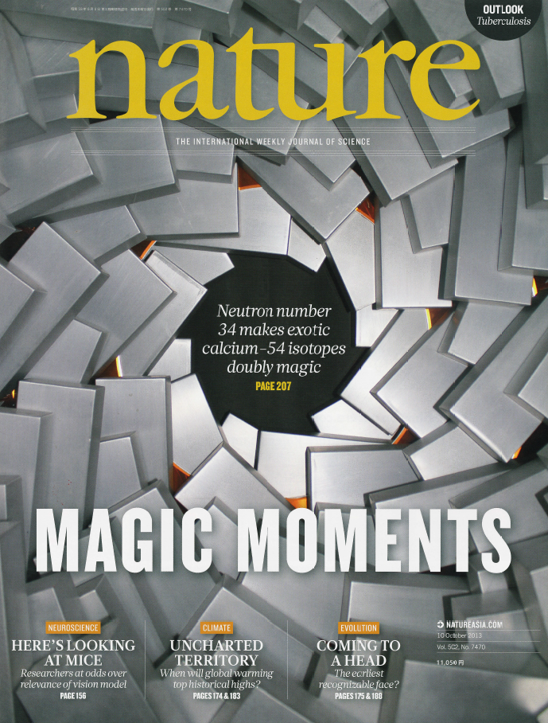
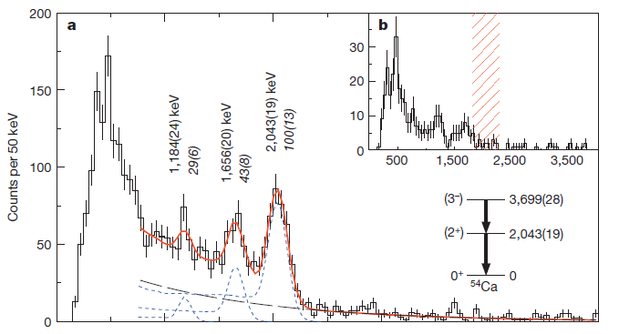
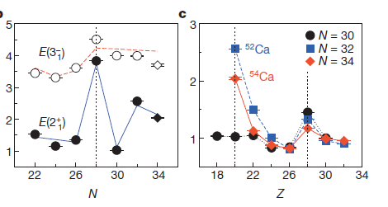
New “Magicity” of N=34 in the Ca isotopes
D. Steppenbeck et al., Nature
Zn-70 primary beam (100 pnA max)
Ti-56 120 pps/pnA, Sc-55 12 pps/pnA
Zn-70 -> Ti-56, Sc-55
Ti-56, Sc-55 + Be -> Ca-54 + X

Slide 22
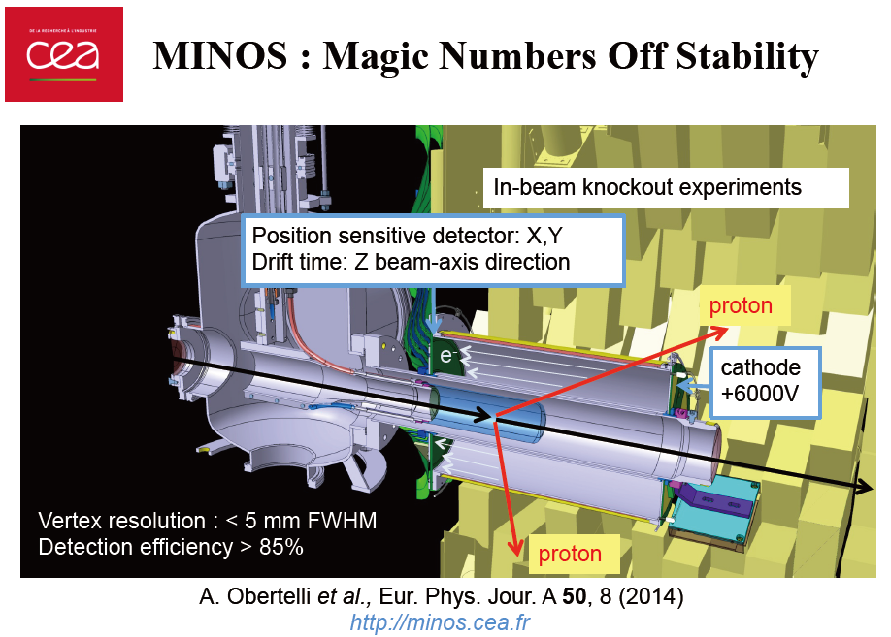

Slide 23
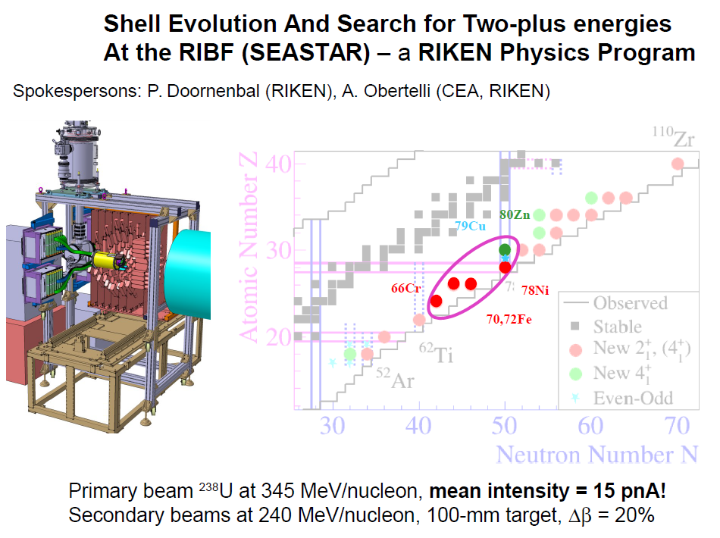
May-2014

Slide 24
Decay spectroscopy

Slide 25
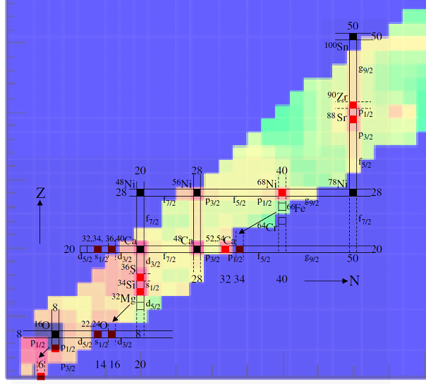
Project Overview and Scientific Goal
Measurements by decay exp.
Standard shell nuclei
Decay curve : T_{1/2}
Excited states : E(2⁺), ..
Isomeric states
Q_{β}
Neutron emission (P_{n})
Particle unbound excited states near particle threshold
New closed shell nuclei ?
Deformed shell quenched nuclei ?
  Nuclear Structure
  New magic number ?
  Disappearance?
  Deformation?
  Nuclear Astrophysics
  R-process path?
Systematic
Study
Nuclear Physics Astrophysics
mass Q-value for reactions
T_{1/2} mean free time
Pn reaction chain
... ...
NISHIMURA

Slide 26
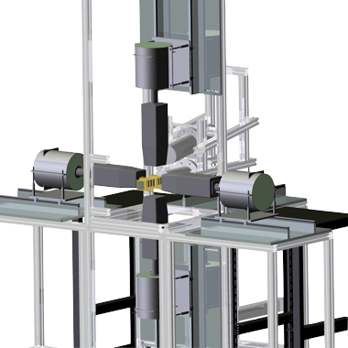
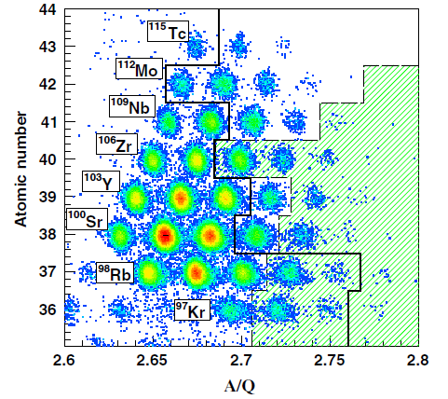

Decay Spectroscopy Setup
Beta-delayed gamma
-> Ge detectors
HI implanted and beta-rays
-> active stopper (DSSSD)
U-238 Acceleration
at Super-Conducting Cyclotron
1st decay spectroscopy 2009 Dec.
U beam intensity
0.1-0.2 pnA on average
2.5 days for data accumulation
U-238 beam
345A MeV
Super-conducting Inflight
Separator to deliver intense
RI beams
Be production target
fission
Particle Identification of
RI beams

Slide 27
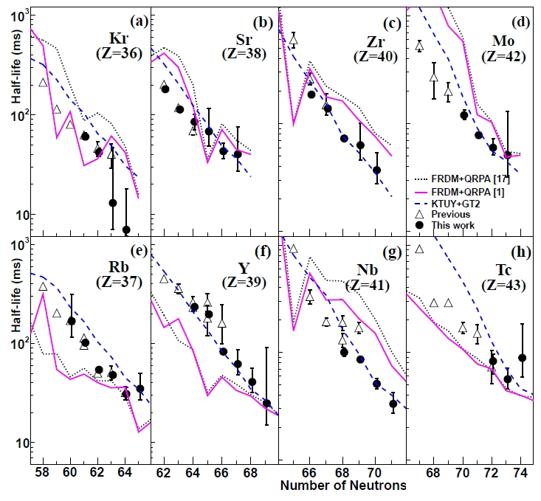
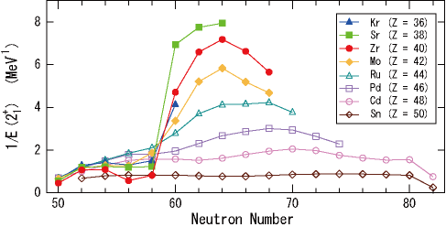
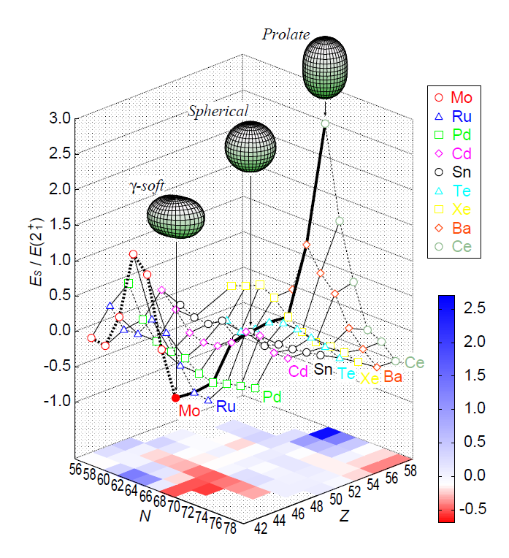
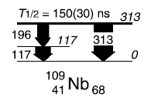
Exotic Collective-Motions at A~110 and
Their Applications to the R-process Nucleosynthesis
New Half-life data for
18 new isotopes
S. Nishimura et al.,
PRL 106, 052502 (2011)
Deformed magic N=64
in Zr isotopes
T. Sumikama et al.,
PRL 106, 202501 (2011)
Low-lying level structure of Nb-109:
A possible oblate prolate shape isomer
H. Watanabe et al.,
Phys. Lett. B 696, 186-190 (2011)
Development of axial
asymmetry in neutron-rich nucleus Mo-110
H. Watanabe et al.,
Phys.Lett.B 704,270-275(2011)

Slide 28
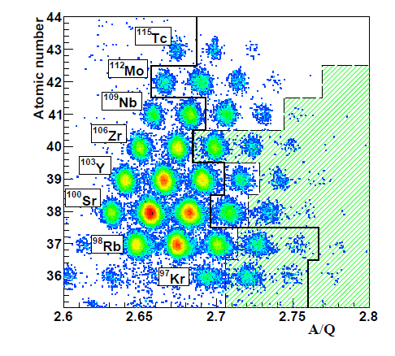
Brand-new half-life data for 18 isotopes
S. Nishimura et al., PRL 106 (11) 052502
T1/2 unknown
R-process waiting points
1/3 ~ 1/2 Shorter Half-lives of
Zr and Nb (A~110)
8 hour data acquisition
T1/2 data of 38 isotopes including
first data for 18 isotopes
FRDM may underestimate Q-value
for Zr and Nb by 1 MeV at A~110
More rapid flow in the rapid
neutron-capture process
than expected

Slide 29
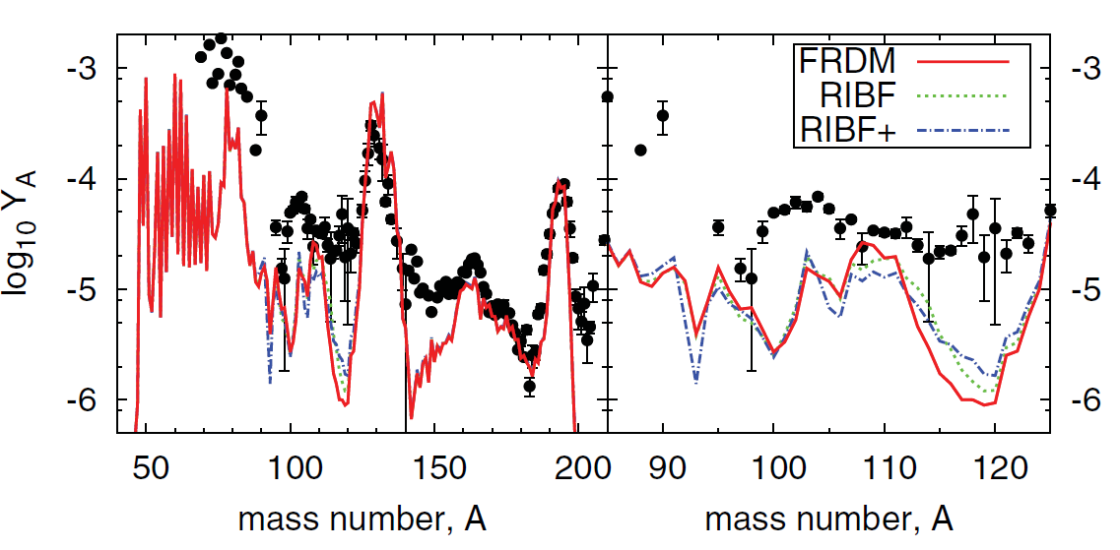
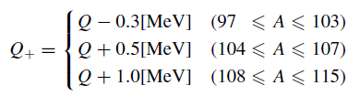
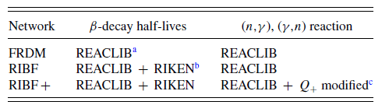
RIBF data → Impact to r-process abundance?
N. Nishimura, et al., PRC 85, 048801 (2012)
38 Half-lives
from RIBF
38 Half-lives
+ ΔQbeta
from RIBF
FRDM
MHD supernova
explosion model
The calculated r-process abundance is improved by factor of x 2.5.
But, there is still issue remaining in mass A=110 – 125!

Slide 30
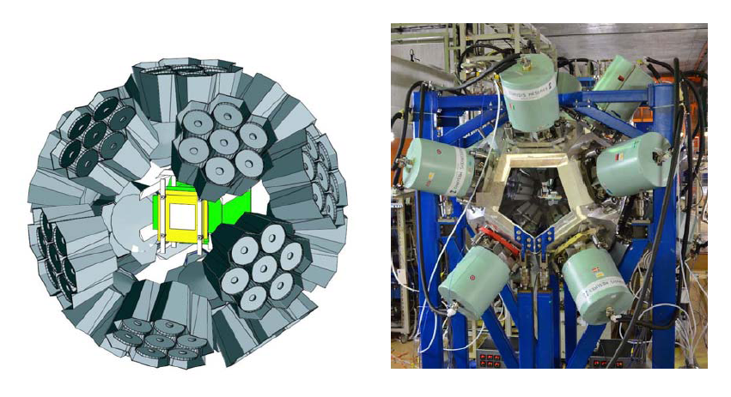
Gain Factors from 2009 to 2013 for Decay Spectroscopy
First decay spectroscopy in 2009
EURICA setup
EUroball-RIKEN Cluster Array
U-beam intensity … x 50 times
- 0.2 pnA → 10 pnA
Gamma-ray efficiency … x 10 times
- 4 Clover detectors (Det. Effi. ~1.5% at 0.662 MeV)
→ 12 Cluster detectors (Det. Eff. ~ 15 % at 0.662MeV)
Beam time x 40 times
- 2.5 days (4 papers) → 100 days … (160 papers)

Slide 31
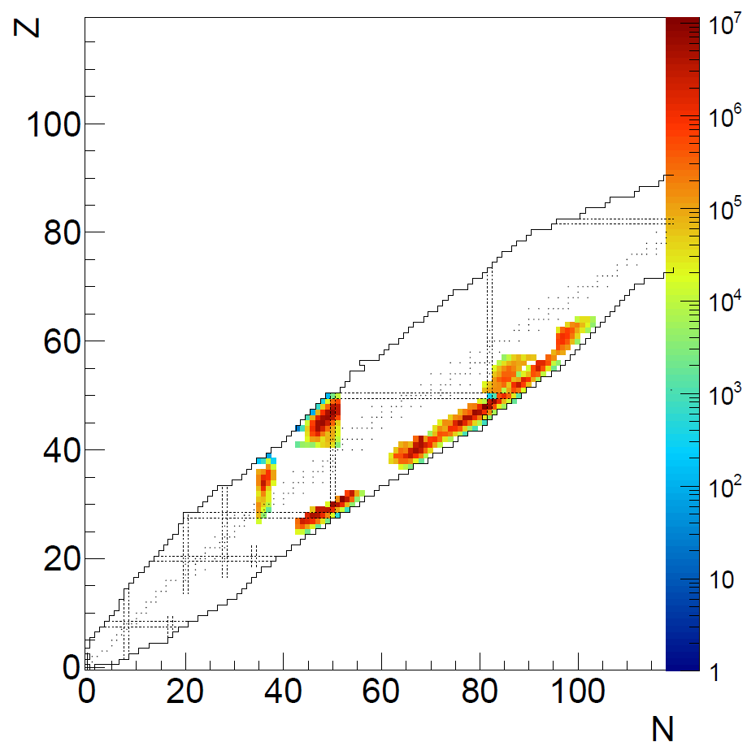
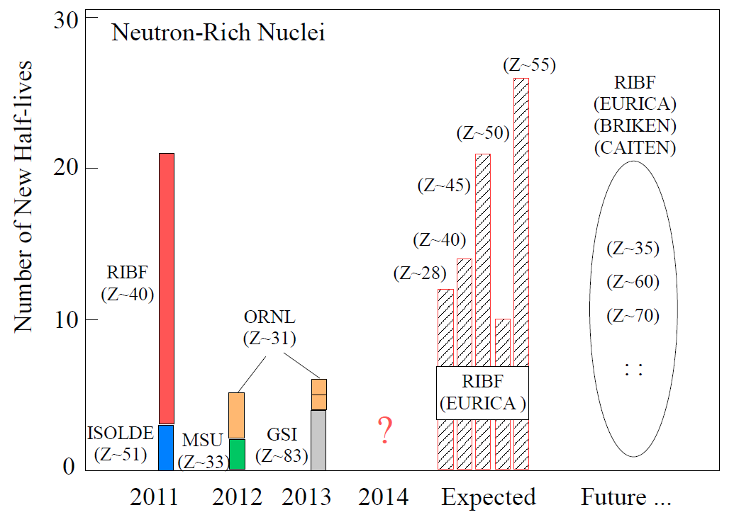
Decay Spectroscopy
S.Nishimura + …
Expected new half-lives
EURICA in 2014, 2015
BRIKEN & CAITEN (2015 ~)
New T1/2 data for more than 100 nuclides would come up soon.

Slide 32
Publications from EURICA
http://ribf.riken.jp/EURICA/
H. Watanabe et al.: Phys. Rev. Lett. 113, 042502 (2014)
Monopole-Driven Shell Evolution below the Doubly Magic Nucleus Sn132
Explored with the Long-Lived Isomer in Pd126
Z. Y. Xu et al.: Phys. Rev. Lett. 113, 032505 (2014)
β-Decay Half-Lives of Co76,77, Ni79,80, and Cu81: Experimental Indication of a Doubly Magic Ni78
J. Taprogge et al.: Phys. Rev. Lett. 112, 132501 (2014)
1p3/2 Proton-Hole State in 132Sn and the Shell Structure Along N = 82
H. Watanabe et al.: Phys. Rev. Lett. 111, 152501 (2013)
Isomers in 126Pd and 128Pd: Evidence for a Robust Shell Closure at the Neutron Magic Number 82
in Exotic Palladium Isotopes
P.-A Söderström et al.: Phys. Rev. C 88, 024301 (2013)
Shape evolution in 116,118Ru: Triaxiality and transition between the O(6) and U(5)
dynamical symmetries

Slide 33
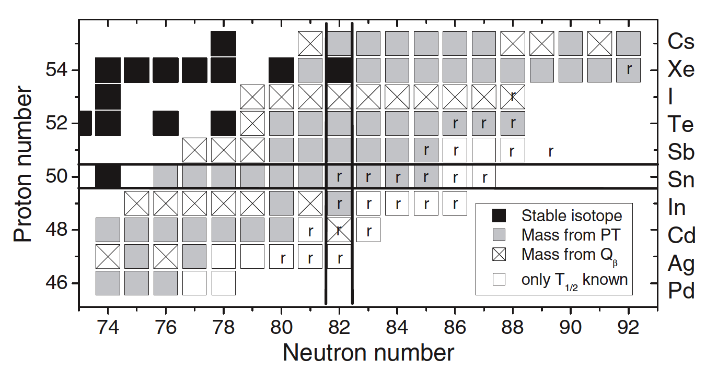
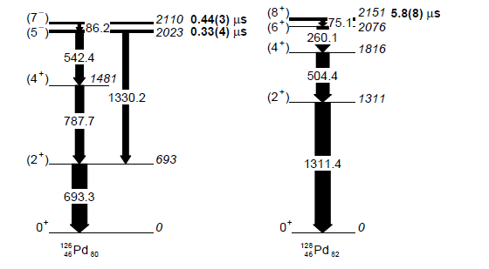
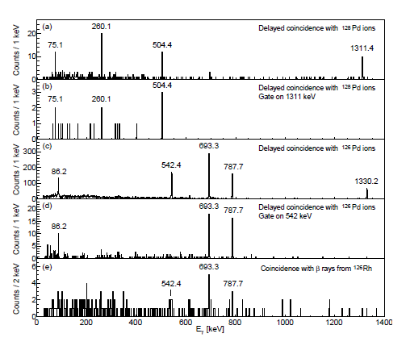
Isomers in 128Pd and 126Pd:
Evidence for a Robust Shell Closure
at the Neutron Magic Number 82 in Exotic Palladium Isotopes
H. Watanabe et al., PRL 111, 152501 (2013)
Typical senority-isomer
observed in Pd-128
No evidence of
shell-quenching ….
T_{1/2} of Cd isotopes
N=80
N=82

Slide 34
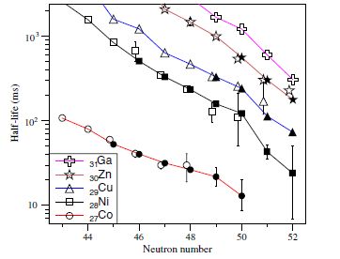
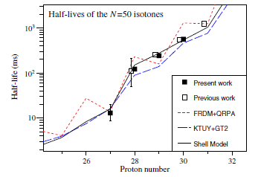
β-Decay Half-Lives of Co76,77, Ni79,80, and Cu81:
Experimental Indication of a Doubly Magic Ni78
Z.Y. Xu et al., Phys. Rev. Lett. 113, 032505 (2014)
NP0702-RIBF10: S. Nishimura
Decay study for 75-78Co, 77-80Ni, 80-82Cu, and 82-83Zn near the N=50 shell closure
Isotope dependence of T1/2
Isotone dependence of T1/2
28
Ni-78
Ni-78
27
50
51

Slide 35
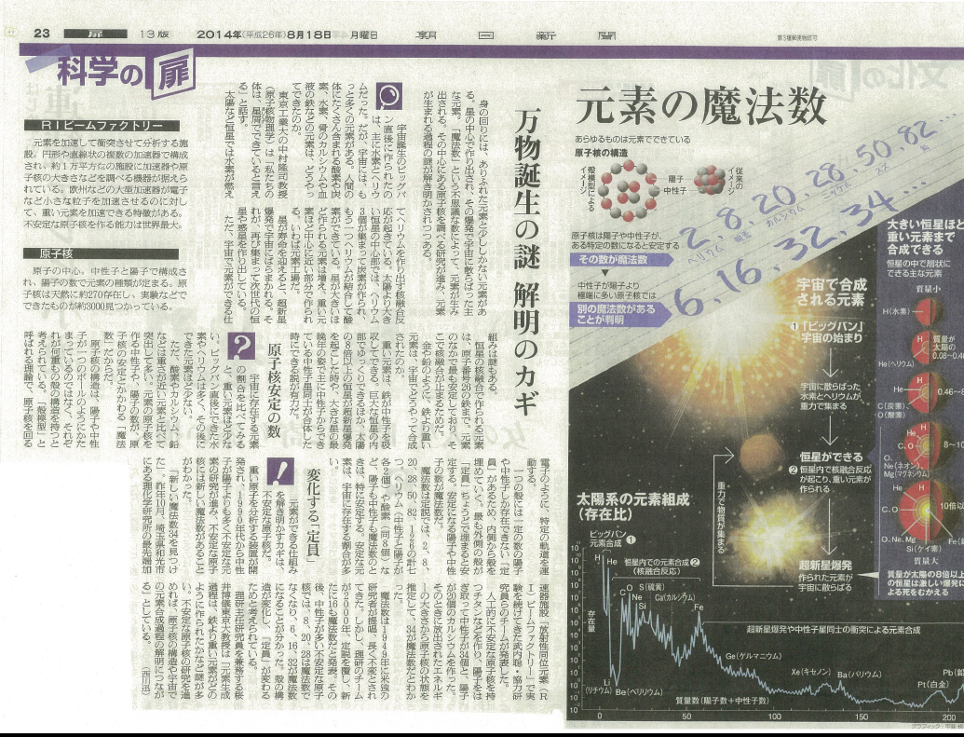
“Asahi Shinbun” News Paper, 18th Aug., 2014
RI Beam Factory
Magic Numbers of Elements

Slide 36




BRIKEN: beta-delayed neutron detection (He-3)
G. Lorusso
S. Nishimura et al
2015-
n + ³He → p(0.574MeV) + t (0.191MeV)
σ=5333b

Slide 37


“Rare RI Ring” for mass measurement
Construction started in April 2012!
Ozawa, Wakasugi, Uesaka et al.
Specialized to mass measurements
of r-process nuclei
Low production rate (~1/day)
Short life time (<50ms)
Key technologies:
Isochronous ring
ΔT/T < 10⁻⁶ for δp/p=±0.5%
Individual injection triggered by
a detector at BigRIPS
efficiency ~ 100%
even for a “cyclotron” beam
Schedule:
2014 Commissioning run
2015~ Mass measurements of RI

Slide 38





RIBF Accelerator Complex : present and future
Uranium beam intensity reached 1000 times compared to the beginning.
RRC
fRC
IRC
RILAC2
SCECR
Typical configuration
He
Be
SRC
RIBF Goal (U)
Beam intensity of ⁴⁸Ca beam reached 415 pnA in 2012.
Delivered 123 pnA of ⁷⁰Zn beam to BigRIPS.
The intensities of U and Xe beams reached 25 pnA and 38 pnA, respectively.
Many renewals in accelerator equipment (fRC, Gas-strippers, Injectors etc.).
2015-2016 upgrade & improvement
to achieve 100pnA U-beam
oven at ECR, RF-power, T control…
GSI present
RIBF Start
New Injector
He gas charge
Stripper
Improvement on
Transmission & Stability
fRC modification
(K570=>K700)
SC-ECR introduced
NCAC 14 Kamigaito

Slide 39

In five years.. (U-beam int. ~ 100 pnA!)
Shunji Nishimura et al.
Z
100 pnA * ~30 days
Accessible RI
Several hundreds of new beta-decay half-lives in five years.
→ Significant contribution in nuclear structure and r-process nucleosynthesis.

Slide 40
Summary
RIBF has started in operation since 2007.
Bunch of data for shell evolution and nuclear astrophysics (r-process path) are being produced via in-beam gamma spectroscopy and decay spectroscopy, and in near future mass measurement.
Primary beam intensity is increased year by year to expand our play ground.

