Slide 1
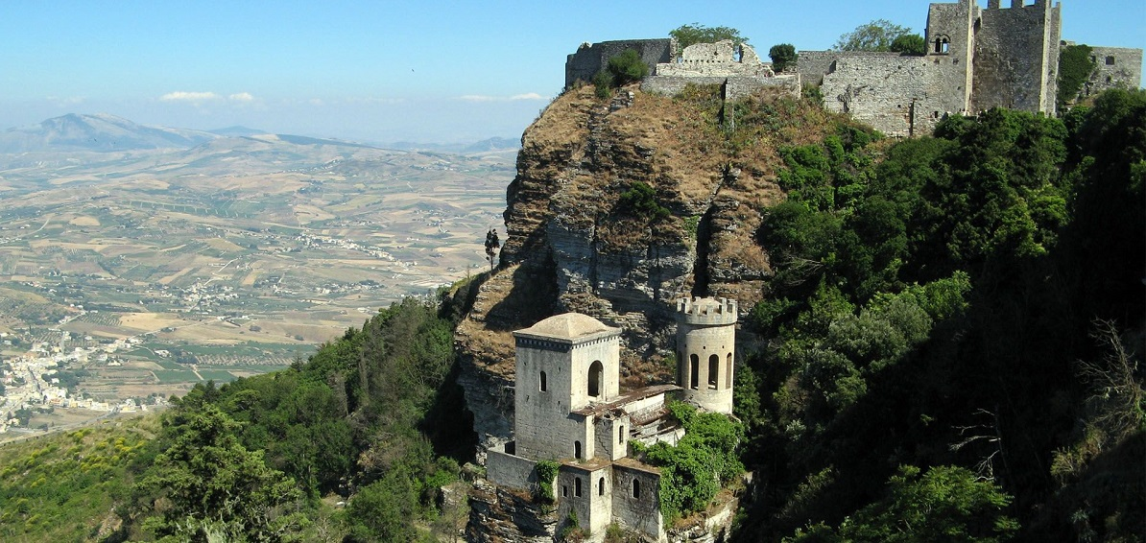

Quark and Glue Components of Proton Spin
Status of nucleon spin components
Momentum and angular momentum sum rules
Lattice results
Quark spin from anomalous Ward identity
Glue spin
erice-sicily.jpg
Erice, Sept. 18, 2015

Slide 2
Where does the spin of the proton come from?

Slide 3
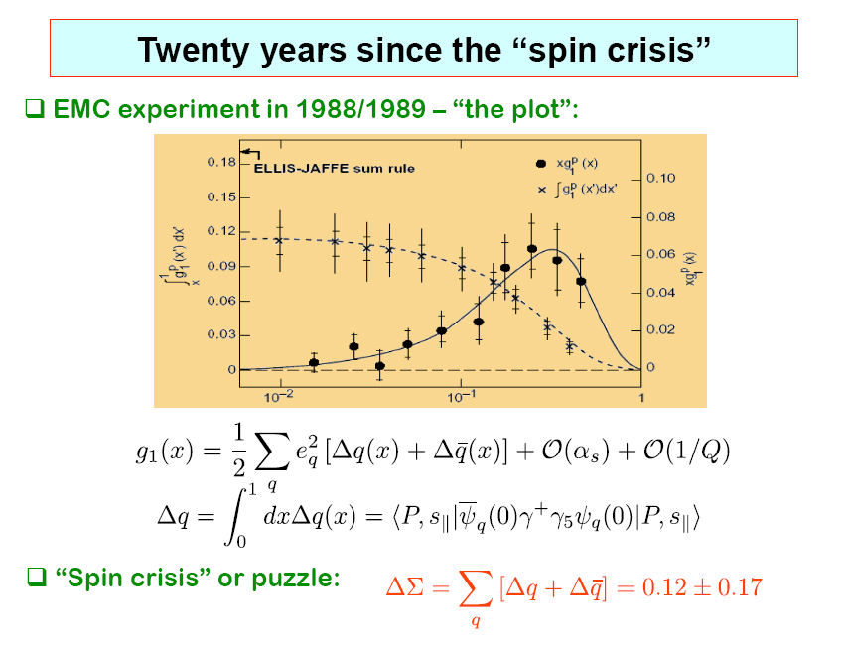
7
∧

Slide 4
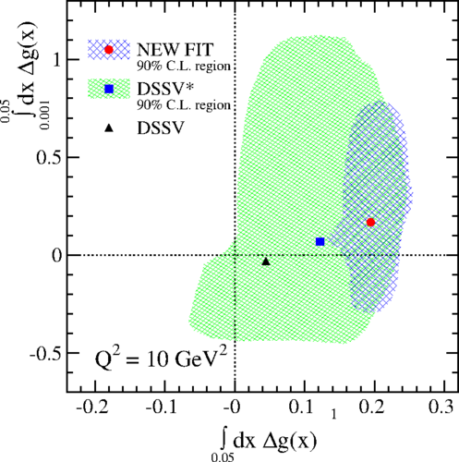
Glue Helicity ΔG
Experimental results from STAR [1404.5134]
PHENIX [1402.6296] COMPASS [1001.4654]
ΔG ~ 0.2 with large error
D. de Florian, R. Sassot, M. Stratmann, W. Vogelsang, PRL 113, 012001 (2014)

Slide 5
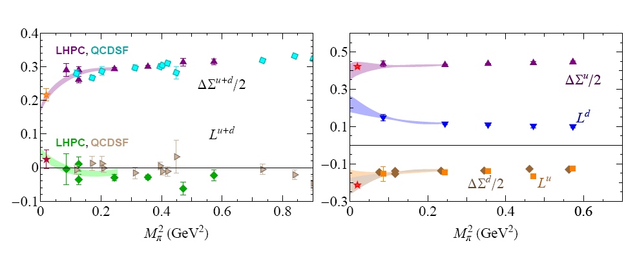
Quark Orbital Angular Momentum (connected insertion)

Slide 6
Status of Proton Spin
Quark spin ΔΣ ~ 20 - 30% of proton spin
(DIS, Lattice)
Quark orbital angular momentum? (lattice calculation (LHPC,QCDSF)→ ~ 0)
Glue spin ~ 0.4 (STAR, PHENIX, COMPASS)
From `proton spin crisis’ to `missing spin puzzle’.
Dark Spin

Slide 7
Hadron Structure with Quarks and Glue
Quark and Glue Momentum and Angular Momentum in the Nucleon

Slide 8
Momenta and Angular Momenta of Quarks and Glue
Energy momentum tensor operators decomposed in quark and
glue parts gauge invariantly --- Xiangdong Ji (1997)
Nucleon form factors
Momentum and Angular Momentum

Slide 9
Renormalization and Quark-Glue Mixing
Momentum and Angular Momentum Sum Rules
Mixing
M. Glatzmaier, KFL
arXiv:1403.7211

Slide 10
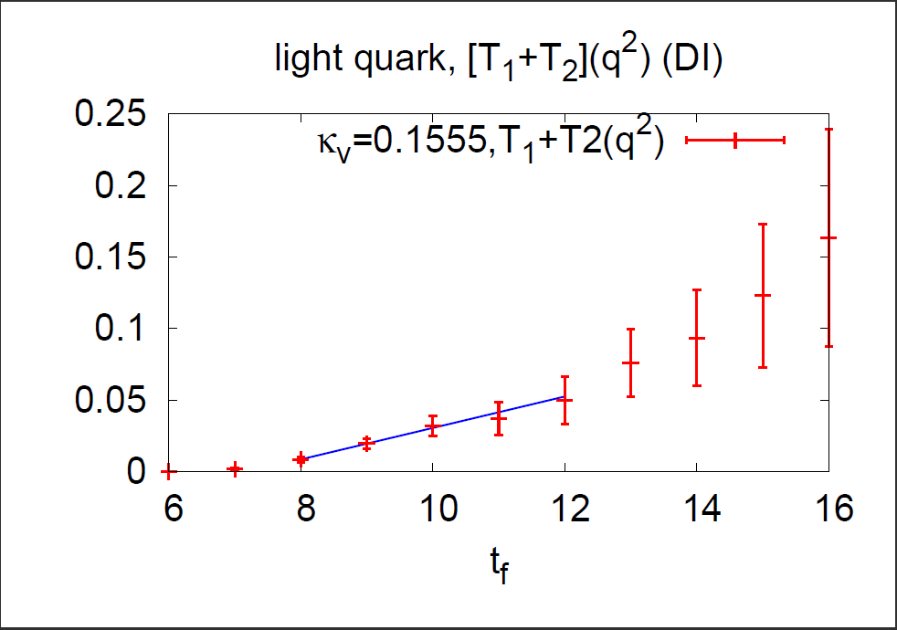
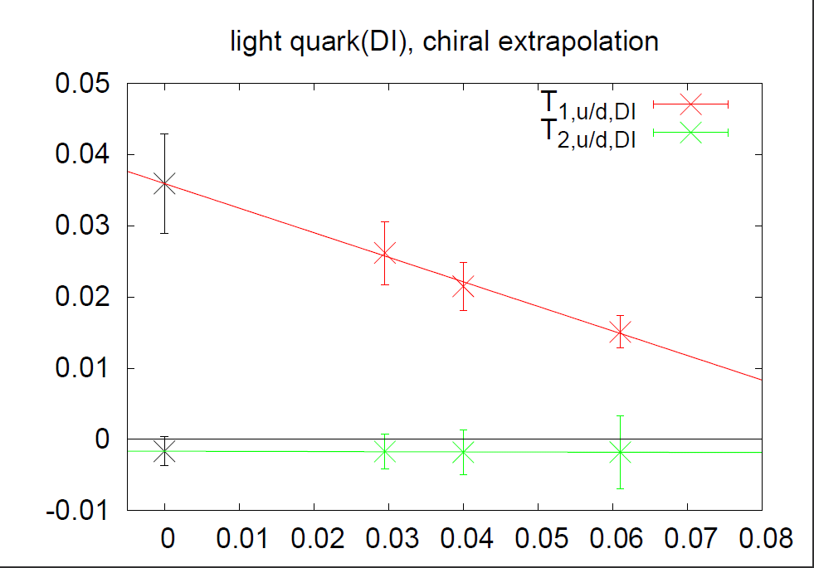
Disconnected Insertions of T₁ (q²) and T₂ (q²) for u/d Quarks
fig_4a.pdf
fig_4a.pdf

Slide 11
Gauge Operators from the Overlap Dirac Operator
Overlap operator
Index theorem on the lattice (Hasenfratz, Laliena, Niedermayer, Lüscher)
Local version (Kikukawa & Yamada, Adams, Fujikawa, Suzuki)
Study of topological structure of the vacuum
  Sub-dimensional long range order of coherent charges
  (Horvàth et al; Thacker talk in Lattice 2006)
  Negativity of the local topological charge correlator (Horvàth et al)

Slide 12
We obtain the following result
where,
Liu, Alexandru, Horvath – PLB 659, 773 (2007)
Noise estimation
with Z₄ noise with color-spin dilution and some dilution in
space-time as well.

Slide 13
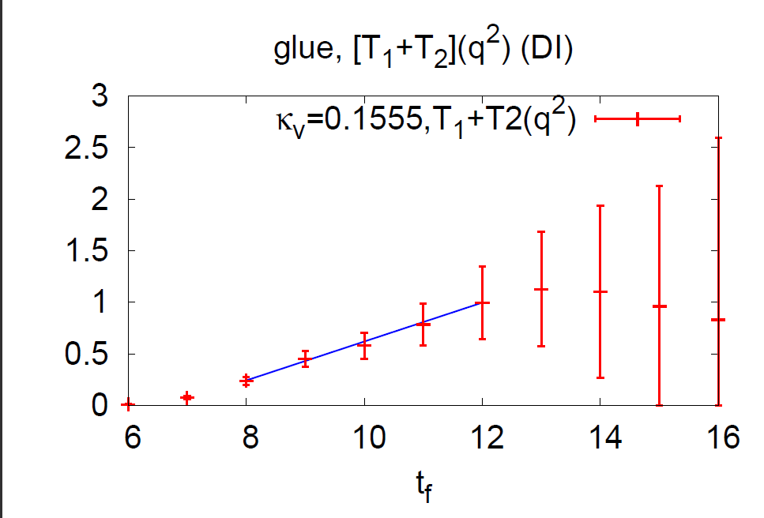
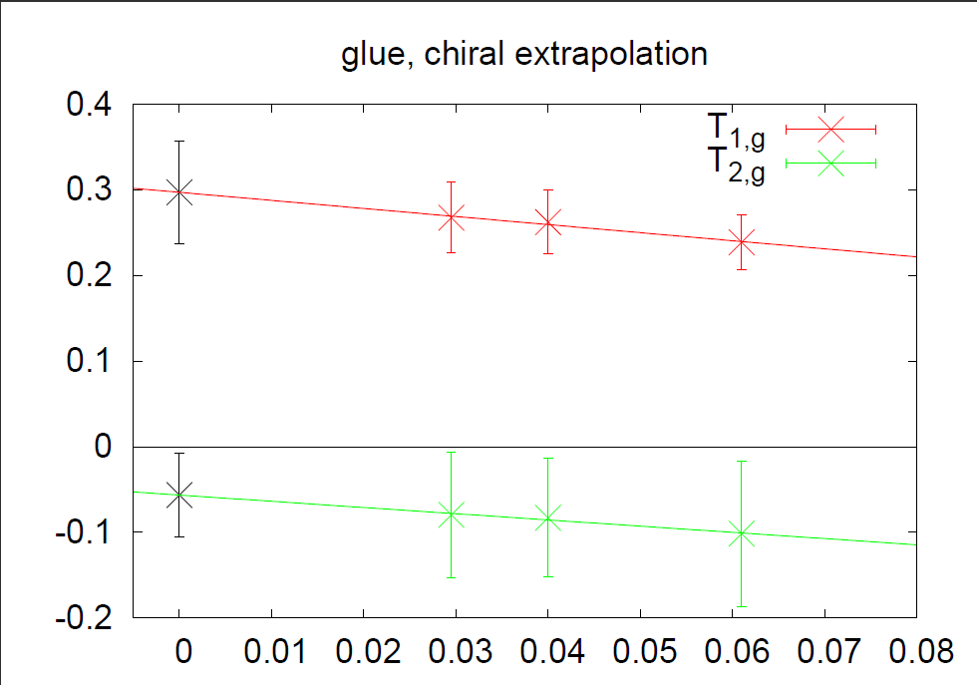
Glue T₁ (q²) and T₂ (q²)
M. Deka et al., PRD (2015), 1312.4816
Quenched 16³ x 24 lattice, β=6.0, m_{Π} ≥ 478 MeV,
500 configurations

Slide 14
Renormalized results: Z_{q} = 1.05, Z_{g} = 1.05
 | CI(u) | CI(d) | CI(u+d) | DI(u/d) | DI(s) | Glue
<x> | 0.416 (40) | 0.151 (20) | 0.567 (45) | 0.037 (7) | 0.023 (6) | 0.334 (56)
T₂(0) | 0.283 (112) | -.217 (80) | 0.061 (22) | -0.002 (2) | -.001 (3) | -0.056 (52)
2J | 0.704 (118) | -.070 (82) | 0.629 (51) | 0.035 (7) | 0.022 (7) | 0.278 (76)
g_{A} | 0.91 (11) | -0.30 (12) | 0.62 (9) | -0.12 (1) | -0.12 (1)
2 L | -0.21 (16) | 0.23 (15) | 0.01 (10) | 0.16 (1) | 0.14 (1)

Slide 15
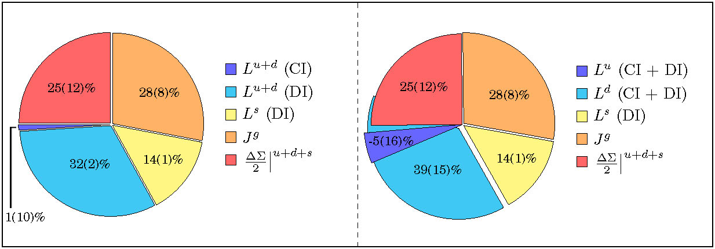
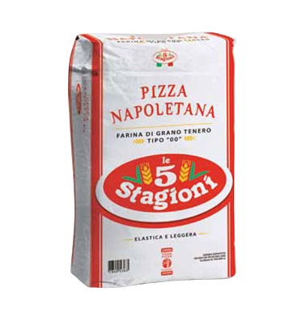
Quark Spin, Orbital Angular Momentum, and Gule Angular Momentum (M. Deka et al, 1312.4816, PRD)
pizza cinque stagioni
These are quenched results so far.

Slide 16
Chiral effective theory of baryons
Little bag model (Brown, Rho)
Clouding bag model (Thomas, Theberge, Miller)
Chiral quark-soliton model (Wakamatsu)

Slide 17
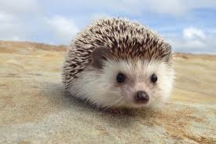
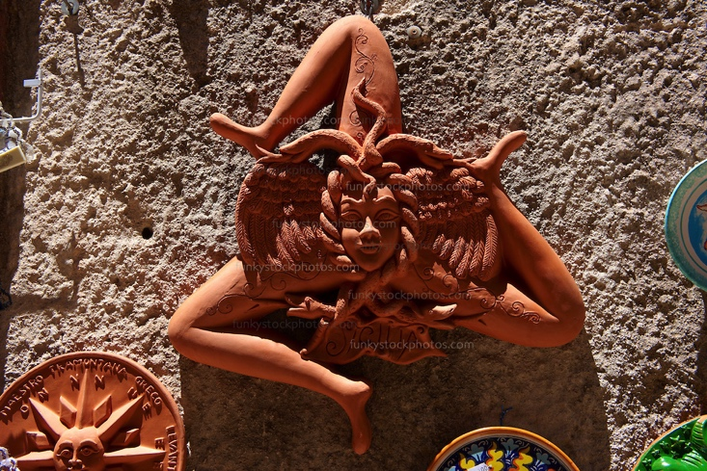
Orbital Angular Momentum
skyrmion
Trinacria, Erice

Slide 18
Quark Spin Calculation with Axial-vector current
Recent calculation of strange quark spin with dynamical fermions
  R. Babich et al. (1012.0562)
  QCDSF (G. Bali et al. 1206.4205) gives
  M. Engelhardt (1210.0025)
  C. Alexandrou et al. (arXiv:1310.6339)
  A.J. Chambers et al. (arXiv:1508.06856)
Leader et al., 1410.1657

Slide 19
Quark Spin from Anomalous Ward Identify
Calculation of the axial-vector in the DI is not sufficient.
AWI needs to be satisfied.
  Overlap fermion --> mP is RGI (Z_{m}Z_{P}=1)
  Overlap operator for has no multiplicative renormalization.
  P is totally dominated by small eigenmodes.
  q(x) from overlap is exponentially local and captures the high modes from A_{μ}⁰.
  Direct check the origin of `proton spin crisis'.

Slide 20
2+1 flavor DWF configurations (RBC-UKQCD)
La ~ 4.5 fm m_{π} ~ 170 MeV
32^3 x 64, a =0.137 fm
(O(a²) extrapolation)
La ~ 2.8 fm m_{π} ~ 330 MeV
La ~ 5.5 fm m_{π} ~ 140 MeV
24^3 x 64, a =0.115 fm
48^3 x 96, a =0.115 fm
La ~ 2.7 fm m_{π} ~ 295 MeV
La ~ 5.5 fm m_{π} ~ 140 MeV
32^3 x 64, a =0.085 fm
64^3 x 128, a =0.085 fm

Slide 21
Connected Insertion from Ward Identity
Y. Yang, M. Gong et al

Slide 22
Disconnected Insertion for the Charm Quark
Topological term is large and negative
Pseudoscalar term and the topological term cancel

Slide 23
Disconnected Insertion for the Strange and u/d Quarks
Strange
u/d (DI)

Slide 24
Anomalous Ward Identity in nucleon at finite q²
Calculate g_{A}(q²), h_{A}(q²), g_{P}(q²), g_{G}(q²) for q² from 0.2 to 1.1 GeV² and fit Z_{A} and Z_{hA.} for the local axial-vector operator
For the 24³ x 64 lattice, 1/Z_{A}= 0.39(3), 1/Z_{hA.}= 12(6)
This explains why the previous calculation of Δs with
axial-vector currents are small.

Slide 25
Renormalized Δs
Δs = - 0.068(8)

Slide 26
Quark Spin from AWI
Overlap fermion on 2+1 flavor 24³×64 DWF lattice (L=2.8 fm)
g_{A}⁰ comp | m_{Π}=330 MeV (m_{V}=m_{sea})
Δu+Δd (CI) | 0.57(2)
Δc | ~0
Δs | -0.068(8)
Δu(DI)=Δd(DI) | -0.09(2)
g_{A}⁰ | 0.32(5)
The triangle anomaly (topological charge) is responsible for the smallness of quark spin in the proton (`proton spin crisis).

Slide 27
Glue Spin and Helicity ΔG
Jaffe and Manohar -- spin sum rule on light cone
  Not gauge invariant
  Light cone not accessible on the Euclidean lattice.
Manohar – gauge invariant light-cone distribution
  After integration of x, the glue helicity operator is
  Non-local and on light cone
Manohar
X.S. Chen, T. Goldman, F. Wang; Wakamatsu; Hatta, etc.
X. Ji, J.H. Zhang, Y. Zhao; Y. Hatta, X. Ji, Y. Zhao

Slide 28
Glue Spin and Helicity ΔG
X.S. Chen, T. Goldman, F. Wang; Wakamatsu; Hatta, etc.
  Gauge invariant but frame dependent
X. Ji, J.H. Zhang, Y. Zhao; Y. Hatta, X. Ji, Y. Zhao
Gauge invariant decomposition
Infinite momentum frame

Slide 29
Glue Spin and Helicity ΔG
Large momentum limit
  Calculate S_{g} at finite P_{z}
  Match to MS-bar scheme at 2 GeV
  Large momentum effective theory to match to IMF
Solution of A_{phys} -- related to A in Coulomb gauge

Slide 30
S_{G} in Coulomb gauge at p² = 0 to 1.24 GeV²
on the 24³ x 64 and 32³ x 64 lattices
Y. Yang ( ),
Preliminary
S_{G} = 0.13(3)

Slide 31
Summary and Challenges
Decomposition of proton spin and hadron masses into quark and glue components on the lattice is becoming feasible. Large momentum frame for the proton to calculate glue helicity remians a challenge.
`Proton Spin Crisis’ is likely to be the second example of observable U(1) anomaly.
Continuum limit at physical pion mass and large lattice volume (5.5 fm) with chiral fermions are being carried out.

Slide 33
Challenges ahead
Continuum limit and physical pion extrapolations with 3 smaller lattices
48³ x 96 and 60³ x 128 lattices with large number of eigenvectors (~ 2000)
Decomposition of glue angular momentum into glue helicity and glue orbital angular momentum

Slide 34
T₁ (q²) and T₂ (q²)
3-pt to 2-pt function ratios
Need both polarized and unpolarized nucleon and different kinematics (p_{i}, q_{j}, s)
to separate out T₁ (q²), T₂ (q²) and T₃ (q²)

Slide 35
Z₃ grid (64) source with low-mode substitution
32³ x 64 lattice, m_{l} (sea)= 0.004 at m_{Π} ~ 200 MeV, 50 conf.

Slide 36
Lattice Parameters
Quenched 16³ x 24 lattice with Wilson fermion
Quark spin and <x> were calculated before for both the C.I. and D.I.
κ = 0.154, 0.155, 0.1555 (m_{π} = 650, 538, 478 MeV)
500 gauge configurations
400 noises (Optimal Z₄ noise with unbiased subtraction) for DI
16 nucleon sources

Slide 37
Renormalized results: Z_{q} = 1.05, Z_{g} = 1.05
 | CI(u) | CI(d) | CI(u+d) | DI(u/d) | DI(s) | Glue
<x> | 0.416 (40) | 0.151 (20) | 0.567 (45) | 0.037 (7) | 0.023 (6) | 0.334 (56)
T₂(0) | 0.283 (112) | -.217 (80) | 0.061 (22) | -0.002 (2) | -.001 (3) | -.056 (52)
2J | 0.704 (118) | -.070 (82) | 0.629 (51) | 0.035 (7) | 0.022 (7) | 0.278 (76)
I.Yu. Kobzarev, L.B. Okun, Zh. Eksp. Teor. Fiz. 43, 1904 (1962) [Sov. Phys. JETP 16, 1343 (1963);
S. Brodsky et al. NPB 593, 311(2001) → no anomalous gravitomagnetic
moment

Slide 38
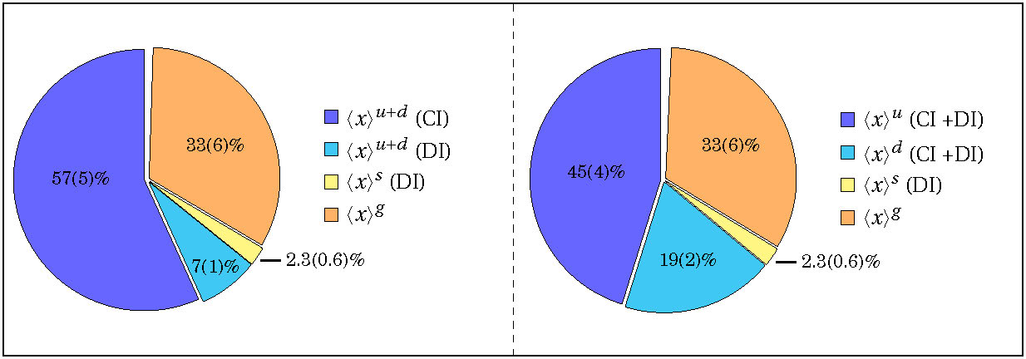
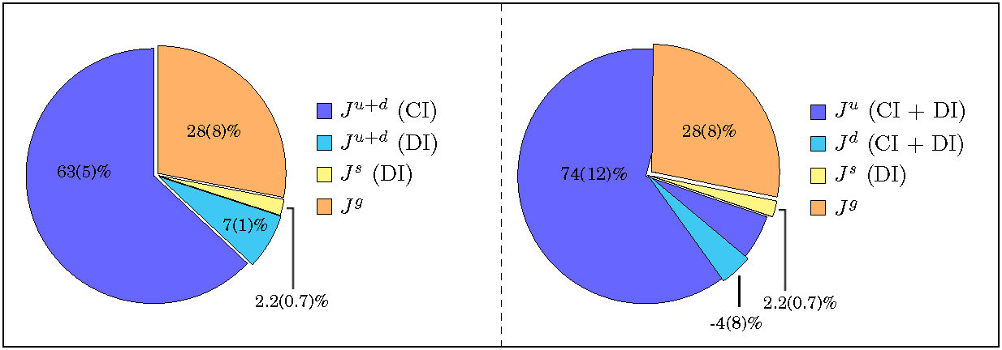
Momentum fractions <x>^{q}, <x>^{g}
Angular Momentum fractions J^{q}, J^{g}

Slide 39
Flavor-singlet g_{A}
Quark spin puzzle (dubbed `proton spin crisis’)
  NRQM
  RQM
  Experimentally (EMC, SMC, …

Slide 40
S.J. Dong, J.-F. Lagae, and KFL, PRL 75, 2096 (1995)
 | Lattice | Expt. (SMC) | NRQM | RQM
 | 0.25(12) 1.20(10) 0.61(13) 0.79(11) -.42(11) -.12(1) 0.45(6) 0.75(11) 0.60(2) | 0.22(10) 1.2573(28) 0.579(25) 0.80(6) -0.46(6) -0.12(4) 0.459(8) 0.798(8) 0.575(16) | 1 5/3 1 1.33 -0.33 0 0.67 1 0.67 | 0.75 1.25 0.75 1 -0.25 0 0.5 0.75 0.67

Slide 41
Renormalized results:
 | CI(u) | CI(d) | CI(u+d) | DI(u/d) | DI(s) | Glue
2J | 0.704 (118) | -.070 (82) | 0.629 (51) | 0.035 (7) | 0.022 (7) | 0.278 (76)
g_{A} | 0.91 (11) | -0.30 (12) | 0.62 (9) | -0.12 (1) | -0.12 (1)
2 L | -0.21 (16) | 0.23 (15) | 0.01 (10) | 0.16 (1) | 0.14 (1)

Slide 42
Summary of Quenched Lattice Calculations
Complete calculation of momentum fractions of quarks (both valence and sea) and glue have been carried out for a quenched lattice:
  Glue momentum fraction is ~ 33%.
  g_{A}⁰ ~ 0.25 in agreement with expt.
  Glue angular momentum is ~ 28%.
  Quark orbital angular momentum is large for the sea quarks (~ 47%).
These are quenched results so far.

Slide 43
Dynamical
Fermions
Isovector g_{A}³ from recent lattice calculations with dynamical fermions
Concerns about excited state contamination and volume dependence
James Zanotti, Parallel-VIII:S4

