Slide 1
Status and Prospects of Hadron Physics at LEPS in Japan
Takashi Nakano (RCNP, Osaka Univ.)
International School of Nuclear Physics
37th Course: Probing hadron structure with lepton and hadron beams
16-24 September, 2015 @ Erice-Sicily

Slide 2
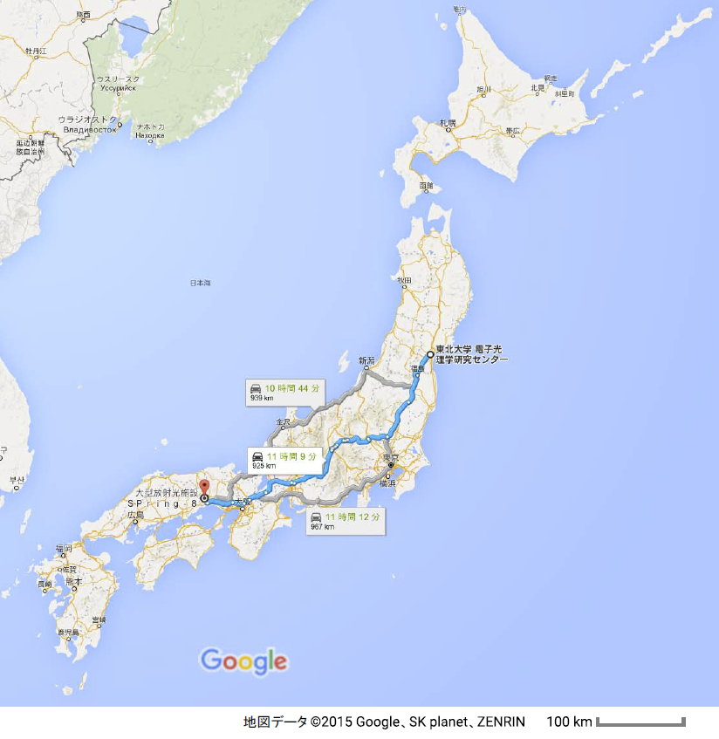
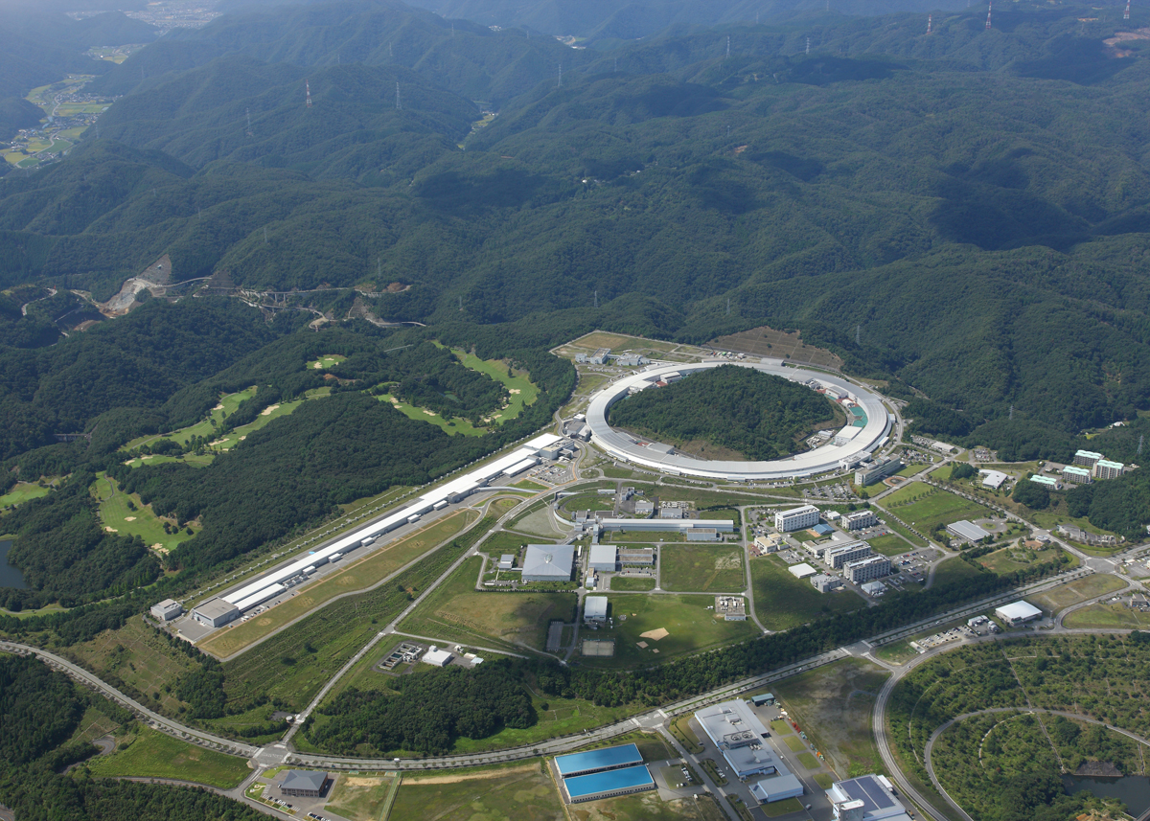
SPring-8/LEPS, LEPS2
LEPS2
LEPS

Slide 3
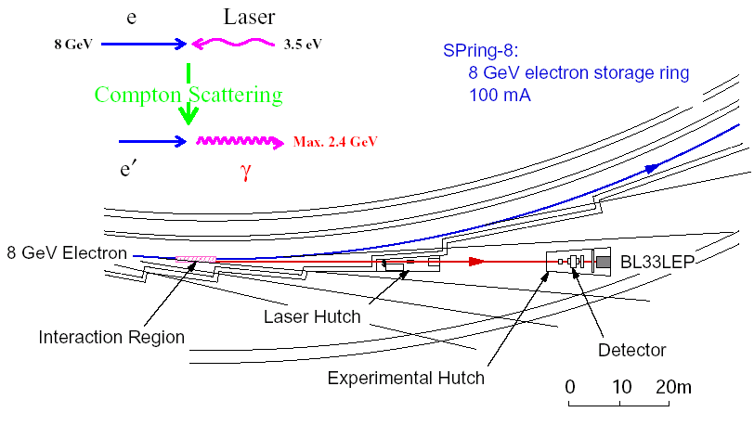
Laser Electron Photon beamline at SPring-8
Operated since 2000.

Slide 4
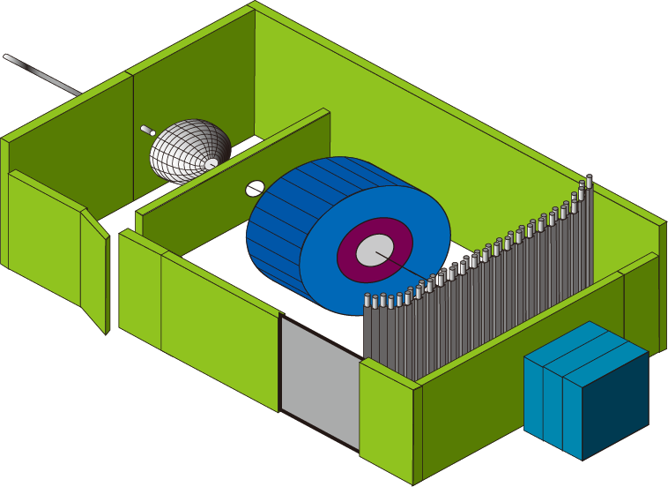
Outline of the LEPS2 facility
Backward Compton scattering
8 GeV electron
10 times high intensity:
Multi-laser injection &
Laser beam shaping
Storage ring
Recoil electron
(tagging)
30m long line
Laser
~135 m
LEP
(GeV γ -ray)
Laser room
Inside SR bldg
BGOegg
LEPS2
spectrometer
Best e-beam divergence
(12 μrad)
Photon beam
does not spread out
→ Construct experimental
apparatus outside SR bldg
Outside SR bldg
BGO EM calorimeter
Large LEPS2 spectrometer
using BNL/E949 magnet
➔expect better resolutions
Experimental bldg
Beam dump

Slide 5
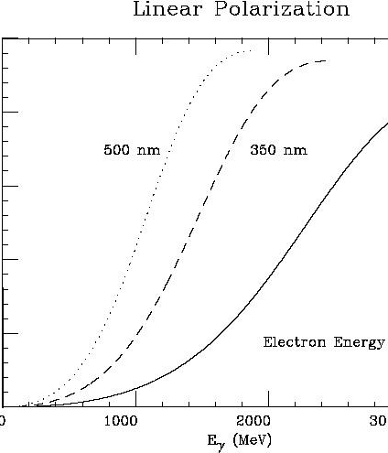
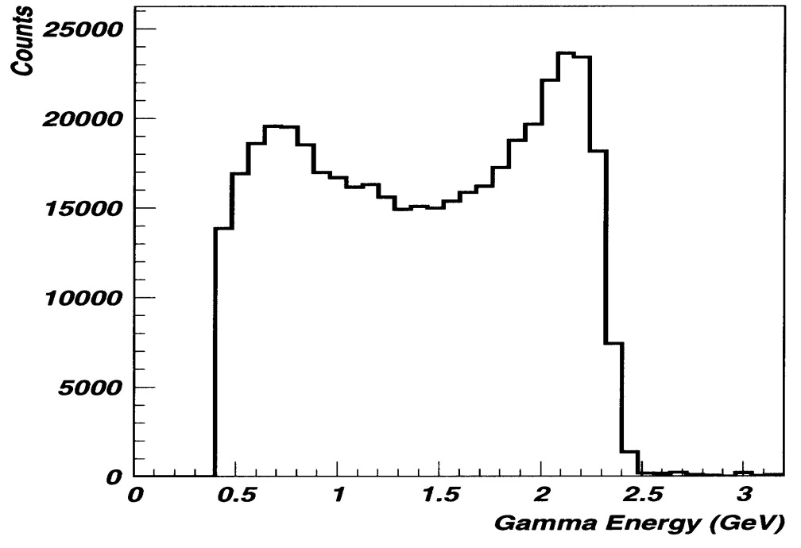
Backward-Compton Scattered Photon
8 GeV electrons in SPring-8 + 350nm(260nm) laser
➔ maximum 2.4 GeV(2.9 GeV) photon
Laser Power ~6 W ➔ Photon Flux ~1 Mcps
Eγ measured by tagging a recoil electron ➔ Eγ>1.4 GeV, ΔEγ ~10 MeV
Laser linear polarization 95-100% ⇒ Highly polarized γ beam
Linear Polarization of γ beam
PWO measurement
tagged
photon energy [GeV]
photon energy [MeV]

Slide 6
Decay polarization with linearly polarized photons→ parity filter
φ → K⁺ + Κ⁻, K*⁰ → K⁺ + π⁻
ε_{γ}
K⁺
Decay Plane // γ
natural parity exchange (-1)^{J}
(Pomeron, Scalar mesons (κ), K*)
Κ⁻π⁻
Photon Polarization
ε_{γ}
K⁺
Decay Plane γ
unnatural parity exchange -(-1)^{J}
(Pseudoscalar mesons (π, Κ))
Κ⁻, π⁻

Slide 7
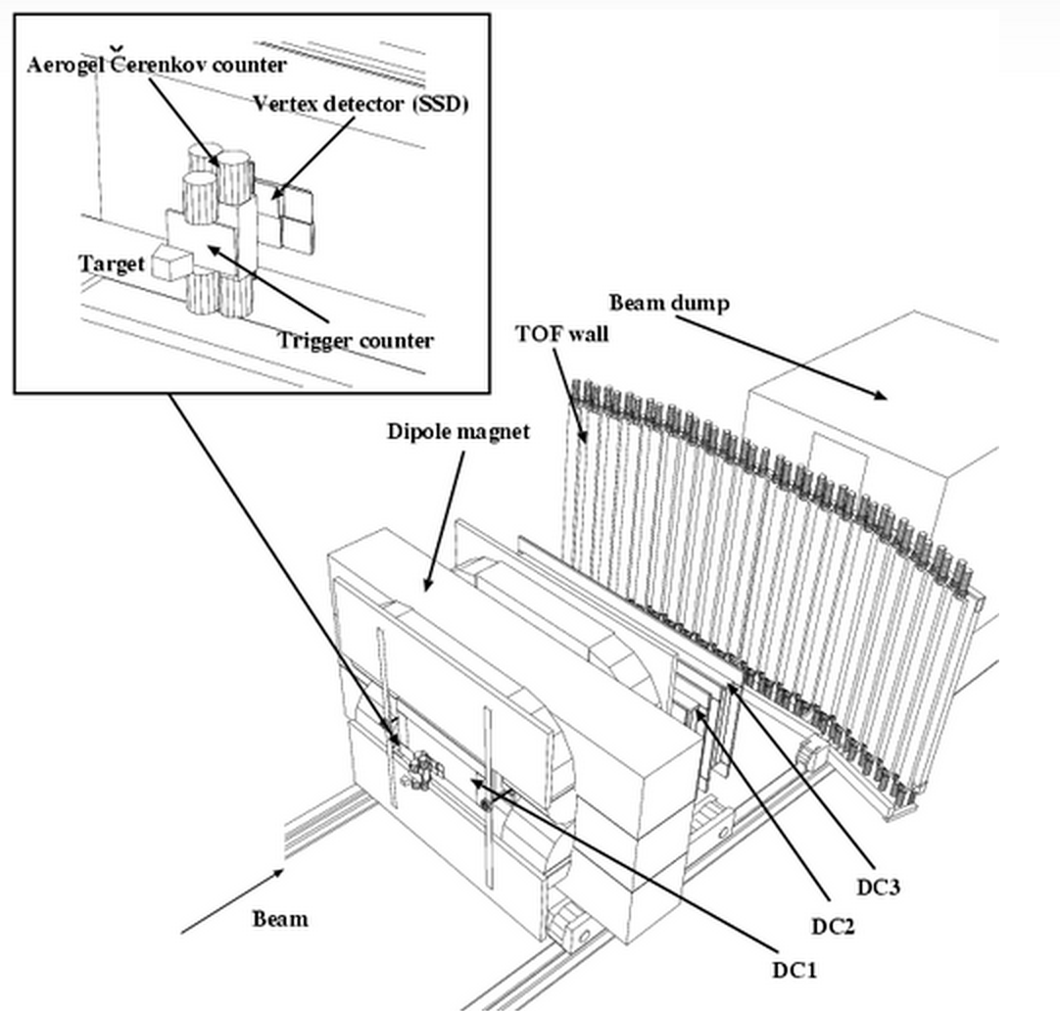


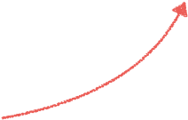

LEPS spectrometer
AC
SSD
・Dipole magnet : 0.7 Tesla
・Acceptance :
        Hori : ± 20°
        Vert : ± 10°
・AC index : 1.03
(reject 0.6 GeV/c π)
Start counter (STC)
K⁺
K⁻
y
x
z
DC3
・Eγ = 1.5 ~ 2.4 GeV
・tagger rate : ~10⁶ cps
・trigger rate : ~ 100 cps
Beam
DC2
DC1
7

Slide 8
γp→φp
T. Mibe et al., Phys. Rev. Lett. 95, 182001 (2005)
From decay asymmetry, the relative strength of natural-party processes to unnatural-parity ones is the same in the peak and off-peak regions.
Possible presence of additional natural parity exchange → signature of 0+ glueball trajectory??

Slide 9

Decay Angular Distributions of γp→φp
Peak
ρ¹₁₋₁=0.197 ±0.030
Off Peak
ρ¹₁₋₁=0.189 ±0.024
W ∝ sin²θ → helicity-conserving processes are dominating.
ρ¹₁₋₁∼0.2→N/(N+UN) ~70%.

Slide 10
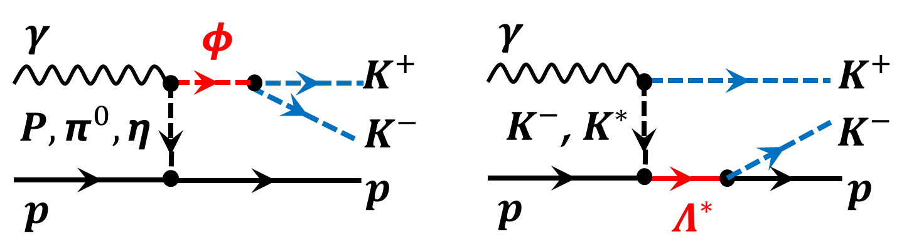
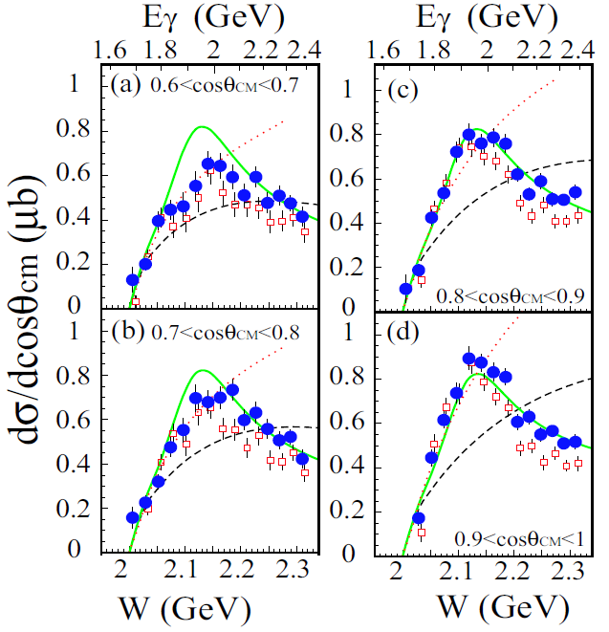
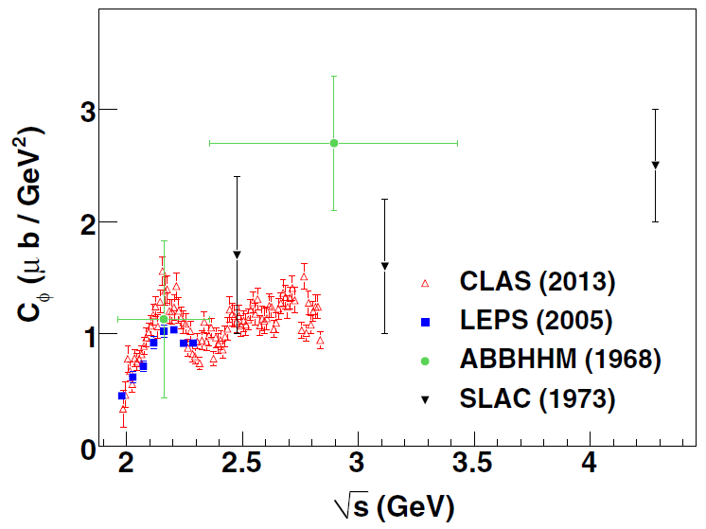
Possible interference between φ and Λ∗(1520) photo-productions

Slide 11
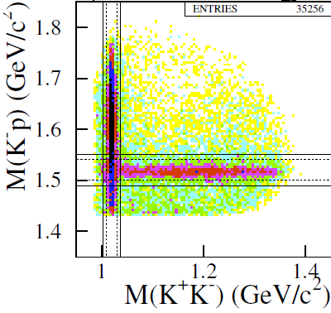
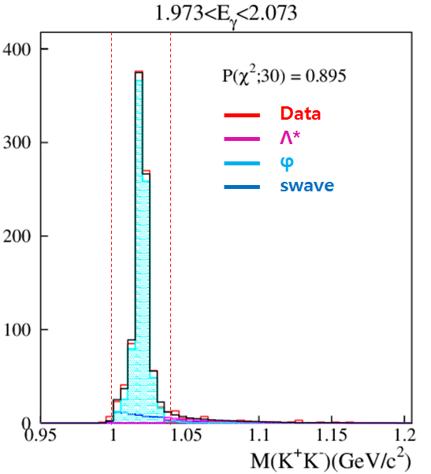
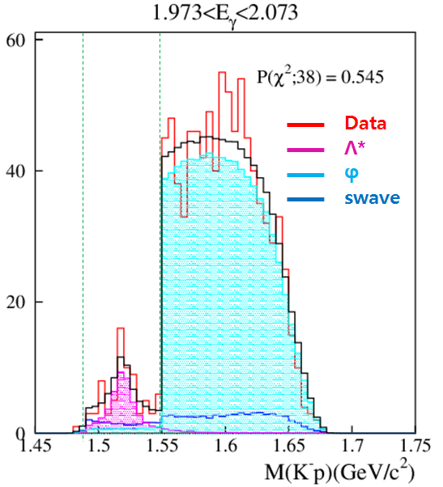
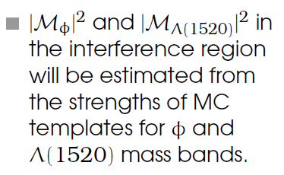
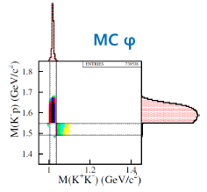
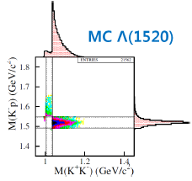
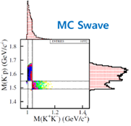
Data analysis

Slide 12
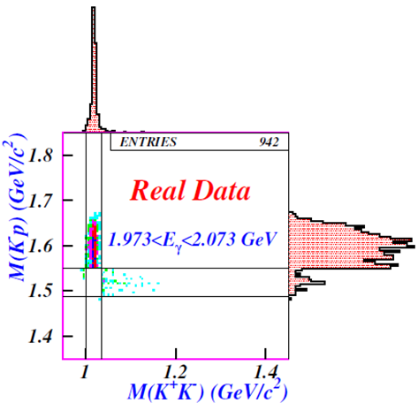
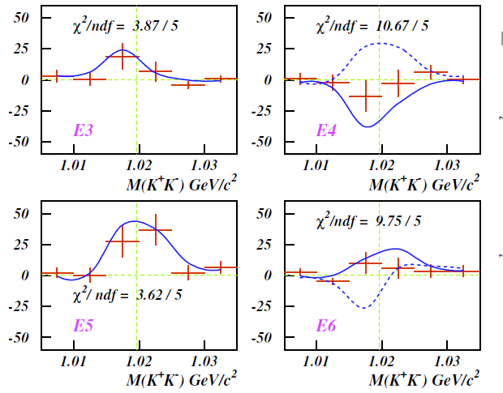
Interference between M_{φ} and M_{Λ(1520)}
Preliminary
Interference Yields (K+K-)
Scatter Plots of the K-K+ and K-p Masses

Slide 13
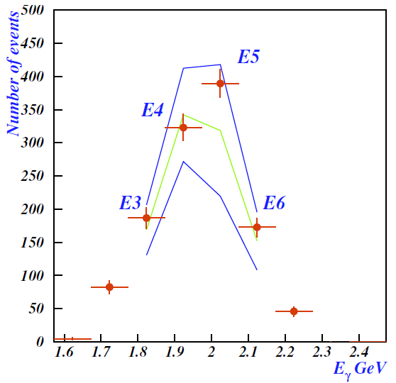
Interference between M_{φ} and M_{Λ(1520)}
Strong constructive interference is seen when the K+K- pairs are observed at forward angles.
However, the interference cannot account for 2.0GeV bump structure in forward differential cross sections for photo-production.
constructive
Preliminary
destructive
S. Y. Ryu, PhD thesis, (2015)

Slide 14
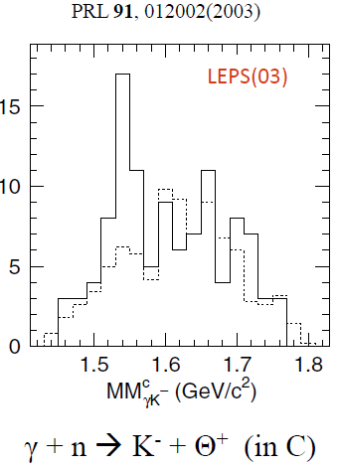
Θ⁺ search
Pentaquark (uudds) low mass
  1540 MeV (naïve QM ~1900 MeV)
narrow width
  Γ < 10 MeV
experimental search
  First evidences from LEPS & DIANA in 2003
  negative results from CLAS(2006) & many other experiments

Slide 15
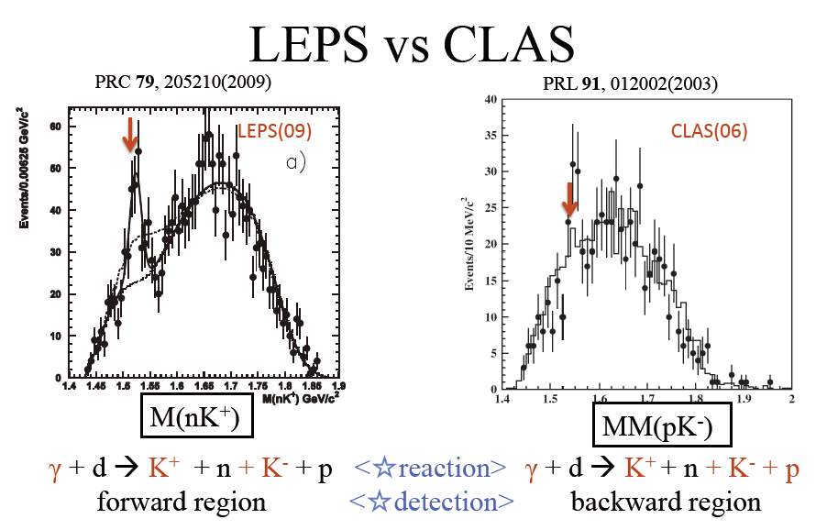

Slide 16
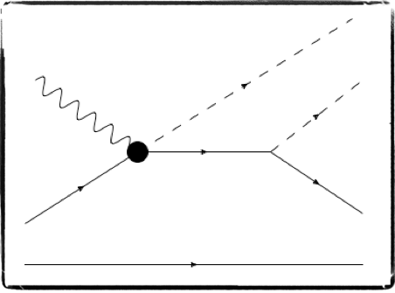



Θ⁺ study at LEPS
Θ⁺ production via γd → K⁻Θ⁺ → K⁻K⁺pn
signal events
K⁻
reference events
K⁺
γ
γ
K⁺
K⁻
Θ⁺
Λ(1520)
p
n
n
p
p
spectator
p
n
spectator
n
signal events : γn → K⁻K⁺n
reference events : γp → K⁻K⁺p
Spectator can not escape from the target.
n/p separation is possible by improving the proton detection efficiency.
16

Slide 17
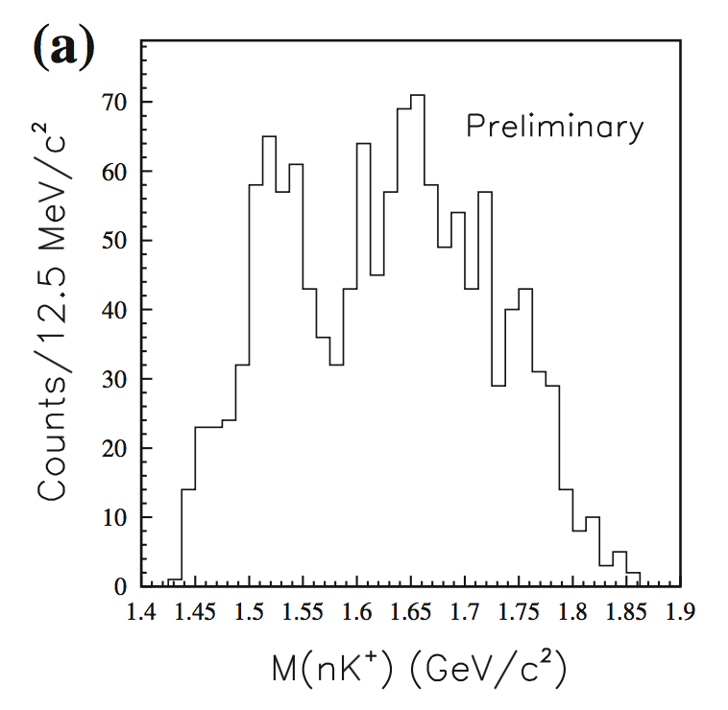
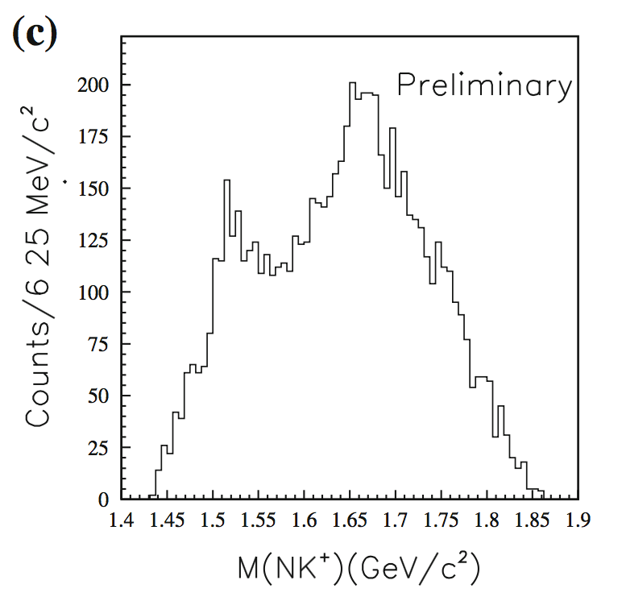
Effect of proton rejection
2003-04 & 2006-07 data
proton rejection cut
z-vertex cut
90% of proton events (with a neutron spectator) are identified by selecting events stemming from the downstream part of the target. Enhancement is seen in the Θ⁺ signal region.
Repeat the experiment with improved proton detection efficiency.
17

Slide 18
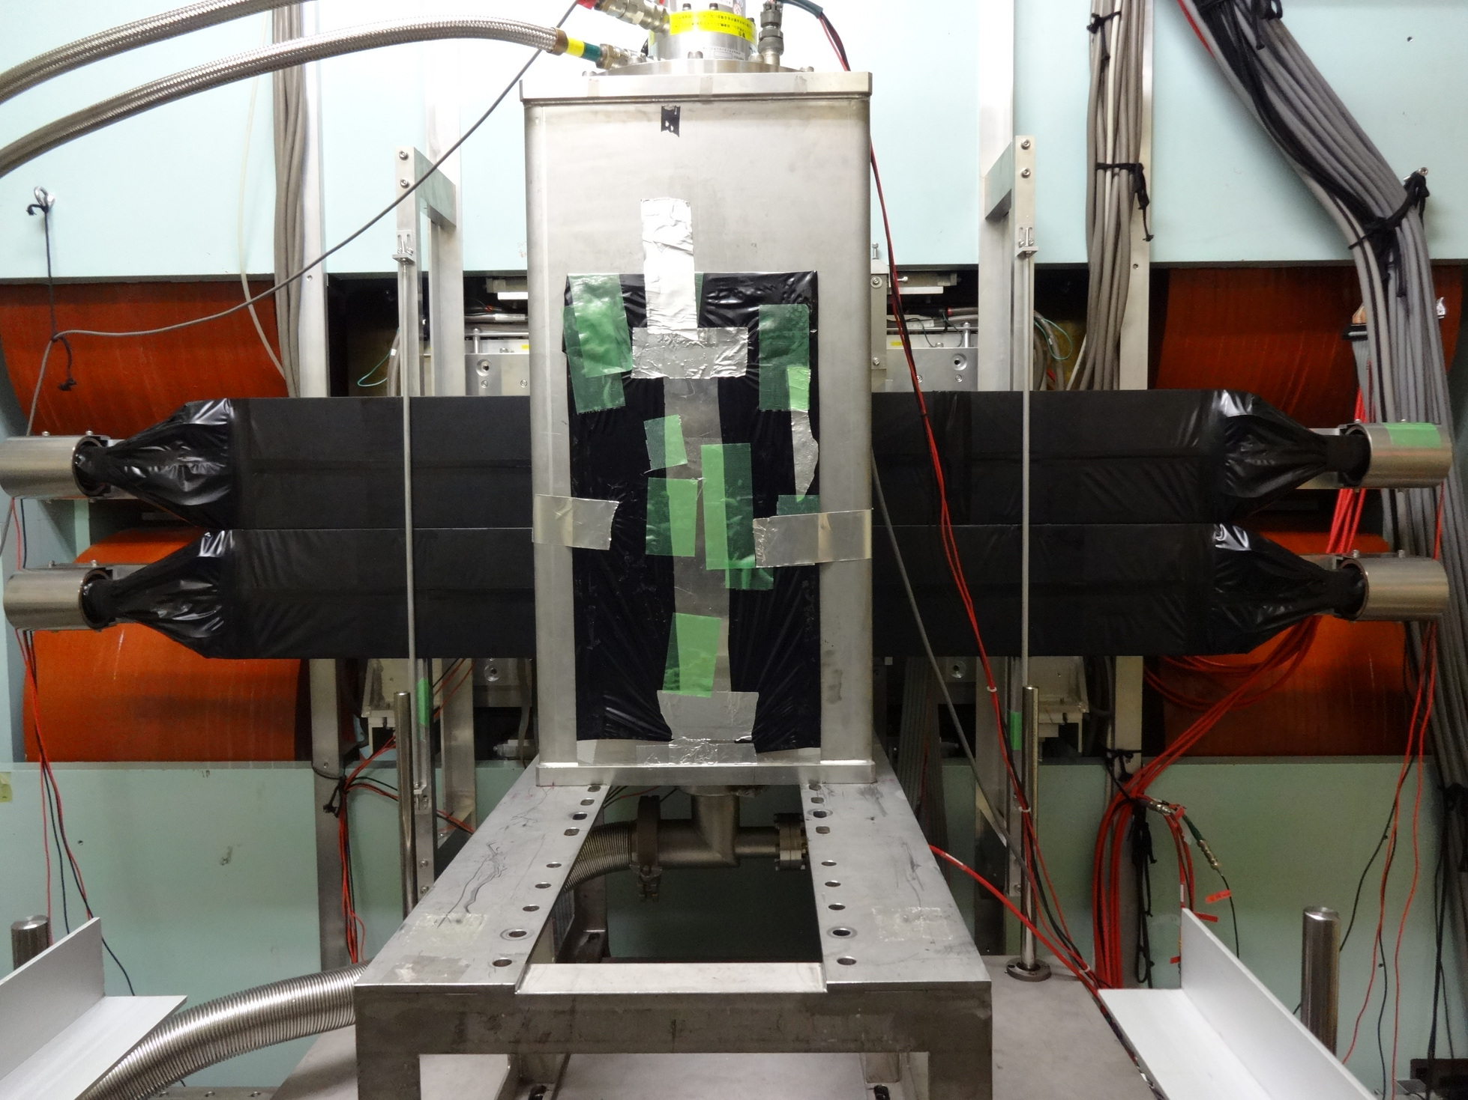
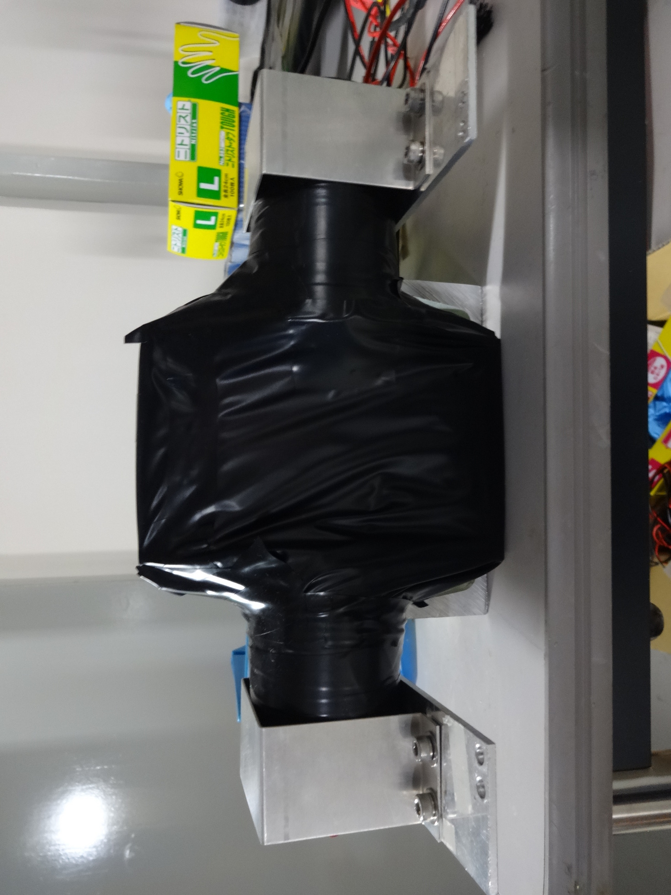
2006 - 2007
2013 - 2014
Small STC
  x : 150 mm
  y : 94 mm
  z : 5 mm
Large STC (LSTC)
  x : 780 mm
  y : 340 mm
  z : 10 mm
18

Slide 19
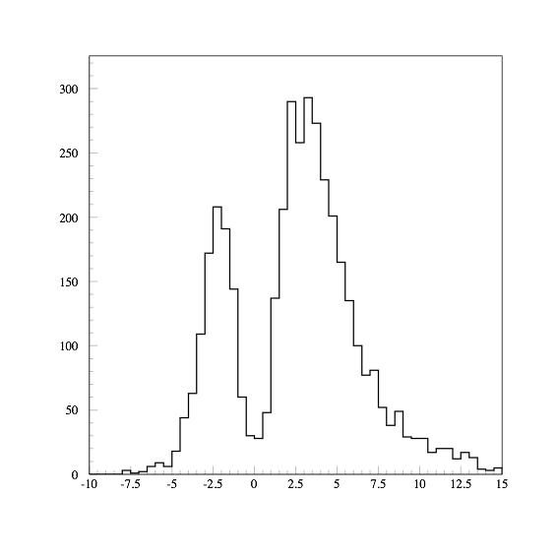
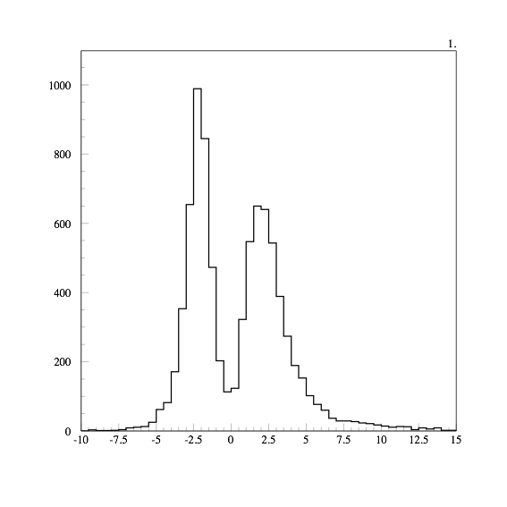
proton detection with STC
proton untagged with STC
p
2006 - 2007 LH2
2013 - 2014 LH2
K⁺
K⁺,K⁻
detect
K⁺,K⁻,p
detect
K⁺,K⁻
detect
K⁺,K⁻,p
detect
K⁻
or
signal
n
K⁺
K⁻
proton tagged with STC
energy loss at STC
energy loss at STC
p
K⁺
Proton detection efficiency is improved by using large-area start counter (STC) in 2013-2014 run.
K⁻
19

Slide 20
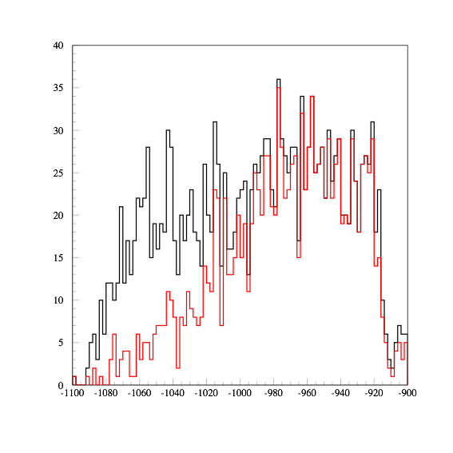
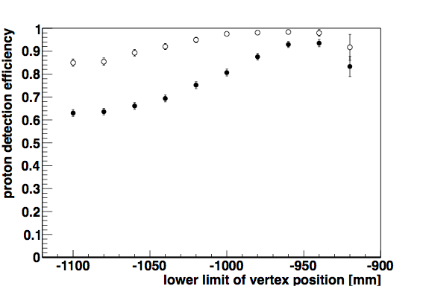


Measured proton detection efficiency
z-vertex point dependence
2013 - 2014
2006 - 2007
Counts
2013 - 2014
90% point
2006 - 2007
90% point
⚫︎ : 2006 - 2007 LH2
⚪︎ : 2013 - 2014 LH2
z-vertex [mm]
Overall proton detection efficiency is:
~60% for 2006-7data
~85% for 2013-14 data
Events from LH2 target.
efficiency becomes ~90 % for events
with z-vertex > -960 mm for 2006-07 data
with z-vertex > -1040 mm for 2013-14 data
20

Slide 21
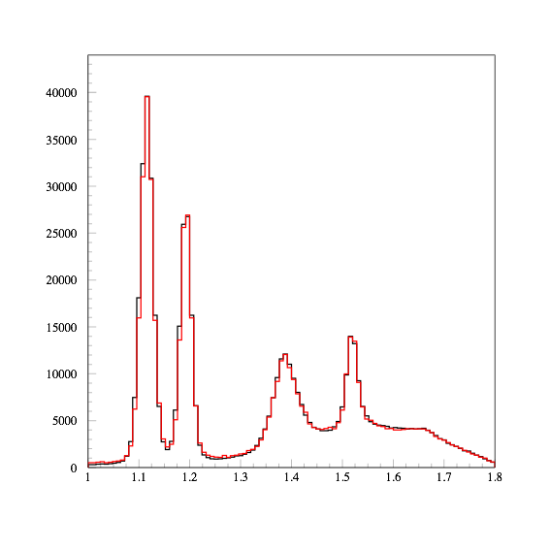
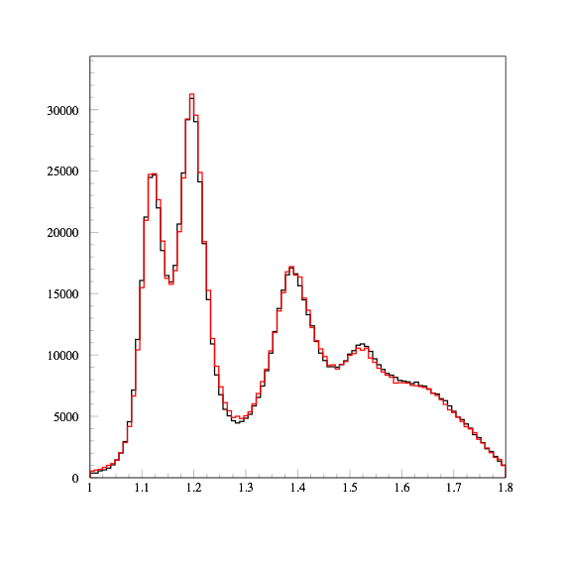
K⁺ missing mass spectra
assuming proton mass for missing mass calculation
γp → K⁺X
γd → K⁺X
Counts
2006 - 2007
2013 - 2014
Counts
2006 - 2007
2013 - 2014
New Θ⁺ result from LEPS will be reported in several months.
MM(K⁺) [GeV/c²]
MM(K⁺) [GeV/c²]
21
Quality of K⁺ missing mass spectra are the almost same.

Slide 22
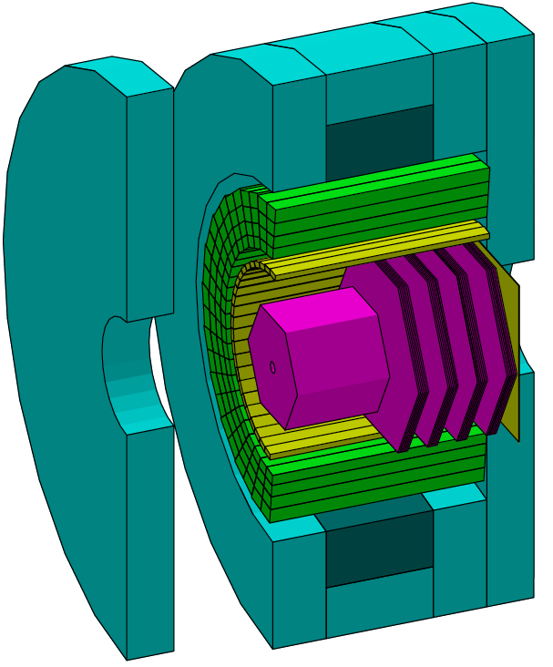
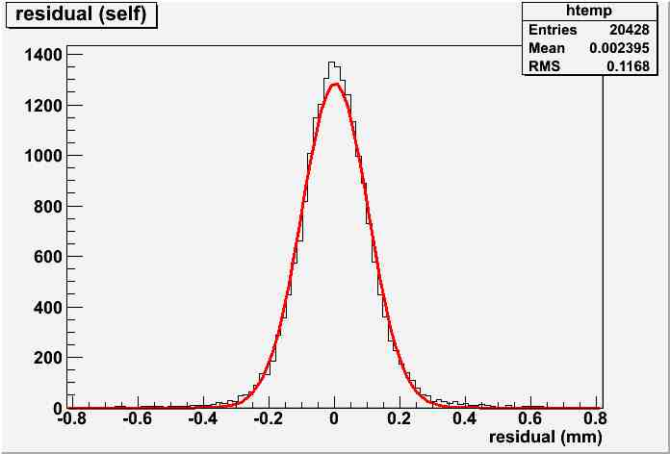
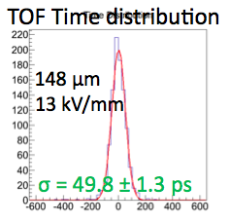
LEPS2 Detector
B=1 T : Δp/p ∼ 1% for θ >7°
2.22 m
RMS=117 μm
γ counter
RPC
TOP
TPC Prototype Residual
RPC ToF time distribution
γ
TPC
DC
5 m
>3σ K/π separation @1.1 GeV/c²

Slide 23
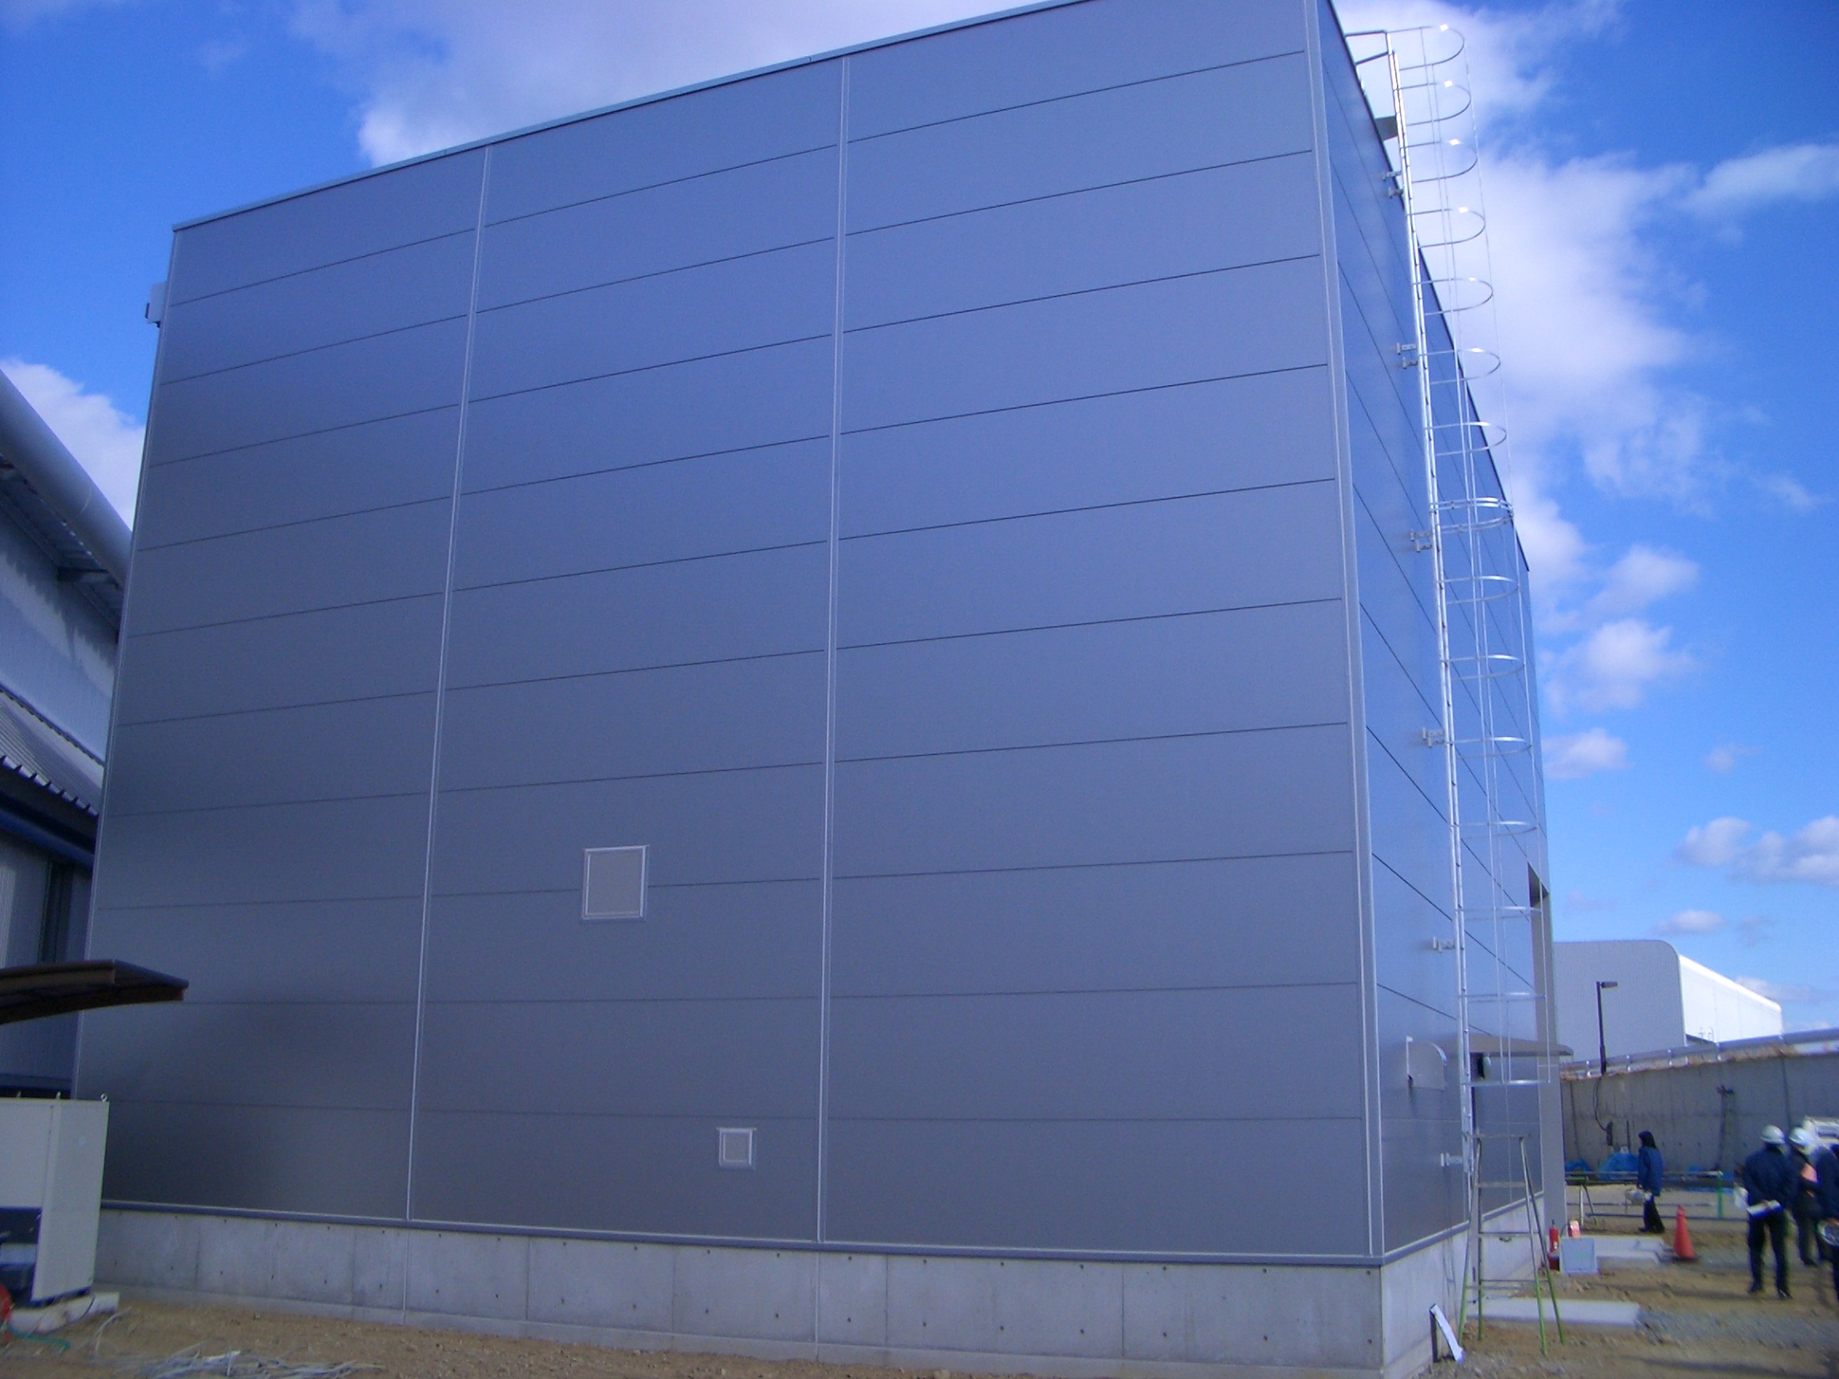
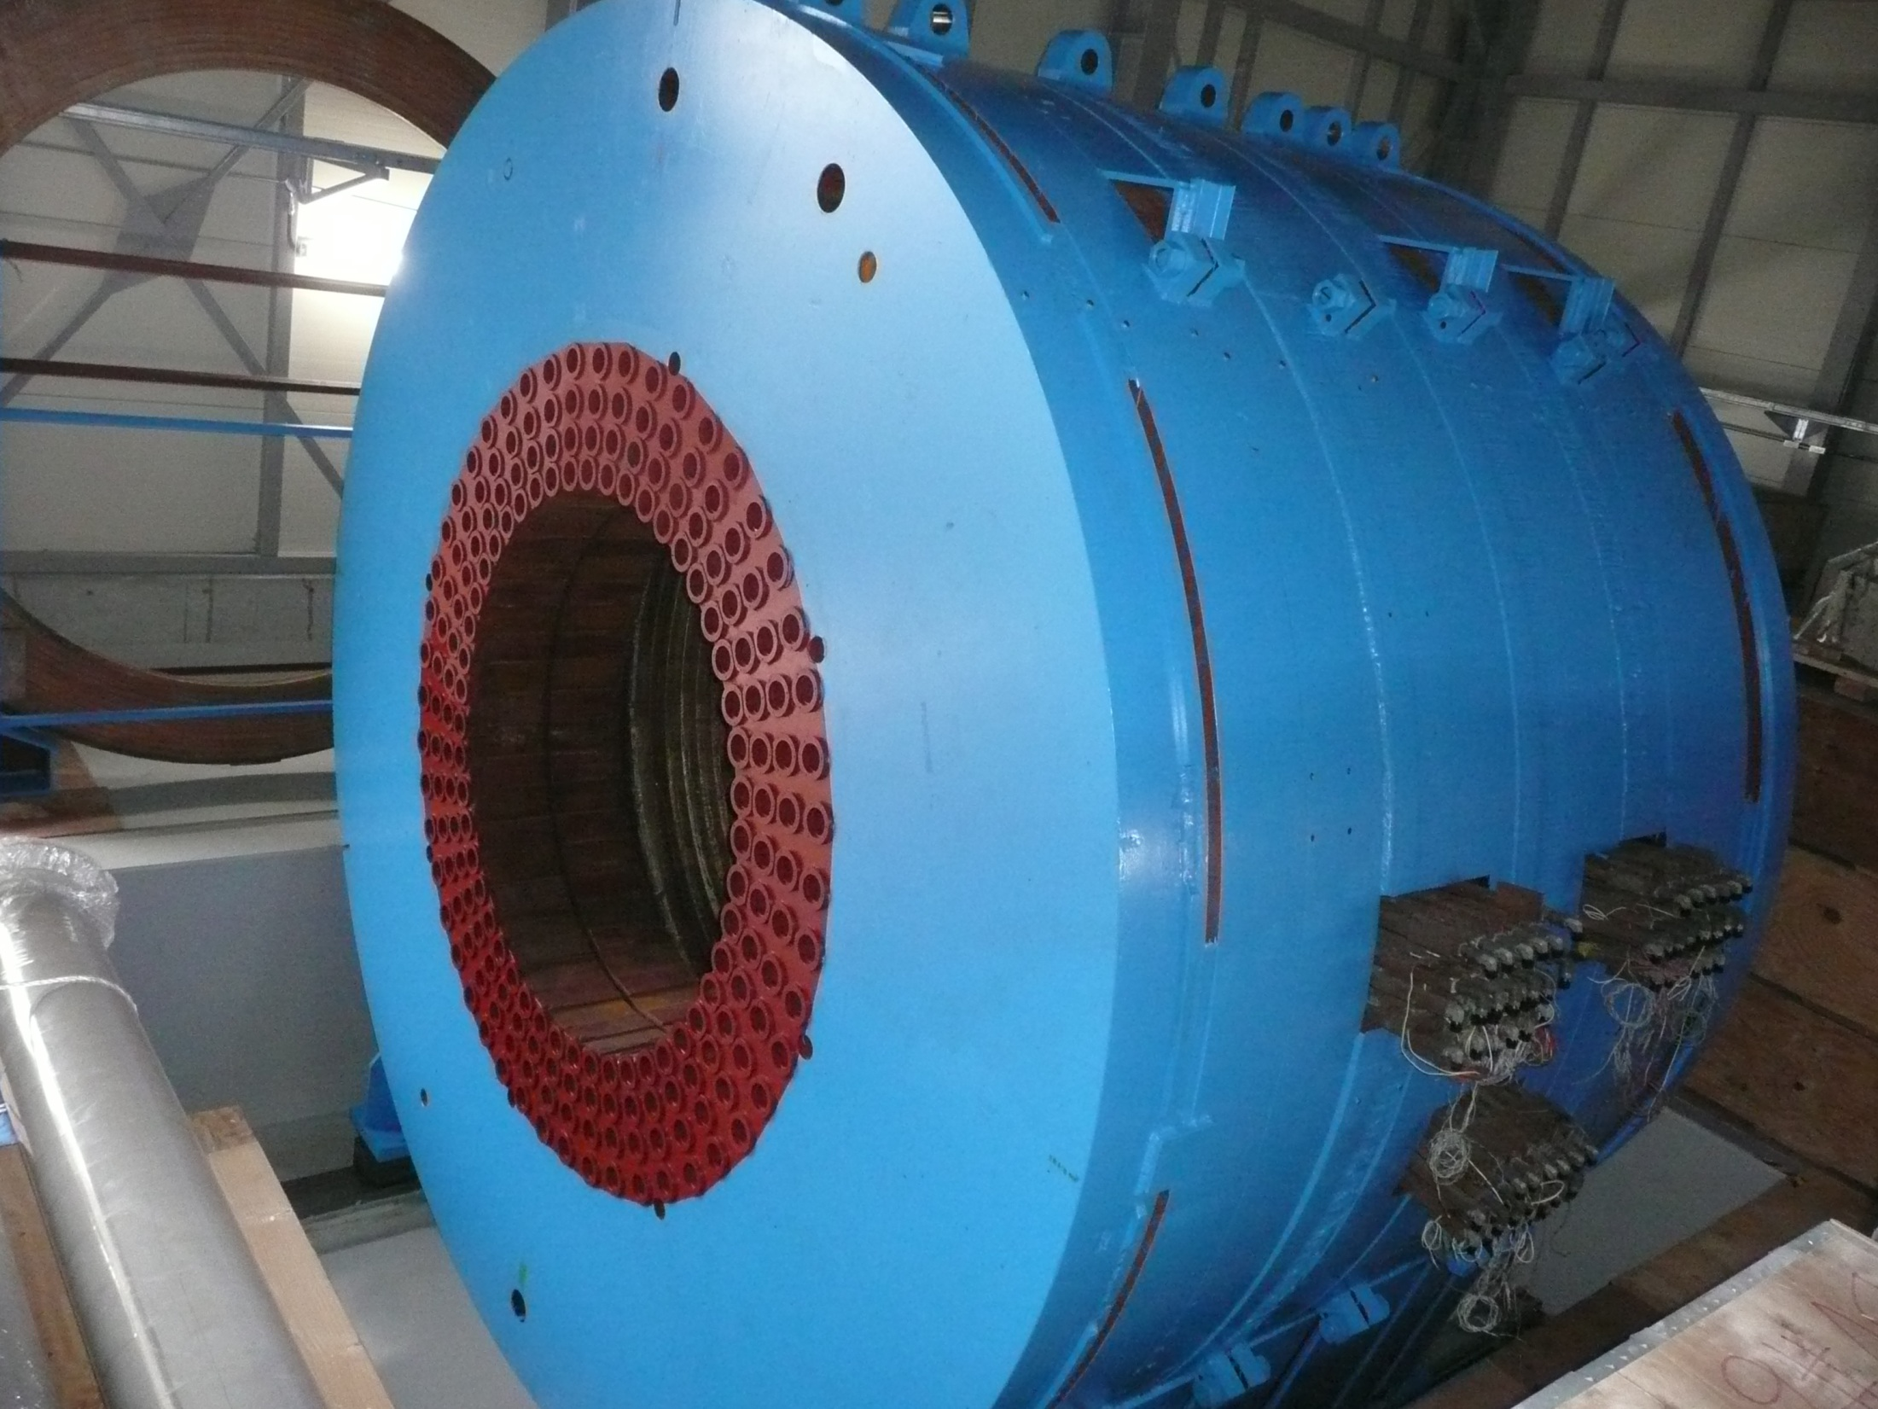
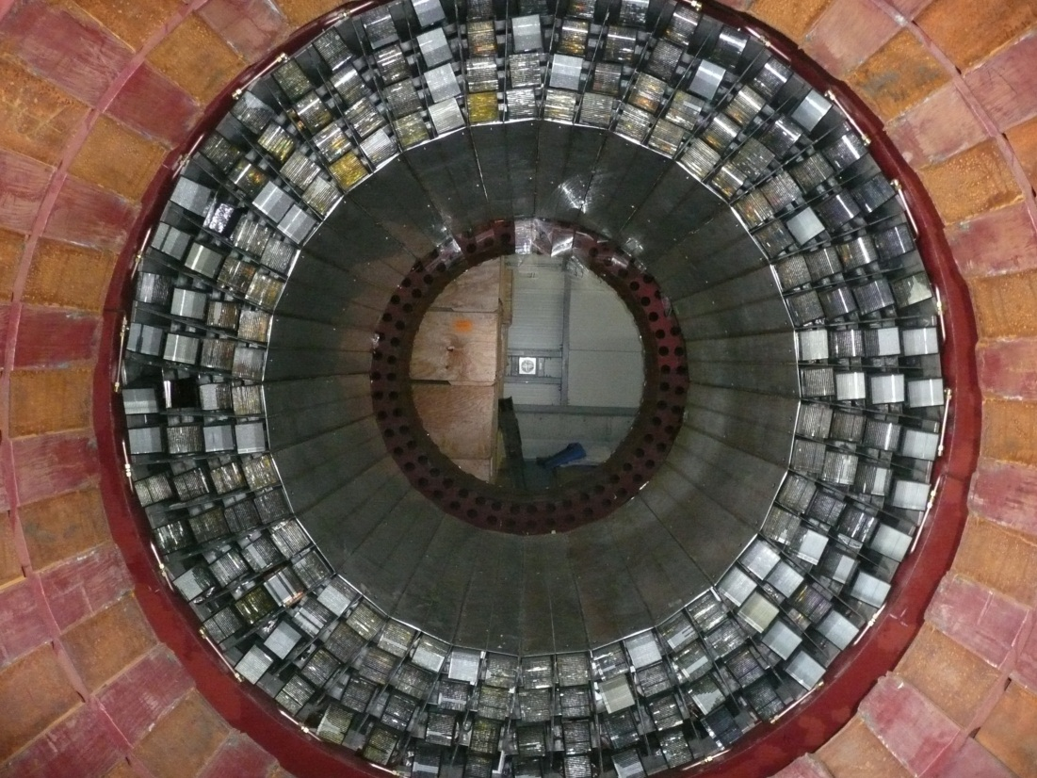
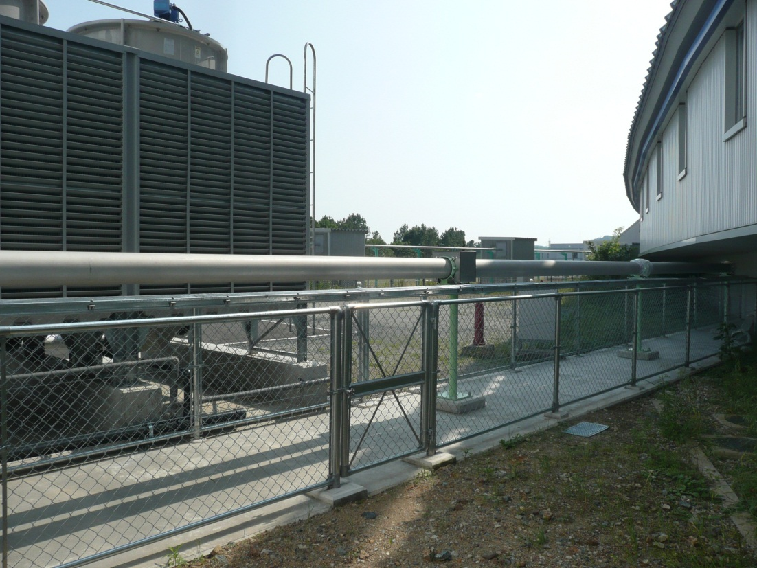
Exp. hall was constructed. (2010.Oct-2012Jan)
Installation of the E949 magnet (2011.Nev-Dec)
γ counters were installed. (2012.June)
Beam pipe (2012.May)

Slide 24
Θ⁺ Search at LEPS2
(t-channel K-exchange is possible)
No Fermi motion correction.
No φ background.
Measure angular dependence of production rate in
large angle region, up to CLAS acceptance.
pK_{s} invariant mass
K* missing mass

Slide 25
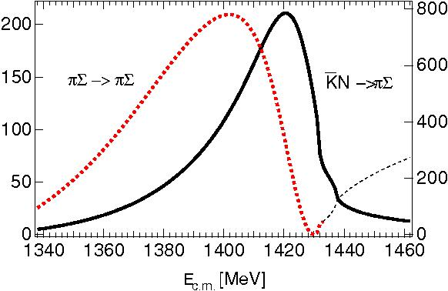
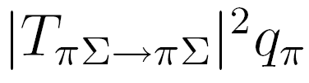
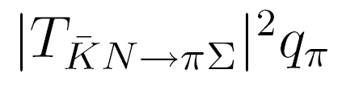
Two pole structure of Λ(1405)
ChUT model prediction by D. Jido, et al. NPA725(2003)

Slide 26
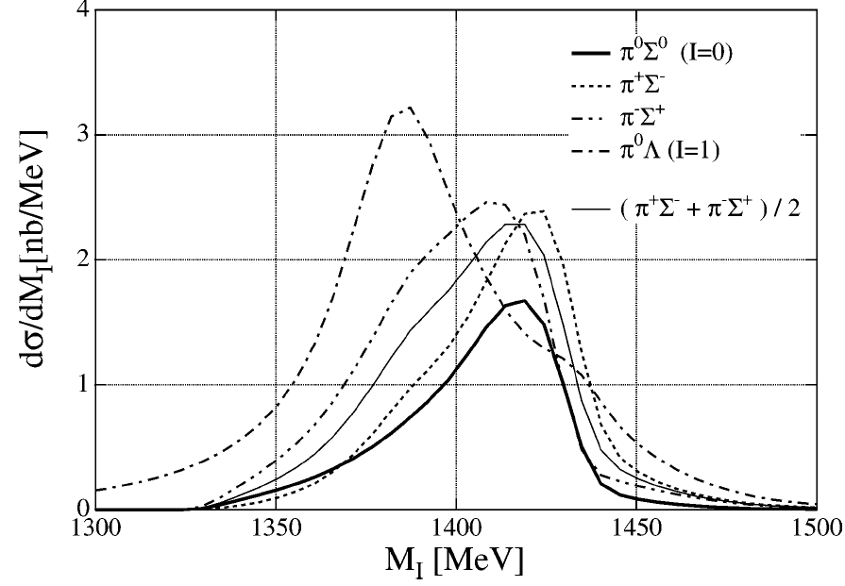
K*(890) Λ(1405) photoproduction with linearly polarized photon
γ
K
E
K*
π
Κ⁻
T.Hyodo et. al, PLB593
p
Λ(1405)
Commissioning of LEPS2 detector will start in 2017.

Slide 27
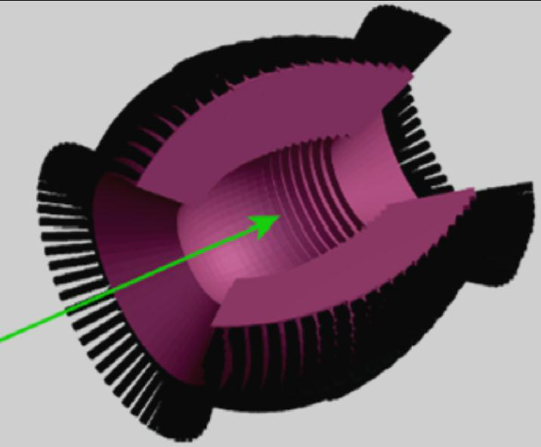
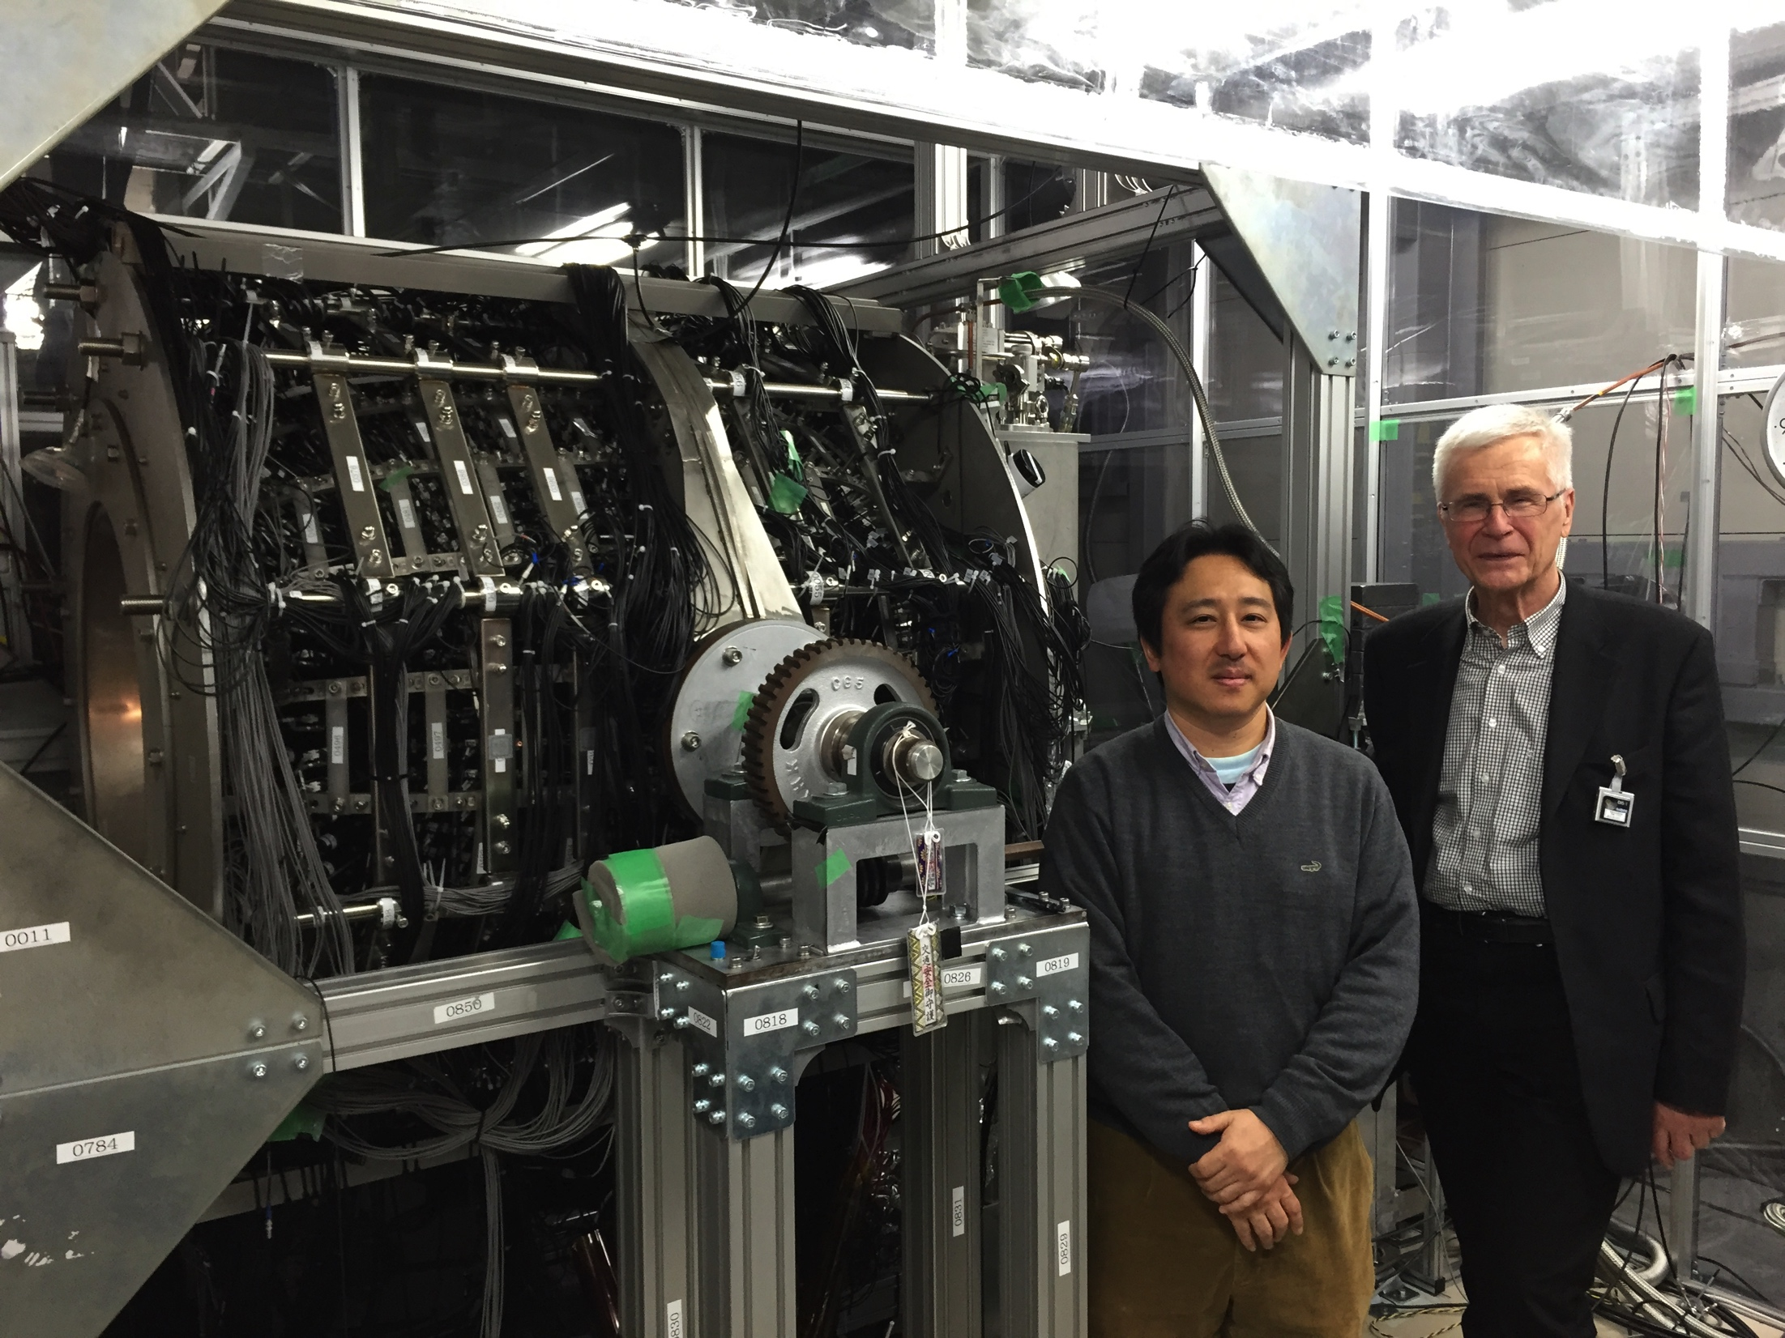
BGO-Egg : constructed @ ELPH, Tohoku U.
Large acceptance photon detector (BGO-Egg)
1320 BGO crystals
Covering 24º ~144º polar angle
1.3% energy resolution for 1 GeV

Slide 28
Experimental Setup
Tagged Photon Energy : 1.3 – 2.4 GeV (355 nm UV laser)
Tagged Photon Intensity : 1.4 – 1.8 Mcps (3 or 4 laser injection)
Target
BGOegg
Upstream
Charge Veto
Counter
6.8°
21°
E949 γ-counter
2 m (Vertical)
x
3.2 m (Horizontal)
γ
1.28 m
z=0 m
z=1.6 m
21°
E949 γ-counter
E949 Magnet
6.8°
Cylindrical Drift Chamber (CDC)
z=12.5 m
Drift Chamber (DC)
Resistive Plate
Chamber (RPC)
Inner Plastic Scintillator (IPS)

Slide 29
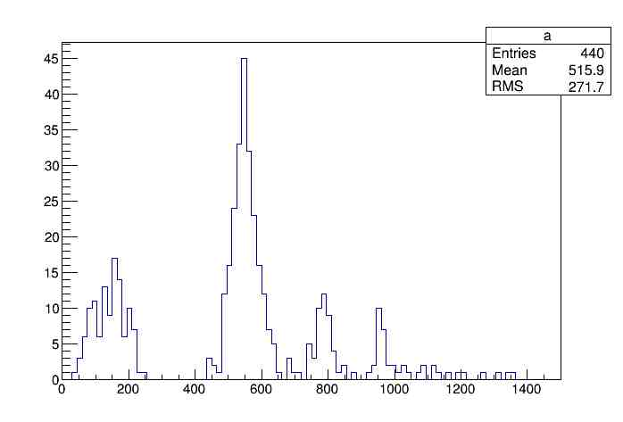
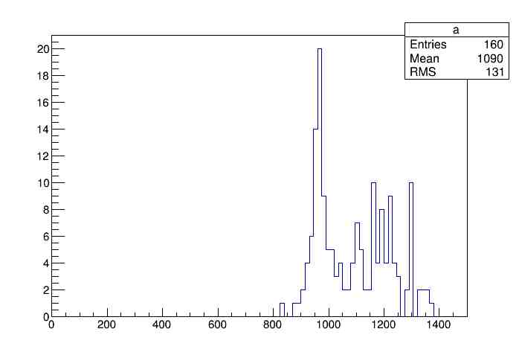
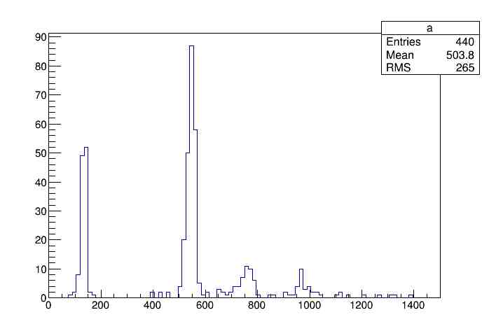


Combination of BGOegg and RPC(TOF)
Momentum conservation
Invariant mass and proton missing mass consistency
Proton missing mass for 2 gammas
Proton missing mass for 6 gammas
η
η’
require
2π⁰ and η
π⁰
ω
η’
MeV
MeV
Invariant mass of 2 gammas
Invariant mass of 6 gammas
η
η’
π⁰
ω
η’
MeV
MeV
By using both BGOegg and RPC, background events are cleaned up.

Slide 30

Mass modification of PS mesons in finite density
Mass of η’ is possibly modified under the finite density compared with the vacuum
  Δm_{η’} ～ -150MeV @ρ₀
  Δm_{η} ～ + 20MeV @ρ₀
P. Rehberg, et al. Phys. Rev. C53(1996) p410
H. Nagahiro, M Takizawa, S. Hirenzaki
Phys. Rev. C 74, 045203 (2006)

Slide 31



Experimental method
v
bound
γ + ¹²C -> η’ x ¹¹B + p
-100
0
100
E_{ex}-E₀(MeV)
H. Nagahiro
Identify η’ production by η tag
Search for a bound state
η’ + N -> η + N
12.5m from the target
→
2 γ
(39%)
η
→
3π⁰->6 γ
(33%)
2m
Vert : ±7° Hori: ±4°
1m
3.2m
BGOegg calorimeter
Forward TOF

Slide 32

Proton missing mass spectra
γ + ¹²C -> X + p
(γ + ¹²C -> η’ x ¹¹B + p)
Mx – M_{11B} - M_{η’}
Signal region (-200~200MeV) is masked.
1/20 of
full data
η tag
side band
hard to see signal shape by only tagging η
missM’(MeV)

Slide 33

back-to-back ηp tag
BG
signal
BGOegg cluster =7 : ~50 %
7th cluster = charged : 50%
7th cluster = charged : ~50%
(proton in nucleus)
proton FSI : ~40% loss
cos (ηp Opening angle)
proton acceptance when η is tagged : ~100%
no events in < -0.9
Fermi motion
-200 < MisM <200MeV masked
cos(Open angle) < -0.9 : 100%
x20 statistics
(~full 2015A)
~100 events
cosOpen
1 order margin
In addition,
x20 statistics
(~full 2015A)
signal region
momentum cut
(-200<MisM<200MeV)
proton ID by BGOegg
90% C.L.
is possible
~10 events
(p_{p} = p_{η} ~ 450-575MeV/c)

Slide 34
η->2γ mode
BGOegg cluster = 2 or 3
signal yield ~ x2 of 3π⁰ mode (BGOegg acceptance)
Mx – M_{11B} - M_{η’}
η mass region
(±45 MeV)
sideband region
(±45∼±90 MeV)
estimated signal
Counts/ 10MeV
missM(MeV)
similar S/N ratio as 3π⁰ mode

Slide 35
Summary
LEPS
  Study of φΛ∗ interference
  Updates on Θ⁺
LEPS2
  Two different experimental setups.
    Solenoid spectrometer
    Study of 2-pole structure of Λ(1405)
    BGOegg + TOF(RPC)
    Backward meson production from proton and nuclei
BGOegg experiment was started last year!

