Slide 1



The emergent properties of QCD matter
Exploring the QCD Phase Structure in High-Energy Nuclear Collisions
Nu Xu^{(1,2)}
⁽¹⁾ College of Physical Science & Technology, Central China Normal University, China
⁽²⁾ Nuclear Science Division, Lawrence Berkeley National Laboratory, USA
Many thanks to Organizers!

Slide 2
Outline
Introduction
(2) Recent Results from BES-I at RHIC
(i) Chirality; (ii) Collectivity; (iii) Criticality
(3) Summary and Outlook

Slide 3
Beam Energy Scan
1
Large E
LHC, RHIC
2
3
Large μ_{B}
FAIR, NICA
RHIC(FXT)
2000 – 2010 (2012):
Top energy programs
Discovery of sQGP
2010 – 2014:
BES-I: 7.7, 11.5, 14.5, 19.6, 27, 39 GeV
- Phase boundary & CP
- Chiral effects
2019 – 2020:
BES-II: 7.7, 11.5, 14.5, 19.6 GeV
FXT*: 4.5, 3.9, 3.6, 3.0 GeV
2022 – 2025:
BES-III (BEST)
Fixed-target program
RHIC, SPS
2
5000 200 20 2 √s_{NN} (GeV)

Slide 4
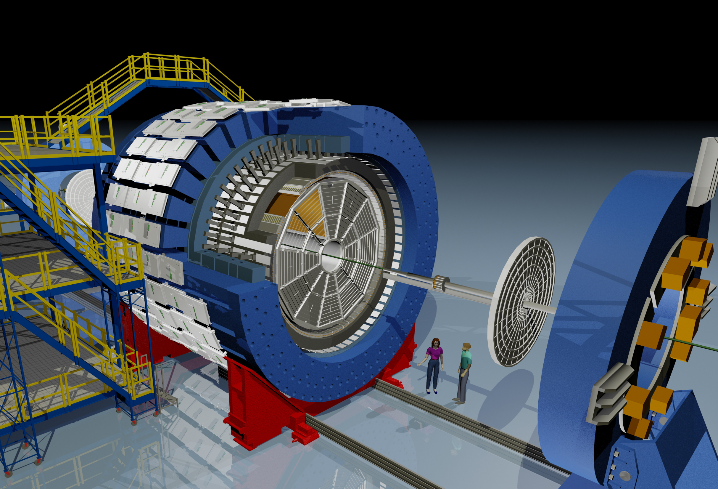

STAR Detector System
EEMC
Magnet
MTD
BEMC
TPC
iTPC
TOF
EPD
HFT

Slide 5
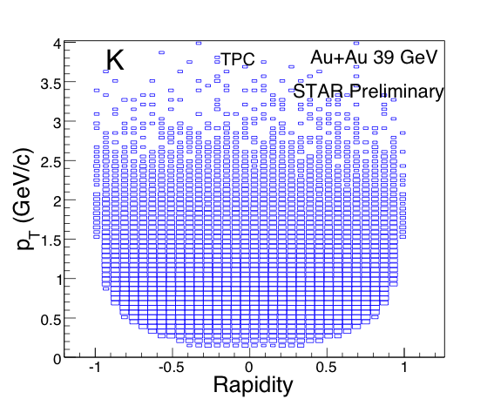
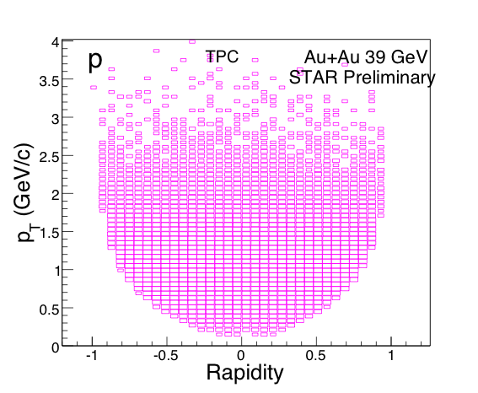
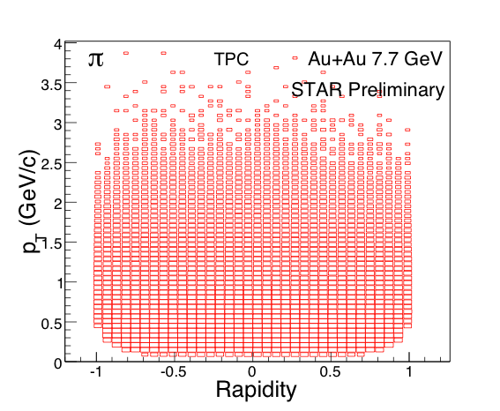
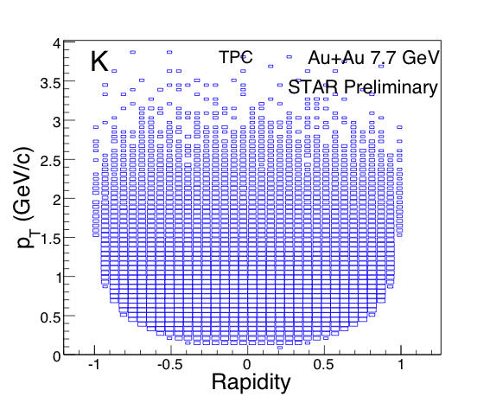
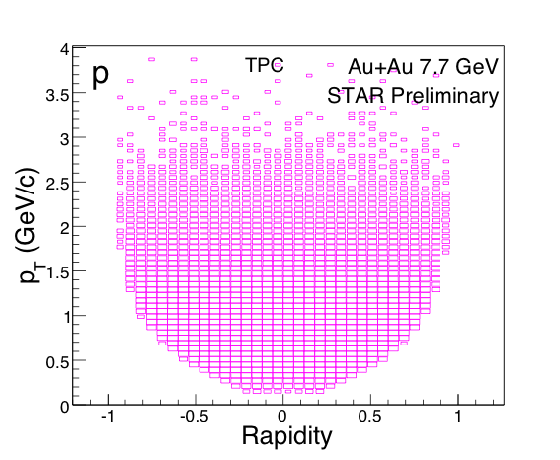
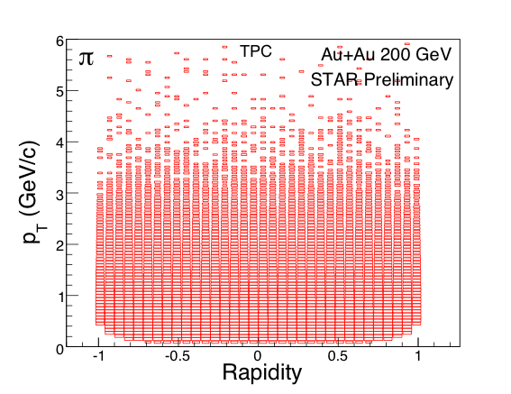
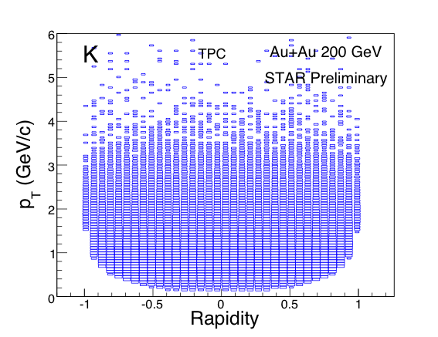
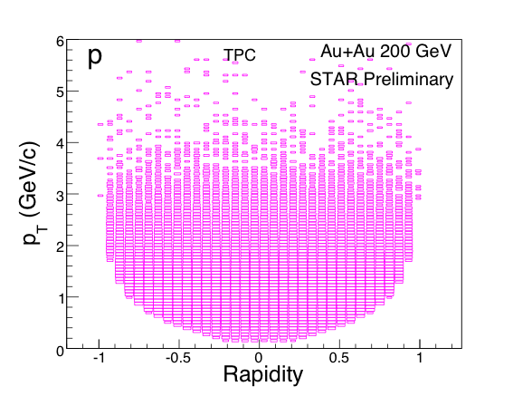
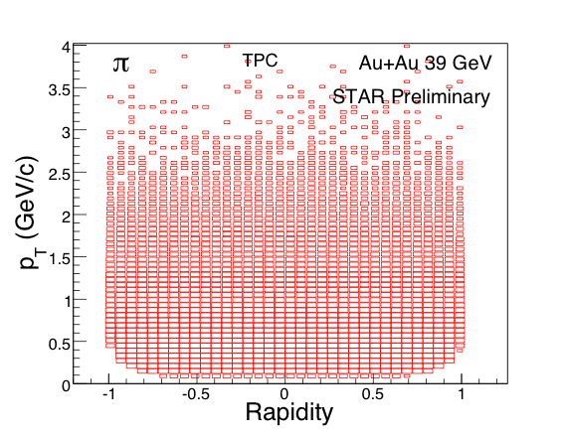
Data Sets for BES-I Program
7.7 GeV 39 GeV 200 GeV
√s_{NN} (GeV) | *μ_{B} (MeV) | *T_{CH} (MeV) | Events (10⁶) | Year
200 | 25 | 166 | 350 | 2010
62.4 | 73 | 165 | 67 | 2010
39 | 112 | 164 | 39 | 2010
27 | 156 | 162 | 70 | 2011
19.6 | 206 | 160 | 36 | 2011
14.5 | 264 | 156 | 20 | 2014
11.5 | 316 | 152 | 12 | 2010
7.7 | 422 | 140 | 4 | 2010
π
K
p
Transverse Momentum (GeV/c)
Particle Rapidity
Largest data sets versus collision energy
STAR: Large and homogeneous acceptance, excellent particle identification capabilities. Especially important for fluctuation analysis!
*(μB, T_{CH}) : J. Cleymans et al., PR C73, 034905 (2006)
μB, T : J. Cleymans et al., PRC 73, 034905 (2006)
μB, T : J. Cleymans et al., PRC 73, 034905 (2006)
μB, T : J. Cleymans et al., PRC 73, 034905 (2006)
μB, T : J. Cleymans et al., PRC 73, 034905 (2006)
μB, T : J. Cleymans et al., PRC 73, 034905 (2006)
μB, T : J. Cleymans et al., PRC 73, 034905 (2006)

Slide 6
The emergent properties of QCD matter
Collectivity

Slide 7
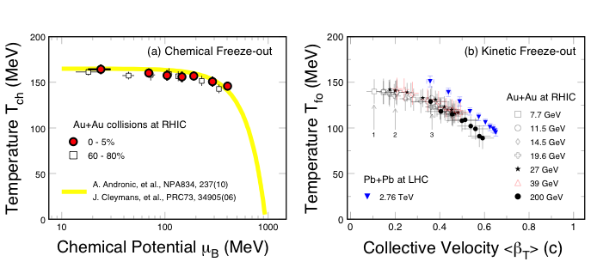
Bulk Properties at Freeze-out
Chemical Freeze-out: (GCE)
- Weak temperature dependence
- Centrality dependence μ_{B}!
- CP about μ_{B} ~ 300 – 400 MeV?
Kinetic Freeze-out:
Central collisions => lower value of
T_{fo} and larger collectivity β_{T}
Stronger collectivity at higher energy,
even for peripheral collisions
ALICE: B.Abelev et al., PRL109, 252301(12); PRC88, 044910(2013).
STAR: J. Adams, et al., NPA757, 102(05); X.L. Zhu, NPA931, c1098(14); L. Kumar, NPA931, c1114(14)

Slide 8
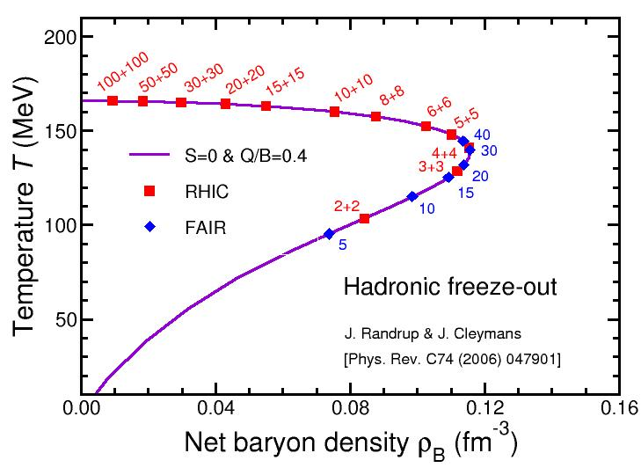
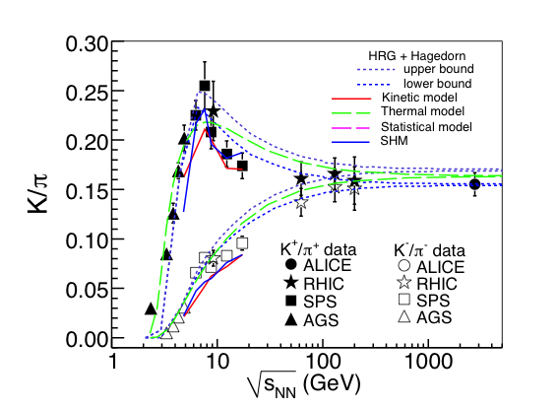
K/π Ratios and Baryon Density
In heavy ion collisions K⁺/π ratio peaks at √s_{NN} ~ 8 GeV,
K⁻/π ratio merges with K⁺/π at higher collision energy
2) Model: Baryon density peaks at √s_{NN} ~ 8 GeV
At √s_{NN} > 8 GeV, pair production becomes important
L. Kumar, et al.1304.2969

Slide 9
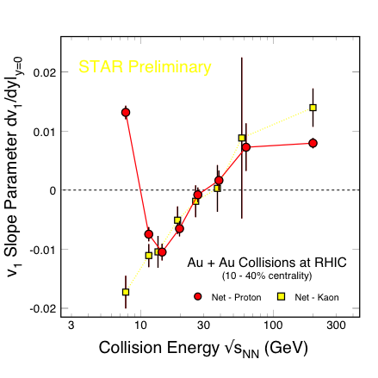
v₁ vs. Energy: Softest Point?
Mid-rapidity net-proton dv₁/dy published in 2014 by STAR, except the point at 14.5 GeV
Minimum at √s_{NN} = 14.5 GeV for net-proton, but net-Kaon data continue decreasing as energy decreases
At low energy, or in the region where the net-baryon density is large, repulsive force is expected, v₁ slope is large and positive!
Softest point for baryons?
- M. Isse, A. Ohnishi et al, PR C72, 064908(05)
- Y. Nara, A. Ohnishi, H. Stoecker, arXiv: 1601.07692
STAR: PRL112, 162301(2014)
STAR: QM2015

Slide 10
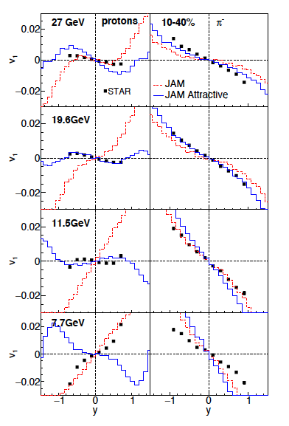

v₁ vs. Energy: Softest Point?
“Attractive force” ➔
Change of the EOS
~ “softest point”
- Y. Nara, A. Ohnishi, H. Stoecker,
arXiv: 1601.07692

Slide 11
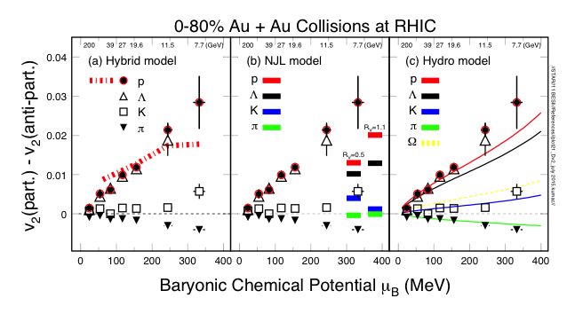
v₂ and Model Comparison
At large μ_{B}, i.e. low collision energies, the number of quark scaling in v₂ is broken
Hydro + Transport: Baryon results fit [J. Steinheimer, et al. PR C86, 44902(13)]
(b) NJL model: Sensitive to vector-coupling, CME, μ_{B} driven.
[J. Xu, et al., PRL112.012301(14)]
(c) Hydro solution: Chemical potential μ_{B} and viscosity η/s driven!
[Hatta et al. PR D91, 085024(15); D92, 114010(15) //NP A947, 155(16)]

Slide 12
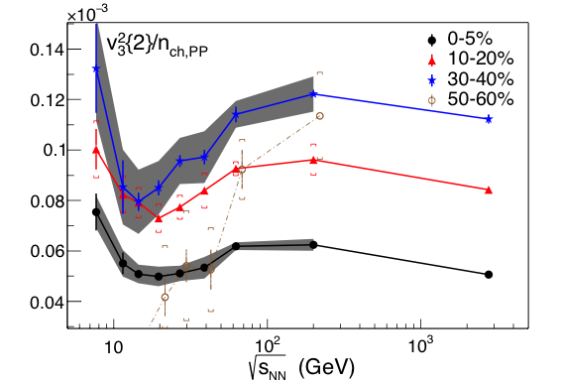
Energy Dependence of v₃
STAR: PRL116, 112302(2016)
At 10 ≤ √s_{NN} ≤ 20 GeV, minima developed in v₃

Slide 13
Summary: Collectivity
At vanishing baryon chemical potential, sQGP, perfect liquid, η/S small
At finite μ_{B} ~ 400 MeV (√s_{NN} ≤ 20 GeV), EoS change

Slide 14
The emergent properties of QCD matter
Criticality

Slide 15
Susceptibilities and Moments
Thermodynamic function:
The susceptibility:
Conserved Quantum Numbers
Thermodynamic function ⬄ Susceptibility ⬄ Moments
Model calculations, e.g. LGT, HRG ⬄ Measurements

Slide 16
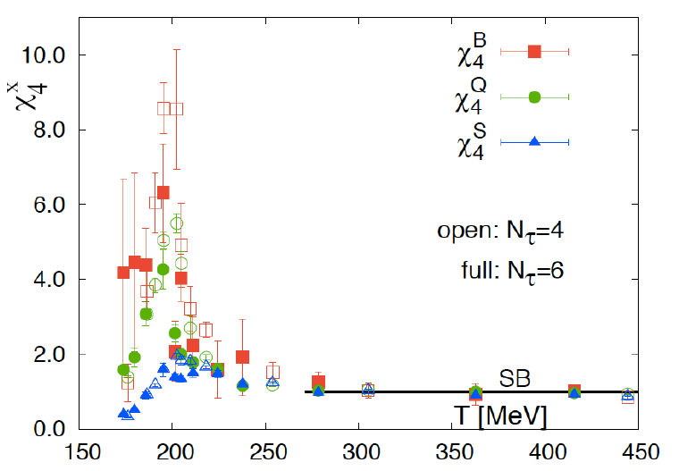
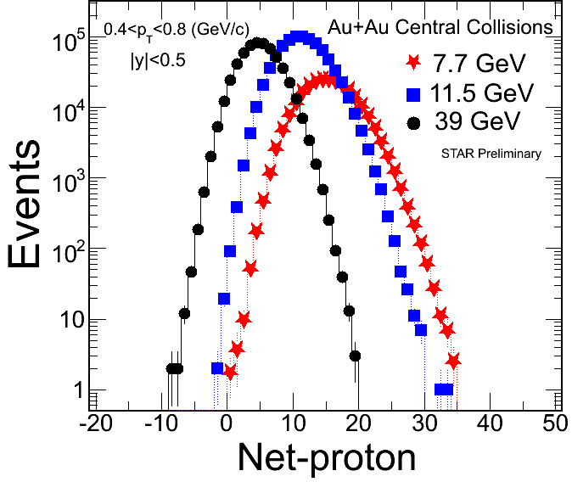
Higher Moments and Criticality
1) Higher moments of conserved quantum numbers: Q, S, B, in high-energy nuclear collisions
2) Sensitive to critical point (ξ correlation length):
3) Direct comparison with calculations at any order:
Extract susceptibilities and freeze-out temperature. An independent/important test of thermal equilibrium in heavy ion collisions.
References:
- STAR: PRL105, 22303(10); ibid, 112, 032302(14)
- S. Ejiri, F. Karsch, K. Redlich, PLB633, 275(06) // M. Stephanov: PRL102, 032301(09) // R.V. Gavai and S. Gupta, PLB696, 459(11) // F. Karsch et al, PLB695, 136(11),
- A. Bazavov et al., PRL109, 192302(12) // S. Borsanyi et al., PRL111, 062005(13) // V. Skokov et al., PRC88, 034901(13)
μ_{B} = 0

Slide 17
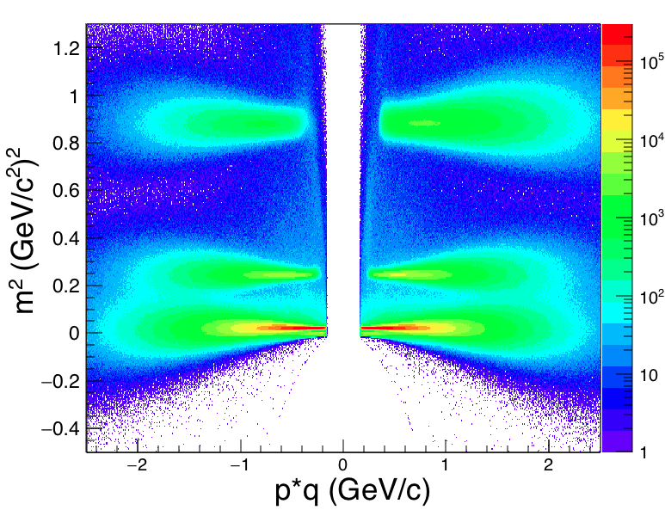
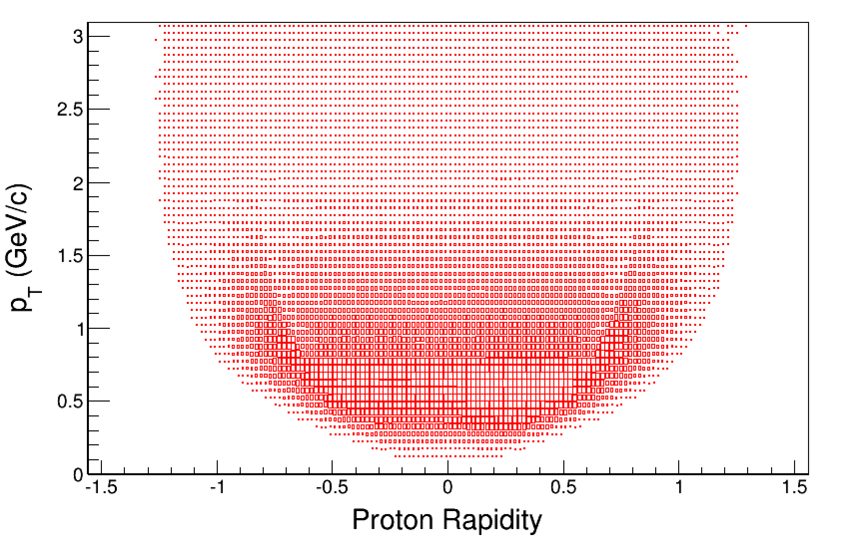
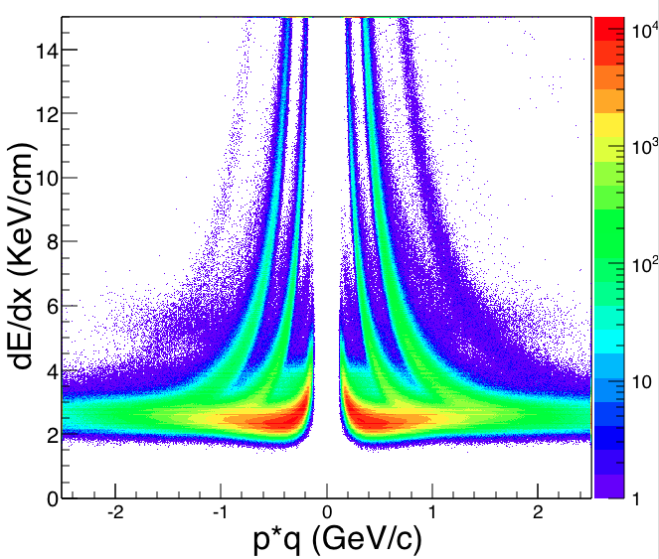
Proton Identification with TOF
Published net-proton results: Only TPC used for proton/anti-proton PID.
TOF PID extends the phase space coverage.
Au+Au ➔ protons
STAR Preliminary
TOF
TOF
TPC
TPC
Acceptance: |y| ≤ 0.5, 0.4 ≤ p_{T} ≤ 2 GeV/c
Efficiency corrections:
TPC (0.4 ≤ p_{T} ≤ 0.8 GeV/c): ε_{TPC} ~ 0.8
TPC+TOF (0.8 ≤ p_{T} ≤ 2 GeV/c): ε_{TPC}*ε_{TOF} ~ 0.5

Slide 18
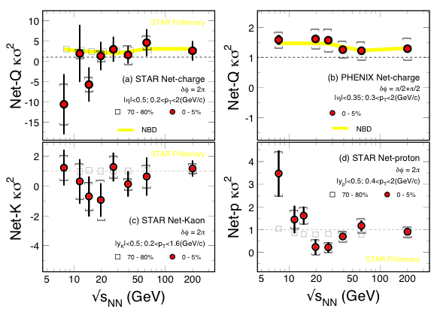
Higher Moments of Net-Q, -K, -p
In STAR:
σ(Q) > σ(K) > σ(p)
The results of net-Q and net-Kaon show flat energy dependence.
Net-p shows non-monotonic energy dependence in the most central Au+Au collisions starting at √s_{NN} < 27 GeV!
PHENIX: talk by P. Garg at QM2015; STAR: talk by J. Thäder and poster by J. Xu at QM2015

Slide 19
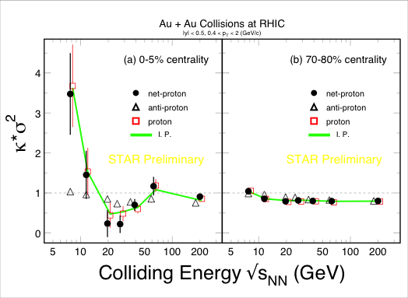
Net-proton Higher Moment
central
peripheral
Flat energy dependence for 70-80% peripheral collisions
Non-monotonic behavior in the most central 0-5%, and 5-10% collisions. Net-p follow protons, especially at lower collision energies
X.F. Luo, CPOD2014, QM2015

Slide 20
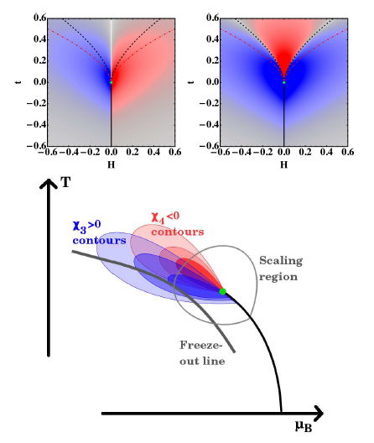
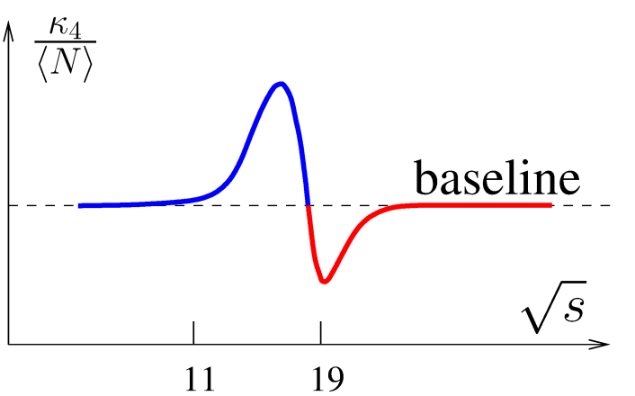
Expectation from Model Calculations
20 200
Characteristic “Oscillating pattern” is expected for the QCD critical point but the exact shape depends on the location of freeze-out with respect to the location of CP
- M. Stephanov, PRL107, 052301(2011)
- V. Skokov, Quark Matter 2012
- J.W. Chen, J. Deng, H. Kohyyama, arXiv: 1603.05198, Phys. Rev. D93 (2016) 034037

Slide 21
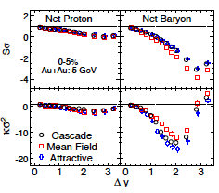
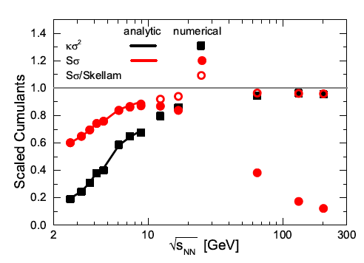
Model Simulation Results
✖
✖
√s_{NN} (GeV)
At √s_{NN} ≤ 10 GeV: Data: κσ² > 1! Model: κσ² < 1!
All models: suppress higher order net-proton fluctuations
(UrQMD, AMPT, RHG and JAM do not reproduce data)
Z. Feckova, J. Steonheimer, B. Tomasik, M. Bleicher, 1510.05519, PRC92, 064908(15)
X.F. Luo et al, NP A931, 808(14)
P.K. Netrakanti et al. 1405.4617, NP A947, 248(16)
P. Garg et al. Phys. Lett. B726, 691(13)
Baryon mean-field (attractive): Shu He et al., 1607.07276

Slide 22
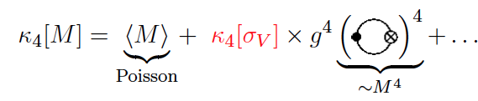
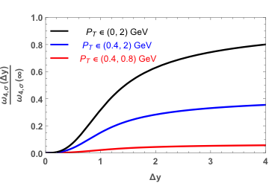
Acceptance Matters
B. Ling, M. Stephanov, 1512.09125, Phys. Rev. C93, 034915(2016)
BES-II
STAR BES-I
Critical
Non-critical
Acceptance is important!
Low p_{T} of protons is more important than wider rapidity. Fixed-target experiment is more advantageous

Slide 23
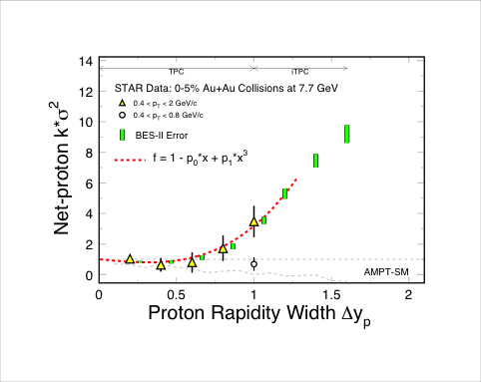
Power-law Behavior vs. Rapidity
STAR BES-II Whitepaper: https://drupal.star.bnl.gov/STAR/starnotes/public/sn0598
BES-I results: Poisson + Baryon conservation + v³. Power-law-like at √s_{NN} ≤ 11.5 GeV only. criticality?
RHIC BES-II: iTPC extend the rapidity coverage to Δy = 1.6, allowing to study kinematic dependence and precision measurement of higher moments

Slide 24
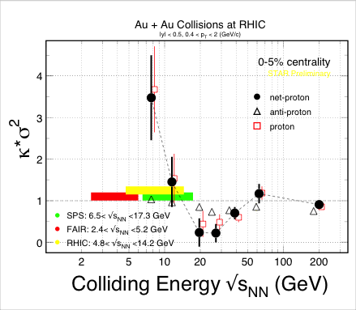
Search for the QCD Critical Point
HADES, preliminary, 2016
CBM
?
?
?
CBM Experiment (2.5 < √s_{NN} < 8 GeV) : Key region for CP search
STAR Data: X.F. Luo et al, PRL112 (2014) 32302; X.F. Luo, PoS(CPOD14)019; QM plenary (15)

Slide 25
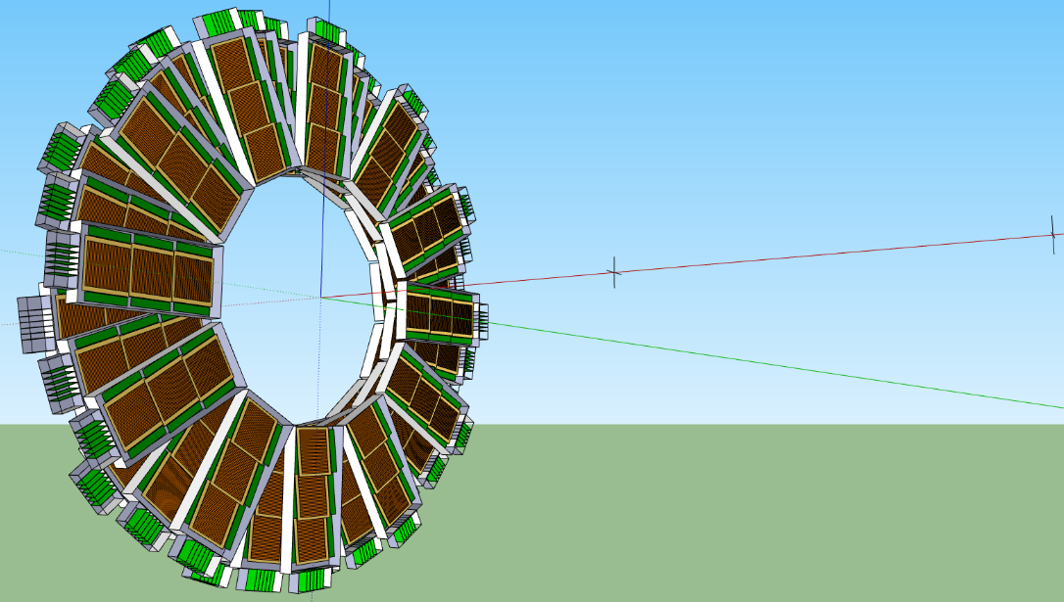
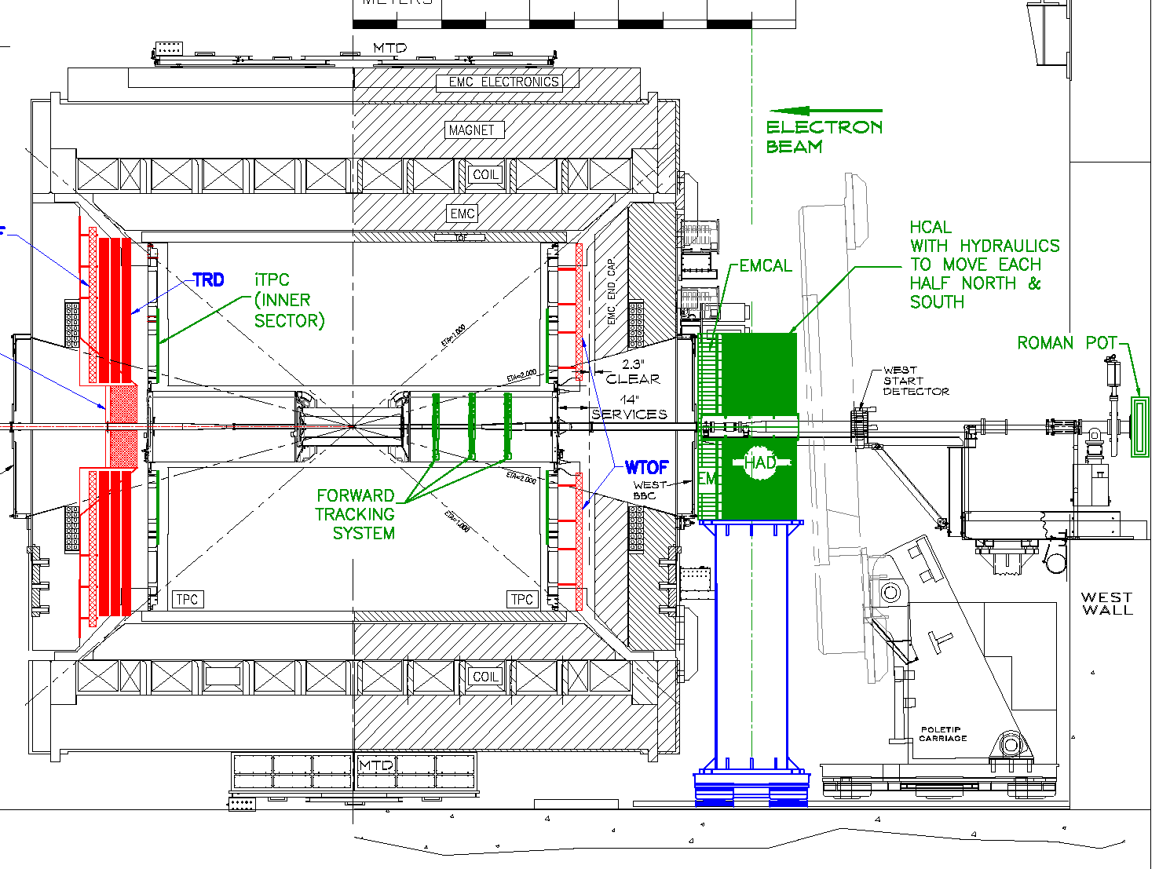
CBM Phase-0 Exp: eTOF at STAR
eTOF
100 cm
collider vertex
(~250 cm)
fixed target pos.
(~500 cm)
MRPC active area
Read-out electronics
Install, commission and use 10% of the CBM TOF modules, including the read-out chains at STAR, starting in 2019
CBM participating in RHIC Beam Energy BES-II in 2019-2020:
Complementary to part of CBM’s physics program:
√s_{NN} = 3, 3.6, 3.9, 4,5, 7.7 GeV (750 ≤ μ_{B} ≤ 420 MeV)
especially for B- & s-production and fluctuations
FAIR (CBM) construction starts 17, beam on target in 21!

Slide 26
Summary and Outlook
LHC & RHIC Top Energy
sQGP properties
BES-I at RHIC:
Non-monotonic energy dependence
Power-law behavior: v³ for k*σ²
BES-II at RHIC: (200 < μ_{B} < 420 MeV)
- Larger acceptance in rapidity
- Larger statistics
- Better understanding of systematics
Possible new discovers are:
- QCD critical point (partial)
- Chiral effects: CVE, CME, …
- …
Longer Future: fixed-target experiment (FXT) at extreme large net-baryon density, 350 < μ_{B} < 750 MeV
( 8 < √s_{NN} < 2 GeV ) CBM at FAIR
FXT: the Beam Energy Scan Three (BEST) for QCD Critical Point!
RHIC BES-II
collider mode
200 < μ_{B} < 420 MeV
Fixed-target BES-III
350 < μ_{B} < 750 MeV

Slide 27
Thank You!

