Slide 1
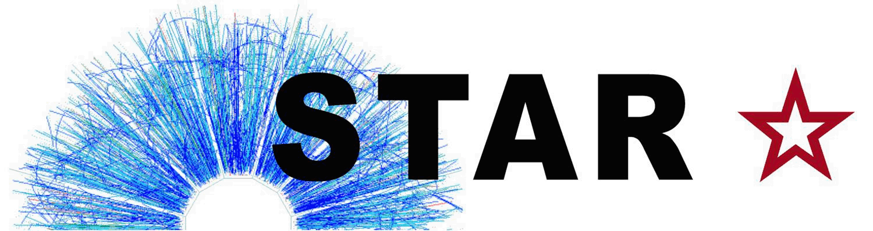

STAR Highlights and Future Plans
Zhangbu Xu
(Brookhaven National Lab)
Introductions
Recent Highlights and Performance with Run15-16
Programs in next 2 years
BES II Program
Detector Upgrades
Longer Term and Summary
38th Erice School of Nuclear Physics 2016

Slide 2


STAR Detector System
15 fully functioning detector systems
EEMCESMD
Magnet
MTD
BEMC
BSMD
TPC
TOF
BBC
FMS
FPS
RP
ZDC
NSAC RECOMMENDATION #I:
The upgraded RHIC facility provides unique capabilities that must be utilized to explore the properties and phases of quark and gluon matter in the high temperatures of the early universe and to explore the spin structure of the proton.
HFT
X10³ increases in DAQ rate since 2000, most precise Silicon Detector (HFT 2014-16)

Slide 3

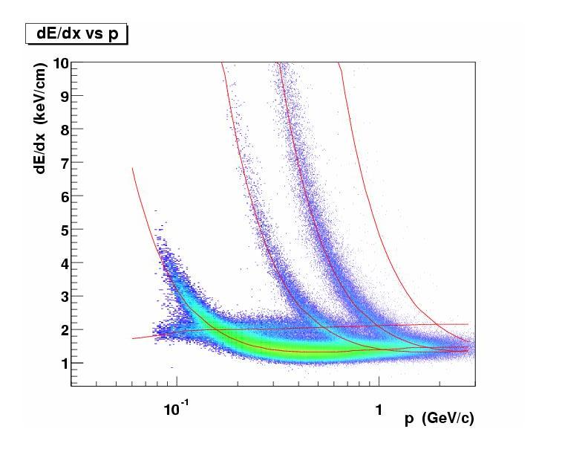
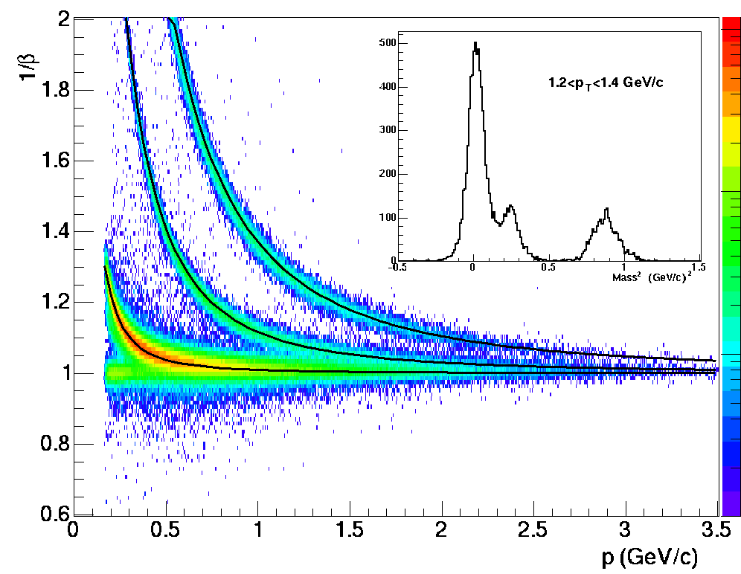
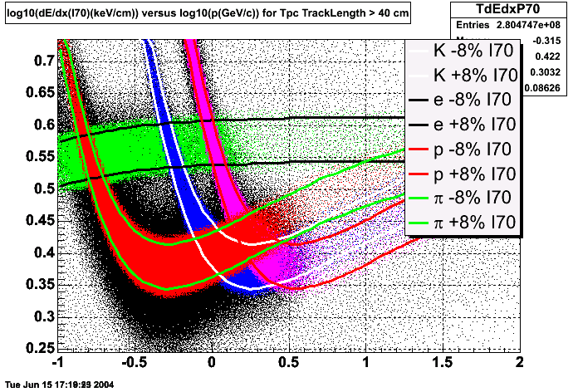
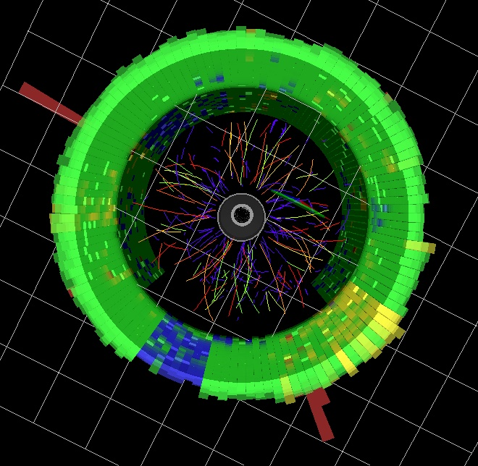
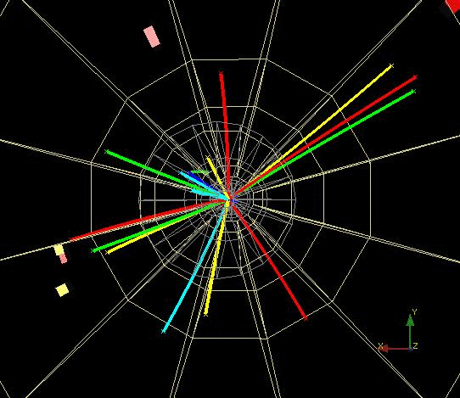
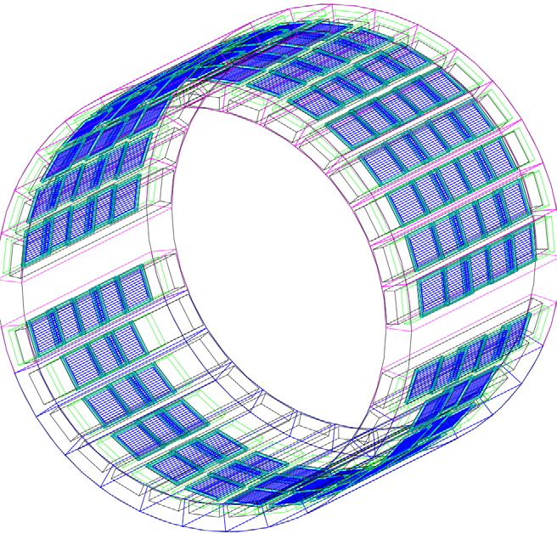
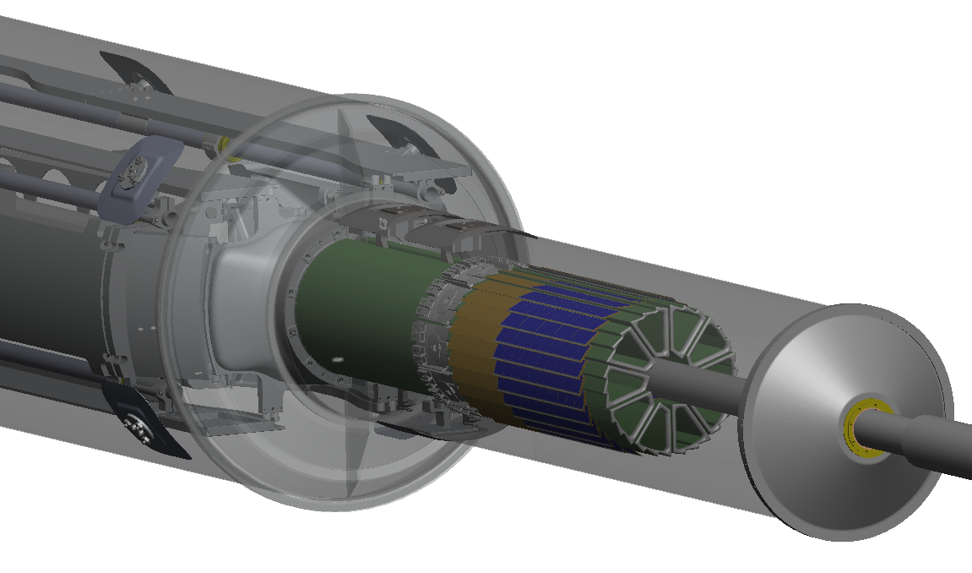
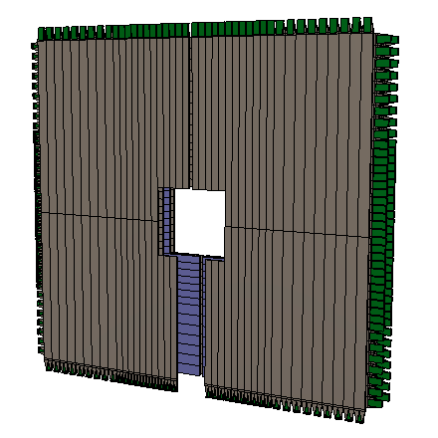
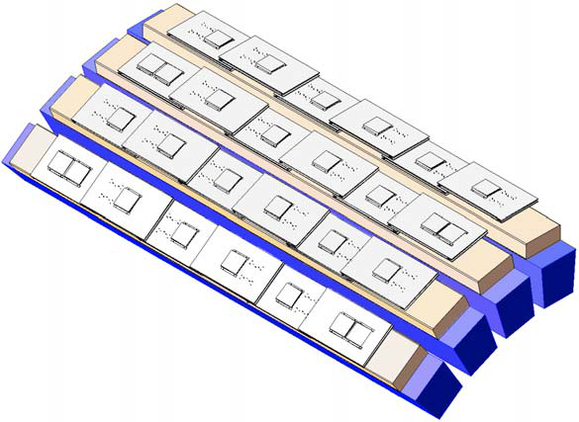
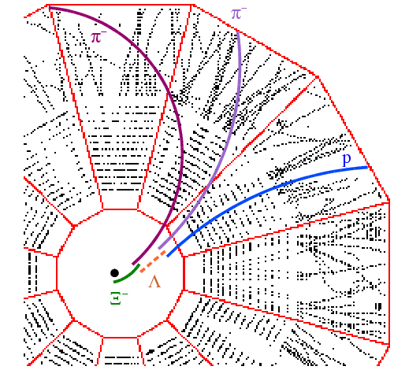
Particle Identification at STAR
TPC TOF TPC
TPC
K p d
π
e, μ
TOF
Log₁₀(p)
Charged hadrons
Hyperons & Hyper-nuclei
EM particles
MTD
HFT
EMC
Jets
Jets & Correlations
High p_{T} muons
Heavy-flavor hadrons
Forward protons
Forward photons
Multiple-fold correlations for identified particles!

Slide 4
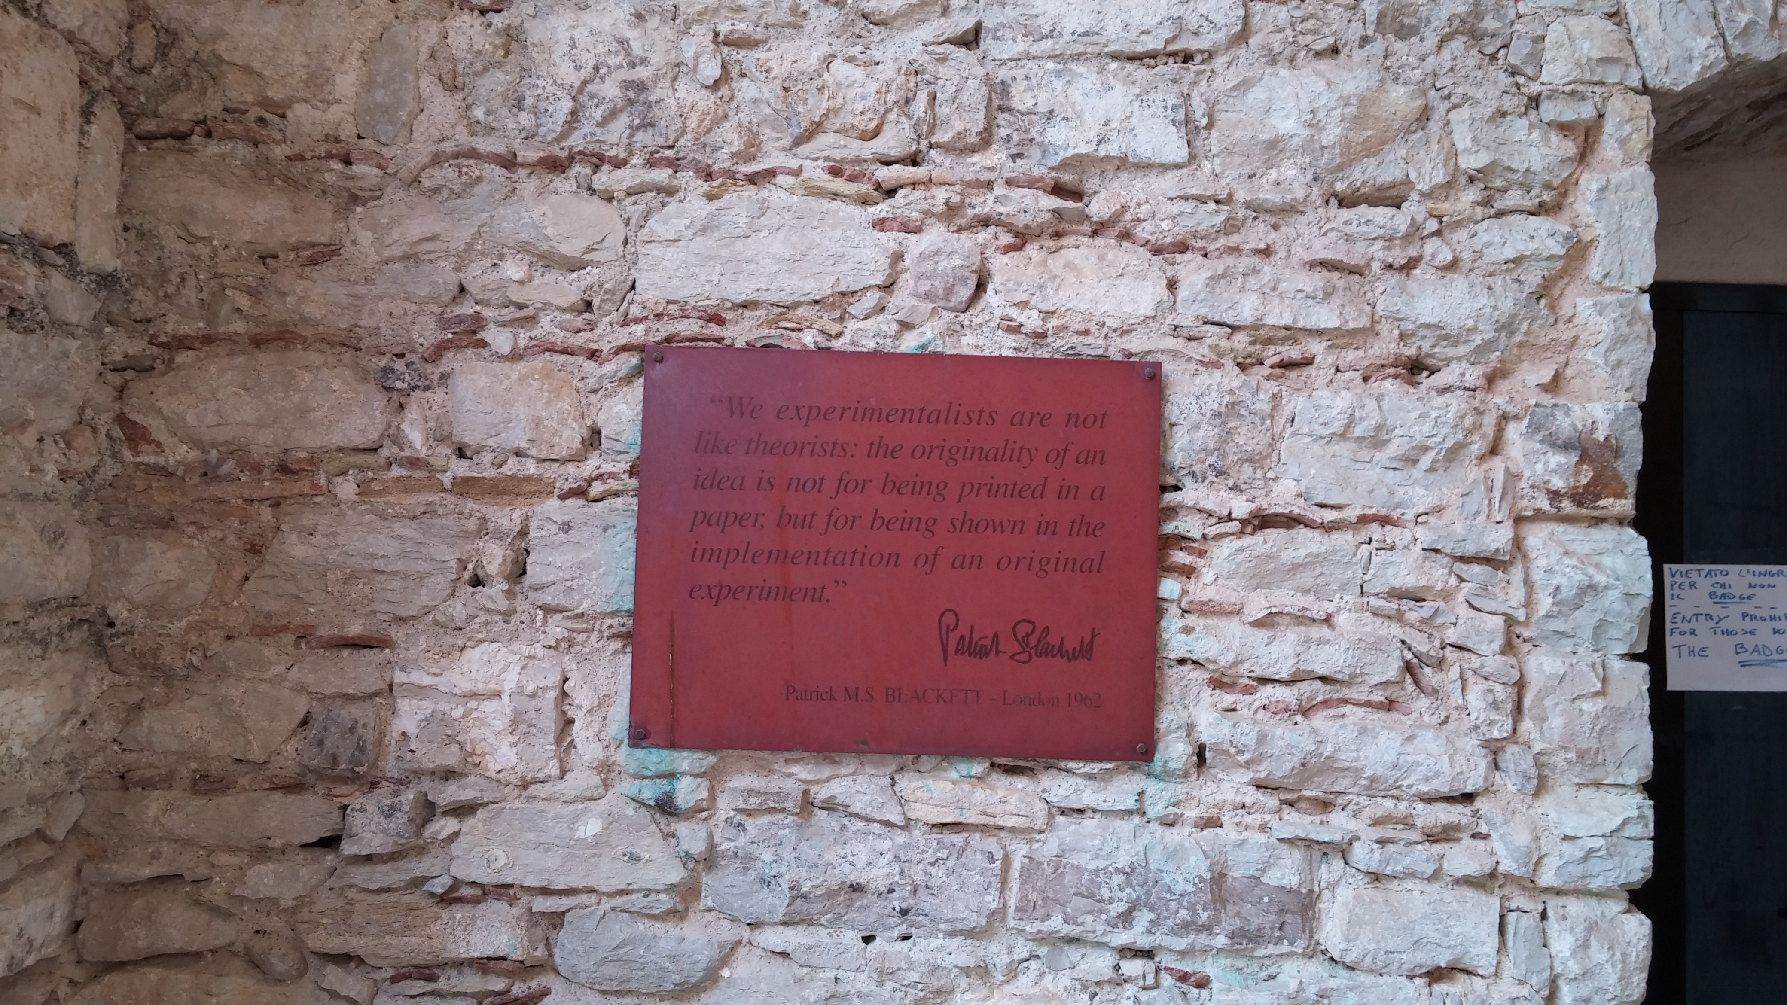
Highlights of Recent Results
Jets
Heavy-Flavor
Dileptons
v_{n}
Spin (W, pp/pA)
Chiral Magnetic Effect
Global Polarization
BES-I highlights

Slide 5
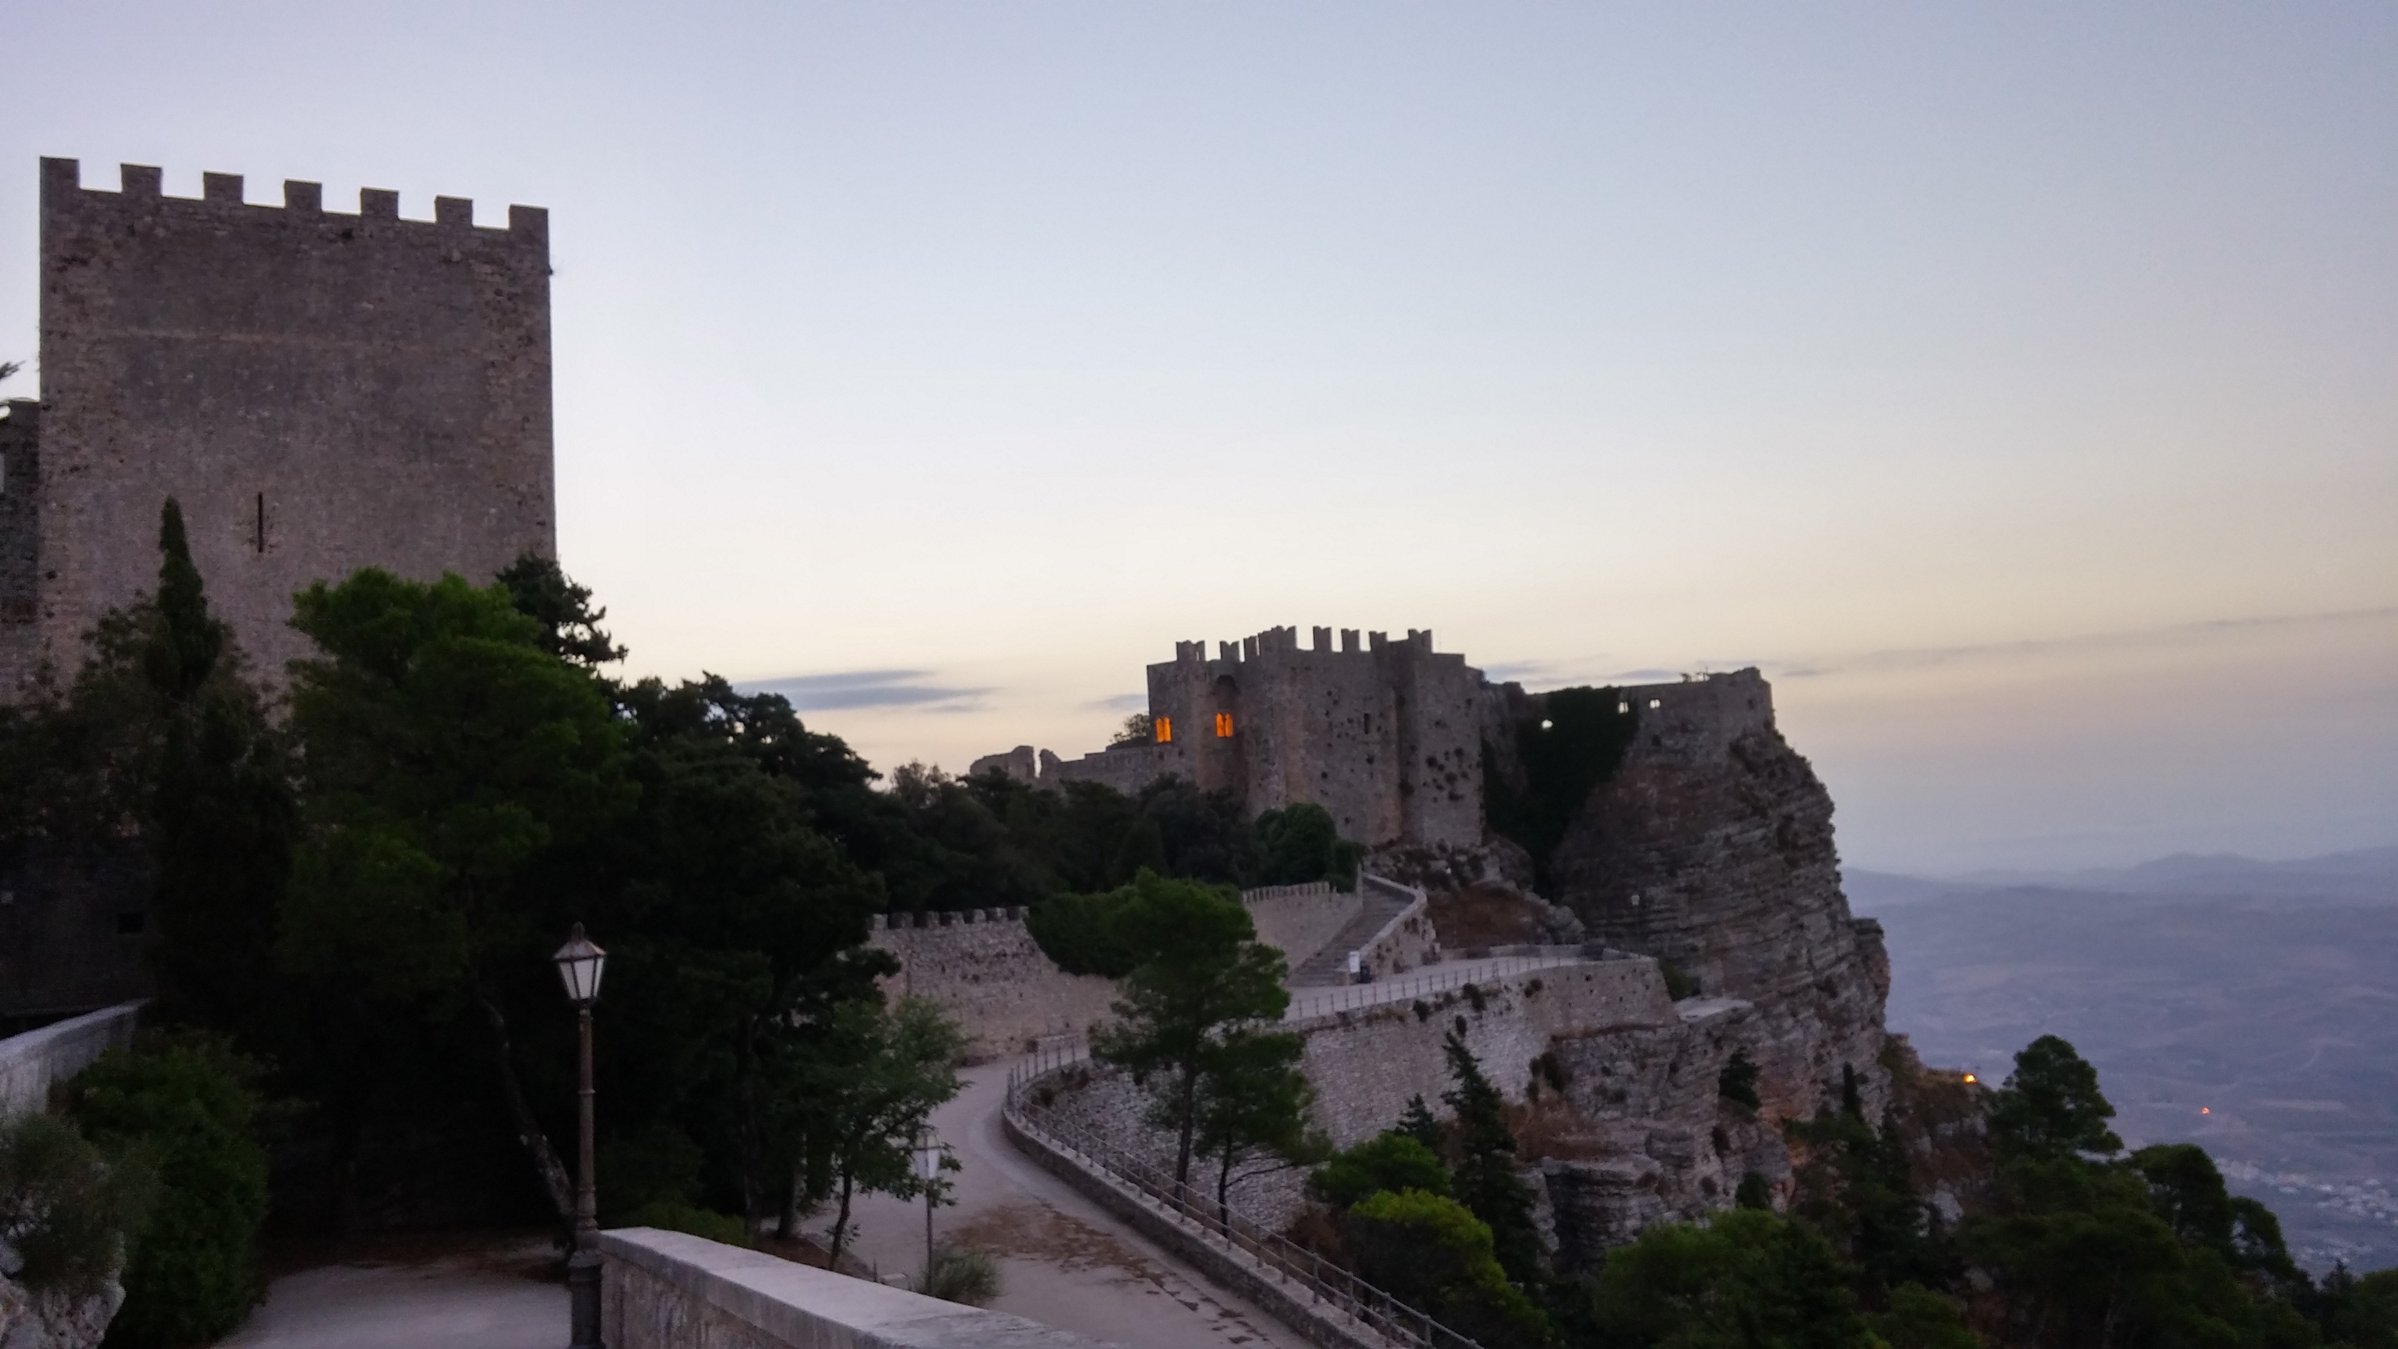
Jet Energy Loss

Slide 6
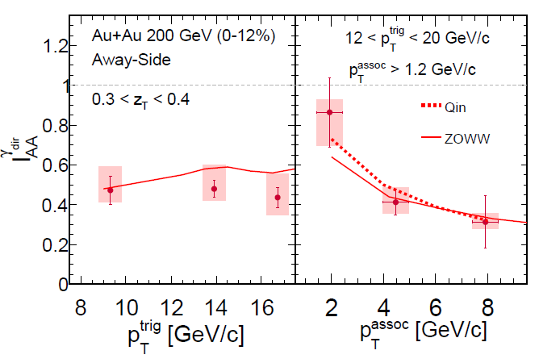
γ-jet correlations
Golden probe of Jet Energy Loss
  Initial jet energy from Eγ
γ and π⁰ triggered hadron I_{AA} similar
  No clear color factor or path length effects observed
Lost energy
reappearing at low p_{T}
independent of E_{γ} (8-20 GeVc)
Paper accepted to PLB: arXiv:1604.01117

Slide 7
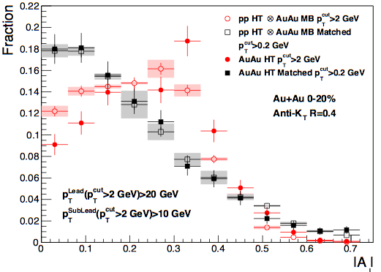
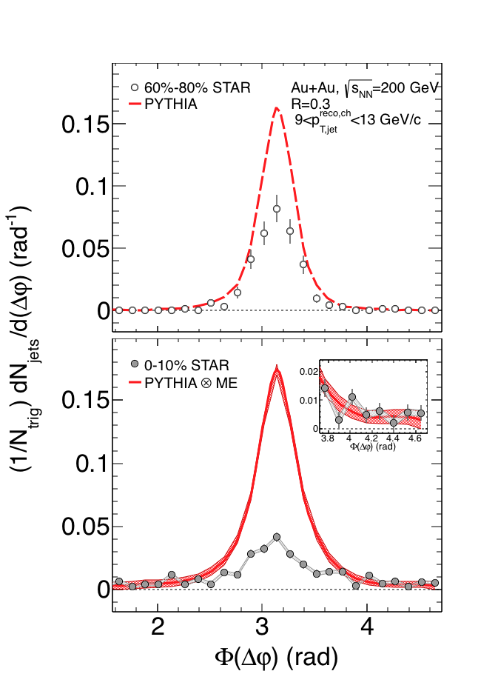
Semi-inclusive hadron jets
STAR Preliminary
STAR Preliminary
arxiv:1609.03878
Semi-inclusive jet measurement to very low p_{T}
Medium induced radiation reappears beyond R=0.5
E_{missed} ~3-5 GeV (less than at LHC)
Au-Au di-jet momentum balance restored to that observed in p+p only by including low-p_{T} particles for R=0.4
Recoil jet Φ(Δφ)_{Au-Au} > Φ(Δφ)_{pp}
First indication of medium-induced acoplanarity
First indication of ability to identify all energy lost to medium (for a certain class of jets)

Slide 8
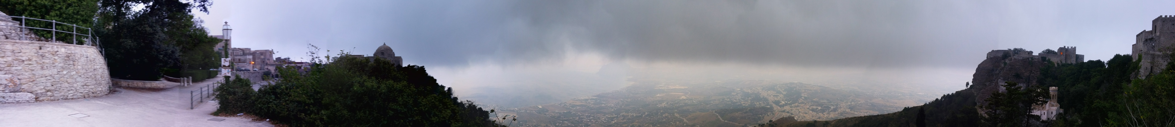
Quarkonium production

Slide 9
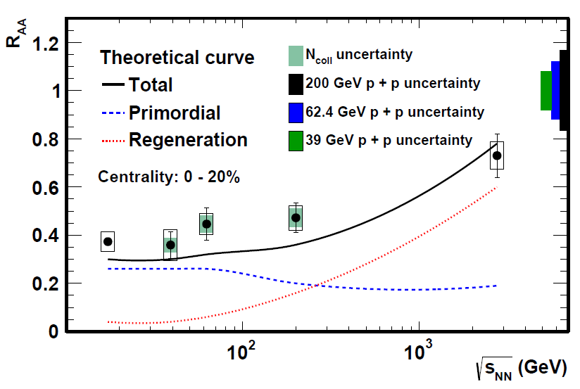
Quarkonia production and probes
arXiv: 1607.07517
New MTD dataset covers whole p_{T} range
with high statistics (x3 more data)
Strong centrality and p_{T} dependence
of J/ψ suppression
Beam Energy dependence of J/ψ R_{AA}
Separation of Upsilon ϒ(2s+3s) from ϒ(1s)
indicating less suppression
at RHIC than at LHC

Slide 10
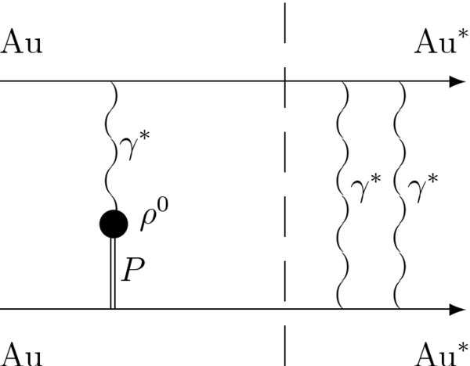
Coherent Vector Meson Production at Rest
Vector meson is created
by virtual photon interaction
with Pomeron (Vector dominant)
STAR paper on UPC:
http://arxiv.org/abs/0712.3320
Vector meson produced at low pt,
~150MeV/c
For peripheral collisions,
the produced rho sits inside
a QGP. Does it know that
the vacuum is excited before
it decays to e+e-?
This provides a direct probe
of excited vacuum structure.
The answer is in the data
Spectator nucleons
QGP
J/Psi
e⁺
e⁻
Spectator nucleons

Slide 11
Coherent J/Psi Production at rest
Suppression at high pT
Huge enhancement at low pT (x40)
T slope consistent with coherent interaction
and interference (photon-Pomeron)
Absolute yields seems to be
independent of centrality
How about sow-mass dileptons?
Stay tune for QM2017

Slide 12

Longitudial and multiple harmonic correlations (3+1D hydrodynamics)

Slide 13
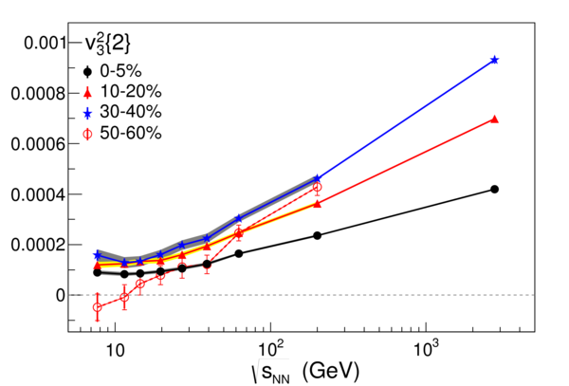
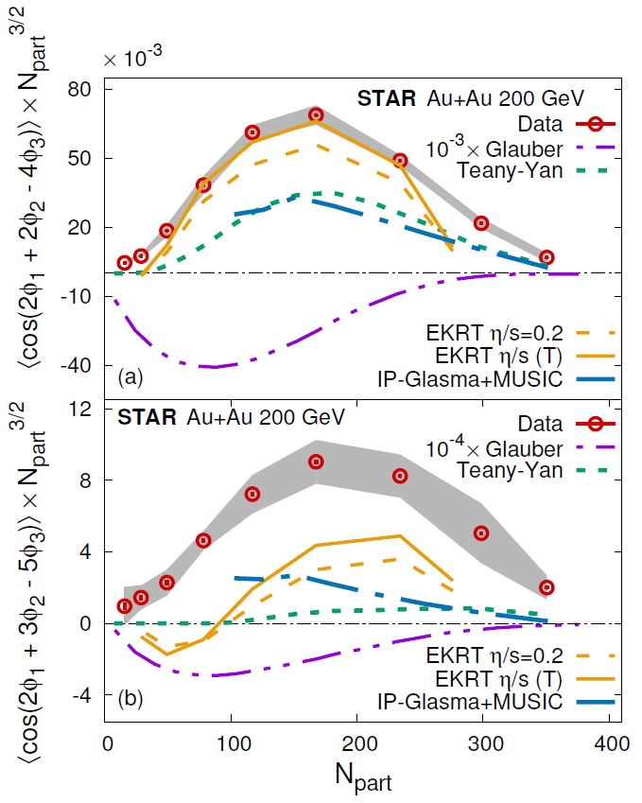
Flows in n^{th} order
PRL 116(2016)
STAR Preliminary
Higher harmonics sensitive to earlier stage
Study BES and small system size:
Turn OFF QGP?
Multiple-Harmonics sensitive to η/s (T)
Models Need longitudial dynamics
(3+1D) to reproduce data
STAR
Preliminary

Slide 14
Timeline of RHIC operation
2010-2013 | 2014 | 2015 | 2016 | 2017 | 2018 | 2019 | 2020 |  | 2022+
Au+Au p+p | Au+Au | p+p p+A | Au+Au d+Au | p+p Au+Au | Isobar Au+Au | Au+Au | Au+Au |  | Au+Au pp,pA
ΔG, QGP property | Charm flow | Ref. A_{N} | D_{c}, Λ_{c} ϒ, Jets | Fc sign | CME, Λ↑ | Critical Point, Phase Transition |  |  | Jets, ϒ forwardA_{N}
BES-I | 200, 14.5 | 200 | 200-19.6 | 500, 62.4 | 200, 27 | BES-II 11-20 | BES-II 7-11 |  | 200
BES-I
BES-II
Expand to include several programs:
p+A in run 15,
pp500 in run17,
Isobar (Zr, Ru-96) in run 18
BES-II more compelling, detector and machine upgrades in 2018
Future high-luminosity jets and Upsilon in 2020+
3+1D hydrodynamics and Unique Cold QCD (DY) portal to EIC

Slide 15
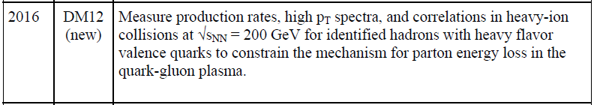
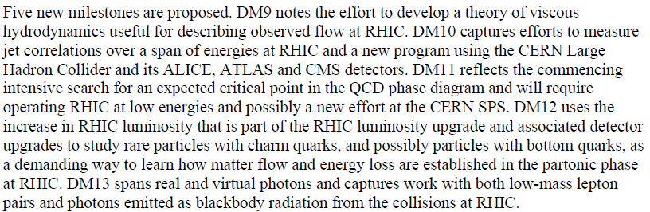
Run 16 Heavy-Flavor Program
- Completion of DM12
Au-Au 200 GeV Highest Priority of STAR and PAC for Run-16
DOE Milestones for High Temperature/High Density Hadronic Matter
http://science.energy.gov/~/media/np/nsac/pdf/docs/perfmeasevalfinal.pdf

Slide 16
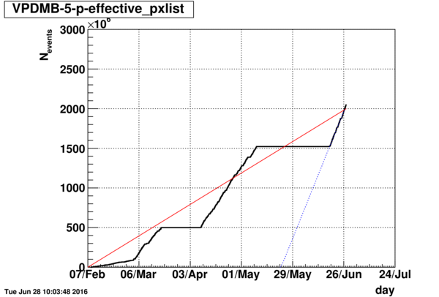
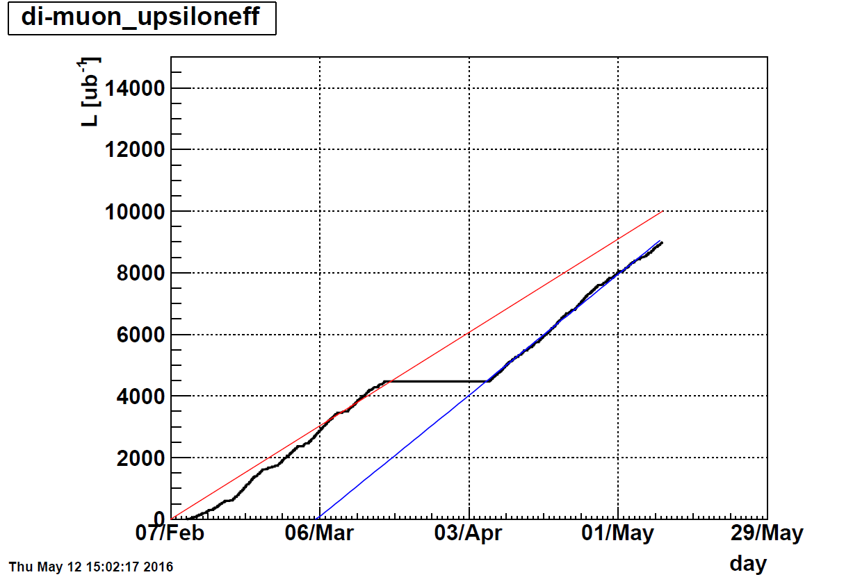
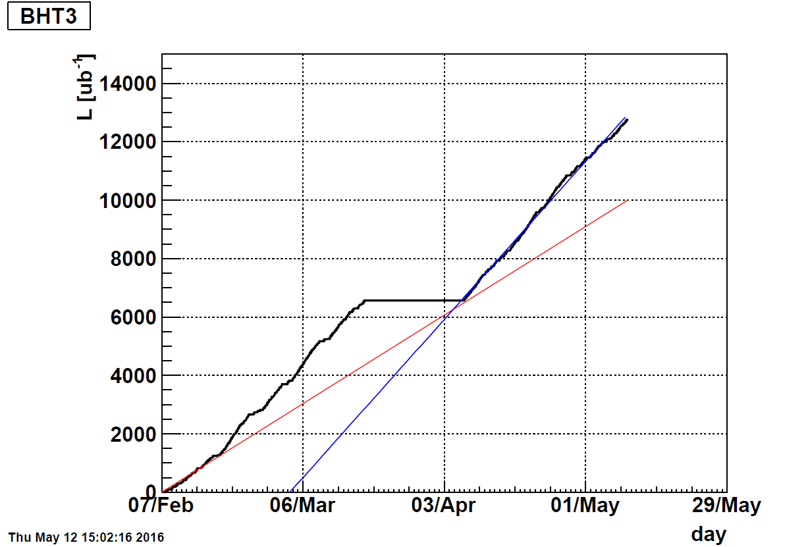
Au+Au Dataset Goals
HFT
Open charm
MTD
Quarkonia
d-Au running
✓
Diode
failure
Firmware
EMC
γ-jet
Minbias goal is about 103%,
Quarkonium (ϒ) and γ-jet integrated luminosities
(within 10%) reach our goals.
✓
Details see Xin Dong’s talk on Saturday

Slide 17
BUR Run17-18 Summary Table
Run | Energy | Duration | System | Goals | priority | Sequence
17 | √s_{NN}=500 GeV √s_{NN}=62.4 GeV | 13-wk 1-wk 2-wk 4-wk | Transverse p+p p+p CeC Au+Au | A_{N} of W±, γ, Drell-Yan, L=400 pb⁻¹, 55% pol RHICf Jets, dileptons, NPE 1.5B MB | 1 3 | 1 2 3
18 | √s_{NN} =200 GeV √s_{NN}=200 GeV √s_{NN}=27 GeV | 3.5-wk 3.5-wk 2-wk | Ru+Ru Zr+Zr Au+Au | 1.2B MB 1.2B MB >500M MB | 2 2 3 | 4 5 6
Options from guidance:
24 cryo-weeks in run 17, 13 weeks in run 18
19 cryo-weeks in run 17, 13 weeks in run 18
If only 15 weeks in run 17, all for pp500
Run xx = year 20xx

Slide 18
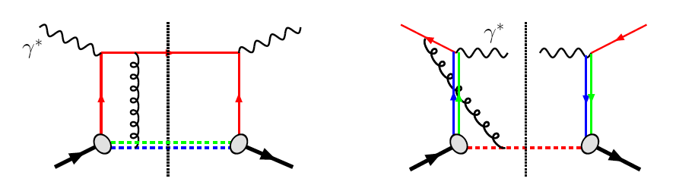
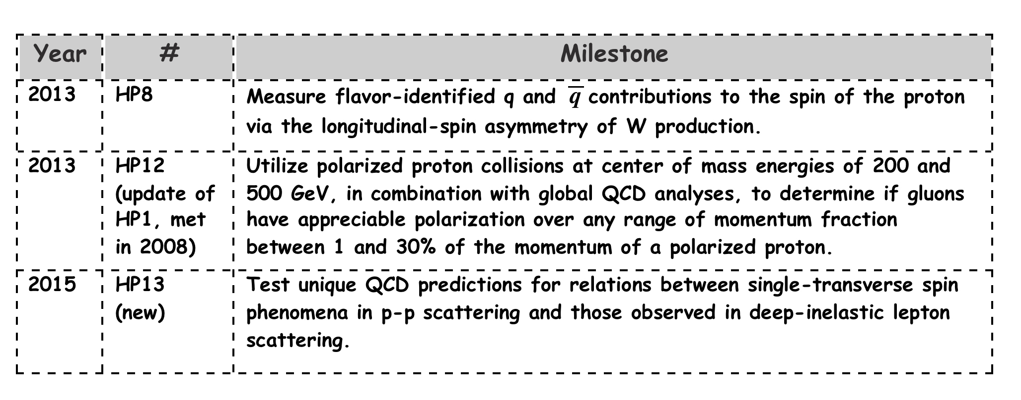
Sea Quarks, Gluons, and Colors
✓
✓
A_{N} of W±,γ, DY in pp 500 are all sensitive to the Sivers sign-change.
STAR can access all three world-class measurements in the proposed 2017 Run – Significant discovery potential before 2020!
Notes:
Not written here but you need to say verbally that one of the more interesting and important tests for these relations between single transverse spin in pp and SIDIS is sign of the Sivers function and we have access to that in A_N of W, gamma and DY.

Slide 19
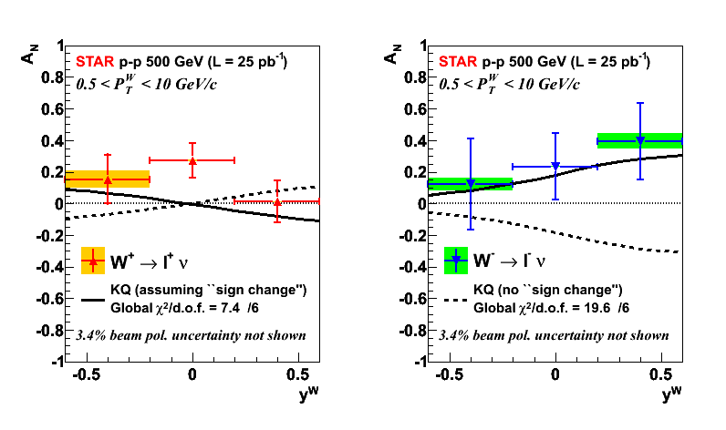
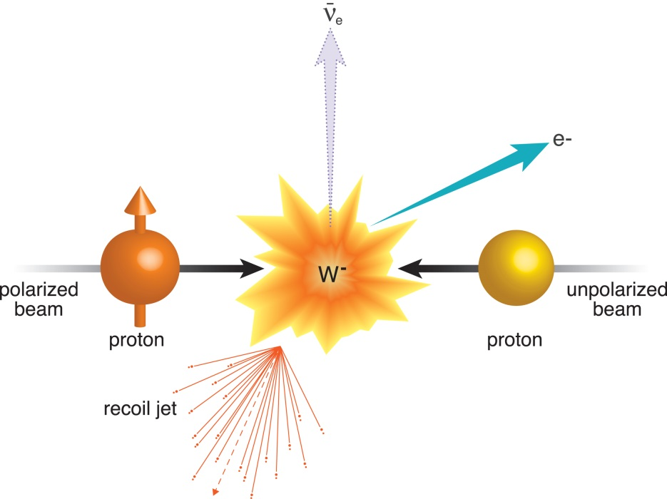
Measure QCD interaction sign and TMD evolution
How to measure certain color interactions are repulsive and others attractive:
A View of the Colorful Microcosm Within a Proton (foundation for run 2017)
https://www.bnl.gov/rhic/news2/news.asp?a=1824&t=pr
STAR paper Phys. Rev. Lett. 116, 132301 (2016), Editors’ Suggestion

Slide 20
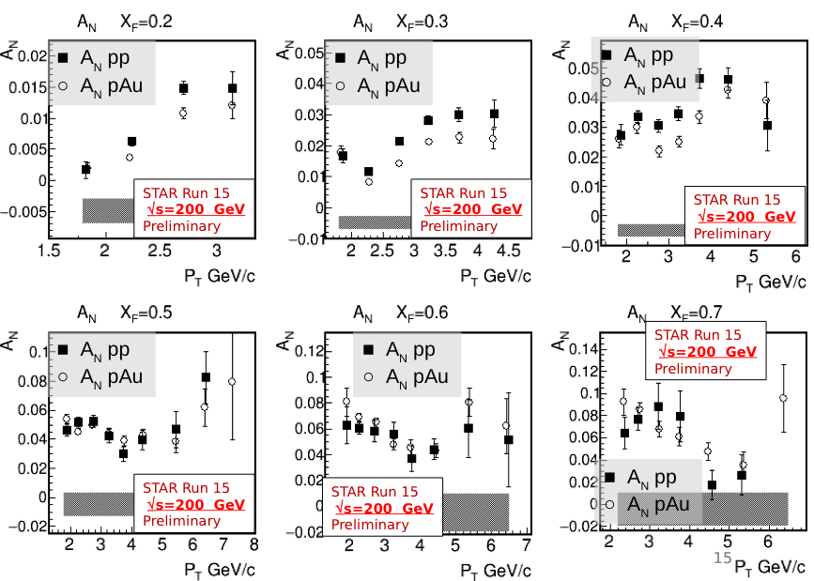
Spin Highlight: Transverse Single-Spin A_{N}
RUN15 polarized p+p and p+A
MPI2015/DIS 2016
Spin asymmetries are a unique way to probe the gluon nuclear wave function and confront CGC and pQCD models.
Forward Meson Spectrometer
  EM calorimeter for detecting forward pi0s
Run 15 pp
  large A_{N}, rising with x_{F}, p_{T}
Run 15: first data for polarized p+A
  compare AN in p+A to p+p
  similar dependence on π⁰ topology
  study centrality and nuclear modification factors
Use RPs to investigate whether A_{N} depends on diffraction
  tag outgoing proton(s)

Slide 21
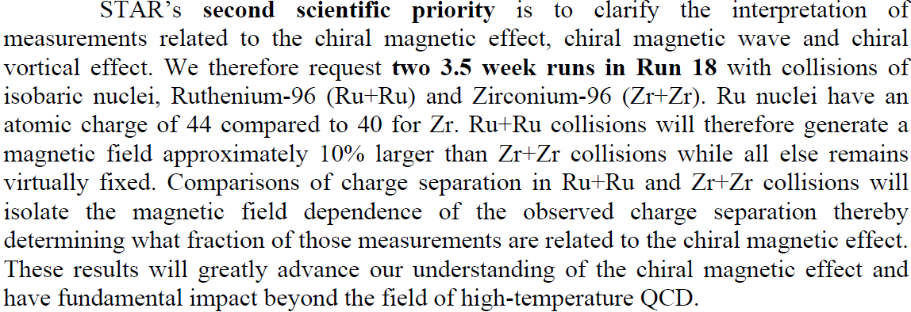
Isobar
Run | Energy | Duration | System | Goals | priority | Sequence
17 | √s_{NN}=500 GeV √s_{NN}=62.4 GeV | 13-wk 1-wk 2-wk 4-wk | Transverse p+p p+p CeC Au+Au | A_{N} of W±, γ, Drell-Yan, L=400 pb⁻¹, 55% pol RHICf Jets, dileptons, NPE 1.5B MB | 1 3 | 1 2 3
18 | √s_{NN} =200 GeV √s_{NN}=200 GeV √s_{NN}=27 GeV | 3.5-wk 3.5-wk 2-wk | Ru+Ru Zr+Zr Au+Au | 1.2B MB 1.2B MB >500M MB | 2 2 3 | 4 5 6

Slide 22
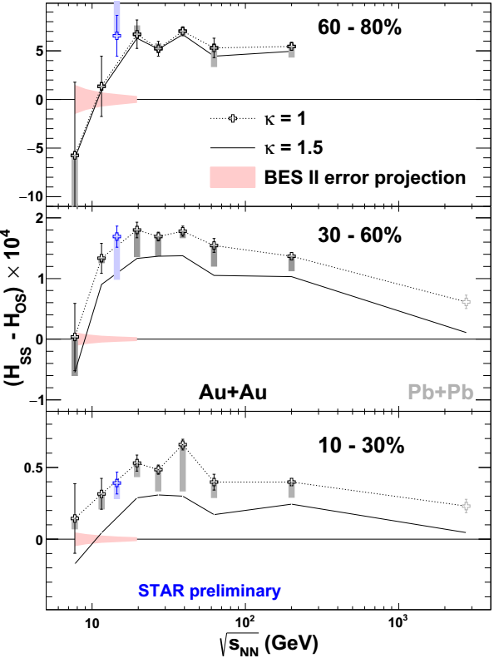
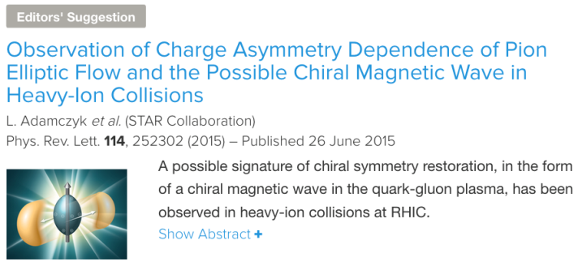
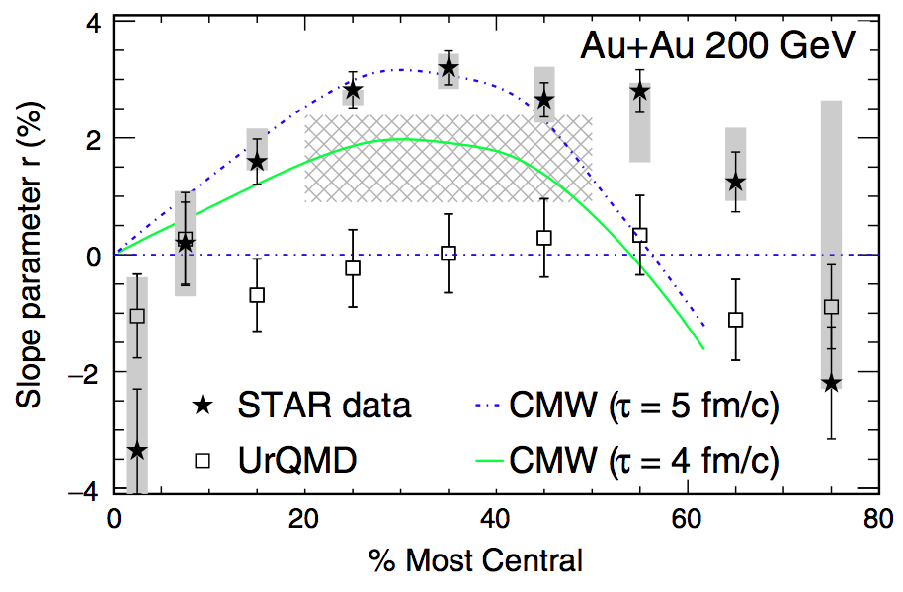
QCD phase transition is a chiral phase transition
PRL113(2014)
Charge separation (14.5GeV)
Bulk charge dependence of π± v₂
Low-mass dilepton excess
Global polarization of hyperons

Slide 23
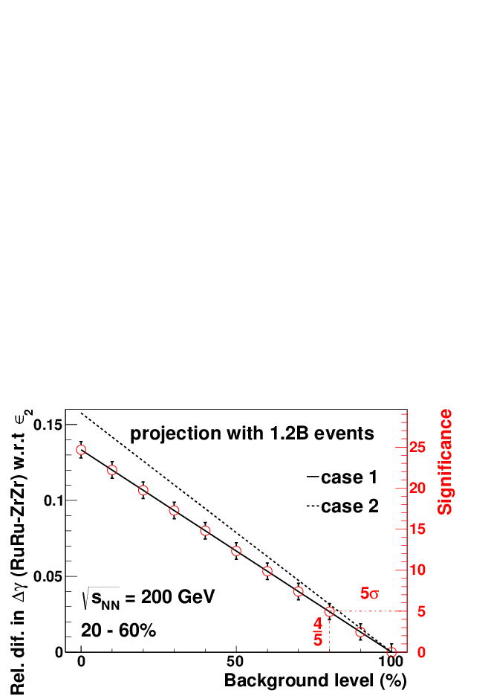
Projections for Isobar
With 1.2B minbias events each species
5σ significance
if 80% observed correlation is background
(0,0)

Slide 24
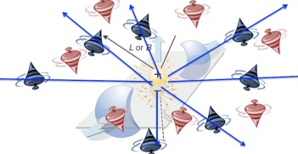
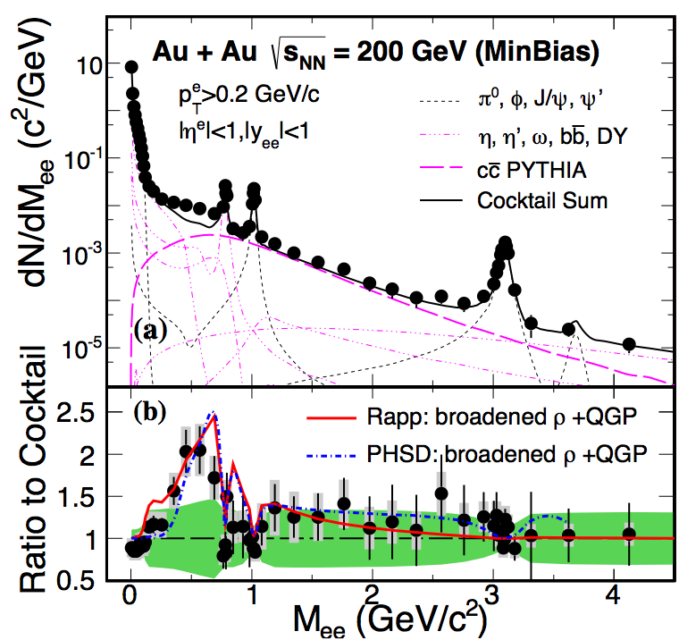
QCD phase transition is a chiral phase transition
Charge separation (14.5GeV)
Bulk charge dependence of π± v₂
Low-mass dilepton excess
Global polarization of hyperons
PRL113(2014)
STAR Preliminary

Slide 25
QCD fluid responds to external field
Current data not able to distinguish
Lambda/AntiLambda polarization difference,
(potentially) Direct measure of
Magnetic Field effect
Need >x10 more data
sum
STAR Preliminary
difference

Slide 26
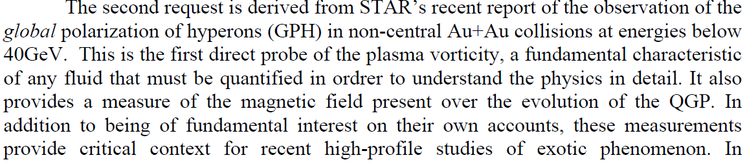
Au+Au at 27GeV
Run | Energy | Duration | System | Goals | priority | Sequence
17 | √s_{NN}=500 GeV √s_{NN}=62.4 GeV | 13-wk 1-wk 2-wk 4-wk | Transverse p+p p+p CeC Au+Au | A_{N} of W±, γ, Drell-Yan, L=400 pb⁻¹, 55% pol RHICf Jets, dileptons, NPE 1.5B MB | 1 3 | 1 2 3
18 | √s_{NN} =200 GeV √s_{NN}=200 GeV √s_{NN}=27 GeV | 3.5-wk 3.5-wk 2-wk | Ru+Ru Zr+Zr Au+Au | 1.2B MB 1.2B MB >500M MB | 2 2 3 | 4 5 6

Slide 27

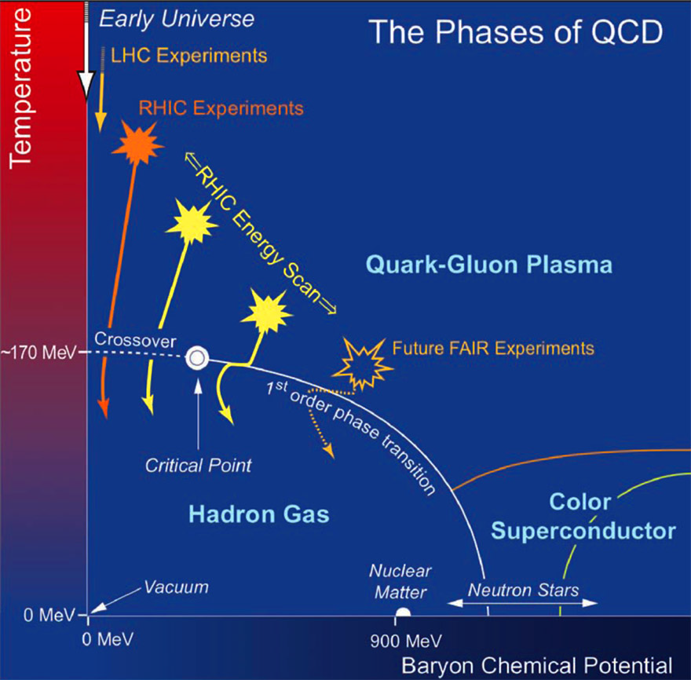
QCD Phase Diagram and Critical Point Search

Slide 28
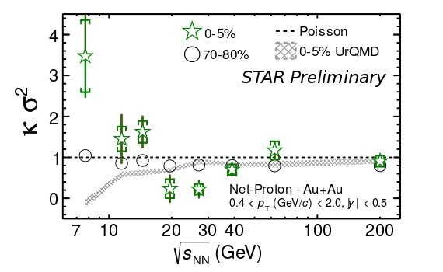
(STAR) Map QCD phase diagram (I)
PRL 116(2016)
PRL112(2014)
Beam Energy Scan Program:
Turn off QGP Signatures
triangle flow (v₃) in peripheral at low energy
consistent with zero
Hadron suppression at high p_{T}
Search for critical point
net-proton Kurtosis possibly not Poissonian and
grow with accepted rapidity window
AND…

Slide 29
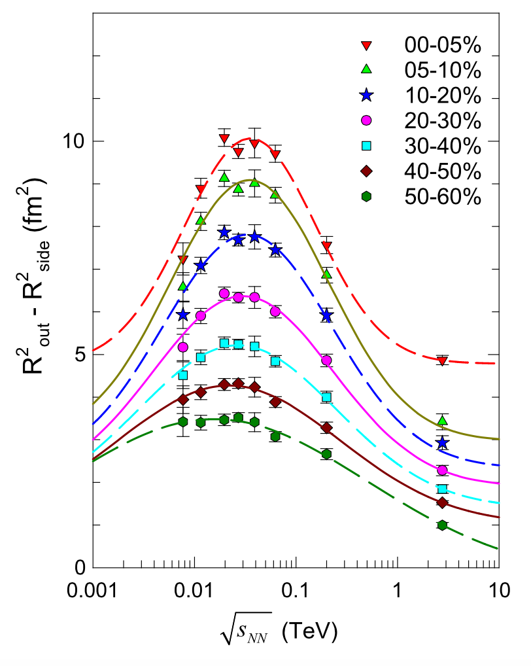
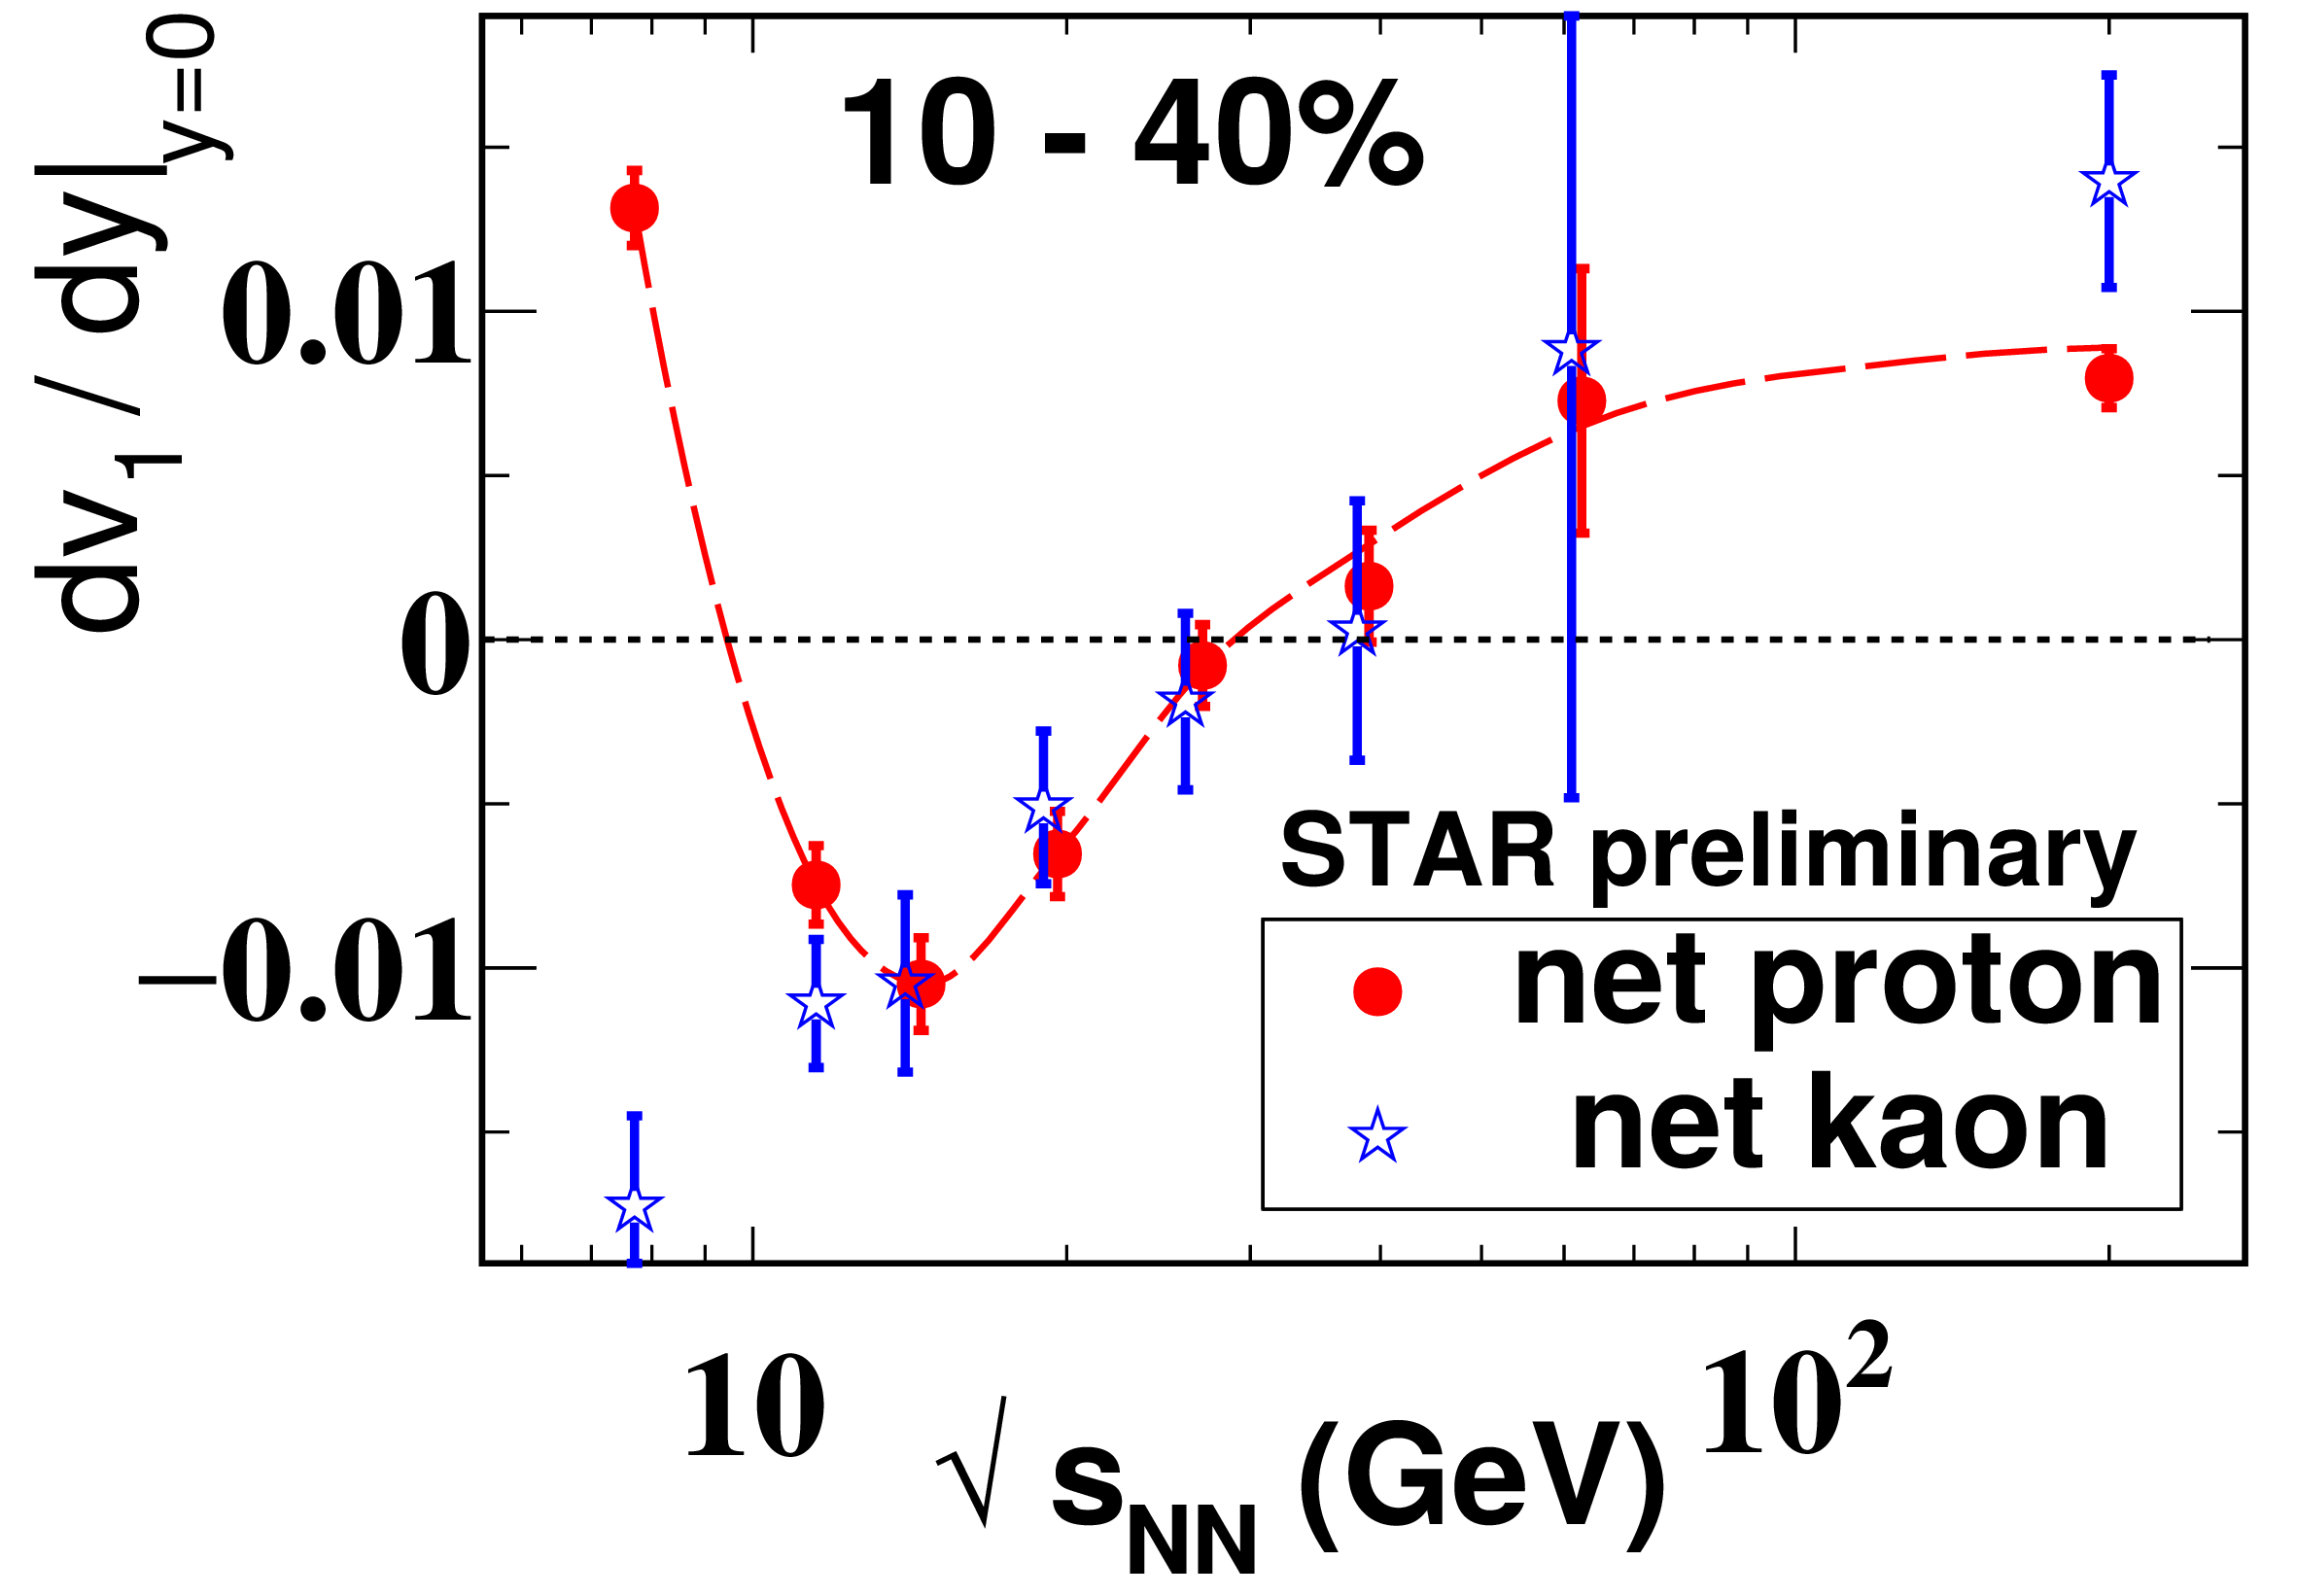
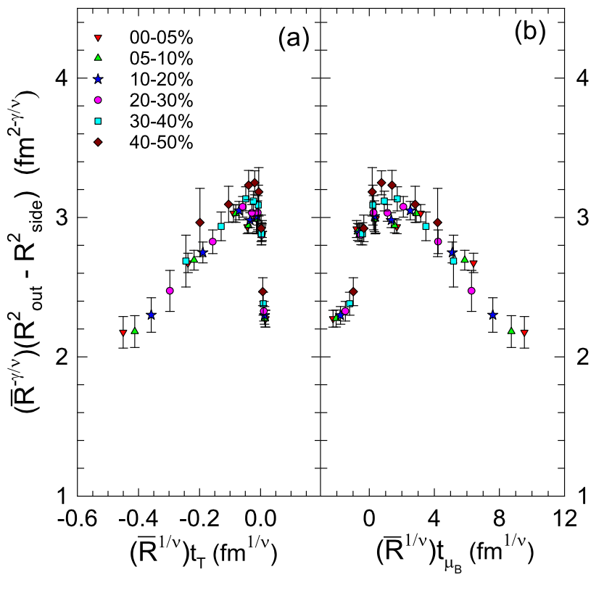
(STAR) Map QCD phase diagram (II)
PRL112(2014)
Beam Energy Scan Program:
…
Search for first-order phase transition
  minimum net-proton v1 slope from
  interplay between baryon stopping and soft EOS
  Finite Size (HBT) Scaling shows Criticality
  compressibility, speed of sound?
R. Lacey, PRL 114, 142301 (April 2015)
STAR, PRC92(2015)

Slide 30
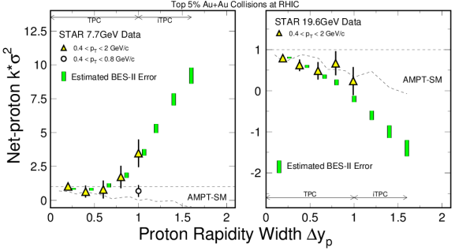
Detector Upgrades necessary for net-proton Kurtosis
Reach the necessary rapidity width of the correlation/fluctuation (~1-2 unit)
B. Ling and M. Stephenaov, Phys.Rev. C93 (2016) 034915

Slide 31
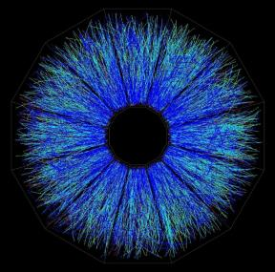
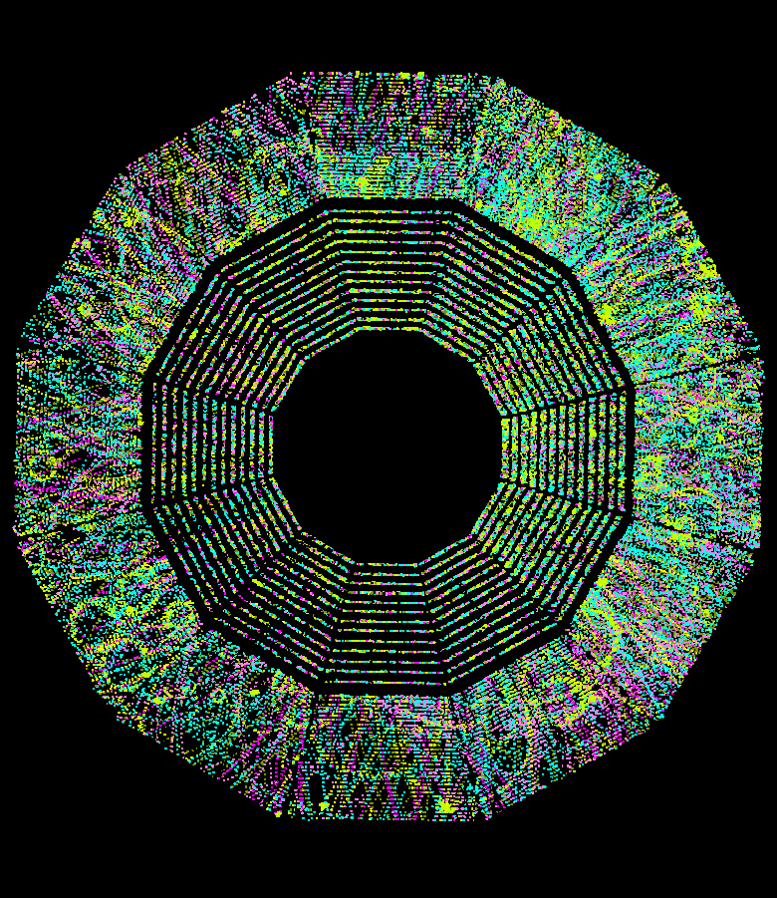
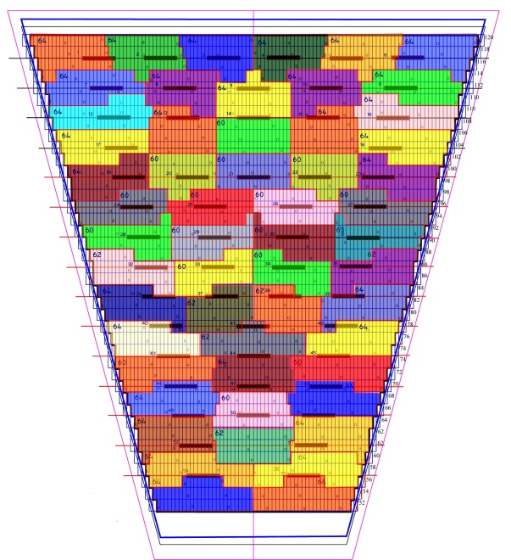
What is STAR iTPC upgrade?

Slide 32
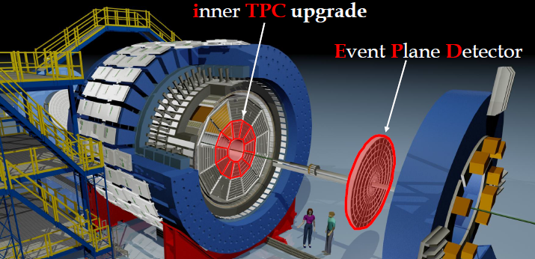
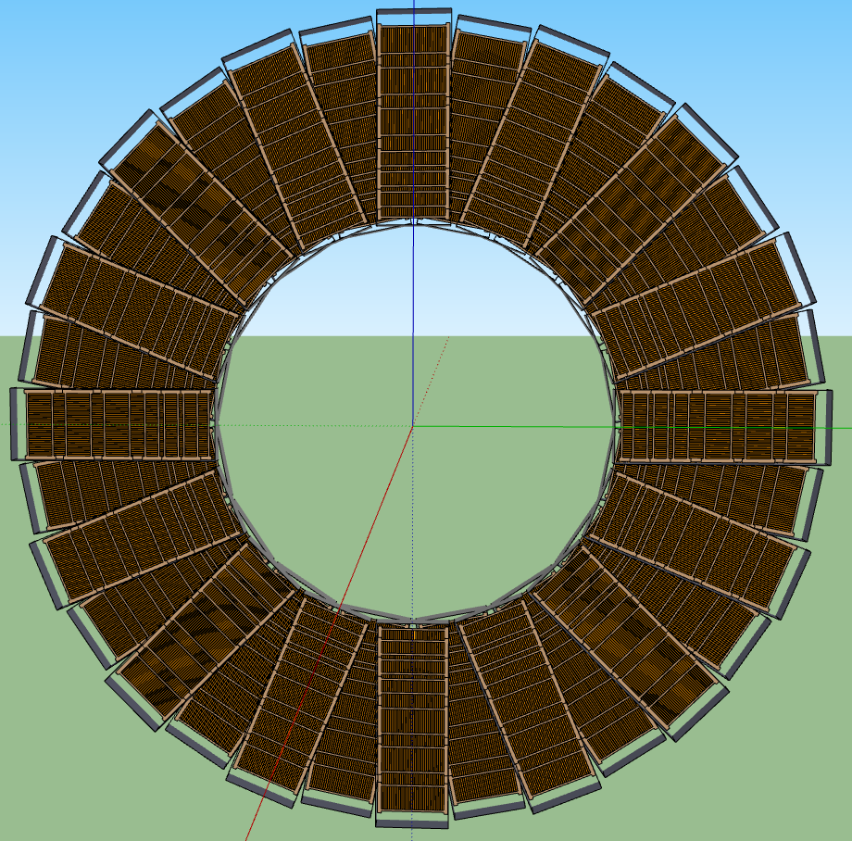
The STAR Upgrades and BES Phase II
Major improvements for BES-II
Endcap TOF
EPD Upgrade:
Improves trigger
Reduces background
Allows a better and independent reaction plane measurement critical to BES physics
iTPC Upgrade:
Rebuilds the inner sectors of the TPC
Continuous Coverage
Improves dE/dx
Extends η coverage from 1.0 to 1.5
Lowers p_{T} cut-in from 125 MeV/c to 60 MeV/c
EndCap TOF Upgrade:
Rapidity coverage is critical
PID at η = 0.9 to 1.5
Improves the fixed target program
Provided by CBM-FAIR

Slide 33



Enable Di-electron measurements
Systematically study di-electron continuum from $\sqrt{S_{NN}}$ = 7.7 – 19.6 GeV
Inner Time Projection Chamber (iTPC) upgrade: reduce systematic and statistical uncertainties
Distinguish models with different ρ-meson broadening mechanisms
Study the total baryon density effect on LMR excess yield in BESII

Slide 34
RHIC has been adaptable to science needs
2010-13 2014-16
BES-I BES-II

Slide 35
RHIC has been adaptable to science needs
2010-2013 | 2014 | 2015 | 2016 | 2017 | 2018 | 2019 | 2020 |  | 2022+
Au+Au p+p | Au+Au | p+p p+A | Au+Au d+Au | p+p Au+Au | Isobar Au+Au | Au+Au | Au+Au |  | Au+Au pp,pA
ΔG, QGP property | Charm flow | Ref. A_{N} | D_{c}, Λ_{c} ϒ, Jets | Fc sign | CME, Λ↑ | Critical Point, Phase Transition |  |  | Jets, ϒ forwardA_{N}
BES-I | 200, 14.5 | 200 | 200-19.6 | 500, 62.4 | 200, 27 | BES-II 11-20 | BES-II 7-11 |  | 200
BES-I
BES-II
Expand to include several programs:
p+A in run 15,
pp500 in run17,
Isobar (Zr, Ru-96) in run 18
BES-II more compelling, detector and machine upgrades in 2018
Future high-luminosity jets and Upsilon in 2020+
3+1D hydrodynamics and Unique Cold QCD (DY) portal to EIC

Slide 36
STAR is a multi-purpose detector; with modern capabilities
Period | Physics | Upgrades
2008 | Generic | Trigger QT
2009 | Generic | TPC/DAQ1000
2010-2011 | BES I, PID | TOF
2013--2015 | Heavy-Flavor | HFT, MTD
2015--2016 | Heavy-Flavor Diffractive, nPDF | FMS, FPS, Roman Pots, HLT
2017 | Spin Sign Change Diffractive | FMS Post-shower
2018 | Isobar (Zr, Ru), CME, dileptons | (EPD?)
2019--2020 | BES II | iTPC, EPD, CBM endcap TOF
2022-2023 | High-statistics Unbiased Jets, Open Beauty, PID FF Drell-Yan, Longitudinal correl | Forward Upgrade, HFT+?
>50M$ worth of upgrades going into 2019+

Slide 37

“The Future”
documents

Slide 38
Rapidity Coverage (BES-II)
TPC (2016-2017)
TPC+iTPC+eTOF+EPD+FMS (2019--)
FMS-FMS

Slide 39


Physics Opportunities beyond BES-II
Define QCD Phase Structure
Study Chiral Properties
Map T dependence of η/s
Test K_{T} factorization
and Universality
Extended coverage and
targeted upgrades open up
many opportunities
for a diverse scientific
program in 2020+

Slide 40
Summary
Many new and exciting results
Compelling Heavy-Ion Programs for run 16 and run 18
  Completion of Heavy-Flavor program for HFT+MTD
  Decisive test of Chiral Magnetic Effect
  Quantifying the role of external field in Global Hyperon Polarization
Compelling Spin Program in run17
Three measurements related to TMD evolution and sign change
(A_{N} W^{+/-}, γ, DY)
Maintain track record in Results and Publications
Preparation for BES II and beyond
(High-statistics of rare probes, 3+1D hydro and Cold QCD)
Work in progress and concerns:
Longer term plan beyond 2020 (upgrades and science)
Operation and (manpower) resources to maintain a viable program
Computing and Analysis Resources (hardware)
Maintain an active scientific collaboration

Slide 41


May it be
your journey on
To light the day
When the night
is overcome
You may rise to
find the sun

