Slide 1
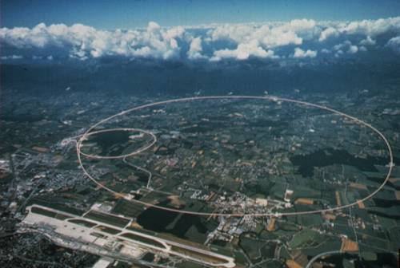


What have we learned from high p_{T} probes?
Erice School in Nuclear Phyiscs
Barbara Jacak
UC Berkeley & LBNL
Sept. 22, 2016

Slide 2
Outline
Jets are quenched!
  Old news, but why and how much?
Quark mass dependence of energy loss
  Constrains the energy loss mechanism
Medium modification of jet fragmentation
  Where does the energy go?
  Quantify parton-medium interactions
Color decoherence of jet vs. coherence in energy loss
  Medium sees the entire jet’s color?
  How do radiated gluons interact with each other as well as the medium?

Slide 3
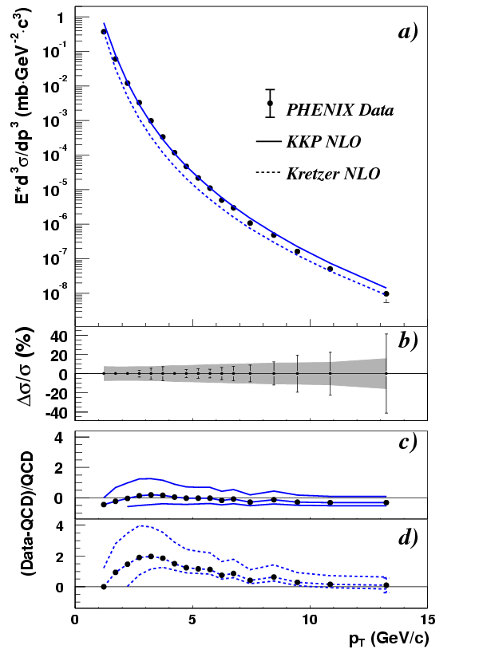
Particle p_{T} spectrum: power law shape
p-p PRL 91 (2003) 241803
Energy loss: the power law tail shifts to the left
Good agreement
with pQCD

Slide 4
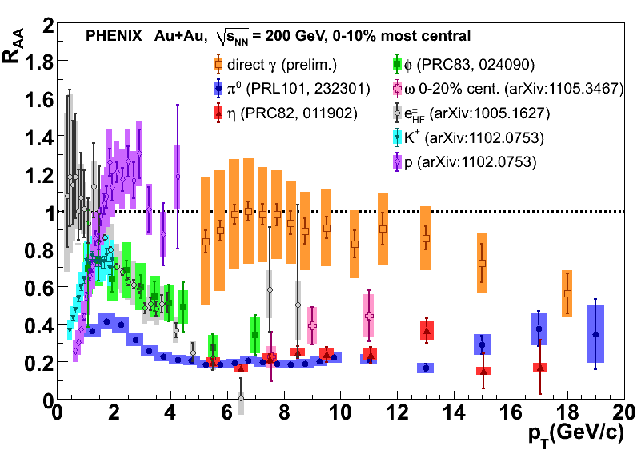
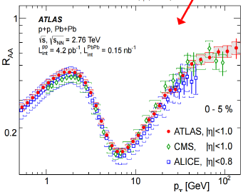
R_{AA}: discovery of large energy loss
R_{AA} flat to 20 GeV/c p_{T}
Depends on spectral shape
less flat at LHC!
Note this is for h± ; particle composition changes!
Also, spectral slope changes with g/q ratio

Slide 5
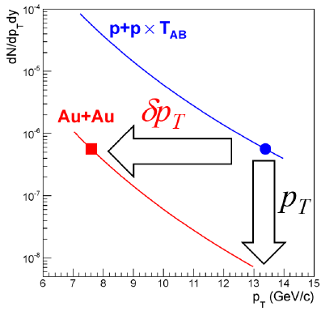
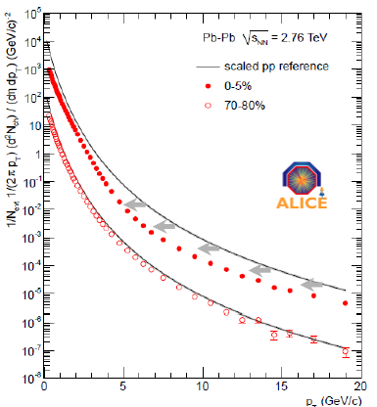
Shifts in the p_{T} spectrum
arXiv:1509.0673
Jet spectrum Shift Periph (60-80%) ➔Central
 | p^{ch}_{T,jet} range [GeV] | Shift R=0.3 [GeV] | Shift R=0.5 [GeV]
Au+Au @ 200 GeV | [10,20] | -6.3 ± 0.6 ± 0.8 | -3.8 ± 0.5 ± 1.8
Pb+Pb @ 2.76 TeV ALICE JHEP 09 (2015) 70 | [60,100] |  | -8 ± 2
δp_{T}/p_{T} proportional to energy density
= 20-30% @ high ετ₀
weak p_{T} dependence

Slide 6
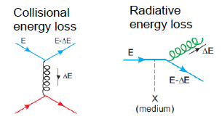
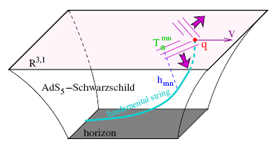
A few questions
What is the mechanism for this?
  Radiation vs. collisional energy loss vs. AdS/CFT picture?
Where does the lost energy go?
  Thermalized in the plasma? Broadened jets?

Slide 7
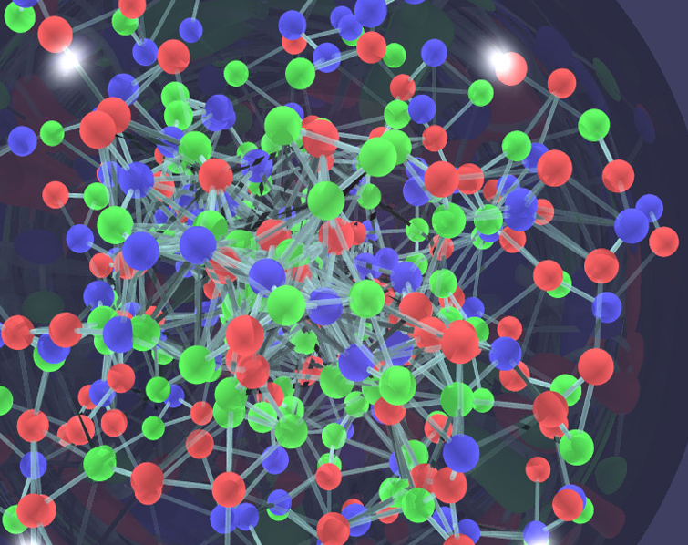
Energy loss and medium density
In dilute medium
  Independent processes: bremsstrahlung & scattering
  Calculate probabilities and add them up
  Independent radiations follow Bethe-Heitler
In dense medium
  Mean free path is short: λ = σ/ρ
  Formation time of radiated gluon: τ = ω/k_{T}²
  Transverse momentum of radiated gluon: k_{T}²=nμ²
  # of collisions n=L/λ, μ=typical p_{T} transfer in 1 scattering
  λ,μ are properties of the medium, combine to q= √μ²/λ
Coherent radiation in the dense medium!
  Next scattering takes place faster than gluon formation
  Add amplitudes for all multiple scatterings
  In QCD this increases the energy loss!
  some evidence for coherence already in cold matter!
<

Slide 8


Energy transport parameters in QGP
>
q : transverse momentum diffusion
    mean p_{T} transfer from medium to the probe
e : longitudinal drag
    from collisions
Key elements of momentum and energy transport in strongly coupled QCD matter!
Values are small in cold nuclear matter. Should increase in quark gluon plasma with increasing α_{s}
<ΔE> ~ L²
>

Slide 9
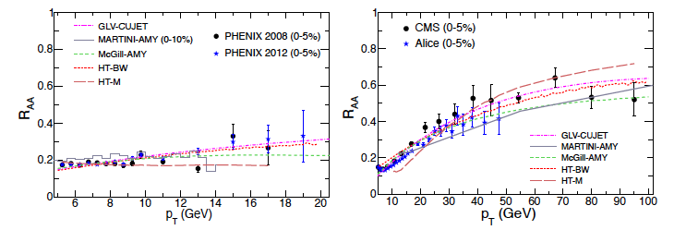
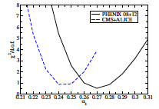
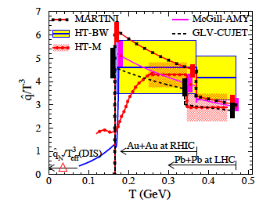
JET collaboration studied the data
>
q large!
decreases w/ √s
parton exchanges momentum w/medium

Slide 10
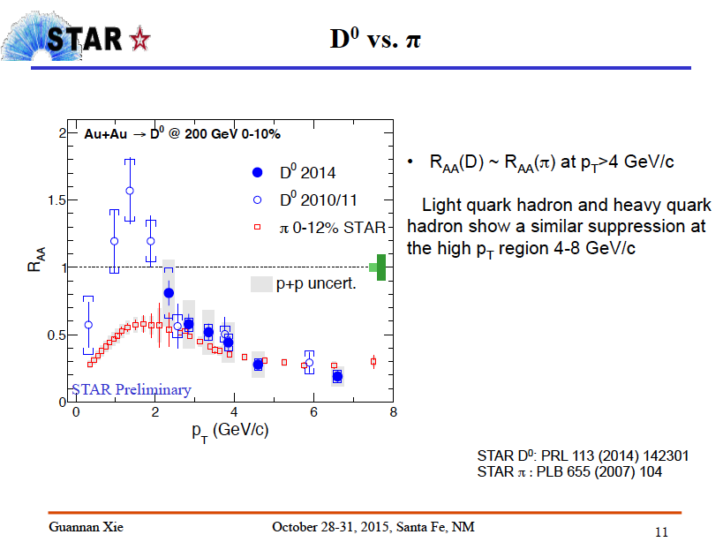
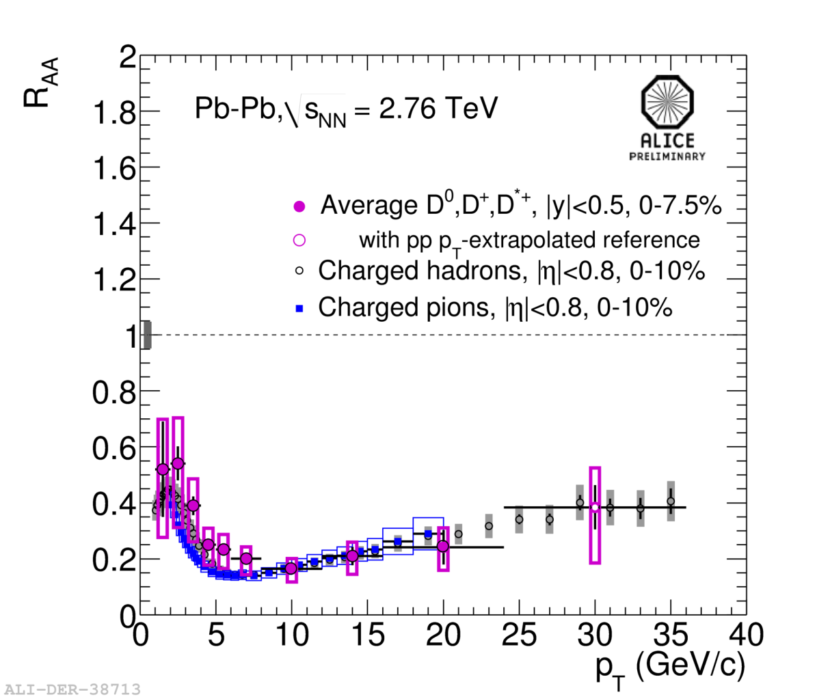
Heavy Quarks lose energy, too!
* As much energy loss as light quarks!
* Less phase space for gluon radiation, so collisional energy loss must be important
ΔE_{collision} ~ L ΔE_{radiative} ~ L²

Slide 11
Questions
Relative contribution of collisional vs. radiative energy loss?
Why should L and L² dependent processes approximately balance to give same R_{AA} for light and charm quarks?
Is b quark energy loss similar or less???????

Slide 12
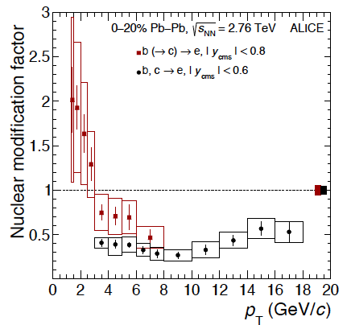
b quark energy loss
R_{AA} (3<p_{T}<6 GeV/c)
~ 0.7
D meson in same pT range < 0.5
quark mass ordering in energy loss! QGP is not equally opaque to all masses
Different balance of radiation & scattering
arXiv:1609.03898 (2016)

Slide 13

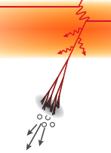
Where does the energy go?
AdS/CFT: excite strong field, produce no gluons!
If gluon radiation/splitting is enhanced by QGP:
  extra gluons at small
  angles (in/near jet cone)
  quark mass dependence!
  radiated gluons thermalize in medium (i.e. they’re gone!)
  remain correlated with leading
  parton, but broaden/change jet

Slide 14
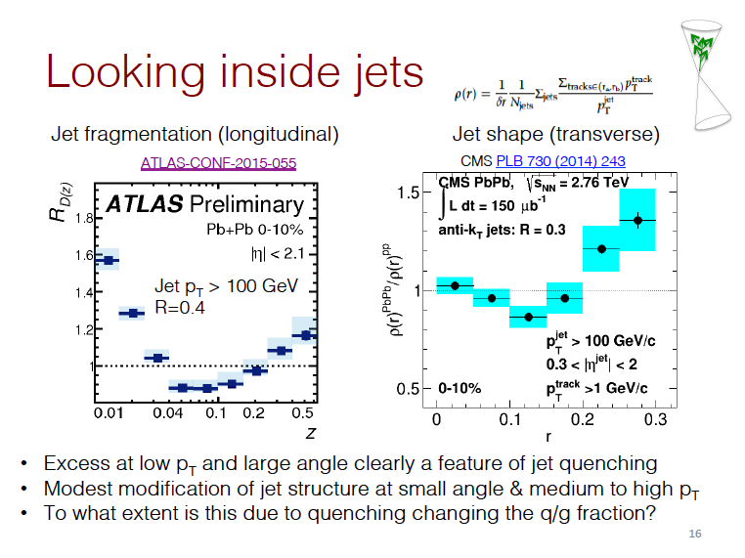
Now let’s consider Jet Fragmentation
Pb+Pb/pp
Z = p(fragment)/p(jet)
Matt Nguyen, QM15

Slide 15
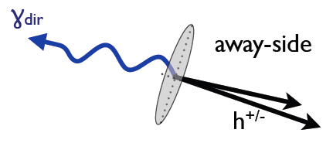
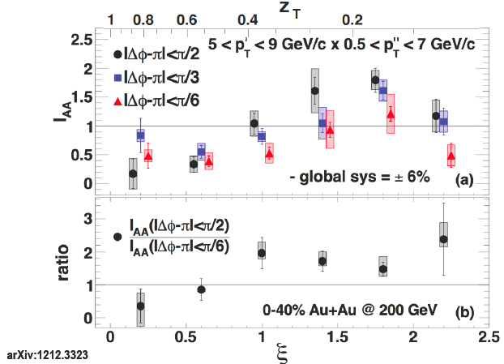

Fragmentation via γ-h correlation
γ: parton energy to ~15%
Suppression of leading particle
“Extra” soft particles at larger angles near the away side jet (Jet broadening)
Au+Au/
p+p
PRL 111, 032301 (2013)

Slide 16
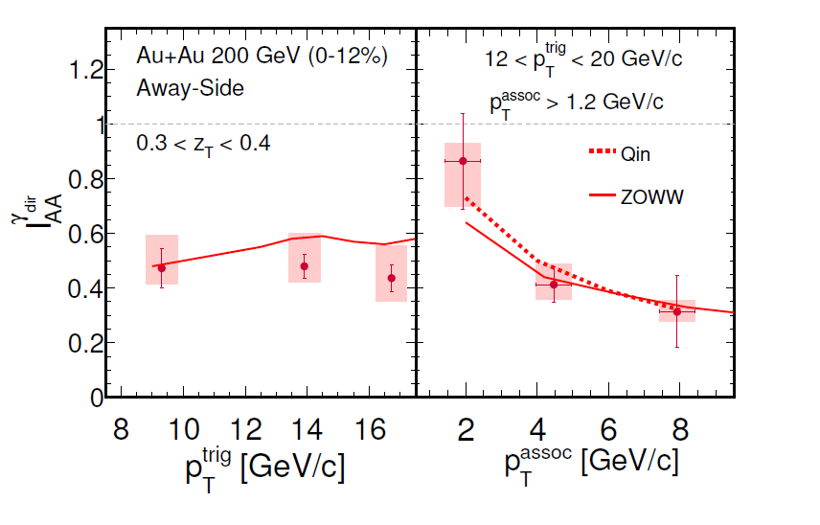
STAR also sees soft particle enhancement
STAR sees extra soft particles
Angular broadening sits at the edge of STAR p_{T} acceptance
NB: photon p_{T} is quite a bit higher at STAR
STAR, arXiv:1604.01117

Slide 17
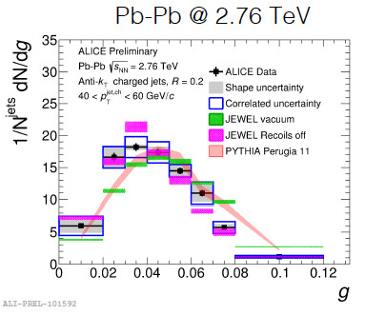

LHC jet centers look collimated
Note this is for R=0.2
Shift of energy to soft particles at large angle could produce such a result
Impact of √s dependence of q?
∧

Slide 18
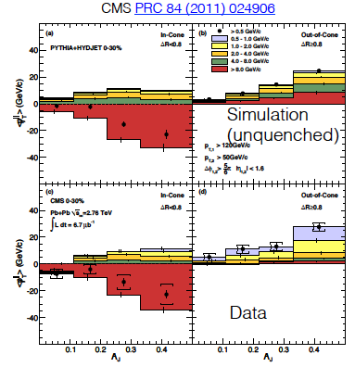
Are jets also broadened at LHC?
Dijet balance recovered at low p_{T} and large angle
But, similar behavior already in p+p
Depends on jet selection??
Different R - different jet population

Slide 19
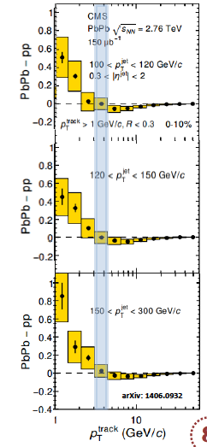
Soft fragment excess at LHC
Look inside jets (p_{T} > 100 GeV)
  R = 0.3 (not wide!)
Fragmentation function is modified
  But only for soft particles
  Otherwise looks like pp jets
Excess soft fragments in PbPb vs. pp for p_{T} < 3 GeV/c
  Is the p_{T} lower at RHIC?

Slide 20
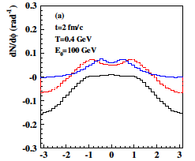
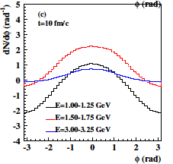
Are these thermal recoil partons?
Linear Boltzmann Transport
kinetic description of parton propagation
hydro description of medium evolution
track thermal recoil partons & their further interactions in medium
Jet transport in medium + jet induced medium excitations
He, Luo, Wang & Zhu
arXiv:1503.0331

Slide 21
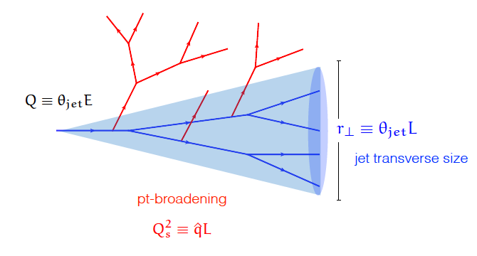
How does energy flow to large angle?
Go from the angular ordering seen in vacuum fragmentation
To a medium-induced cascade –> time-ordered
Y. Mehtar-Tani, et al.
High energy jets fragment mostly outside the plasma
radiate gluons as they transit plasma, producing secondary showers with enhanced splitting
Softer jets resolved by medium; fragment inside?

Slide 22
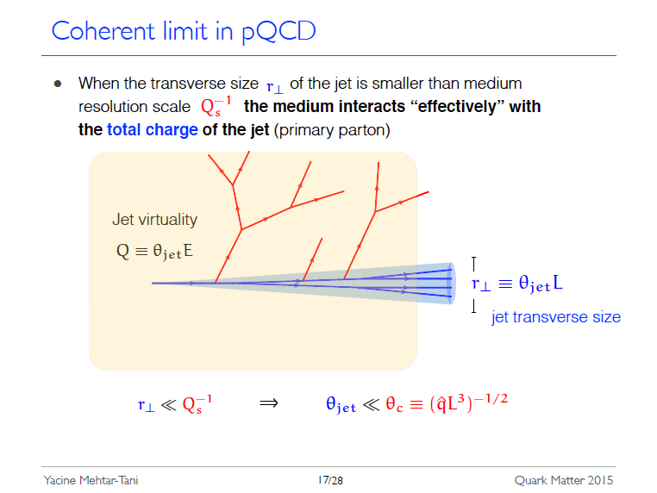
100 GeV jet centers look “normal”, but with less energy

Slide 23
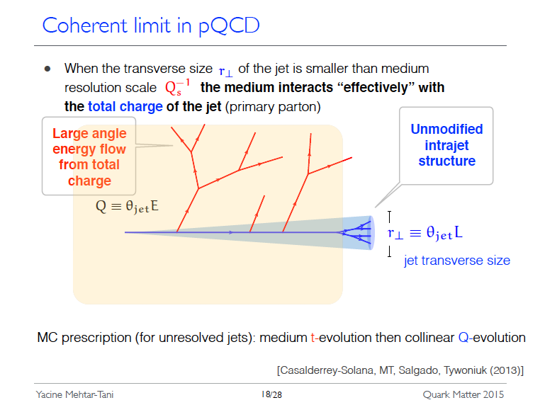
Can describe transition for larger r_{T} as “decoherence”: here the medium can resolve the jet and breaks jet’s color coherence

Slide 24
What happens inside the medium?
It is ~thermal and expanding hydrodynamically
Interaction of radiated gluons in the medium can become turbulent
Are the radiations sequential or do they interfere?
Cold nuclear matter is a good testing ground, even though it is less dense

Slide 25
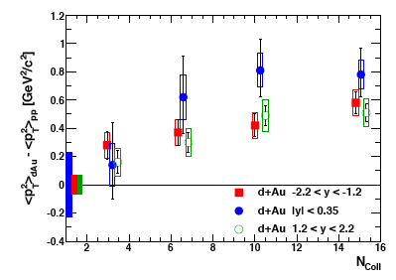
Triple differential J/ψ data in d+A
J/ψ
PRC87, 034911 (2013)
p_{T} broadening
  -> multiple scattering
p_{T}, y, centrality dependence not reproduced by various models

Slide 26
but
d+Au -> J/ψ
Arleo, et al 1304.090
coherent parton energy loss and p_{T} broadening from multiple scattering in the nucleus is consistent with data!
ˆq₀ = 0.075 GeV²/fm
Dynamics of the probe & structure of the medium mix!!

Slide 27
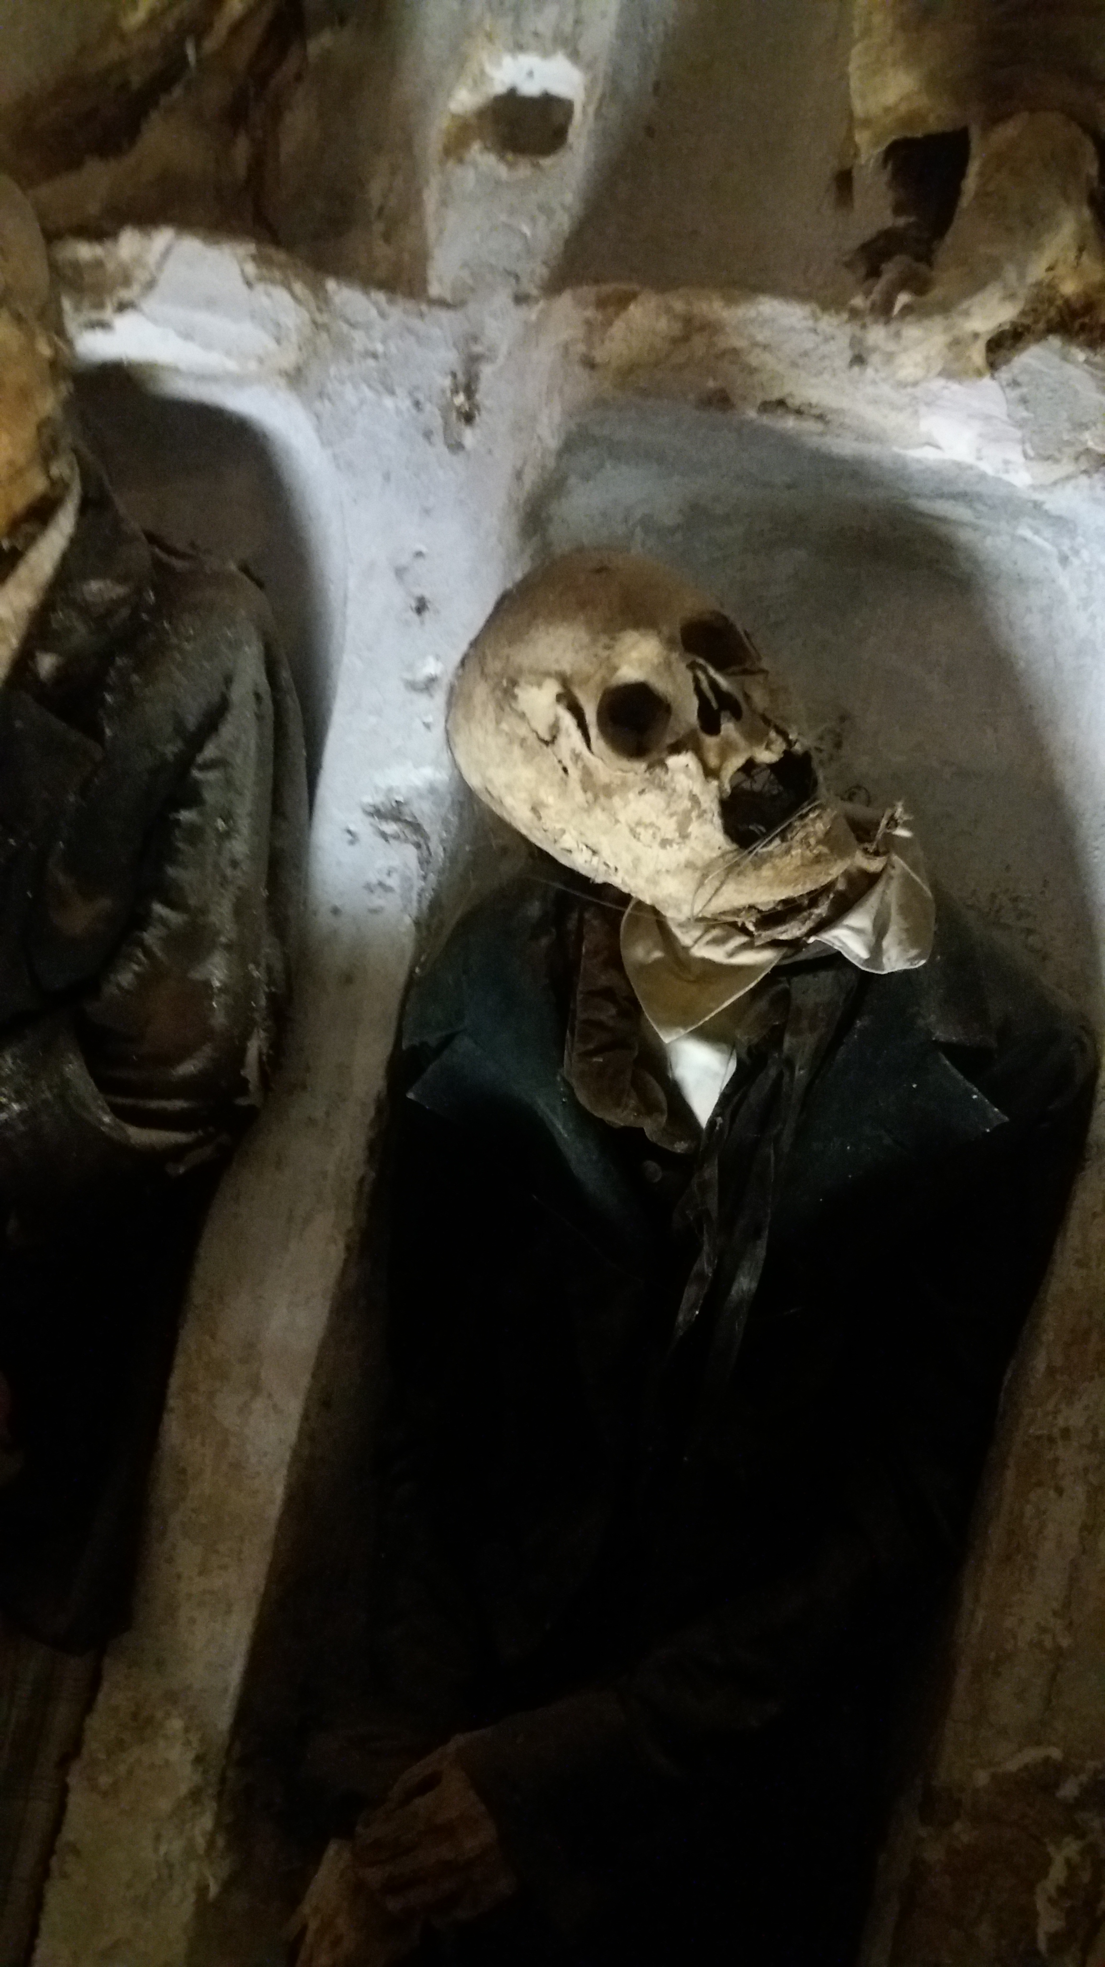
Oh oh!

Slide 28
Why worry about “parton dynamics”?
Nuclear parton distribution functions (e.g. EPS09) aren’t the whole story!
In p/d+A you probe cold nuclear matter with a parton, not a photon.
  It can lose energy before the hard scattering
  It can lose energy after the hard scattering
  It can experience multiple scattering
No factorization!!!!
These are effects upon the probe, not part of the structure of cold nuclear matter!
How to sort this out?

Slide 29
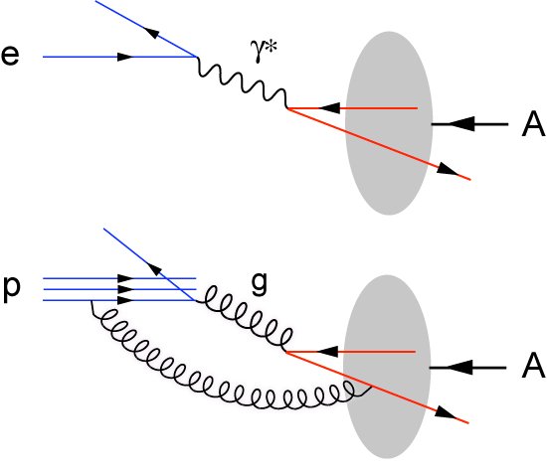
Change the beam!
Hadron-Hadron
Electron beam: deep inelastic scattering
p
p/A
p/A
  Probe is a gluon
  Probe has structure!
  Dynamics of the probe mixed up with structure of the nucleus
  Point-like probe
  No strong interaction before the large momentum transfer process
  Control probe kinematics by measuring scattered electron

Slide 30
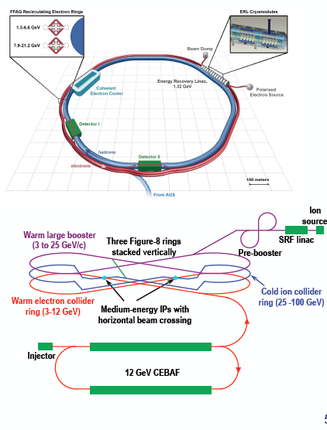
Use ions in electron-ion collider

Slide 31
Conclusions
Evidence for ~constant fractional energy shift
q = 3.5 – 5.5 * T³
Charm quark energy loss is large, b smaller
  collisional energy loss is important
Lost energy appears in soft particles at large angle
  Medium response?
  Compare jets resolved (and not) by the medium
  γ-jet and γ-h over large photon energy range
Be careful of factorization assumptions…
  Initial/final state radiation can interfere
  How best to include p+A in nPDF fits??
  Sort out using electron-ion collisions!
^

Slide 32
Backup

Slide 33
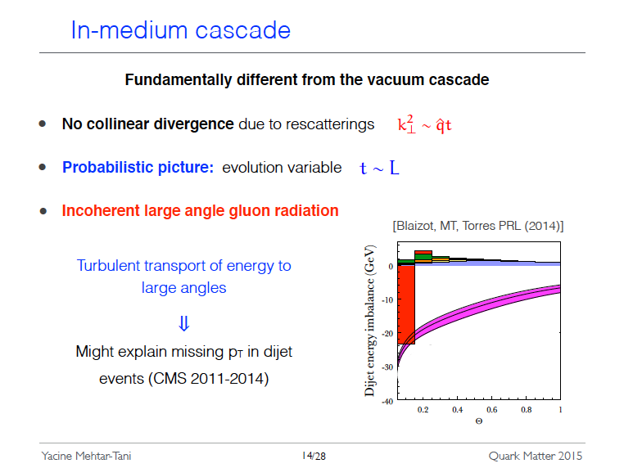

Slide 34
d+Au -> J/ψ from PHENIX
Triple differential J/ψ
data in d+A collisions
Au
Forward + y
d-going
Backward - y
Au-going
d
8/13/12
Au

Slide 35
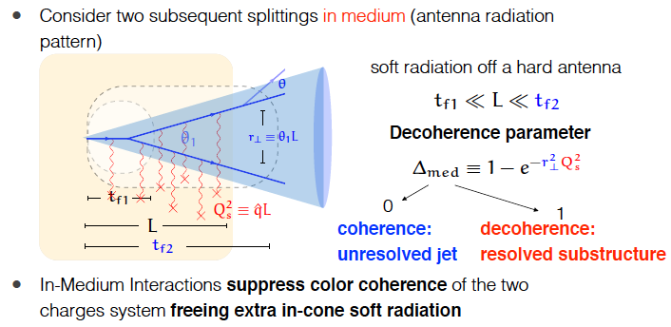

Slide 36

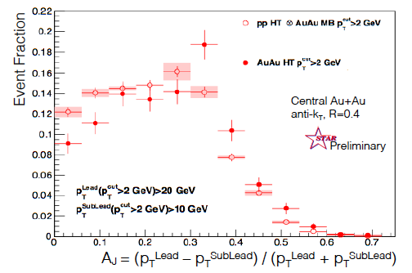
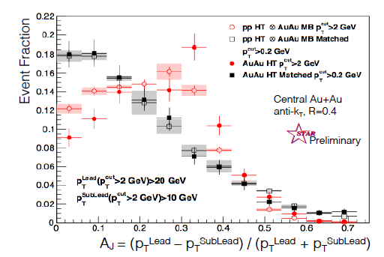
Au+Au dijet imbalance
Larger imbalance in Au+Au than in p+p
Decrease constituent p_{T} threshold (2 to 0.2 GeV/c) -> imbalance vanishes
Jet softening & broadening!

Slide 37
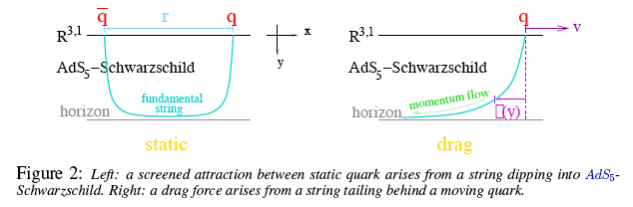
Interactions with plasma?
radiation (bremsstrahlung)
collisional energy loss
In plasma: interactions among charges of multiple particles
charge is spread, screened in characteristic (Debye) length, λ_{D}
also the case for strong, rather than EM force … Effect on collisions?
α_{s} is not small so coupling is strong!
In AdS/CFT: QGP field is modeled as ∞ strongly coupled
  q & g interact with this QGP as with a tiny black hole
  No particles to hit, none can survive inside. Eloss ➔ collective excitations
Δ
S. Gubser

Slide 38
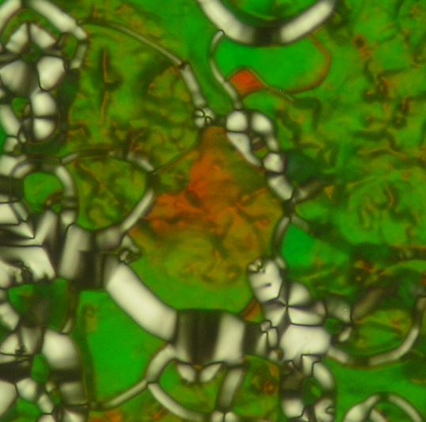

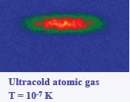
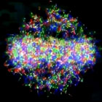
Many types of strongly coupled matter
Quark gluon plasma is like other systems with strong coupling - all flow and exhibit phase transitions
Cold atoms: coldest & hottest matter on earth are alike!
Dusty plasmas & warm, dense plasmas
have liquid and even crystalline phases
In all these cases have a competition:
Attractive forces ⇔ repulsive force or kinetic energy
High T_{c} superconductors: magnetic vs. potential energy
Result: many-body interactions, not pairwise!
QCD is a great test lab: we know the Lagrangian!
Strongly correlated condensed matter:
liquid crystal phases and superconductors

Slide 39
Transport: search for the lost energy
If AdS/CFT is right, don’t produce any gluons!
If gluon radiation/splitting is enhanced by QGP:
  extra gluons at small
  angles (in/near jet cone)
  radiated gluons thermalize in medium (i.e. they’re gone!)
  remain correlated with leading
  parton, but broaden/change jet

Slide 40
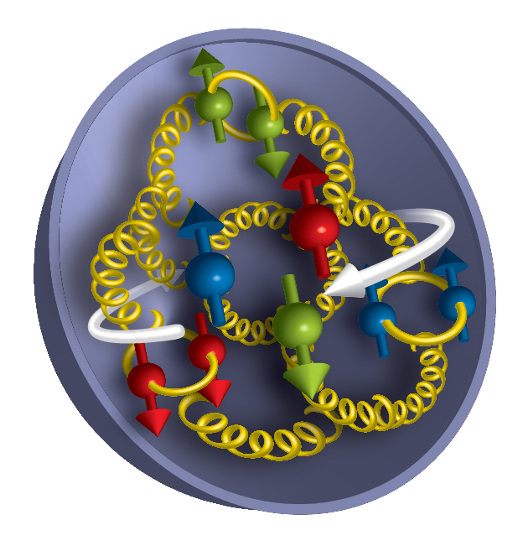
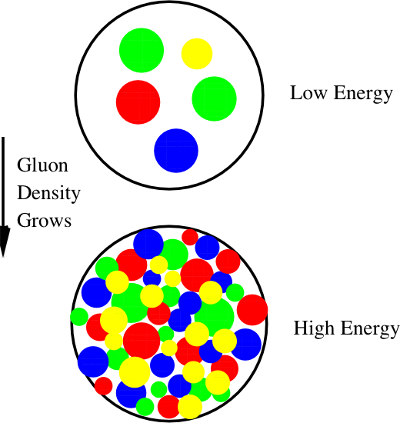
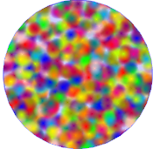

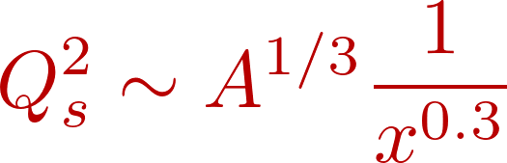
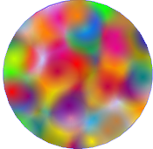
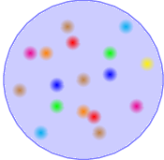







Hot, dense gluonic matter: surprising Are cold dense gluons weird too?
    Look deep in a nucleus: gluons are numerous
    At high density
    what then?
Saturation
Smaller gluon momentum➔
1/Q_{S}²
BFKL
DGLAP
Increasing probe energy ➔
+
?

Slide 41
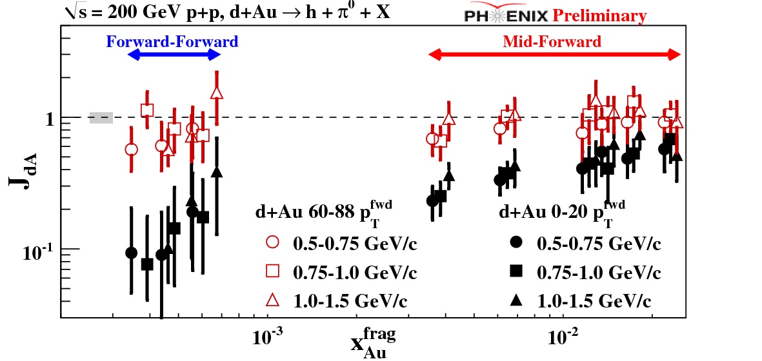
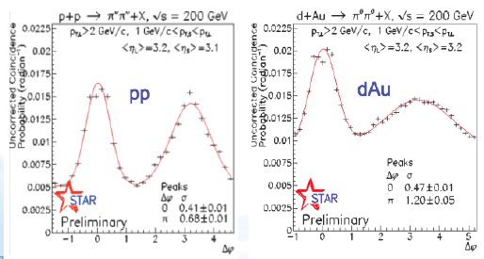
See hints at RHIC for saturation of gluons
Dilute parton system (deuteron)
P_{T} is balanced by many gluons
Dense gluon
field (Au)
Saturated gluon field is
easier to equilibrate???
QCD Compton scattering to find out (q+g -> q+γ):
no final state effects on γ!
Being measured now…
But – incoming parton dynamics are still confusing (the probe loses energy)

Slide 42
Currently a raging debate
Just WHAT is inside the hot dense QCD plasma?
  Individual gluons?
  Pure fields?
  Multi-gluons that continuously
  split & re-form?
  i.e. composite quasiparticles
  (in classical liquids voids fill this role)
Energy loss: radiative? elastic?
  Excite collective modes in QGP?
Dynamical properties of this new material?
  Viscosity, speed of sound, diffusion
  i.e. transport of momentum, energy & particles
L
q
q
g

Slide 43
Heavy Quarks stop, too!

Slide 44
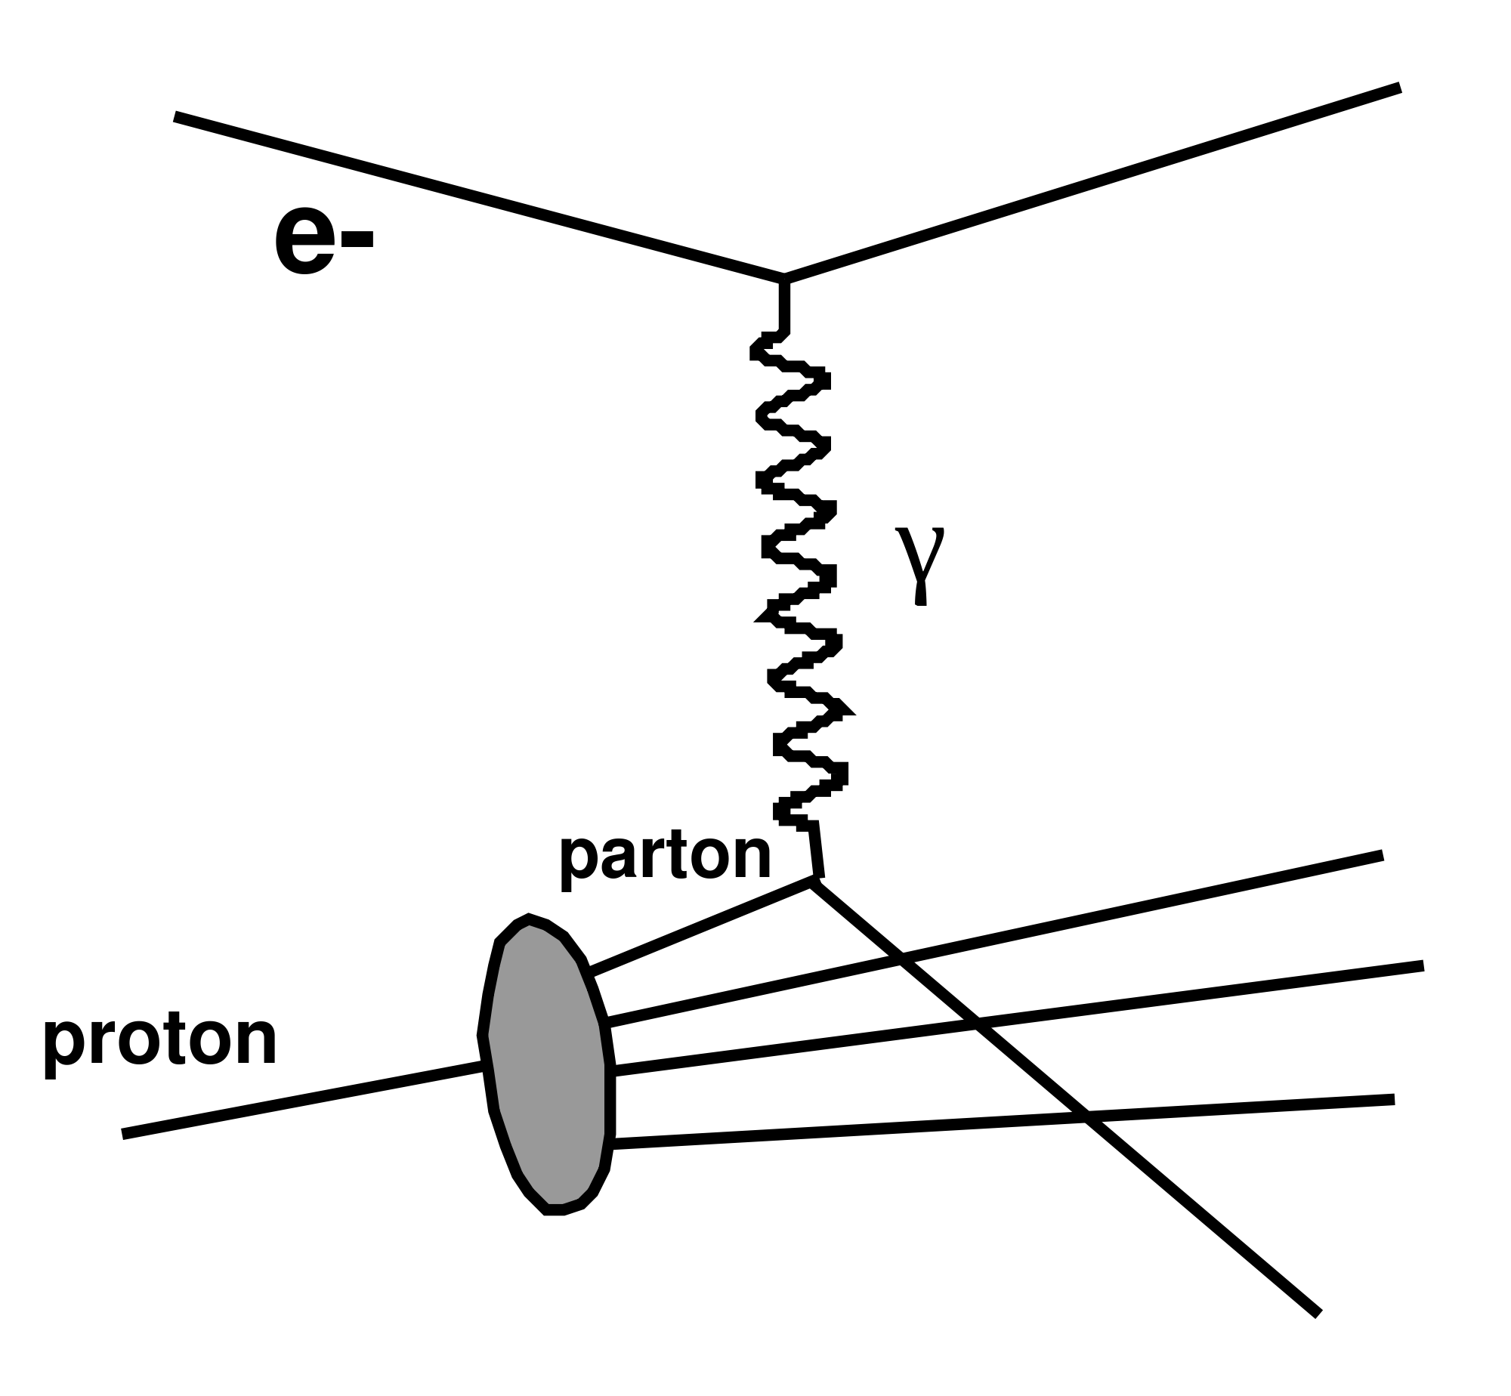
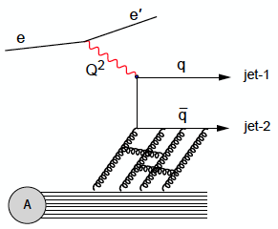

Probe nucleons & nuclei with electrons!
How many gluons are there?
        Measure e+p, e+A ➔ e
How are they distributed?
    In space? In momentum?
    Measure e+p, e+A ➔ e + hadrons, e + γ or J/ψ
How are they correlated inside nucleus?
        Measure e+p, e+A ➔
        e + ≥ 2 hadrons
What’s gluon range inside a nucleus?
      Measure hadron production
In vacuum
In nucleus

Slide 45

EIC ideas

Slide 46

Structure deep inside nuclei?
High gluon density, small coupling at low x (p_{g}/p_{N})
  More in nuclei than nucleons
Can describe saturated
  gluon distribution as a field
Easier to equilibrate if we start from this?
Linear QCD
BFKL: gluon
emission
Nonlinear QCD
BK/JMWLK gluon recombination
BK/JMWLK
(McLerran, Venugopalan)
BFKL
DGLAP
What effects of incoming parton dynamics?
See Ann. Rev. Nucl Part (60) 2010 F. Gelis et al., , arXiv:1002.0333)

Slide 47



In the longer term
An electron-ion collider
probe structure directly
Enhance Q_{S} with A, not energy

Slide 48


Surprise: large heavy quark energy loss!
Non photonic electrons
π⁰, η
b + c !
► more energy loss than gluon radiation can explain!
► charm quarks flow along with the QGP liquid!!
Who ordered that?
Mix of radiation + collisions (diffusion)
but collisions with what?
Drag force of strongly coupled plasma on moving quark?

Slide 49

Jet Fragmentation function
D(z) = 1/N_{jet} dN(z)/dz; z = p_{had}/p_{jet}
Measure: count partners per trigger as fraction of trigger momentum
z_{T} = p_{Ta}/p_{Tt} ~ z for γ trigger
ξ = ln(1/z_{T})
Modification factor similar to R_{AA}:
FFn experimental challenge:
measure the parton p
Use trigger γ or jet

Slide 50
What are the properties of hot QCD matter?
thermodynamic (equilibrium)
  T, P, ρ
  EOS (relation between T, P, V, energy density)
  v_{sound}, static screening length
transport properties (non-equilibrium)*
  particle number, energy, momentum, charge
  diffusion sound viscosity conductivity
In plasma: interactions among charges of multiple particles
charge is spread, screened in characteristic (Debye) length, λ_{D}
NB: we deal with strong, not EM force: exchange g instead of γ
  measuring these is new for nuclear/particle physics!
  Nature is nasty to us: does a time integral…

