Slide 1
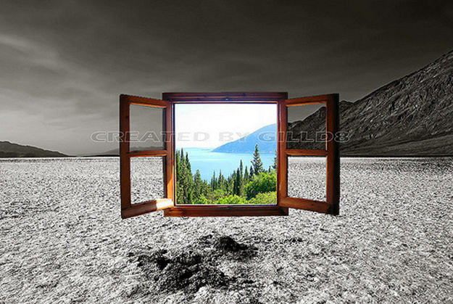
Observation of the Critical Point in the Phase Diagram for Hot and Dense Nuclear Matter
Roy A. Lacey
Stony Brook University
Roy.Lacey@Stonybrook.edu
Outline
Introduction
  Phase Diagram & its ``landmarks”
Strategy for CEP search
  Anatomical & operational
Finite Size Scaling (FSS)
  Basics
  Scaling Examples
Results
  FSS functions for susceptibility
  FSS functions for fluctuations
  Dynamic FSS
Epilogue
Essential points;
Finite-Size Scaling provides an important “window” for locating and characterizing the CEP
The existence of the CEP is not a moot point

Slide 2
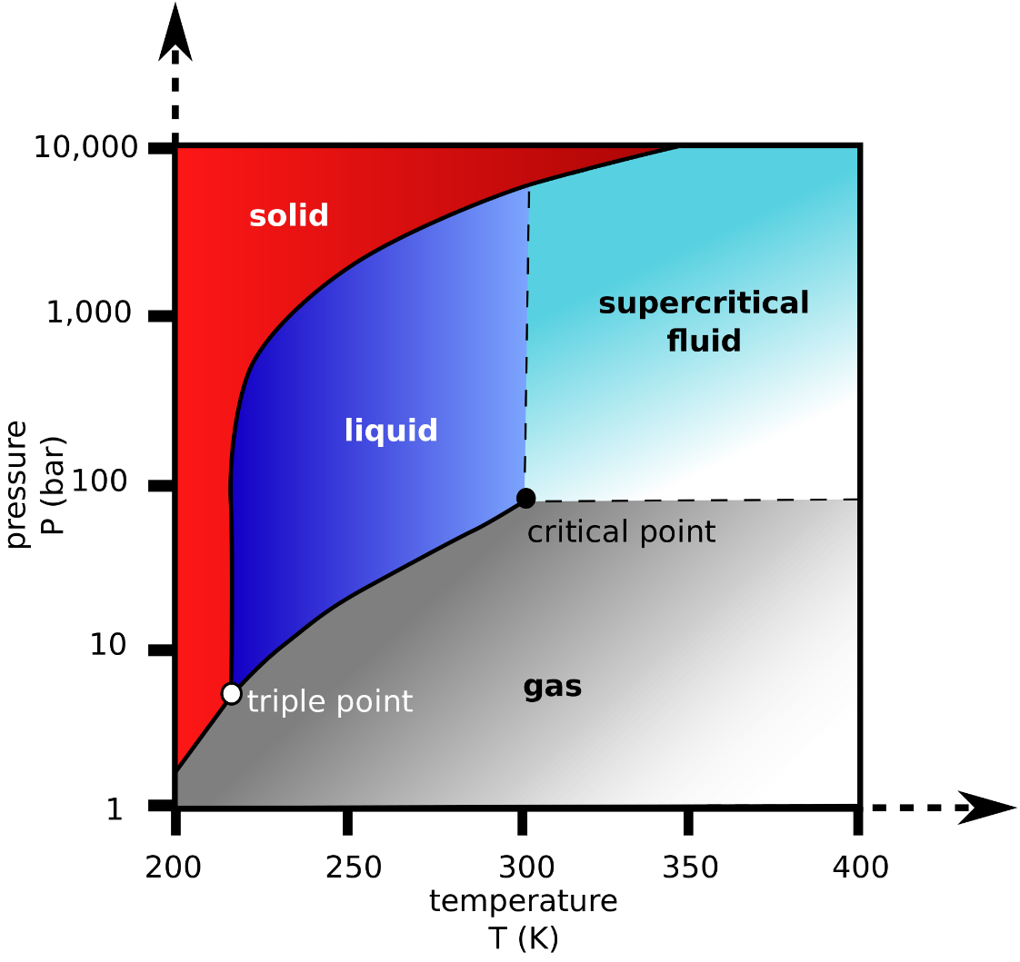
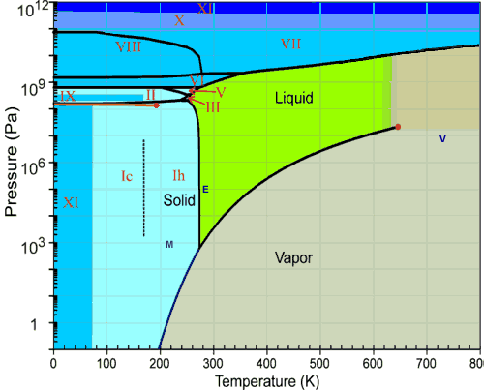
Characterizing the phases of matter
Phase diagram for H₂O
The location of the critical End point (CEP) and the phase coexistence regions are fundamental to the phase diagram of any substance !
Critical Point
End point of 1st order
(discontinuous) transition
The properties of each phase is also of fundamental interest

Slide 3
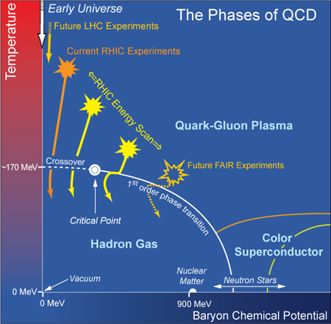
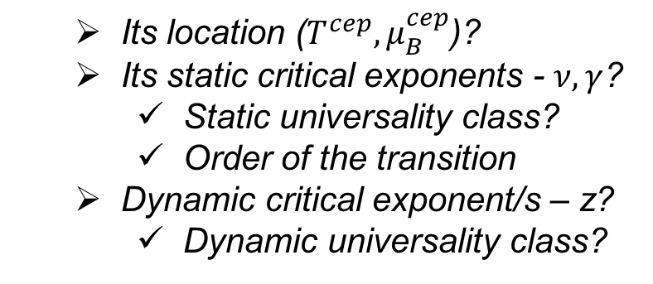
QCD Phase Diagram
Quantitative study of the QCD phase diagram is a current focus of our field
Essential question:
What new insights do we have on
the CEP “landmark” from the RHIC beam energy scan (BES-I)?
  Its location ($T^{cep}{, μ}_{B}^{cep}$)?
  Its static critical exponents - $ν, γ$?
    Static universality class?
    Order of the transition
  Dynamic critical exponent/s – z?
    Dynamic universality class?
All are required to fully characterize
the CEP
Focus:
The use of Finite-Size/time Scaling to
locate and characterize the CEP!

Slide 4
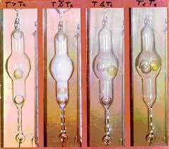
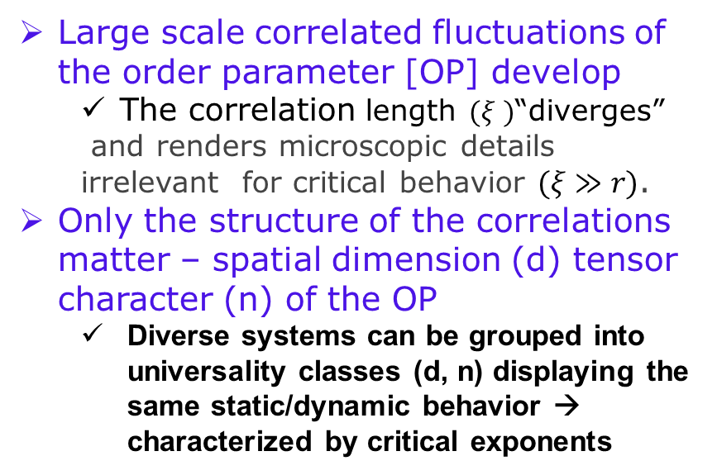
The CEP “Landmark”
Large scale correlated fluctuations of the order parameter [OP] develop
  The correlation length $(ξ )$“diverges”
  and renders microscopic details irrelevant for critical behavior $(ξ≫r)$.
Only the structure of the correlations matter – spatial dimension (d) tensor character (n) of the OP
  Diverse systems can be grouped into universality classes (d, n) displaying the same static/dynamic behavior → characterized by critical exponents
Transitions are anomalous
near the CEP
Critical
opalescence
[CO₂]
3D-Ising Universality Class
The critical end point is characterized by singular behavior at T = T_{c+/-}

Slide 5
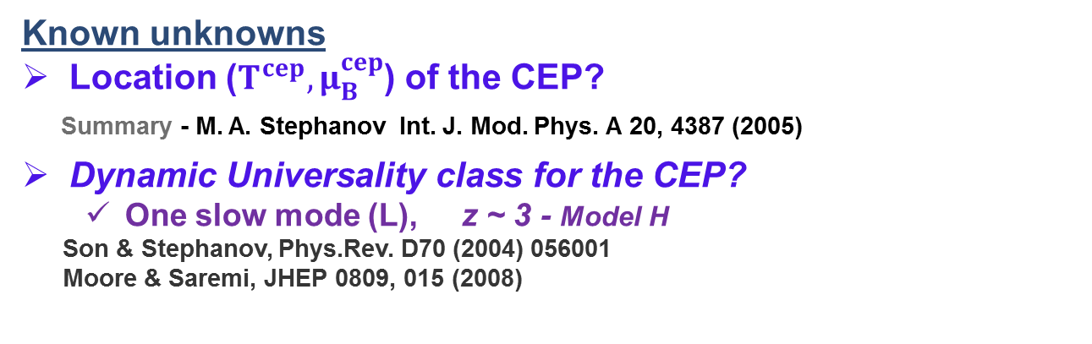
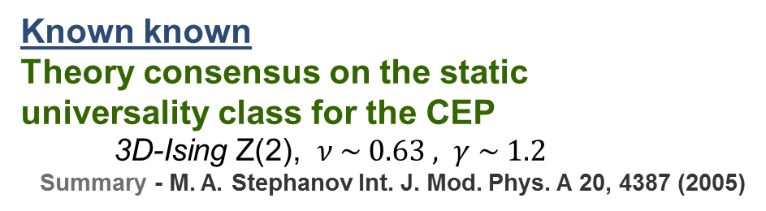
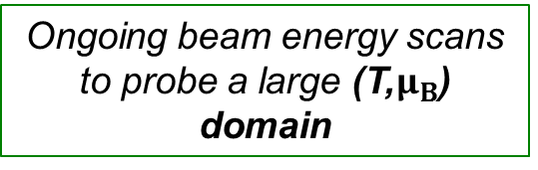
QCD Knowns & unknowns
Scaling relations
Known known
Theory consensus on the static
universality class for the CEP
3D-Ising Z(2), $ν \sim 0.63 , γ \sim 1.2$
Summary - M. A. Stephanov Int. J. Mod. Phys. A 20, 4387 (2005)
Known unknowns
Location ($T^{cep}{, μ}_{B}^{cep}$) of the CEP?
Summary - M. A. Stephanov Int. J. Mod. Phys. A 20, 4387 (2005)
Dynamic Universality class for the CEP?
  One slow mode (L), z ~ 3 - Model H
Son & Stephanov, Phys.Rev. D70 (2004) 056001
Moore & Saremi, JHEP 0809, 015 (2008)
Experimental verification
and characterization of
the CEP is an imperative
Three slow modes (NL)
  z_{T} ~ 3
  z_{v} ~ 2
  z_{s} ~ -0.8 [critical speeding-up]
Y. Minami - Phys.Rev. D83 (2011) 094019
[critical slowing down]
Ongoing beam energy scans to probe a large (T,$μ_{B}$) domain

Slide 6
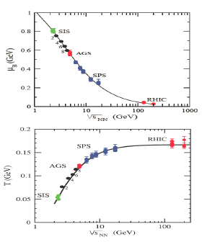
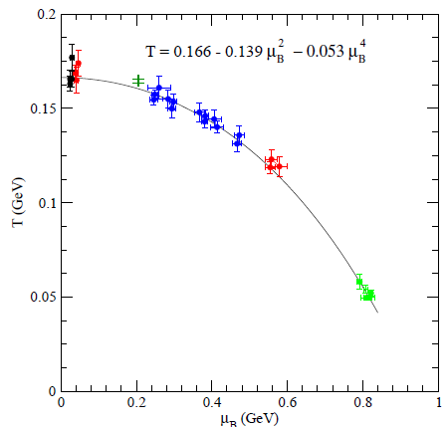




Operational Strategy(
Near the CEP, anomalous transitions can influence reaction dynamics and thermodynamics → experimental signatures for the CEP
($μ_{B}$,T) at chemical freeze-out
J. Cleymans et al.
Phys. Rev. C73, 034905
Andronic et al.
Acta. Phys.Polon. B40,
1005 (2009)
LHC → access to high T and small $μ_{B}$
RHIC → access to different systems and
a broad domain of the ($μ_{B}$,T)-plane
RHIC_{BES} to LHC → $\sim$360 $\sqrt{s_{NN}}$ increase
Vary $\sqrt{s_{NN}}$ to explore the (${T, μ}_{B}$)-plane for
experimental signatures which could signal the CEP

Slide 7

Anatomy of search strategy
Anomalous transitions near the CEP lead to critical fluctuations of the conserved charges (q = Q, B, S)
The moments of the distributions grow as powers of
Cumulants of the distributions
Familiar cumulant ratios
**Fluctuations can be
expressed as a ratio
of susceptibilities**
A pervasive idea → use beam energy scans to vary $μ_{B} \&$T, and search for enhanced/non-monotonic fluctuation patterns
Proviso → Finite size/time effects

Slide 8

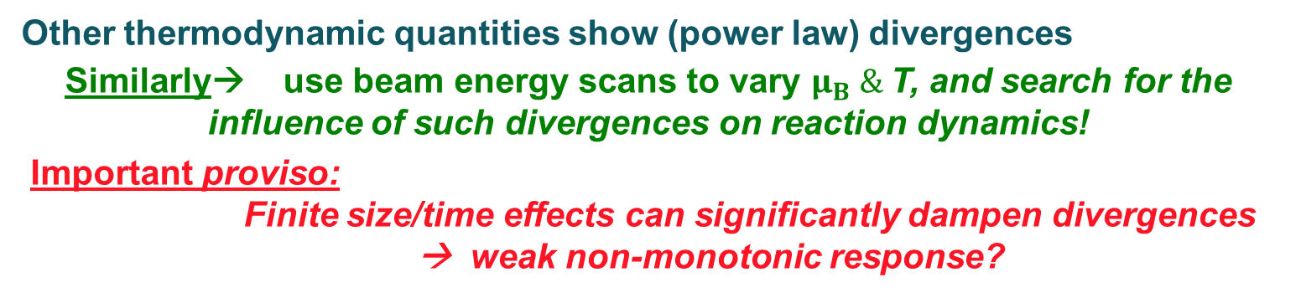
Anatomy of search strategy
$H_{2}$O
Other thermodynamic quantities show (power law) divergences
Similarly→ use beam energy scans to vary $μ_{B} \&$T, and search for the influence of such divergences on reaction dynamics!
Important proviso:
    Finite size/time effects can significantly dampen divergences → weak non-monotonic response?

Slide 9
Anatomy of search strategy
Inconvenient truths:
  Finite-size and finite-time effects complicate the search and characterization of the CEP
    They impose non-negligible constraints on the magnitude of ξ.
  The observation of non-monotonic signatures, while helpful, is neither necessary nor sufficient for identification and characterization of the CEP.
    The prevailing practice to associate the onset of non-monotonic signatures with the actual location of the CEP is a ``gimmick’’ .
A Convenient Fact:
  The effects of finite size lead to specific volume dependencies which can be leveraged, via scaling, to locate and characterize the CEP → This constitutes the only credible approach to date!

Slide 10
Basics of Finite-Size Effects
Illustration
large L
T > T_{c}
small L
L characterizes the system size
T close to T_{c}
note change in peak heights,
positions & widths
→ A curse of Finite-Size Effects (FSE)
→ Only a pseudo-critical point is observed → shifted from the genuine CEP

Slide 11
The curse of Finite-Size effects
Finite-size effects on the sixth order cumulant
-- 3D Ising model
Influence of FSE on the phase diagram
Pan Xue et al arXiv:1604.06858
E. Fraga et. al.
J. Phys.G 38:085101, 2011
FSE on temp
dependence
of minimum
~ L^{2.5n}
Displacement of pseudo-first-order transition lines and CEP due to finite-size
A flawless measurement, sensitive to FSE, can Not locate and characterize the CEP directly
One solution → exploit FSE

Slide 12
The Blessings of Finite-Size
critical exponents
M. Suzuki, Prog. Theor. Phys. 58, 1142, 1977
L scales
the volume
Finite-size effects have a specific influence on the succeptibility
The scaling of these dependencies give access to the CEP’s location, critical exponents and scaling function.

Slide 13
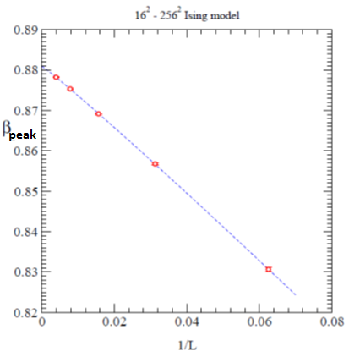
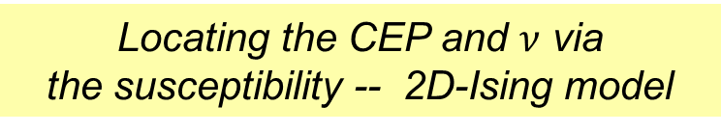

Model demonstration of Finite-Size Scaling
Locating the CEP and $ν$ via
the susceptibility -- 2D-Ising model
Finite-Size Scaling of the peak position gives the location of the deconfinement transition and the critical exponent $ν$

Slide 14
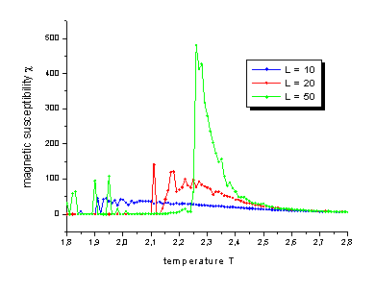
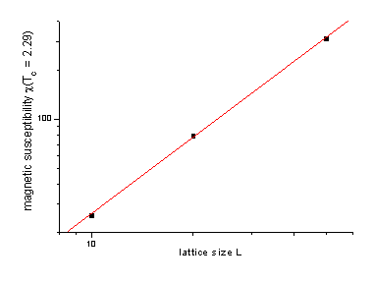
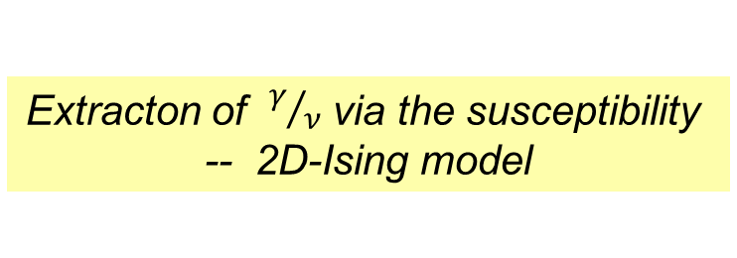
Model demonstration of Finite-Size Scaling
Extracton of $γ/ν$ via the susceptibility
-- 2D-Ising model
Finite-Size Scaling of the peak heights give
Recall; these critical exponents reflect the static universality class and the order of the phase transition

Slide 15
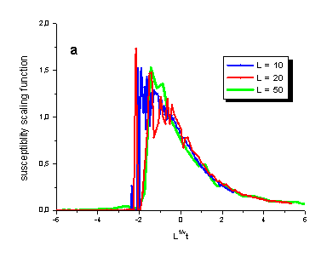
Model demonstration of Finite-Size Scaling
Extracton of the scaling function for
the susceptibility -- 2D-Ising model
M. Suzuki,
Prog. Theor. Phys. 58, 1142, 1977
The susceptibility observed for different system sizes, can be re-scaled to an identical Scaling function

Slide 16
Model demonstration of Finite-Size Scaling
**Fluctuations → susceptibility ratio**
Extracton of the scaling function for
critical fluctuations -- 3D-Ising model
Values for the CEP
+
Critical exponents
Corollary:
Scaling function can be used to extract critical exponents and the location of the CEP

Slide 17
Model demonstration of Finite-Size Scaling
**Fluctuations → susceptibility ratio**
Extracton of the scaling function for
critical fluctuations -- 3D-Ising model
Values for the CEP
+
Critical exponents
Corollary:
Scaling function can be used to extract critical exponents and the location of the CEP

Slide 18

Experimental Results
Strategy
Extract scaling functions for the susceptibility and critical fluctuations (susceptibility ratios)?
The scaling functions for the susceptibility and critical fluctuations (susceptibility ratios) should result from the same values of the CEP and critical exponents!
Interferometry measurements
used as a susceptibility ($κ$) probe
Fluctuations measurements
used as a susceptibility-ratio probe
Phys.Rev.Lett. 114 (2015) no.14, 142301
arXiv:1606.08071

Slide 19
Statistical Mechanics – Not serendipity
Compressibility
For an isothermal change
Stoki´c, Friman, and K. Redlich, Phys.Lett.B673:192-196,2009
From partition function one can show that
The compressibility diverges at the CEP
At the CEP the inverse compressibility → 0
Scaling function provides an independent measure!

Slide 20
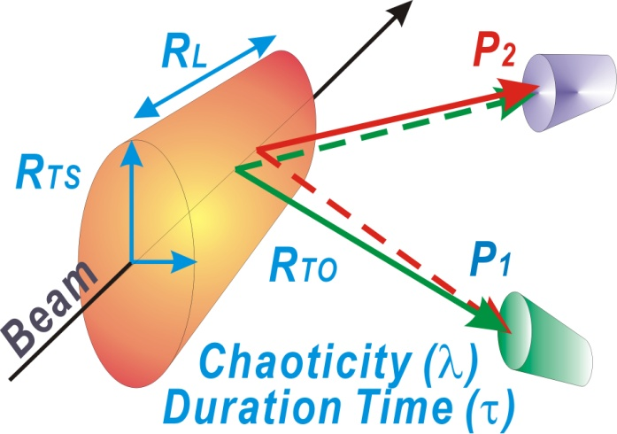
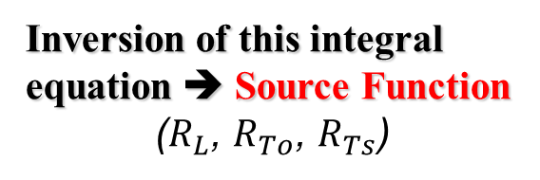
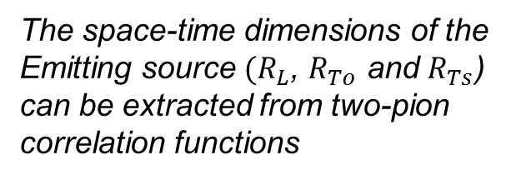
Interferometry Measurements
3D Koonin Pratt Eqn.
The space-time dimensions of the
Emitting source $(R_{L}$, $R_{To}$ and $R_{Ts}$)
can be extracted from two-pion
correlation functions
Correlation
function
Encodes FSI
Source function
(Distribution of pair separations)
Two pion correlation function
Inversion of this integral equation ➔ Source Function
($R_{L}$, $R_{To}$, $R_{Ts}$)
q = p₂ – p₁
S. Afanasiev et al.
PRL 100 (2008) 232301
Interferometry measurements give access to the space-time
dimensions of the emitting source produced in the collisions

Slide 21
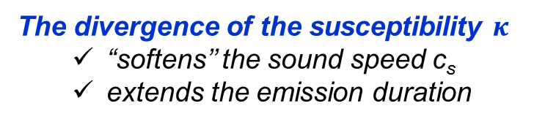

Interferometry as a susceptibility probe
Hung, Shuryak, PRL. 75,4003 (95)
The measured radii encode
space-time information for
the reaction dynamics
T. Csörgő. and B. Lörstad, PRC54 (1996) 1390-1403
Chapman, Scotto, Heinz, PRL.74.4400 (95)
Makhlin, Sinyukov, ZPC.39.69 (88)
emission
duration
The divergence of the susceptibility $κ_{}$
  “softens’’ the sound speed c_{s}
  extends the emission duration
(R²_{out} - R²_{side}) sensitive to the $κ_{}$
emission
lifetime
  (R_{side} - R_{init})/ R_{long} sensitive to c_{s}
Specific non-monotonic patterns expected as a function of √s_{NN}
  A maximum for (R²_{out} - R²_{side})
  A minimum for (R_{side} - R_{initial})/R_{long}

Slide 22

$√s_{NN}$ dependence of interferometry signal
Lacey QM2014
.
Adare et. al. (PHENIX)
arXiv:1410.2559
The measurements validate the expected non-monotonic patterns!
** Note that $R_{long}$, $R_{out}$ and $R_{side}$ [all] increase with $√s_{NN}$ **
Confirm the expected patterns for Finite-Size-Effects?
Use Finite-Size Scaling (FSS) to locate and characterize the CEP

Slide 23
$$Size dependence of HBT excitation functions$$
Phys.Rev.Lett. 114 (2015) no.14, 142301
The data validate the expected patterns for Finite-Size Effects
  Max values decrease with decreasing system size
  Peak positions shift with decreasing system size
  Widths increase with decreasing system size
Perform Finite-Size Scaling analysis
with length scale

Slide 24
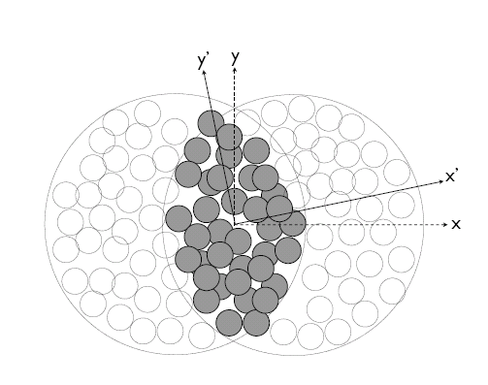

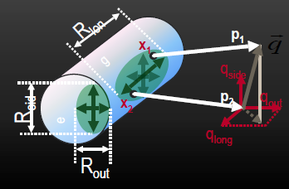

Length Scale for Finite Size Scaling
Lacey QM2014
.
Adare et. al. (PHENIX)
arXiv:1410.2559
is a characteristic length scale of the
initial-state transverse size,
σ_{x} & σ_{y} → RMS widths of density distribution
scales
the volume
scales the full RHIC and LHC data sets

Slide 25
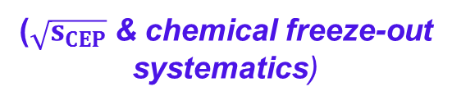

$Extraction of CEP \&$critical exponents
Phys.Rev.Lett. 114 (2015) no.14, 142301
From slope
From intercept
** Same $ν$ value from analysis of the widths **
The critical exponents validate
  the 3D Ising model (static) universality class
  2nd order phase transition for CEP
($\sqrt{s_{CEP}}$ & chemical freeze-out
systematics)

Slide 26
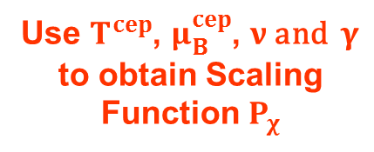


$$Extraction of the χ scaling function$$
Phys.Rev.Lett. 114 (2015) no.14, 142301
2nd order phase transition
3D Ising Model (static) universality class for CEP
M. Suzuki,
Prog. Theor. Phys. 58, 1142, 1977
Use $T^{cep}$, $μ_{B}^{cep}$, $ν$and $γ$
to obtain Scaling
Function $P_{χ}$
**Scaling function validates
the location of the CEP and
the (static) critical exponents**
$T^{}anf$ $μ_{B}^{}$ are from $√s_{NN}$

Slide 27

$$Fluctation Data$$
Cumulants of the distributions
(STAR) Phys.Rev.Lett. 112 (2014) 032302
**Fluctuations → susceptibility ratio**
Scaling functions are derived
from these data

Slide 28


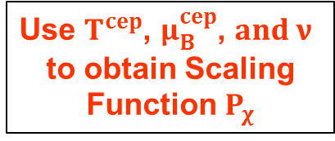
$$Fluctation Scaling Functions$$
arXiv:1606.08071
Compressibility
Fluctuation measurements
+
M. Suzuki,
Prog. Theor. Phys. 58, 1142, 1977
The scaling functions for the critical fluctuations should result from the same values of the CEP and critical exponents
** The compressibility diverges at the CEP **
Validation of the location of
the CEP and the (static)
critical exponents
Use $T^{cep}$, $μ_{B}^{cep}$, $and ν$
to obtain Scaling
Function $P_{χ}$
$T^{}anf$ $μ_{B}^{}$ are from $√s_{NN}$

Slide 29

$$Fluctation Scaling Functions$$
arXiv:1606.08071
Fluctuation measurements
+
M. Suzuki,
Prog. Theor. Phys. 58, 1142, 1977
The scaling functions for the critical fluctuations should result from the same values of the CEP and critical exponents
Use $T^{cep}$, $μ_{B}^{cep}$, $and ν$
to obtain Scaling
Function $P_{χ}$
** Validation of the location of
the CEP and the (static)
critical exponents **

Slide 30

$$Fluctation Scaling Functions$$
arXiv:1606.08071
Fluctuation measurements
+
M. Suzuki,
Prog. Theor. Phys. 58, 1142, 1977
Use $T^{cep}$, $μ_{B}^{cep}$, $and ν$
to obtain Scaling
Function $P_{χ}$
**further validation of
the location of the CEP and
the (static) critical exponents**

Slide 31
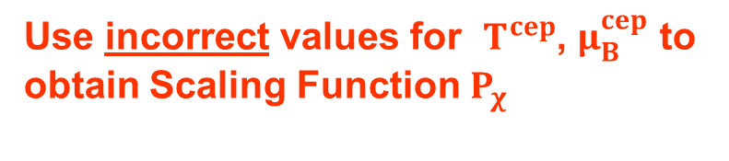

$$Scaling Function Tests$$
arXiv:1606.08071
Fluctuation measurements
+
M. Suzuki,
Prog. Theor. Phys. 58, 1142, 1977
Use incorrect values for $T^{cep}$, $μ_{B}^{cep}$ to obtain Scaling Function $P_{χ}$
** Invalidate incorrect
CEP location **

Slide 32
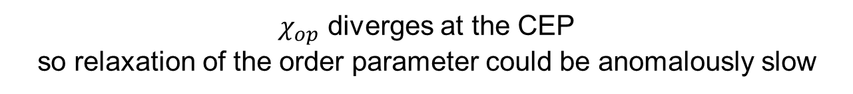

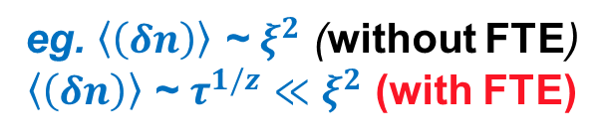
A $FAQ$
What about Finite-Time Effects (FTE)?
$χ_{op}$ diverges at the CEP
so relaxation of the order parameter could be anomalously slow
dynamic
critical exponent
An important consequence
Non-linear dynamics →
Multiple slow modes
z_{T} ~ 3, z_{v} ~ 2, z_{s} ~ -0.8
z_{s} < 0 - Critical speeding up
z > 0 - Critical slowing down
Y. Minami - Phys.Rev. D83 (2011) 094019
Significant signal attenuation for
short-lived processes
with z_{T} ~ 3 or z_{v} ~ 2
eg. $\left\langle \left(δn\right)\right\rangle$ ~ $ξ^{2}$ (without FTE)
$\left\langle \left(δn\right)\right\rangle$ ~ $τ^{1/z}$ $≪$ $ξ^{2}$ (with FTE)
**Note that observables driven by the sound mode
would NOT be similarly attenuated**
The value of the dynamic critical exponent/s is crucial for HIC
Dynamic Finite-Size Scaling (DFSS) can be used to estimate the dynamic critical exponent z
→ employed in this study

Slide 33


$$Dynamic Finite−Size Scaling$$
**Experimental estimate of the dynamic critical exponent**
2nd order phase transition
DFSS ansatz
at time $τ$when T is near T_{cep}
For
T = T_{c}
M. Suzuki,
Prog. Theor. Phys. 58, 1142, 1977
The magnitude of z is similar to the predicted value for z_{s} but the sign is opposite

Slide 34
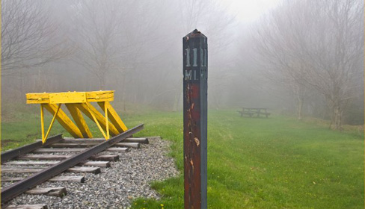
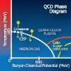
Epilogue
Strong experimental indication for the CEP and its location
  New Data from RHIC (BES-II) together with theoretical modeling, can provide crucial validation tests for the coexistence regions, as well as to firm-up characterization of the CEP!
(Dynamic) Finite-Size Scalig analysis
3D Ising Model (static) universality class for CEP
2nd order phase transition
Landmark validated
Crossover validated
Deconfinement
validated
(Static) Universality
class validated
Model H dynamic
Universality class
invalidated?
Other implications!
Much additional work required to get to “the end of the line”

Slide 35
End

