Slide 1
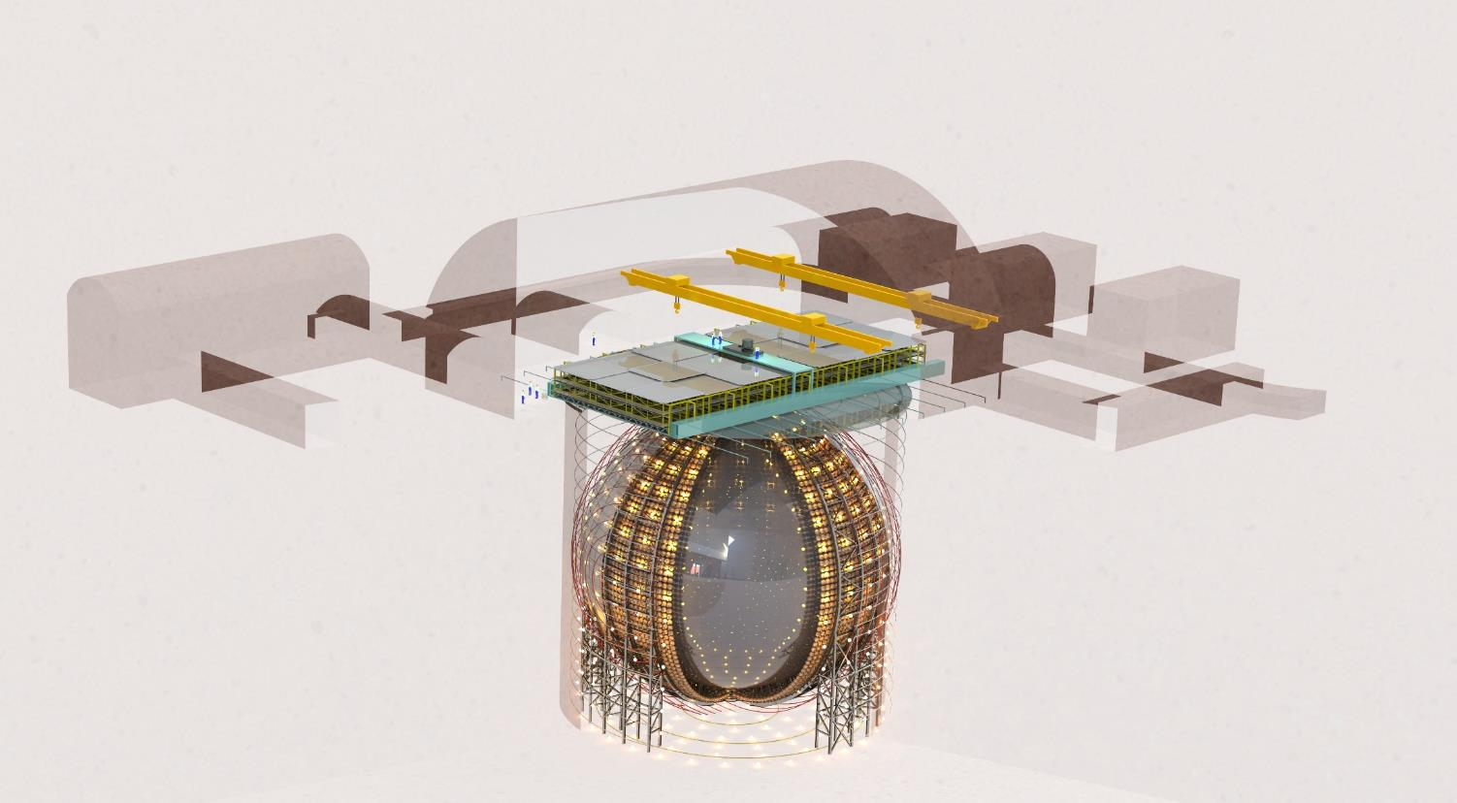
JUNO - the Detector and Physics Plans
Jun Cao
Institute of High Energy Physics
INTERNATIONAL SCHOOL OF NUCLEAR PHYSICS, Erice-Sicily
September 16-24, 2019

Slide 2

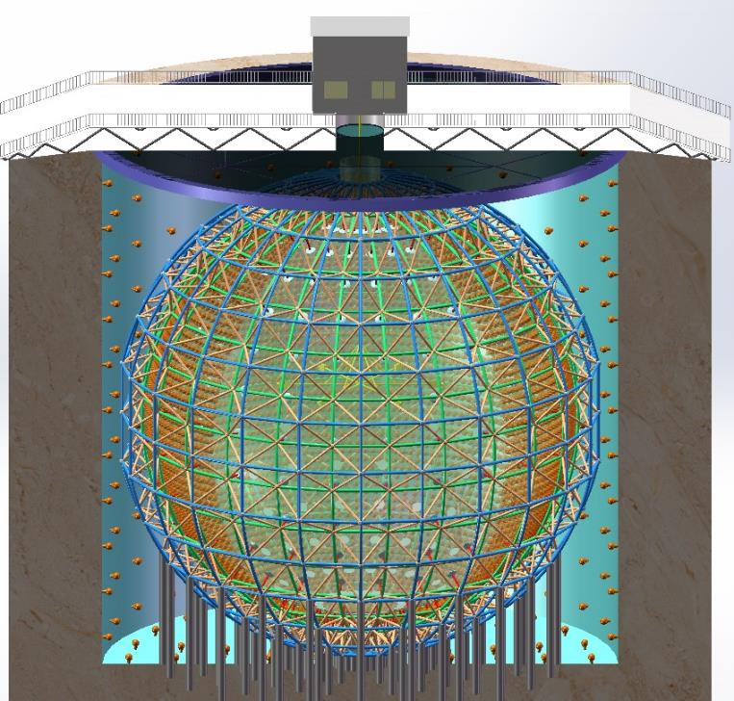
The JUNO Experiment
Jiangmen Underground Neutrino Observatory, a multiple-purpose neutrino experiment, approved in Feb. 2013, 300 M$
20 kton LS detector
3% energy resolution
700 m underground
Rich physics possibilities
  Reactor neutrino
  for Mass Hierarchy and precision measurement of oscillation parameters
  Supernova neutrino
  Geo-neutrino
  Solar neutrino
  Atmospheric neutrino
  Proton decay
  Exotic searches
Talk by Y.F. Wang at ICFA seminar 2008, Neutel 2011; by J. Cao at Nutel 2009, NuTurn 2012;
Paper by L. Zhan, Y.F. Wang, J. Cao, L.J. Wen, PRD78:111103, 2008; PRD79:073007,2009

Slide 3
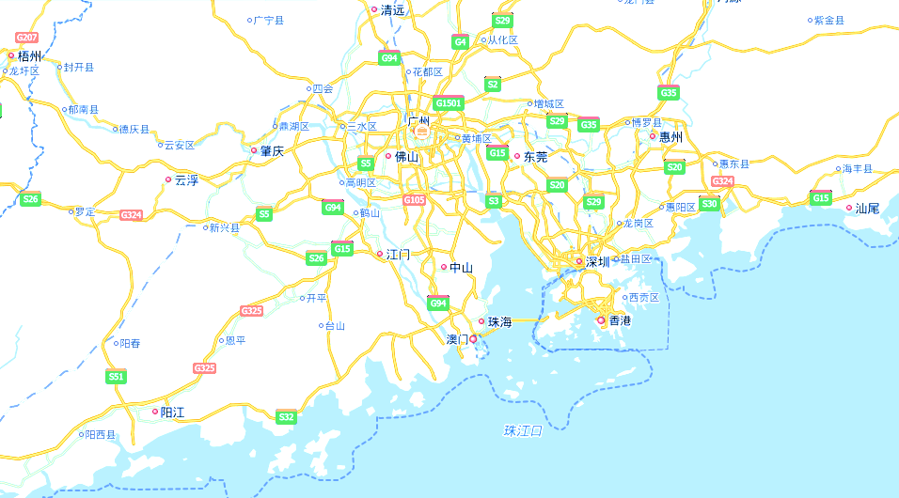
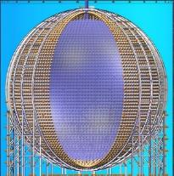
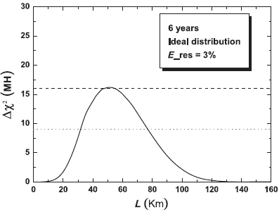
Location of JUNO
NPP | Daya Bay | Huizhou | Lufeng | Yangjiang | Taishan
Status | Operation | Planned | Planned | Operation | Operation / Pending
Power | 17.4 GW | 17.4 GW | 17.4 GW | 17.4 GW | 9.2 + 9.2 GW
700 m underground
20 kt Liquid scintillator
40 kt water shielding
Guang Zhou
Shen Zhen
Daya Bay
JUNO
Hong Kong
53 km
53 km
JUNO-TAO
Taishan NPP
Yangjiang NPP

Slide 4
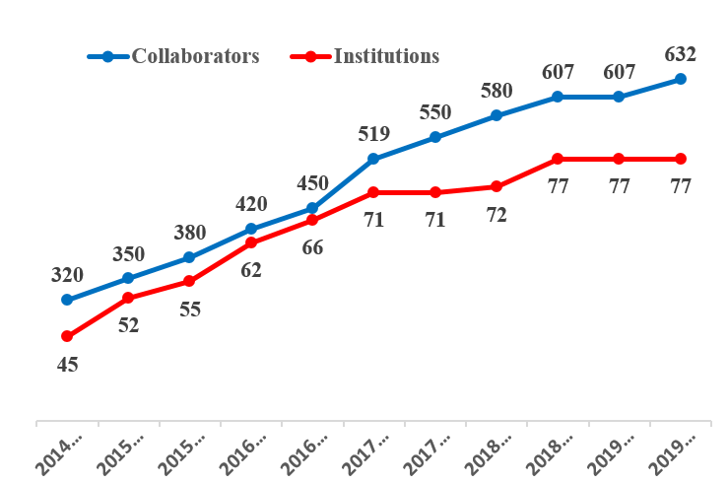
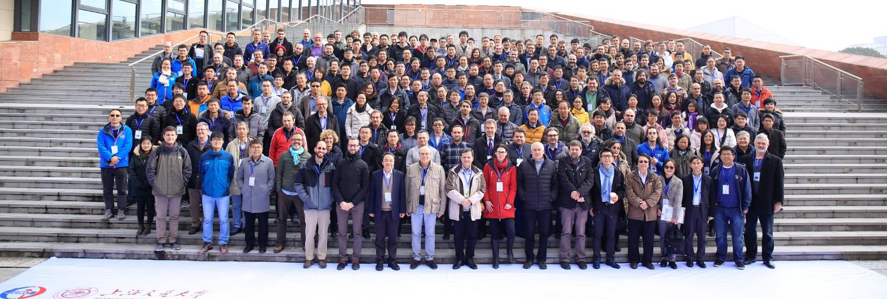
JUNO Collaboration
77 institutions, 600 collaborators
China (34), Taiwan,China (3) Thailand (3), Pakistan, Armenia
Italy (8), Germany (7), France (5), Russia (3), Belgium, Czech, Finland, Latvia, Slovakia
Brazil (2), Chile (2), USA (3)

Slide 5
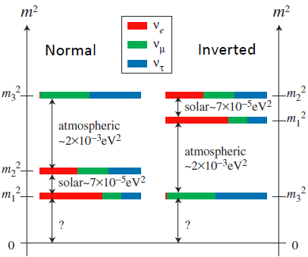
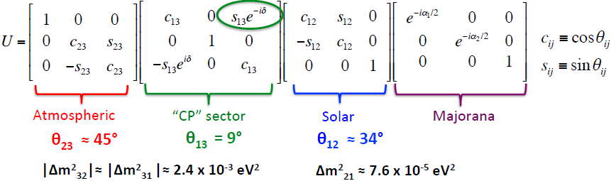
Neutrino Mixing
2-neutrino oscillation: (Δm², θ)
3-neutrino oscillation:
→ 6 oscillation parameters
Known: |Δm²₃₂| θ₂₃ Δm²₂₁ θ₁₂ θ₁₃
Unknown: δ_{CP} Sign of Δm²₃₂

Slide 6
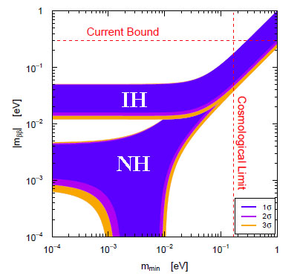
Mass Hierarchy
Mass hierarchy: Which neutrino is the lightest?
Impacts on oscillation probability, MH and CP degeneracy.
Roadmap for 0νββ experiment
Understanding the mass origin and neutrino mixing in theory.
Some GUT theories predict normal MH
Nucleosynthesis in supernova, neutrino mass scale … …

Slide 7
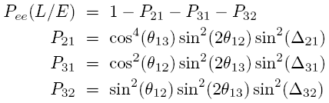
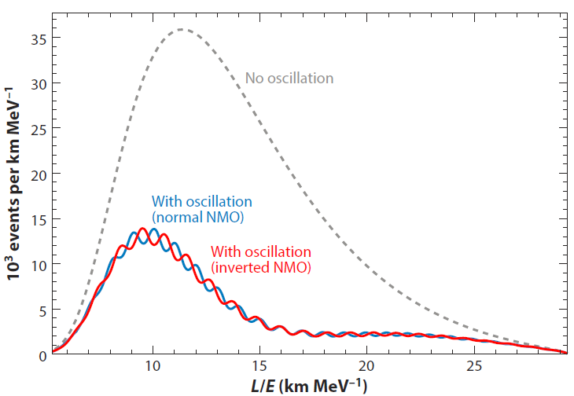

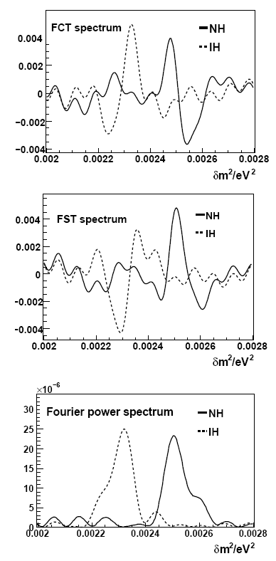
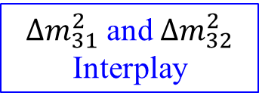
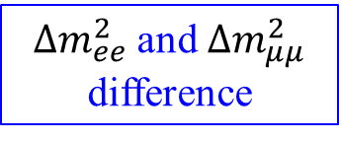
MH with Reactor
Relative measurement
Not rely on δ_{CP} and θ₂₃
JUNO energy resolution: $3\%/\sqrt{E}$
Petcov et al., PLB533(2002)94, J. Learned et al., PRD78, 071302 (2008), L. Zhan, Y. Wang, J. Cao, L. Wen, PRD78:111103, 2008, PRD79:073007, 2009
$∆m_{31}^{2}$ and $∆m_{32}^{2}$ Interplay
$∆m_{ee}^{2}$ and $∆m_{μμ}^{2}$ difference
Matter Effect
Reactor
Atmospheric
Accelerator

Slide 8
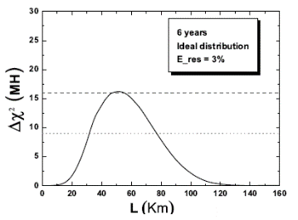
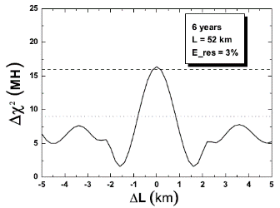
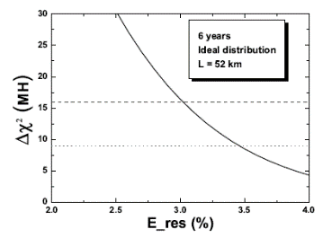
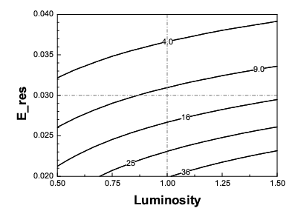
Requirements for Reactor Experiment
Proper baseline: 45-60 km
Equal baselines
3% Energy resolution
100k events=20 kton×35 GW×6 year

Slide 9
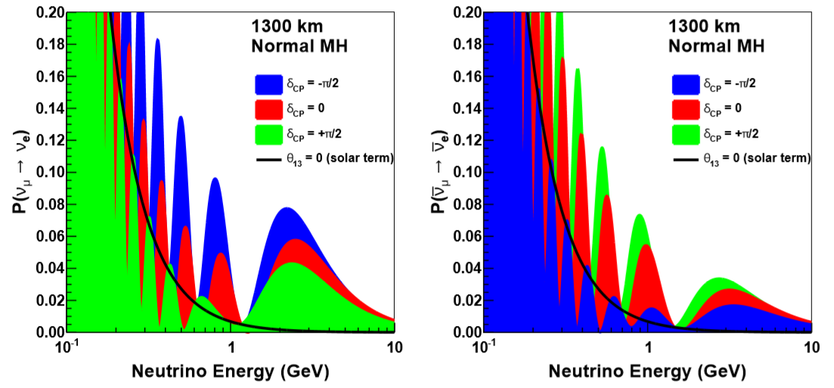
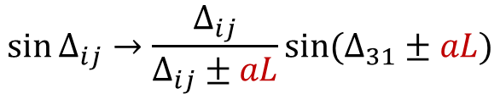
MH with Matter Effect
Accelerator, Atmospheirc
Both ν_{e} appearance channel and ν_{μ} disappearance channel
Matter effect (aL) and CP asymmetry for neutrino and anti-neutrino due to electron in matter. Large effect at long distance
DUNE at 1300 km resolves degeneracy of MH and δ_{CP}
$$P_{vac}(ν_{μ}→ν_{e})=P_{atm}{{+P}_{sol}+P}_{int}$$
$$\sin{∆_{ij}}→\frac{∆_{ij}}{∆_{ij}±aL}sin{(∆_{31}}±aL)$$
$$P_{mat}(ν_{μ}→ν_{e})≈(1±2\frac{E}{12 GeV})P_{vac}(ν_{μ}→ν_{e})$$
Appearance channel: Accelerator w/ ν and $\overline{ν}$
NOvA, DUNE

Slide 10
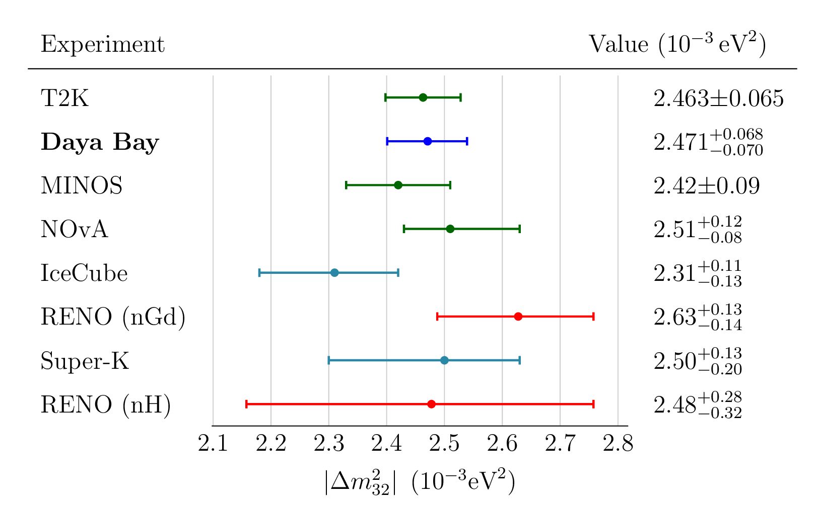
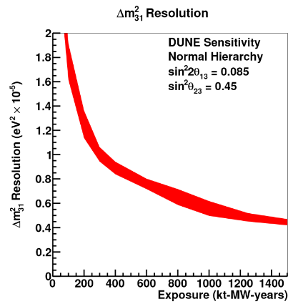
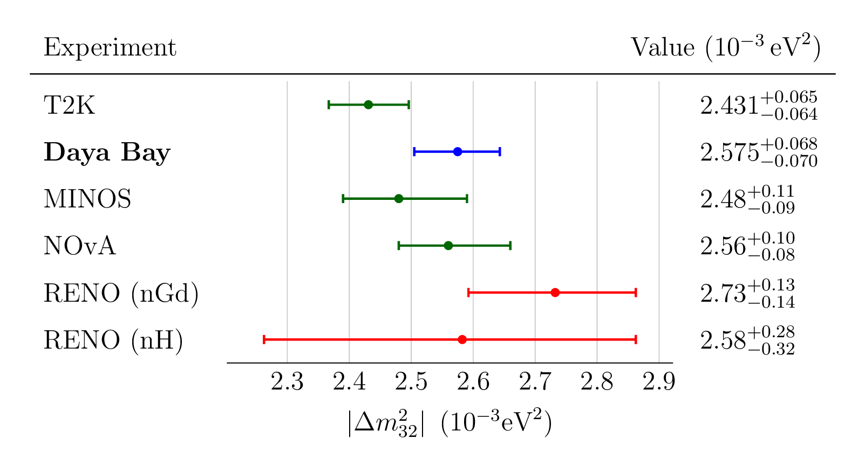
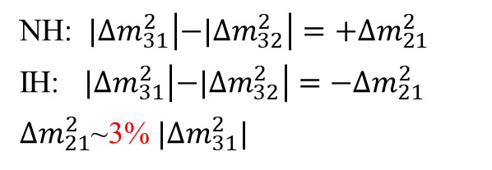
MH with absolute $Δm2$
NH: ${|∆m}_{31}^{2}\left|−{|∆m}_{32}^{2}\right|=+{∆m}_{21}^{2}$
IH: ${|∆m}_{31}^{2}\left|−{|∆m}_{32}^{2}\right|=−{∆m}_{21}^{2}$
${∆m}_{21}^{2}$~3% ${|∆m}_{31}^{2}|$
NH
JUNO | Statistics | +BG +1% b2b +1% EScale +1% EnonL
sin² θ₁₂ | 0.54% | 0.67%
Δm²₂₁ | 0.24% | 0.59%
Δm²₃₁ | 0.27% | 0.44%
IH
T2K, NOvA
~ 1%
T2HK
~ 0.6% (10y)
DUNE

Slide 11
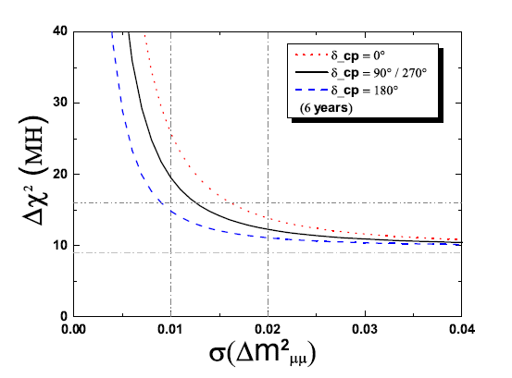
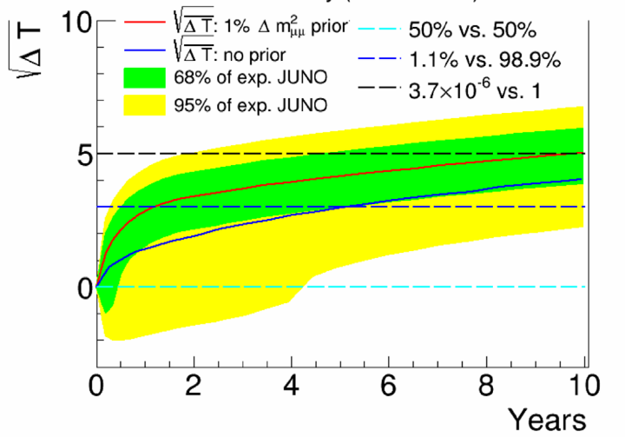

JUNO Sensitivity for MH
6 Years | Relative | w/ abs. Δm²
Statistics only | 4σ | 5σ
Realistic case | 3σ | 4σ
3-4σ in 6y, 4-5σ in 10y

Slide 12
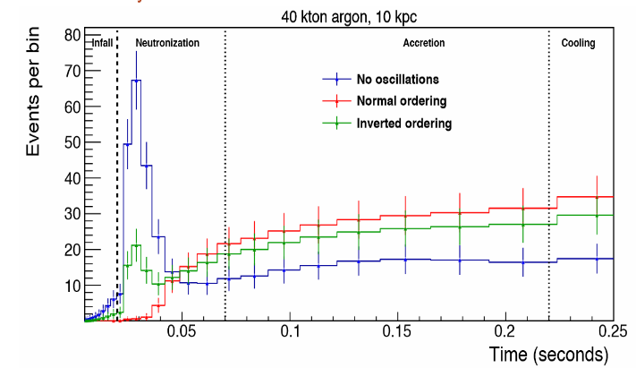
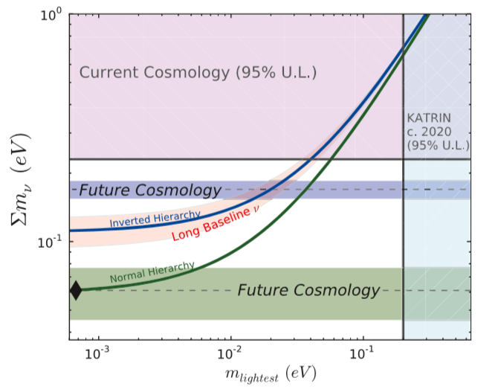
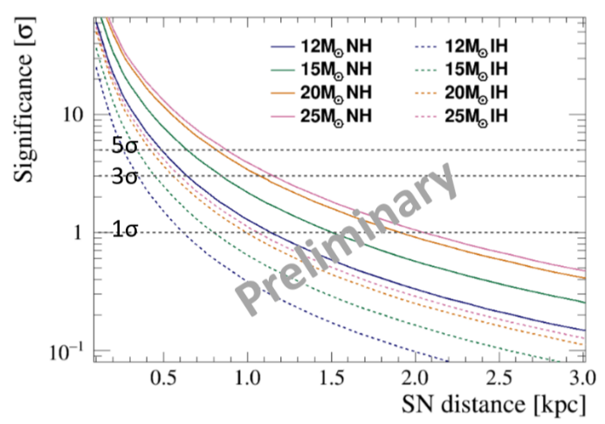
MH with Supernova/Cosmology
Supernova burst
Pre-Supernova
Cosmology determine (Σm=m₁+ m₂+ m₃) to 0.1 eV
|Δm²₃₂|~2.5×10⁻³ eV²
Δm²₂₁~7×10⁻⁵ eV²
E. Worcester: Neutrino2018
Huiling Li, SNEWS, 2019
K.N.Abazajian 2015 Astropart. Phys. 63 66

Slide 13
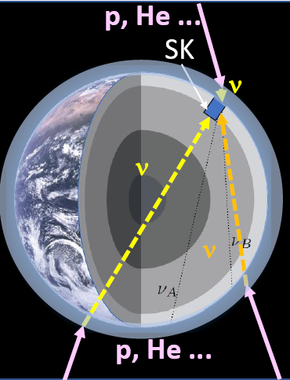
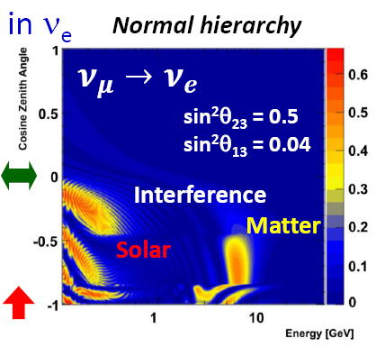
Current Experiment – Super-K
Hayato, Neutrino2018
5326 days, 328 kt.yr
Δχ² = 4.34
CLs: Inverted MH rejection 80.6-96.7%
Inverted MH
Normal MH

Slide 14
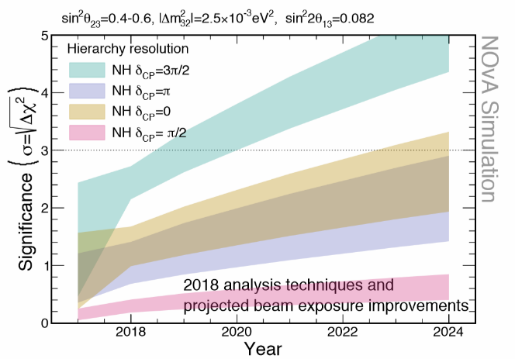
Current Experiment - NOvA
Fermilab (700kW) to Minnesota (810 km). 14 kt LS detector
Prefer NH at 1.8σ
Extended running through 2024, proposed accelerator improvement
  3σ (if NH and δ_{CP}=3π/2) for allowed range of θ₂₃ by 2020
  3σ for 30-50% (depending on octant) of δ_{CP} range by 2024.

Slide 15
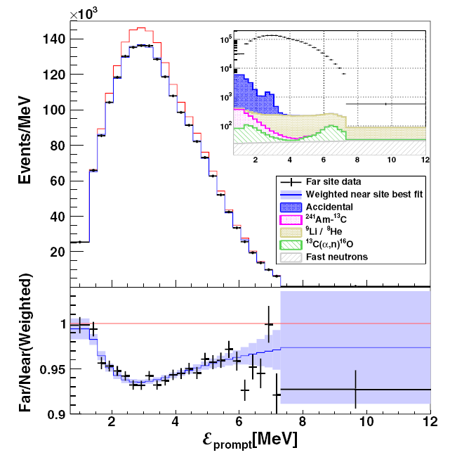
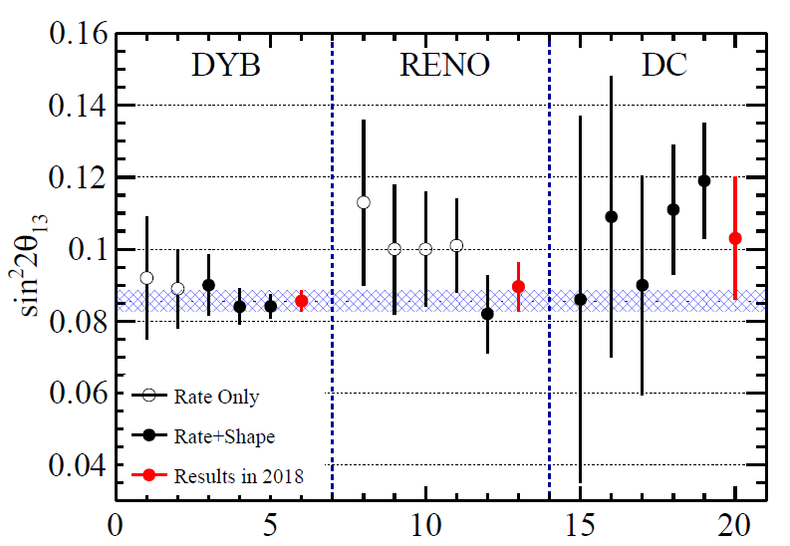
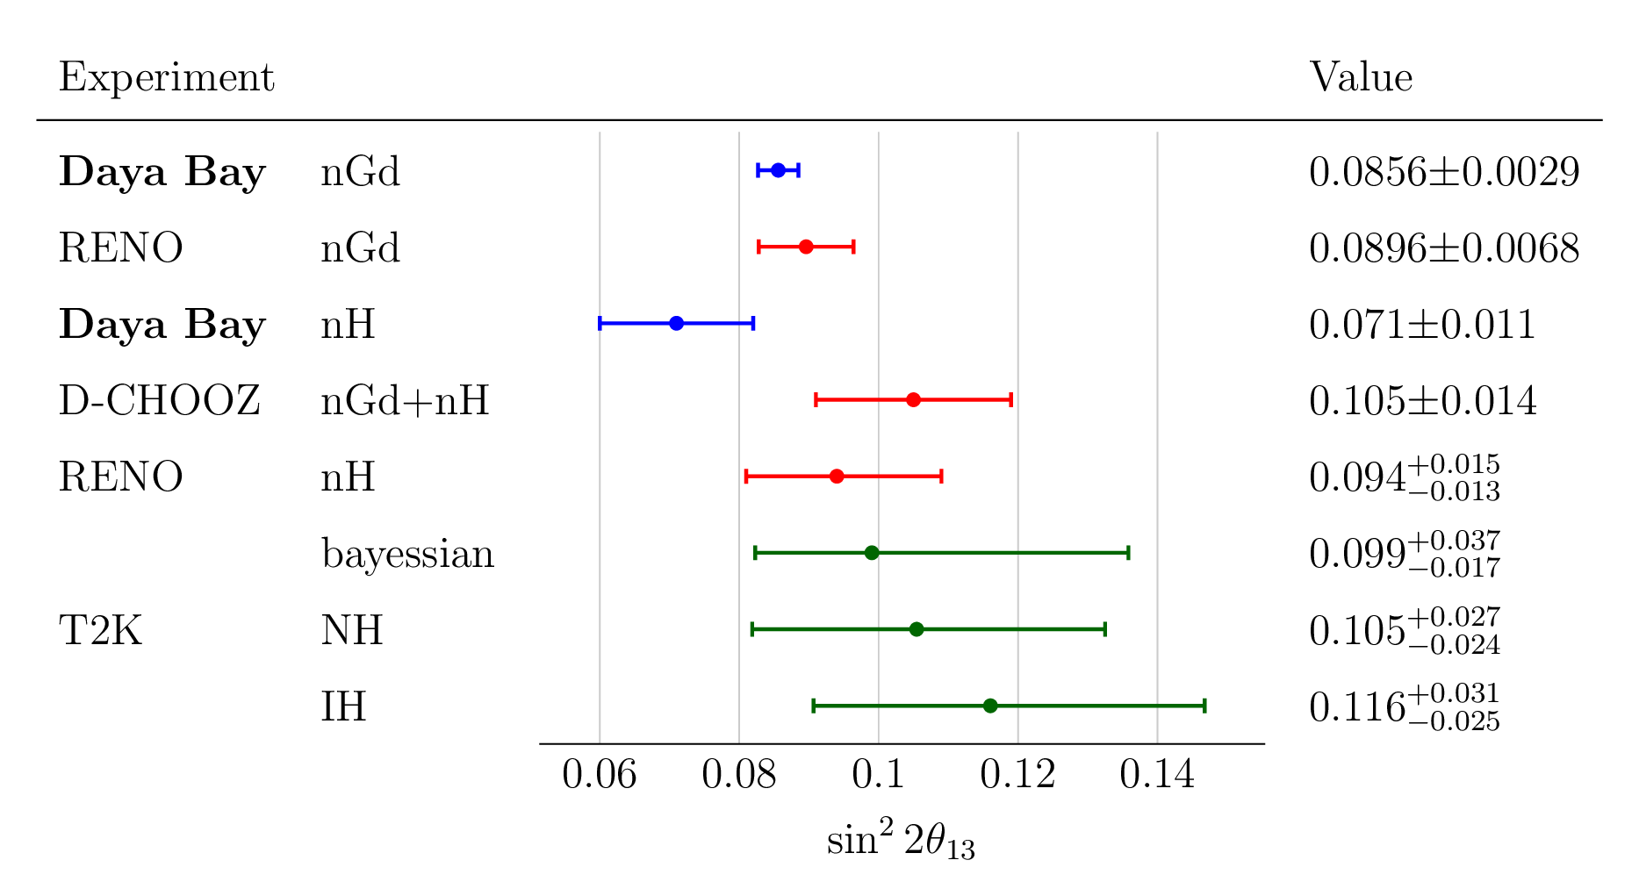
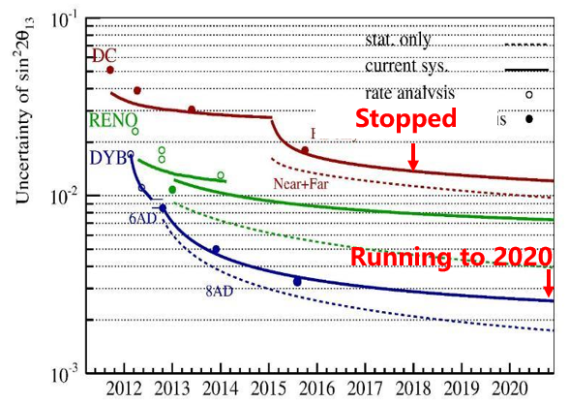
Large θ₁₃ enables MH determination
3.4%
sin²2θ₁₃

Slide 16
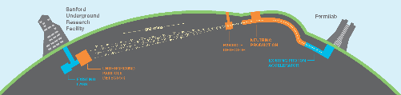
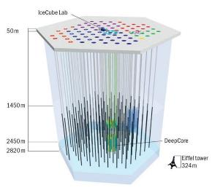
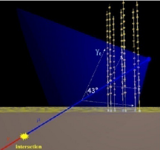
Next Generation Oscillation Exp
DUNE in US, 10-40 kton Liquid Argon
JUNO: 20 kton Liquid Scintillator
INO in India, 50 kton Iron+RPC
PINGU at South Pole
Hyper-K, T2HK in Japan, 260 kton water
ORCA in Mediterranean

Slide 17
Mass Hierarchy
P. Coyle
  NOvA: extended operation to 2025
  JUNO: 2021
  DUNE: 2026
  Hyper-K: 2027
  ORCA: 202x
  PINGU: 202x
  INO: Paused
Just for demonstration. It depends on real schedule, real value of parameters, operation assumption, systematic assumption, etc.

Slide 18
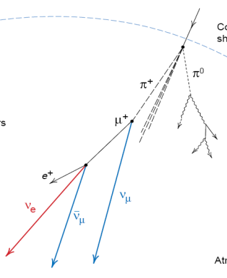
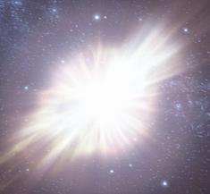
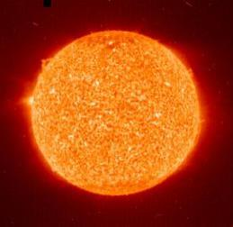

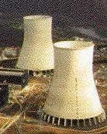
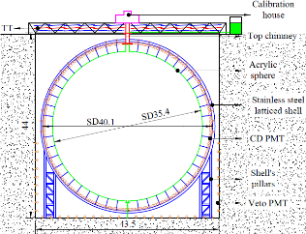
JUNO: Multiple Purpose Observatory
JUNO Yellow book
J. Phys. G 43, 030401 (2016)
Supernova ν
5000 in 10s
@10kpc
Sun
Solar ν
10s - 1000s / day
700 m
Atmospheric ν
Several / day
Cosmic Ray
100 k/day
After reducing 200,000 times w/ 700 m rock
26.6 GW, 53 km
Reactor ν
60 / day
Geo-ν
1 / day
JUNO, 20 kton LS

Slide 19
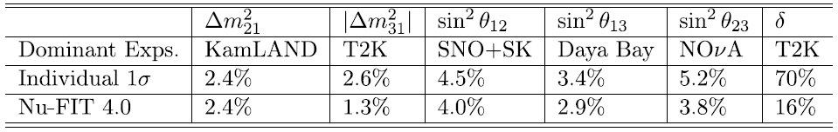
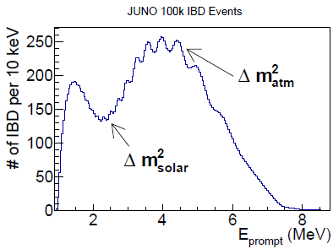
2) Precision Measurements
Current precision
Probing the unitarity of U_{PMNS} to 1%, New physics?
 | Statistics | +BG +1% b2b +1% EScale +1% EnonL
sin² θ₁₂ | 0.54% | 0.67%
Δm²₂₁ | 0.24% | 0.59%
Δm²₃₁ | 0.27% | 0.44%
Only JUNO can do!

Slide 20
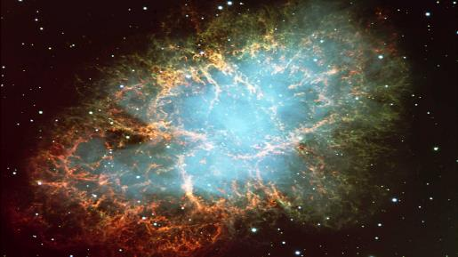
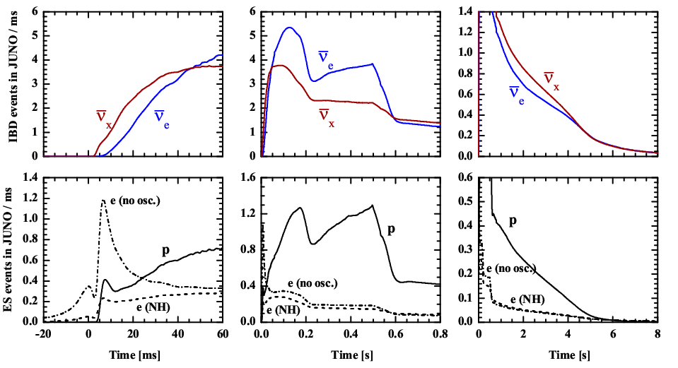
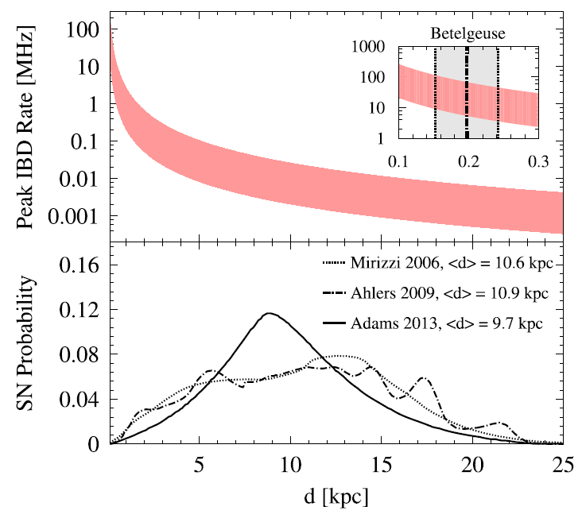
3) Supernova Burst Neutrinos
Burst
Accretion
Cooling
SN@10kpc, w/ 1D simulations from Garching group
For particle physics:
Bound on absolute neutrino mass
Discriminate Mass ordering of neutrinos
Collective neutrino oscillation
…
For astrophysics:
SN explosion mechanism
Locating SN
Coincidence with Gravitational wave
SN nucleosynthesis
…
Event Rate

Slide 21



3) Supernova Burst Neutrinos
SN @ 10kpc
Full flavor detection and low threshold energy ~0.2MeV in LS (JUNO only)
IBD is the golden channel, ~5000 events for SN@10kpc
Especially the pES channel can provide us more information about $ν_{x}$, better than other type of detectors, e.g. WC, LAr-TPC detectors
PSD method to distinguish events from eES and pES

Slide 22





4) Diffused Supernova Neutrino Background
DSNB: Past core-collapse events
  10/sec in the visible universe
  Cosmic star-formation rate
  Core-collapse neutrino spectrum
  Rate of failed SNe
JUNO detection significance ~ 3$σ$
DSNB Observable window:
11 <${ E}_{{\overline{v}}_{e}}$ < 30 MeV
3 events/year before PSD
10 Years’ sensitivity

Slide 23



5) Solar Neutrino
A new low-threshold (2MeV) ⁸B measurement (upturn + day/night asymmetry), solar and reactor discrepancy
High Z
Low Z
1611.09867
solar metallicity problem

Slide 24



6) Geo-neutrino
Geothermal energy: Earth’s interior thermodynamics.
Up to now, ~100 geo-ν observed by KamLAND and Borexino
400/year by JUNO
Discriminate BSE models

Slide 25

7) Proton Decay
Proton decay: physics at very high energy scale, where neutrino mass/mixing might be related with.
Hyper-K: τ~10³⁵ years for eπ⁰
JUNO: τ~2×10³⁴ years for νK⁺
Takaaki Kajita, Neutrino2018

Slide 26
8) Other
Atmospheric neutrino
  JUNO will have 1-2 σ sensitivity
    Measure both lepton and hadron energy
    Tracking and good energy resolution
Neutrinos from Dark Matter
  Annihilation in the Sun (Earth, Galaxy)
Exotic searches
  Non-standard interaction
  Lorentz invariance violation
  Sterile neutrino w/ reactor neutrino oscillation
  …

Slide 27



Future: Double beta-decays
After MH measurement (~2030)
Cosmogenic backgrounds can be removed by a cut of LS volume along the muon track for seconds
  Active LS shielding is as effective as future dedicated 0νββ detectors
1.35 /ton.yr
¹³⁶Xe-loaded LS in balloon
¹³⁰Te doped LS
Zhao et al., arXiv: 1610.07143, CPC 41 (2017) 5

Slide 28

JUNO Detector
LS | acrylic | water | PMT | Optical baffle | SS lattice | water | HDPE
17.7 m 0.12 1.43 0.8 0.5 1.2 m
JUNO CDR, arXiv_1508.07166

Slide 29
State-of-Art LS Detector
 | Daya Bay | BOREXINO | KamLAND | JUNO
Target Mass | ~20 t | ~300 t | ~1 kt | ~20 kt
Photoelectron Yield (PE/MeV) | ~160 | ~500 | ~250 | ~1200
Photocathode Coverage | ~12% | ~34% | ~34% | ~78%
Energy Resolution | ~8%/√E | ~5%/√E | ~6%/√E | 3%/√E
Mass Hierarchy drives the detector specification
Unprecedented energy resolution (3%）
  PMT Coverage 78%
  PMT Detection Eff. > 27%
  LS attenuation length > 20 m
  Calibration
Low background (e.g. 1 ppt for acrylic, 10⁻¹⁵ g/g/ for LS)
20 times more statistics, mechanical challenges
Solar neutrino → low bkg 10⁻¹⁷ g/g for LS
Supernova neutrino → Electronics, Trigger, DAQ, Onsite computing
→ Refresh many studies by an order

Slide 30








Central Detector Design
SNO, SNO+
Acrylic Sphere:
  ID: 35.4 m
  Thick:120 mm
SS truss:
  ID: 40.1 m
  OD: 41.1 m
Acrylic sphere
+
SS truss
SS truss+ Acrylic sphere
Balloon
+
SS tank
March, 2014
July, 2015
Acrylic module+
SS tank
Final decision:
Acrylic sphere + SS truss
Acrylic sphere
+
SS tank
Balloon + Acrylic support+ SS tank
KamLAND, Borexino

Slide 31






Central Detector Acrylic Sphere R&D
SS structure to hold a acrylic sphere and to mount PMTs
  Supporting bar to hold the Acrylic tank
  Stress of acrylic <3.5 MPa everywhere
Main issues:
  Mechanical precision for 3 mm PMT clearance
  Thermal expansion matching: 21ºC ± 1ºC
  Earth quake and liquid-solid coupling
  Transparency 96.5%, U/Th/K < 1 ppt
Started panel production
Panel size: 3m x 8m x 0.12m
Acrylic divided into 200+ panels

Slide 32



Veto
Tasks:
  Shield rock-related backgrounds
  Tag & reconstruct cosmic-rays tracks
Detector:
  Top tracker: refurbished OPERA scintillators
  Water Č detector
Pool lining: HDPE
Earth magnetic field compensation coil

Slide 33

Liquid Scintillator
System design & goal
  Long attenuation length: 15m➔>20m
    Al2O3 Filtration column
    Distillation
    Water extraction
    Gas stripping
  Highest possible light yield for JUNO：
    2.5 g/L PPO + 3 mg/L Bis-MSB
  Low radioactive backgrounds
    10⁻¹⁵ g/g for reactor
    10⁻¹⁷ g/g for solar neutrinos
OSIRIS
  An online detector with 20t LS for a sensitivity of 10⁻¹⁵ g/g per day
Linear Alky Benzene | Atte. L(m) @ 430 nm
RAW | 14.2
Vacuum distillation | 19.5
SiO₂ coloum | 18.6
Al₂O₃ coloum | 22.3
LAB from Nanjing, Raw | 20
Al₂O₃ coloumn | 25
A pilot LS purification system at Daya Bay

Slide 34



High QE PMT
A new type of PMT developed by IHEP & NNVC based on MCP to collect photoelectrons
  Intrinsically high collection efficiency
    No wire mesh in front of dynode
    transparent + reflective photocathode
  Easy for mass production
Performance
  MCP-PMT: good on DE, P/V, after pulse, bkg
  Dynode PMT: good on TTS,
Based on performance, cost, risk (DE>27%)
  MCP-PMT: 15000, first 8000, DE=28%*100%=28%, later >30%
  Dynode PMT: 5000, all delivered, DE =31%*90%= 28%
PDE | Mean（%）
All | 28.0
HAMAMATSU | 28.1
NNVT | 27.9

Slide 35


Small PMT system
Calibrate non-uniformity and
non-linearity of Large-PMTs
  Reduce energy scale uncertainty
  Improve energy resolution
  (non-stochastic term)
Increase optical coverage (~3%)
  Improve energy resolution
  (stochastic term)
Extend the energy measurement
  Improve muon physics
Independent system for Supernova
PMT Choice: 3” HZC XP72B22
Readout: Catiroc chip +
GCU/HV/BEC for LPMT
  20” PMTs: 17631
  3” PMT: 25600

Slide 36






PMT Instrumentation
PMT testing
  20,000 20” PMTs & 25,000 3” PMTs
  4 mass testing equip
PMT potting
  With base
  Failure rate < 0.5%/6 years
PMT protection
  Mechanism & requirements understood
  Acrylic + steel cover with holes
PMT installation

Slide 37



Calibration
4 calibration facilities
  Routinely Source into LS by
    Automatic Calibration Unit: at central axis
    Rope Loop System : a plane
  Source into Guided Tube adhere to acrylic outer wall
  ROV: “sub-marine” anywhere in the LS
Choice of sources & location scan
  Simulation shows that the response map of the detector can be obtained
All has been prototyped and tested, proceeding for production

Slide 38




Electronics
20000 ch. for LPMT & 100 m cable needed
Dynamic range: 1- 4000 PE
Noise: < 10% @ 1 PE
Resolution: 10%@1PE, 1%@100 PE
Failure rate: < 0.5%/6 years
Final solution: 1 GHz sampling FADC in a small box (×3 ch. ) in water; all cables in corrugated pipes
芯片版图

Slide 39



Software and Computing
  JUNO Software framework: SNiPER
  Unified detector description service for all applications
  Integrated the algorithms for physics generator, simulation, calibration, reconstruction and analysis
Geant4 based Simulation and reconstruction software
  Computing
  1/10 of final computing system was set, 1000 CPU cores and 1 PB disk storage
  Distributed computing platform was built based on DIRAC
Simulated 100 GeV Muon crossing JUNO
https://github.com/SNiPER-Framework/sniper

Slide 40








Installation
SS Main Structure
+Acrylic sphere
+PMT
+VETO+Cali.
SS Main Structure
Acrylic sphere
Clean
LS Filling
Acrylic sphere Installation platform
cover、Bridge、Cali.、TT in paralles
PMT Module
pool lining、Earth magnetic field shielding coils、Tyvek etc.
In clean room, 21ºC ±1ºC

Slide 41



Civil Construction Status
Vertical Tunnel: 563 m
1265 m @ slope of 42%
Surface building
Experimental hall
Overburden: 700 m
Width: 49 m
Length: 55 m
A 50 m diameter, 70 m high cavern

Slide 42




JUNO-TAO
Taishan Antineutrino Observatory (TAO), a ton-level, high energy resolution LS detector at 30m from the core, a satellite exp. of JUNO.
Measure reactor neutrino spectrum w/ sub-percent E resolution.
  Provide model-independent reference spectrum for JUNO
  Provide a benchmark for investigation of the nuclear database
Full coverage of SiPM with 50% PDE (-50 ℃) + LS → 4500 p.e./MeV
  $1.5\%/\sqrt{E}$ photon statistical resolution
  < 1% energy resolution for e⁺ at >3 MeV
w/ statisitics (3y)
Ratio to Daya Bay 8% smearing
“True” spectrum by summation
3% (JUNO) smearing
TAO smearing
Energy resolution

Slide 43

JUNO-TAO Detector Concept
2.6 ton Gd-LS in a spherical vessel
  1-ton FV, 4000 ν’s/day
10 m² SiPM of 50% PDE
Operate at -50℃
From Inner to Outside
  Gd-LS working at -50℃
  SiPM and support
  Cryogenic vessel
  1~1.5 m water or HDPE shielding
  Muon veto
Laboratory in a basement at -10 m,
30-35 m from Taishan core (4.6 GW)
Plan to be online in 2021
LAB
Gd-LS

Slide 44




JUNO-TAO Progress
Feasibility studies almost done
LS works at -50℃
Mechanical design in good shape
Readout options
Have a good understanding on budget
Measured onsite muon/neutron flux
Will prototype low temp. LS detector
Working on Conceptual Design Report

Slide 45
Summary
JUNO is motivated to measure the Mass Hierarchy
  20 kton liquid scintillator
  3%/sqrt(E) energy resolution
  Advance detector technology
Rich physics program. World-leading studies on
  Precision measurement, Supernova ν, Geo-ν, solar ν, DSNB, proton decay, …
  Future JUNO-0νββ
Design, R&D, and most contracting done. Complete construction in 2021
New short-baseline experiment TAO, High energy solution measurement of reactor neutrino spectrum
  JUNO reference spectrum
  Benchmark for nuclear database

Slide 46



UNESCO World Heritage

Slide 47




Reactor Neutrino Detection
ν-e scattering
Inverse beta decay (IBD in LS)
Prompt signal
Delayed signal, Capture on H (2.2 MeV, 180μs) or Gd (8 MeV, 30μs)
$$E\left({\overline{ν}}_{e}\right)=E_{\text{prompt}}+Q−m_{e}$$
$E_{\text{prompt}}+ 0.8 MeV$
Capture on H
Capture on Gd
0.1% Gd

