Slide 1
Crossover width criteria for the two-flavor NJL-type models
International School of Nuclear Physics
42nd Course
QCD under extreme conditions – from heavy-ion collisions to the phase diagram
Erice, Sicily
Universidad Autónoma de Nuevo León
Enrique Valbuena Ordóñez
In collaboration with:
Nallaly Berenice Mata Carrizal
Adrián Jacob Garza Aguirre
José Rubén Morones Ibarra
September 20th, 2021

Slide 2
QCD at finite temperature and chemical potential
Lattice QCD
Strong interaction in the low temperature range at zero chemical potential is known from first principles, even if QCD is not renormalizable at those energy ranges¹
Lattice QCD has a severe sign problem when trying to analyze the nonzero chemical potential regime²
Effective field theories that emulate the properties of QCD are used in order to analyze a QCD-like phase diagram
Karsch, F.; Nucl. Phys. A 698, 2002
Giordano, M., Kapas, K., Katz, S. D., Nogradi, D., Pasztor, A.; Phys. Rev. D 102, 2020

Slide 3
NJL and PNJL models
Like all effective field theories, the NJL and PNJL models are non-renormalizable, hence the need to use some sort of regularization scheme
The NJL model introduces a chirally-symmetric four-point quark (originally baryon) interaction term to Dirac’s lagrangian³
The NJL model doesn’t account for quark confinement
An effective potential that depends on the Polyakov loop is introduced to the NJL to account for confinement related phenomena (PNJL model)⁴
698, 2002
Giordano, M.,. D, 2020
Nambu, Y., Jona-Lasinio, G.; Phys. Rev. 122, 1961
Ratti, C., Thaler, M. A., Weise, W.; Phys. Rev. D 73, 2006

Slide 4
Lagrangian formulation
$$ℒ_{QCD}=\overline{ψ}\left(iγ^{μ}D_{μ}−\hat{m}\right)ψ−\frac{1}{4}{G^{μν}}_{a}{G_{μν}}^{a}$$
$$↓$$
$$ℒ_{NJL}=\overline{ψ}\left(iγ^{μ}D_{μ}−\hat{m}\right)ψ+\frac{G}{2}\left[{\left(\overline{ψ}ψ\right)}^{2}+{\left(\overline{ψ}iγ_{5}τ^{b}ψ\right)}^{2}\right]$$
$$ℒ_{PNJL}=\overline{ψ}\left(iγ^{μ}D_{μ}−\hat{m}\right)ψ+\frac{G}{2}\left[{\left(\overline{ψ}ψ\right)}^{2}+{\left(\overline{ψ}iγ_{5}τ^{b}ψ\right)}^{2}\right]−𝒰\left(Φ,Φ^{∗},T\right)$$
Chiral symmetry in $ℒ_{NJL}$ is achieved under the same condition as in $ℒ_{QCD}$
Because of the point nature of the quark interaction in the NJL-type models, gauge symmetry is lost
For this same reason, the NJL-type models are non-renormalizable, so a form factor must be unavoidably applied to divergent integrals

Slide 5
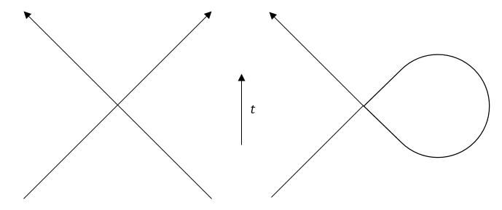
Mean field approximation
$$\overline{ψ}\left(iγ^{μ}D_{μ}−\hat{m}\right)ψ+\frac{G}{2}\left[{\left(\overline{ψ}ψ\right)}^{2}+{\left(\overline{ψ}iγ_{5}τ^{b}ψ\right)}^{2}\right]$$
$$↓$$
$$\overline{ψ}\left(iγ^{μ}D_{μ}−\hat{m}+σ+iγ_{5}π^{b}τ^{b}\right)ψ−\frac{1}{2G}\left[σ^{2}+{\left(π^{b}\right)}^{2}\right]$$
Isospin symmetry is used in this work
This implies $π^{b}=0$
Ratti, C., Thaler, M. A., Weise, W.; Phys. Rev. D 73, 2006

Slide 6
Order parameters
The chiral symmetry is the order parameter for the NJL model in the chiral limit⁵
Chiral symmetry is restored if and only if both the current quark mass and the dynamically generated quark mass are equal to zero
With a nonzero current mass scheme, chiral symmetry serves as an approximate order parameter only
In the PNJL model, chiral symmetry serves as an order parameter in the chiral limit once again
The Polyakov loop serves as another order parameter in the quenched limit⁶
Both the chiral symmetry and the Polyakov loop are approximated order parameters in the finite current mass PNJL model
698, 2002
Giordano, M.,. D, 2020
v. 122, 1961
3, 2006
Klevansky, S. P.; Rev. Mod. Phys. 64, 1992
Sasaki, C., Friman, B., Redlich, K.; Phys. Rev. D 75, 2007

Slide 7
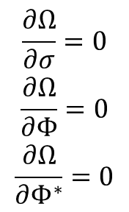
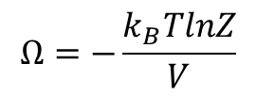
Thermodynamic potentials and gap equations
$$Z=\int{\prod_{j}{\left(Dφ_{j}\right)}}e^{i\int{d^{4}x\left(ℒ−μN\right)}}$$
$$Ω=−\frac{k_{B}TlnZ}{V}$$
$$Ω_{NJL}=\frac{σ^{2}}{2G}−2N_{c}N_{f}\int{\frac{d^{3}p}{{\left(2π\right)}^{3}}\left[E_{p}+Tln\left(1+e^{−\frac{E_{p}+μ}{T}}\right)+Tln\left(1+e^{−\frac{E_{p}−μ}{T}}\right)\right]}$$
$$Ω_{PNJL}=\frac{σ^{2}}{2G}+𝒰\left(Φ,Φ^{∗},T\right)−2N_{c}N_{f}\int{\frac{d^{3}p}{{\left(2π\right)}^{3}}\left[E_{p}+\frac{T}{N_{c}}ln\left(1+3Φe^{−\frac{E_{p}+μ}{T}}+3Φ^{∗}e^{−\frac{2\left(E_{p}+μ\right)}{T}}+e^{−\frac{3\left(E_{p}+μ\right)}{T}}\right)+\frac{T}{N_{c}}ln\left(1+3Φ^{∗}e^{−\frac{E_{p}−μ}{T}}+3Φe^{−\frac{2\left(E_{p}−μ\right)}{T}}+e^{−\frac{3\left(E_{p}−μ\right)}{T}}\right)\right]}$$
$$\begin{matrix}\frac{∂Ω}{∂σ}=0 \\ \frac{∂Ω}{∂Φ}=0 \\ \frac{∂Ω}{∂Φ^{∗}}=0\end{matrix}$$

Slide 8
Crossover
We know a crossover exists in QCD at zero chemical potential from first principles (Lattice QCD)
We don’t know if a critical end point or other features exist in the high chemical potential regime of the phase diagram because of the sign problem
Depending if a critical end point exists or not, the crossover region may extend over all the phase diagram or it may end at the critical end point
A crossover region represents a continuous region on the T-μ plane where the order parameter changes continuously

Slide 9
Susceptibilities
Susceptibilities are determined by the rate of change of the thermodynamic potential with respect to the (approximate) order parameters
Susceptibilities are divergent during a phase transition, and are convergent otherwise
By taking a straight line in the T-μ plane, the chiral susceptibility graph along that line looks like a bell curve if the line doesn’t cross the phase transition line
By taking a straight line in the T-μ plane, the chiral susceptibility graph along that line has a vertical asymptote where the phase transition is located

Slide 10
Local and global criteria
The local criterion takes the local maximum of the susceptibility as the delimitation point between two phases
If the susceptibility presents a discontinuity, the point where it’s located is taken instead
This criterion may be extended to locate the crossover region in all the points between the susceptibilities’ inflection curves
The global criterion takes the order parameter value where the global maximum of the susceptibility is located
If the susceptibility doesn’t have a global maximum because a critical end point is present, the order parameter value at the critical end point is taken instead
Extending this criterion to locate a crossover region is not straightforward, as the extension would depend on the used resolution to build the diagram

Slide 11
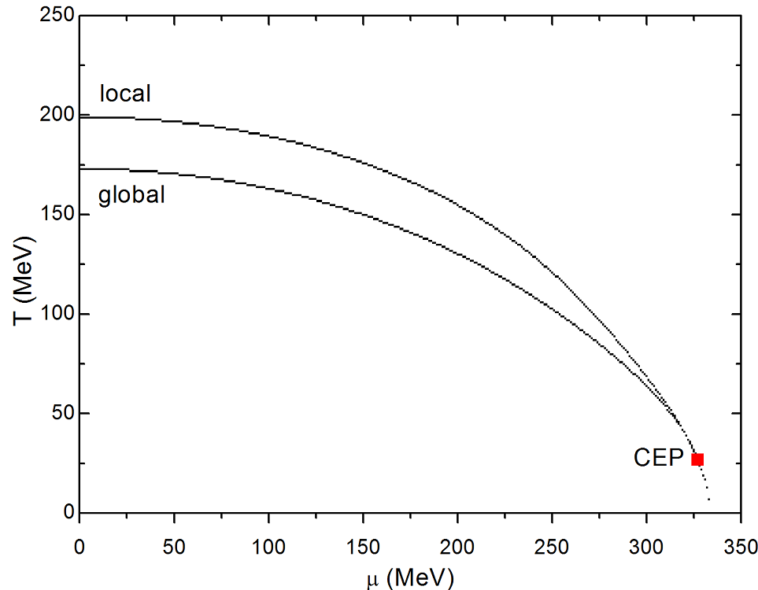
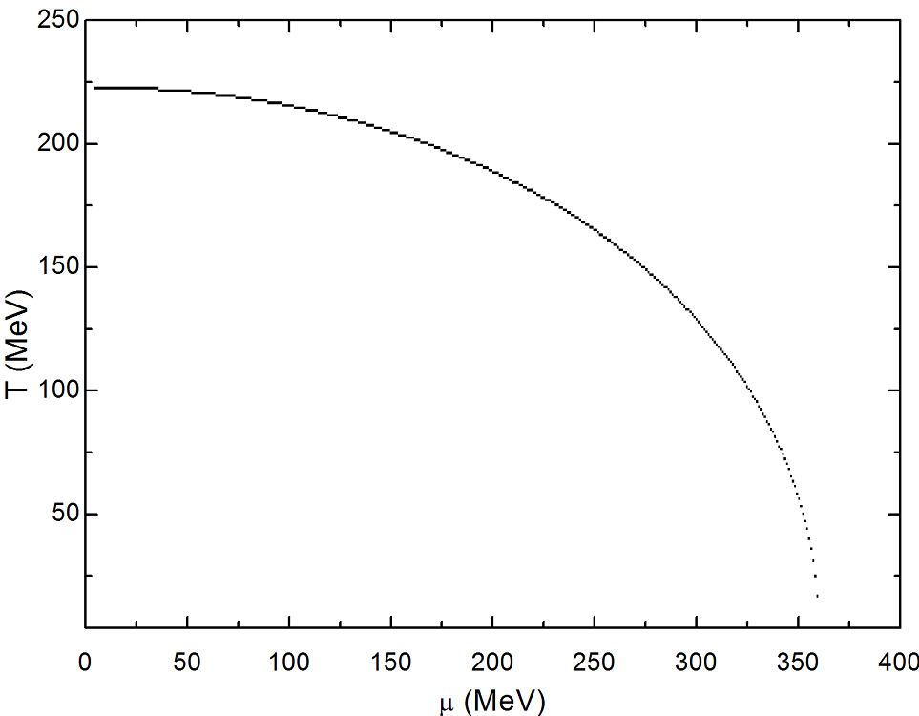
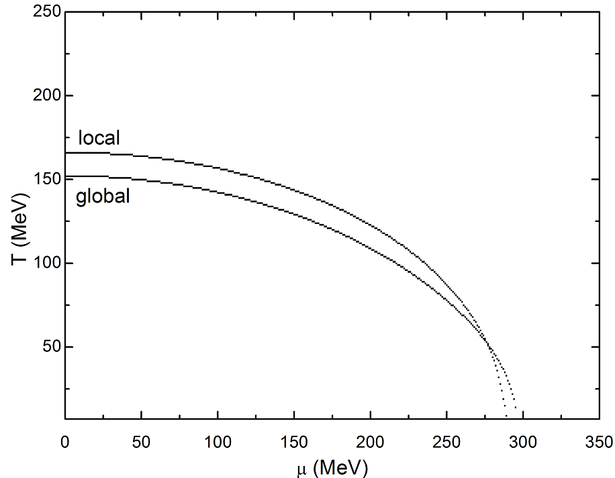
NJL phase diagrams
a b c
UV cutoff: Kohyama, H., Kimura, D., Inagaki, T.; Nucl. Phys. B 896, 2015
PTR: Cui, Z.-F.; Zhang, J.-L., Zong, H.-S.; Sci. Rep. 7, 2017
PV: Klevansky, S. P.; Rev. Mod. Phys. 64, 1992

Slide 12
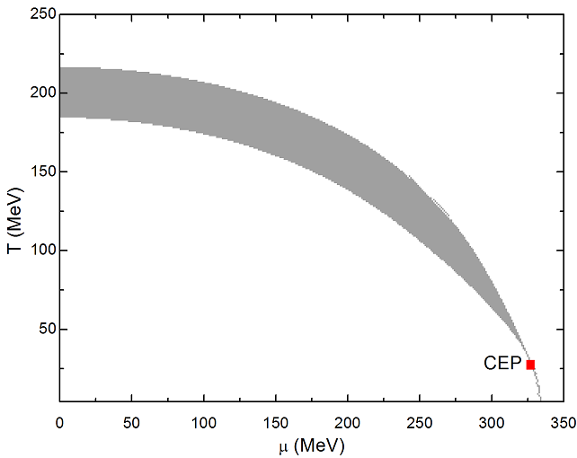
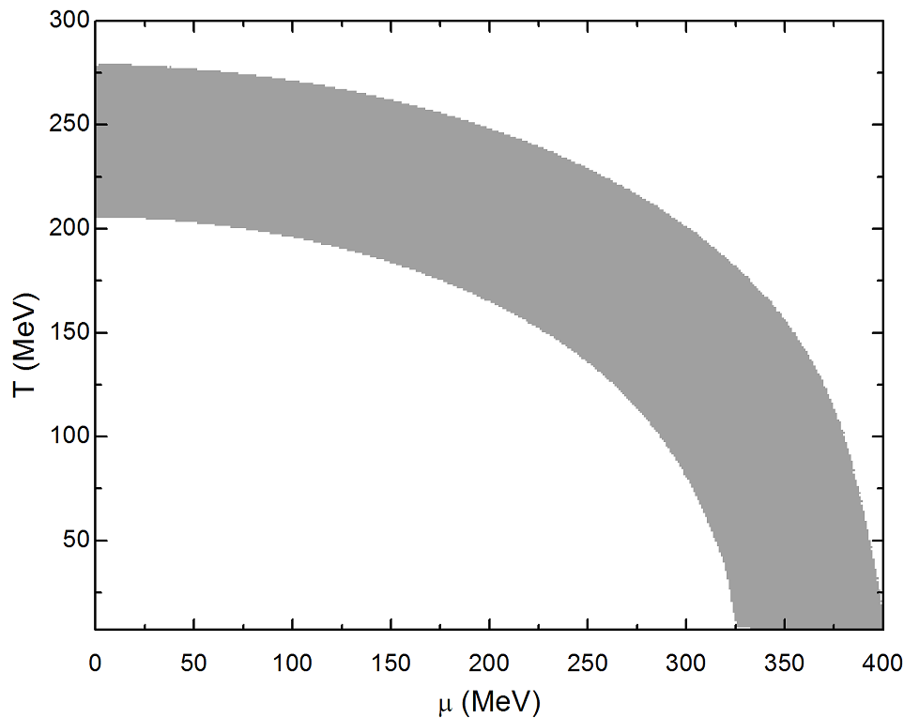
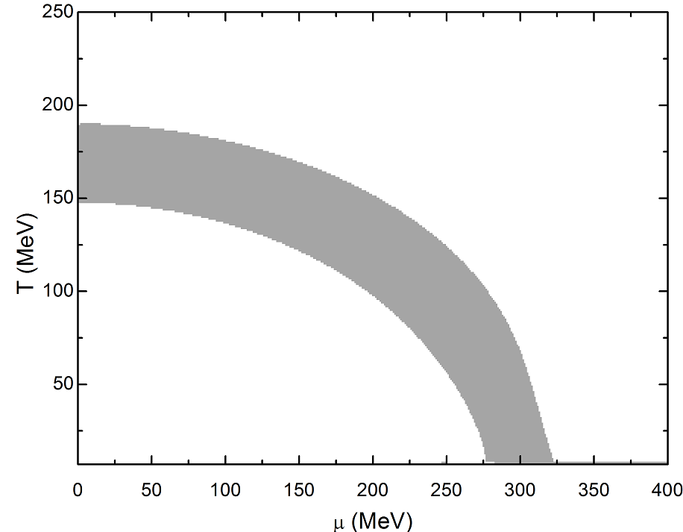
NJL phase diagrams (local extended)
a b c
UV cutoff: Kohyama, H., Kimura, D., Inagaki, T.; Nucl. Phys. B 896, 2015
PTR: Cui, Z.-F.; Zhang, J.-L., Zong, H.-S.; Sci. Rep. 7, 2017
PV: Klevansky, S. P.; Rev. Mod. Phys. 64, 1992

Slide 13
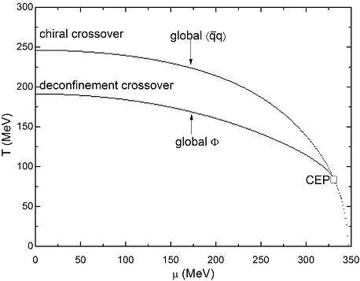
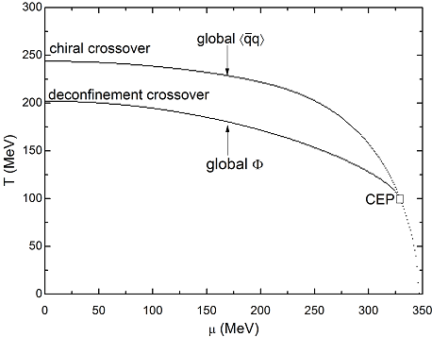
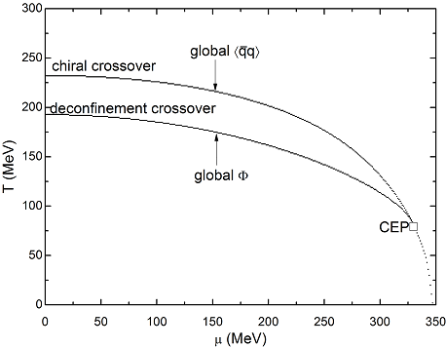
PNJL phase diagrams (global)
a b c
Ratti, C., Thaler, M. A., Weise, W.; Phys. Rev. D 73, 2006
Rößner, S., Ratti, C., Weise, W.; Phys. Rev. D 75, 2007
Fukushima, K.; Phys. Rev. D 77, 2008

Slide 14
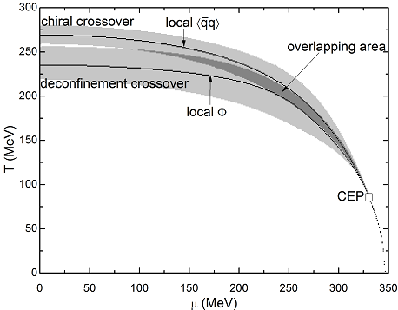
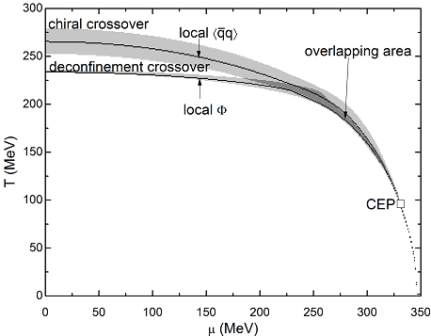
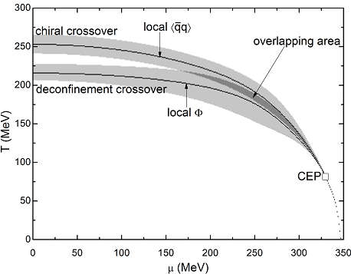
PNJL phase diagrams (local)
a b c
Ratti, C., Thaler, M. A., Weise, W.; Phys. Rev. D 73, 2006
Rößner, S., Ratti, C., Weise, W.; Phys. Rev. D 75, 2007
Fukushima, K.; Phys. Rev. D 77, 2008

