Slide 1
MAGIC
Matter, Astrophysics, Gravitationalwaves & Ion Collisions
E. Most, A. Motornenko, M.O. Kuttan, J. Papenfort, L. Weih, L. Rezzolla, ITP
M. Hanauske, St. Schramm†, J. Steinheimer, H. Stoecker*, FIAS
FIAS & Institut f.Theoretische Physik, Goethe Universitaet Frankfurt *GSI Darmstadt, CCNU, Wuhan; HU, Huzhou; USTC, Hefei

Slide 2
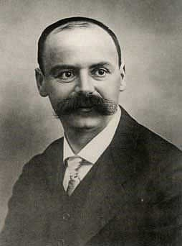
Matter, Gravity and Neutron Stars
1915 A. Einstein, born in Ulm, published GR:
Gravity governs the motion of masses
and light by curving spacetime.
1915 Karl Schwarzschild,
born1873 in Frankfurt am Main,
found the static point source solution of the theory of GR: BHs !
1916 K.S.’ last article: “Neutron Star” solution of GR: NS !
SchwarzSchild died in WW I just after publishing these articles..
SchwarzSchild’s solutions of GR: black holes & neutron stars
Add Einstein‘s Gravitational Waves - we see a whole new Universe!

Slide 3
Neutron Star, Quark Star, Black hole ?

Slide 4
Chiral Mean Field description of QCD matter
Chiral SU(3) parity-doublet quark-hadron mean-field model — unified phenomenological approach to model QCD thermodynamics at wide range of scales;
𝝁_{B}=0 lattice QCD data is used to constrain parameters of model’s quark sector;
Nuclear liquid-vapor phase transition gives strong signals in fluctuations even at 𝝁_{B}=0;
Chiral symmetry restoration and transition to quark-dominated phase are at very high 𝝁_{B} and/or T;
Model produces neutron stars in agreement with modern constraints;
Model’s EoS can be used as an input for both finite T and T=0 neutron star physics
… as well as for hydro simulations of heavy ions collisions.
Stefan Schramm: “That is most of what is known about QCD phenomenology”

Slide 5
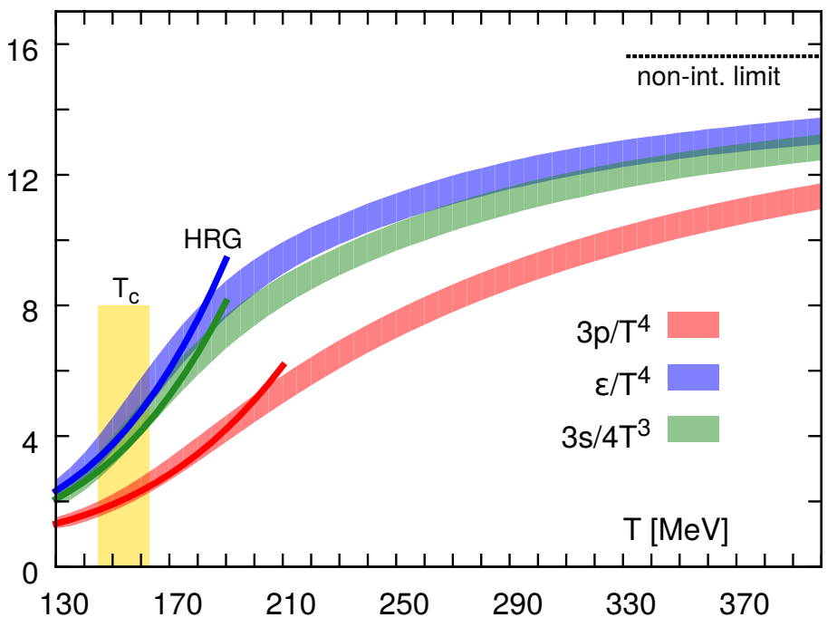
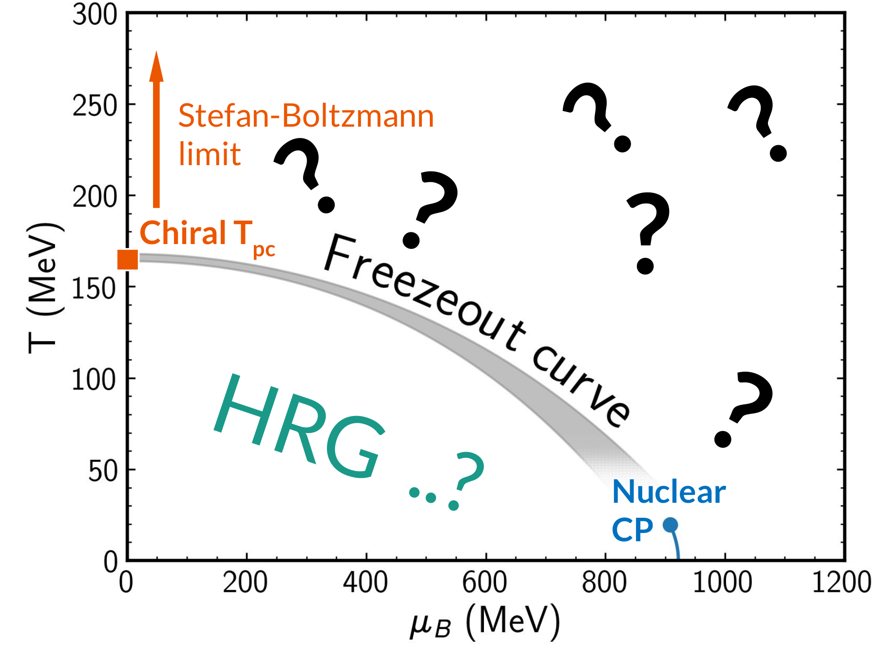
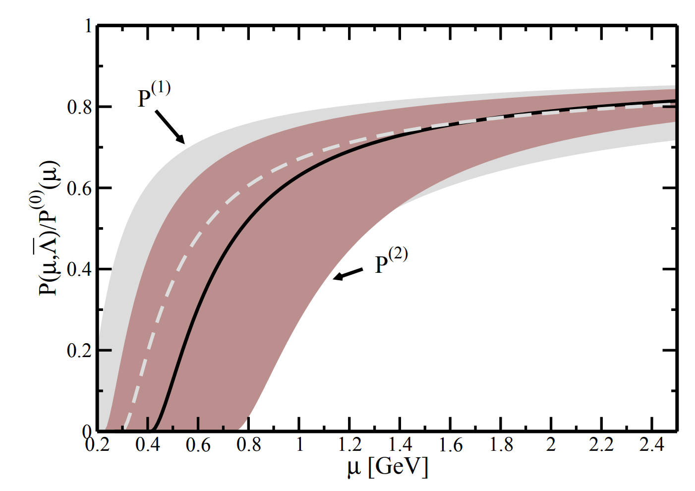
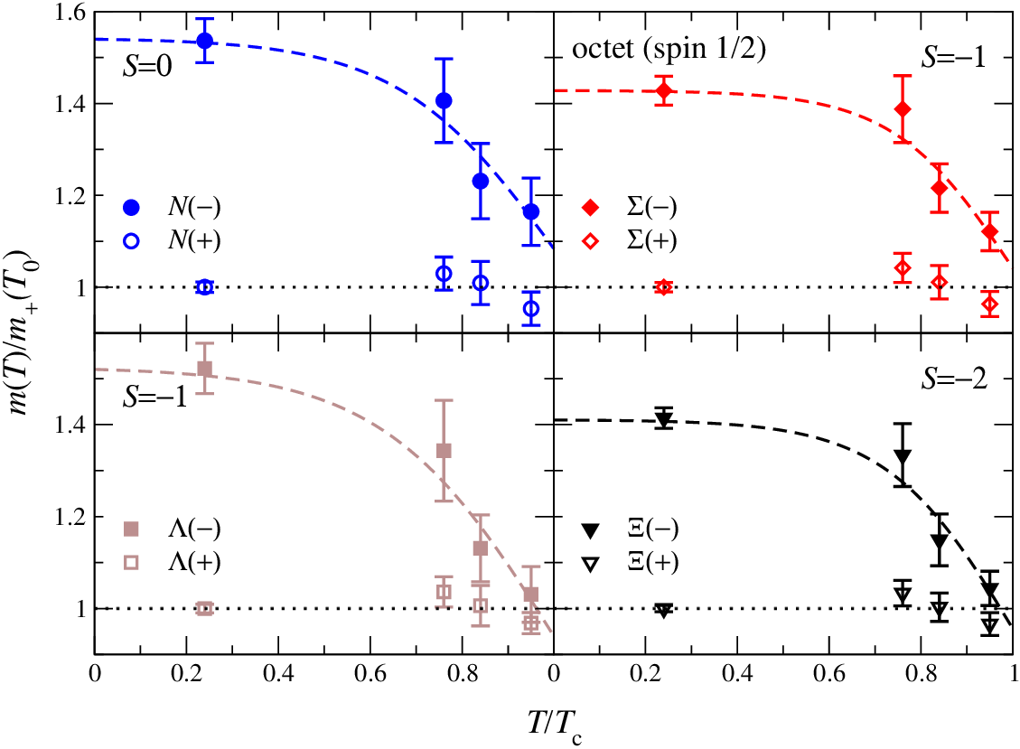
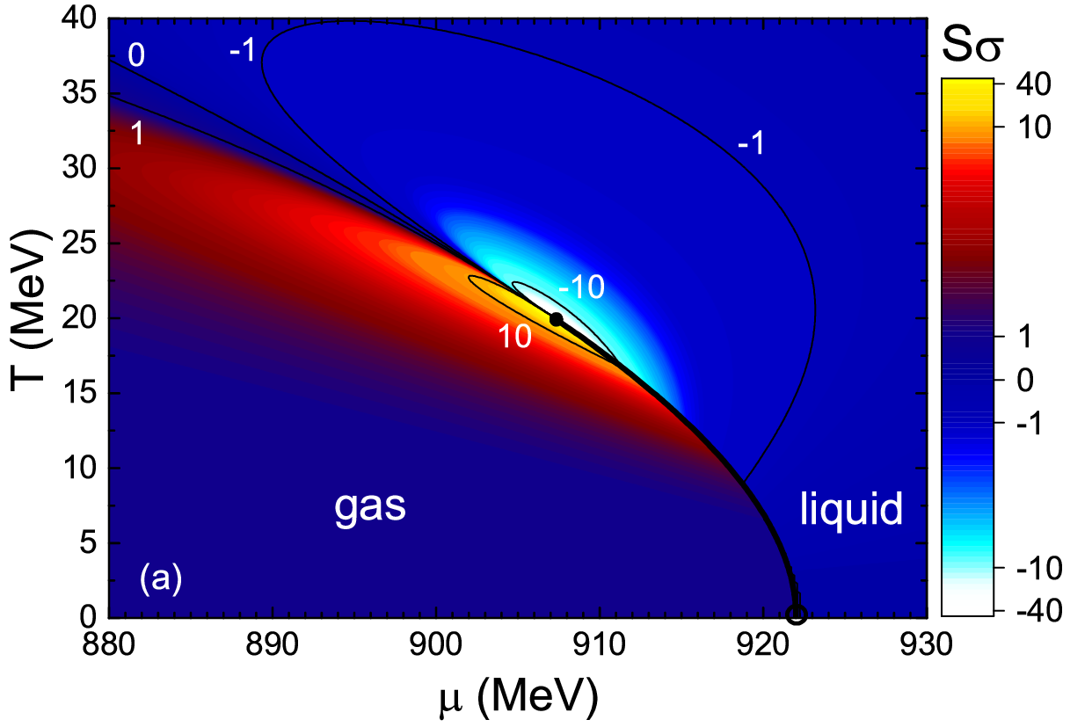
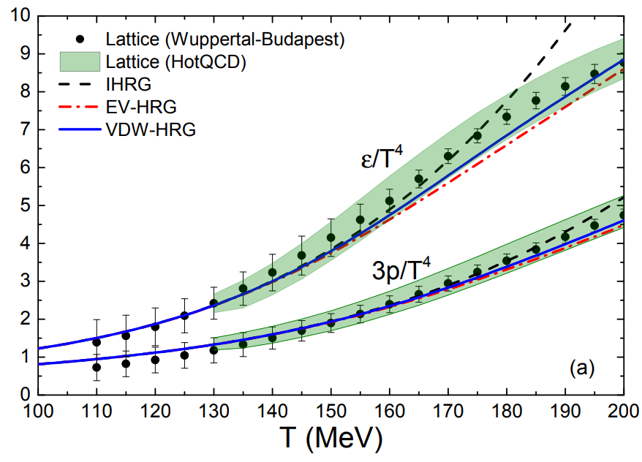
QCD phenomenology for the EoS
Stefan-Boltzmann limit μ_{B}=0 HotQCD, 1407.6387
Stefan-Boltzmann limit T=0
A. Kurkela, P. Romatschke,
A. Vuorinen, 0912.1856
Parity doubling G. Aarts et al., 1710.08294
Nuclear matter properties
J. Pochodzalla et al., Phys.Rev.Lett. 75 (1995)
V. Vovchenko et al., 1506.05763
Hadron Resonance Gas
Vovchenko,
Gorenstein,
Stoecker,
1609.03975

Slide 6
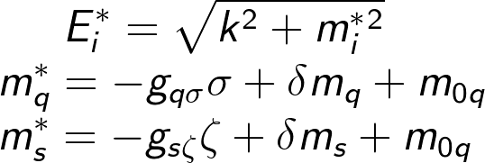
Including Quarks: Stefan-Boltzmann limit for QCD matter
We include quarks within PNJL inspired approach (Fukushima, hep-ph/0310121):
Polyakov loop Φ — is assumed as deconfinement order parameter:
Φ=0 — no quarks, Φ=1 — free quarks.
Effective masses of the quarks are generated by chiral fields σ and 𝜻:
Polyakov loop Φ is controlled by the potential U(Φ):
Fukushima, hep-ph/0310121
Roessner, Ratti, Weise, hep-ph/0609281

Slide 7
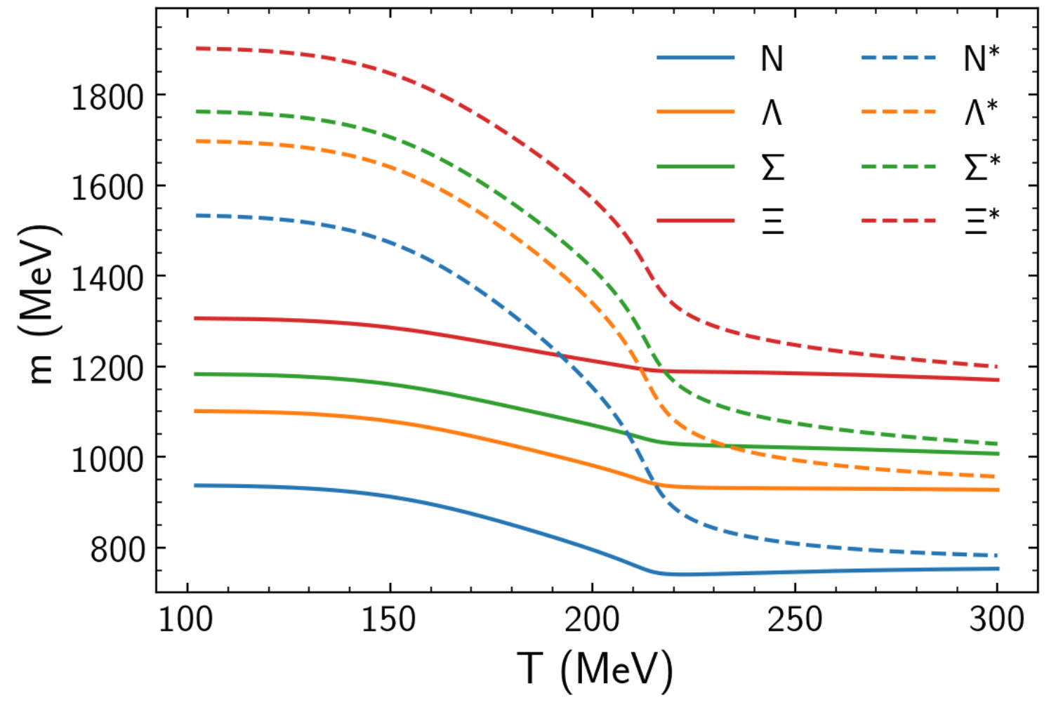
SU(3)_{f} octet and parity doubling: nuclear matter and lattice
We include all states of the SU(3)_{f} baryon octet:
together with their parity partners (G. Aarts et al., 1710.08294), i.e. states with the same quantum numbers but opposite parity. Those interact within SU(3)_{f} σ model:
with effective masses generated by chiral fields σ and 𝜻:
‘+’ stands for positive and ‘−’ for negative parity states

Slide 8
Chiral SU(3)_{f} parity-doublet Polyakov-loop quark-hadron model
Chiral — chiral symmetry restoration among parity partners and in the quark sector, chiral field is a proxy interaction between quarks and hadrons
SU(3) — 3-flavor (u, d, s) chiral Lagrangian: respective baryon octet interacts through mesonic fields. Realization of σ-ω model.
P. Papazoglou et al., nucl-th/9706024
parity-doublet — parity doubling among the baryon octet
C. E. Detar and T. Kunihiro, Phys.Rev. D39 (1989)
T. Hatsuda and M. Prakash, Phys.Lett. B224 (1989)
G. Aarts et al., 1703.09246 and 1812.07393
quark-hadron — realization of the deconfinement, PNJL-like
K. Fukushima, hep-ph/0310121
C. Ratti, M.A. Thaler, W. Weise, hep-ph/0506234
J. Steinheimer, S. Schramm, H. Stoecker, 1009.5239
A single framework for QCD thermodynamics, simultaneously satisfies constraints from lattice QCD and known nuclear matter properties, as well as neutron star observations.

Slide 9
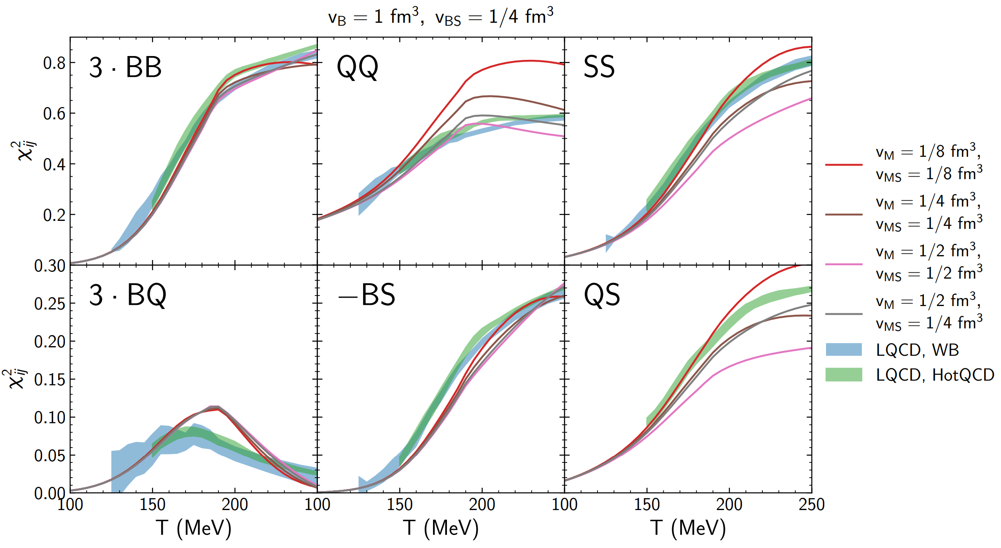
Meson EV size
The hadron repulsion strength has the following hierarchy non-strange baryons ￫ non-strange mesons ￫ strange hadrons
v_{B}= 1 fm³ , v_{M}=½ fm³, v_{BS}=v_{MS}= ¼ fm³, provides a description for most correlators.

Slide 10
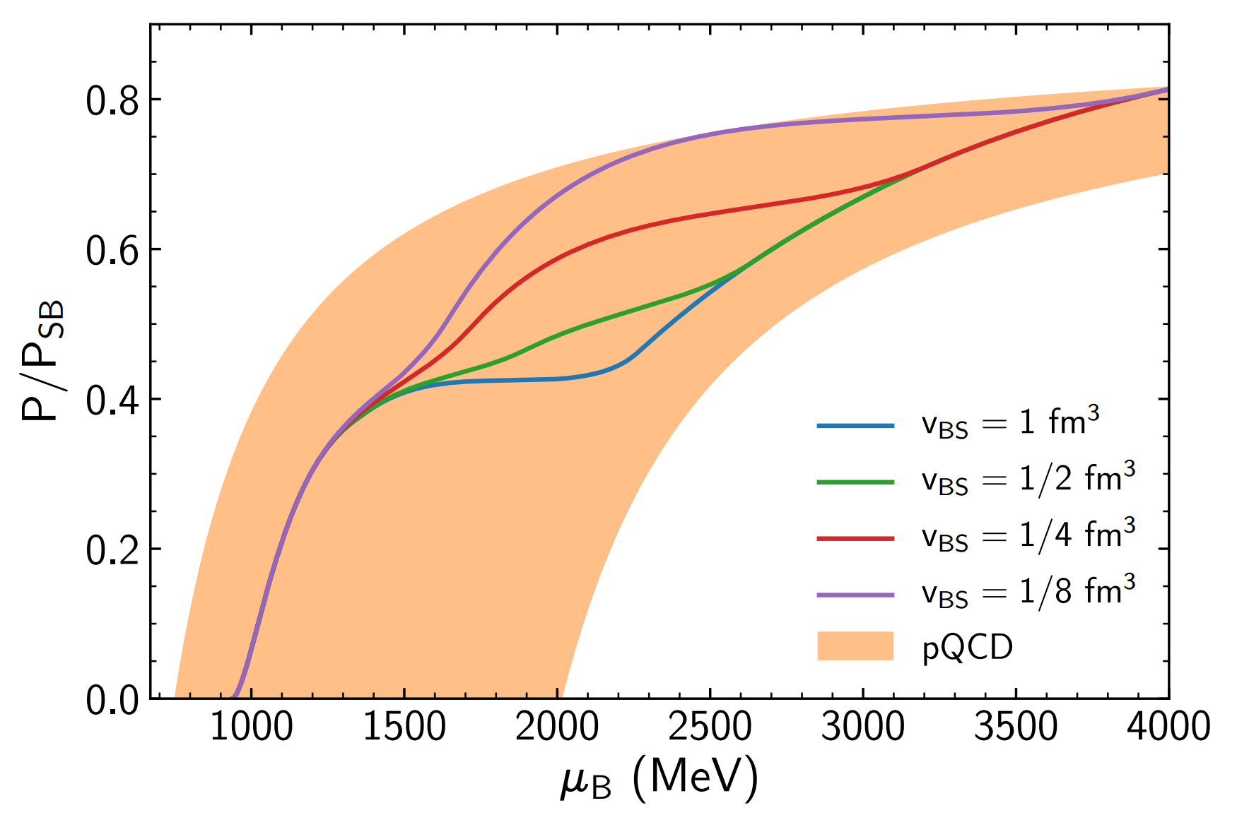
Comparison with pQCD data for cold quark matter
CMF gives reasonable description for v_{BS}=¼ fm³.
For smaller values — too many degrees of freedom appear, overshooting of PQCD results.
Then at high muB hadrons are suppressed and SB limit is slowly approached.
PQCD data from:
A. Kurkela, P. Romatschke, and A. Vuorinen,
Phys. Rev. D 81, 105021 (2010)

Slide 11
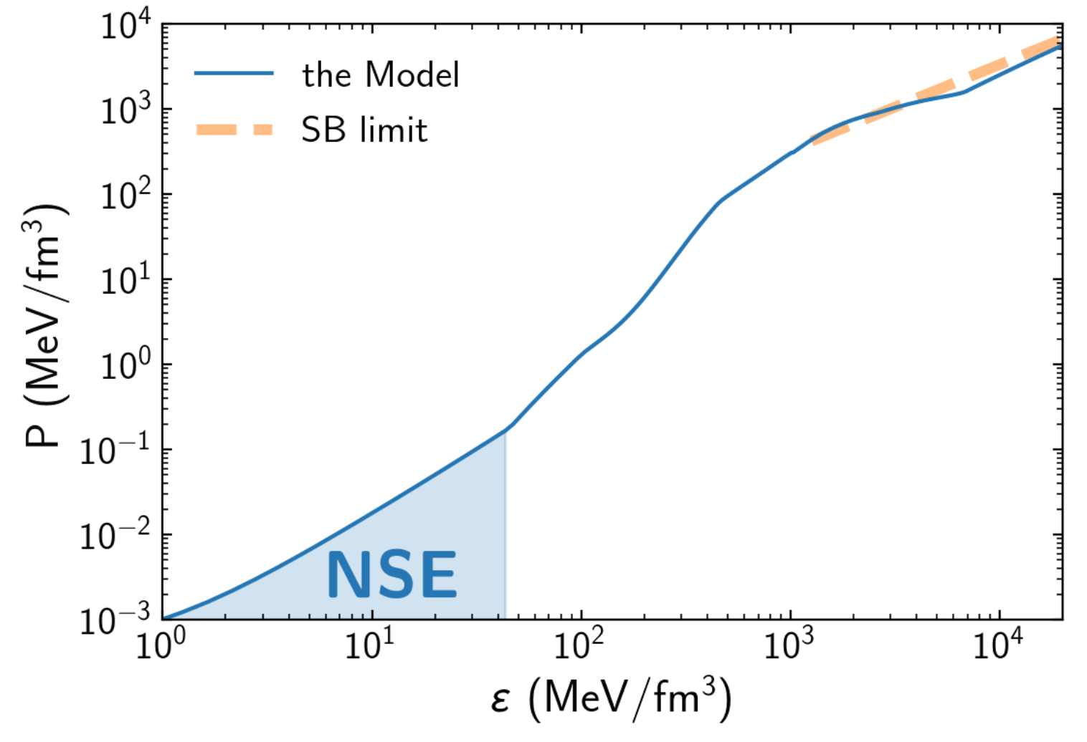
Application to neutron stars
The model can be easily employed for the description of neutron star matter at T=0 in beta-equilibrium without any changes to the parameters. The EoS then can be used as an input to model neutron stars by solving Tolman–Oppenheimer–Volkoff equation:
Additional input is needed to model star’s crust — Nuclear Statistical Equilibrium (Baym, Pethick, Sutherland,1971, Astrophys. J. , 170,299.)
The model approaches Stefan-Boltzmann limit at high energy densities.

Slide 12
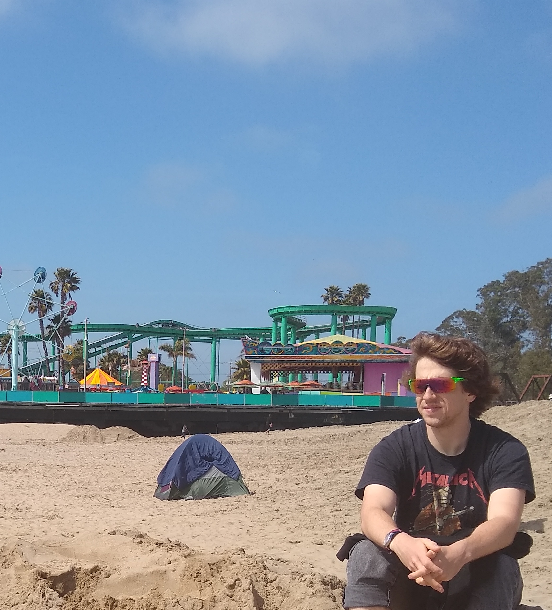
Neutron Star Masses-Radius Anton Motornenko
Features:
Maximum NS-
mass observed
=2.0xMsolar & <2.1xMsolar- limit of GW170817
Radii ~ 12-13km observed
hybrid star’s rel.EoS at high 𝝁_{B} must agree with lattice QCD data at low 𝝁_{B}
Anton Motornenko, Vovchenko, Steinheimer, Stefan Schramm, Stoecker 1809.02000, NPA (2019), QM’19 Wuhan

Slide 13
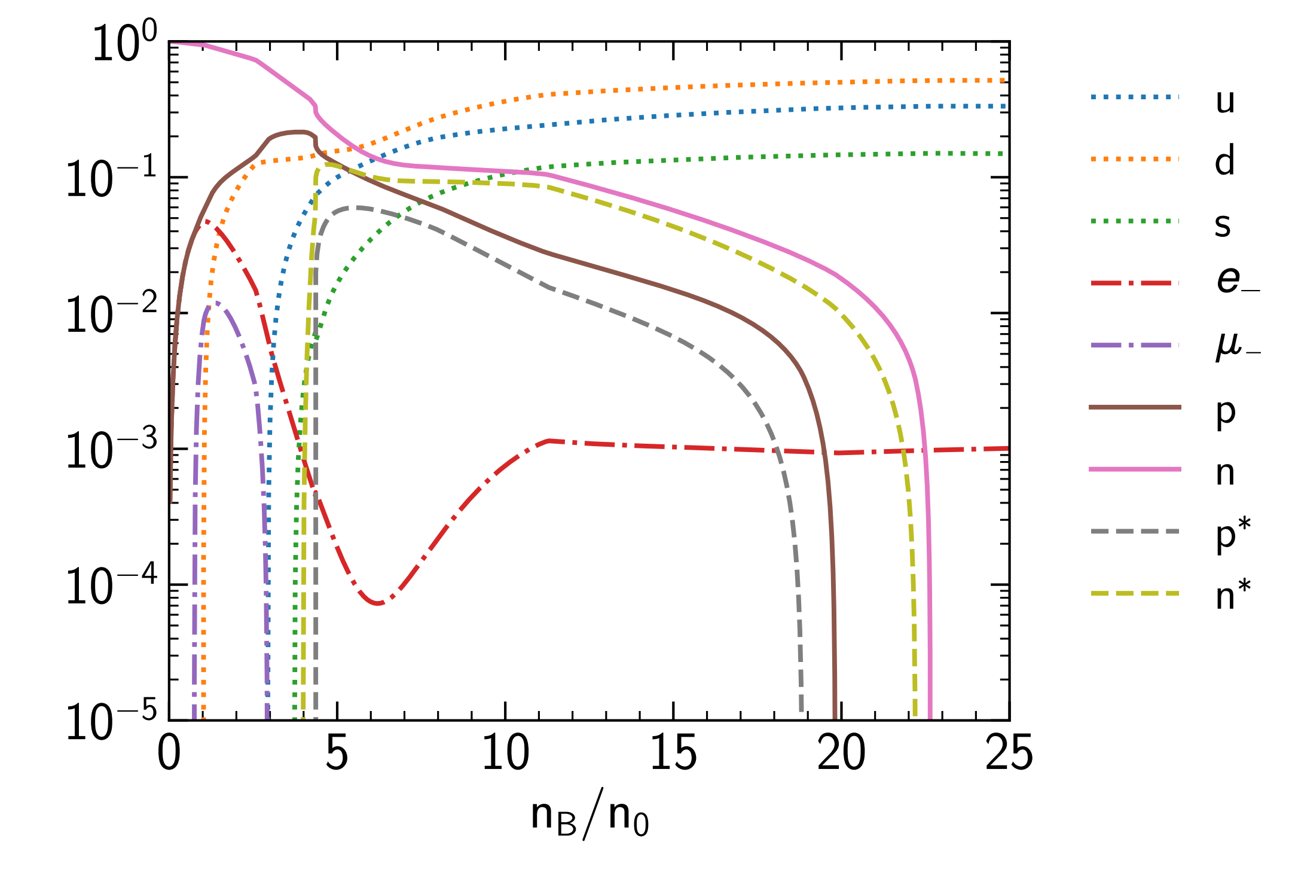
Equation of state at T=0: neutron stars
Particle yields normalized to baryon density:
Equation of state for neutron stars:
T=0
Electric charge is zero
Leptons are included
No nuclear ground state
Chiral transition is at n≈4n₀
Quark matter is at n≈23n₀
Hyperons at T=0 are suppressed by hard-core repulsion (nevertheless are present at T ≠ 0)
Strange quarks are included

Slide 14
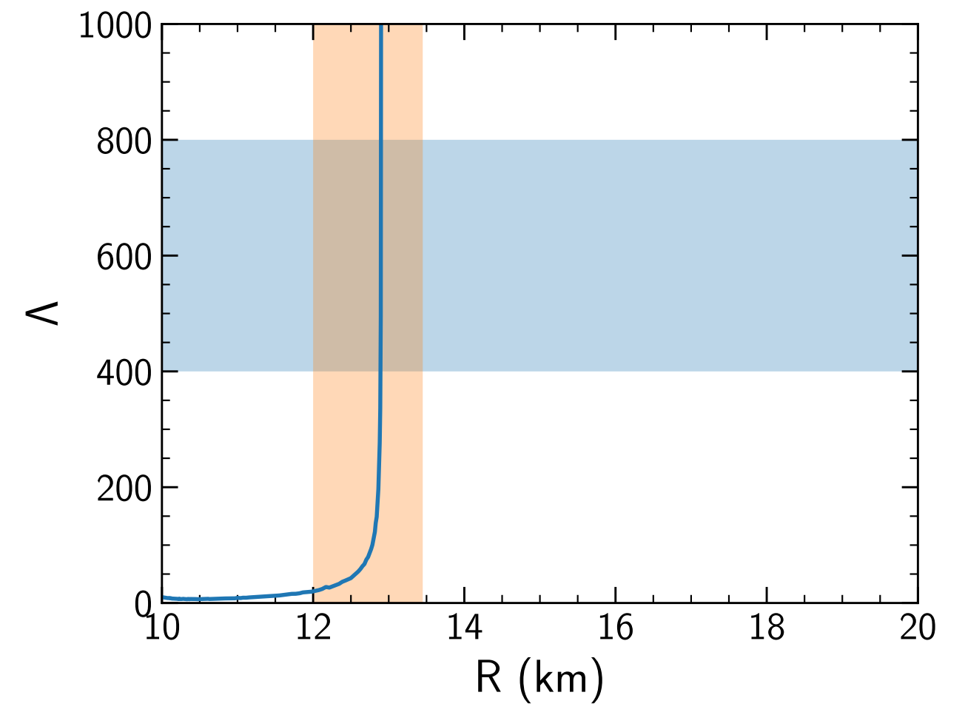
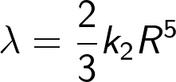
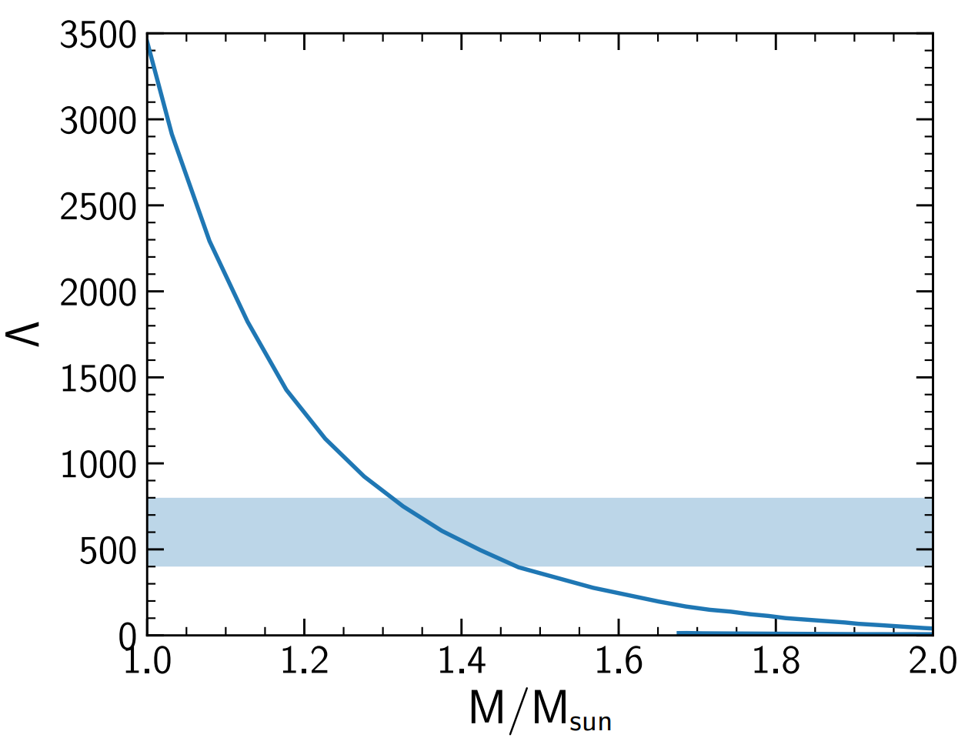
Neutron star tidal deformabilities
Tidal deformability — measures stars’ induced quadruple moment Q_{ij} as a response to the external tidal field :
important EoS-dependent quantity for inspiral phase of binary neutron star system. Related to second Love number k₂:
One presents the dimensionless tidal deformability Λ (mostly dependent on compactness M/R):
Bands — recent constraints for radius and tidal deformability of 1.4M_{sun} star.
Most, Weih, Rezzolla, Schaffner-Bielich., 1803.00549
Line — results on Λ using EoS obtained from the model.

Slide 15
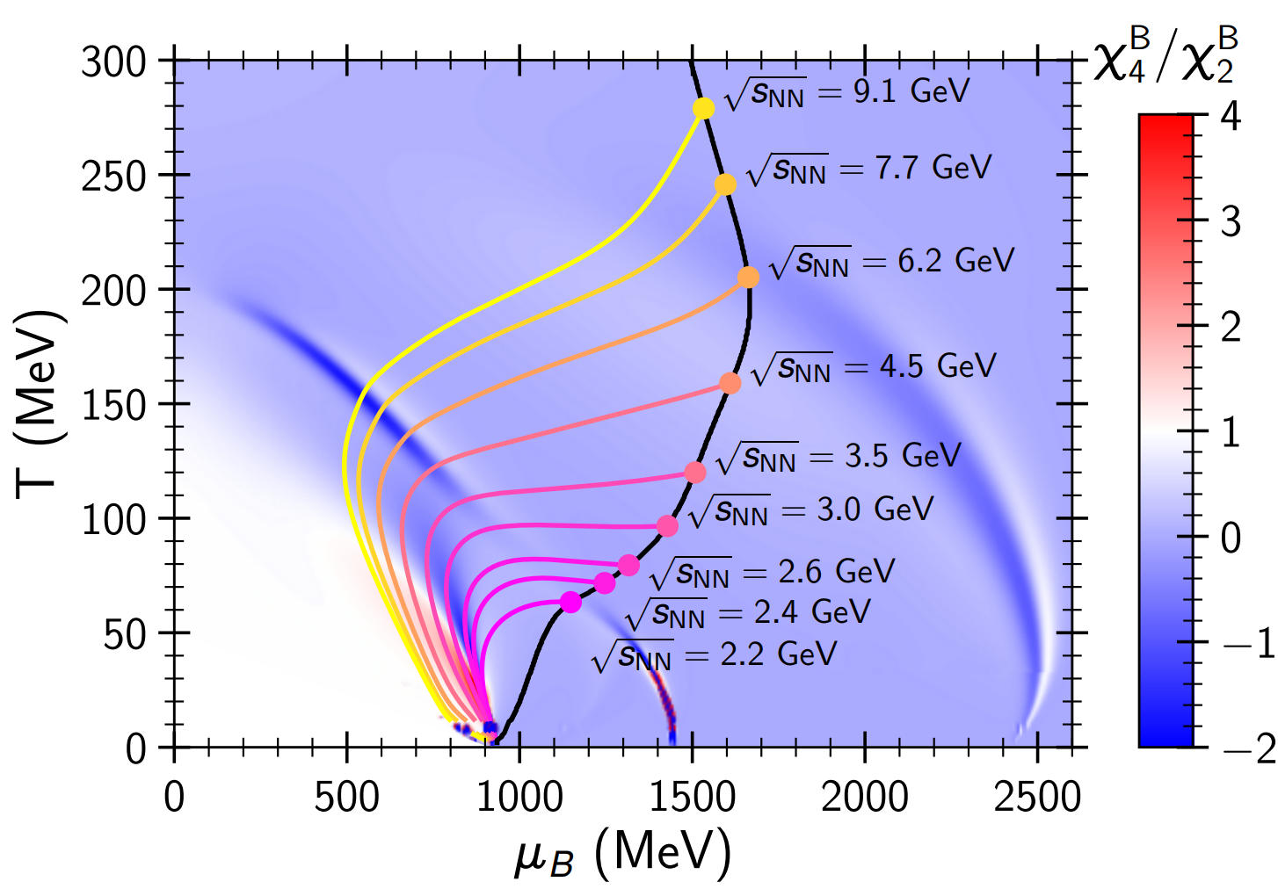
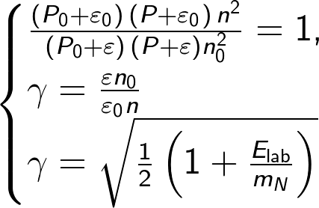
Probing phase diagram by heavy ions collisions
Isentropes (S/A = const) illustrate hydrodynamical evolution of the central region in heavy ion collision.
Initial entropy per baryon S/A, was estimated by Taub adiabat (shock wave solution):
(A. H. Taub, Phys. Rev. 74, 328 (1948))
P₀, ε₀, and n₀ correspond to the initial pressure, energy density, and baryon density in the local rest frame of each slab

Slide 16
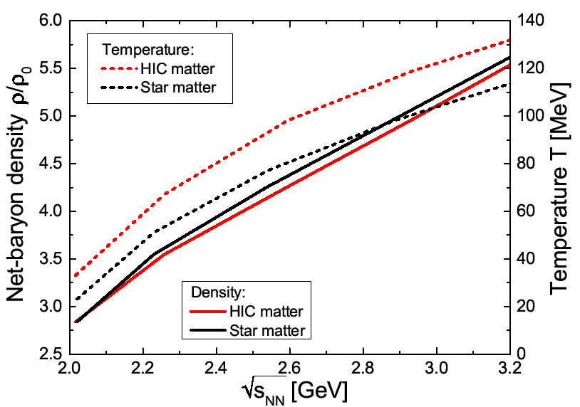
Neutron Star merger vs. heavy ion collisions: Baryon Densities and Temperatures
+ initialize by Relativistic Rankine Hugoniot Taub Adiabat with Relativistic CMF- EoS
Compare central heavy ion collisions
with head-on neutron star collisions:
Rankine Hugoniot Taub Adiabate
conserve baryon number and energy momentum current densities across shock front yields stationon.1+1D, hydrodynamical equation for n, p vs E:
E^2 -E_0^2=(p-p0)(E/n- E0/n0)
Temperature
Density
J. Steinheimer & A. Motornenko

Slide 17
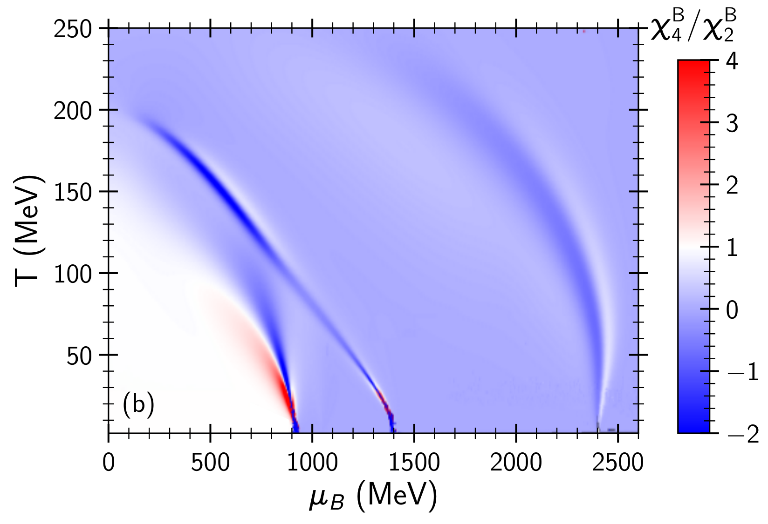
Kurtosis and the phase diagram
_{Chiral condensate}
Quark
Matter
_{Quarks+hadrons,}
_{Chiral condensate=0}
Quark fraction
Hadronic liquid
Dilute hadrons

Slide 18
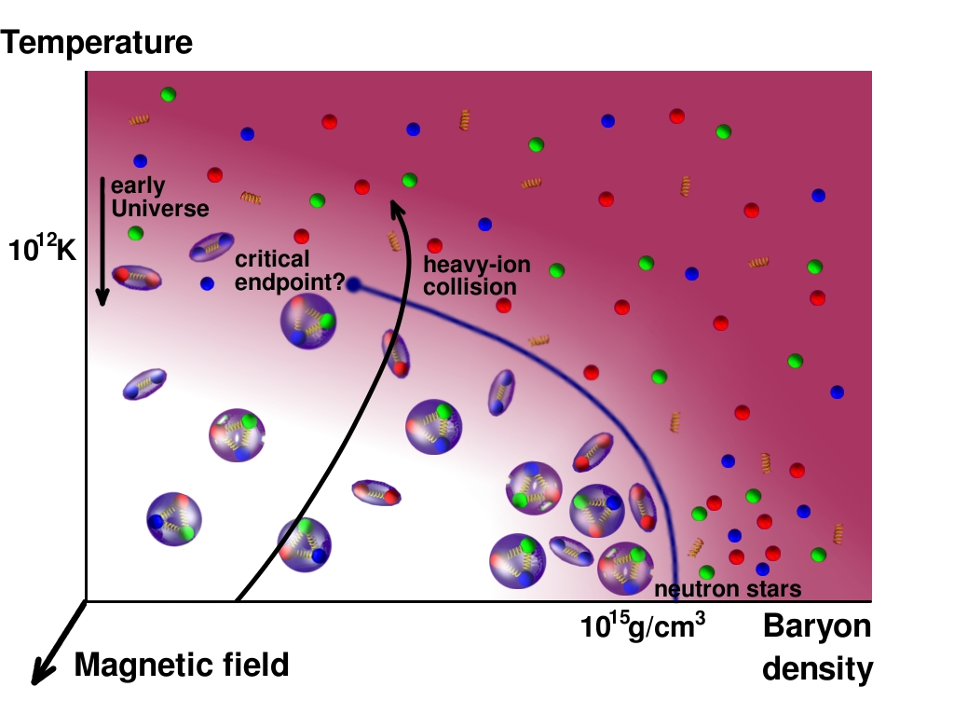
Dense Matter, Strange Matter, Quark Matter, Quark Stars?
FAIR: Relativistic collisions of NS-NS vs. Heavy Ions
Neutron Star -Neutron Star Collisions

Slide 19
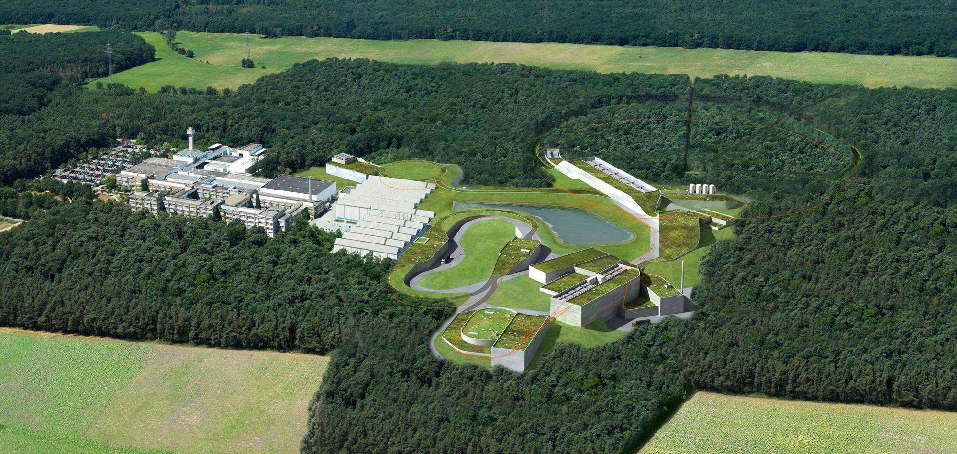
Death-Star- Machines - FAIR HIAF NICA STAR
NeutronStar matter in the Lab - Heavy Ion Collisions
Charm and Beauty of International Collaboration
Observers
Poland
Slovenia
Russia
Rosatom
Finland
France
Germany
India
Italy
Spain
Sweden
Romania
Austria Czech
Hungary
China
H. Stoecker FAIR Discoveries
UK
11.11. 2019

Slide 20
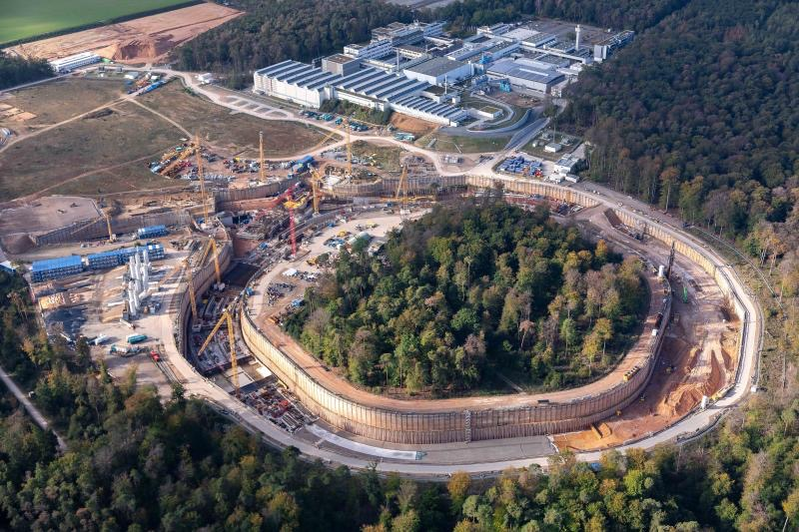

Slide 21
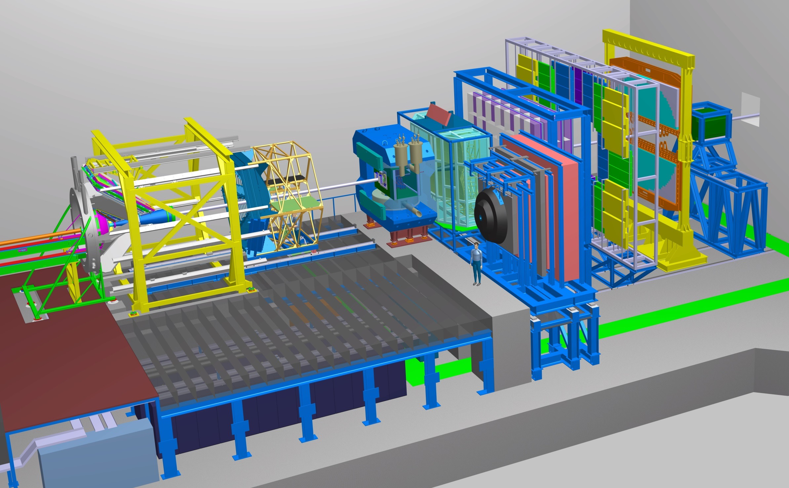
The CBM experiment
Transition
Radiation
Detector
Time of Flight
Detector
Ring
Imaging
Cherenkov
Dipol
Magnet
Silicon
Tracking
System
HADES
p+p, p+A
A+A (low mult.)
Micro
Vertex
Detector
Muon
Detector
Projectile
Spectator
Detector
DAQ/FLES HPC cluster
2/27/2018
H. Stoecker FAIR Discoveries

Slide 22
The CMF model applied in fluid dynamical simulations of HIC
Relativistic 4D Hydrodynamics for Heavy Ion Collisions@FAIR
Jan Steinheimer , FIAS Frankfurt
Special Relativistic 3+1Dim Hydrodynamics for HIC ’80-/’90-ies :
G.Graebner, D.Rischke, et al., ITP, Goethe University

Slide 23
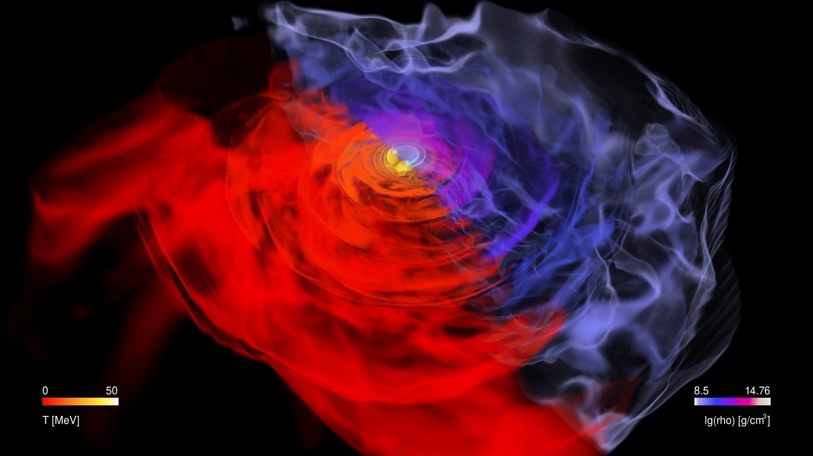
Nuclear Matter EoS in Binary NS Mergers &
Quark Matter Phase Transition Signatures
in Gravitational Waves
Most, Papenfort, Dexheimer, Hanauske, Schramm, Stoecker, Rezzolla (PRL 2019)
see also Bauswein, Bastian, Blaschke, Chatziioannou, Clark, Fischer, Oertel
(PRL 2019)

Slide 24
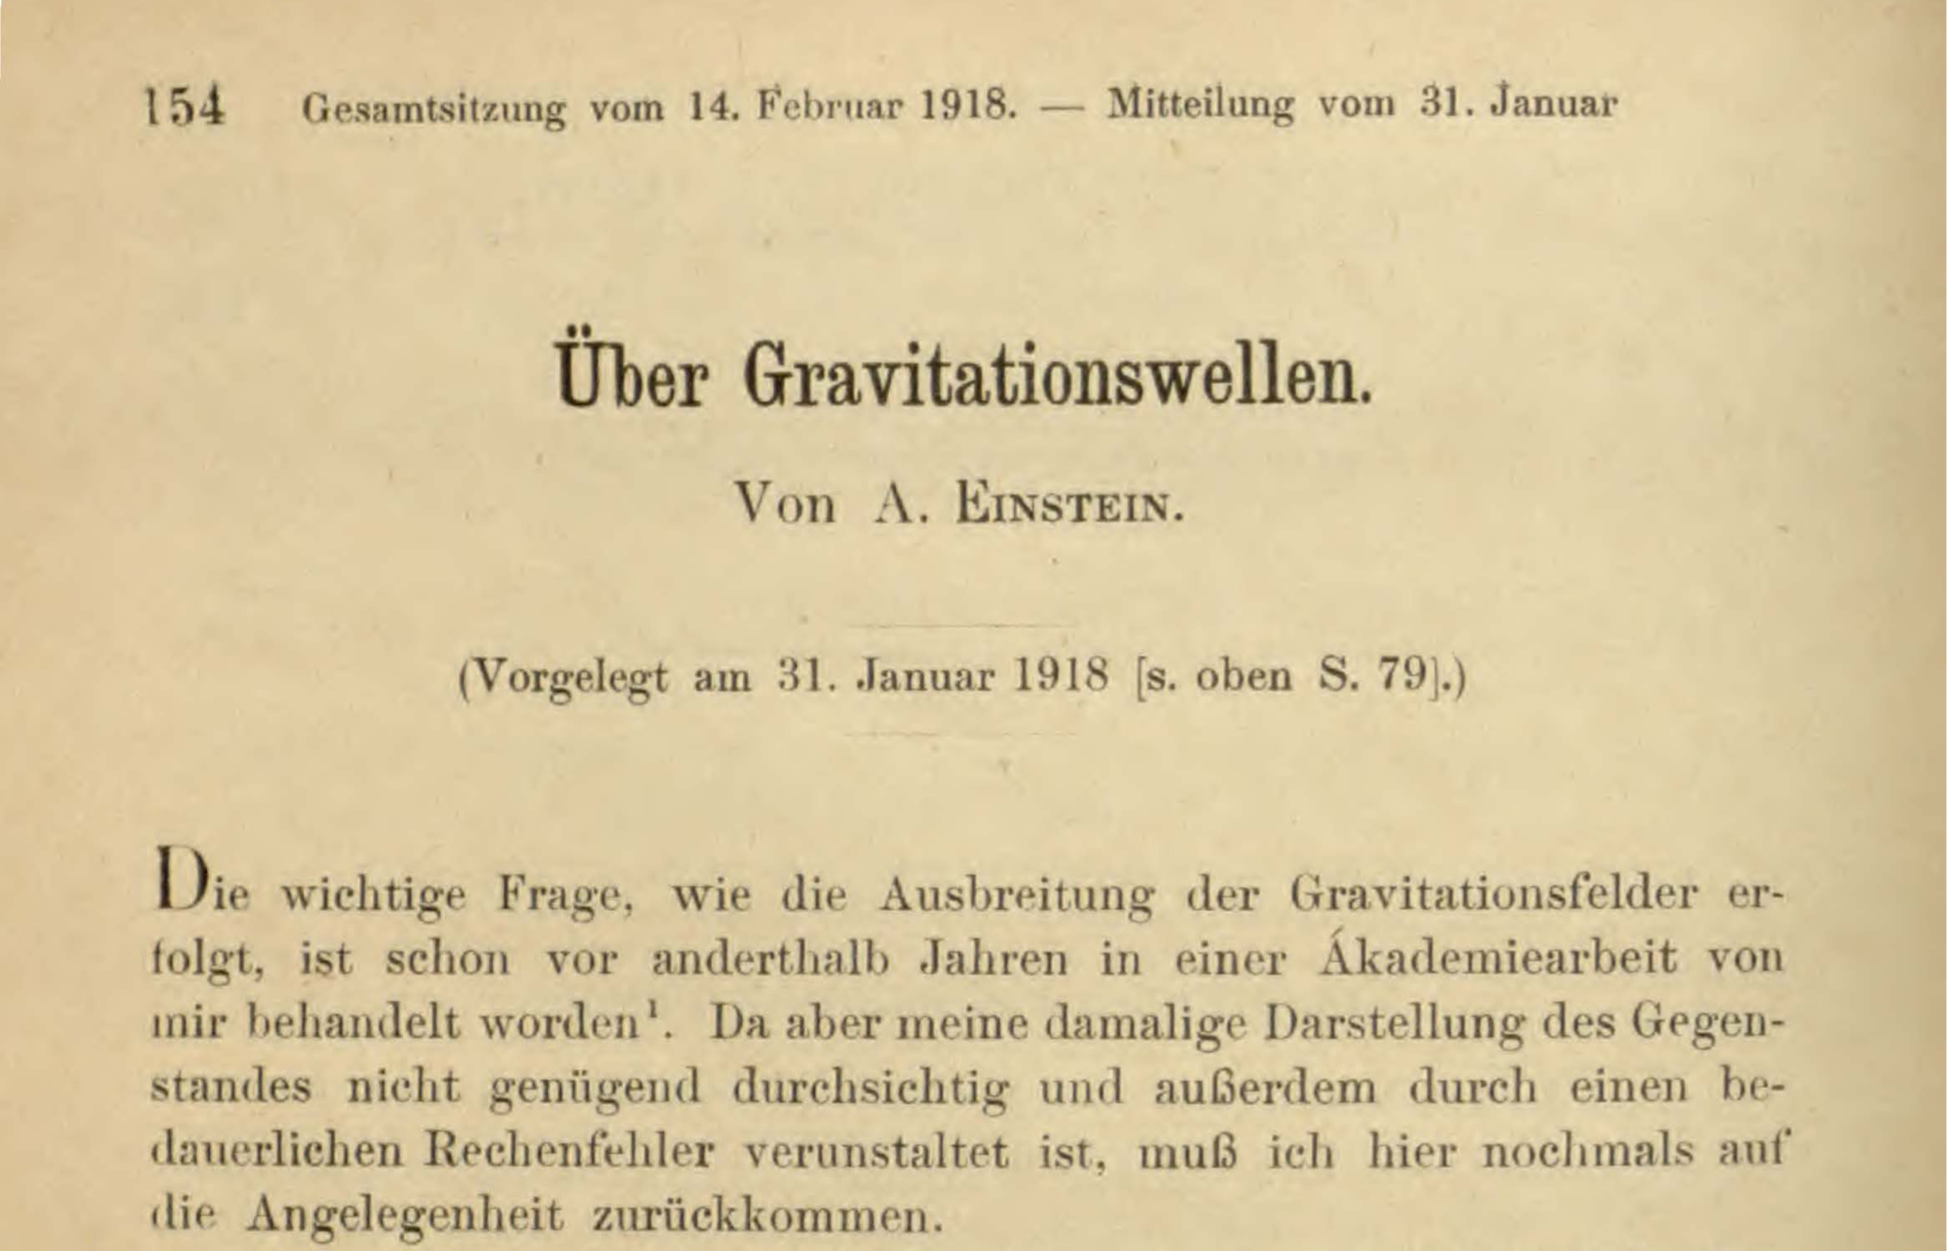
Sitzungsberichte der Königlich-Preußischen Akademie der Wissenschaften
Einstein‘s First work on Gravitational Waves, Juni 1916, was …wrong…

Slide 25
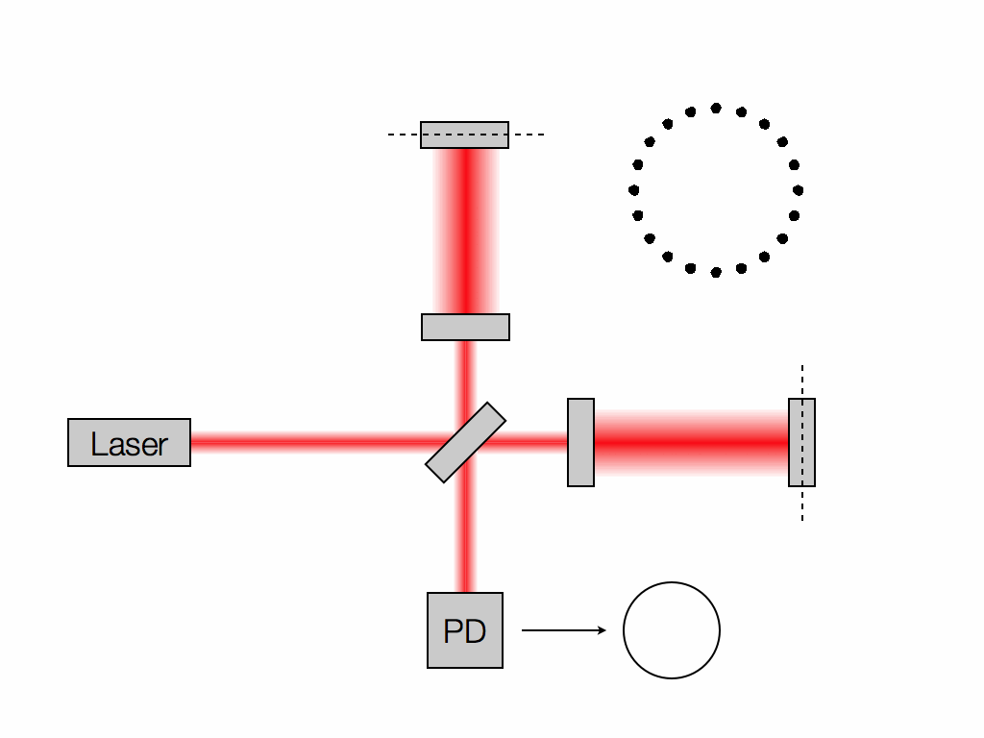
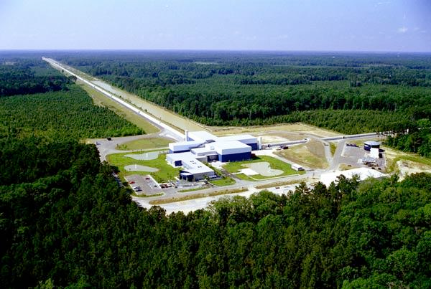
Gravitational Waves discovered
Collision of 2 Neutron Stars GW170817
Masses of BHs: 1.4 &1.4 Solar Masses
Distance to Earth Gpc
Length Difference 10^-21 m
Credit: Les Wade from Kenyon College.

Slide 26
The ideal fluid equations - but should include bulk- & shear viscosity & thermoconductivity - cf. A. Muronga & J. Noronha
These equations do not possess analytic solutions in strong-field regimes: numerical approaches inevitable

Slide 28
Disco-Fox, Merengue and Tango- Phase

Slide 29
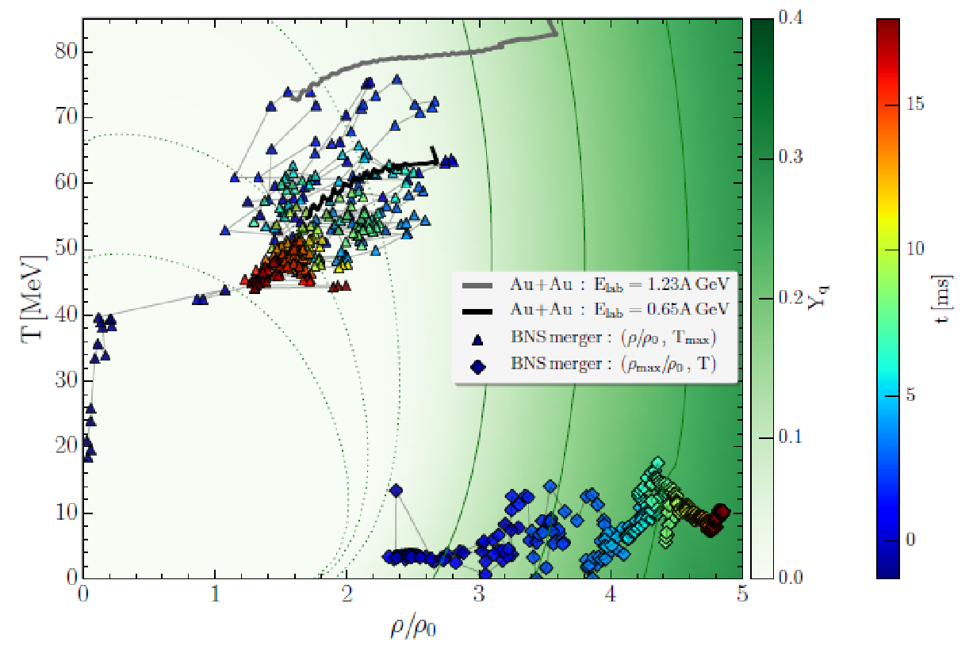
Where it’s hot and dense in neutron star mergers
Separation of hot hadronic corona and dense, cold quark matter core
Heavy ion Collisions GSI + FAiR same environment as
Bin. Neutron Star mergers

Slide 30
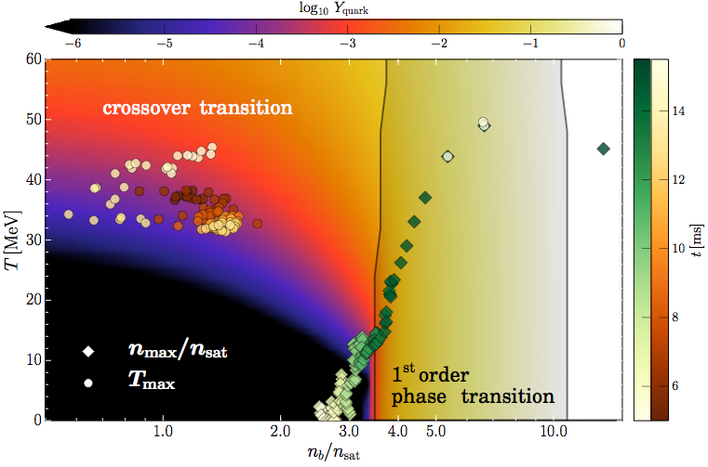
T, n Evolution in the phase diagram
Evolution of the max. temperature and density.
Quarks appear early on in Torus: T~50 MeV
Once core reaches density n/n_0 ~ 3.5, transition into SQM occurs

Slide 31
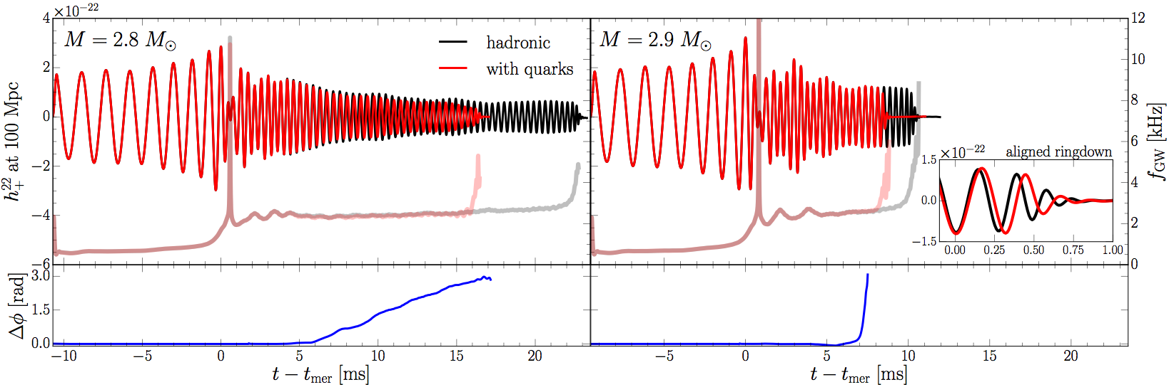
Gravitational Wave Emission from BNSM- ML!
“low-mass” binary
“high-mass” binary
In low-mass binary, after ~ 5 ms, quark fraction is large enough to change quadrupole moment and yield differences in the waveforms.
In high-mass binary, phase transition takes place rapidly after ~ 5 ms
. Waveforms are similar but ringdown is different (free fall for PT).
Mismatch hadronic inspiral and post-merger phase:
clear Signature of Quark Matter - crossing or 1.OPT ?

Slide 32
✴Spectra of post-merger shows peaks, some ”quasi-universal”.
✴When used together with tens of observations, they will set tight constraints on EOS: radius known with ~1 km precision.
✴ Magnetic fields unlikely to be detected during the inspiral but
important after the merger: instabilities and EM counterparts.
✴Mergers lead to tiny but important ejected matter and kilo-/ macro-nova emission - “high-A” nucleosynthesis very robust.
✴GW170817 provided new limits on maximum mass and radii:
_{2.01}+0.04
M /M . 2.16
+0.17
0.15
0.04
TOV Ⓢ
12.00 < R_{1.4}/km < 13.45
8.53 < R_{1.4}/km < 13.74
R¯_{1.4} = 12.45 km
R¯_{1.4} = 13.06 km
hadronic EOSs
phase transitions
Merging binaries of NSs are Einstein’s richest laboratory: GWs, nuclear physics, astrophysic: more to come!…

Slide 33
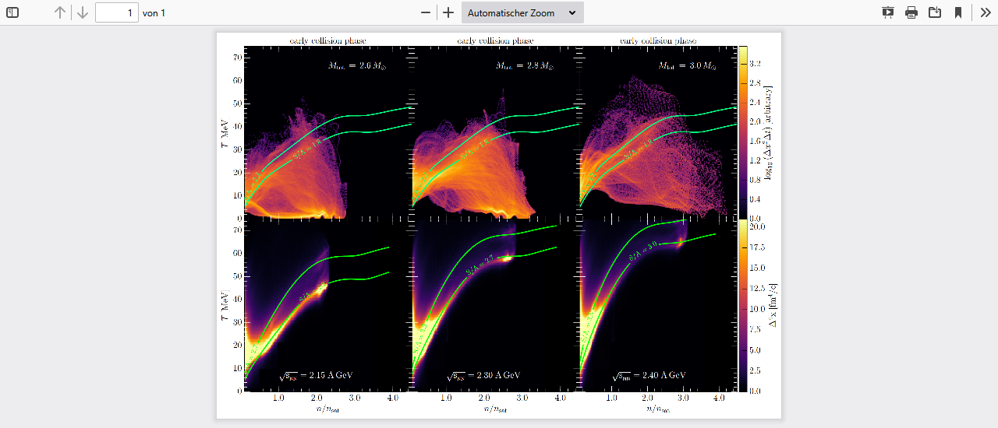
Summary:
T(n), S/A in
Binary
Neutron
Star
Collision
T(n), S/A in
Binary
Heavy Ion
Collision
Neutron Star S/A > 2, increases with NS mass
GSI/FAIR S/A > 2, increases with E_LAB
Tune Kern-Kern => Stern-Stern EoS in the LAB!
E.Most, A.Motornenko, J. Steinheimer et al

