Slide 1
Modern Scattering theory and the XYZ phenomena
Alessandro Pilloni
International School of Nuclear Physics - 44th Course
Erice, September 18-24, 2023

Slide 2
Definition of exotics
Despite it’s wrong, the vaste majority of hadrons obeys QM
Whatever is beyond $q\overline{q}$ for mesons and $qqq$ for baryons is exotic
Flavor exotics: e.g. doubly charged meson, baryon with positive strangeness Ex.: $T_{cc}^{+}$ ; if OZI rule enforced, $Z_{c,b}$, $P_{c}$…
Spin exotics: $J^{PC}$ not allowed in QM Ex.: $π_{1}(1600)$ with $J^{PC}=1^{−+}$
Criptoexotics: $J^{PC}$ allowed, but properties not compatible with QM expectations Ex.: $Y(4260)$, $Λ(1405)$, hybrid baryons, $X(3872)$
A. Pilloni – Modern Scattering theory and the XYZ phenomena
Notes:
2 slides su Zc, a Bes e a Belle
2 slide su tetraquark model: dall’hamiltoniana di Jaffe al calcolo delle masse
1 slide su molecular models, dove sono i carichi? (non in Tornqvist, si in Hanhart, vedere Braaten, citare Nefediev)
2 slides su decay channels, dove si dovrebbe vedere, e a seconda del modello, vedere qualche plot
1 slide su Y(4260), tetraquark? C’è lo strano (si vede la f0)
1 slide su Zc a cleo (anche il neutro)

Slide 3
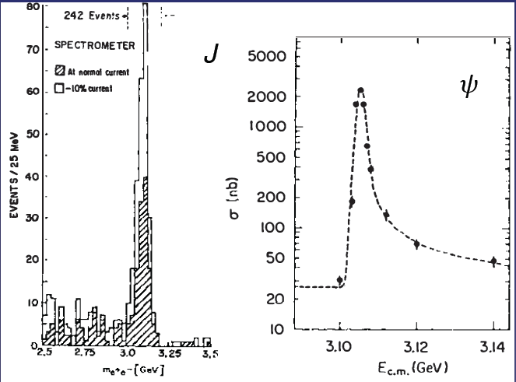
Quarkonium orthodoxy
$$Q$$
$$\overline{Q}$$
Potential models
(meaningful when $M_{Q}→∞$)
$$V\left(r\right)=−\frac{C_{F}α_{s}}{r}+σr$$
(Cornell potential)
$$α_{s}\left(M_{Q}\right)∼0.3$$
(perturbative regime)
OZI-rule, QCD multipole
Solve NR Schrödinger eq. → spectrum
Effective theories
(HQET, NRQCD, pNRQCD...)
Heavy quark spin flip suppressed by quark mass, approximate heavy quark spin symmetry (HQSS)
Integrate out heavy DOF
↓
(spectrum), decay & production rates
A. Pilloni – Modern Scattering theory and the XYZ phenomena
Notes:
2 slides su Zc, a Bes e a Belle
2 slide su tetraquark model: dall’hamiltoniana di Jaffe al calcolo delle masse
1 slide su molecular models, dove sono i carichi? (non in Tornqvist, si in Hanhart, vedere Braaten, citare Nefediev)
2 slides su decay channels, dove si dovrebbe vedere, e a seconda del modello, vedere qualche plot
1 slide su Y(4260), tetraquark? C’è lo strano (si vede la f0)
1 slide su Zc a cleo (anche il neutro)

Slide 4
Multiscale system
Systematically integrate out the heavy scale,
$$m_{Q}≫Λ_{QCD}$$
$$m_{Q}≫m_{Q}v≫m_{Q}v^{2}$$
$$m_{b}∼5 \text{GeV}, m_{c}∼1.5 \text{GeV}$$
$$v_{b}^{2}∼0.1, v_{c}^{2}∼0.3$$
Full QCD
NRQCD
pNRQCD
Factorization (to be proved) of universal LDMEs
Good description of many production channels, some known puzzles (polarizations)
A. Pilloni – Modern Scattering theory and the XYZ phenomena
Notes:
2 slides su Zc, a Bes e a Belle
2 slide su tetraquark model: dall’hamiltoniana di Jaffe al calcolo delle masse
1 slide su molecular models, dove sono i carichi? (non in Tornqvist, si in Hanhart, vedere Braaten, citare Nefediev)
2 slides su decay channels, dove si dovrebbe vedere, e a seconda del modello, vedere qualche plot
1 slide su Y(4260), tetraquark? C’è lo strano (si vede la f0)
1 slide su Zc a cleo (anche il neutro)

Slide 5
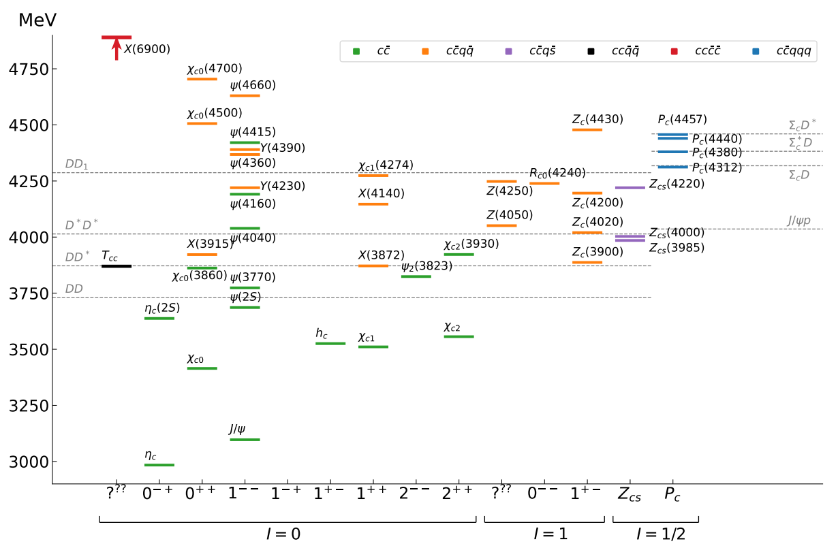
Exotic landscape in $c\overline{c}$
Esposito, AP, Polosa, Phys.Rept. 668
JPAC, PPNP
A host of unexpected resonances have appeared
decaying mostly into charmonium + light Hardly reconciled with usual $q\overline{q}$ pheno
A. Pilloni – Meson decays at EIC
Notes:
2 slides su Zc, a Bes e a Belle
2 slide su tetraquark model: dall’hamiltoniana di Jaffe al calcolo delle masse
1 slide su molecular models, dove sono i carichi? (non in Tornqvist, si in Hanhart, vedere Braaten, citare Nefediev)
2 slides su decay channels, dove si dovrebbe vedere, e a seconda del modello, vedere qualche plot
1 slide su Y(4260), tetraquark? C’è lo strano (si vede la f0)
1 slide su Zc a cleo (anche il neutro)

Slide 6
Pentaquarks
LHCb, PRL 115, 072001
LHCb, PRL 117, 082003
LHCb, PRL 122, 222001
Initially a broad and a narrow state with opposite parities seen in $Λ_{b}→J/ψ p K^{−}$ decay
A higher statistics 1D analysis is able to resolve the fine structure of the $P_{c}(4450)$ peak.
Moreover, a new isolated $P_{c}(4312)$ at the $Σ_{c}^{+}{\overline{D}}^{0}$ threshold appears
The old assignment of quantum numbers might be jeopardized by this new finding
A. Pilloni – Modern Scattering theory and the XYZ phenomena
Notes:
Controlla la parte su Regge

Slide 7
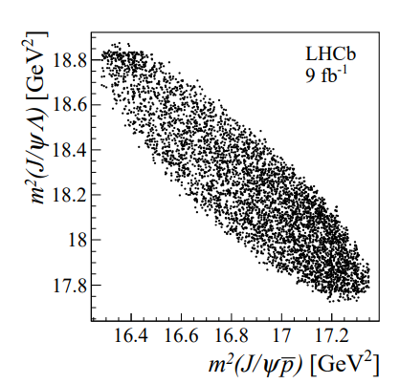
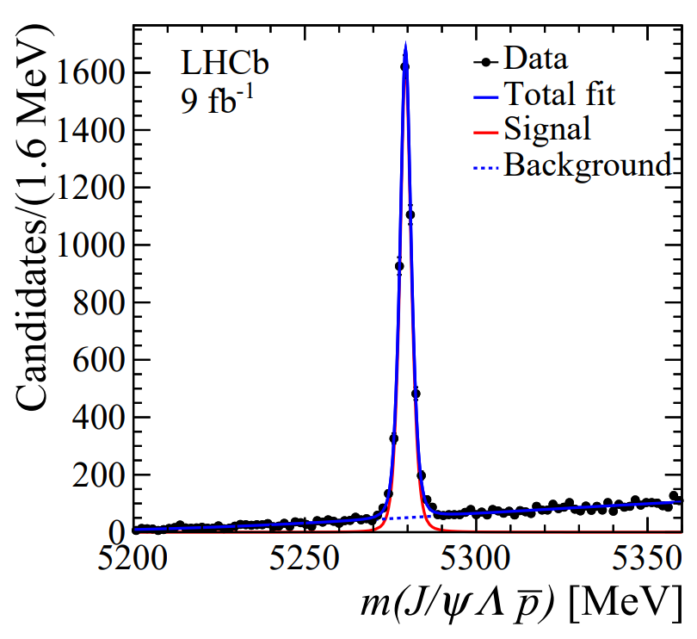
Strange pentaquarks?
LHCb, PRL131, 031901
How about searching for pentaquarks in meson decays?
Phase space is smaller, less stuff going on
$$B^{−}→J/ψ\left(→μ^{+}μ^{−}\right)Λ^{0}\left(→pπ^{−}\right) \overline{p}$$
4k events, 93% purity
A. Pilloni – Modern Scattering theory and the XYZ phenomena
Notes:
Controlla la parte su Regge

Slide 8
Strange pentaquarks?
Bingo! $P_{cs}$!
$$m=4338.2±0.7±0.4 \text{MeV}$$
$$Γ=7.0±1.2±1.3 \text{MeV}$$
It remains to be seen the connections with the nonstrange pentaquarks
No $K^{∗}$ expected in this $Λ^{0}\overline{p}$ mass region
None seen, mostly flat
A. Pilloni – Modern Scattering theory and the XYZ phenomena
Notes:
Controlla la parte su Regge

Slide 9
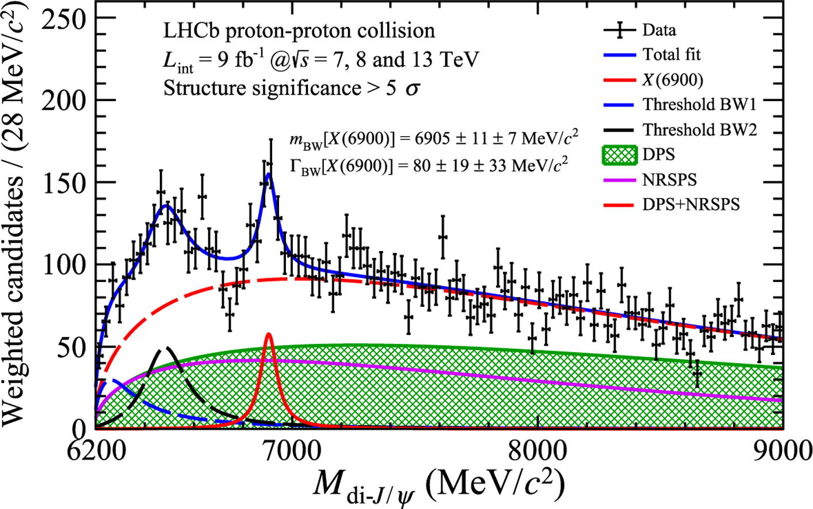
Fully charm: the $X(6900)$
LHCb, Sci.Bull. 65 (2020) 23, 1983
Two structures are seen in the $J/ψ J/ψ$ spectrum
The heavier one is narrower and well assessed
The nature of the lighter one is unclear
A. Pilloni – Modern Scattering theory and the XYZ phenomena
Notes:
Y(4260), M=4263 +- 5, Gamma = 95+-14
D_1(2420)^0, M=2421.3 ±0.6, Gamma =27.1 ±2.7
D_1(2420)^+-, M=2423.4 ±3.1, Gamma =25 ±6
I D_1 hanno J^P = 1^+
La molecola D_1 D sta 22 MeV sotto
Se la Y è D_1 D, il pione lega fortemente, come fa la Y a essere così larga?
Come funziona lo scambio del pione???

Slide 10
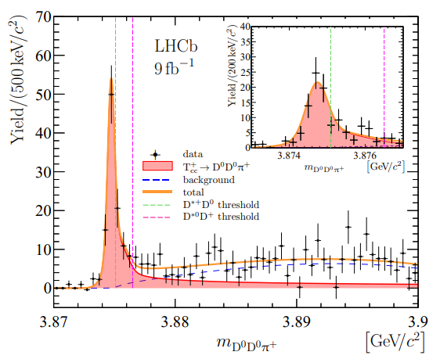
Very open charm: the $T_{cc}^{+}$
LHCb, Nature Phys. 18 7, 751-754
LHCb, Nature Commun. 13 1, 3351
A supernarrow state is seen at the $D^{∗+}D^{0}$ threshold
BW parameters give
$δm_{BW}=−273±61 \text{keV}$
$Γ_{BW}=410±65 \text{keV}$
It cannot mix with ordinary charmonia It does not have lighter open channels
A. Pilloni – Modern Scattering theory and the XYZ phenomena
Notes:
Y(4260), M=4263 +- 5, Gamma = 95+-14
D_1(2420)^0, M=2421.3 ±0.6, Gamma =27.1 ±2.7
D_1(2420)^+-, M=2423.4 ±3.1, Gamma =25 ±6
I D_1 hanno J^P = 1^+
La molecola D_1 D sta 22 MeV sotto
Se la Y è D_1 D, il pione lega fortemente, come fa la Y a essere così larga?
Come funziona lo scambio del pione???

Slide 11
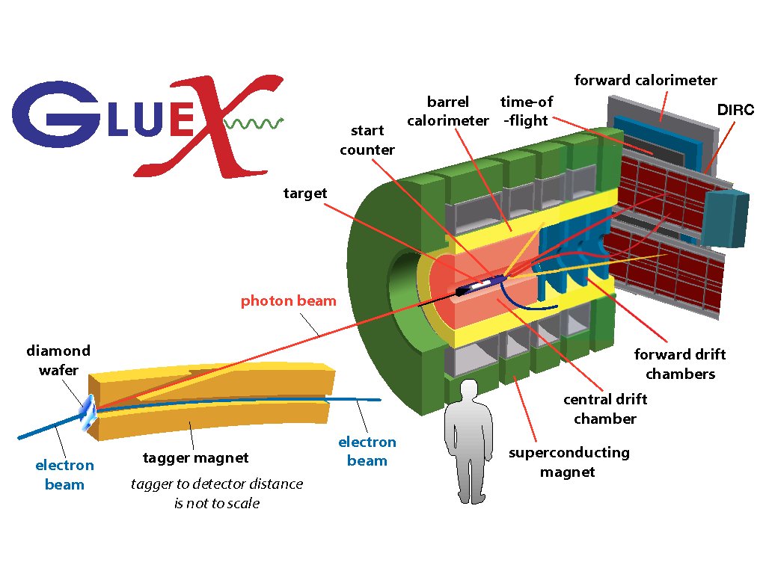
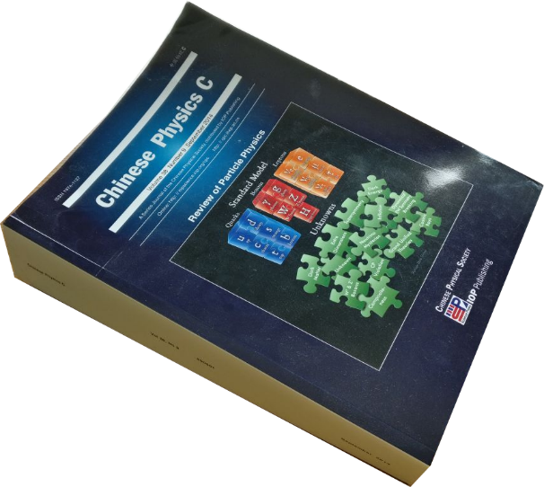
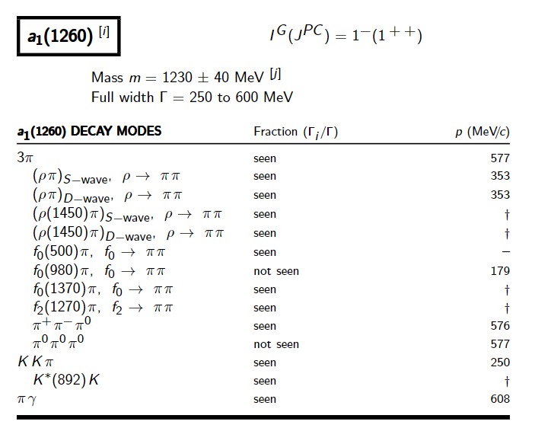
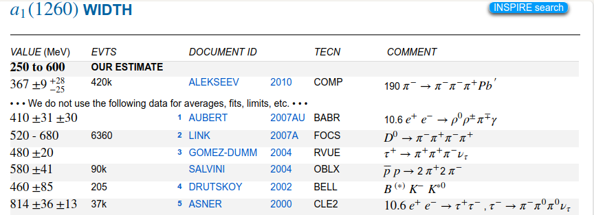
How theorists think of experiments
All the information about hadrons is collected by the Particle Data Group
$$G$$
Changing beam and target, you can change the font
P
D
What theorists see…
What experimentalists present…
A. Pilloni – Modern Scattering theory and the XYZ phenomena

Slide 12
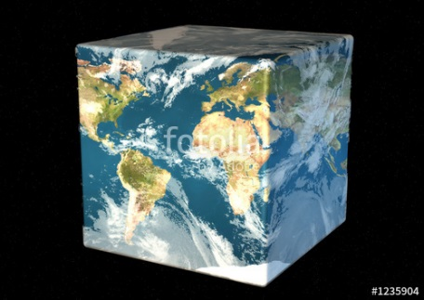
The Richness of the Spectrum
Meson
Baryon
Glueball
Hybrids
Tetraquark
Molecule
Experiment
Data
Amplitude analysis
QCD
Lattice QCD
With great statistics comes great responsibility!
Peter Parker, PhD
For theorists, this is an experimental business
For experimentalists, this is grandma’s recipe
A. Pilloni – Modern Scattering theory and the XYZ phenomena

Slide 13
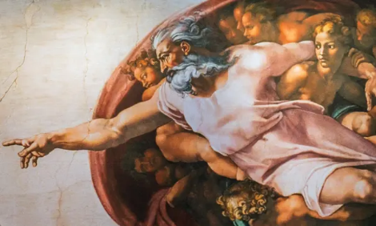
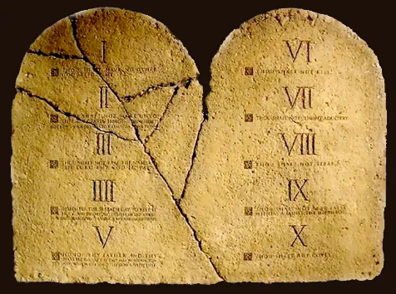
Top-down approach
You are given a model/theory
$$f(s)$$
You calculate the amplitude
You compare with data. Or you don’t.
Predictive power ✓
Physical interpretation ✓ (within the model! ✗) Biased by the input ✗
A. Pilloni – Modern Scattering theory and the XYZ phenomena

Slide 14
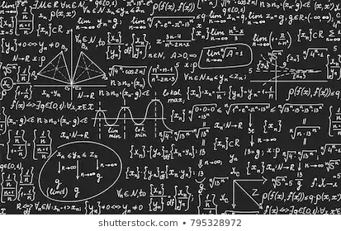
Bottom-up approach
Less predictive power ✗
Some physical interpretation ✗ Minimally biased ✓
You extract physics
You choose a set of generic amplitudes at the hadron level
You start with data
A. Pilloni – Modern Scattering theory and the XYZ phenomena

Slide 15
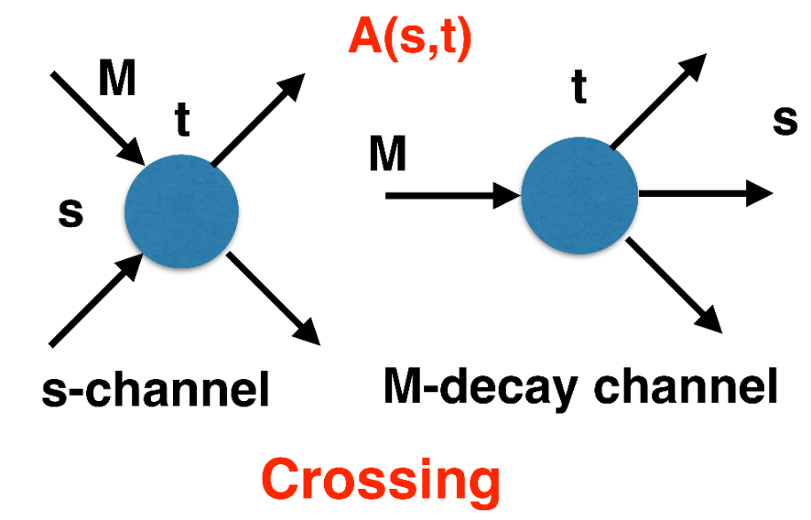
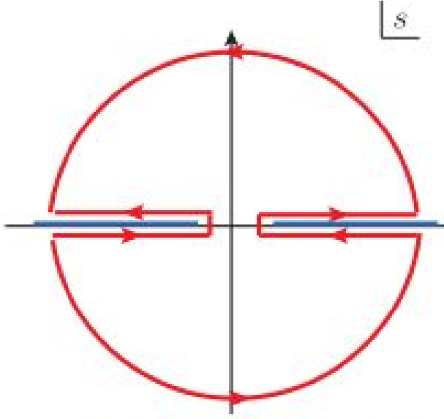
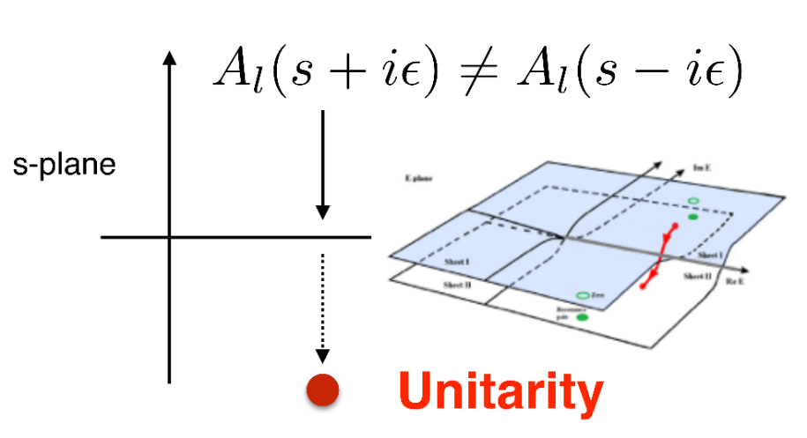
$S$-Matrix principles
$$t_{l}\left(s\right)=\lim_{ε→0}t_{l}(s+iε)⁡$$
Analyticity
$$\text{Im} t_{l}=ρ_{l}{\left|t_{l}\right|}^{2} ⁡$$
These are constraints the amplitudes have to satisfy, but do not fix the dynamics
They can be imposed with an increasing amount of rigor, to extract robust physics information
The «background» phenomena can be effectively parameterized in a controlled way
+ Lorentz, discrete & global symmetries
A. Pilloni – Modern Scattering theory and the XYZ phenomena
Notes:
Controlla la parte su Regge

Slide 16
Crossing symmetry
$$π^{+}$$
$$K^{+}$$
$$π^{+}$$
$$K^{−}$$
$$π^{+}$$
$$K^{+}$$
$$π^{−}$$
$$K^{−}$$
$$π^{+}$$
$$K^{−}$$
$$π^{+}$$
$$K^{+}$$
All these processes are not independent, but are described by the same amplitude!
Simplification – Complication!
It also relates a $1→3$ decay to $2→2$ scattering
A. Pilloni – Modern Scattering theory and the XYZ phenomena
Notes:
Controlla la parte su Regge

Slide 17
Analyticity
Complex analytic functions are extremely regular and smooth
Integrals are easy (Cauchy theorem)
If you know the function in a region, you can extend it in a unique way everywhere
Complex functions are characterized by its non-analyticities (poles and cuts)
Analyticity
If I turn on an interaction at $t=0$, and I want nothing happens f$or t<0$, I cannot have singularities in the upper plane
$$f\left(t\right)=\int_{−∞}^{+∞}{e^{−iωt}f\left(ω\right) dω}=2πi\sum_{>/<}{{\text{Res}}_{\text{i}} }$$
A. Pilloni – Modern Scattering theory and the XYZ phenomena
Notes:
Controlla la parte su Regge

Slide 18
Unitarity
$S$ is the scattering operator ($∝$ time evolution from $−∞$ to $+∞$)
We isolate the «nothing happens» part $S=1+i A$
$$\text{Im} A_{i→f}=\frac{1}{2}\sum_{n}{A_{i→n}A_{f→n}^{†}}$$
$$SS^{†}=1$$
Below threshold there are no available states in the sum, so $\text{Im} A(E<E_{\text{thr}})=0$
If a function is nonsingular on the real axis, it admits an analytic continuation using Schwartz reflection principle, $A\left(z^{∗}\right)=A^{∗}(z)$. Above threshold close to the real axis,
$$\text{Im} A\left(E+i ε\right)=\frac{1}{2i}\left[A\left(E+iε\right)−A^{∗}(E+iε)\right]=\frac{1}{2i}\left[A\left(E+iε\right)−A(E−iε)\right]>0$$
So a cut opens on the real axis at threshold
A. Pilloni – Modern Scattering theory and the XYZ phenomena
Notes:
Controlla la parte su Regge

Slide 19
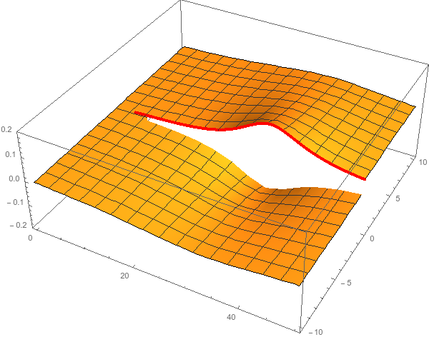
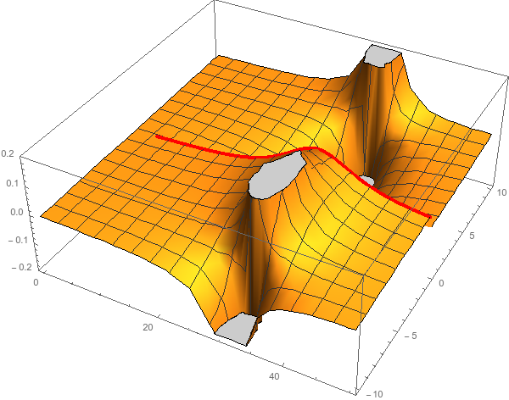
Unitarity & Pole hunting
Unitarity creates a branch cut on the real axis, two sheets continuosly connected
I sheet
II sheet
Finding resonances means writing analytic amplitude, and hunting for poles in the complex plane
A. Pilloni – Modern Scattering theory and the XYZ phenomena
Notes:
Controlla la parte su Regge

Slide 20
Partial waves in $2→2$ scattering
Let us consider the elastic scattering of two equal mass spinless particles
$s={\left(p_{1}+p_{2}\right)}^{2}=$ energy squared
$t={\left(p_{1}−p_{3}\right)}^{2}∝\cos{θ}=$ momentum transferred
$$3$$
$$1$$
$$θ$$
$$2$$
$$4$$
Legendre polynomial
$$A\left(s,t\right)=\sum_{l}{A_{l}\left(s\right)P_{l}(\cos{θ})}$$
$$\text{Im} A_{l}\left(s\right)=ρ\left(s\right){\left|A_{l}\left(s\right)\right|}^{2}$$
Phase space (known)
Partial wave
Partial waves diagonalize unitarity: each one statisfy a separate equation Each partial wave has definite orbital angular momentum = spin
Remember: I can only measure cross section (amplitude squared)
A. Pilloni – Modern Scattering theory and the XYZ phenomena

Slide 21
Bound and virtual states
Decreasing the potential strength, the pole reaches threshold
The pole jumps on the 2nd sheet (dineutron), it becomes a virtual state
Example from $pn$ scattering Bound state on the real axis 1st sheet (deuteron)
$$V(r)$$
$$\text{Im} E$$
$$r$$
$$V$$
Deuteron
$$\text{Re} E$$
$${}_{}^{1}S$$
Deuteron pole
Dineutron pole
$${}_{}^{3}S$$
A. Pilloni – Modern Scattering theory and the XYZ phenomena
Notes:
Controlla la parte su Regge

Slide 22
Coupled channels
$ρ_{ψp}(s):$ +
$ρ_{ΣD}(s):$ +
$ρ_{ψp}(s):$ −
$ρ_{ΣD}(s):$ +
$ρ_{ψp}(s):$ −
$ρ_{ΣD}(s):$ −
$ρ_{ψp}(s):$ +
$ρ_{ΣD}(s):$ −
I sheet
II sheet
III sheet
IV sheet
Virtual state
$$J/ψ p$$
$$Σ_{c}^{+}\overline{D^{0}}$$
?
?
Bound state
Compact state
Diving under the first cut one access the II sheet, where generally bound states appear
Diving under both cuts one access the III sheet, where generally compact states appear
Diving twice one access the IV sheet, where virtual states appear poles only relevant close to the higher threshold
Data live above the real axis on the I sheet
A. Pilloni – Modern Scattering theory and the XYZ phenomena
Notes:
Controlla la parte su Regge

Slide 23
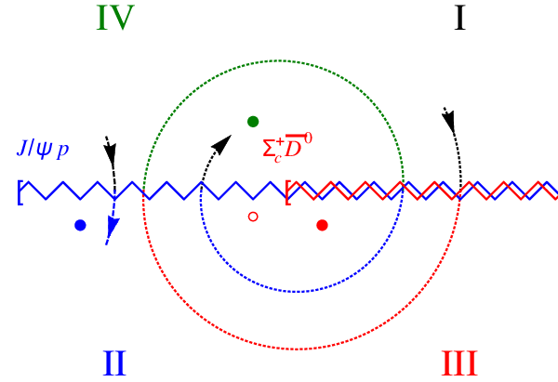
Coupled channels
Virtual state
Bound state
Resonance
A. Pilloni – Modern Scattering theory and the XYZ phenomena
Notes:
Controlla la parte su Regge

Slide 24
New pentaquarks discovered
The lowest $P_{c}(4312)$ appears as an isolated peak at the $Σ_{c}^{+}{\overline{D}}^{0}$ threshold
A detailed study of the lineshape provides insight on its nature
Bottom-up: DON’T YOU DARE describing everything!!! Focus on the peak region
A. Pilloni – Modern Scattering theory and the XYZ phenomena
Notes:
Controlla la parte su Regge

Slide 25
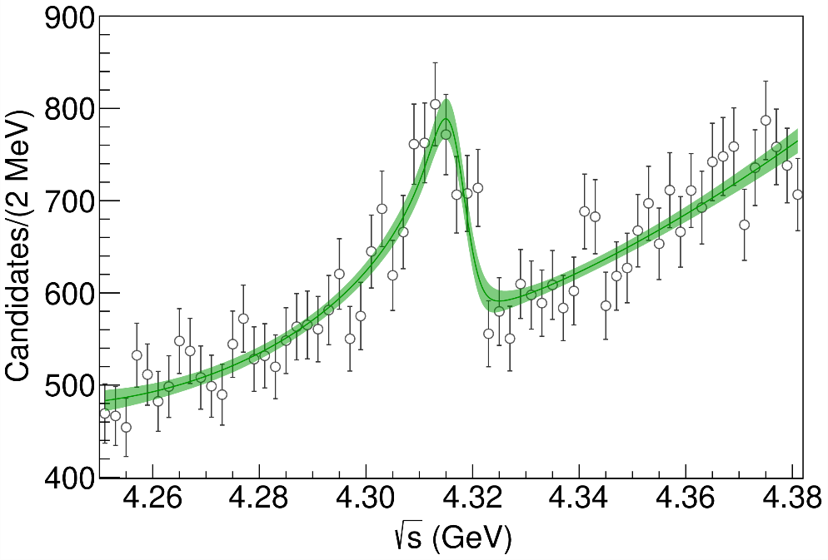
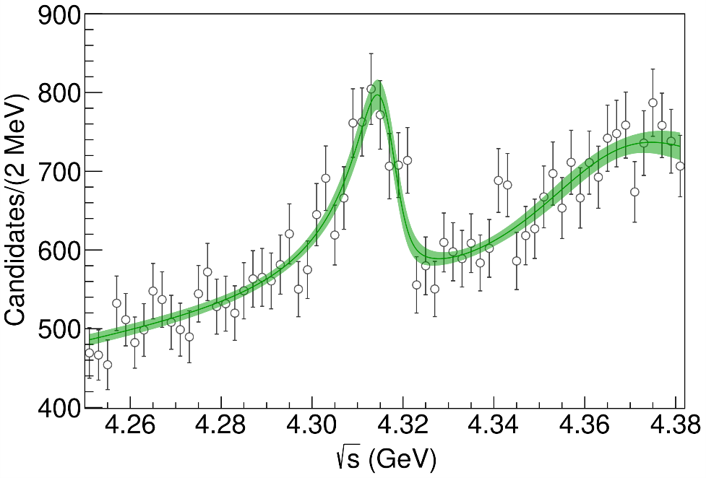
Minimal(istic) model for $P_{c}(4312)$
( data)
Fernandez-Ramirez, AP et al. (JPAC), PRL 123, 092001
Effective range expansion We can set $c_{ii}=0$ to reduce to the scattering length approximation
$$c_{ii}=0$$
Finite $c_{ii}$
A. Pilloni – Modern Scattering theory and the XYZ phenomena
Notes:
2 slides su Zc, a Bes e a Belle
2 slide su tetraquark model: dall’hamiltoniana di Jaffe al calcolo delle masse
1 slide su molecular models, dove sono i carichi? (non in Tornqvist, si in Hanhart, vedere Braaten, citare Nefediev)
2 slides su decay channels, dove si dovrebbe vedere, e a seconda del modello, vedere qualche plot
1 slide su Y(4260), tetraquark? C’è lo strano (si vede la f0)
1 slide su Zc a cleo (anche il neutro)

Slide 26
Minimal(istic) model for $P_{c}(4312)$
Effective range expansion We can set $c_{ii}=0$ to reduce to the scattering length approximation
$$c_{ii}=0$$
Finite $c_{ii}$
A. Pilloni – Modern Scattering theory and the XYZ phenomena
Notes:
2 slides su Zc, a Bes e a Belle
2 slide su tetraquark model: dall’hamiltoniana di Jaffe al calcolo delle masse
1 slide su molecular models, dove sono i carichi? (non in Tornqvist, si in Hanhart, vedere Braaten, citare Nefediev)
2 slides su decay channels, dove si dovrebbe vedere, e a seconda del modello, vedere qualche plot
1 slide su Y(4260), tetraquark? C’è lo strano (si vede la f0)
1 slide su Zc a cleo (anche il neutro)

Slide 27
Minimal(istic) model for $P_{c}(4312)$
Effective range expansion We can set $c_{ii}=0$ to reduce to the scattering length approximation
Points to a virtual state
$$c_{ii}=0$$
Finite $c_{ii}$
A. Pilloni – Modern Scattering theory and the XYZ phenomena
Notes:
2 slides su Zc, a Bes e a Belle
2 slide su tetraquark model: dall’hamiltoniana di Jaffe al calcolo delle masse
1 slide su molecular models, dove sono i carichi? (non in Tornqvist, si in Hanhart, vedere Braaten, citare Nefediev)
2 slides su decay channels, dove si dovrebbe vedere, e a seconda del modello, vedere qualche plot
1 slide su Y(4260), tetraquark? C’è lo strano (si vede la f0)
1 slide su Zc a cleo (anche il neutro)

Slide 28
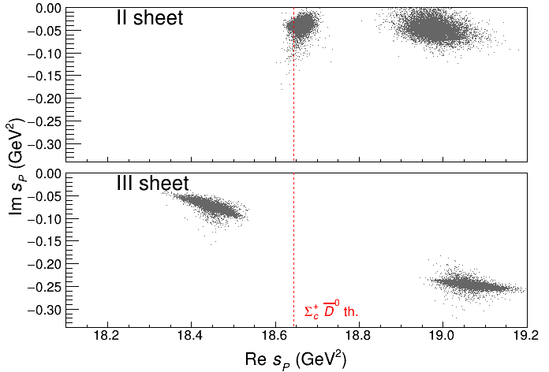
Minimal(istic) model for $P_{c}(4312)$
Effective range expansion We can set $c_{ii}=0$ to reduce to the scattering length approximation
Points to a virtual state
Doesn’t point to a resonance
$$c_{ii}=0$$
Finite $c_{ii}$
A. Pilloni – Modern Scattering theory and the XYZ phenomena
Notes:
2 slides su Zc, a Bes e a Belle
2 slide su tetraquark model: dall’hamiltoniana di Jaffe al calcolo delle masse
1 slide su molecular models, dove sono i carichi? (non in Tornqvist, si in Hanhart, vedere Braaten, citare Nefediev)
2 slides su decay channels, dove si dovrebbe vedere, e a seconda del modello, vedere qualche plot
1 slide su Y(4260), tetraquark? C’è lo strano (si vede la f0)
1 slide su Zc a cleo (anche il neutro)

Slide 29
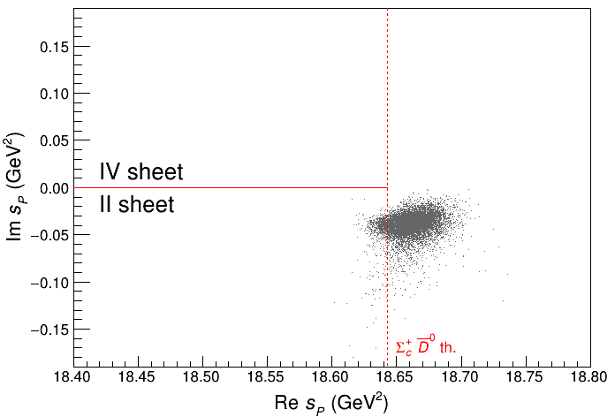
Minimal(istic) model for $P_{c}(4312)$
Effective range expansion We can set $c_{ii}=0$ to reduce to the scattering length approximation
Points to a virtual state
Doesn’t point to a resonance
$$c_{ii}=0$$
Finite $c_{ii}$
A. Pilloni – Modern Scattering theory and the XYZ phenomena
Notes:
2 slides su Zc, a Bes e a Belle
2 slide su tetraquark model: dall’hamiltoniana di Jaffe al calcolo delle masse
1 slide su molecular models, dove sono i carichi? (non in Tornqvist, si in Hanhart, vedere Braaten, citare Nefediev)
2 slides su decay channels, dove si dovrebbe vedere, e a seconda del modello, vedere qualche plot
1 slide su Y(4260), tetraquark? C’è lo strano (si vede la f0)
1 slide su Zc a cleo (anche il neutro)

Slide 30
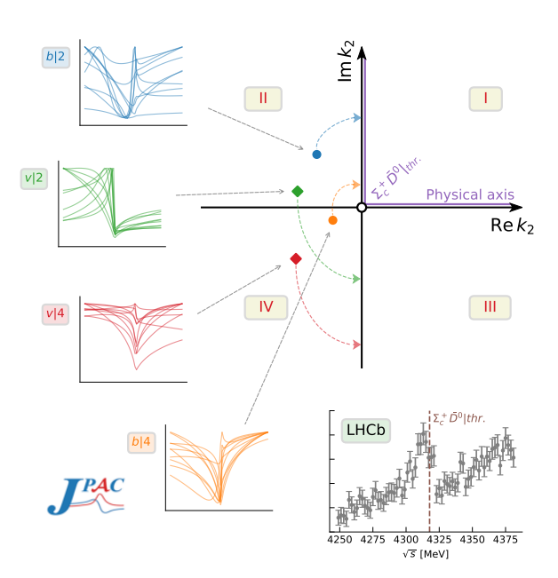
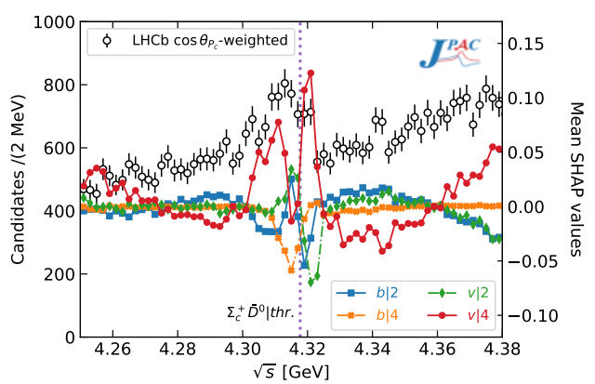
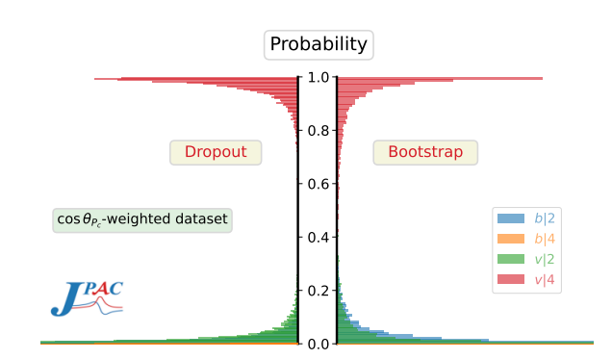
Minimal(istic) model with ANN
Ng, et al. (JPAC), PRD 105, L091501
Same conclusion reached if the analysis is performed with a Deep Neural Network
The peak region has the largest impact for the decision
Highest probability for a virtual state in the IV sheet
A. Pilloni – Modern Scattering theory and the XYZ phenomena
Notes:
2 slides su Zc, a Bes e a Belle
2 slide su tetraquark model: dall’hamiltoniana di Jaffe al calcolo delle masse
1 slide su molecular models, dove sono i carichi? (non in Tornqvist, si in Hanhart, vedere Braaten, citare Nefediev)
2 slides su decay channels, dove si dovrebbe vedere, e a seconda del modello, vedere qualche plot
1 slide su Y(4260), tetraquark? C’è lo strano (si vede la f0)
1 slide su Zc a cleo (anche il neutro)

Slide 31
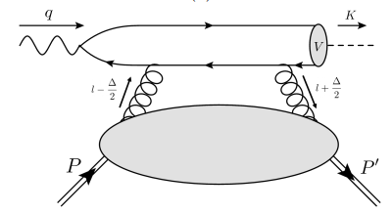
$J/ψ$ photoproduction at threshold
The common lore is that the study of vector quarkonium photoproduction at threshold is directly related to nucleon matrix elements
GPD
Assumptions:
Factorization proof for timelike DVCS can be extended at threshold as the heavy quark mass plays the role of a hard scale
The top vertex contains the trivial $γ$-$ψ$ coupling ${\left|ψ\left(0\right)\right|}^{2}$
The exchange of anything but gluons is (OZI-, mass-) suppressed
The exchange is dynamically dominated by gluons carrying $J=2$
Then one extracts matrix element of the energy momentum tensor $\left\langle p′ | T_{μν}(0) | p\right\rangle$
A. Pilloni – Modern Scattering theory and the XYZ phenomena

Slide 32
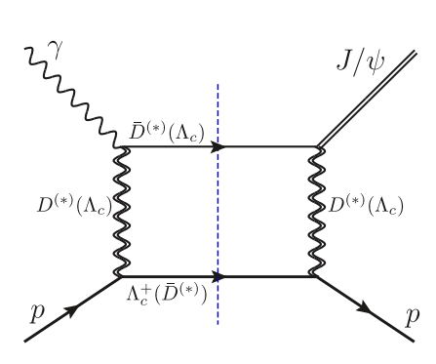
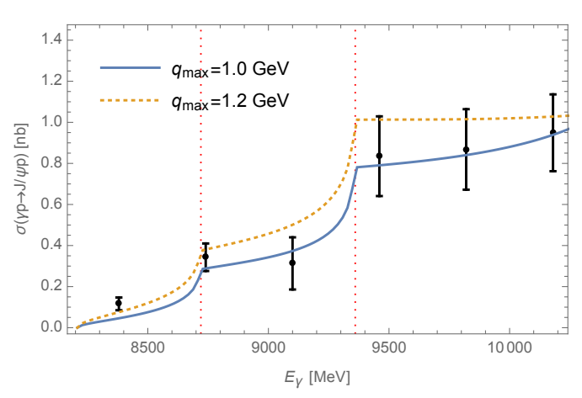
Role of open charm
Highly off-shell t-channel propagators
Du et al. Eur.Phys.J.C 80, 11, 1053
The role of intermediate open charm thresholds has been pointed out,
Maybe «all that glitters is not glue» ….
Calculation based on EFT and known couplings, S-wave saturates the cross section
A. Pilloni – Modern Scattering theory and the XYZ phenomena
Notes:
2 slides su Zc, a Bes e a Belle
2 slide su tetraquark model: dall’hamiltoniana di Jaffe al calcolo delle masse
1 slide su molecular models, dove sono i carichi? (non in Tornqvist, si in Hanhart, vedere Braaten, citare Nefediev)
2 slides su decay channels, dove si dovrebbe vedere, e a seconda del modello, vedere qualche plot
1 slide su Y(4260), tetraquark? C’è lo strano (si vede la f0)
1 slide su Zc a cleo (anche il neutro)

Slide 33
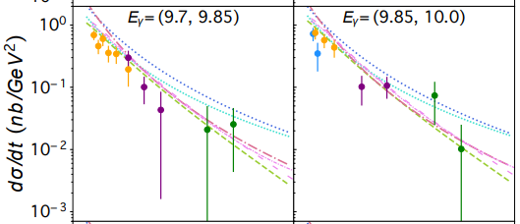
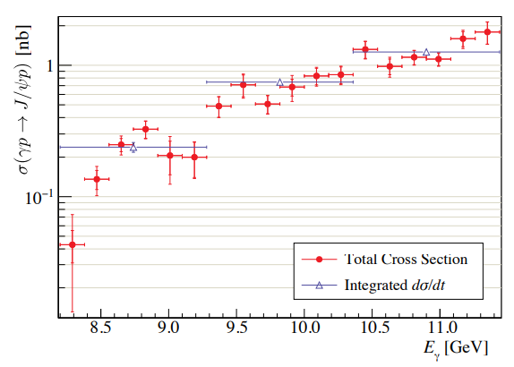
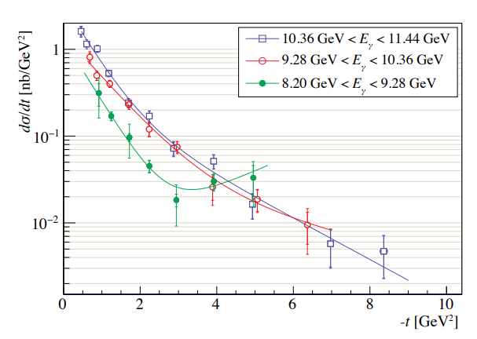
$J/ψ$ photoproduction at threshold
Nature 615, 813
Cusp at the $Λ_{c}\overline{D^{∗}}$ treshold
PRC108, 025201
A. Pilloni – Modern Scattering theory and the XYZ phenomena

Slide 34
Unitary reanalysis
Winney et al. PRD108, 054018
Differential and total cross sections are fitted with a unitary model
In lack of polarization observables and SDME, only orbital angular momentum is considered (spinless approx.)
Truncated sum of PWs, $ℓ≤3$
The dominant S-wave can include coupled channels, for higher waves cusps are suppressed and there is no point
A. Pilloni – Modern Scattering theory and the XYZ phenomena

Slide 35
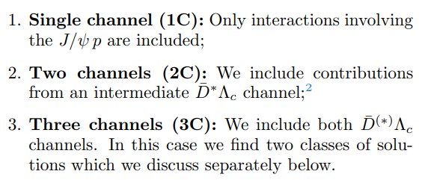
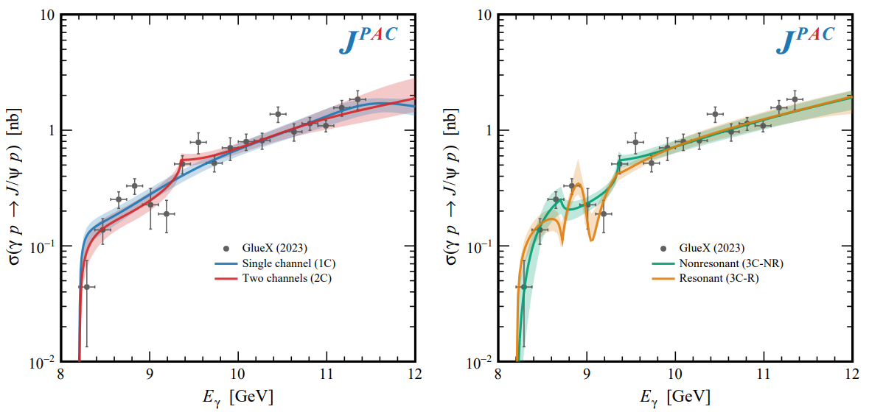
Total cross section
A. Pilloni – Modern Scattering theory and the XYZ phenomena

Slide 36
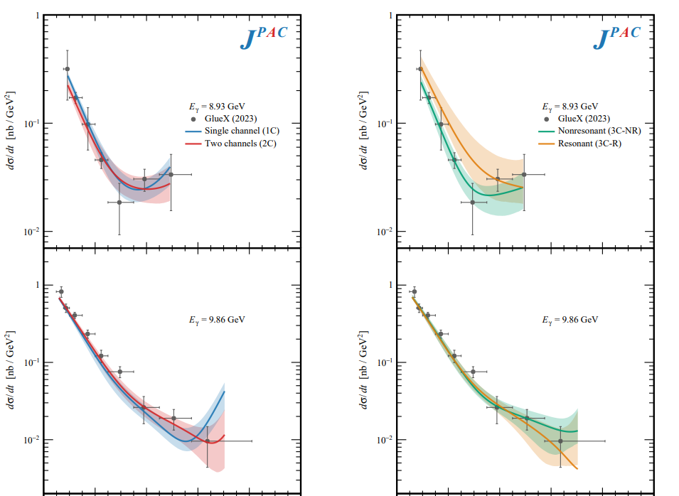
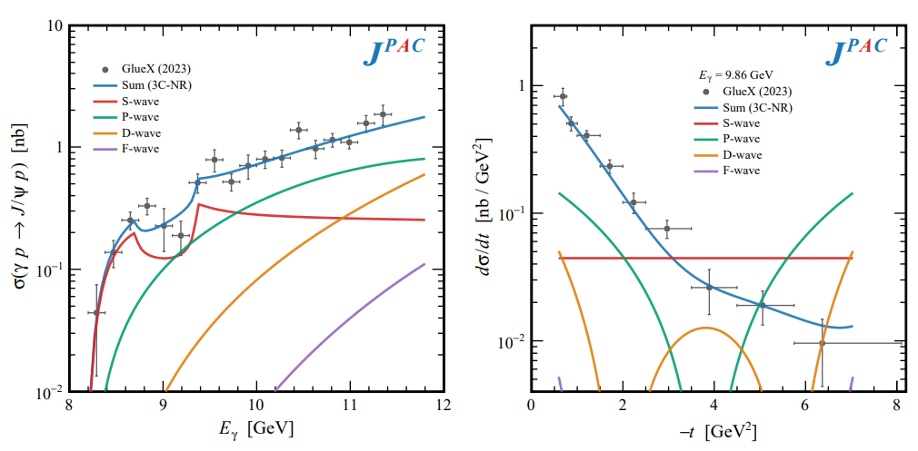
Differential cross section
This is realized with the interference of various waves, - constructive in the forward direction - distructive in the backward direction because of the Legendre polynomials
Good hierarchy between waves
A. Pilloni – Modern Scattering theory and the XYZ phenomena

Slide 37
Contribution of open charm
Naively Wilk’s theorem says the single channel is unfavored at $3.7σ$
(no look elsewhere etc.),
indication but not the end of the story
Contribution of open charm $>25\%$ at 90% CL
A. Pilloni – Modern Scattering theory and the XYZ phenomena

Slide 38
Vector Meson Dominance
Since unitary model parametrize separately the production and scattering amplitude, one can compare with the predictions of VMD
$$γ$$
$$ψ$$
$$ψ$$
$$ψ$$
$$F\left(s,t\right)=$$
$=g_{γψ}×$
But $G\left(s_{\text{th}}\right)=0$
$$p$$
$$p$$
$$p$$
$$p$$
The value of the scattering amplitude at threshold is called scattering length
According to VMD, a small photoproduction cross sections implies a small scattering length O(1am)
With the unitary model, the value of the amplitude at threshold is an unrelated parameter, the scattering length enters with the energy dependence
A. Pilloni – Modern Scattering theory and the XYZ phenomena

Slide 39
Vector Meson Dominance
VMD badly excluded, except for the poorly constrained 3C-R model
Scattering lengths generally of O(1fm), but smaller ones are not excluded
Crucial to constrain better these fits by measuring open charm final states
A. Pilloni – Modern Scattering theory and the XYZ phenomena

Slide 40
Conclusions
Bottom-up approaches are important!
They allow us to get the most out of high statistics data!
The study of analytic stuctrures offer insights ino the nature of resonances
Needs rigorous methods, as well as fantasy
Thank you!
A. Pilloni – The importance of an earnest amplitude
Notes:
2 slides su Zc, a Bes e a Belle
2 slide su tetraquark model: dall’hamiltoniana di Jaffe al calcolo delle masse
1 slide su molecular models, dove sono i carichi? (non in Tornqvist, si in Hanhart, vedere Braaten, citare Nefediev)
2 slides su decay channels, dove si dovrebbe vedere, e a seconda del modello, vedere qualche plot
1 slide su Y(4260), tetraquark? C’è lo strano (si vede la f0)
1 slide su Zc a cleo (anche il neutro)

Slide 41
Notes:
2 slides su Zc, a Bes e a Belle
2 slide su tetraquark model: dall’hamiltoniana di Jaffe al calcolo delle masse
1 slide su molecular models, dove sono i carichi? (non in Tornqvist, si in Hanhart, vedere Braaten, citare Nefediev)
2 slides su decay channels, dove si dovrebbe vedere, e a seconda del modello, vedere qualche plot
1 slide su Y(4260), tetraquark? C’è lo strano (si vede la f0)
1 slide su Zc a cleo (anche il neutro)

Slide 42
Backup

Slide 43
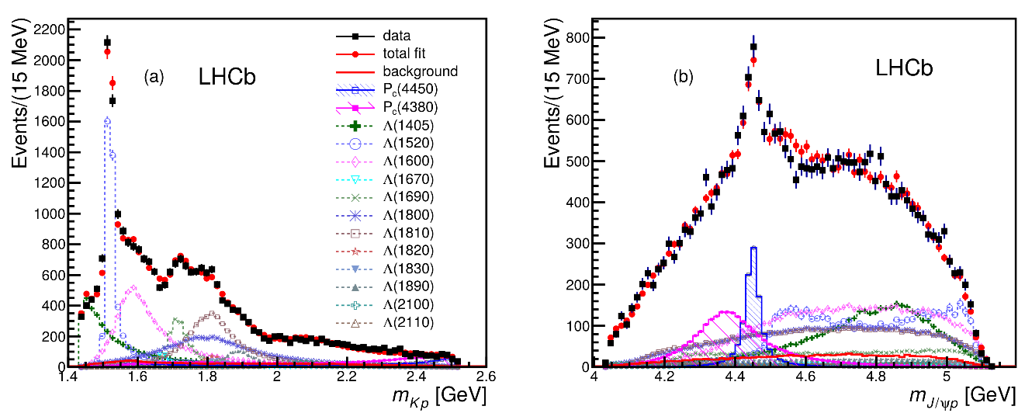
Pentaquarks!
LHCb, PRL 115, 072001
LHCb, PRL 117, 082003
Two states seen in $Λ_{b}→\left(J/ψ p\right) K^{−}$,
evidence in $Λ_{b}→\left(J/ψ p\right) π^{−}$
$$M_{1}=4380±8±29 \text{MeV} \\ Γ_{1}=205±18±86 \text{MeV}$$
$$M_{2}=4449.8±1.7±2.5 \text{MeV} \\ Γ_{2}=39±5±19 \text{MeV}$$
Quantum numbers $$J^{P}=\left({\frac{3}{2}}^{−},{\frac{5}{2}}^{+}\right) \text{or}\left({\frac{3}{2}}^{+},{\frac{5}{2}}^{−}\right)\text{or}\left({\frac{5}{2}}^{+},{\frac{3}{2}}^{−}\right)$$
Opposite parities needed for the interference to correctly describe angular distributions, low mass region contaminated by $Λ^{∗}$ (model dependence?)
No obvious threshold nearby
A. Pilloni – Modern Scattering theory and the XYZ phenomena
Notes:
Y(4260), M=4263 +- 5, Gamma = 95+-14
D_1(2420)^0, M=2421.3 ±0.6, Gamma =27.1 ±2.7
D_1(2420)^+-, M=2423.4 ±3.1, Gamma =25 ±6
I D_1 hanno J^P = 1^+
La molecola D_1 D sta 22 MeV sotto
Se la Y è D_1 D, il pione lega fortemente, come fa la Y a essere così larga?
Come funziona lo scambio del pione???

Slide 44
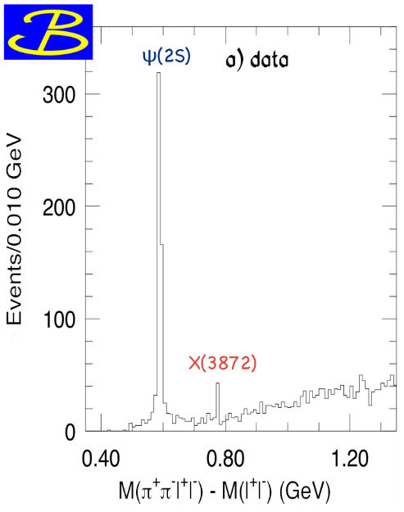
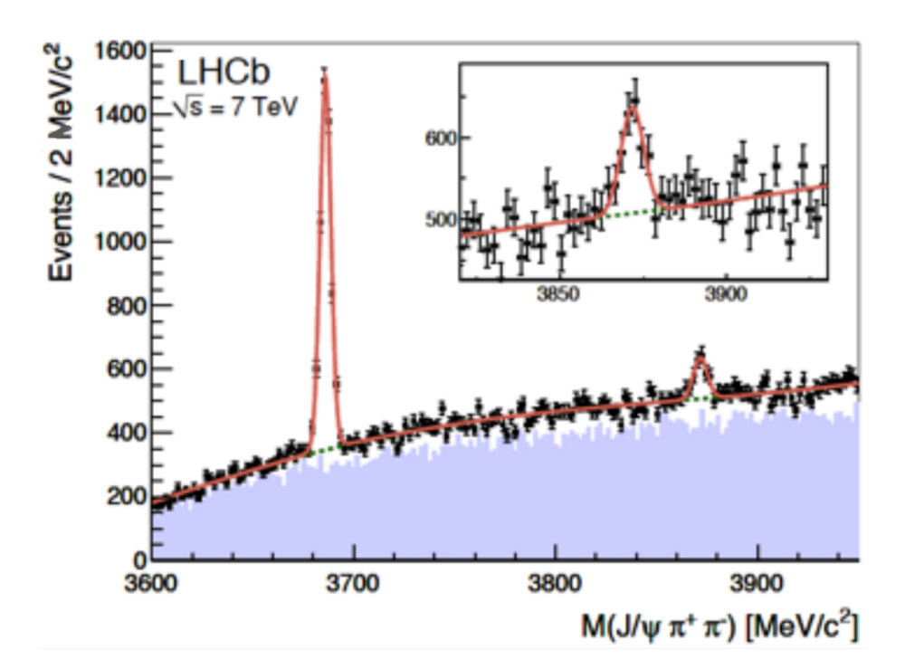
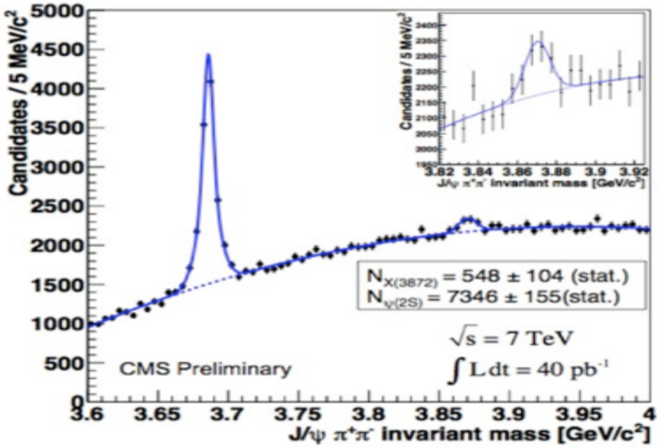
$X(3872)$
Discovered in $B→K X→K J/ψ ππ$
Quantum numbers $1^{++}$
Very close to $DD^{∗}$ threshold
Too narrow for an above-treshold charmonium
Isospin violation too big $\frac{Γ\left(X→J/ψ ω\right)}{Γ\left(X→J/ψ ρ\right)}\sim 1.1±0.4$
Mass prediction not compatible with $χ_{c1}(2P)$
$M=3871.65±0.06$MeV
$$M_{X}−M_{DD^{∗}}=−3±192 \text{keV}$$
$Γ=1.19±0.2\text{1 }\text{MeV}$
A. Pilloni – Modern Scattering theory and the XYZ phenomena

Slide 45
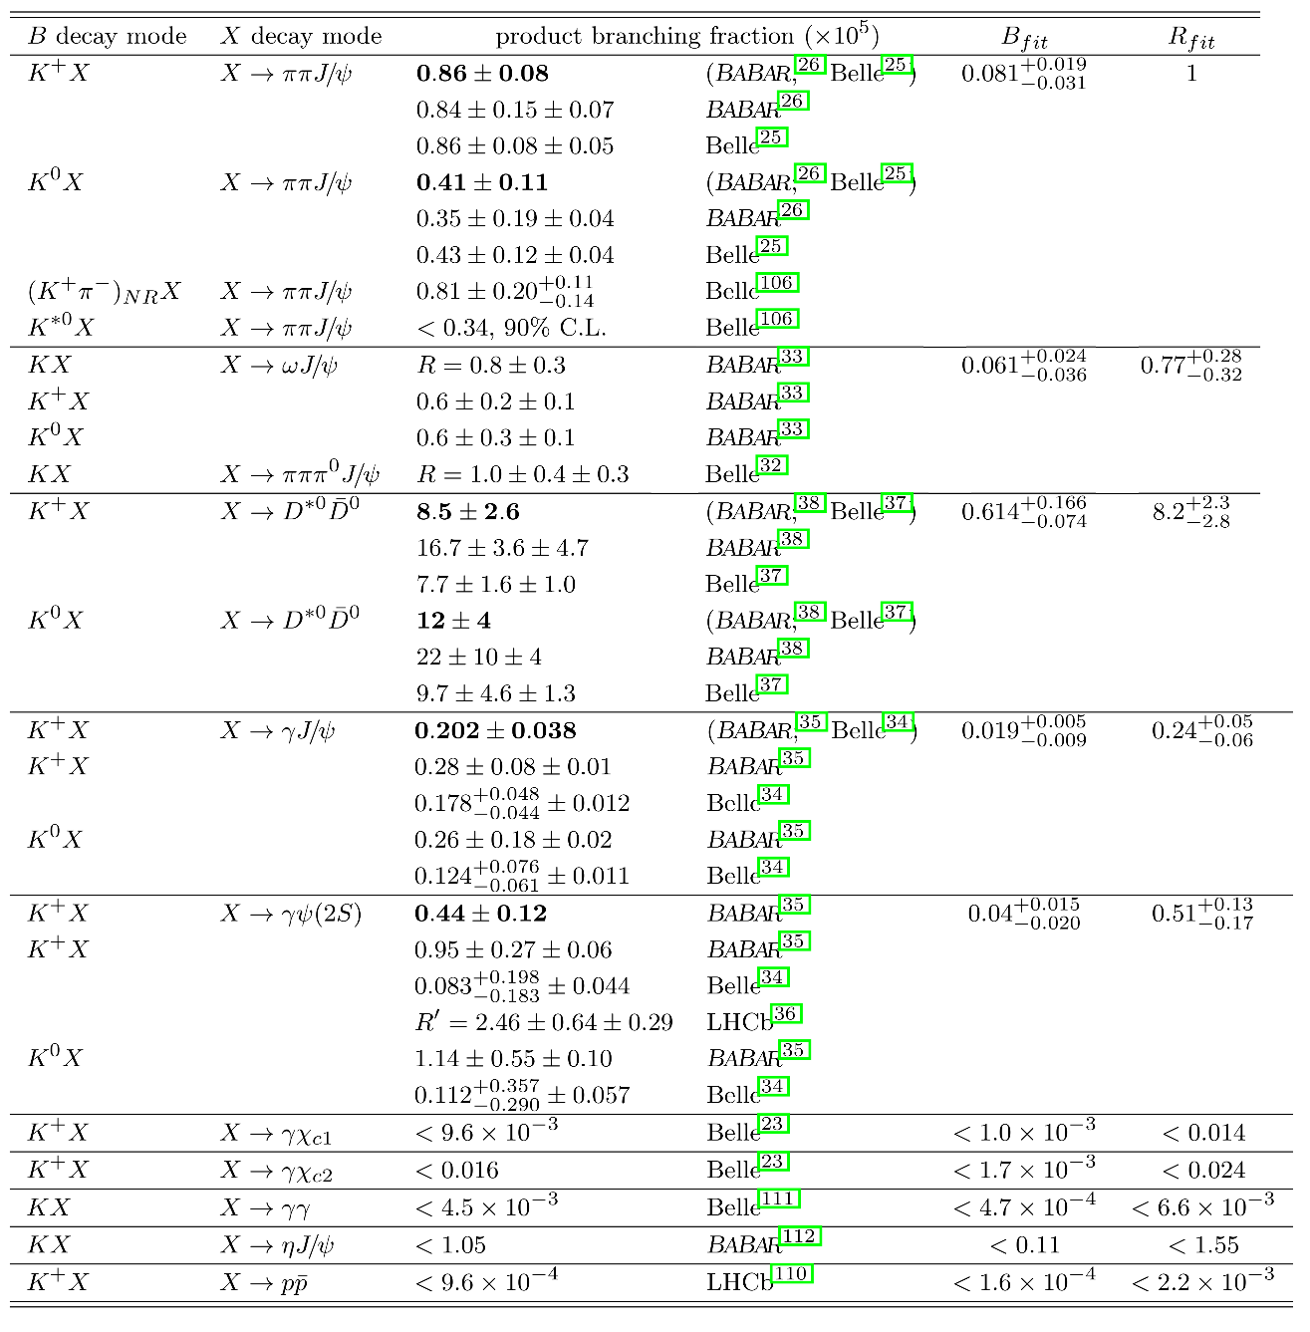
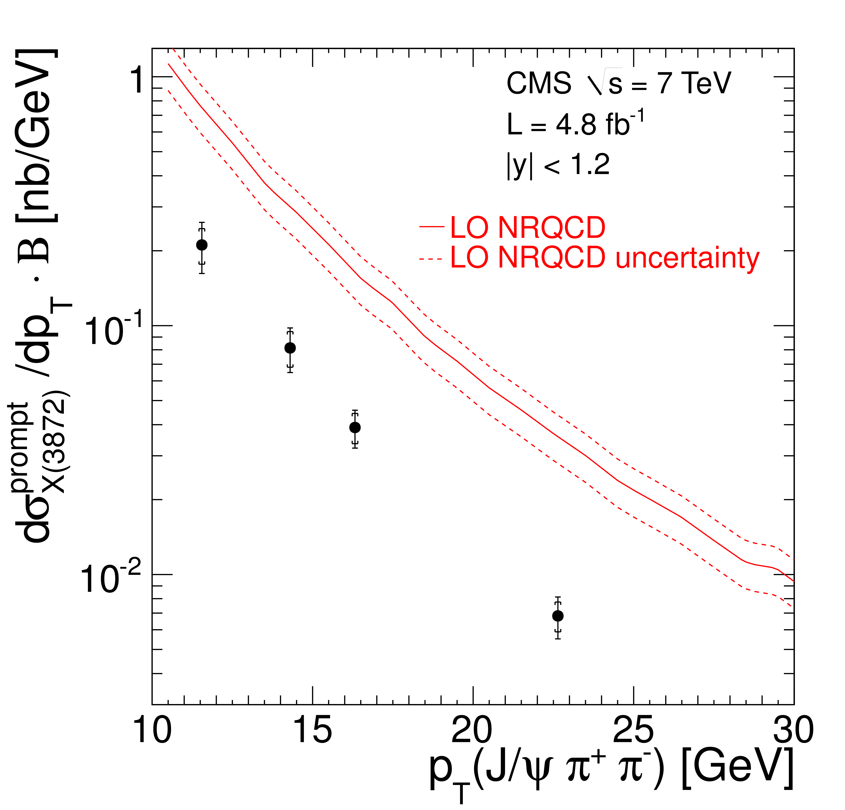
$X(3872)$
Large prompt production at hadron colliders
$$σ_{B}/σ_{TOT}=\left(26.3±2.3±1.6\right)\%$$
$$σ_{PR}×B(X→J/ψππ)=\left(1.06±0.11±0.15\right) \text{nb}$$
CMS, JHEP 1304, 154
A. Pilloni – Modern Scattering theory and the XYZ phenomena

Slide 46
Broad exotics in $B$ decays
Lots of new exotics have been seen by LHCb with multidimensional amplitude analyses of $B→$ 3+ body
Most of these are broad, and the precise determination can crucially depend on the amplitude model, so that the resonant nature cannot be assessed with the same strong statements as for the narrow guys
A. Pilloni – Modern Scattering theory and the XYZ phenomena
Notes:
Y(4260), M=4263 +- 5, Gamma = 95+-14
D_1(2420)^0, M=2421.3 ±0.6, Gamma =27.1 ±2.7
D_1(2420)^+-, M=2423.4 ±3.1, Gamma =25 ±6
I D_1 hanno J^P = 1^+
La molecola D_1 D sta 22 MeV sotto
Se la Y è D_1 D, il pione lega fortemente, come fa la Y a essere così larga?
Come funziona lo scambio del pione???

Slide 47
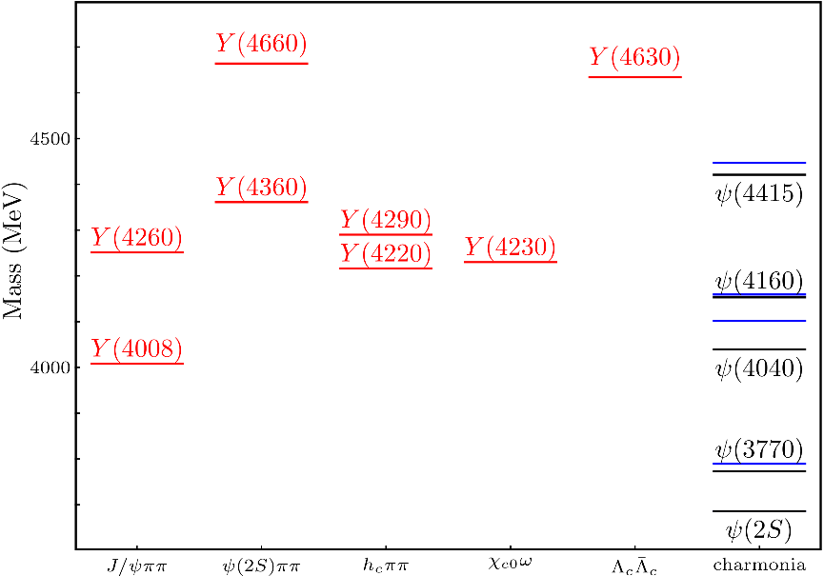
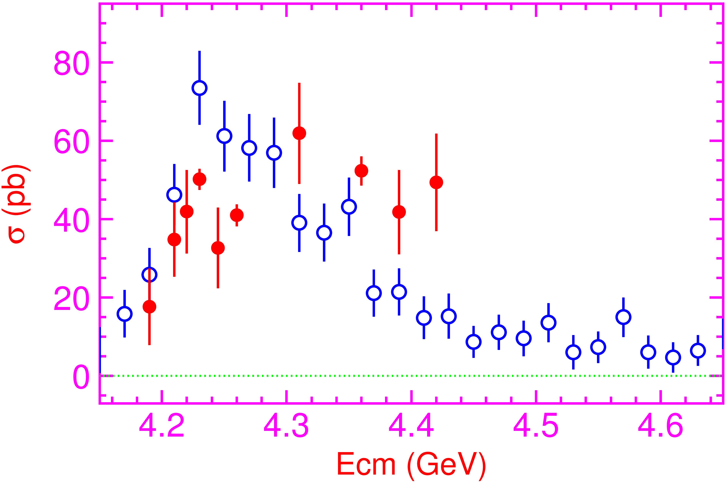
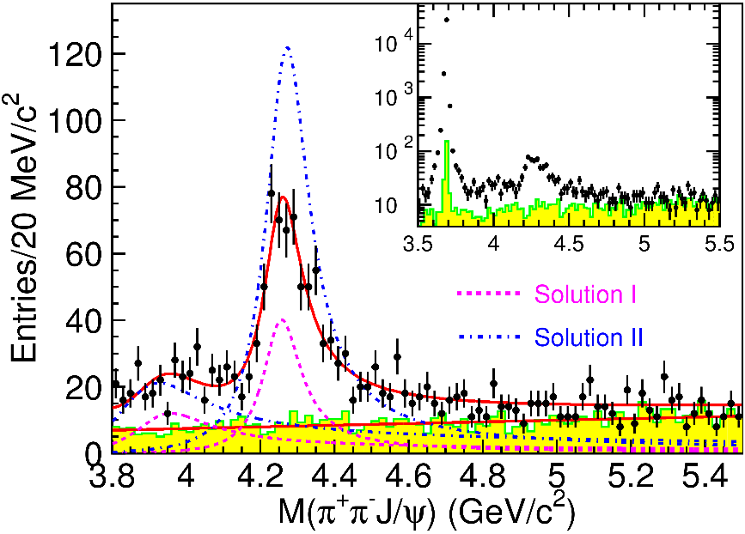
Vector $Y$ states
Lots of unexpected ${J^{PC}=1}^{−−}$ states found in ISR/direct production (and nowhere else!)
Seen in few final states, mostly $J/ψ ππ$ and $ψ\left(2S\right) ππ$
Not seen decaying into open charm pairs
Large HQSS violation
Belle $J/ψππ$
BES $h_{c}ππ$
A. Pilloni – Modern Scattering theory and the XYZ phenomena
Notes:
Y(4260), M=4263 +- 5, Gamma = 95+-14
D_1(2420)^0, M=2421.3 ±0.6, Gamma =27.1 ±2.7
D_1(2420)^+-, M=2423.4 ±3.1, Gamma =25 ±6
I D_1 hanno J^P = 1^+
La molecola D_1 D sta 22 MeV sotto
Se la Y è D_1 D, il pione lega fortemente, come fa la Y a essere così larga?
Come funziona lo scambio del pione???

Slide 48
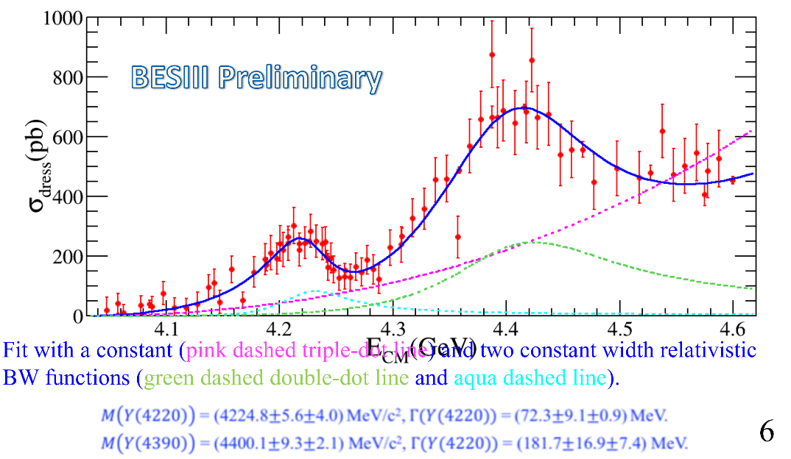
Vector $Y$ states in BESIII
BESIII, PRL118, 092002 (2017)
BESIII, PRL118, 092001 (2017)
$$e^{+}e^{−}→J/ψ ππ$$
New BESIII data show a peculiar lineshape for the $Y(4260)$
The state appear lighter and narrower, compatible with the ones in $h_{c}ππ$ and $χ_{c0}ω$
A broader old-fashioned $Y(4260)$ is appearing in $\overline{D}D^{∗}π$, maybe indicating a ${\overline{D}D}_{1}$
dominance
$$e^{+}e^{−}→π^{+}D^{0}D^{∗−}$$
A. Pilloni – Modern Scattering theory and the XYZ phenomena
Notes:
Y(4260), M=4263 +- 5, Gamma = 95+-14
D_1(2420)^0, M=2421.3 ±0.6, Gamma =27.1 ±2.7
D_1(2420)^+-, M=2423.4 ±3.1, Gamma =25 ±6
I D_1 hanno J^P = 1^+
La molecola D_1 D sta 22 MeV sotto
Se la Y è D_1 D, il pione lega fortemente, come fa la Y a essere così larga?
Come funziona lo scambio del pione???
Close propone che la Y è D_1 D^* col pione scambiato in onda S,
La Y però non va in Ds come se fosse tetraquark

Slide 49
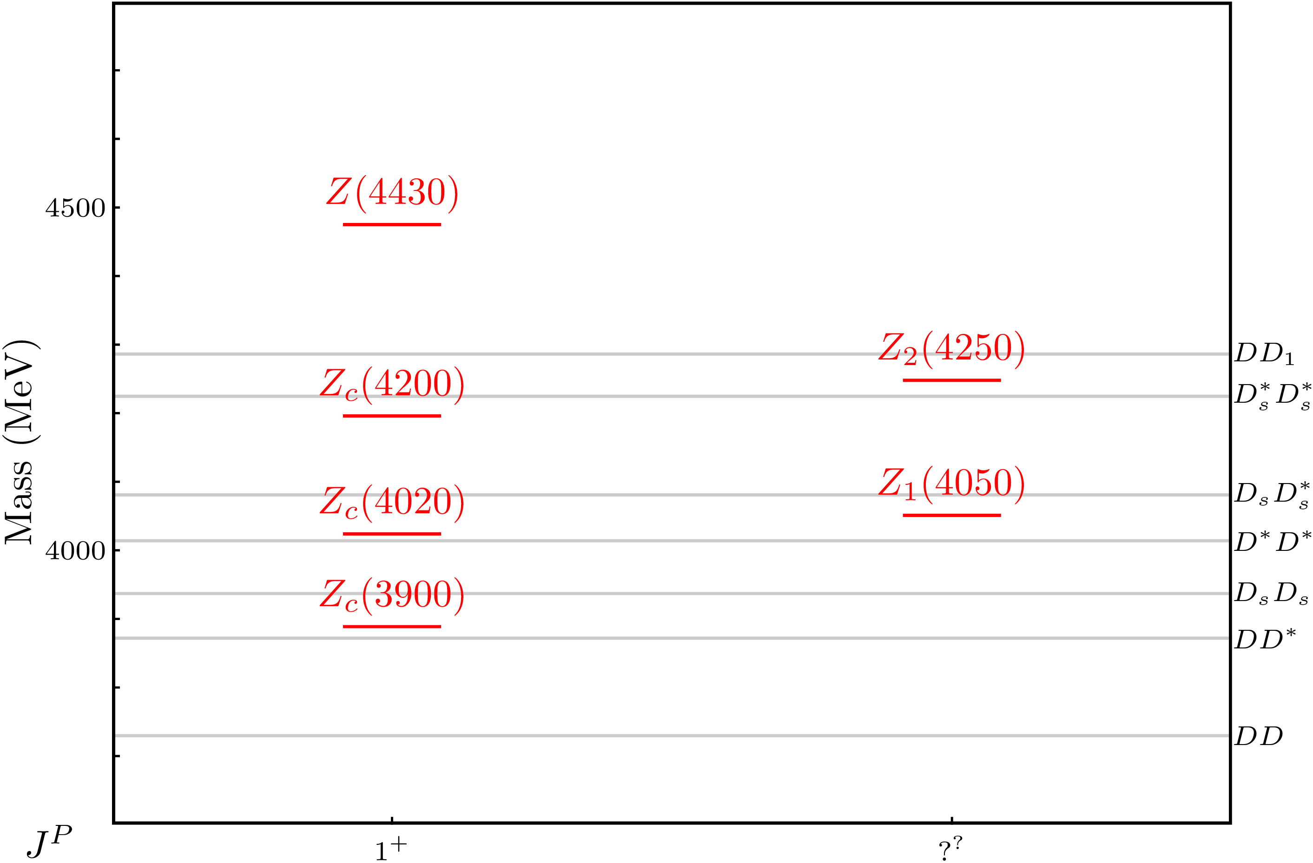
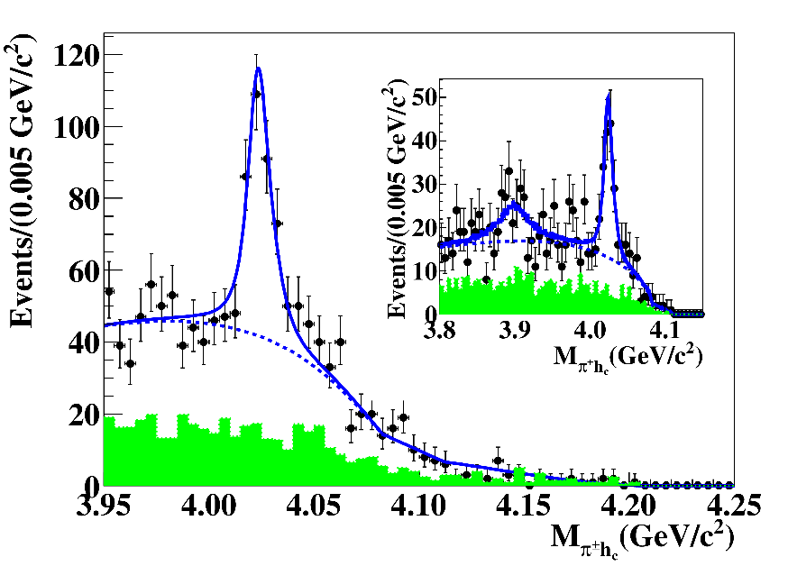
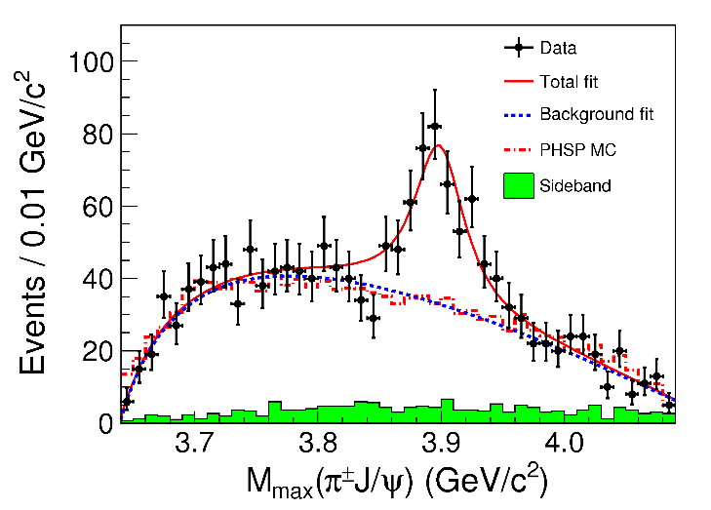
Charged $Z$ states: $Z_{c}\left(3900\right), Z_{c}^{′}(4020)$
Charged quarkonium-like resonances have been found, 4q needed
Two states $J^{PC}=1^{+−}$ appear slightly above $D^{(∗)}D^{∗}$ thresholds
$e^{+}e^{−}→Z_{c}{\left(3900\right)}^{+}π^{−}→J/ψ{ π}^{+}π^{−}$ and $→{\left(DD^{∗}\right)}^{+}π^{−}$ $M=3888.7±3.4$MeV, $Γ=35±7$ MeV
$e^{+}e^{−}→Z_{c}^{′}{\left(4020\right)}^{+}π^{−}→h_{c}{ π}^{+}π^{−}$ and $→{\overline{D}}^{∗0}D^{∗+}π^{−}$
$M=4023.9±2.4$MeV, $Γ=10±6$ MeV
A. Pilloni – Modern Scattering theory and the XYZ phenomena
Notes:
Y(4260), M=4263 +- 5, Gamma = 95+-14
D_1(2420)^0, M=2421.3 ±0.6, Gamma =27.1 ±2.7
D_1(2420)^+-, M=2423.4 ±3.1, Gamma =25 ±6
I D_1 hanno J^P = 1^+
La molecola D_1 D sta 22 MeV sotto
Se la Y è D_1 D, il pione lega fortemente, come fa la Y a essere così larga?
Come funziona lo scambio del pione???

Slide 50
A Strange partner : $Z_{cs}\left(3985\right)$
A strange partner of the $Z_{c}\left(3900\right)$seems to appear in open charm decays
$$e^{+}e^{−}→Z_{cs}{\left(3985\right)}^{+}K^{−}→D_{s}^{+}\overline{D^{∗0}}{ K}^{−}$$ $M={3982.5}_{−2.6}^{+1.8}±2.1$MeV, $Γ={12.8}_{−4.4}^{+5.3}±3.0$ MeV
A. Pilloni – Modern Scattering theory and the XYZ phenomena
Notes:
Y(4260), M=4263 +- 5, Gamma = 95+-14
D_1(2420)^0, M=2421.3 ±0.6, Gamma =27.1 ±2.7
D_1(2420)^+-, M=2423.4 ±3.1, Gamma =25 ±6
I D_1 hanno J^P = 1^+
La molecola D_1 D sta 22 MeV sotto
Se la Y è D_1 D, il pione lega fortemente, come fa la Y a essere così larga?
Come funziona lo scambio del pione???

Slide 51
Charged $Z$ states: $Z_{b}\left(10610\right), Z_{b}^{′}(10650)$
Anomalous dipion width in $Υ\left(5S\right)$,
2 orders of magnitude larger than $Υ\left(nS\right)$
Moreover, observed $Υ\left(5S\right)→h_{b}\left(nP\right)ππ$ which violates HQSS
$Υ\left(5S\right)→Z_{b}{\left(10610\right)}^{+}π^{−}→Υ\left(nS\right){ π}^{+}π^{−},h_{b}\left(nP\right){ π}^{+}π^{−}$ and $→{\left(BB^{∗}\right)}^{+}π^{−}$ $M=10607.2±2.0$MeV, $Γ=18.4±2.4$ MeV
$Υ\left(5S\right)→Z_{b}^{′}{\left(10650\right)}^{+}π^{−}→Υ\left(nS\right){ π}^{+}π^{−},h_{b}\left(nP\right){ π}^{+}π^{−}$ and $→{\overline{B}}^{∗0}B^{∗+}π^{−}$
$M=10652.2±1.5$MeV, $Γ=11.5±2.2$ MeV
2 twin resonances!
A. Pilloni – Modern Scattering theory and the XYZ phenomena
Notes:
Y(4260), M=4263 +- 5, Gamma = 95+-14
D_1(2420)^0, M=2421.3 ±0.6, Gamma =27.1 ±2.7
D_1(2420)^+-, M=2423.4 ±3.1, Gamma =25 ±6
I D_1 hanno J^P = 1^+
La molecola D_1 D sta 22 MeV sotto
Se la Y è D_1 D, il pione lega fortemente, come fa la Y a essere così larga?
Come funziona lo scambio del pione???

Slide 52
Broad exotics in $B$ decays
Lots of new exotics have been seen by LHCb with multidimensional amplitude analyses of $B→$ 3+ body
Most of these are broad, and the precise determination can crucially depend on the amplitude model, so that the resonant nature cannot be assessed with the same strong statements as for the narrow guys
A. Pilloni – Modern Scattering theory and the XYZ phenomena
Notes:
Y(4260), M=4263 +- 5, Gamma = 95+-14
D_1(2420)^0, M=2421.3 ±0.6, Gamma =27.1 ±2.7
D_1(2420)^+-, M=2423.4 ±3.1, Gamma =25 ±6
I D_1 hanno J^P = 1^+
La molecola D_1 D sta 22 MeV sotto
Se la Y è D_1 D, il pione lega fortemente, come fa la Y a essere così larga?
Come funziona lo scambio del pione???

Slide 53
Charged $Z$ states: $Z(4430)$
$$Z{\left(4430\right)}^{+}→ψ(2S){ π}^{+} \\ {I^{G}J}^{PC}=1^{+}1^{+−}$$
$M=4475±7_{−25}^{+15}$MeV
$Γ=172±{13}_{−34}^{+37}$MeV
Far from open charm thresholds
If the amplitude is a free complex number, in each bin of $m_{ψ^{′}π^{−}}^{2}$, the resonant behaviour appears as well
A. Pilloni – Modern Scattering theory and the XYZ phenomena
Notes:
Y(4260), M=4263 +- 5, Gamma = 95+-14
D_1(2420)^0, M=2421.3 ±0.6, Gamma =27.1 ±2.7
D_1(2420)^+-, M=2423.4 ±3.1, Gamma =25 ±6
I D_1 hanno J^P = 1^+
La molecola D_1 D sta 22 MeV sotto
Se la Y è D_1 D, il pione lega fortemente, come fa la Y a essere così larga?
Come funziona lo scambio del pione???

Slide 54
Tetraquarks: the $B^{+}→J/ψ φ K^{+}$ decay
$$\text{In} J/ψ φ: \left\{\begin{aligned}\text{1}× 1^{−+} \\ \text{2}× 0^{++} \\ 3× 1^{++}\end{aligned}\right.$$
$$In J/ψ K^{+}:2×1^{+}$$
Widths from 50 to 230 MeV
A. Pilloni – Modern Scattering theory and the XYZ phenomena
Notes:
Y(4260), M=4263 +- 5, Gamma = 95+-14
D_1(2420)^0, M=2421.3 ±0.6, Gamma =27.1 ±2.7
D_1(2420)^+-, M=2423.4 ±3.1, Gamma =25 ±6
I D_1 hanno J^P = 1^+
La molecola D_1 D sta 22 MeV sotto
Se la Y è D_1 D, il pione lega fortemente, come fa la Y a essere così larga?
Come funziona lo scambio del pione???
Close propone che la Y è D_1 D^* col pione scambiato in onda S,
La Y però non va in Ds come se fosse tetraquark

Slide 55
The S-Matrix principles
Future cannot change the past
100%, something will happen
The anti-particle is an anti-particle and not just a different particle
(analyticity)
(unitarity)
(crossing symmetry)
Sherlock Holmes, QFT
Analyticity
Unitarity
Crossing
Parametrize your ignorance.
Build a model.
Fit data.
Have fun.
A. Pilloni – Modern Scattering theory and the XYZ phenomena

Slide 56
Life is not easy...
A. Pilloni – Modern Scattering theory and the XYZ phenomena
Notes:
2 slides su Zc, a Bes e a Belle
2 slide su tetraquark model: dall’hamiltoniana di Jaffe al calcolo delle masse
1 slide su molecular models, dove sono i carichi? (non in Tornqvist, si in Hanhart, vedere Braaten, citare Nefediev)
2 slides su decay channels, dove si dovrebbe vedere, e a seconda del modello, vedere qualche plot
1 slide su Y(4260), tetraquark? C’è lo strano (si vede la f0)
1 slide su Zc a cleo (anche il neutro)

Slide 57
Resonances = Unstable states
$$ψ(t)=e^{−i E_{0} t} e^{− \frac{Γ}{2} t }$$
$$ψ(E)=\frac{1}{E−E_{0}+i\frac{Γ}{2}}$$
The function explodes for value of energy $E=E_{0}−i\frac{Γ}{2}$
Resonances are poles in the complex energy plane
$ψ_{out}\left(r\right)∼e^{i k z}+\frac{f\left(E,θ\right)}{r} e^{ikr}$
Excited states are unstable
They manifest as resonant peaks
A. Pilloni – Modern Scattering theory and the XYZ phenomena

Slide 58
Unitarity
$$\text{Im} A_{i→f}=\frac{1}{2}\sum_{n}{A_{i→n}A_{f→n}^{†}}$$
I have different values of $A$ across the real axis
$$i\sqrt{e^{iπ}}=−1$$
$$i\sqrt{e^{iπ}}=1$$
$$i\sqrt{1}=i$$
Example: $i\sqrt{E}$
$$i\sqrt{e^{2iπ}}=i$$
$$i\sqrt{e^{2iπ}}=−i$$
$$i\sqrt{1}=−i$$
...but I can decide to get the negative solution
I sheet
II sheet
A. Pilloni – Modern Scattering theory and the XYZ phenomena
Notes:
Controlla la parte su Regge

Slide 59
The $1→3$ decay chains
Each set of angles is defined in a different reference frame
A. Pilloni – Modern Scattering theory and the XYZ phenomena

Slide 60
What do we know?
A. Pilloni – Modern Scattering theory and the XYZ phenomena

Slide 61
Polarization vs. decay observables
$$\text{π}$$
c
$$\text{π}$$
Measurements of EDM/MDM require the reconstruction of the spin polarization of the heavy baryon
c
$${\text{ϕ}}_{Λ_{\text{c}}}=0$$
lab frame
I discuss the $Λ_{c}^{+}→p K^{−}π^{+}$ 3-body decay
2 Dalitz variables ($m_{Kp},θ_{Λ^{∗}}$) : encode resonance dynamics
3 Euler angles ($φ_{Λ_{c}},θ_{Λ_{c}},φ_{K}$) : encode information about polarization
A. Pilloni – Modern Scattering theory and the XYZ phenomena

Slide 62
$Λ_{c}^{+}→p K^{−}π^{+}$
Belle, PRL117, 011801
The dynamics in the Dalitz is extremely rich Resonances appear in all subchannels
$$Λ_{c}^{+}→\left\{\begin{matrix}K^{∗0} p \\ Δ^{++}K^{−} \\ Λ^{∗0}π^{+}\end{matrix}\right\}→pK^{−}π^{+}$$
Each chain prefers a variable choice A proper amplitude analysis is mandatory
A. Pilloni – Modern Scattering theory and the XYZ phenomena

Slide 63
Wigner rotations
Let’s analyze the process in the decay plane
$${\vec{p}}_{2}$$
$${\vec{p}}_{0},Λ′$$
$${\vec{p}}_{2}$$
$${\vec{p}}_{1},λ$$
$${\vec{p}}_{0},Λ$$
$${\vec{p}}_{3}$$
Boost in the ${\vec{p}}_{12}$ direction
$${\vec{p}}_{1},λ′$$
$${\vec{p}}_{3}$$
(23) rest frame
(12) rest frame
Helicities are not Lorentz invariant A boost disaligned with the momentum mixes (rotates) the helicities
↓
Additional $d$-functions: Wigner rotations
A. Pilloni – Modern Scattering theory and the XYZ phenomena

Slide 64
Wigner rotations
c
$$Δ$$
$$Δ$$
$$\text{π}$$
$$\text{π}$$
$$Δ$$
The new rotation is about the $y$ axis, the angle is defined in the rest frame of the $p$ or $Λ_{c}$
A. Pilloni – Modern Scattering theory and the XYZ phenomena

Slide 65
The Breit-Wigner
$$A_{i→f}\left(s\right)=\frac{g_{i}g_{f}}{m^{2}−s−i \sum_{f}{g_{f}^{2}ρ_{f}(s)}}$$
$$=\frac{1}{\sqrt{ρ_{i}(m^{2})ρ_{f}(m^{2})}}\frac{Γ\left(m^{2}\right) \sqrt{BR_{i}BR_{f}}}{m^{2}−s−i m Γ(s) }$$
Usually one calls $m$ the BW mass and $Γ\left(m^{2}\right)=g^{2}ρ(m^{2})$ the BW width and states $\sum_{f}{BR_{f}}=1$. If the resonance is narrow, the energy dependence of the width can be neglected, $Γ\left(s\right)≃Γ(m^{2})$
However:
Unitarity is a property of PW and not of a single resonance
The amplitude does not have a pole at $s=m^{2}−i m Γ(m^{2})$
If the resonance is narrow and far from threshold this is ok
A. Pilloni – Modern Scattering theory and the XYZ phenomena
Notes:
Controlla la parte su Regge

Slide 66
You shall not sum!
The simplest ansatz for a PW amplitude is the Breit-Wigner
What if I have two resonances? Can I add two BWs?
$$A_{l}\left(s\right)=\frac{g^{2}}{m^{2}−s−i g^{2}ρ(s)}$$
$$A_{l}\left(s\right)=\frac{g_{1}^{2}}{m_{1}^{2}−s−i g_{1}^{2}ρ(s)}+\frac{g_{2}^{2} e^{iα}}{m_{2}^{2}−s−i g_{2}^{2}ρ(s)}$$
Unitarity is broken, $\text{Im} A_{l}\left(s\right)≠ρ\left(s\right){\left|A_{l}\left(s\right)\right|}^{2}$
Unitarity is saturated, $\text{Im} A_{l}\left(s\right)=\text{Im}\frac{m^{2}−s+i g^{2}ρ(s)}{{\left|m^{2}−s−i g^{2}ρ\left(s\right)\right|}^{2}}=ρ\left(s\right){\left|A_{l}\left(s\right)\right|}^{2}$
But that’s precisely what experimentalists do!
Phases take partially into account the modifications of unitarity due to inelastic channels. However, when we shoot for precision, we need better ansätze
Of course they are not stupid, this works if the two resonances are well isolated. Unfortunately we have no simple alternative solution that can work in all situation, we have to proceed case by case and we live on different timescales
A. Pilloni – Modern Scattering theory and the XYZ phenomena
Notes:
Controlla la parte su Regge

Slide 67
Bound and virtual states
The amplitude close to threshold can be expanded as
$$A\left(E\right)=\frac{1}{\frac{1}{a}+\frac{1}{2}r_{0}k^{2}−ik+O\left(k^{4}\right)}$$
$a$ is the scattering length
$r_{0}$is the effective range
The sign of $a$ controls whether we have a bound or virtual state
A. Pilloni – Modern Scattering theory and the XYZ phenomena
Notes:
Controlla la parte su Regge

Slide 68
Weinberg’s criterion and lineshapes
Let us imagine to have a theory with a bound state with a binding momentum much smaller than the inverse of the range of the potential
The potential is just a delta function, we calculate the $2→2$ scattering amplitude
+
+
+ …
$$A(E)=\frac{1}{1/a−i\sqrt{2μE}}$$
This has a pole at $E=−E_{B}=−\frac{1}{2μa^{2}}$ and residue $g^{2}=\sqrt{\frac{2E_{B}}{μ}}$
A. Pilloni – Modern Scattering theory and the XYZ phenomena
Notes:
Controlla la parte su Regge

Slide 69
Weinberg’s criterion and lineshapes
Now let us consider the propagation of a bare intermediate state
+
+
+ …
$$A\left(E\right)=\frac{g_{0}^{2}}{E_{0}−E−ig_{0}^{2}\sqrt{2μE}}=\frac{g_{0}^{2}}{{−E}_{B}−E−ig_{0}^{2}\sqrt{2μE}−g_{0}^{2}\sqrt{2μE_{B}}}$$
This has a pole at $E_{B}$ and residue $g^{2}=\sqrt{\frac{2E_{B}}{μ}}\left(1−Z\right)$ where $Z$ is the w.f. renormalization, $Z={\left(1+g_{0}^{2}\sqrt{\frac{μ}{2E_{B}}}\right)}^{−1}$= overlap between the bare state and the continuum
A. Pilloni – Modern Scattering theory and the XYZ phenomena
Notes:
Controlla la parte su Regge

Slide 70
Weinberg’s criterion and lineshapes
The amplitude can be rewritten as
$$A\left(E\right)=\frac{1}{\frac{1}{a}+\frac{1}{2}r_{0}k^{2}−ik}$$
Thus identifying $a=−2 \frac{1−Z}{2−Z}\frac{1}{\sqrt{2μE_{B}}}$, $r_{0}=−\frac{Z}{1−Z}\frac{1}{\sqrt{2μE_{B}}}$
So a negative $r_{0}$ points to a short range component in the wave function
This is true up to corrections of the order of the range of the potential, which btw are positive under general assumptions
Esposito, Maiani, Pilloni, Polosa, Riquer, 105 (2022) 3, L031503
A. Pilloni – Modern Scattering theory and the XYZ phenomena
Notes:
Controlla la parte su Regge

Slide 71
L. Maiani
A. Pilloni – Modern Scattering theory and the XYZ phenomena
Notes:
Controlla la parte su Regge

Slide 72
L. Maiani
A. Pilloni – Modern Scattering theory and the XYZ phenomena
Notes:
Controlla la parte su Regge

Slide 73
Coupled channels
For coupled channels, $2→2$ unitarity gets easily generalized from
$$\text{Im} A_{l}^{−1}\left(s\right)=−ρ\left(s\right)=−\left(\begin{matrix}ρ_{1}(s) & 0 & 0 \\ 0 & ρ_{2}(s) & 0 \\ 0 & 0 & ⋱\end{matrix}\right)$$
With two channels, a simple form is given by Flatté,
$$A_{l}^{−1}\left(s\right)∝det {\left(K^{−1}−i ρ\left(s\right)\right)}^{−1}∝m^{2}−s−i g_{1}^{2}ρ_{1}\left(s\right)−g_{2}^{2}ρ_{2}\left(s\right)$$
Having two channels, I have two Riemann sheets for each phase space function, so 4 Riemann sheets
A. Pilloni – Modern Scattering theory and the XYZ phenomena
Notes:
Controlla la parte su Regge

Slide 74
The lineshape of the $X(3872)$
Blue line is $D^{0}\overline{D^{∗0}}$,
$D^{+}D^{∗−}$ is $δ=8.2 \text{MeV}$
heavier
Because of experimental resolution, different lineshapes are indistinguishable
Unitary parametrizations tend to be narrower, $Γ_{BW}=1.39±0.24±0.10 \text{MeV}$, $Γ_{fl}={0.22}_{−0.06−0.13}^{+0.07+0.11} \text{MeV}$
A. Pilloni – Modern Scattering theory and the XYZ phenomena
Notes:
Controlla la parte su Regge

Slide 75
The lineshape of the $X(3872)$
Esposito, Maiani, AP, Polosa, Riquer, PRD 105 (2022) 3, L031503
LHCb data is fitted with the Flatte’ parametrization
The $D^{0}\overline{D^{∗0}}$ threshold
Two options: a) I set $δ=0$ b) I expand at threshold
The $D^{+}D^{∗−}$ threshold
The $J/ψ ρ,ω,$ and other unknown channels
This considers coupled channel, but Weinberg’s criterion applies to single channel bound states only
A. Pilloni – Modern Scattering theory and the XYZ phenomena
Notes:
Controlla la parte su Regge

Slide 76
The lineshape of the $X(3872)$
Esposito, Maiani, AP, Polosa, Riquer, PRD 105 (2022) 3, L031503
Option b)
Option a)
According to Weinberg’s, the first result points to a sizeable short-range structure of the X(3872)
Still disagreement on how to perform the extraction though
A. Pilloni – Modern Scattering theory and the XYZ phenomena
Notes:
Controlla la parte su Regge

Slide 77
Diquarks
Attraction and repulsion in 1-gluon exchange approximation is given by
$$3_{c}×3_{c}∈{\overline{3}}_{c}$$
Now the two quarks are identical particles, they obey Fermi statistics
If we restrict to the ground state in S-wave, we have two options
$${\overline{3}}_{color}\left(A\right)×{\overline{3}}_{flavor}\left(A\right)×1_{spin}\left(A\right)$$
«Good» diquark
$${\overline{3}}_{color}\left(A\right)×6_{flavor}\left(S\right)×3_{spin}\left(S\right)$$
«Bad» diquark
Because of spin-spin interaction, good diquark are lighter, and easier to produce From the flavor point of view, it behaves like an antiquark
A. Pilloni – Modern Scattering theory and the XYZ phenomena

Slide 78
Reference frames
M. Mikhasenko, AP et al. (JPAC), to appear
The 5 variables of each chain can be expressed in terms of the variables of another chain
A. Pilloni – Modern Scattering theory and the XYZ phenomena

Slide 79
Isobar model in the helicity formalism
The natural choice for the amplitude looks
with the cross section given by the trace with the spin-density matrix
No! The helicities have not the same meaning in the different chains!
A. Pilloni – Modern Scattering theory and the XYZ phenomena

Slide 80
Wigner rotations
Let’s analyze the process in the decay plane
$${\vec{p}}_{2}$$
$${\vec{p}}_{0},Λ′$$
$${\vec{p}}_{2}$$
$${\vec{p}}_{1},λ$$
$${\vec{p}}_{0},Λ$$
$${\vec{p}}_{3}$$
Boost in the ${\vec{p}}_{12}$ direction
$${\vec{p}}_{1},λ′$$
$${\vec{p}}_{3}$$
(23) rest frame
(12) rest frame
Helicities are not Lorentz invariant A boost disaligned with the momentum mixes (rotates) the helicities
↓
Additional $d$-functions: Wigner rotations
A. Pilloni – Modern Scattering theory and the XYZ phenomena

Slide 81
Wigner rotations
c
$$Δ$$
$$Δ$$
$$\text{π}$$
$$\text{π}$$
$$Δ$$
The new rotation is about the $y$ axis, the angle is defined in the rest frame of the $p$ or $Λ_{c}$
A. Pilloni – Modern Scattering theory and the XYZ phenomena

Slide 82
Isobar model in the decay plane
The natural choice for the amplitude looks
$ζ_{2(1)}^{1}$ is the angle between $π$ and $Λ_{c}$ in the $p$ rest frame
$ζ_{3(1)}^{1}$ is the angle between $K$ and $Λ_{c}$ in the $p$ rest frame
${\hat{θ}}_{2(1)}$ is the angle between $K$ and $p$ in the $Λ_{c}$ rest frame
${\hat{θ}}_{3(1)}$is the angle between $π$ and $p$ in the $Λ_{c}$ rest frame
A. Pilloni – Modern Scattering theory and the XYZ phenomena

Slide 83
Isobar model in the decay plane
The natural choice for the amplitude looks
All the angles are polar: no azimuthal phases all these functions can be expressed in term of the Mandelstam variables $σ_{1}=m_{Kπ}^{2},$ $σ_{2}=m_{pπ}^{2},$ $σ_{3}=m_{pK}^{2}$
Now all the spins are aligned correctly
$ζ_{2(1)}^{1}$ is the angle between $π$ and $Λ_{c}$ in the $p$ rest frame
$ζ_{3(1)}^{1}$ is the angle between $K$ and $Λ_{c}$ in the $p$ rest frame
${\hat{θ}}_{2(1)}$ is the angle between $K$ and $p$ in the $Λ_{c}$ rest frame
${\hat{θ}}_{3(1)}$is the angle between $π$ and $p$ in the $Λ_{c}$ rest frame
A. Pilloni – Modern Scattering theory and the XYZ phenomena

Slide 84
Isobar model out of the decay plane
Now that everything is aligned with the $K^{∗}$ chain, we can use the Euler angles of chain 1 for the full thing
In this form it is straightforward to check that, for unpolarized $Λ_{c}$, the cross section does not depend on the 3 Euler angles
A. Pilloni – Modern Scattering theory and the XYZ phenomena

Slide 85
Amplitude model
$$Z_{c}\left(3900\right)?$$
$${u: D}_{0}(2400)$$
$${u:Z}_{c}\left(3900\right)?$$
$$"σ, f_{0}(980)"$$
$$D_{1}(2420)$$
Logarithmic branch points simulate resonant behavior, only in special kinematics
Coleman and Norton, Nuovo Cim. 38, 438
Schmid, Phys.Rev. 154, 1363
Szczepaniak, PLB747, 410-416
Szczepaniak, PLB757, 61-64
Guo, Nucl.Phys.Rev.37, 406
$$π$$
Isobars
Rescattering
$$D_{1}$$
$$Y(4260)$$
$$D^{∗}$$
$$π$$
$$\overline{D}$$
$$J/ψ$$
Triangle singularity?
A. Pilloni – Modern Scattering theory and the XYZ phenomena

Slide 86
Fit: III
( data)
A. Pilloni – Modern Scattering theory and the XYZ phenomena
Notes:
Controlla la parte su Regge

Slide 87
Fit: III+tr.
( data)
A. Pilloni – Modern Scattering theory and the XYZ phenomena
Notes:
Controlla la parte su Regge

Slide 88
Fit: IV+tr.
( data)
A. Pilloni – Modern Scattering theory and the XYZ phenomena
Notes:
Controlla la parte su Regge

Slide 89
Fit: tr.
( data)
A. Pilloni – Modern Scattering theory and the XYZ phenomena
Notes:
Controlla la parte su Regge

Slide 90
Pole extraction
III
III+tr.
IV+tr.
A. Pilloni – Modern Scattering theory and the XYZ phenomena
Not conclusive at this stage
Notes:
Controlla la parte su Regge

Slide 91
Triangle singularity
$$π$$
$$D_{1}$$
Logarithmic branch points can simulate a resonant behavior, only in very special kinematical conditions
Coleman and Norton, Nuovo Cim. 38, 438
$$Y(4260)$$
$$D^{∗}$$
$$π$$
$$\overline{D}$$
$$J/ψ$$
However, this effects cancels in Dalitz projections, no peaks Schmid, Phys.Rev. 154, 1363
Szczepaniak, PLB747, 410-416
Szczepaniak, PLB757, 61-64
Guo, Meissner, Wang, Yang PRD92, 071502
...but the cancellation can be spread in different channels, you might still see peaks in other channels only!
A. Pilloni – Modern Scattering theory and the XYZ phenomena

Slide 92
Total cross section
With optical theorem one gets the total cross section $J/ψ p→\text{X}$.
This has been estimated from the A-dependence of nuclear targets, $4\text{mb}$ at $\sqrt{s}=6.2 \text{GeV}$. VMD estimates provide values at least 1order of magnitude smaller
A. Pilloni – Modern Scattering theory and the XYZ phenomena

Slide 93
Prompt production of $X(3872)$
However, the applicability of Watson theorem is challenged by the presence of pions that interfere with $DD^{∗}$ propagation
$$D^{∗}$$
$$π$$
$$π$$
(CDF acceptance)
$$π$$
$$π$$
$$π$$
$$\overline{D^{0}}$$
A solution can be FSI (rescattering of $DD^{∗}$), which allow $k_{max}$ to be as large as $5m_{π}$, $σ\left(p\overline{p}→DD^{∗}|k<k_{max}\right)≈230 \text{nb}$
Artoisenet and Braaten, PRD81, 114018
However, this is controversial because of the presence of comover that interfere with $DD^{∗}$ propagation
Bignamini et al. PLB684, 228-230
Esposito, Piccinini, AP, Polosa, JMP 4, 1569
Guerrieri, Piccinini, AP, Polosa, PRD90, 034003
$$σ_{MC}\left(p\overline{p}→DD^{∗}|k<k_{max}\right)≈0.1 \text{nb}$$
$σ_{exp}\left(p\overline{p}→X(3872)\right)≈30−70 \text{nb}$!!!
The comparison of production of other light nuclei suggests a different behavior
Esposito, Guerrieri, Maiani, Piccinini, AP, Polosa, Riquer, PRD92 (2015) 3, 034028
Bignamini et al. PRL103 (2009) 162001
A. Pilloni – Modern Scattering theory and the XYZ phenomena
Notes:
2 slides su Zc, a Bes e a Belle
2 slide su tetraquark model: dall’hamiltoniana di Jaffe al calcolo delle masse
1 slide su molecular models, dove sono i carichi? (non in Tornqvist, si in Hanhart, vedere Braaten, citare Nefediev)
2 slides su decay channels, dove si dovrebbe vedere, e a seconda del modello, vedere qualche plot
1 slide su Y(4260), tetraquark? C’è lo strano (si vede la f0)
1 slide su Zc a cleo (anche il neutro)

Slide 94
Multiplicity dependence
The $X(3872)$is more and more suppressed wrt $ψ(2S)$when more comovers are present Does it make the $X(3872)$a fragile molecule?
The $X(3872)$is more and more suppressed wrt $ψ(2S)$when more comovers are present Does it make the $X(3872)$a fragile molecule? No.
LHCb 2009.06619
Deuteron is a molecule, but it increases
CMS JHEP04(2014), 103
ALICE EPJC80, 9, 889
$Υ(2S)$ and $Υ\left(3S\right)$ are not molecules, but they decrease
$Υ(2S)$ and $Υ\left(3S\right)$ are not molecules, but they decrease
A. Pilloni – Modern Scattering theory and the XYZ phenomena
Notes:
2 slides su Zc, a Bes e a Belle
2 slide su tetraquark model: dall’hamiltoniana di Jaffe al calcolo delle masse
1 slide su molecular models, dove sono i carichi? (non in Tornqvist, si in Hanhart, vedere Braaten, citare Nefediev)
2 slides su decay channels, dove si dovrebbe vedere, e a seconda del modello, vedere qualche plot
1 slide su Y(4260), tetraquark? C’è lo strano (si vede la f0)
1 slide su Zc a cleo (anche il neutro)

Slide 95
The comover model
The interaction with final state comoving particles can help create/destroy a hadron
Baym PLB138, 18
For a compact state in 𝑝𝑝 collisions the number evolves following
hadron yield
destruction cross section
$$τ\frac{dN_{𝒬}}{dτ}=−⟨vσ⟩_{𝒬}ρ_{c}N_{𝒬}$$
comover density at initial time (Glauber model) $∝N_{ch}$
In the Comover Interaction Model one takes $⟨vσ⟩_{𝒬}∼πr_{𝒬}^{2}$
This has proved to be successful at describing 𝑝Pb and PbPb data
Ferreiro PLB749, 98
Ferreiro, Lansberg JHEP10(2018), 94
A. Pilloni – Modern Scattering theory and the XYZ phenomena
Notes:
2 slides su Zc, a Bes e a Belle
2 slide su tetraquark model: dall’hamiltoniana di Jaffe al calcolo delle masse
1 slide su molecular models, dove sono i carichi? (non in Tornqvist, si in Hanhart, vedere Braaten, citare Nefediev)
2 slides su decay channels, dove si dovrebbe vedere, e a seconda del modello, vedere qualche plot
1 slide su Y(4260), tetraquark? C’è lo strano (si vede la f0)
1 slide su Zc a cleo (anche il neutro)

Slide 96
Bottomonia & $X(3872)$
Further validate the model using CMS $pp$ data Using same cross sections as in 𝑝Pb and PbPb
Same model for a compact $X(3872)$
Esposito, Ferreiro, AP, Polosa, Salgado EPJC 81 (2021) 7, 669
A. Pilloni – Modern Scattering theory and the XYZ phenomena
Notes:
2 slides su Zc, a Bes e a Belle
2 slide su tetraquark model: dall’hamiltoniana di Jaffe al calcolo delle masse
1 slide su molecular models, dove sono i carichi? (non in Tornqvist, si in Hanhart, vedere Braaten, citare Nefediev)
2 slides su decay channels, dove si dovrebbe vedere, e a seconda del modello, vedere qualche plot
1 slide su Y(4260), tetraquark? C’è lo strano (si vede la f0)
1 slide su Zc a cleo (anche il neutro)

Slide 97
Deuteron in coalescence model
Solution of the evolution equation with recombination
$$\frac{N_{m}}{N_{h}}=\frac{{\left\langle vσ\right\rangle }_{m}}{{\left\langle vσ\right\rangle }_{m}+{\left\langle vσ\right\rangle }_{hh}}+\left(\frac{N_{m}^{0}}{N_{h}^{0}}−\frac{{\left\langle vσ\right\rangle }_{m}}{{\left\langle vσ\right\rangle }_{m}+{\left\langle vσ\right\rangle }_{hh}}\right)e^{−\left({\left\langle vσ\right\rangle }_{m}+{\left\langle vσ\right\rangle }_{hh}\right)ρ_{c}\ln\left(ρ_{c}/ρ_{c}^{pp}\right)}$$
Numbers of molecule at $t=0$,
$≈0$ in Pythia
The coalescence momentum for deuteron is known to be $Λ=50 ÷200 \text{MeV}$
Cross sections calculated from scattering of constituents
A. Pilloni – Modern Scattering theory and the XYZ phenomena
Notes:
2 slides su Zc, a Bes e a Belle
2 slide su tetraquark model: dall’hamiltoniana di Jaffe al calcolo delle masse
1 slide su molecular models, dove sono i carichi? (non in Tornqvist, si in Hanhart, vedere Braaten, citare Nefediev)
2 slides su decay channels, dove si dovrebbe vedere, e a seconda del modello, vedere qualche plot
1 slide su Y(4260), tetraquark? C’è lo strano (si vede la f0)
1 slide su Zc a cleo (anche il neutro)

Slide 98
$X(3872)$ again
The coalescence momentum for the $X(3872)$ is $Λ=30 ÷300 \text{MeV}$
Controversies for $N_{m}/N_{h}$: How is the 𝑋 produced?
Through ${\overline{D}}^{0}D^{∗0}$: $N_{m}/N_{h}≈0$
Through $χ_{c1}(2P)$: $N_{m}/N_{h}≈1$
The difference shown with a green band
A. Pilloni – Modern Scattering theory and the XYZ phenomena
Notes:
2 slides su Zc, a Bes e a Belle
2 slide su tetraquark model: dall’hamiltoniana di Jaffe al calcolo delle masse
1 slide su molecular models, dove sono i carichi? (non in Tornqvist, si in Hanhart, vedere Braaten, citare Nefediev)
2 slides su decay channels, dove si dovrebbe vedere, e a seconda del modello, vedere qualche plot
1 slide su Y(4260), tetraquark? C’è lo strano (si vede la f0)
1 slide su Zc a cleo (anche il neutro)

