Slide 1
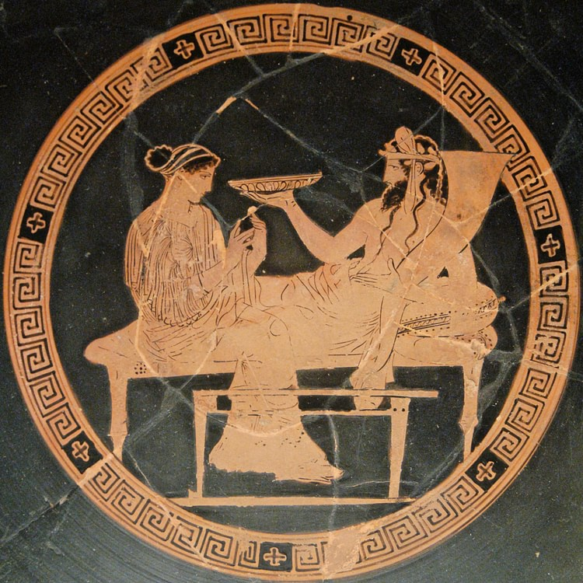

“ISOSPIN and BETA DECAY”
Berta Rubio
IFIC Valencia (Spain)
45th Erice International School
Nuclei in the Laboratory and in Stars
16-22 September 2024

Slide 2
Motivation and planning of this talk
First of all, I thought of the Erice school more as school than as a workshop, so I chose a "simple" topic.
Secondly, I believe the concept of isospin is particularly helpful in understanding beta decay.
Thirdly, one might wish that the isospin concept could be used more often in beta decay, but unfortunately, nature limits the cases we can profit from this understanding. I want to explain why that is.
Fourthly , while the examples I will show teach us many things, in this talk, I will focus only on the results related to isospin.
Finally, some of the introductory ideas were already introduced by K. Wimer.

Slide 3




Let us remember what β decay is at the nucleon level
β+
e⁺
$p→n+e+ +$ν
p
ν
In vacuum the proton is stable
(more tan 10³⁴ years experimental limit)
β−
e⁻
n$→p+e− +$ν
n
ν
In vacuum the neutron decays
with T_{1/2} 10 min and 11 s.
This is because the n is slightly
heavier than the p.
0.14% heavier
Thanks God de neutron becomes stable inside the nucleus and our World
can exists
Notes:
So, it is a relatively simple process

Slide 4
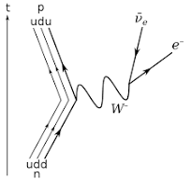






Let us remember what β decay is at the nucleon level
e⁺
β+
p$→n+e+ +$ν
ν
n$→p+e− +$ν
e⁻
β−
At fundamental level (quarks structure of
the nucleons):
ν
u$ud→udd+e+ +$ν
ud$d →uud+e− +$ν
Notes:
At the level of the quarks is also very simple

Slide 5






β decay and intrinsic spin
(from now on I will refer to β +) β + decay: allowed transitions, Fermi transitions
F
e⁺
s_{e} + s_{ν}=0
ν
Fermi decay (no spin flip)
$p→n+e+ +$ν
GT
e⁺
s_{e} + s_{ν}=1
ν
Gamow Teller decay (spin flip)

Slide 6










The isospin concept and β decay:
Similar to the spin concept
The isospin at the nucleus level
Nucleon with isospin t
The nucleus will have
a total isospin T that can have
several values, with:
T_{z} of the nucleus =$\sum_{i}{\text{t}\text{z} }i$ = l N-Z I/2
and
$$T≥Tz$$
Two substates
t_{z}=-1/2
t_{z}=+1/2

Slide 7
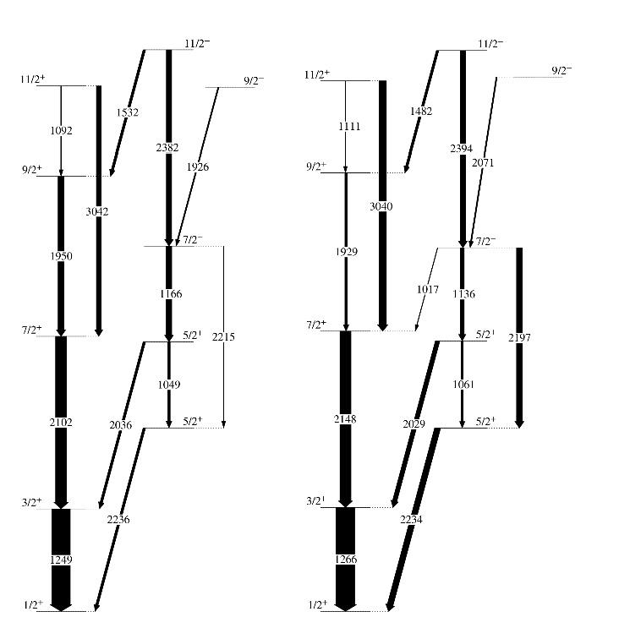
Two important consequences of these definitions
If the nuclear force were charge independent then the isospin T would be conserved. A consequence of this conservation law, is that nuclear states with the same quantum numbers, including the isospin, should be very similar. This becomes very clear when one compares mirror nuclei.
31
31
₁₆S₁₅
₁₅P₁₆
D. Tonev et al EPJ Web Conf. 194 (2018) 03001
Original data: Jenkins et al. PRL 116 (2016) 102502
Illustrative example of two “close” mirror nuclei, energies are very similar,
(Transition probabilities not necessarily!!)

Slide 8













Back to the isospin at the β decay level
β+ increases the Tz in one unit
t_{z}=-1/2
β decay
t_{z}=+1/2
β− decreases the isospin Tz in one unit

Slide 9








β decay and isospin
(allowed transitions)
F
e⁺
t_{e} + t_{ν}=0
ν
Fermi decay, no change in isospin
$p→n+e+ +$ν
GT
e⁺
t_{e} + t_{ν}=1
ν
Gamow Teller decay isospin can change in one unit

Slide 10
β decay and the Isobaric Analogue State (IAS):
Superallowed Fermi transitions
F
e⁺
ν
Fermi decay, no change in isospin
$p→n+e+ +$ν
GT
e⁺
ν
Superallowed Fermi transition con populate only one state, the IAS: no change in angular
momentum, no change in parity, no spin flip, no change in isospin, only third component
in isospin changes

Slide 11
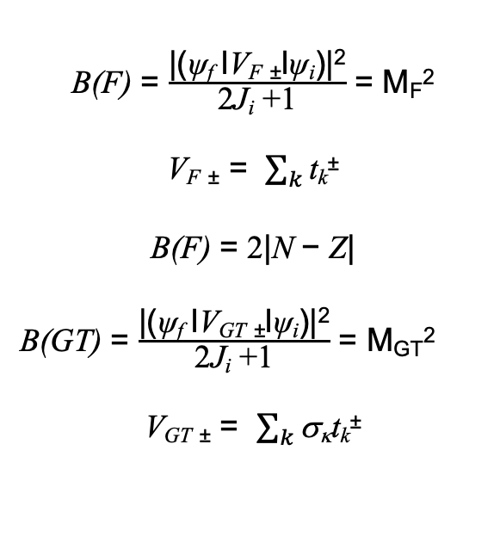
β decay transition probability or β strength
Theoretically
B(F) = $\frac{\text{|(}\text{ψ}\text{f} \text{l}\text{V}\text{F} \text{±}\text{l}\text{ψ}\text{i}\text{)|}\text{2}}{\text{2}\text{J}\text{i} \text{+1}}$ = M_{F}²
V_{F} ± = $\sum_{k}{\text{t}\text{k}\text{±}}$
B(F) = 2|N − Z|
B(GT) = $\frac{\text{|(}\text{ψ}\text{f} \text{l}\text{V}\text{GT} \text{±}\text{l}\text{ψ}\text{i}\text{)|}\text{2}}{\text{2}\text{J}\text{i} \text{+1}}$ = M_{GT}²
V_{GT} ± = $\sum_{k}{\text{s}\text{k}\text{t}\text{k}\text{±}}$
This is model
independent
Superallowed F decay*
is one of the simplest
decay that exists in nuclei
* They are used to determine the probability that the quark of flavor u
decays into a quark of flavor d, V_{ud}², the most precise matrix element
of the Cabbibo-Kobayashi-Maskawa matrix.
See: See J. Hardy and I. Towner for the last compilation,
PHYSICAL REVIEW C 102, 045501 (2020)

Slide 12
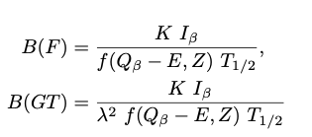
β decay transition probability or β strength
Experimentally
β decay energy
Direct β feeding to the level
β decay half life

Slide 13

Three beautiful examples

Slide 14

The β decay of ⁵²Ni
(at the left side of the
N=Z line or Tz=0)
T_{1/2} 43 ms
T_{z}=0 or N=Z nuclei

Slide 15
The β decay of ⁵²Ni
T_{1/2} 43 ms
t_{z}=0 or N=Z nuclei
T_{z}= -2
T_{z}= -1
28
24

Slide 16

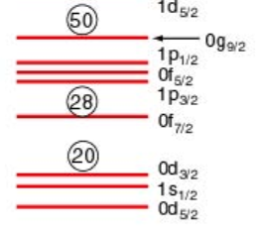



52Ni ground state
Isospin and beta decay
πf_{7/2}→νf_{7/2}
52Co IAS
T=2
T_{z}=-2
0⁺
⁵²₂₈Ni₂₄
T_{1/2}=43 ms
β⁺
F
Because the parent is 0⁺:
0⁺→0⁺ only Fermi decay
T=2 IAS
0⁺
0⁺→1⁺ only GT decay
1⁺
1⁺
GT
Sp
Can we confirm these
expectations?
How easy (or complicated) is to do it experimentally?
1⁺
6⁺
⁵²Co
T=1
T_{z}=-1
43 ms is a very short time!!

Slide 17
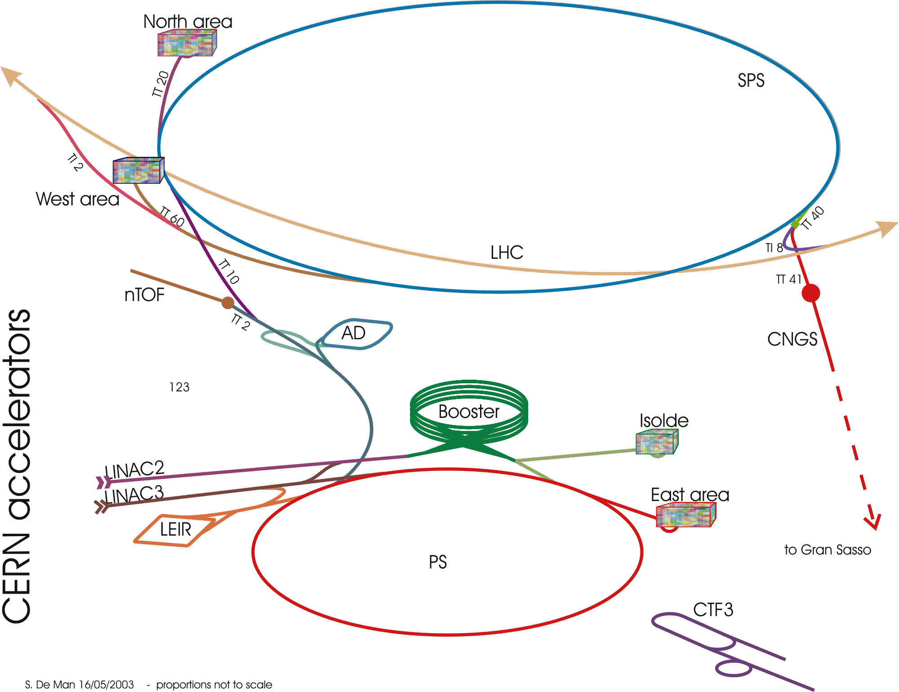
Isolde (CERN)
1GeV p
67 years old facility.
Many Exotic nuclei
Dicovered.
Constant improvement

Slide 18
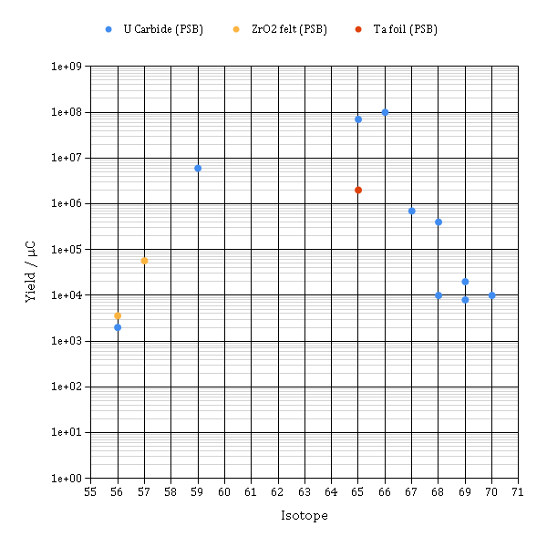
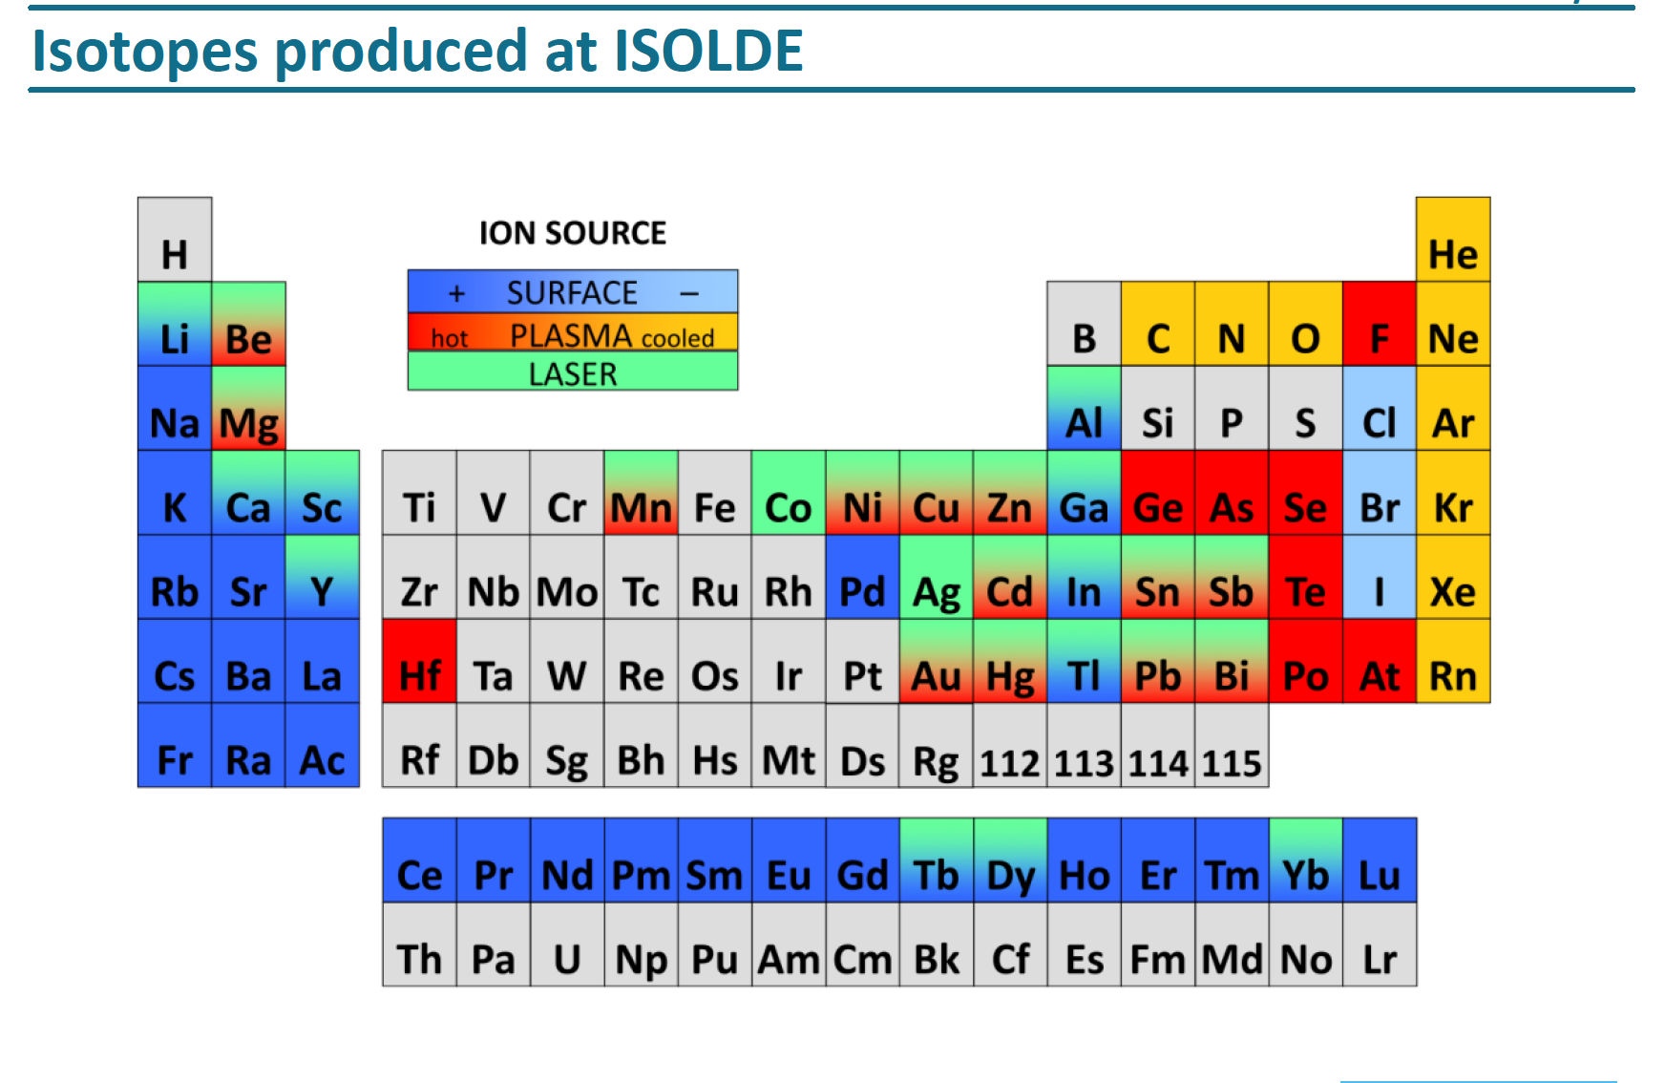
Radioactive nuclei production techniques
Isotopic Separation On-Line (ISOL)
thick target
ion source
mas separator
Intense Proton beam
difussion
⁵²Ni
Notes:
One look into the web page…

Slide 19
Radioactive nuclei production techniques
Isotopic Separation On-Line (ISOL)
thick target
ion source
mas separator
Intense Proton beam
difussion
In-flight fragmentation
heavy projectile
thin target
spectrometer
Cocktail beam

Slide 20
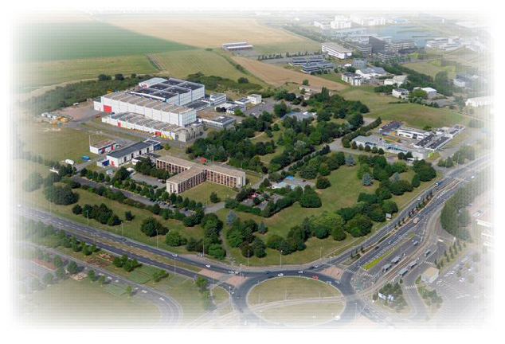
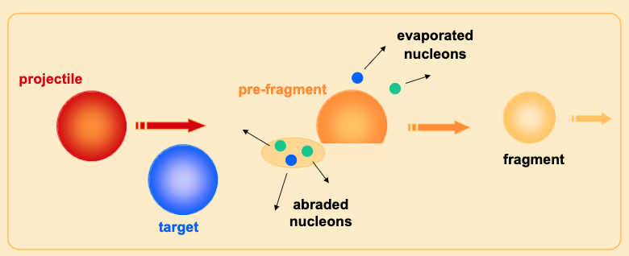
Tz=-2
The Tz=-2 52Ni decay was measured at GANIL (LISE), with a fragmentation
Reaction of 58Ni on Ni natural target
A nuclear reaction to produce the
nucleus of interest
⁵⁸Ni
⁵⁸Ni
⁵²Ni
^{Nat}Ni
⁵²Ni
and many other
fragments!!

Slide 21
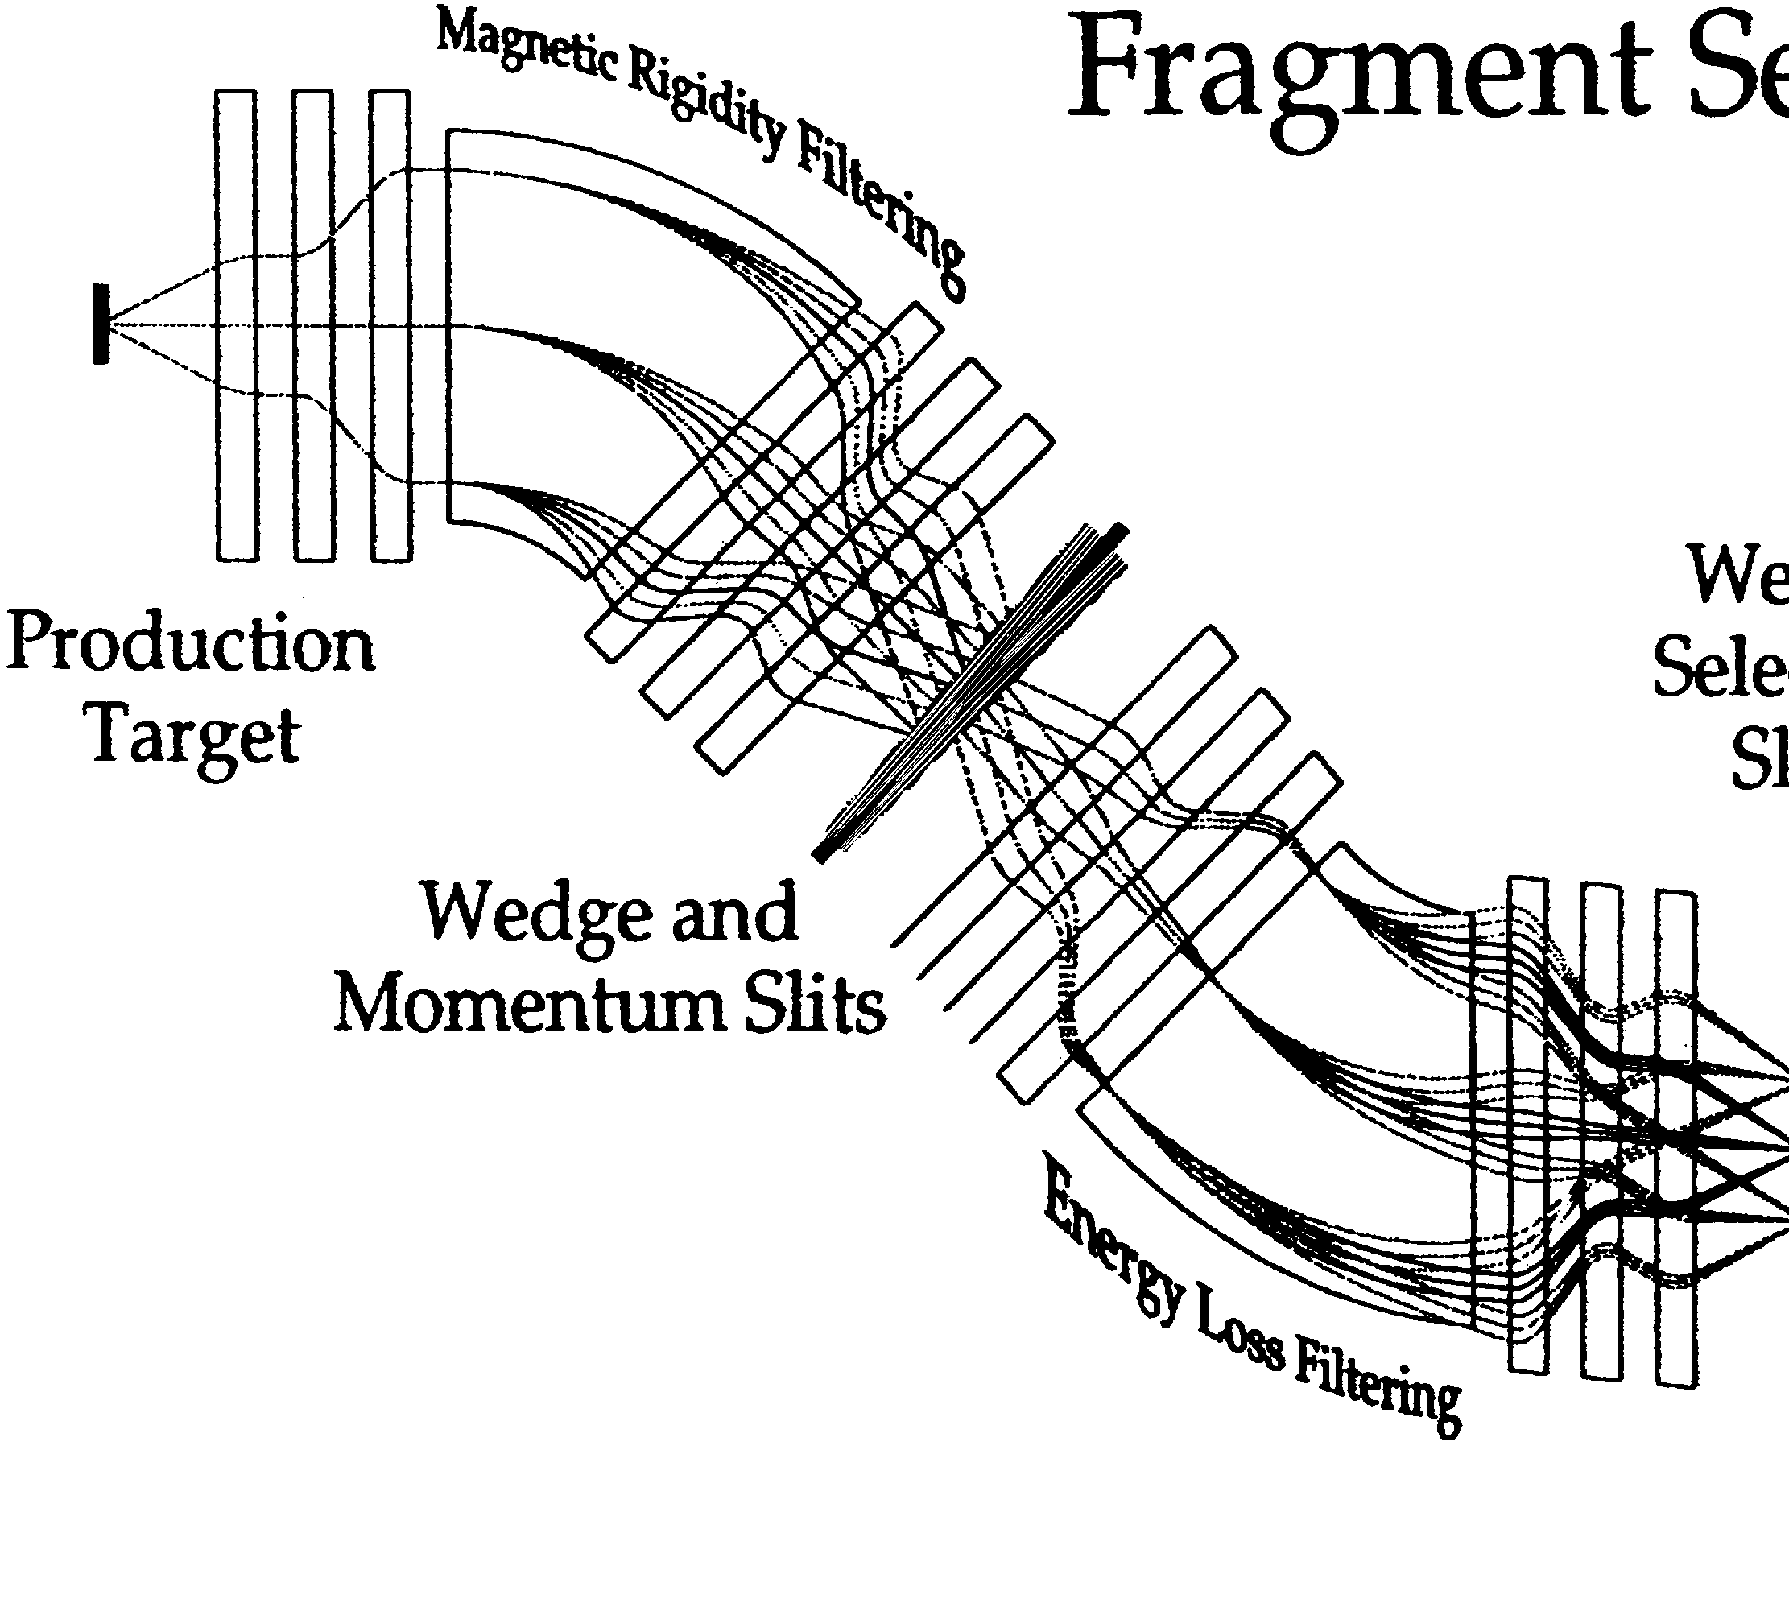
A separation method “in-flight”
(remember, we only have 42 ms before
half of the nuclei produced disappear)
Beam, ⁵⁸Ni
74.5 MeV/u
D1
ΔE
detector
D2
⁵²Ni
ToF

Slide 22
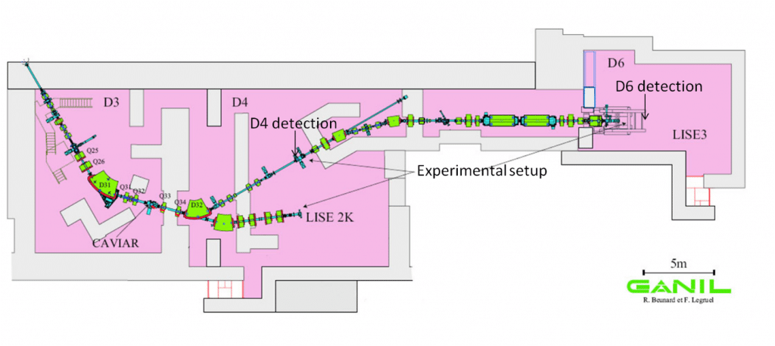
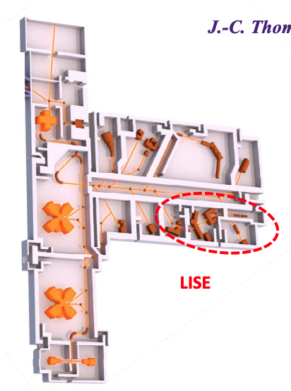
A separation method “in-flight”
(remember, we only have 42 ms before
half of the nuclei produced disappear)
The LISE spectrometer at GANIL
a 40 years old facility, 20 m.
GANIL
accelerators
A
Beam, ⁵⁸Ni
74.5 MeV/u
D1
ΔE
detector
D2
⁵²Ni
To the
Experimental
set-up
ToF
Notes:
Two cyclotrons, to produce the HI beam , LISE spectrometer, 20 m od separator, the products have different trajectories, but many of them arrive to the final focal plane

Slide 23
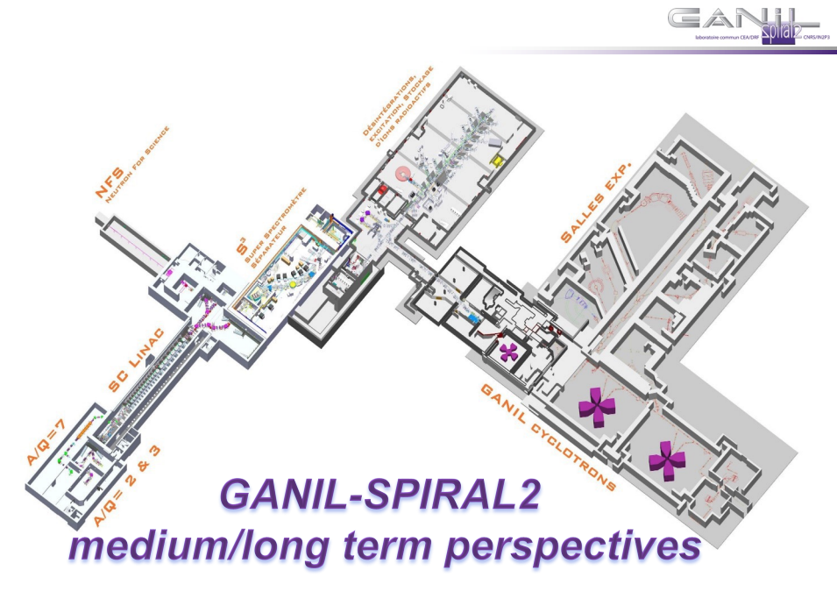
(Parenthesis)
(GANIL has evolved a lot since then
and a good part of SPIRAL II is either working or
being constructed)
(End of Parenthesis)

Slide 24


⁵²Ni
⁵²Co
The experimental set-up
e+
ν
⁵² Ni
ν are difficult to detect
β can be detected but the energy is
not well defined
But we can detect the radiation after
the β decay: gamma rays and protons
0⁺
1⁺
β⁺
1⁺
Sp
1⁺
6⁺
⁵²Co
Notes:
Remember p separation energy low

Slide 25




The experimental set-up:
Implantation and charged particle
detectors
⁵²Ni
⁵²Co
e+
γ
ν
γ
e+
⁵²Ni

Slide 26
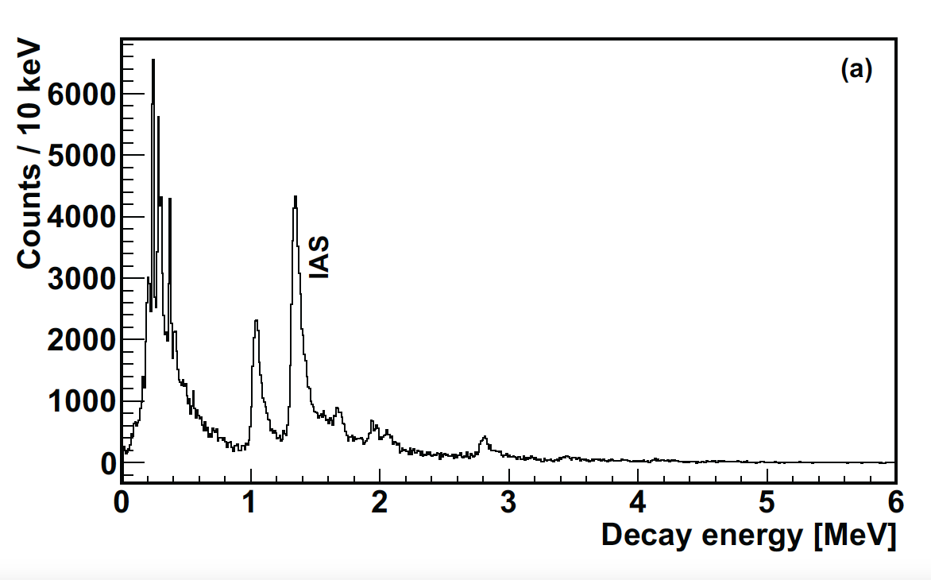









The experimental set-up:
Implantation and charged particle
detectors
⁵²Ni
⁵²Co
e+
γ
ν
γ
DSSSD charge particle detector spectrum
e+
e+
⁵²Ni
Proton spectrum
DSSSD

Slide 27
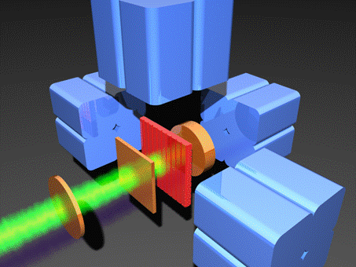
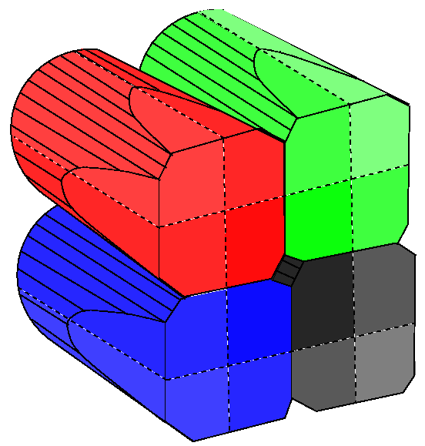
Exogam Germanium detectors

Slide 28
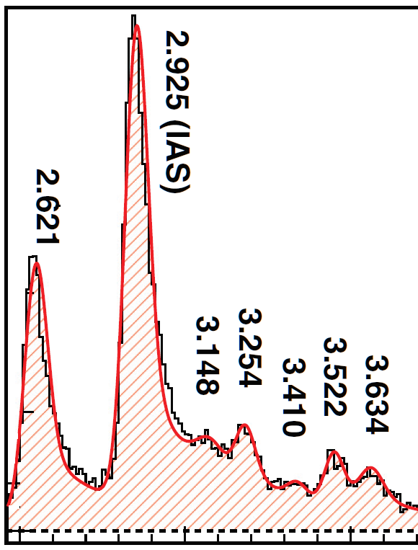
The β decay, and in particular de F decay, allows us to identify a single level with a very well define nuclear structure in a region of high level density,. This is very un usual
πf_{7/2}→νf_{7/2}
T=2
T_{z}=-2
T=2
T_{z}=+2
0⁺
⁵²₂₈Ni₂₄
T_{1/2}=43 ms
β⁺
⁵²₂₄Cr₂₈
F
β⁻
56%
T=2 IAS ???
T=2 IAS
0⁺
2926
1⁺
2622
1⁺
20 known levels
7.3%
Sp
1%
T=1
519
1⁺
T=1
378
2⁺
6⁺
6⁺
T=1
T_{z}=-1
β⁺
⁵²₂₇Co₂₅
⁵²₂₅Mn₂₇
T=1
T_{z}=+1

Slide 29
Unfortunately, nature does not help us to compare the two mirror processes β+
and β−, 52Cr is stable!
t_{z}= -2
t_{z}= -1
β+
β−

Slide 30

⁵²Cr
⁵²Mn
e-
β−
ν
e⁻
β−
⁵²Cr
ν
⁵²Mn

Slide 31
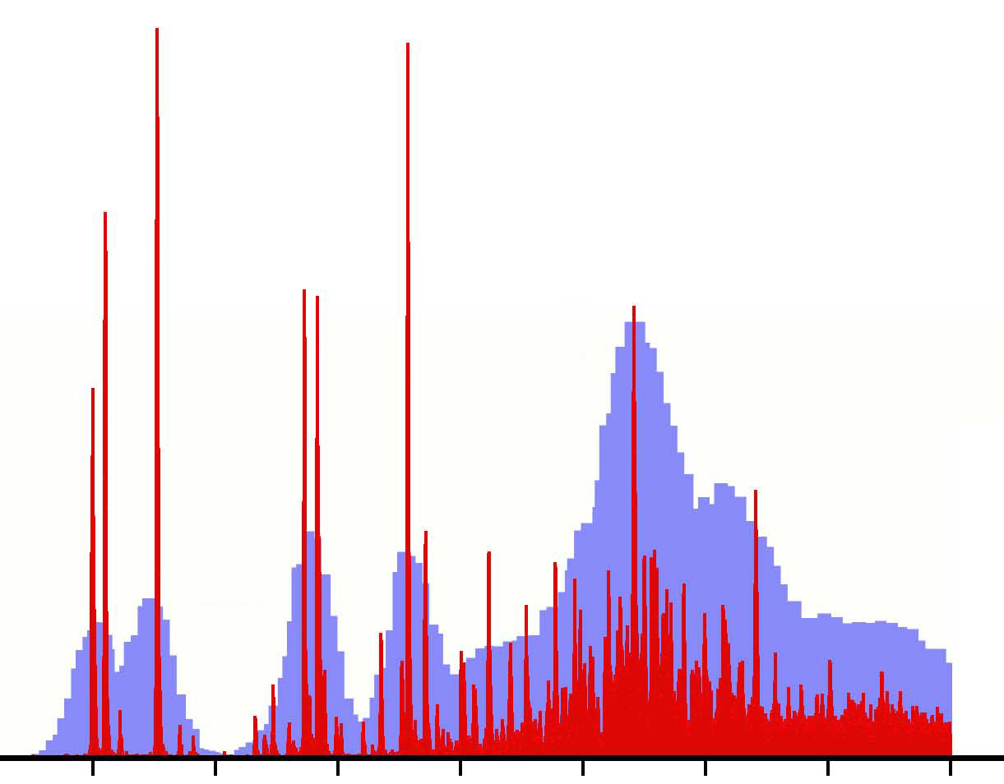

⁵²Mn
⁵²Cu
e-
β−
ν
e⁻
β−
⁵²Mn
ν
⁵²Cu
(p,n)
t (tritium)
58Ni(p,n)58Cu
J. Rapaport et al. NPA 1983
3He
(3He,t) reaction
58Ni(3He,t)58Cu
Y. Fujita et al. EPJA13 (2002)411

Slide 32
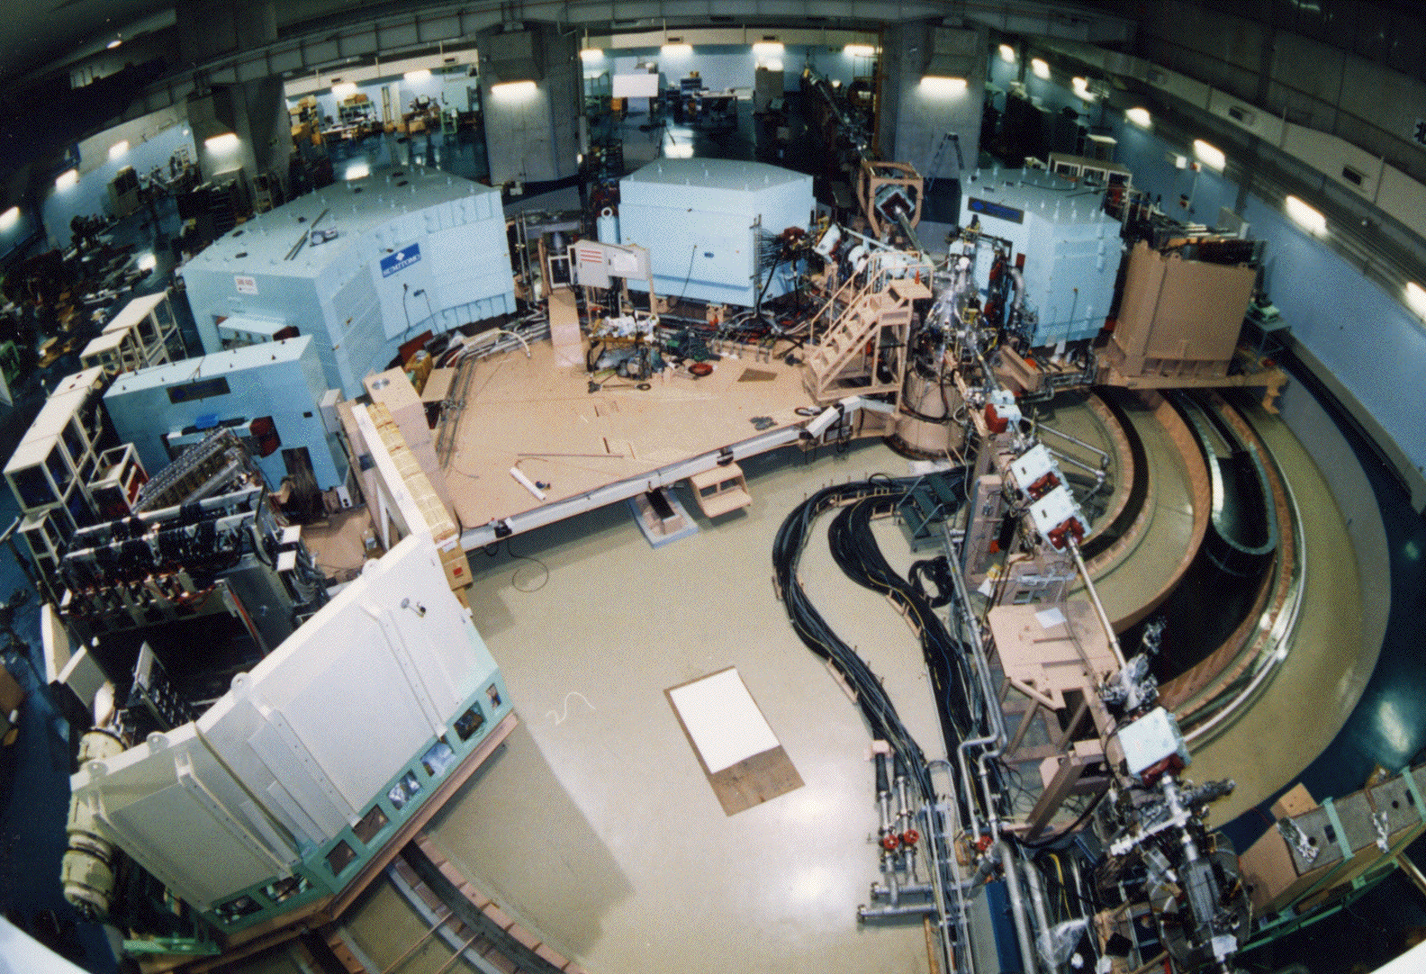
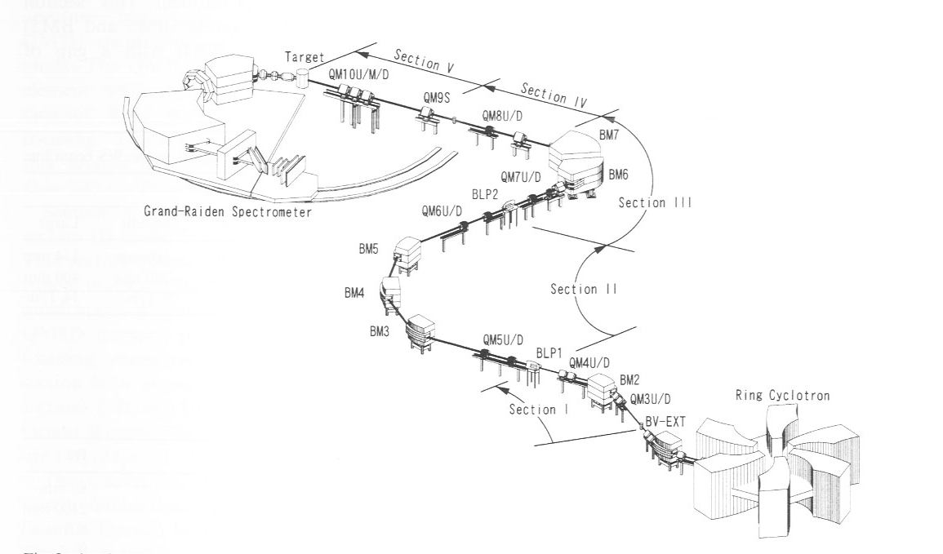
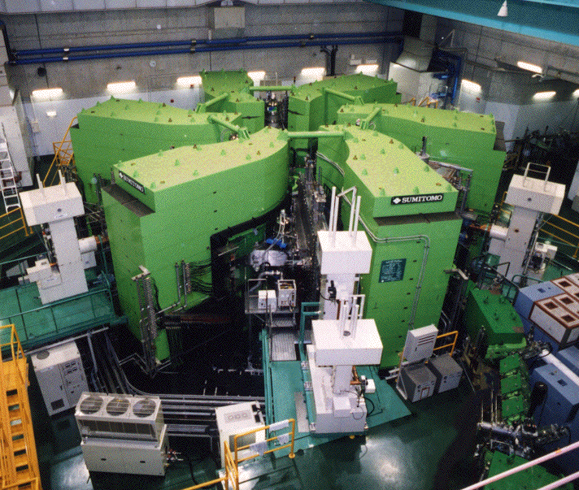
(3He,t) CE Reactions @ RCNP(Osaka)
3He
Notes:
Schematic view of the high resolution facility at RCNP Osaka, consisting of the RCNP Ring Cyclotron, a high dispersion beamline and the high resolution magnetic spectrometer Grand Ridden

Slide 33
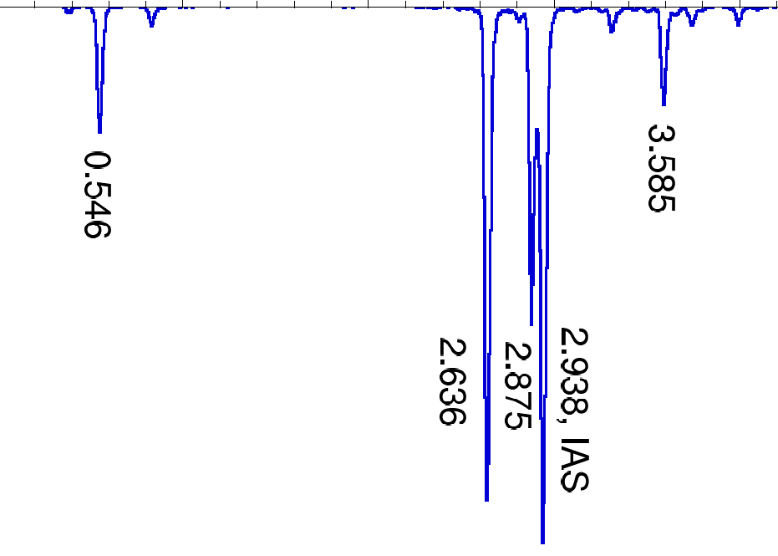
πf_{7/2}→νf_{7/2}
T=2
T_{z}=-2
T=2
T_{z}=+2
0⁺
0⁺
⁵²₂₈Ni₂₄
T_{1/2}=43 ms
β⁺
⁵²Cr (3He,t)
F
56%
T=2 IAS
0⁺
T=2 IAS
2938
0⁺
2926
1⁺
2875
1⁺
2622
20 known levels
1⁺
1⁺
2636
S. Orrigo et al.
PRC 93 (2016)
044336
Sp
T=1
519
1⁺
T=1
546
1⁺
2⁺
T=1
378
2⁺
T=1
378
6⁺
6⁺
Y. Fujita et al.
Acta Phys.Pol. B43,
153 (2012)
⁵²Co
T=1
T_{z}=-1
β⁺
⁵²Mn
T=1
T_{z}=+1
β⁺
Review paper: Y. Fujita, B. Rubio, W. Gelletly, Prog.Part.Nucl.Phys. 66 (2011) 549-606

Slide 34
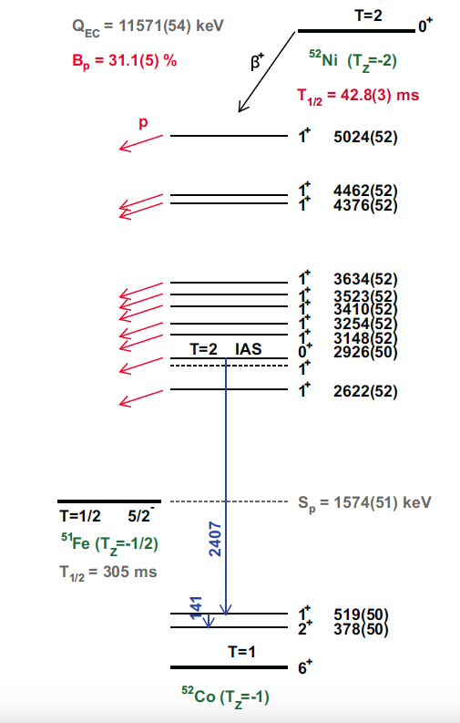
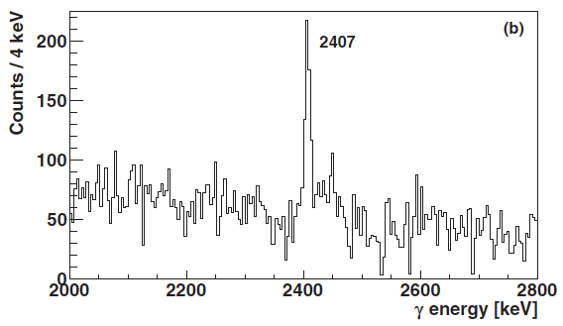
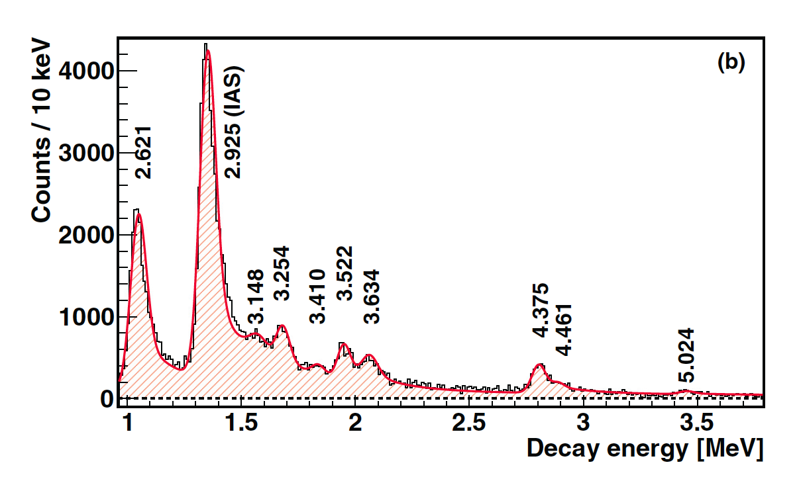
The proton decay of the IAS is isospin forbidden
52Co, IAS (T=2)→ 51Fe (T=1/2) + p (t=1/2)
As a consequence, proton and γ de-excitation compete
Proton decay
γ
protons
γ decay
Notes:
Explain again here why isopin purity

Slide 35
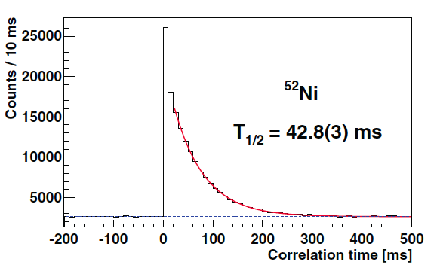


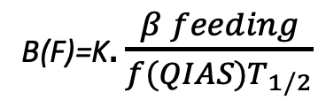
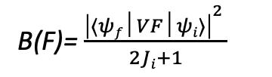
The Fermi Strength
B(F)=K$. \frac{β feeding}{f(QIAS)T_{1/2}}$
Number of implanted ions
Number of decaying protons
Number of decaying γ rays
B(F)= $\frac{{\left|⟨ψf│VF│ψi⟩\right|}^{2} }{2Ji+1}$
= $\frac{ N−Z}{2}$
B(F) ^{expected} = 4
B(F) ^{experimental} = 4.1 (8)

Slide 36

Does Isospin always work so perfectly?
Can two states with different isospin mix?
In fact, not so far away….

Slide 38
t_{z}= -2
β+
(3He,t)
t_{z}= +2

Slide 39
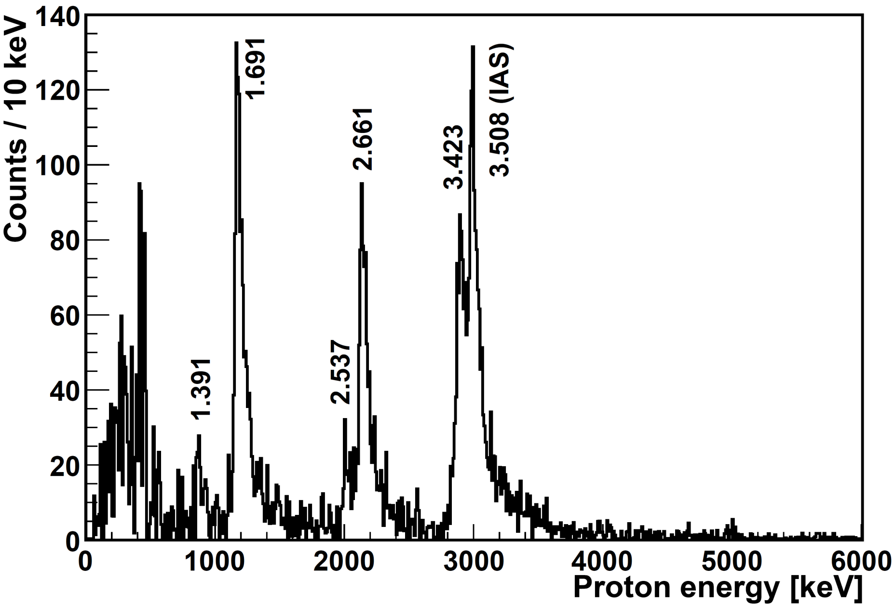
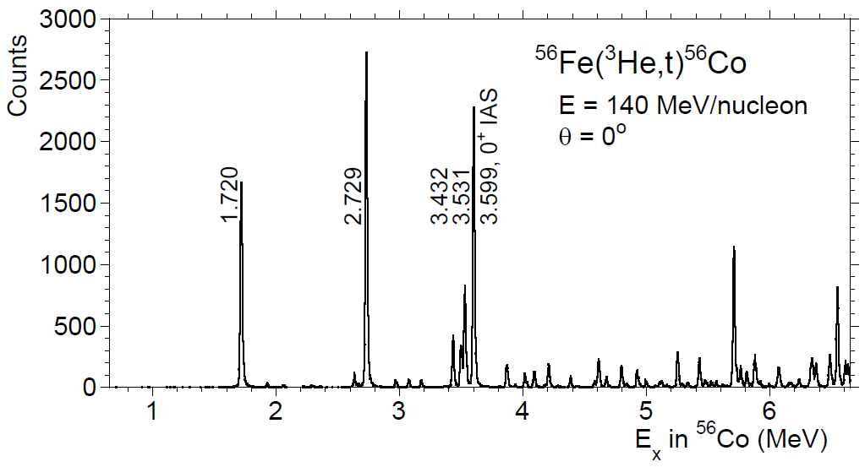
Comparison of 56Zn β+ decay and 56Fe “β-”(3He,t)
First observation, mirror symmetry works beautifully here (not such a surprise)
β+
⁵⁶Zn → ⁵⁶Cu
Orrigo et al.
PRL 112 (2014) 222501
H. Fujita et al., Annual Report
RCNP Osaka (2010)
Notes:
E_{x} = (56/55)*E_{p} + 560 keV. Besides, E’_{p}=E_{p} - 44 keV to account for the external calibration made with alpha-source (recalibrated on 53Ni peaks).
Error = +- 10 keV. Beta-decay energy resolution ~ 70 keV. CE energy resolution ~ 20 keV.

Slide 40
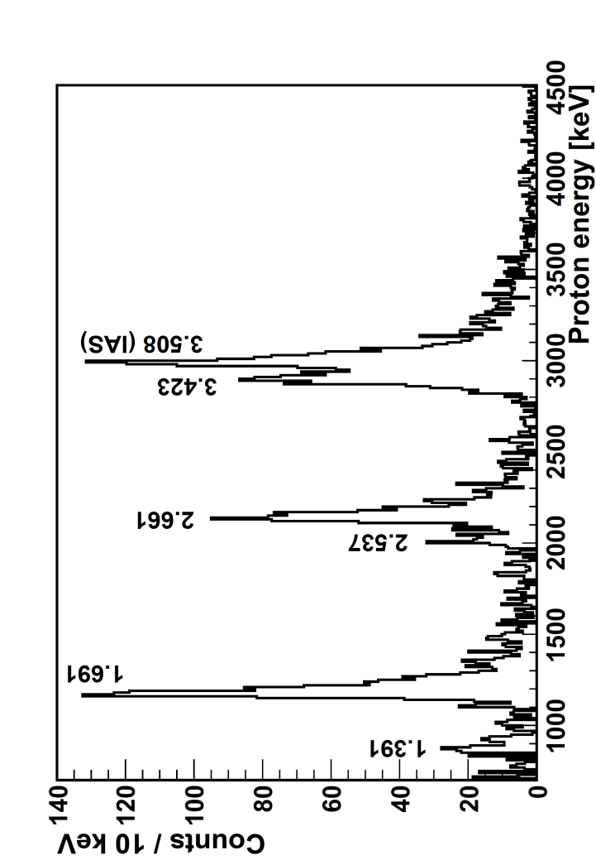

Second surprise:
This is the first
observation of
Beta-delayed
gamma-proton
decay in the fp shell
T = 2
0+
⁵⁶Zn
T_{Z} = -2
β
T = 2
IAS
0+
1+
T = 1
γ
1+
T = 1
1+
P
T = 1
S_{p} = 560 keV
⁵⁵Ni
⁵⁶Cu
T_{Z} = -1
Notes:
“X” means hindrance of the p-decay of the IAS, because it is isospin forbidden. The p-decay of the IAS is ispospin forbidden, but it has been observed. The only possible gamma branching is expected from the decay of IAS. This is confirmed by the fact that we observe the de-excitation gamma-ray at 1835 keV. In CE the existence of isospin mixing T = 1 and T = 2 in the mirror 56Co IAS is seen. Thus the p-decay can be due to the T = 1 component of the IAS.

Slide 41
Third surprise:
B(F) is not 4 as
expected
T = 2
0+
⁵⁶Zn
T_{Z} = -2
β
⁵⁶Zn → ⁵⁶Cu
T = 2
IAS
0+
B(F)=2.5
1+
T = 1
γ
1+
T = 1
H. Fujita et al., PRC 88,054329 (2013)
1+
T = 1
S_{p} = 560 keV
⁵⁶Cu
T_{Z} = -1
Notes:
“X” means hindrance of the p-decay of the IAS, because it is isospin forbidden. The p-decay of the IAS is ispospin forbidden, but it has been observed. The only possible gamma branching is expected from the decay of IAS. This is confirmed by the fact that we observe the de-excitation gamma-ray at 1835 keV. In CE the existence of isospin mixing T = 1 and T = 2 in the mirror 56Co IAS is seen. Thus the p-decay can be due to the T = 1 component of the IAS.

Slide 42
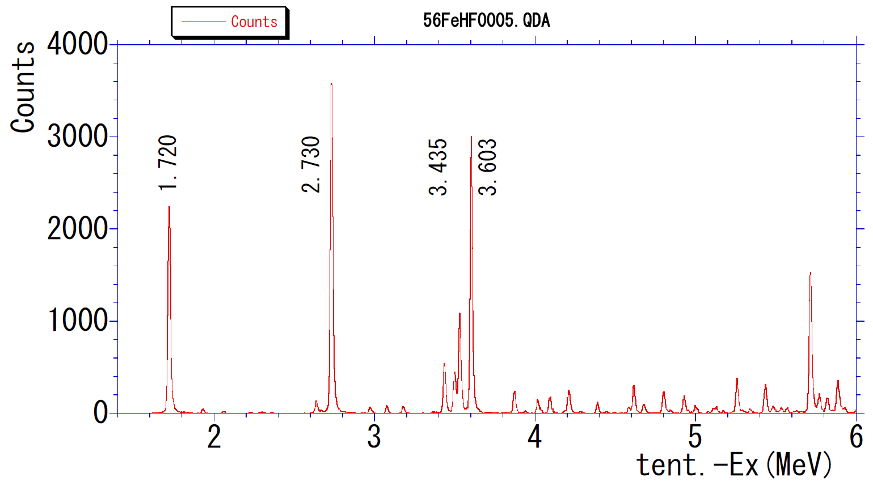
IAS 0+
⁵⁶Fe(³He,t)⁵⁶Co
E = 140 AMeV
ϑ = 0°
3.533
IAS 0+
⁵⁶Co excitation energy [MeV]

Slide 43
Yes, isospin mixing exists at the nuclear level and
can be quantified as in the present example.
(One can imagine many experimental improvements).
T = 2
0+
⁵⁶Zn
T_{Z} = -2
β
⁵⁶Zn → ⁵⁶Cu
T = 2
IAS
0+
B(F)=2.5 (5)
0+
B(F)=1.5
T = 1
γ
1+
T = 1
IAS(56Cu)=77%(T=2)+33%(T=1)
And the charge dependent part
Of the Hamiltonian, responsible for
the mixing can be deduced: Hc=40(23) keV
Orrigo et al. PRL 112 (2014) 222501
(to be compared with 32.3(5) keV
H. Fujita et al. PRC 88,054329 (2013))
1+
T = 1
S_{p} = 560 keV
⁵⁶Cu
T_{Z} = -1
Notes:
“X” means hindrance of the p-decay of the IAS, because it is isospin forbidden. The p-decay of the IAS is ispospin forbidden, but it has been observed. The only possible gamma branching is expected from the decay of IAS. This is confirmed by the fact that we observe the de-excitation gamma-ray at 1835 keV. In CE the existence of isospin mixing T = 1 and T = 2 in the mirror 56Co IAS is seen. Thus the p-decay can be due to the T = 1 component of the IAS.

Slide 44
How far can one go in the Tz=-2 chain?

Slide 45
64Se is the
heaviest Tz=-2 β-bound
nucles
Tz=-2
2p
2p
But they were a lot more difficult to produce!!
Because they needed fragmentation of 78Kr
2p
Tz=+2
64Zn is the heaviest Tz=+2 stable targets
B. Rubio, Cocoyoc, 2019 Jan 10th

Slide 46
64Se is the
heaviest Tz=-2 β-bound
nucles
Tz=-2
2p
2p
2p
Tz=+2
64Zn is the heaviest Tz=+2 stable targets
B. Rubio, Cocoyoc, 2019 Jan 10th

Slide 47

RIKEN

Slide 48
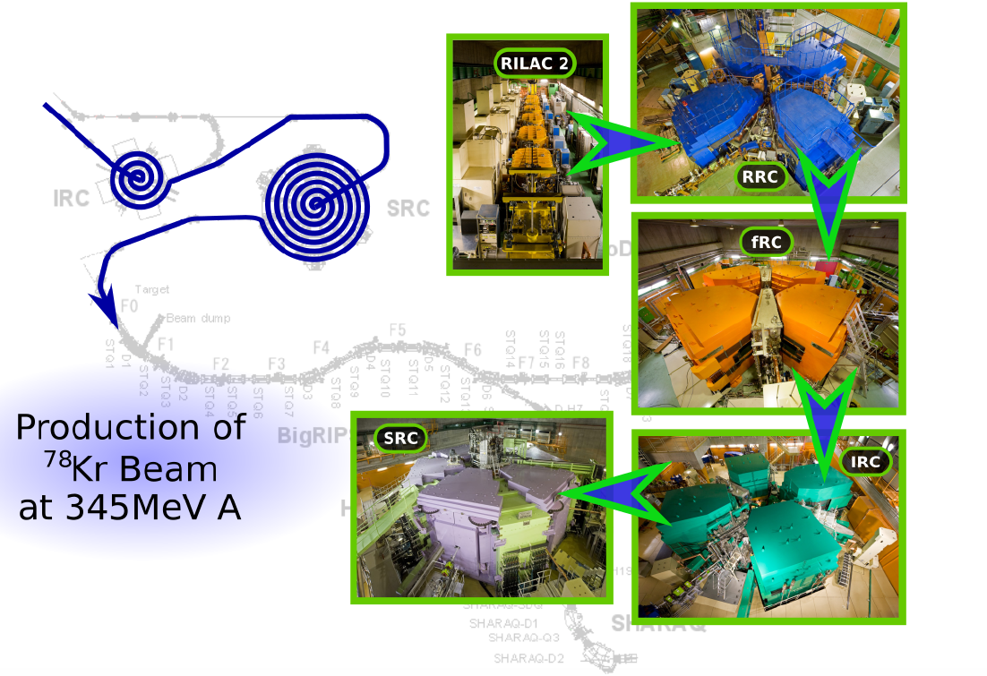
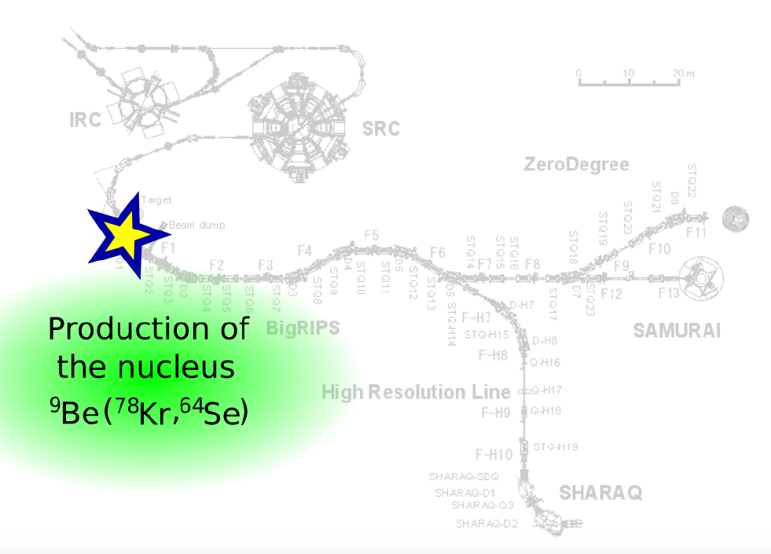
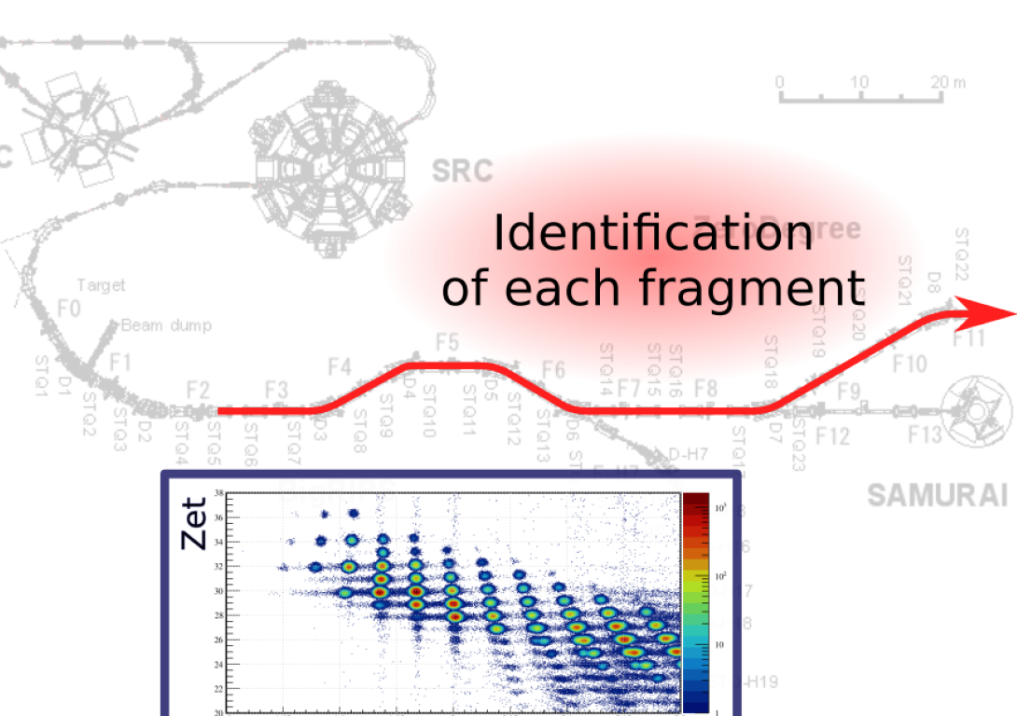

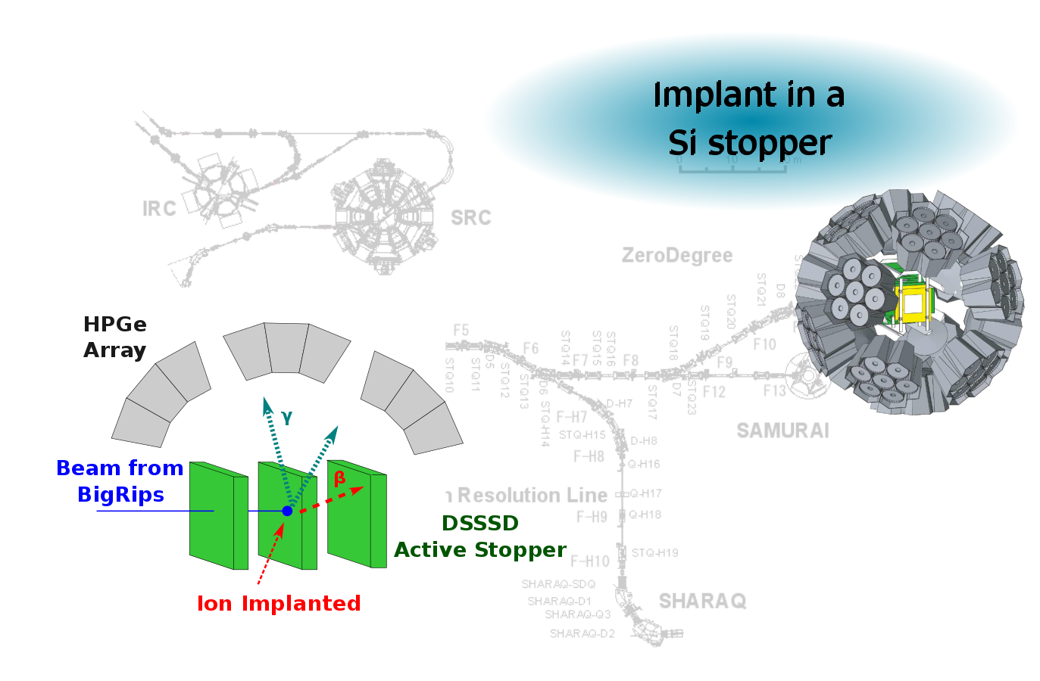
BigRips
200pnA
Five accelerators
17 years old
77 m long
P. Aguilera, Ph. D thesis
Santiago de Chile
and submitted to PRC
EURICA: 12 EUROBALL
Ge CLUSTERS

Slide 49
This is the heaviest T=2 multiplet that exits
T=2
0+
T=2
0+ IAS
T=2 multiplet
T=1 multiplet
T=1
0+
T=1
0+ IAS
⁶⁴As
63 ms
F. Diel et al. (3He,t)
Phys. Rev. C 99, 054322 (2019)
All these information from β+
Decay studies at RIKEN
P. Aguilera et al.

Slide 50
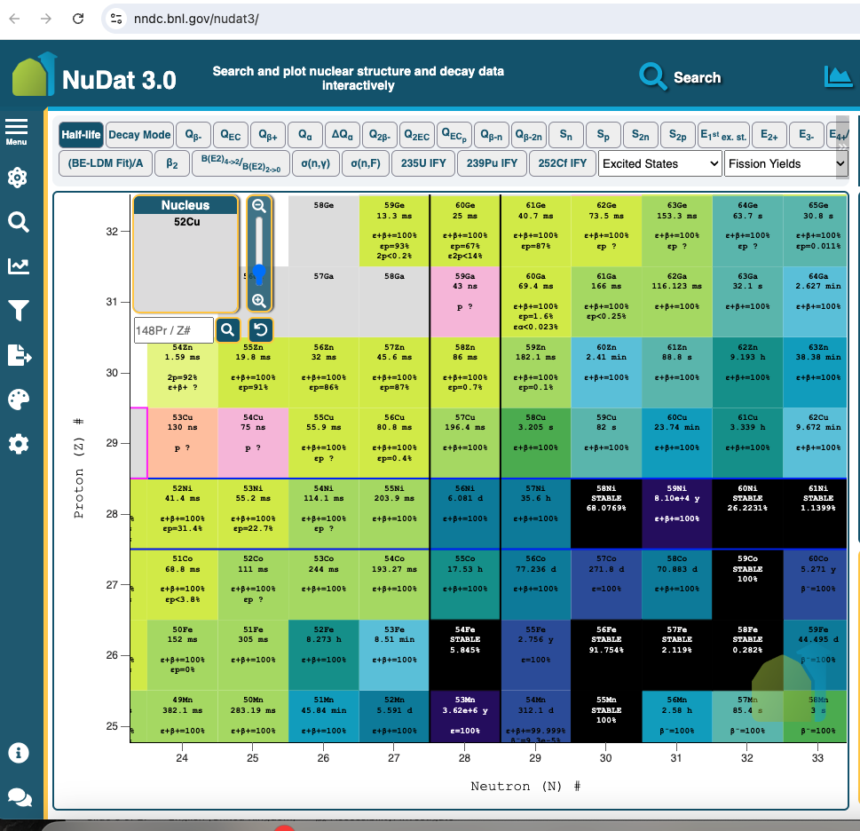
N=Z line

Slide 51
Tz=-2
T=2
Tz=-1
T=1
Tz=-0
T=0
or
T=1
Tz=+1
T=1
Tz=+2

Slide 52
t_{z}=0 or N=Z nuclei
Only because
isopin mixing
Exists, we can observe
In beta decay some
small fragment
of the Fermi transition.
(example 66Ga)
Only in this part of
the nuclide table
Fermi “superallowed”

Slide 53
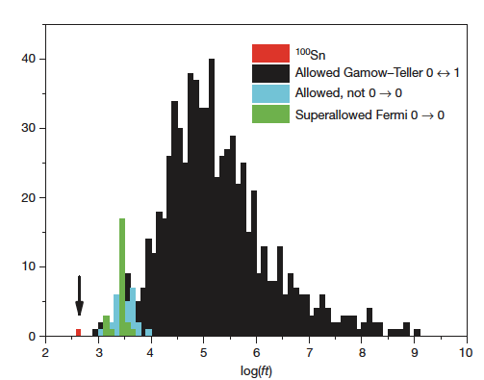
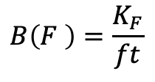

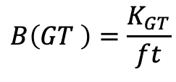
$$B\left(F \right)=\frac{K_{F}}{ft}$$
$$t=\frac{T_{1/2}}{feeding}$$
$$B\left(GT \right)=\frac{K_{GT}}{ft}$$
Figure from C.B. Hinke et al., Nature 486, 341 (2012)

Slide 54
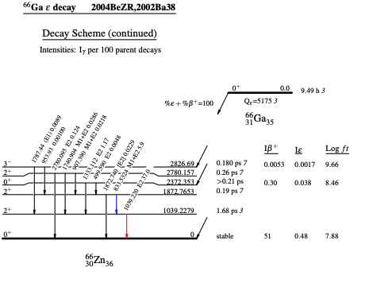
Superallowed
Fermi transitions
log ft=7.8
Not Superallowed
Fermi transition

Slide 55
Conclusions
Isospin is really a very useful concept understanding the beta decay
through the Fermi decay.
Fermi decay allow us to locate states
of very well defined isospin (and structure) in regions of excitation energy
where the level density is already high. It is an extremely clean probe.
Its probability is easy to calculate and model independent.
It is important for our understanding of proton rich exotic nuclei.
States of different isospin can mix and the Fermi decay provide us with
the “amount” of mixing in a very clear way, and information on the
isospin component of the nuclear force.
Superallowed beta decay, if it happens, dominates the decay and
consequently is the main contributor to the half life: it is very fast.
I have shown few examples of these ideas and show that they hold
close to the drip line. Maybe it was expected, but one had to test them experimentally.
We have learned many more things in our measurements, but I have concentrated
on the idea of isospin in this talk

Slide 56
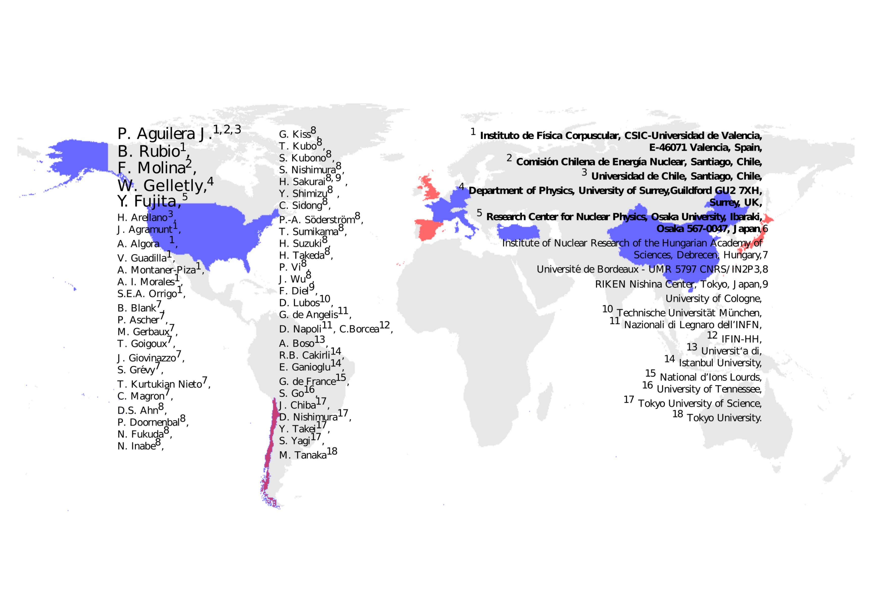


The Collaboration
P. Aguilera
S. Orrigo
F. Molina
B. Rubio
W. Gelletly
Y. Fujita

Slide 57
Thank you for your attention

Slide 59
$$B\left(F \right)=\frac{K_{F}}{ft}$$
100Sn allowed GT
transition
$$t=\frac{T_{1/2}}{feeding}$$
$$B\left(GT \right)=\frac{K_{GT}}{ft}$$

Slide 61
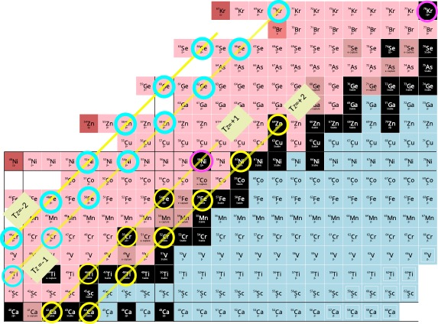

Slide 62
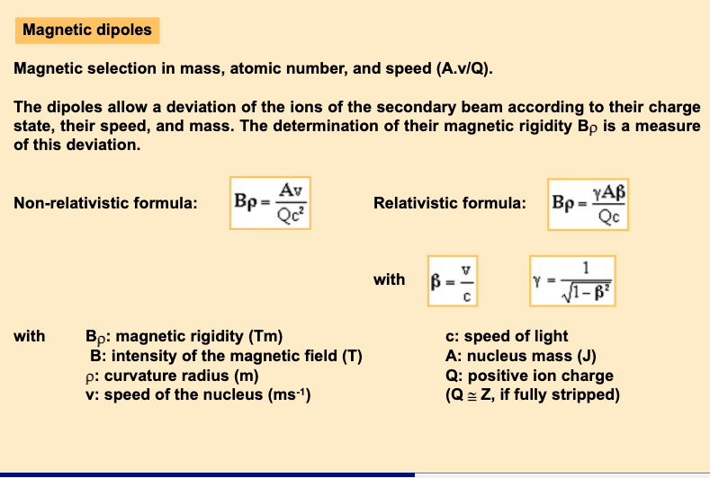

Slide 63
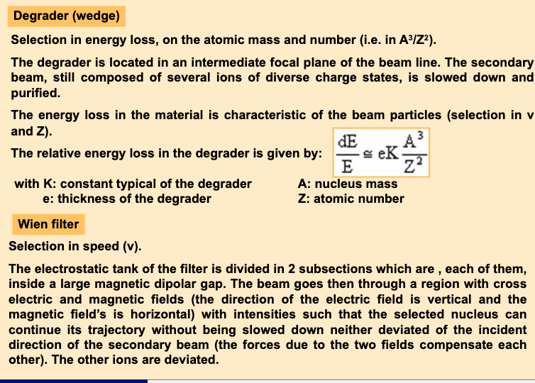

Slide 64
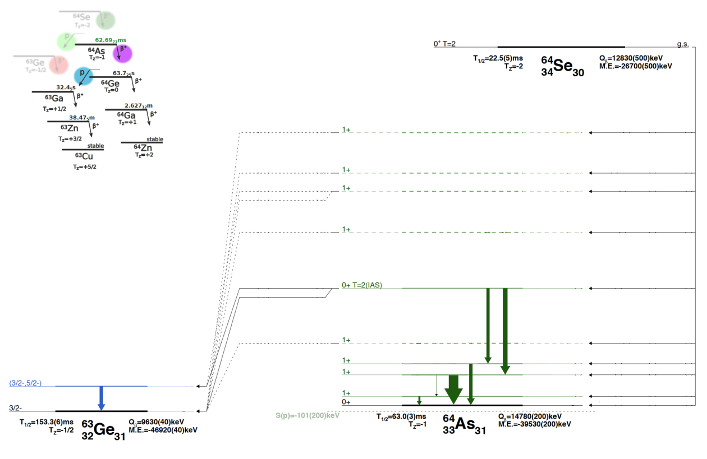
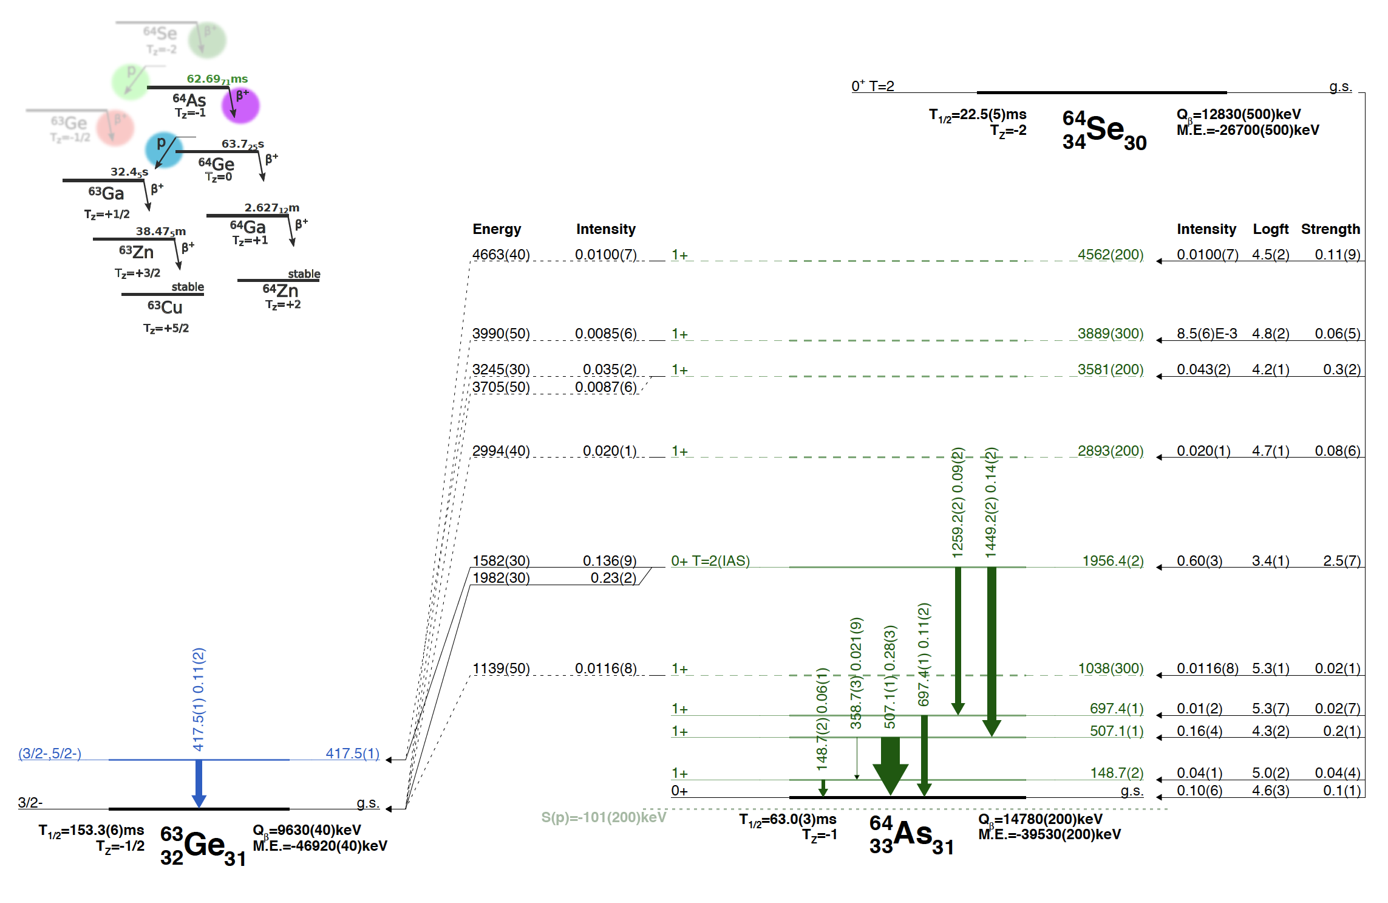
The decay of Tz=-2 ⁶⁴Se, the heaviest beta-decaying Tz=-2 that exists
B. Rubio, IFIC-Valencia, Nuclear Tapas 2023

Slide 65

This is the heaviest T=2 multiplet that exits
IAS
T=2
⁶⁴Se
⁶⁴Zn
-27429 (100)keV
IAS
T=1
⁶⁴As
-39597(44)
⁶⁴Ga
P. Aguilera, Ph. D thesis
Santiago de Chile
and submitted to PRC
Tz=0
⁶⁴Ge

Slide 66







β decay and isospin
(allowed transitions)
F
e⁺ tz=+1/2
t_{e} + t_{ν}=0
ν
tz=+1/2
Fermi decay, no change in isospin
$p→n+e+ +$ν
GT
e⁺
tz=+1/2
t_{e} + t_{ν}=1
ν
tz=+1/2
Gamow Teller decay isospin can change in one unit

Slide 67
Under certain experimental conditions charge-exchange
reactions are mirror processes of beta decay
Both processes are governed by the στ operator
We could use β+
on the Tz= -1 side
And a charge-exchange reaction
on the Tz= +1 side
ν
β+
p
n
Notes:
We could use two processes that are very similar and under certain circumstances could be considered as mirror processes

