Slide 1
Gaussian Expansion Method and its application to resonant states in nucear and hadron physics
E. Hiyama (Kyushu Univ./RIKEN)

Slide 2
Currently, it is interesting to study resonance states in nuclear and hadron phyics.
One of Epoch-making data :tetra neutron system (many talks in this workshop)
In hadron physics
Tetra quark systems and pentaquark systems
One of Epoch-making data: heavy penta quark system at LHCb
Then, it is interesting to challenge these two subjects using our method,
Gaussian Expansion Method.

Slide 3
Outline of my talk
(1) Gaussian Expansion Method
(2) tetra neutron system structure with complex scaling method
(2)heavy penta quark system with real scaling method

Slide 4
Our few-body caluclational method
Gaussian Expansion Method (GEM) , since 1987
,
・A variational method using Gaussian basis functions
・Take all the sets of Jacobi coordinates
Developed by Kyushu Univ. Group,
Kamimura and his collaborators.
Review article :
E. Hiyama, M. Kamimura and Y. Kino,
Prog. Part. Nucl. Phys. 51 (2003), 223.
High-precision calculations of various 3- and 4-body systems:
Exotic atoms / molecules ,
3- and 4-nucleon systems,
multi-cluster structure of light nuclei,
Light hypernuclei,
3-quark systems,

Slide 5

Gaussian Expansion Method (GEM)
r
r
2
R
R
R
1
2
3
1
r
C=2
3
C=1
C=3
Notes:
Determined by diagonalizing H

Slide 6

r
r
2
R
R
R
1
2
3
1
r
C=2
3
C=1
C=3
Basis functions of each Jacobi coordinate
C_{NL,lm}
Determined by diagonalizing H

Slide 7
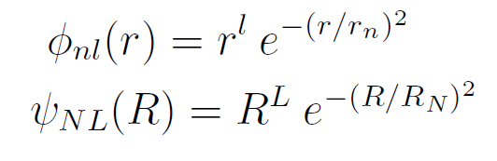
Radial part :
Gaussian
function
Gaussian ranges
in geometric
progression
Both the short-range correlations and the exponentially-damped tail are simultaneously reproduced accurately.
R
In the case of four-body problem,
We have one more Jabobi coordinate.
r
ρ

Slide 8
Next, by solving eigenstate problem, we get
eigenenergy E and unknown coefficients C_{n .}
( H_{i n}) - E ( N_{i n} )
C_{n}
=0
In principle, we can apply this method to N-body problem.
However,…

Slide 9
By solving eigenstate problem, we get
eigenenergy E and unknown coefficients C_{n .}
( H_{i n}) - E ( N_{i n} )
C_{n}
=0
The problem:
we need huge memory to calculate N-body systems.
Up to know, it became to calculate five-body problem.
In the case of four-body problem, it was already possible
to calculate bound state and resonant state.
I will show you the results.

Slide 10
To show that our method can provide with accurate energies and wavefunction,
・We performed a benchmark test calculation for the ground state of 4He using
AV8 NN potential among 7 different few-body research group.
Kamada et al., Phys. Rev. C64 (2001), 044001

Slide 11
Benchmark-test 4-body calculation : Phys. Rev. C64 (2001), 044001
by 7 groups
⁴He
①
②
n
n
③
p
p
④
4 nucleon
bound state
⑤
Realistic NN
force: AV8’
⑥
⑦

Slide 12
Benchmark-test calculation of the 4-nucleon bound state
Good agreement among 7different methods
In the binding energy, r.m.s. radius and wavefunction density
GEM
ours
Notes:
ours

Slide 13
4n breakup threshold
Exp.
E(MeV)
～-1.0 MeV
～3 MeV
Γ=2.6 MeV (Upper limit)
Now, we have new data for tetraneutron system.
Theoretical important issue:
・Can we describe observed 4n system using realistic NN interaction and T=3/2
three-body force?
Motivated by experimental data, we started to study tetra neutron system.
E. Hiyama, R. Lazauskass, J. Carbonell and M. Kamimura, Phys. Rev. C93, 044004 (2016)

Slide 14
To answer these issues,
We employ AV8 NN potential + a phenomenological three-body force.
These parameters (W₁,W₂,b₁,b₂) are determined so as to reproduce the binding energies of the ground states of ³H, ³He and ⁴He. E. Hiyama, M. Kamimura, and B.F. Gibson, PRC70, 031001(R) (2004).
For 4n system, we need T=3/2 three-body force. We use the
same potential with T=1/2, but, different parameter of W₁.
W₁(T=3/2)= free b₁=4.0fm => W₁ should be adjusted so as to reproduce
the observed 4n system
W₂(T=3/2) = +35 MeV b₂=0.75

Slide 15
The observed 4n system was reported from the bound region to resonant region.
In order to obtain energy position (E_{r}) and decay width (Γ), we use complex
scaling method.
The energy pole is stable
with respect to θ.
Re(E) corresponds to energy
With respect to 4n breakup threshold.
Im(E) corresponds to Γ/2.
4n breakup threshold

Slide 16
energy trajectory of J=0+ state changing W₁

Slide 17
In order to reproduce the data of 4n system,
We need W₁(T=3/2)= -36 MeV～-30MeV.
It should be noted that W₁(T=1/2)=-2.04 MeV
to reproduce the observed binding energy
of ⁴He, ³He and ³H.
Attraction is 15 times
Stronger.
Exp.
W₁(T=3/2)= free b₁=4.0fm
W₂(T=3/2) = +35 MeV b₂=0.75 fm
Question: W₁ value for T=3/2 is reasonable?
To check the validity of three-body
force, we calculate the energies
of ⁴H,⁴He(T=1),⁴Li.

Slide 18
p
n
⁴H
p
p
n
n
⁴Li
n
p

Slide 19
Exp. ⁴H (-5.29 MeV)
If we use W₁=-36MeV～-30 MeV
to reproduce the observed data of 4n,
We have strong binding energies
of ⁴H, ⁴He (T=1) and ⁴Li.
This result is inconsistent with
the data of A=4 nuclei.
The J=2⁻ state of A=4 nuclei
should be resonant states.
On the contrary, when W ₁～-18 MeV, we have unbound states for A=4 nuclei. How about tetraneutron system?

Slide 20
If W₁(T=3/2)～-18 MeV, the energy of tetraneutron is ～-6MeV,
and Γ=8MeV, which is inconsistent with recent data of
tetraneutron.
It should be noted that W₁(T=1/2)=-2.04 MeV
to reproduce the observed binding energy
of ⁴He, ³He and ³H.
still 9 times strong attraction
Exp.
W₁(T=3/2)= free b₁=4.0fm
W₂(T=3/2) = +35 MeV b₂=0.75 fm

Slide 21
How do we consider this inconsistency?
・The T=3/2 force is just a phenomenological.
Appearance of tetraneutron is dependent on Hamiltonian employed
or dependent on method employed?
We employ INOY potential. But we do not have any sharp resonant state.
After the confirmation on tetraneutron system experimentally,
To check the method, It might be necessary to have benchmark test for 4n resonant state
using the same NN interaction.

Slide 22
Outline of my talk
(1) tetra neutron system structure with complex scaling method
(2)heavy penta quark system with real scaling method

Slide 23
q
q
c
q
c
4380±8±29

Slide 24
To describe the data of Pc(4380)⁺ and Pc(4459)⁺ state, there are theoretical
effort.
・Cusp?
Phys. Rev. D92 071502 (2015), Phys. Lett. B751 59 (2015)
・Meson-Baryon state?
Phys. Rev. Lett. 115 172001(2015), Phys. Rev. D92 094003 (2015)
Phys. Rev. Lett. 132002 (2015), Phys. Rev. D92 114002 (2015)
Phys. Lett. B753 547 (2016)
・Baryoncharmonnia
Phys. Rev. D92 031502 (2015)
・Tightly bound pentaquark states
Eur. Phys. J. A48 61 (2012), Phys. Lett. B 749 454 (2015),
Phys. Lett. B749 289 (2015) , Phys. Lett. B764 254 (2017) etc.

Slide 25
Motivated by the experimental data of pentaquark system at LHCb,
We calculate this system within the framework of non-relativistic
constituent quark model.
Σc*+D*
q
q
c
Σc+D*
q
Pc(4450)
c
Σ*+D
This is 5-body problem and it requested to calculate
resonant state. Then, we should develop our method
For resonant state.
J/Ψ+Δ
Σc+D
Λc+D*
Δ+ηc
To describe the experimental data,
It is necessary to reproduce the observed
threshold.
The Hamiltonian is important
to reproduce the low-lying energy
spectra of meson and baryon system.
Pc(4380)
Λc+D
J/Ψ+p

Slide 26
Hamiltonian
ーΛ/r
Λ=0.1653GeV²
K=0.5069
ξ_{α}=(2π/3)kp β=A((2m_{i}m_{j})/(m_{i}+m_{j}))^{(-B)}
Kp=1.8609 A=1.6553 B=0.2204
B. Silvestre-Brac and C. Semay,
Z. Phys. C 61 (1994) 271
m_{q}=315 MeV, m_{c}=1836 MeV

Slide 27
Cal. Exp.
Baryon
N: 953 MeV 939 MeV
Δ: 1265 MeV 1232
Λc: 2276 MeV 2286
Σc:2451 MeV 2465
Σc*:2531 MeV 2545
Meson
D: 1862 MeV 1870
D*:2016 MeV 2010
J/Ψ:3102 MeV 3094
ηc :3007 MeV 2984
χ_{c} l=1,s=0: 3462.4 MeV hc:3525 MeV
L=1,S=1 :3486.5 MeV 3530 MeV
Calculated energy spectra for meson and baryon systems are in good agreement with the observed data.

Slide 28
q
C
C
q
q
4
3
q
q
q
q
C
C=1(J/Ψ+p,ηc+p)
C=2(Λc+D,Σc+D)
C=3
C=4
Ψ_{JM}(qqqcc)= Φ_{JM}^{(C=1)} +Φ_{JM} ^{(C=2)} +φ_{JM}^{(c=3)} +Φ_{JM} ^{(C=4)}
Φ_{αJM}(qqqcc)=A_{qqqq}{[(color)^{(c)}_{α} (isospin)^{(c)}_{α}
(spin)^{(C)}_{α} (spatial)^{(c)}_{α}]_{JM}}

Slide 29
Wavefunction of
Color part
q
q
C
Similar for C=2
C
q
4
C
3
q
q
q
q
C=2(Λc+D,Σc+D)
1
X
1
=1

Slide 30
Confining channels
3
X
3
=3
3
X
3
=3
3
X
3=8 + 1
X
3=8 + 1
3
I take color singlet.
I take color singlet.

Slide 31
q
C
C
q
q
4
3
q
q
q
q
C
C=1(J/Ψ+p,ηc+p)
C=2(Λc+D,Σc+D)
C=3
C=4
Ψ_{JM}(qqqcc)= Φ_{JM}^{(C=1)} +Φ_{JM} ^{(C=2)} +φ_{JM}^{(c=3)} +Φ_{JM} ^{(C=4)}
Φ_{αJM}(qqqcc)=A_{qqqq}{[(color)^{(c)}_{α} (isospin)^{(c)}_{α}
(spin)^{(C)}_{α} (spatial)^{(c)}_{α}]_{JM}}
(spatial)^{(c)}_{α}=φ_{nl}^{(c)}(r_{c})ψ_{νλ}^{(c)}(ρ_{c})φ^{(c)}_{kj}(s_{c})Φ_{n LM}^{(c)}(R_{c})
Same procedure
is taken for
r,ρ, and s.
R

Slide 32
For the Pc(4380) and (4450), we consider the following 9 candidates states,
Total orbital angular momentum: L=0, 1, 2
Total Spin : S=1/2, 3/2, 5/2
For example, in the case of total orbital angular momentum L=0, S=1/2, 3/2, 5/2, J^{π}=1/2⁻,3/2⁻,5/2⁻
We take s-waves for all coordinates.
q
C
C
q
q
4
0
0
0
0
3
q
q
q
q
C
C=1(J/Ψ+p,ηc+p)
C=2(Λc+D,Σc+D)
C=3
C=4

Slide 33
(H-E)Ψ=0
By the diagonalization of Hamiltonian, we obtain N eigenstates for each J^{π}.
Here, we use about 40,000 basis functions.
Then, we obtained 40,000 eigenfunction for each J^{π}.
First, we investigate J=1/2-, namely, L(total angular momentum)=0, S(total spin)=1/2.
・・・・
・・・・
L=0,S=1/2 for example

Slide 34
q
C
C
q
q
4
3
q
q
q
q
C
C=1(J/Ψ+p,ηc+p)
C=2(Λc+D,Σc+D)
C=3
C=4
First, we take two channels.

Slide 35
Confining channels
3
X
3
=3
3
X
3
=3
3
X
3=8 + 1
X
3=8 + 1
3
I take color singlet.
I take color singlet.

Slide 36
Σc*+D*(4587)
N+J/Ψ*(4584)
N+ ηc* (4544)
Σc+D*(4505)
Pc(4450)
Σc+D(4353)
Λc+D*(4323)
Λc+D(4171)
J/Ψ+N(4040)
L=0,S=1/2

Slide 37
q
C
C
q
q
4
3
q
q
q
q
C
C=1(J/Ψ+p,ηc+p)
C=2(Λc+D,Σc+D)
C=3
C=4
Next, we take two scattering channels.

Slide 38
Results before doing the scattering calculation
Bound-state approximation
q
q
c
Σc*+D*
q
c
Σc+D*
Pc(4450)
Σ*+D
Do these states correspond
to resonance states or
discrete non-resonance
continuum states?
J/Ψ+Δ
Σc+D
Λc+D*
Δ+ηc
Pc(4380)
Λc+D
L=0,S=1/2
L=0, S=3/2
J/Ψ+p

Slide 39
useful method: real scaling method
often used in atomic physics
In this method, we artificially scale the range parameters
of our Gaussian basis functions by multiplying a factor α:
r_{n}→αr_{n} in r^{l}exp^{(-r/r )} for exmple 0.8 <α<1.5
2
n
and repeat the diagonalization of Hamiltonian for many
value of α.
← resonance state
Non-resonance continuum state
α: range parameter of Gaussian basis function
[schematic illustration of the real scaling]
What is the result in our pentaquark calculation?

Slide 40
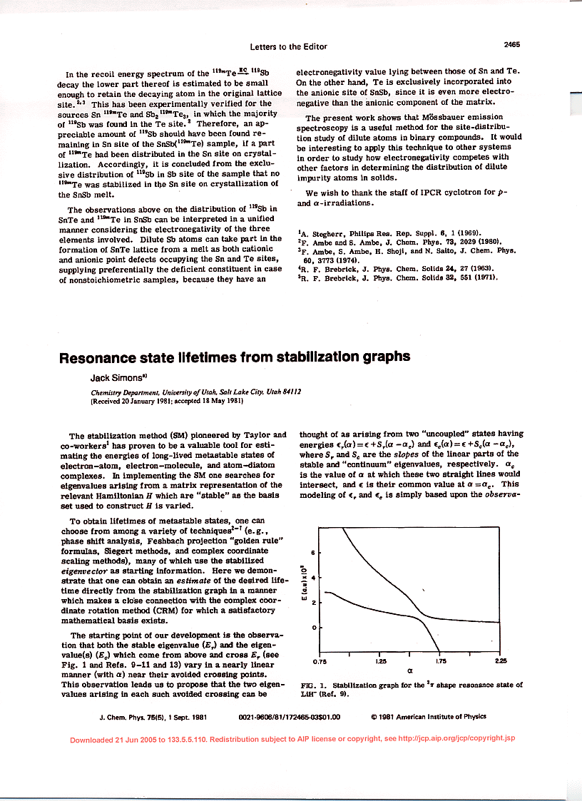

Slide 41
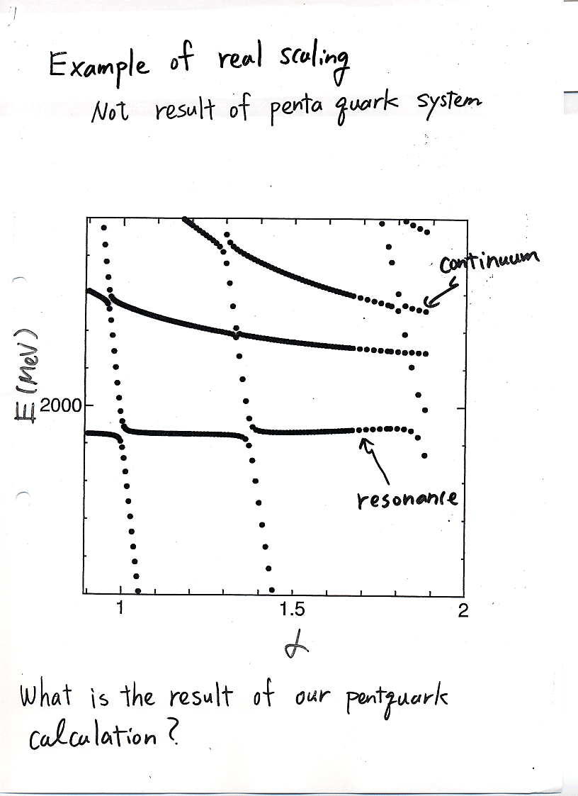

Slide 42
q
C
C
q
q
4
3
q
q
q
q
C
C=1(J/Ψ+p,ηc+p)
C=2(Λc+D,Σc+D)
C=3
C=4
R_{nR} => αR_{nR}

Slide 43
Results before doing the scattering calculation
Bound-state approximation
All states are melted into each meson-
baryon continuum decaying state.
Then, there is no resonant state
between 4000 MeV to 4600 MeV.
Σc*+D*
Σc+D*
Σc*+D* threshold
Pc(4450)
Σ*+D
J/Ψ+Δ
Σc+D
Λc+D*
Δ+ηc
MeV
Pc(4380)
J/Ψ+p threshold
Λc+D
α
ηc+N
J/Ψ+p
L=0, S=1/2

Slide 44
One resonance
at ４６９０ MeV
Much higher than the
observed data
Why we have a resonance
state at such higher energy?

Slide 45
This corresponds to resonant state, like a feshbach resonant state.
It is considered that other states are melted into various threshold.
Σc*+D*(4587)
N+J/Ψ*(4584)
N+ ηc* (4544)
Σc+D*(4505)
q
q
c
Pc(4450)
q
Σc+D(4353)
c
Λc+D*(4323)
Λc+D(4171)
For example, let us consider this state.
J/Ψ+N(4040)
Confining channels
L=0,S=1/2

Slide 46
L=0,S=1/2
Σc*+D*(4587)
N+J/Ψ*(4584)
+
N+ ηc* (4544)
Σc+D*(4505)
Pc(4450)
Σc+D(4353)
Λc+D*(4323)
ηc+N channel
Λc+D(4171)
Conjecture: 4119 MeV can be describe as ηc+N like.
However, due the restriction of the configurations, namely,
by only C=4 and 5 channels, the mass energy is up than the
ηc+N by about 200 MeV. In order to investigate this conjecture,
we solve scattering states including ηc+N channel only with
real scaling method. If 4119 MeV is ηc+N like structure, this
State should be melted into ηc+N threshold.
J/Ψ+N(4040)
ηc+N(3900)

Slide 47
L=0,S=1/2
Σc*+D*(4587)
N+J/Ψ*(4584)
N+ ηc* (4544)
Σc+D*(4505)
Pc(4450)
Σc+D(4353)
Λc+D*(4323)
100 MeV
Λc+D(4171)
Melted into η_{c}+N threshold
J/Ψ+N(4040)
η_{c}+N
100 MeV difference
4119 MeV is η_{c}+N like structure!
ηc+N(3900)

Slide 48
L=0,S=1/2
No coupled with any threshold
then, exist as a resonant state
J/Ψ*+N like
Σc*+D*(4587)
N+J/Ψ*(4584)
N+ ηc* (4544)
Σc+D*(4505)
Λc+D,Λc+D*
Pc(4450)
Mixture of ηc+N,Λc+D*,Σc+D
Σc+D(4353)
Λc+D*(4323)
J/Ψ+N like structure
Λc+D(4171)
ηc+N like structure
J/Ψ+N(4040)
ηc+N(3900)

Slide 49
Resonant state=> it is highly energy region than the observed data.
Λc+D*,J/ψ+N,Σc+D*
J/ψ+N structure

Slide 50
Summary
・Motivated by the observed Pc(4380) and Pc(4450) systems at LHCb,
we calculated energy spectra of qqqcc system using non-relativistic constituent quark
model. To obtain resonant states, we also use real scaling method.
・Currently, we find no sharp resonant states (penta-quark like)
with L=0,S=1/2 (J^{π}=1/2⁻) and L=0, S=3/2(J^{π}=3/2⁻) at observed energy region.
However, we have one resonant state at 4690 MeV for J^{π}=1/2⁻
and at 4890 MeV for J^{π}=3/2⁻ . This can be penta-quark state.
From our calculation, we would suggest that the resonant states observed
at LHCb are meson-baryon resonant states which we cannot calculate in our model.

Slide 51
Conclusion
In this way, since there are many important subjects in the resonant states, then it is necessary to develop the method for this purpose.
Here, I show the tetraneutron system and heavy pentaquark system
with CSM and real scaling method.
In the future, I will apply the method to the many kinds of tetra-quark systems and exotic nucleus such as ⁷H etc.

Slide 52
L=0,S=1/2
Σc*+D*(4587)
N+J/Ψ*(4584)
+
N+ ηc* (4544)
Σc+D*(4505)
Pc(4450)
Σc+D(4353)
Λc+D*(4323)
J/Ψ+N channel
Λc+D(4171)
J/Ψ+N(4040)
ηc+N(3900)

Slide 53
L=0,S=1/2
Σc*+D*(4587)
N+J/Ψ*(4584)
N+ ηc* (4544)
Σc+D*(4505)
Pc(4450)
Σc+D(4353)
Λc+D*(4323)
J/Ψ+N like structure
Melted into J/psi+N
Λc+D(4171)
J/Ψ+N
J/Ψ+N(4040)
ηc+N(3900)

