Slide 1
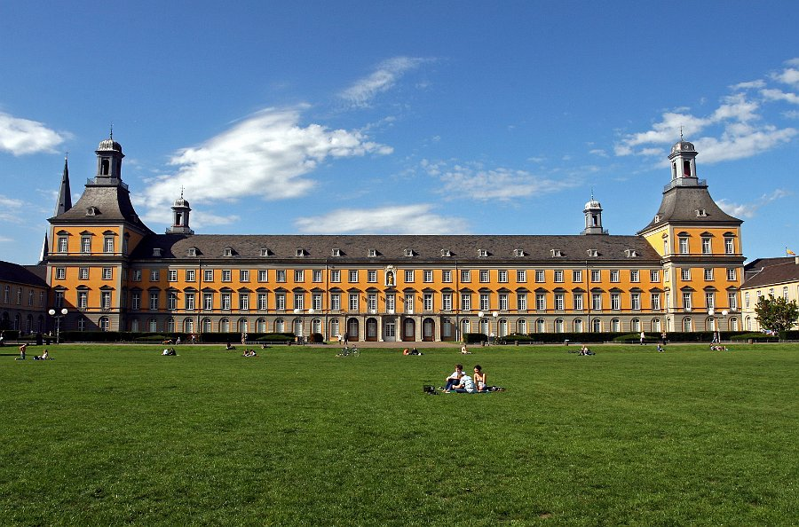
Non-equilibrium physics with strongly-interacting fermions
Michael Köhl
Universität Bonn

Slide 2
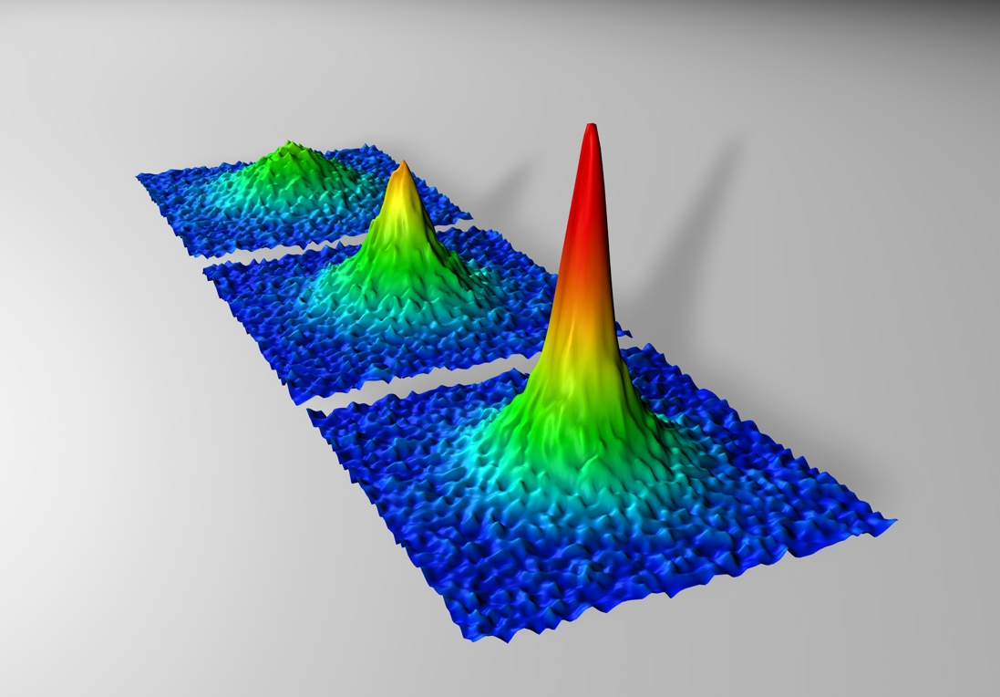
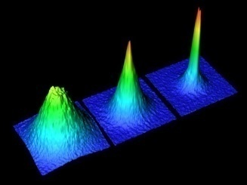
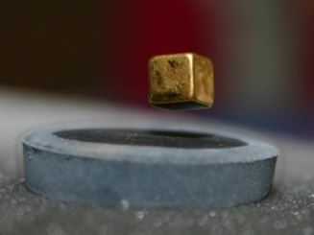
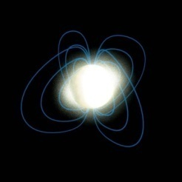
Strongly-interacting fermions
10⁻⁸
10⁰
10¹²
T[K]
10¹³
10²³
10³⁸
n[cm⁻³]
tunable
precise microscopic understanding
complex systems
technologically
highly relevant
extreme conditions
no experiments possible
In recent years:
Cold atoms address open questions from other fields

Slide 3
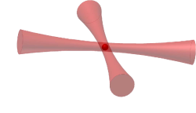
Atomic quantum gases
Produced by laser cooling and evaporative cooling
Nanokelvin temperature, ~ 0.1 T_{F}
Macroscopic quantum states: 100 μm size, many atoms (~ 10⁶)
Laser beam
Hyperfine states
Laser beam
|↓> = |F=9/2, m_{F}=-9/2>
|↑> = F=9/2, m_{F}=-7/2>
↓ ↑
↓ ↑
↓ ↑
100 μm
↓ ↑
Bosons (eg. ⁸⁷Rb, ³⁹K,...)
Fermions (eg. ⁶Li, ⁴⁰K,...)
→ Bose-Einstein condensation
→ Degenerate Fermi gas

Slide 4
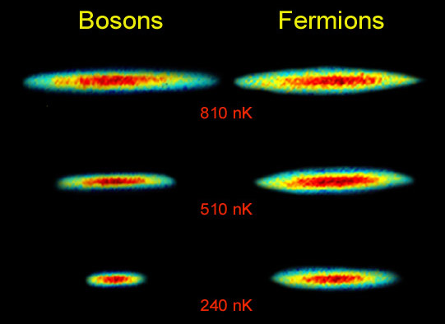
Bosons vs. Fermions
Rice University
Bosons condense
to ground state
Fermions fill up the
Fermi sea

Slide 5
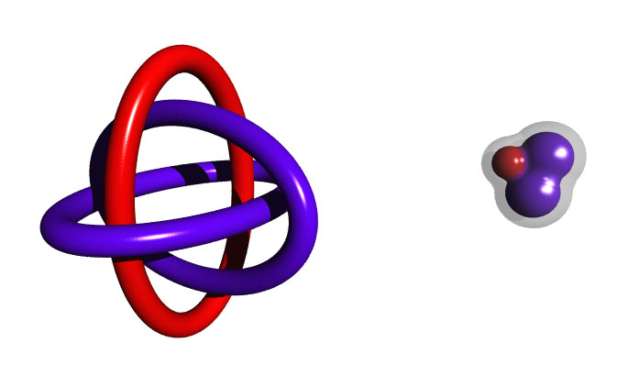
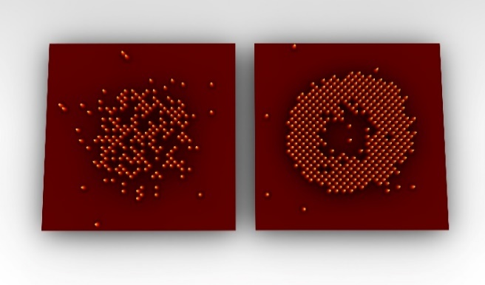

Some examples
Search for the perfect fluid:
Cold fermions vs. Quark-gluon plasma
Few particles systems, observation of Efimov states
Strong correlations and
quantum magnetism in lattices
Cao et al., Science (2012)
η/s > 1/4π (universal in strong coupling?)

Slide 6
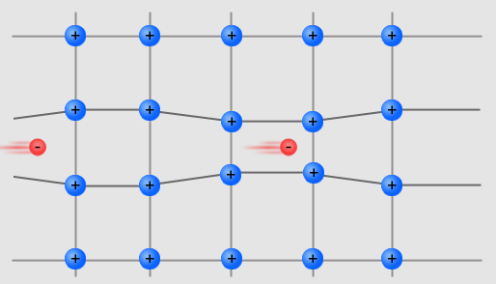
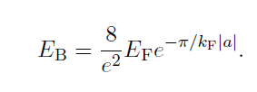
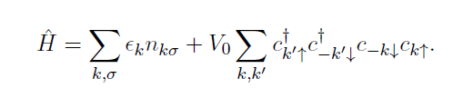
Example: Superconductivity
Cooper’s idea: Electrons pair with binding energy
Scattering length
Temperature T < E_{B}:
phase transition to a superconducting state
E_{B} << E_{F} or: pair size >> particle distance
BCS superconductivity:
Effective electron attraction due
to coupling to lattice vibrations
Many-body Hamiltonian: pairing between fermions of opposite k and spin only.
c_{kσ}: fermionic annihilation operator
for momentum k and spin σ
n_{kσ}: density operator

Slide 7
Fermionic pairing
Bose Einstein condensate
of molecules
BCS superfluid

Slide 8
Fermionic pairing
Molecular BEC
BCS superfluid

Slide 9
Fermionic pairing
Magnetic field
Feshbach scattering resonance
3000
Molecular BEC
Unitary interaction
BCS superfluid
a
0
-3000
200
210
B[G]

Slide 10
Fermionic pairing
Molecular BEC
Crossover superfluid
BCS superfluid

Slide 11
Fermi pair condensates
Composite bosons

Slide 12
BEC-BCS crossover

Slide 13
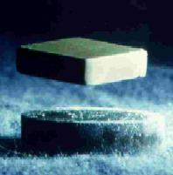
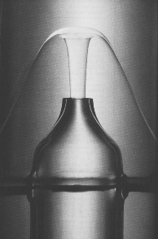

2nd Order Phase Transitions
superconductor
superfluid He
Bose-Einstein condensation
Notes:
I show you some examples for systems which undergo a 2nd order phase transitions, like the Ising magnet, critical opalescence, superfluidity, superconductivity and also Bose-Einstein condensation, which we studied.
An important feature of 2nd order phase transitions is the divergence of the correlation length. This is the length scale over which the system behaves coherently. When the system approaches the phase transition this length scale becomes bigger and bigger until it diverges at the phase transition.
As a consequence also other properties, like the heat capacity, show a divergence at the phase transition. The divergence can be described by a power-law with a certain exponent, which is the critical exponent.
These exponents are very powerful tools, because they are universal numbers.
The systems can be divided into universality classes, which are given by the symmetry and the kind of interactions of the system. The systems in the upper box belong to the Ising-model universality class, the lower ones to the XY-model-universality class.
All members of one universality class show the same behavior when they undergo a phase transition. And so they can be described by the same critical exponents!
In the following I want to show you how we observed the diverging correlation length and could measure the corresponding critical exponent
XY-model: also planar magnets (Heisenberg easy plane anisotropy: 3d spins with coupling only between x and y)

Slide 14

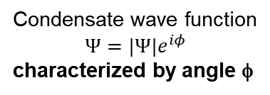
Long-range order
Emergence of long-range order „spontaneously“ breaks the symmetry of the Hamiltonian
Crystallization | Translational symmetry
Magnetism | Rotational symmetry of the spin
Bose-Einstein condensation | Phase of the wave function
Symmetries are important
y
Condensate wave function
$${Ψ=|Ψ|e}^{iφ}$$
characterized by angle φ
f
x
Spin rotating in the xy-plane
characterized by angle φ
Same universality class => same critical behaviour

Slide 15
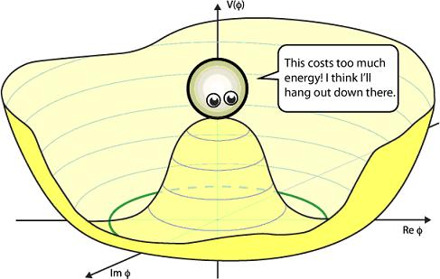

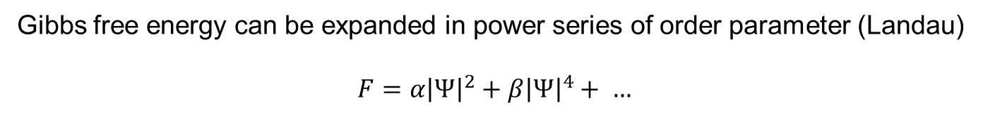


Spontaneous symmetry breaking
Gibbs free energy can be expanded in power series of order parameter (Landau)
$$F=α{\left|Ψ\right|}^{2}+β{\left|Ψ\right|}^{4}+ …$$
Temperature-dependent coefficients
High T: $α>0, β>0$ => minimum of free energy at $\left|Ψ\right|=0.$
Low T: $α<0, β>0$ => minimum of free energy at $\left|Ψ\right|>0.$
$$F(\left|Ψ\right|)$$
Every phase angle φ has the same energy
=> system selects randomly a value of φ
$$Re Ψ$$
$$Im Ψ$$

Slide 16




Fluctuations of the order parameter
$$F(\left|Ψ\right|)$$
Amplitude fluctuations
„Anderson-Higgs mode“
(Nobel prize 2013)
Often unstable!
$$Re Ψ$$
$$Im Ψ$$
Phase fluctuations
„Nambu-Goldstone mode“
(Nobel prize 2008)
Always present!
Magnet: spin waves
BEC: phonons
Stability requires additional symmetries
for $k→0$

Slide 17
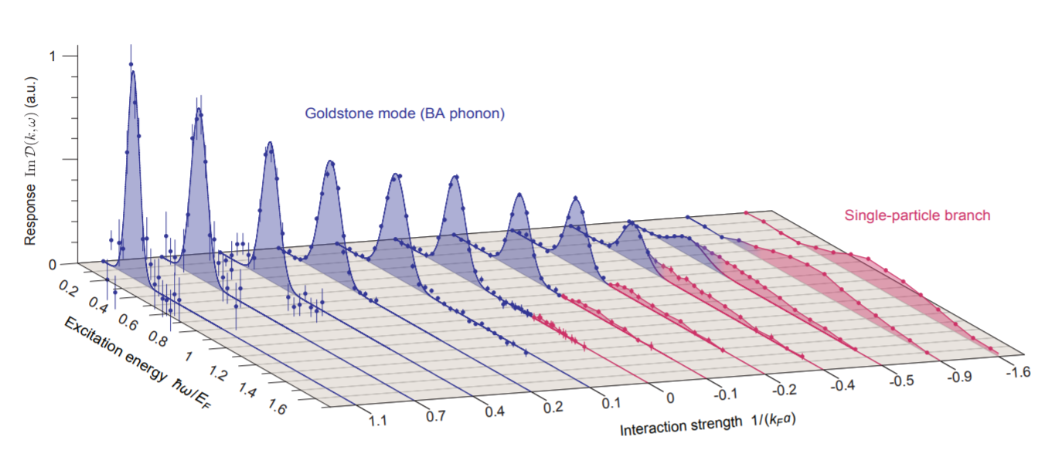
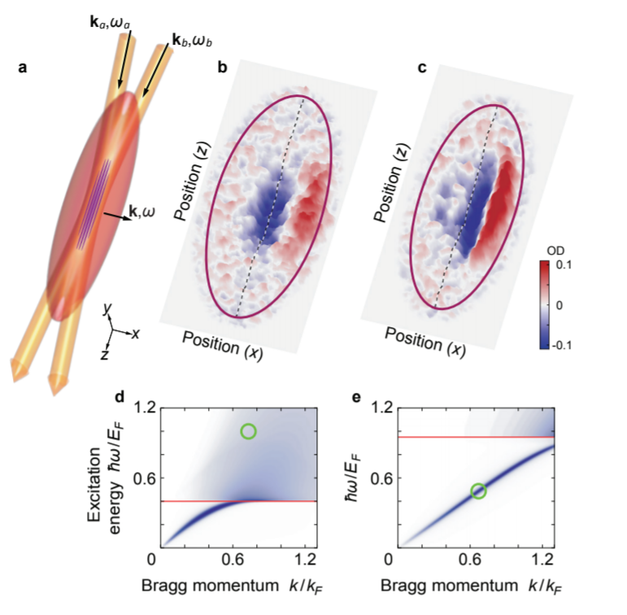
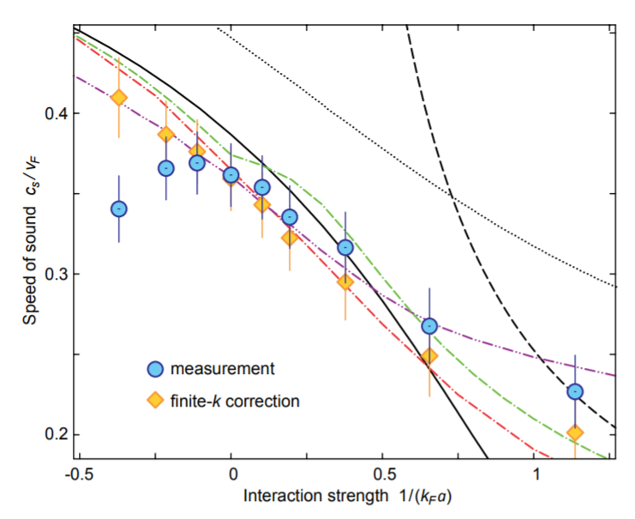
Goldstone mode
Experiment: „Bragg“ scattering
Hoinka et al., Nat. Phys. 13, 943–946 (2017)

Slide 18
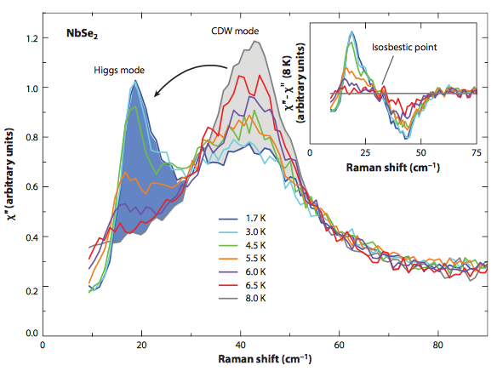
Higgs/amplitude mode: Previous work
Particle physics
ATLAS & CMS collaboration
Condensed matter physics
no linear response coupling to normal probes
Cold atoms (bosons):
Raman spectra in NbSe2 indirect coupling via CDW
R. Sooryakumar, M.V. Klein, PRL 45, 8 (1980)
M.-A. Méasson et al, PRB 89, 060503 (2014)
in 3He: review by Halperin & Varoquax (1990)
Stöferle et al., PRL (2004)
Bissbort et al., PRL (2011)
Endres et al., Nature (2012)
Hoang et al., PNAS (2016).
Leonard et al., Science (2017)
weakly interacting
See also review by Pekker and Varma (2015)

Slide 19
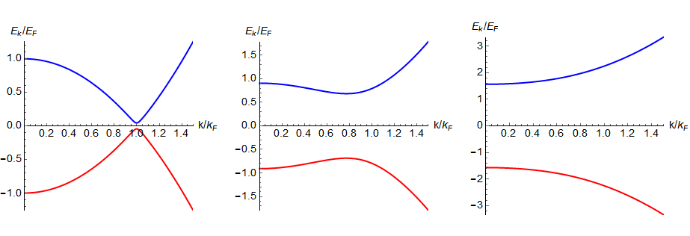
Higgs mode in BCS superconductors
Quasi particles
Quasi holes
Particle-hole symmetry:
Dirac-like spectrum near k_{F}
Paradigmatic for Higgs mode!
Varma, Littlewood 1981;
Theory for cold atoms: Stringari, Pitaevski, Bruun, Zhai, Nikuni, Griffin …

Slide 20
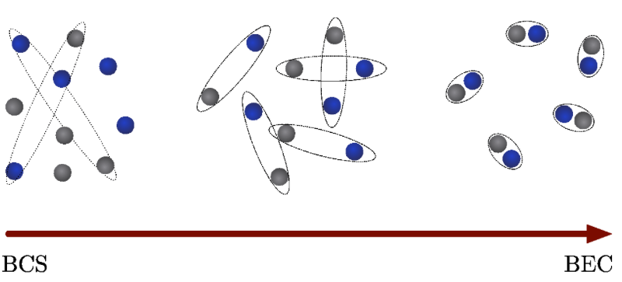
Cold Fermi gases: BCS-BEC crossover
strongly interacting
BCS
BEC of molecules
tuning of scattering length

Slide 21
BCS-BEC crossover: excitation spectra
BCS
1/k_{F}a=-2
Unitarity
1/k_{F}a=0
BEC
1/k_{F}a=1
Particle-hole symmetry:
Dirac-like spectrum near k_{F}
Paradigmatic for Higgs mode!
stable Higgs mode
????
no stable Higgs mode

Slide 22
Excitation scheme
„Dephasing“ from many-body physics
Time evolution at effective Rabi frequency
Periodic drive leads to modulation of the superconducting gap
Alternative proposals: rapid quench of interaction strength (Volkov & Kogan, Stringari)

Slide 23
Far-off resonant rf-excitation scheme
Spontaneous symmetry breaking
effectively a periodic driving
with a (momentum dependent) frequency

Slide 24
Numerical simulation (Kollath group)
Higgs mode
Fourier transform of
the time evolution of
External drive
|Δ|
n₃
Quasiparticle
excitations

Slide 25
Experimental results on BCS side
4x10⁶ ⁶Li atoms trapped in harmonic potential, T/T_{F}~0.07
far red-detuned rf-excitation
observation of condensate fraction (by projection)
condensate fraction
Higgs mode
-> clear mode at 2 Δ ∼ 0.6 Ε_{F}

Slide 26
Experimental results across crossover
BCS
clear mode at 2 Δ ~0.6E_{F}
still present at unitarity
washed out on BEC side
BEC

Slide 27
Frequency of the mode
Chang et al., PRA 2004
Gezerlis et al., PRC 2008
Bulgac et al., PRA 2008
Chen, Sci. Rep. 2016
Haussmann et al., PRA 2007
Pieri et al., PRB 2004

Slide 28
Width of the mode
width of peak
BEC side
~ expected broadening
from excitation scheme
BCS side

Slide 29
Is it a collective mode?
Combine spectroscopy with momentum resolution
Quasiparticles:
Pronounced dispersion
(Feld et al., Nature 2011)
Expand for quarter period in weak trap
Higgs excitation:
Same resonance
frequency for all momenta
within condensate

Slide 30
Summary
Cold atomic gases are model system for tuneable superconductors
Equilibrium properties reveal 2nd order phase transition
Non-equilibrium: collective Goldstone and Higgs mode

Slide 31
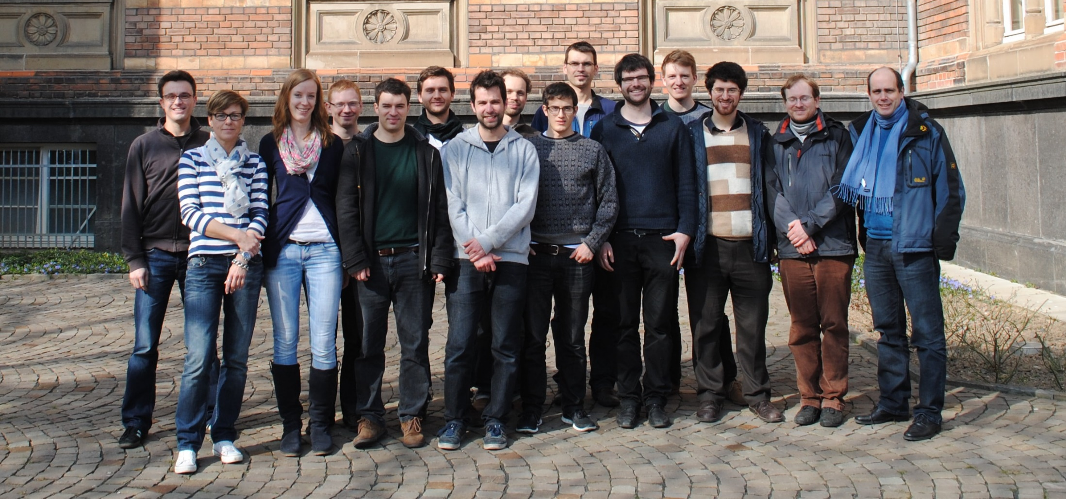
Thanks
www.quantumoptics.eu
Fermi Na-Li: A. Behrle, K. Gao, T. Harrison, A. Kell, M. Link
Collaborators J. Kombe, J.S. Bernier, C. Kollath (theory)
Fermi K : C. Chan, J. Drewes, M. Gall, N. Wurz
Trapped ions: M. Breyer, P. Fürtjes, K. Kluge, P. Kobel, J. Schmitz & H.-M. Meyer
QED Tests: T. Langerfeld
€€€: Alexander-von-Humboldt Foundation, ERC, ITN Comiq, DFG (SFB/TR 185)

