Slide 1

The virtue of precision spectroscopy :
A new axial-vector meson and
The structure of the (ππ) S-wave isobar
Stephan Paul
for the COMPASS collaboration
TUM

Slide 2
Light Mesons, Quarks and Gluons
Quark model mesons (u, d, s quarks)
q
q
Glueballs (gluons and no valence quarks)
q
q
Multiquarks (quark-antiquark pairs)
q
q
Hybrids (quarks and gluonic excitation, which contribute to static properties)
q
q
Klempt Zaitsev Phys Rep 454 (2007) 1

Slide 3
How to produce “other” mesons
Diffraction: πp_{target} ➝ X + p_{recoil}➝ nπ + p_{recoil}
  isospin = 1
  spin-alignment M of resonance X w.r.t. to production mormal
  PWA is clean
  isospin = 0 possible in decay products of X
Central production: pp_{target} ➝ p_{fast} + X + p_{recoil}
➝ p_{fast} + nπ/Κ/η + p_{recoil}
  isospin = 0
  “glue-rich” systems
  PWA with ambiguities for n=2
  typically populating low spin states J
J/ψ-decays: J/ψ ➝ X + γ_{recoil}
pp-annihilations or heavy meson decays (Dalitz plot analysis)
  typically populating low spin states J

Slide 4
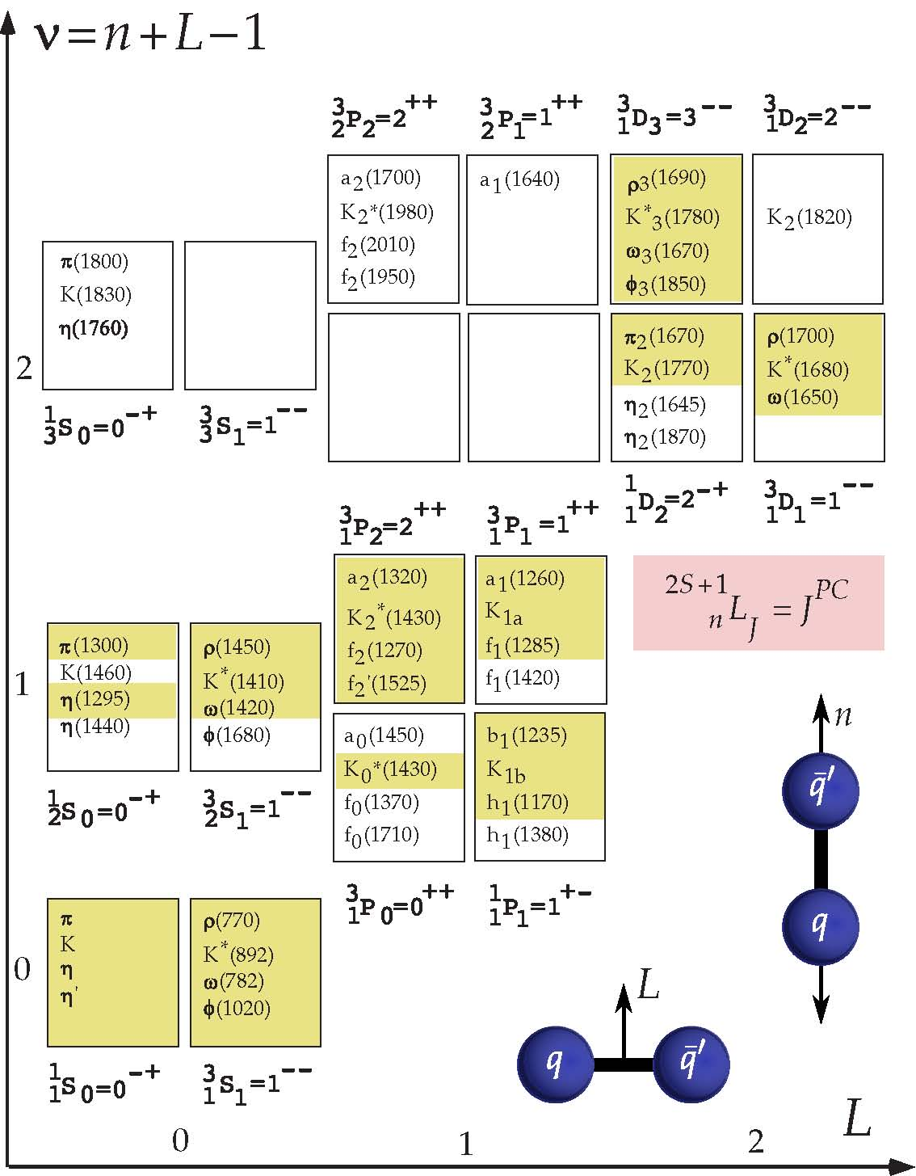
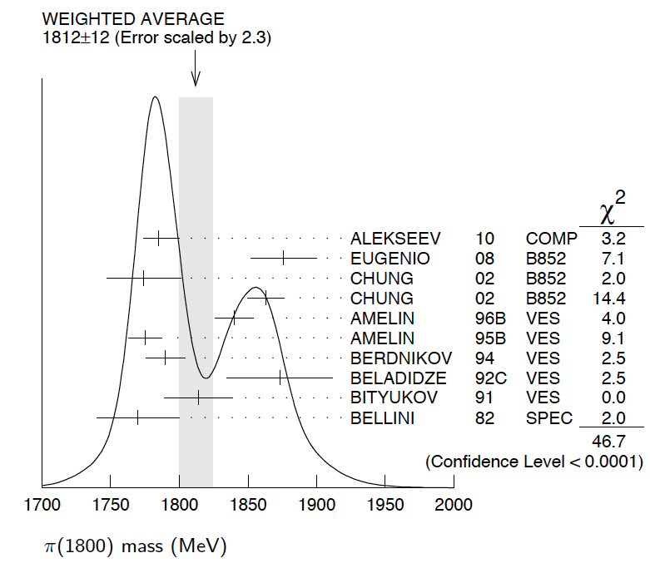

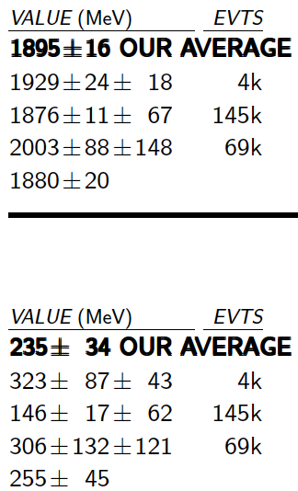

Constituent Quarks and Mesons
a₄(2040)
2
Limits for light mesons
many missing/disputed
states in mass region
m ~ 2 GeV/c²
Identification of heavy
states difficult
  broad states
  large number
  overlap + mixing
π₂(1880)
2
f₀(500)
f₀(980)
f₀(1500)

Slide 5
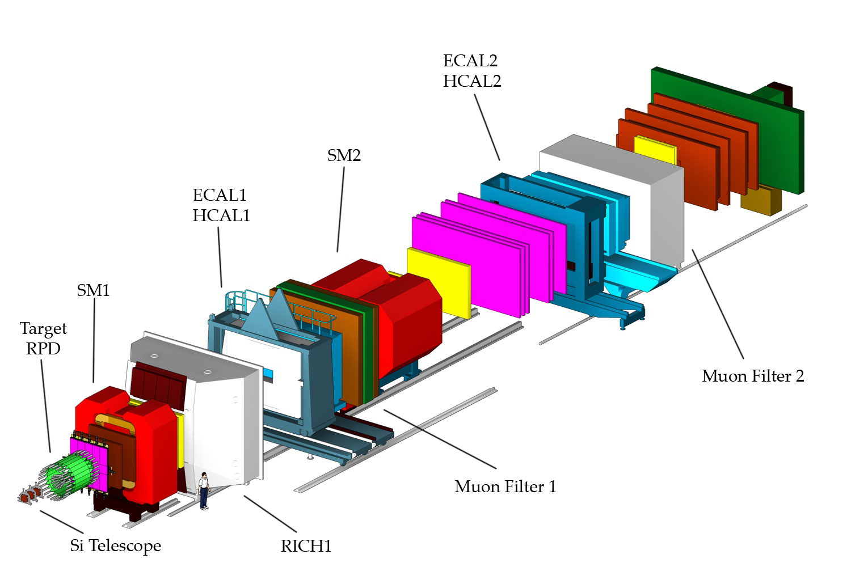
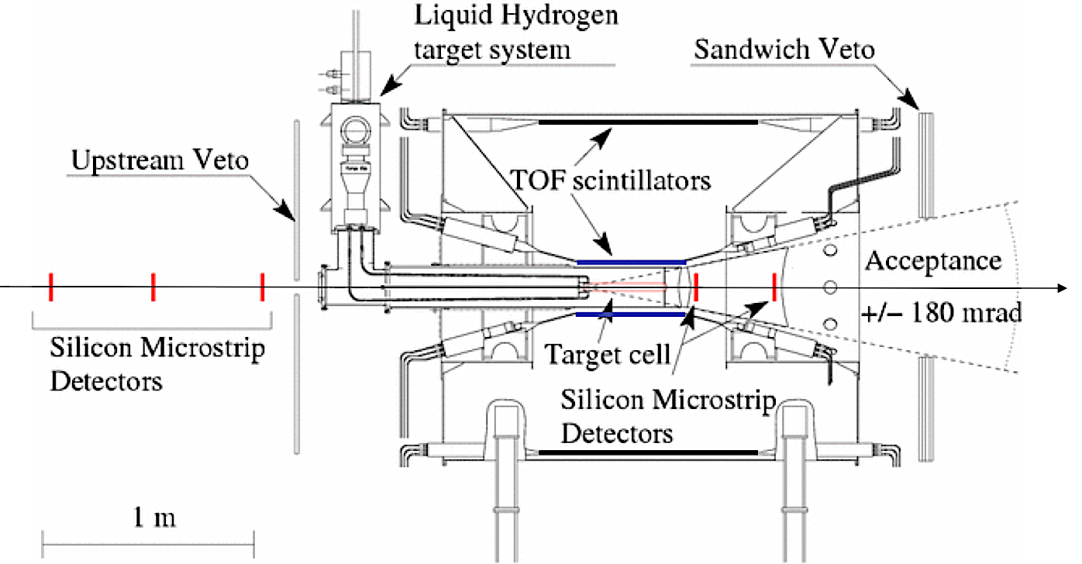
The COMPASS Experiment
CERN SPS
Hadron beam:
190 GeV/c π, K, p
5∙10⁷ particles/SPS-spill
60 days data taking 2008
Trigger: RPD hit, beam veto
50m

Slide 6
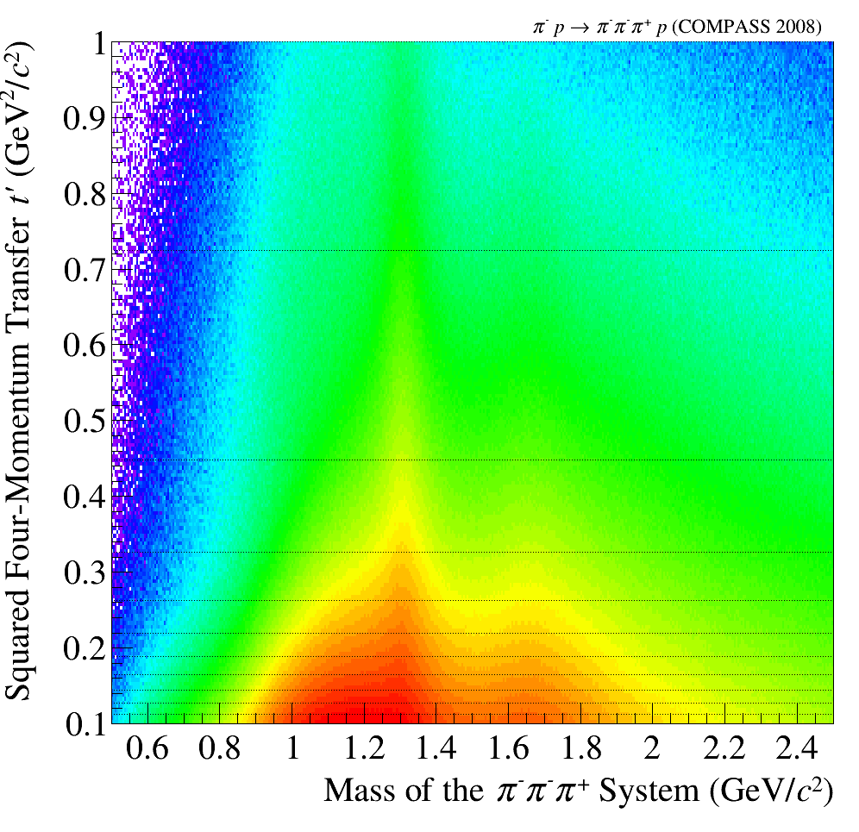
Kinematics and Isobars
isobar model
low t’
high t’
0.8< m_{3π}<0.85
1.6 < m_{3π}<1.65
grid of t’ used
Δm: 20 MeV/c²

Slide 7
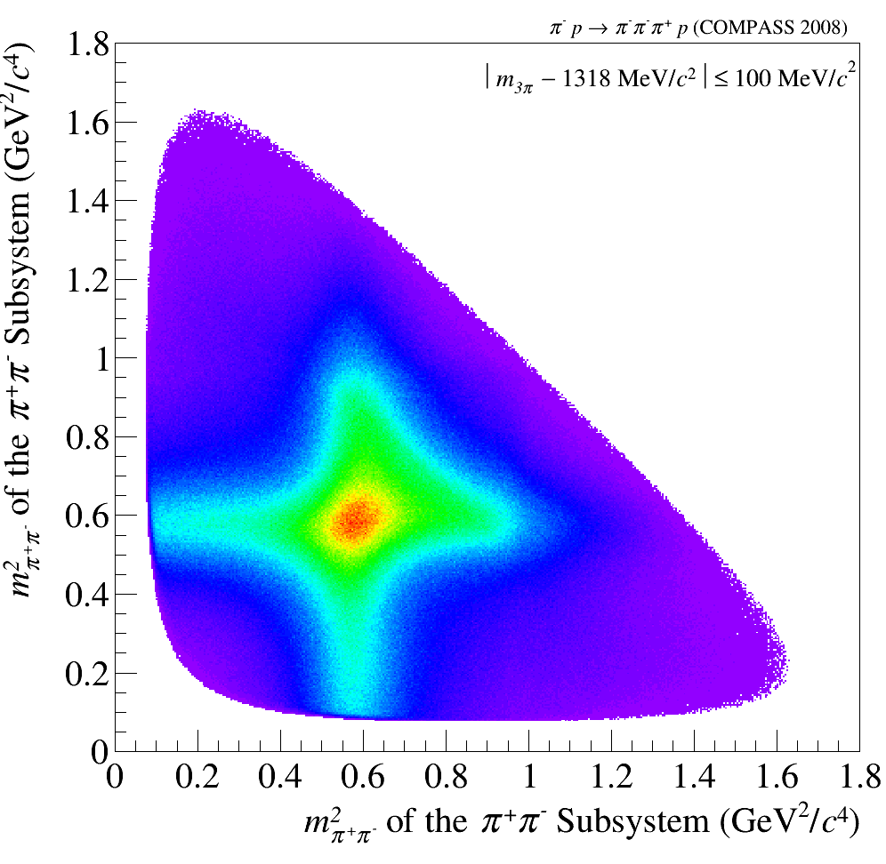
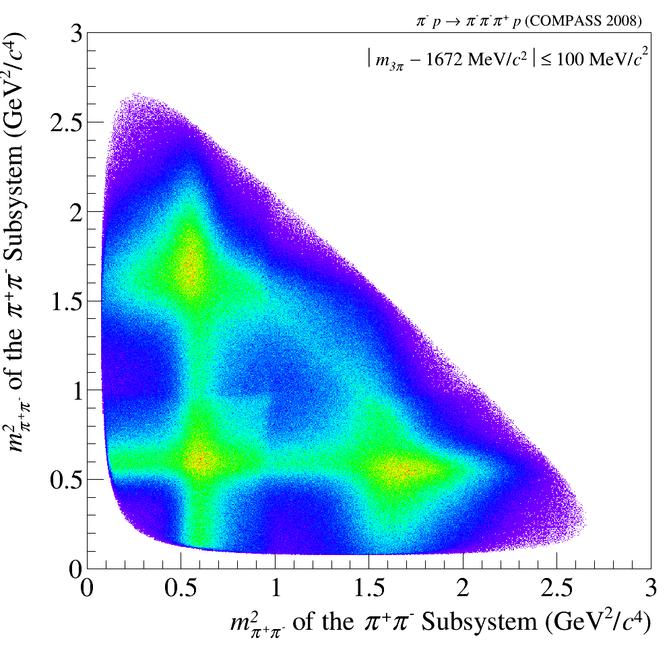
First Impressions
Motivation for Isobar Model
m²_{2π}
m²_{2π}
Preliminary
Preliminary
Preliminary
f₂(1270)
ρ
ρ
m²_{2π}
m²_{2π}
t’_{3π}
used in analysis
Preliminary

Slide 8
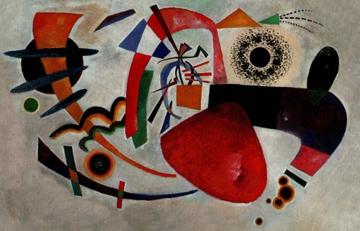
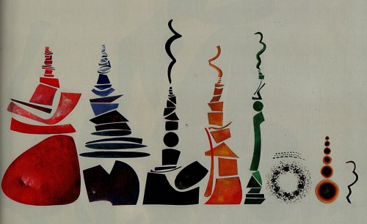
Partial wave analysis
inspired by M. Pennington
raw data
after PWA
πf₂
πf₀
Flat wave
(ππ)_{S} π
ρ(770)π
Art taken from Urs Wehrli: “Kunst aufgeräumt”

Slide 9
Partial wave analysis
Whats PWA ?
Describe population in 5-dimensional phase space in πππ by model
Define a set of quantum numbers J^{PC}
Define a set of possible decay channels for each J^{PC}
(X⁻ → isobar + π; isobar→ππ ) : wave (88 waves used)
  each such “wave” has a pre-determined population in phase space
  each wave may have alignment of J described by quantum number m
For each bin of 20 MeV/c² mass of πππ: determine which coherent combination of waves fits distribution best
Obtain spin-density matrix
Describe spin density matrix (submatrix) by model containing resonances and non-resonant contributions connecting all mass bins
Determine resonance parameters
step 1
step 2

Slide 10
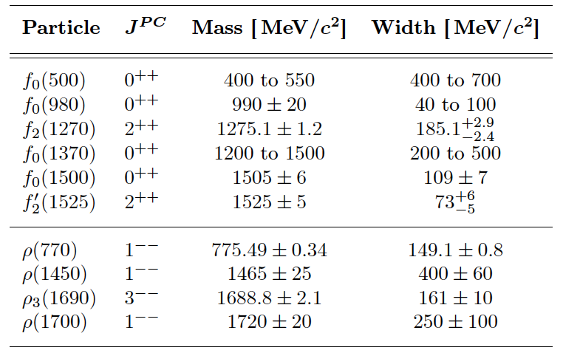
Fit Model - Isobars
[ππ]_{S}
*
not used
*
*weak coupling to ππ

Slide 11
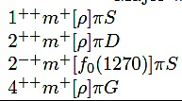

Major waves
Major waves
J^{PC}m^{ε}[isobar]πL
2
mass independent fits
minimal m = (0,1) waves
compare: π⁻π⁺π⁻ and : π⁻π⁰π⁰

Slide 12
t’ dependence of mass distributions
low t
high t’
high t
1⁺⁺0⁺ρπ S
2⁺⁺1⁺ ρπ D
2⁻⁺0⁺ f₂ π S
4⁺⁺1⁺ ρπ G

Slide 13
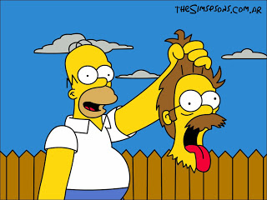
More exotic families
f₀(980)

Slide 14
Waves involving f₀(980)
1⁺⁺0⁺ f₀(980) π P
0⁻⁺0⁺ f₀(980) π S
2⁻⁺0⁺ f₀(980) π D

Slide 15
Waves involving [ππ]_{S}
1⁺⁺0⁺[ππ]_{S} π P
0⁻⁺0⁺[ππ]_{S} π S
2⁻⁺0⁺[ππ]_{S} π D

Slide 16
Mass-dependent fit
Use only lowest m = 0,1 waves (so far)
This work: 6 waves
Model:
2 resonances : a₁(1260) and a₁´ + non resonant term
2 resonances : a₂(1320) and a₂´ + non resonant term
1 resonance : a₄(2040) + non resonant term
2 resonances : π₂(1670) and π₂´ + non resonant term
1 resonance : a₁(1420) + non resonant term
1 resonance : π (1800) + non resonant term
  231 mass distributions with 23100 data points
  352 free parameters
  systematic studies with 5 and 7 waves performed
1⁺⁺0⁺ρπ S
2⁺⁺1⁺ ρπ D
4⁺⁺1⁺ ρπ G
2⁻⁺0⁺ f₂ π S
1⁺⁺f₀(980) π P
0⁻⁺f₀(980) π S

Slide 17


Non-resonant processes
Resonance
Deck
π⁻
π⁺
π⁺
π⁺
π⁻
π⁻
π⁻
p
n
p
ρ, σ
π⁻
ρ, σ
P
R
R
π⁻
π⁻
p
p
p

Slide 18
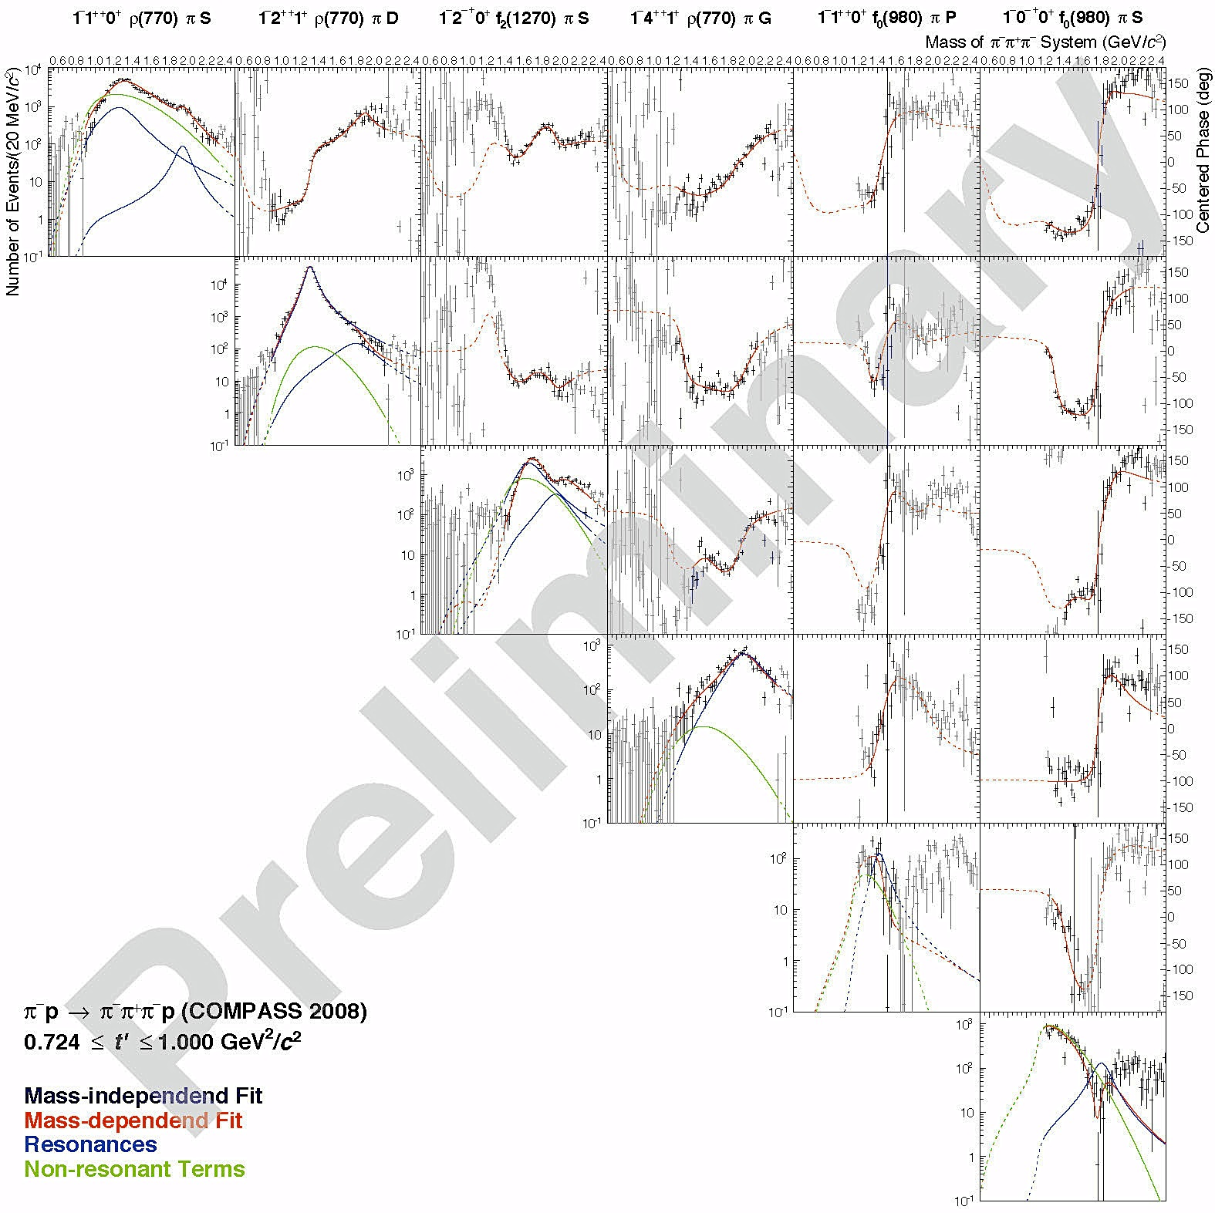
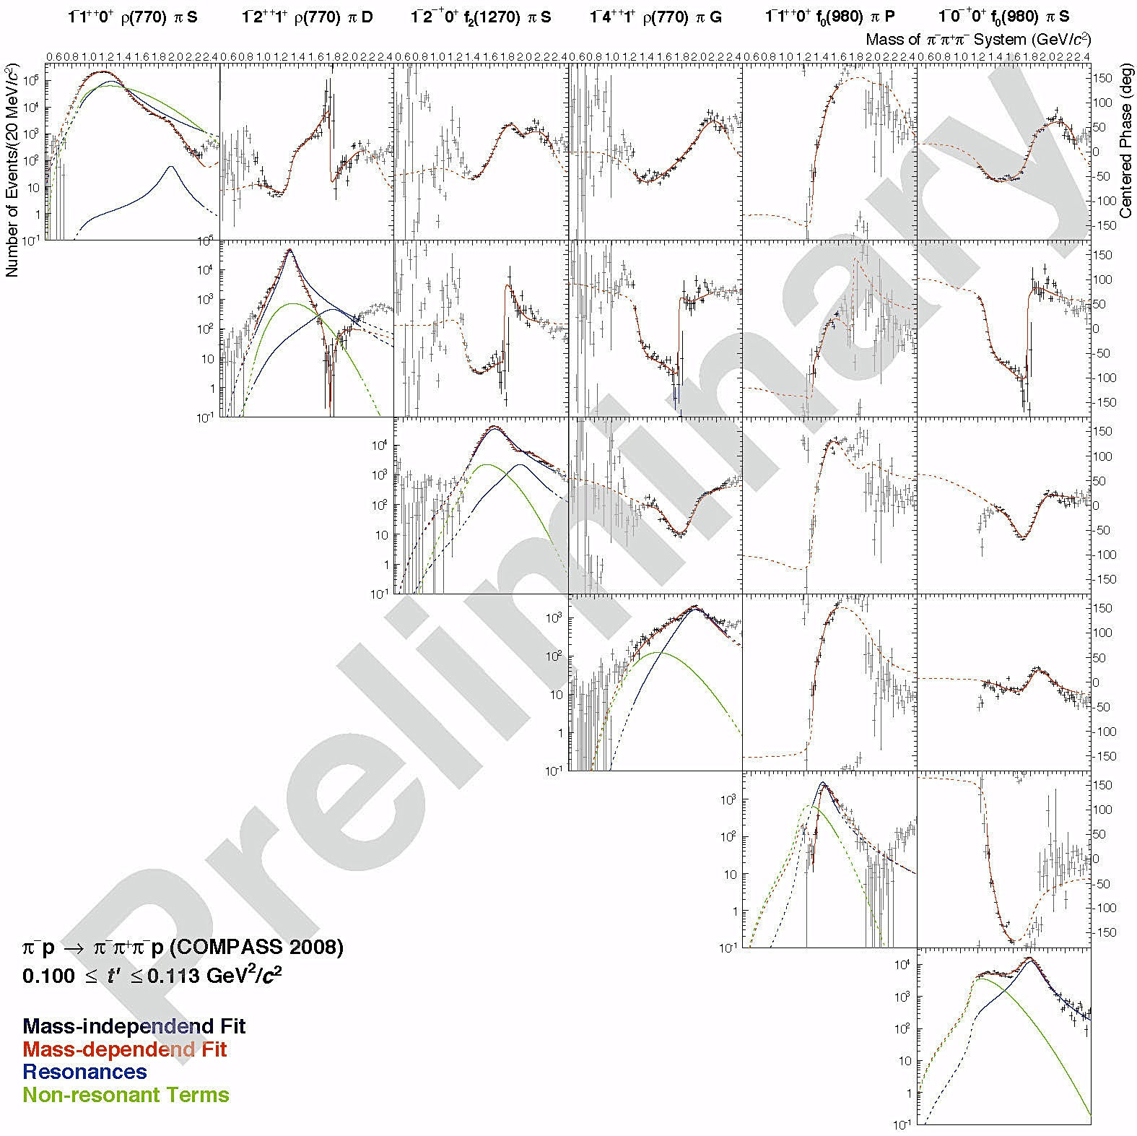
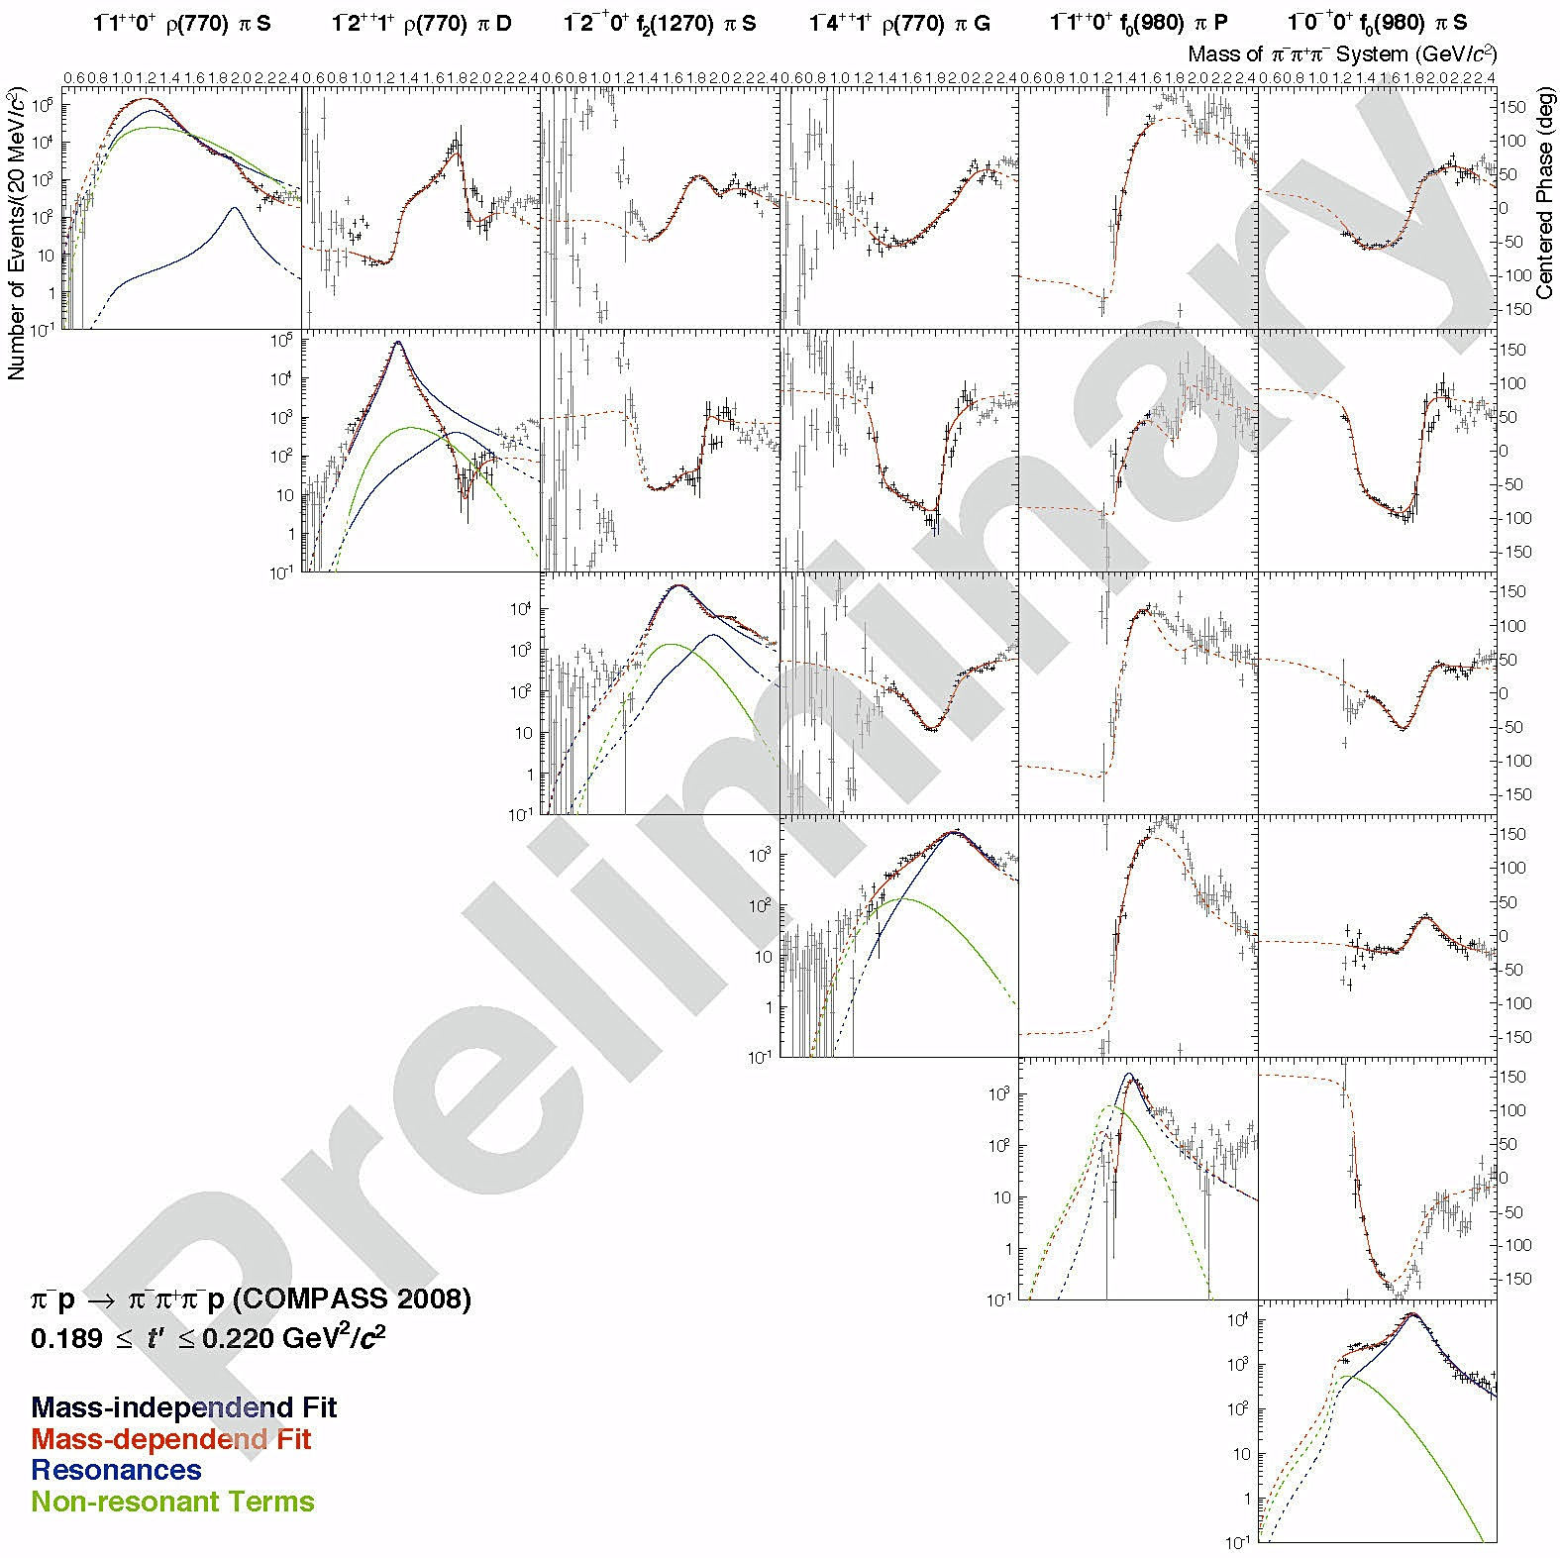
COMPASS “Colour Holography”
Reference
waves
Interferometry
simultaneous fit in 11 t-bins

Slide 19
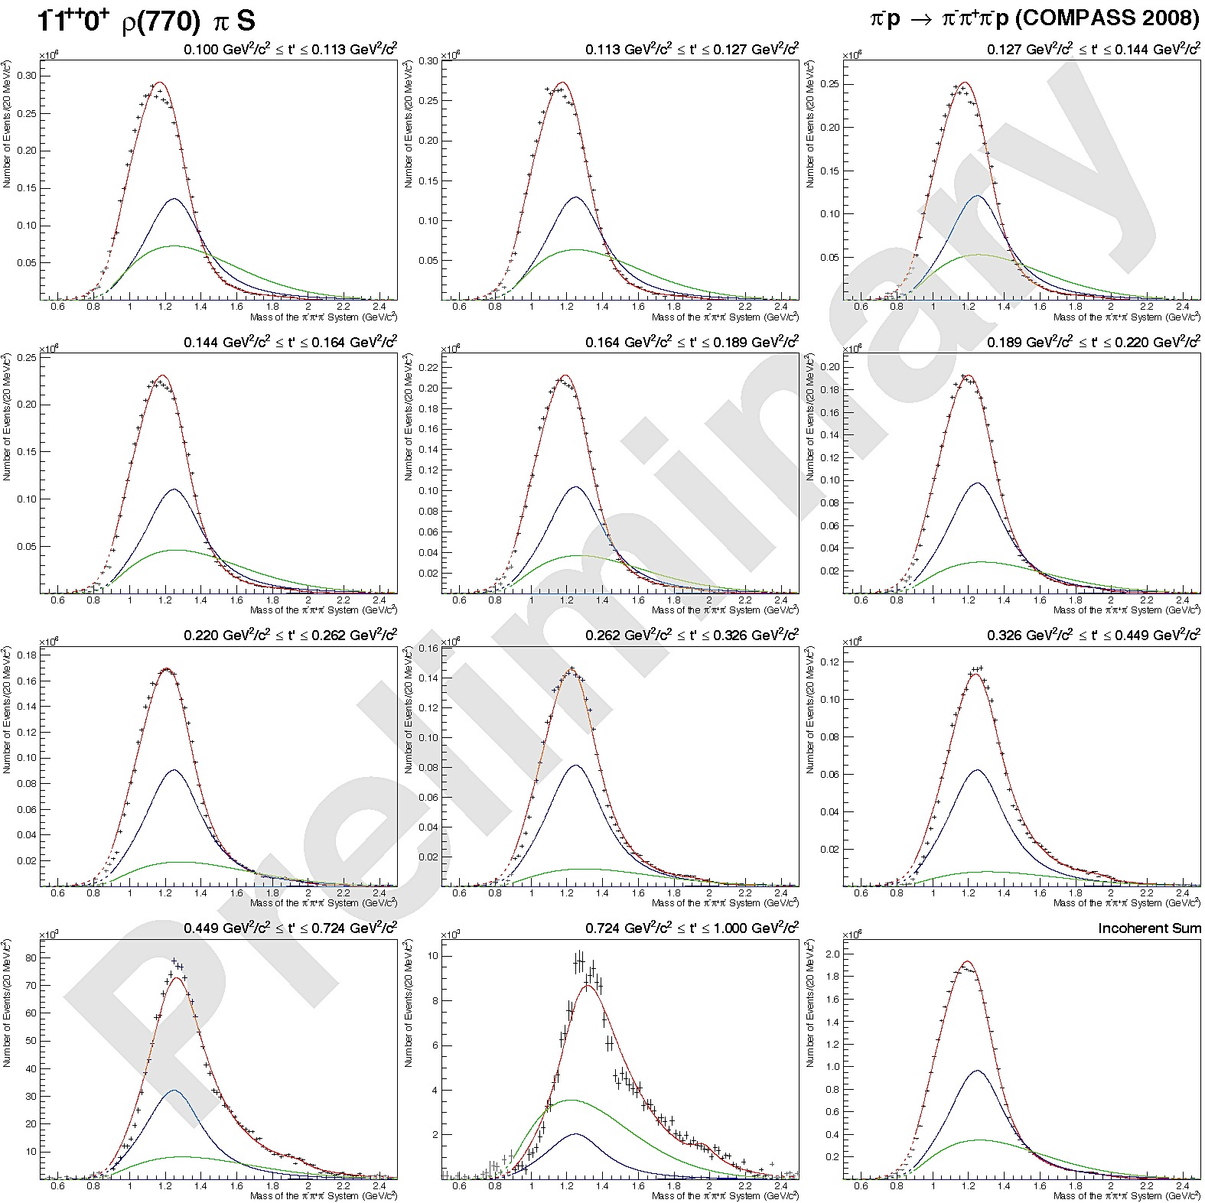

Mass dependent fits
Fit in 11 t-bins
t
t
incoherent sum

Slide 20
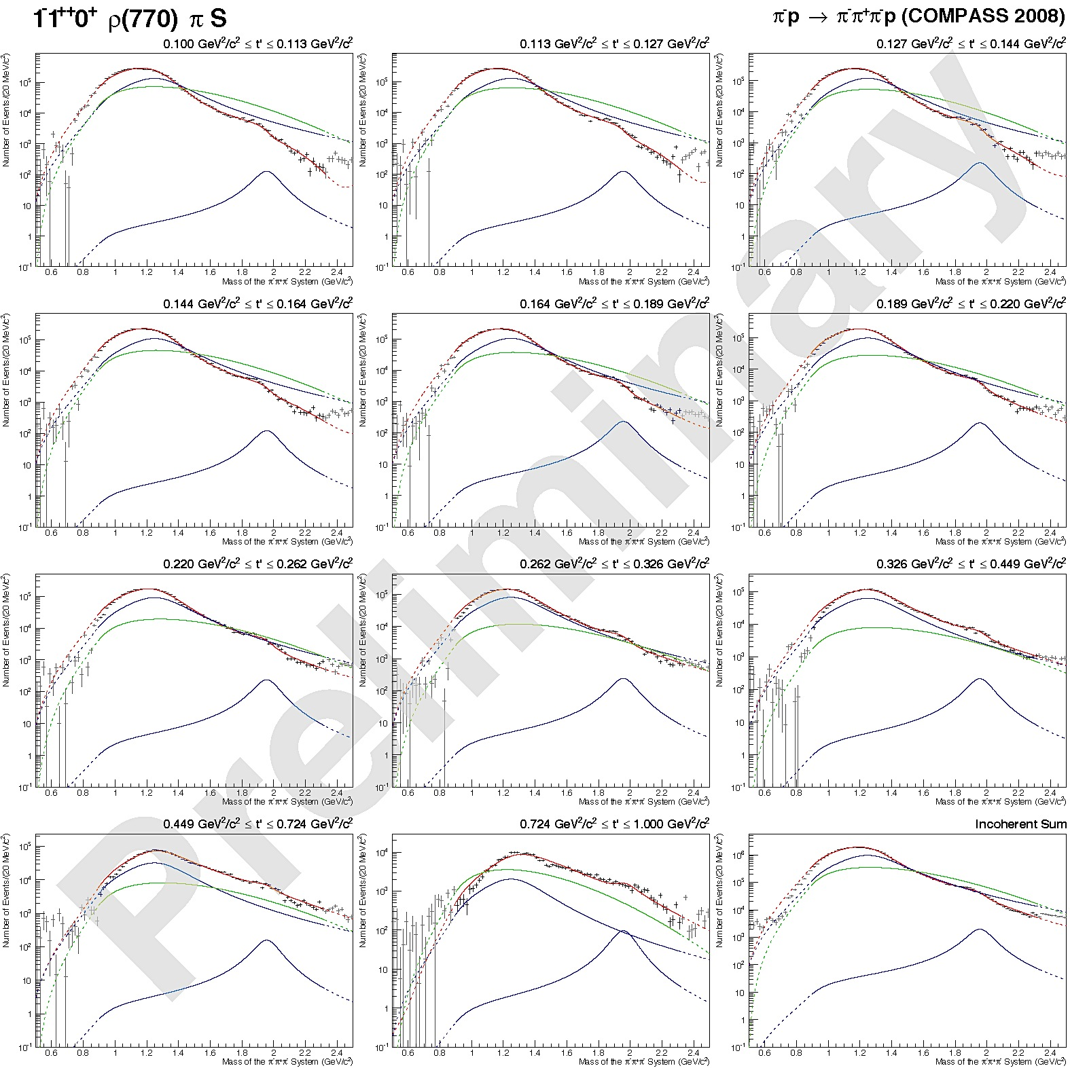
Mass dependent fits
Fit in 11 t-bins
t
t
incoherent sum

Slide 21
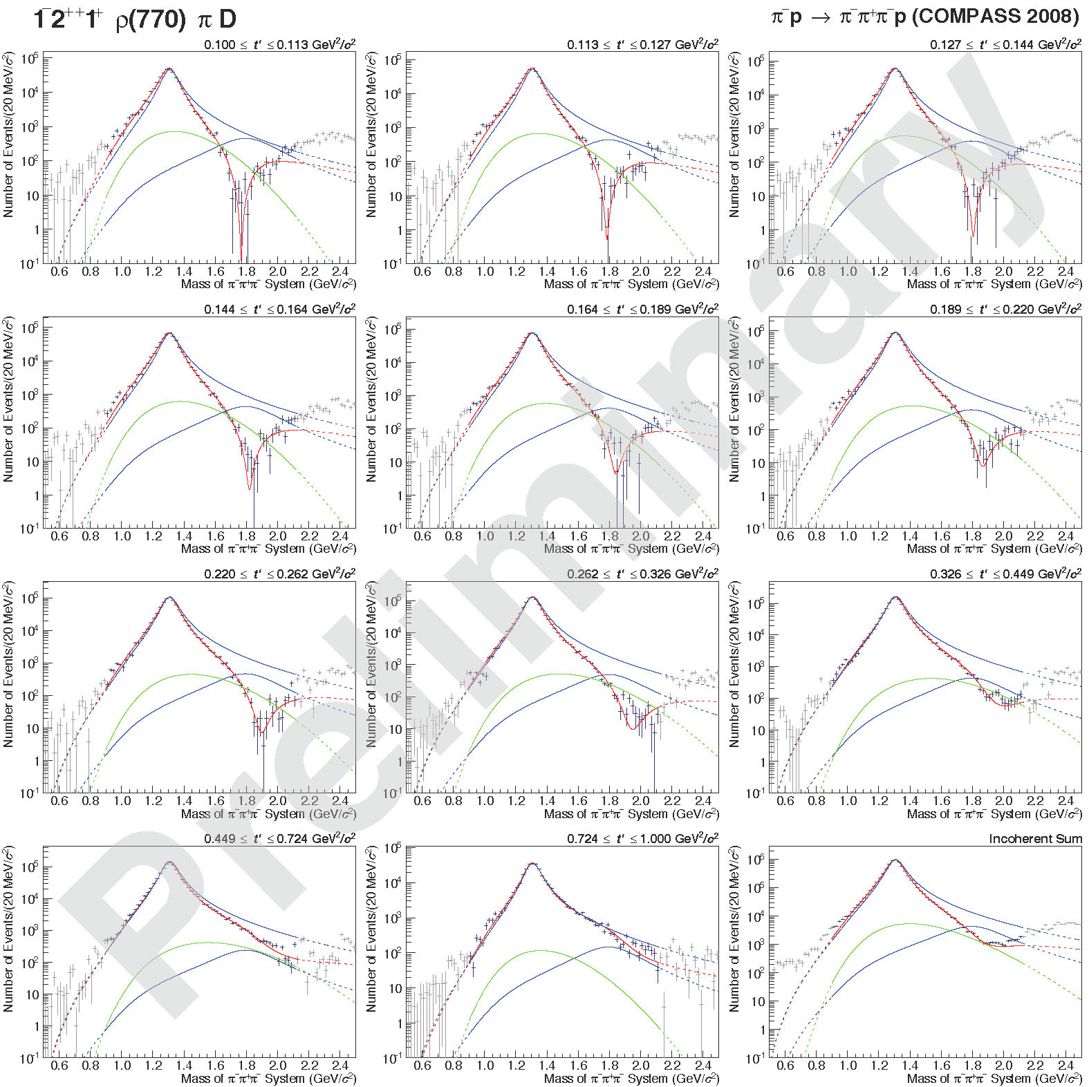
Mass dependent fits a₂(1320)
t
t

Slide 22

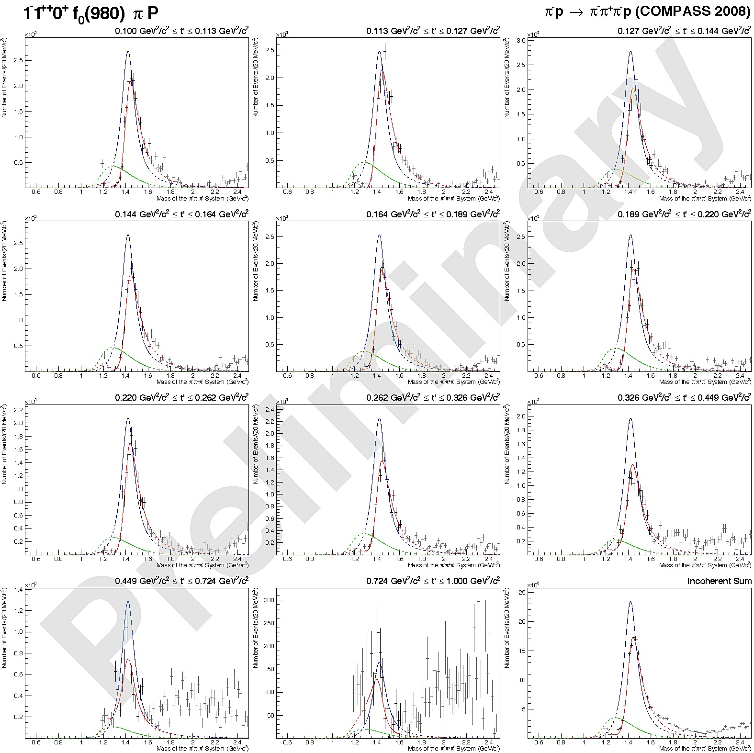

Mass dependent fits a₁(1420)
t
Fit in 11 t-bins
t
incoherent sum

Slide 23
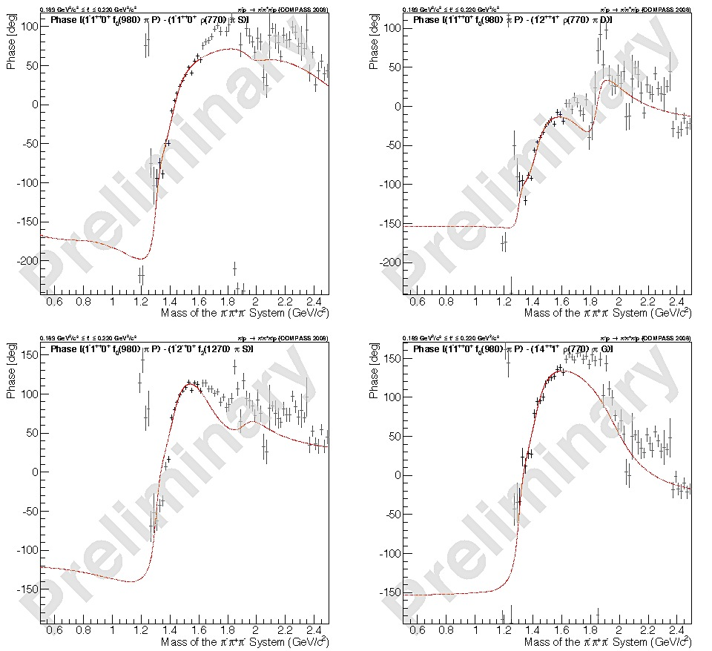
Phase: a₁(1420)
Fit in 11 t-bins:
medium t
fit range
a₁(1420)
a₁’
a₂’
a₄
π₂

Slide 24
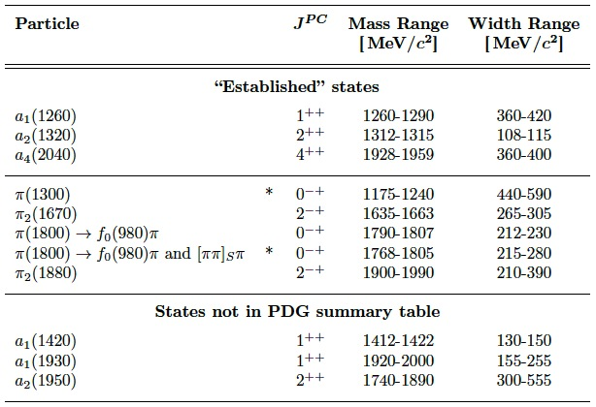




Results of Mass-Dependent Fit
PDG
Compass is a bit on the low side

Slide 25
t’ dependence of amplitudes
amplitudes
production phases
interference minimum
phase jump
non-resonant: b > 10
resonant : b < 10
phases measured w.r.t. a₁(1260)

Slide 26
(ππ)_{S-wave}
m
Method:
Replace 2-body fixed parametrisation
  e.g. Breit-Wigner/Flatté description of an isobar or (ππ)_{S} (à la Pennington)
  by histogram [2m_{π}, m_{3π}−m_{π}]
Histogram-entries are free parameters
  instead of e.g. 3 isobars with J^{PC} = 0⁺⁺ use n histogram bins of two body mass [m₁₂ , m₁₂ + δm] with these quantum numbers
  δm = 40 MeV/c²
  δm = 10 MeV/c² around f₀(980) (± 80 MeV/c² )
obtain new phase information:
Need of reference wave (analyzer):
  J^{PC} = 1⁺⁺0⁺ ρπ S (wave containing a₁(1260) and a₁’)

Slide 27
Correlation: m_{2π} – m_{3π}
low t
high t

Slide 28
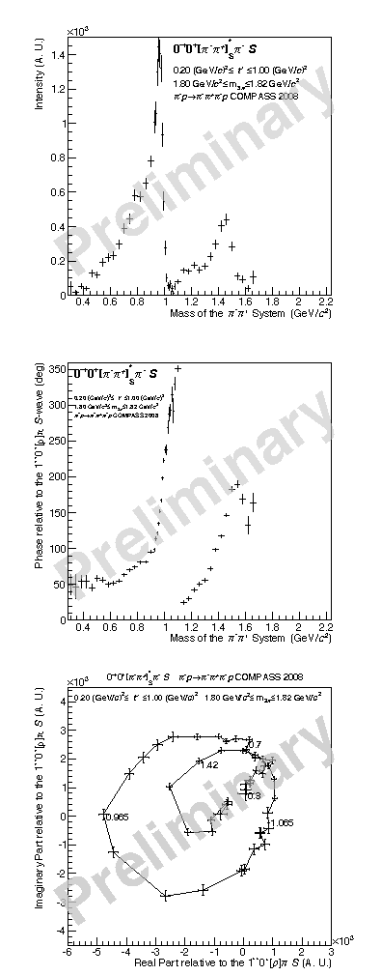
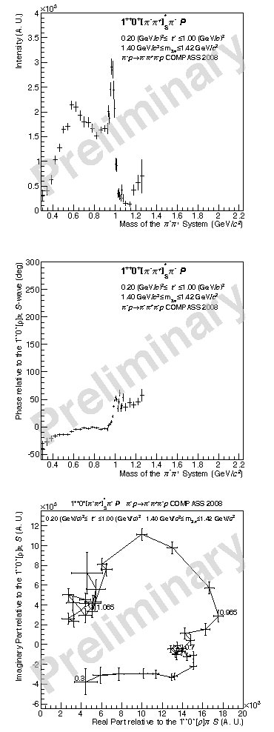
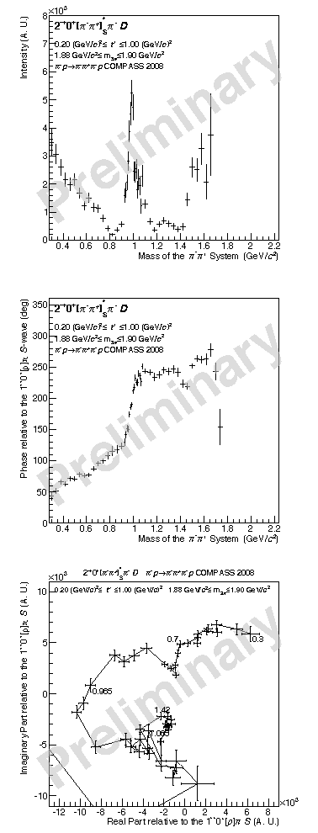
Details on (ππ)_{S-wave}
at π(1800)
at a₁(1420)
at π₂(1880)
ππ_{S} Intensities
in the resonance
region
ππ_{S} phases
in the resonance
region
φ_{production} + φ_{decay}
f₀(980)
f₀(980)
high t’

Slide 29
Conclusion
Establish new “2D” fit method to perform PWA
  mass independent: m_{3π} bins and t’ bins
  Observe “various components” of resonances with different t’-dependencies:
    extract resonance parameters
    Identify non-resonant components
Establish new method to establish shape of isobar-spectrum
  first application: [ππ]_{S}*:
    Shows strong dependence on mother wave
    Shows strong dependence on m_{3π}
    no unique parametrization yet
  Reveals information on scalar isobars
  Reveals different faces of f₀(980)
  Allows to measure phases in decays

Slide 30
Conclusion I
Find new iso-vector state a₁(1420)
  M_{a1(1420)} = 1412-1422 MeV/c² , Γ_{a1(1420)} = 130-150 MeV/c²
  decay into f₀(980)π in relative P-wave
  observe full phase motion with respect to reference waves
  coupling seems exclusively to f₀(980)
  Phase-behavior of (ππ)_{S} hints to strong ss-component
  Phase behavior opposite to (ππ)_{S} – coupling of π(1800) and π₂(1880) ?
  Nature of a₁(1420) ? Isospin partner of f₁(1420) (considered to be exotic) ?
  Dynamically generated through a₁(1260) ⟷ KK* ⟷ f₀ (980) channel ?

Slide 31
Conclusion II
Study of a₁(1260)
Sort out higher excitations of a₁ , a₂
  Radial excitation of π :
    π(1800) well known: COMPASS observes decay into f₀(980) and f₀(1500)
Orbital-excitation of π
  π₂(1670) , π₂(1880)

Slide 32
Prospects
Perform fits to 25-20 waves simultaneously (or more)
  fix branching fractions being independent of t’
  Gain stability
  Obtain reliable values for mass, width, branching ratios
  Identify nature of light meson spectrum
Extend de-isobarred analysis to (ππ)_{L=0,1,2}
Perform mass-dependent fits to (ππ)_{L=0,1,2}
  de-convolute spectral function and phases f(M_{2π},M_{3π},φ_{2π},t’)
  de-convolute Deck and rescattering
Perform joint fits for: π⁻π⁺π⁻ and π⁻π⁰π⁰
Other final states 5π, πηη, KK(nπ)..

Slide 33
Sneak Preview on (ππ) S-wave
from J^{PC}= 0⁻⁺
t’
t’

Slide 34
Sneak Preview – Large Fits
Preview to
21 wave-fit
in 2 bins of t’

Slide 35
Preview into πηη

Slide 36
The End
a₁(1420)
a₁’
a₂’
π₂
a₄

Slide 37
Major waves m = 1
mass independent fits
m = 1 = m_{min} + 1 waves
compare: π⁻π⁺π⁻ and : π⁻π⁰π⁰

