Slide 1
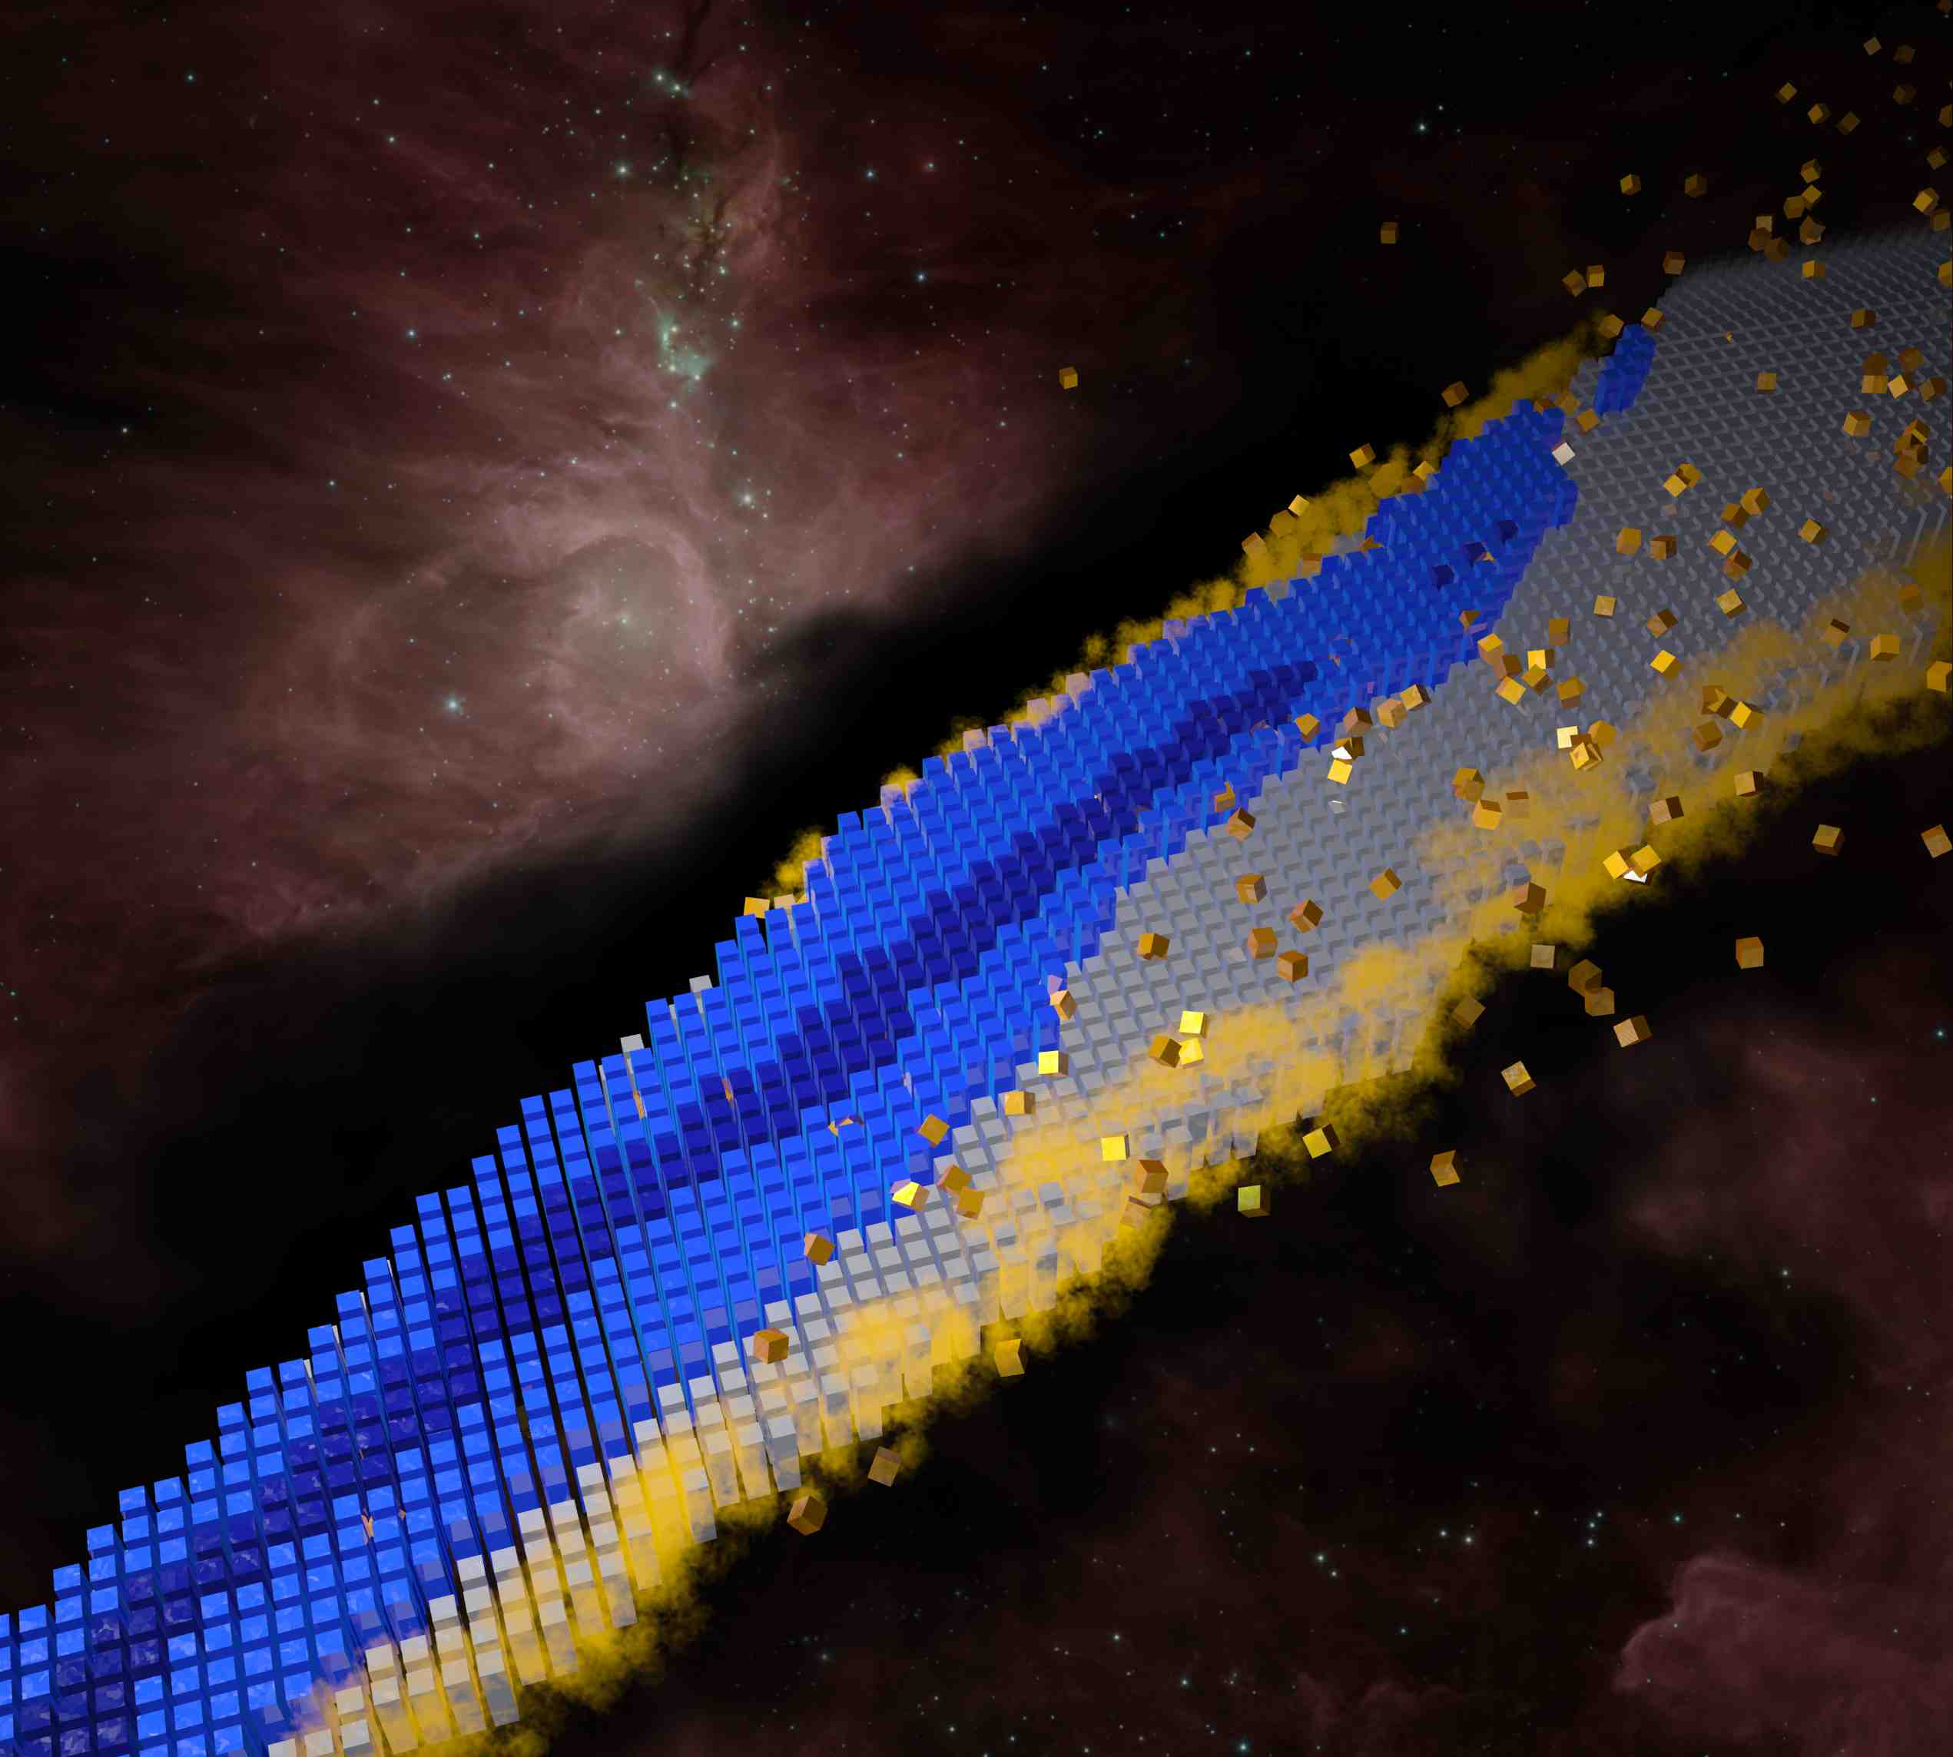
Applications of Nuclear Density Functional Theory
Witold Nazarewicz, Michigan State University/FRIB
INTERNATIONAL SCHOOL OF NUCLEAR PHYSICS, 40th Course
The Strong Interaction: From Quarks and Gluons to Nuclei and Stars
Erice-Sicily: September 16-24, 2018
Menu
Introduction to nuclear DFT
Global applications
  Charge radii
Localization measure
Model extrapolations and machine learning
Conclusions

Slide 2


Guiding principle: the scientific method…
J. Phys. G 43, 044002 (2016)

Slide 3
Weinberg’s Laws of Progress in Theoretical Physics
From: “Asymptotic Realms of Physics” (ed. by Guth, Huang, Jaffe, MIT Press, 1983)
First Law: “The conservation of Information” (You will get nowhere by churning equations)
Second Law: “Do not trust arguments based on the lowest order of perturbation theory”
Third Law: “You may use any degrees of freedom you like to describe a physical system, but if you use the wrong ones, you’ll be sorry!”

Slide 4
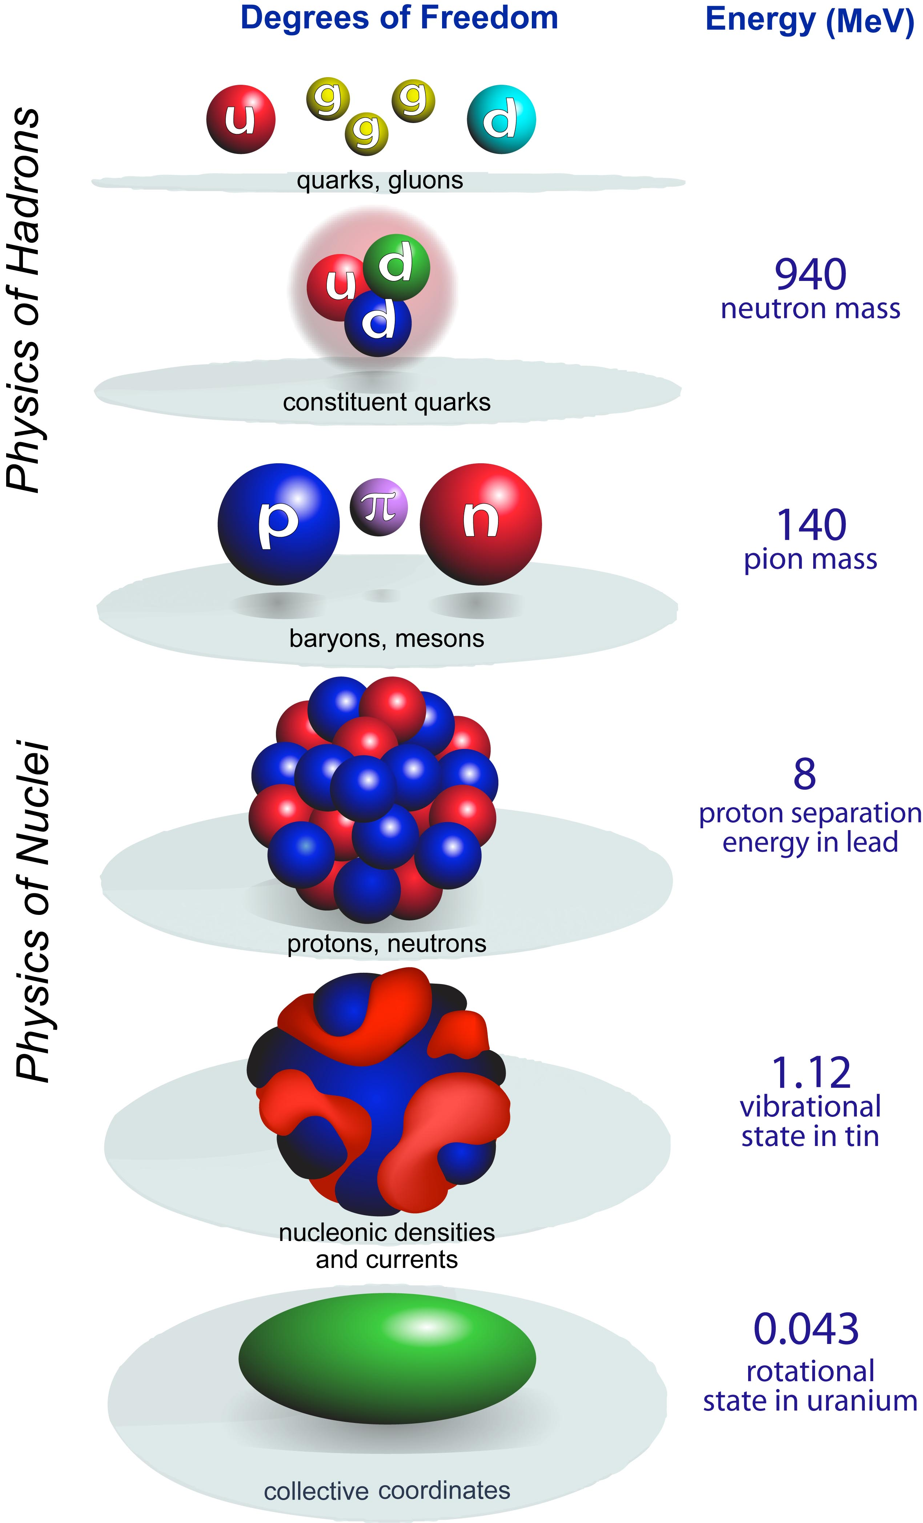

scale
separation
LQCD
Hot and dense quark-gluon matter
Hadron structure
quark
models
Resolution
Nuclear-Particle Physics
A-body
Nuclear structure
Nuclear reactions
New standard model
Societal applications
Effective Field Theory
CI
Most efficient approach: resolving power of a theoretical model taken as low as reasonably possible for the question at hand
Nuclear models must reproduce physical reality: phenomenology
DFT
collective
J. Phys. G 43, 044002 (2016)

Slide 5
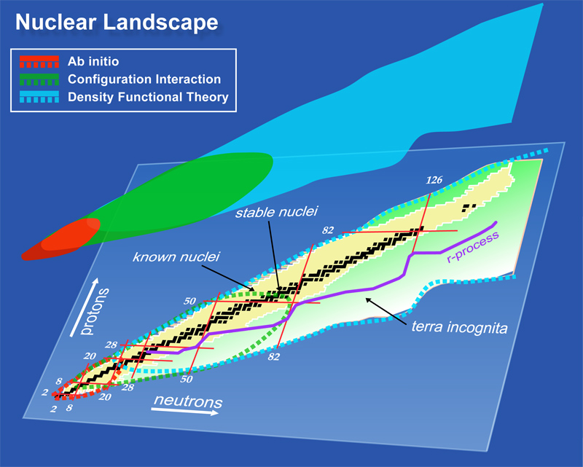
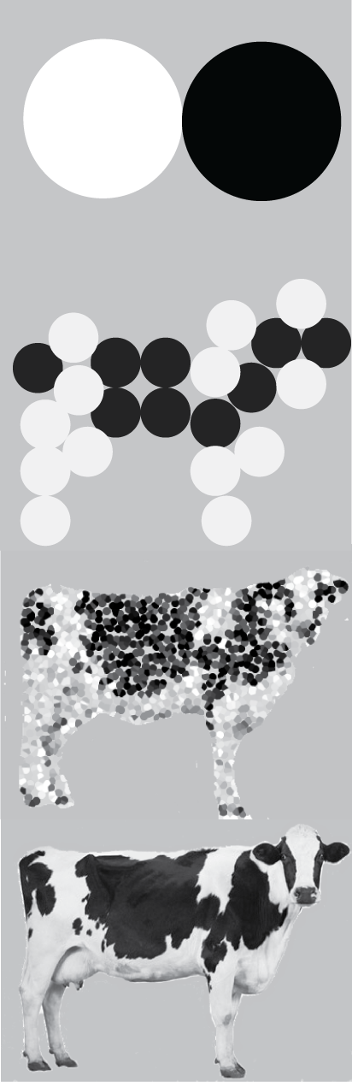
dimension of the problem

Slide 6
Nuclear Density Functional Theory and Extensions
Technology to calculate observables
Global properties
Spectroscopy
DFT Solvers
Functional form
Functional optimization
NN+NNN
interactions
Density Matrix
Expansion
Density dependent
interactions
Energy Density
Functional
Input
Optimization
Fit-observables
experiment
pseudo data
DFT variational principle
HF, HFB (self-consistency)
Symmetry breaking
Symmetry restoration
Multi-reference DFT (GCM)
Time dependent DFT (TDHFB)
Observables
Direct comparison with experiment
Pseudo-data for reactions and astrophysics

Slide 7
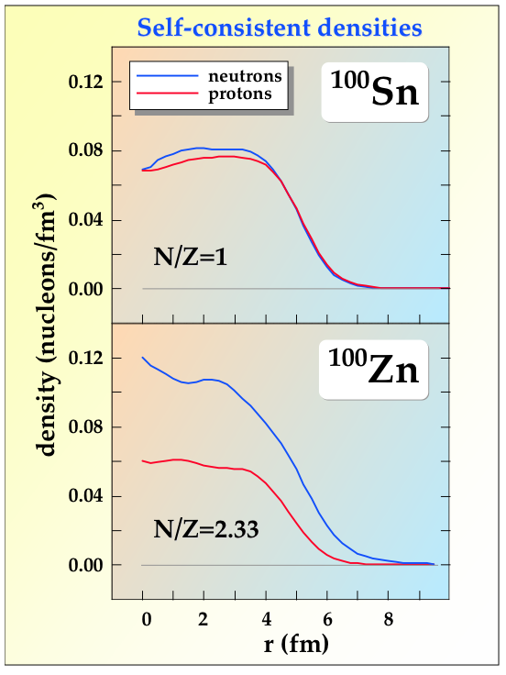
Mean-Field Theory ⇒ Density Functional Theory
Degrees of freedom: nucleonic densities
Nuclear DFT
two fermi liquids
self-bound
superfluid
mean-field ⇒ one-body densities
zero-range ⇒ local densities
finite-range ⇒ gradient terms
particle-hole and pairing channels
Does not have to be related to a force
Has been extremely successful. A broken-symmetry generalized product state does surprisingly good job for nuclei.

Slide 8

Nuclear Energy Density Functional
isoscalar (T=0) density
+isoscalar and isovector densities:
  spin, current, spin-current tensor, kinetic, and kinetic-spin
+ pairing densities
isovector (T=1) density
p-h density
p-p density (pairing functional)
Expansion in densities and their derivatives
Constrained by microscopic theory: ab-initio functionals provide quasi-data!
Not all terms are equally important. Usually ~12 terms considered
Some terms probe specific experimental data
Pairing functional poorly determined. Usually 1-2 terms active
Most popular: Skyrme, Gogny, Covariant
Becomes very simple in limiting cases (e.g., unitary limit)
Can be extended into multi-reference DFT (GCM) and projected DFT

Slide 9
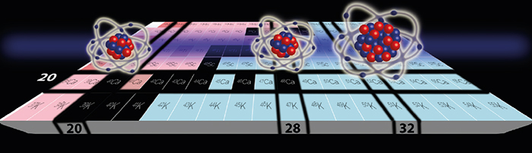
Charge radii of calcium isotopes
A-body and DFT meet
Nature Physics 12, 594 (2016)
The local Fayans functional offers superb description of binding energies and charge radii: S. A. Fayans, JETP Lett. 68, 169 (1998)
Recent optimization Fy(Δr): P.G. Reinhard and WN, Phys. Rev. C 95, 064328 (2017)

Slide 10
A.J. Miller et al: Proton superfluidity and charge radii in proton-rich calcium isotopes, submitted

Slide 11
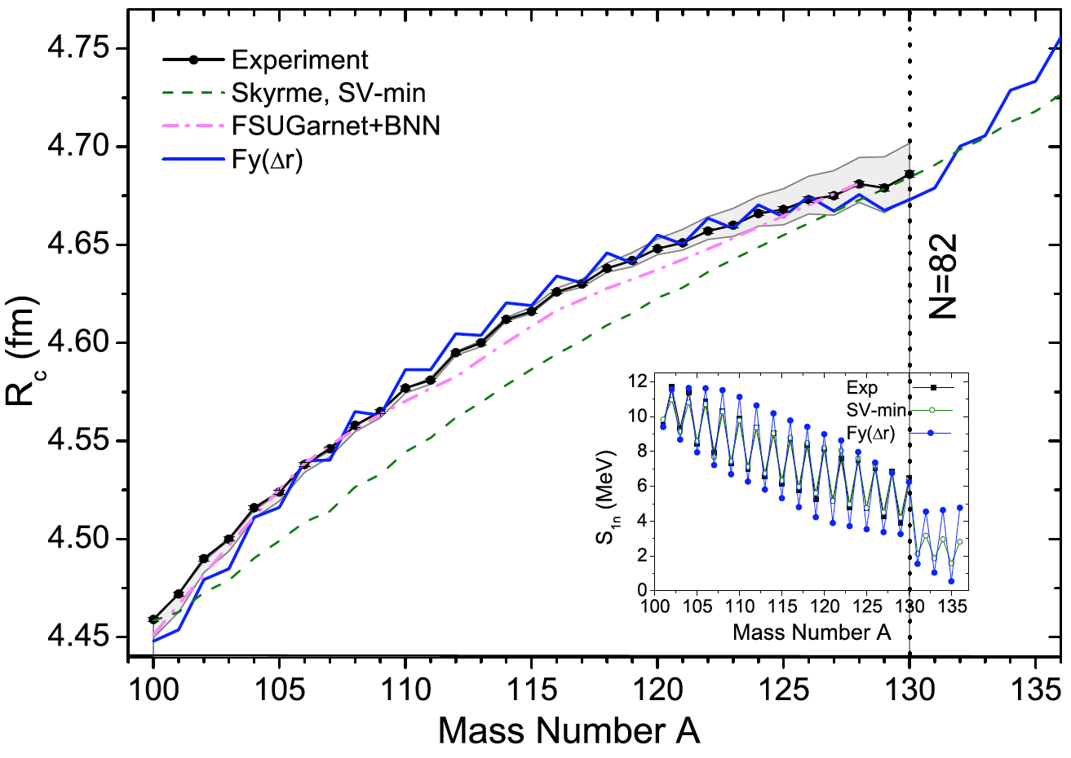
From Calcium to Cadmium
M. Hammen et al. Phys. Rev. Lett. 121, 102501 (2018)

Slide 12
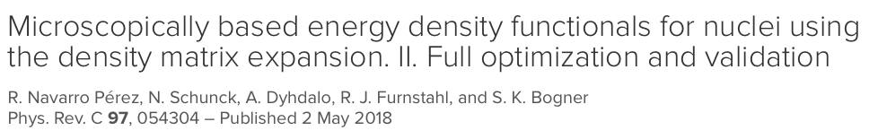
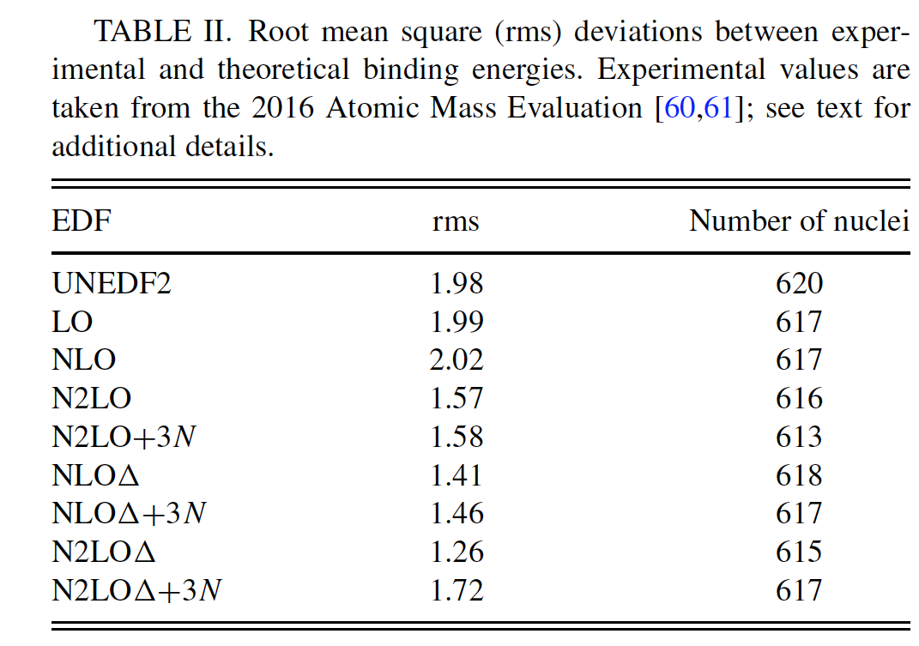
Summary (novel functionals, charge radii)
By using the tools of numerical optimization and linear regression, we developed new local Fayans energy density functional Fy(Δr, HFB). This functional provide excellent description of selected nuclear properties, such as charge radii and separation energies.

Slide 13
Single-particle localization measure
1. One-body density matrix:
q=n,p
2. The probability of finding two nucleons with the same spin at spatial locations r and r’ (same-spin pair probability) for isospin q:
local density
3. The conditional probability for finding a nucleon at r’ when we know with certainty that another nucleon with the same spin and isospin is at r :

Slide 14
4. Consider the local short-range behavior of the conditional probability, which one can obtain by performing a spherical averaging over a shell of radius δ about the point r and then Taylor expanding the resulting expression:
kinetic energy density
current density
A value of localization corresponds in this definition to a totally localized particle, as found in an alpha-particle for all combinations of spin and isospin. The value of ½ marks the localization of particles in a Fermi gas.
Becke and Edgecombe, J. Chem. Phys. 92, 5397 (1990)

Slide 15
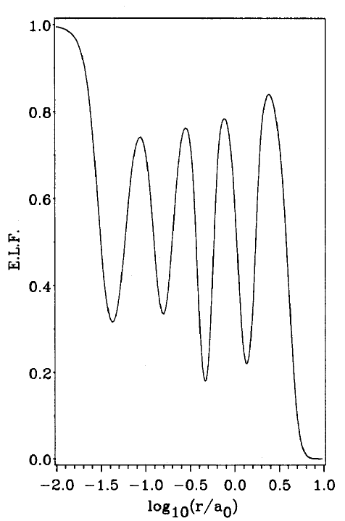
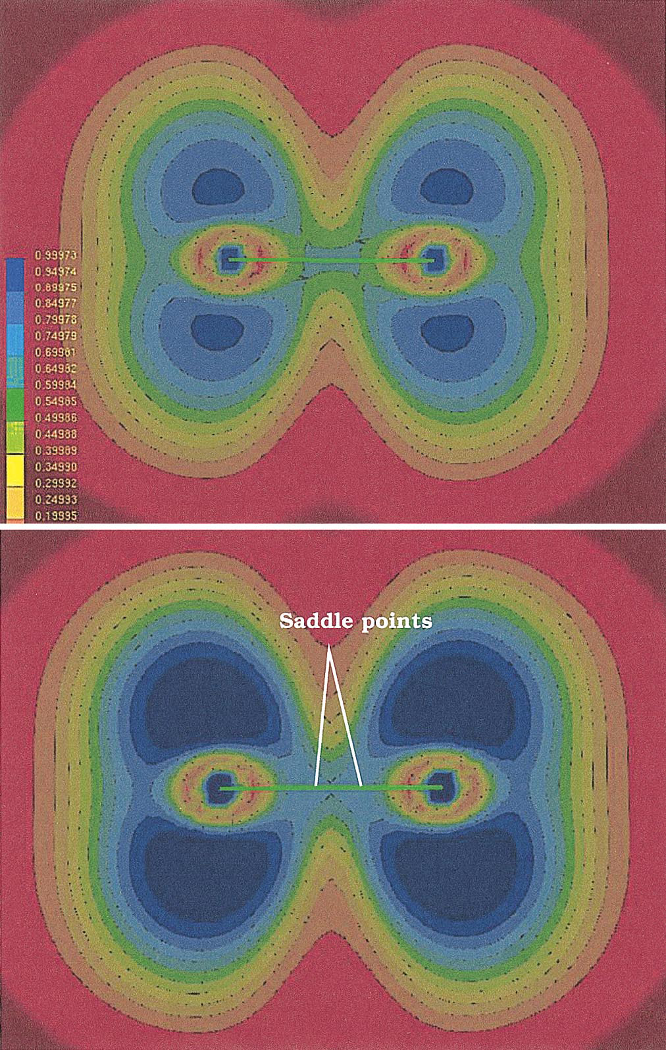
Electron Localization Function (ELF) in molecules
ELF for F₂ in a molecular plane
Shell structure of Xe
Becke and Edgecombe, J. Chem. Phys. 92, 5397 (1990)
Kohout and Savin, Int. J. Quantum Chem. 60, 875 377 (1996).
Scemama et al., J. Chem. Phys. 121, 1725(2004)

Slide 16
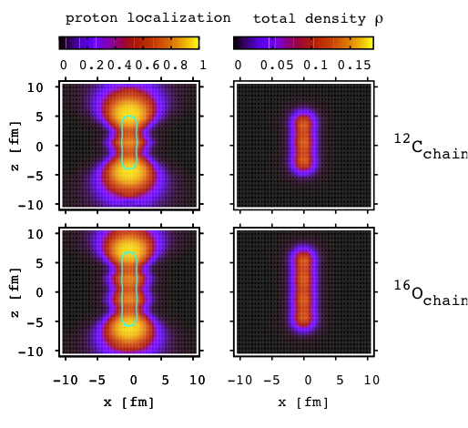
Application to nuclear clusters
P.-G. Reinhard, J. A. Maruhn, A. S. Umar, and V. E. Oberacker, Phys. Rev. C 83, 034312 (2011)

Slide 17
Fission and localization measure; SF yields
J. Sadhukhan, WN, N. Schunck, Phys. Rev. C 93, 011304(R) (2016)
C. Zhang, B. Schuetrumpf, WN. Phys. Rev. C 94, 064323 (2016)

Slide 18
²³²Th
¹³²Sn
¹⁰⁰Zr

Slide 19
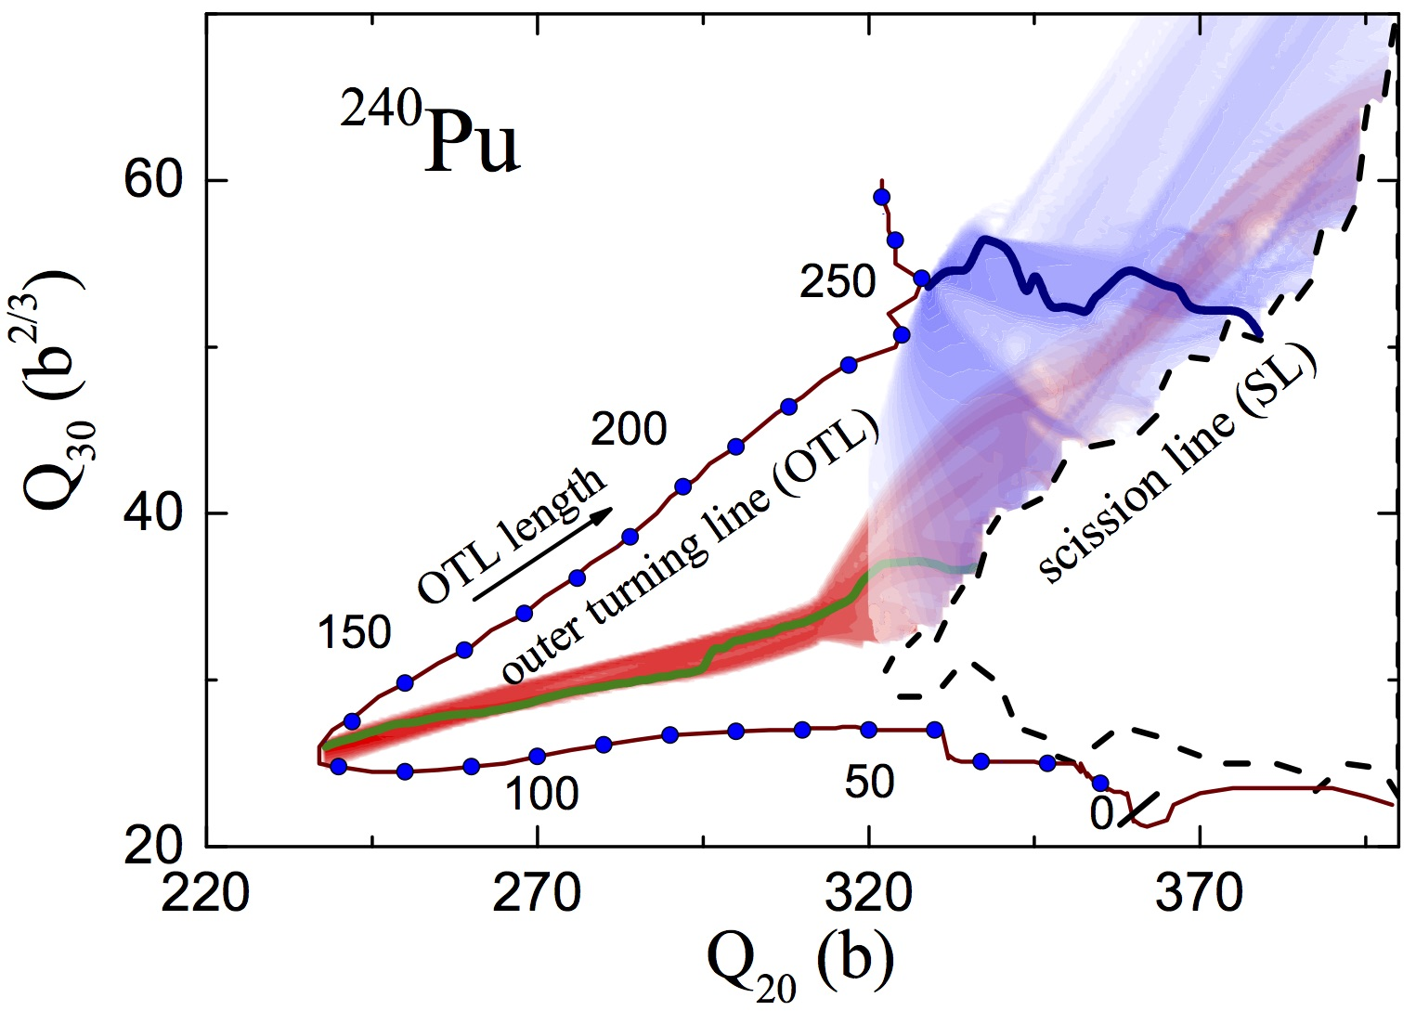
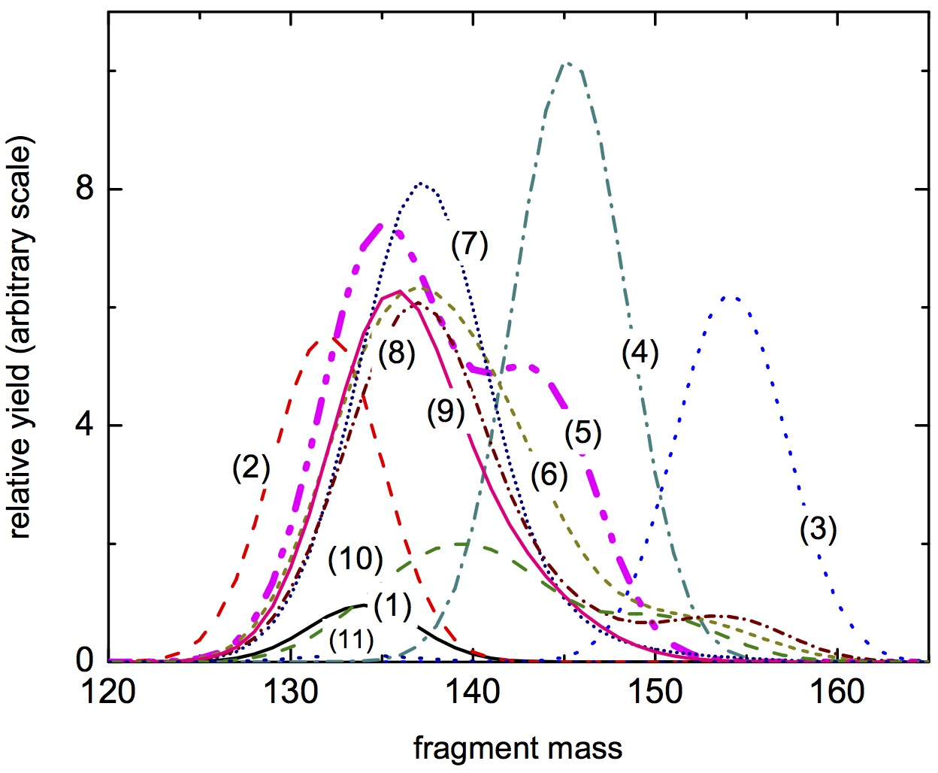
NLF to understand fission yields
J. Sadhukhan, C. Zhang, WN, N. Schunck, Phys. Rev. C 96, 061301 (2017)

Slide 20
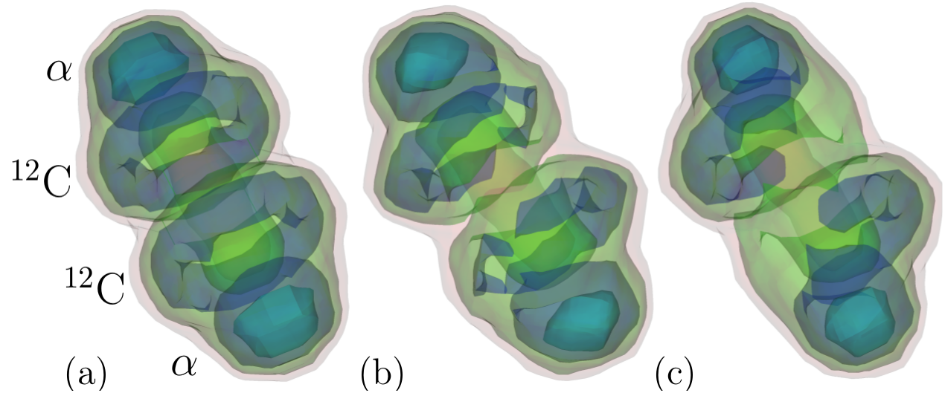
Localization in TDHF
B. Schuetrumpf & WN, Phys. Rev. C 96, 064608 (2017), featured as phys.aps.org Focus
¹⁶O+¹⁶O at E_{cm}=20 MeV
t=330 fm/c
b=0
b=2 fm
b=4 fm

Slide 21
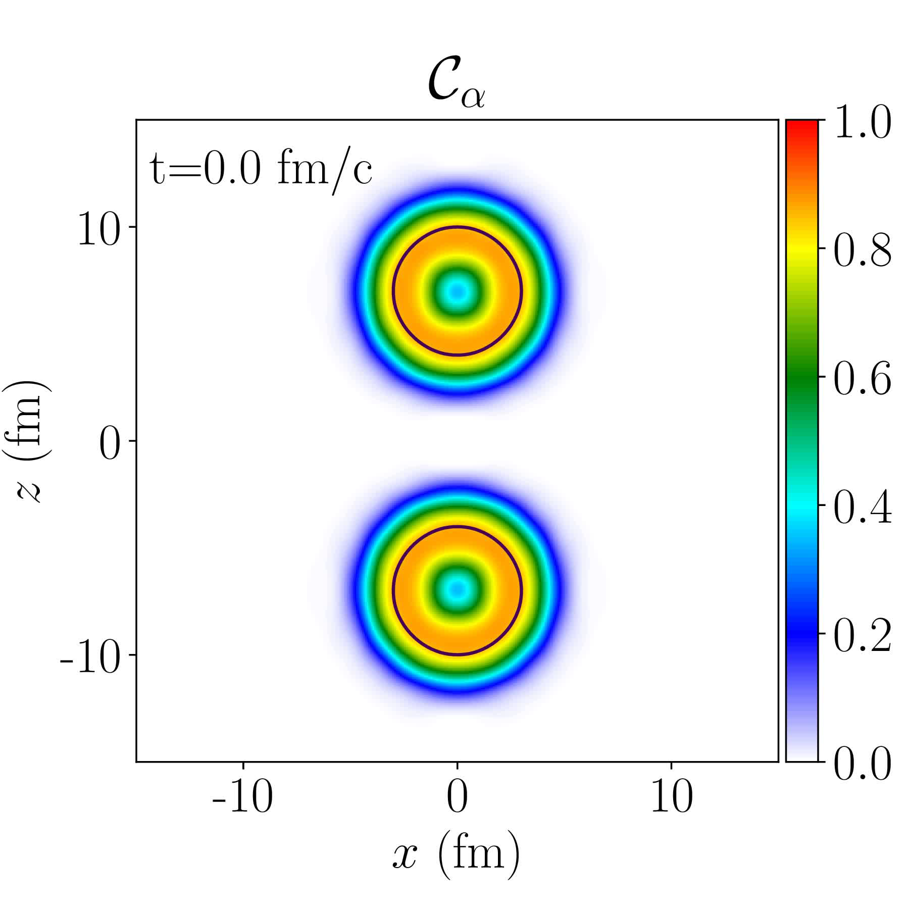

¹⁶O+¹⁶O
E_{cm}=20 MeV
¹⁶O+¹⁶O
E_{cm}=100 MeV, b=2fm
After t~180 fm/c the system oscillates between two cluster configurations.

Slide 22

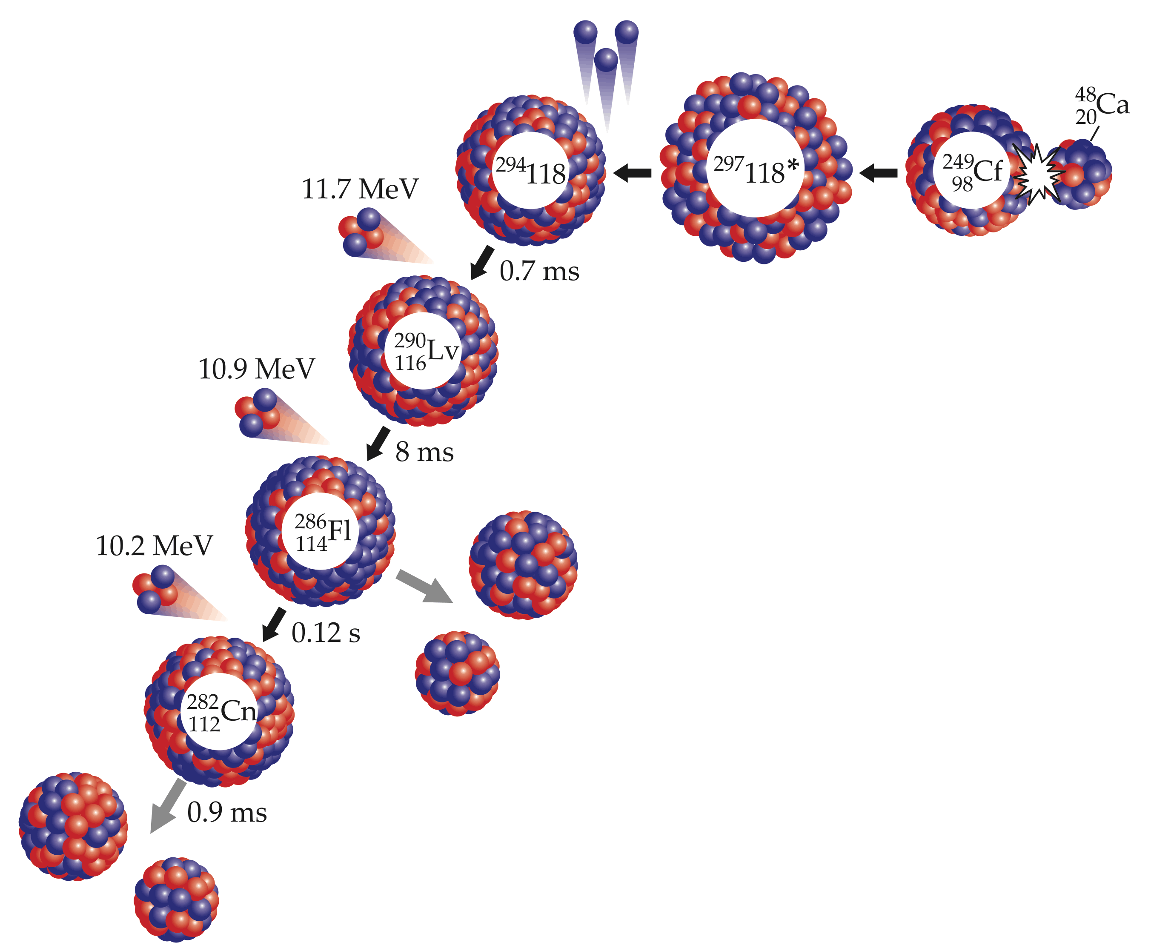

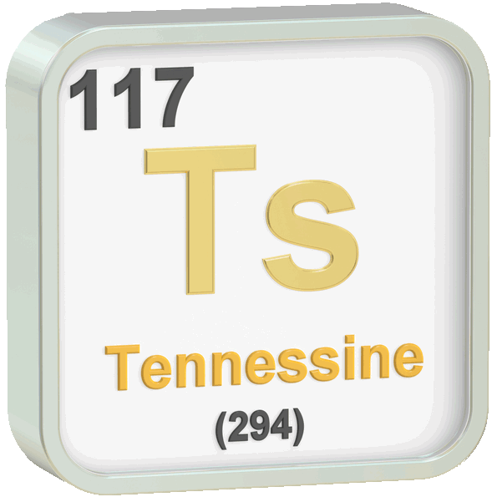

Oganesson – the heaviest nucleus known
Og discovered 2002/2006
Blessed by IUPAC/IUPAP 2015
Named 2016
Physics Today 68, 32 (2016)

Slide 23
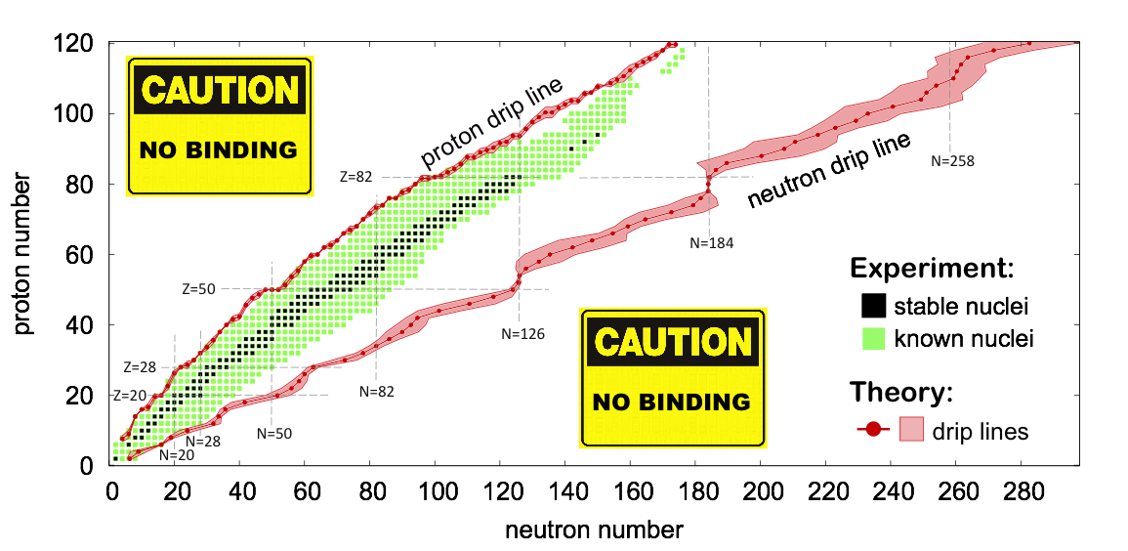
≈100 isotopes of Og
proton drip line
N=170
beta stable
N≈192
neutron drip line
N≈270

Slide 24

²⁹⁴Og is expected to be a deformed semi-bubble!
B. Schuetrumpf et al., Phys. Rev. C 96, 024306 (2017)
protons
neutrons
nuclear
electrostatic
²⁹⁴Og
Og is a strongly frustrated system: a competition between long-range Coulomb and short-range nuclear interactions gives rise to exotic distributions of protons
³⁰²Og

Slide 25
Localization of oganesson (Z=118)
P. Jerabek et al., Phys. Rev. Lett. 120, 053001 (2018)
(Massey/MSU collaboration)
Xe
Rn
Og
10.125 eV
The relativistic 7s contraction results in 7p shielding

Slide 26
P. Jerabek et al., Phys. Rev. Lett. 120, 053001 (2018)
(Massey/MSU collaboration)
NLF
ELF
Og is expected to have an enormous polarizability (more than 58 a.u.; 44 a.u in NR), almost double that of Rn (33 a.u.). Thus, for Og one expects an increase in van-der-Waals interactions compared to the lighter rare gases.

Slide 27

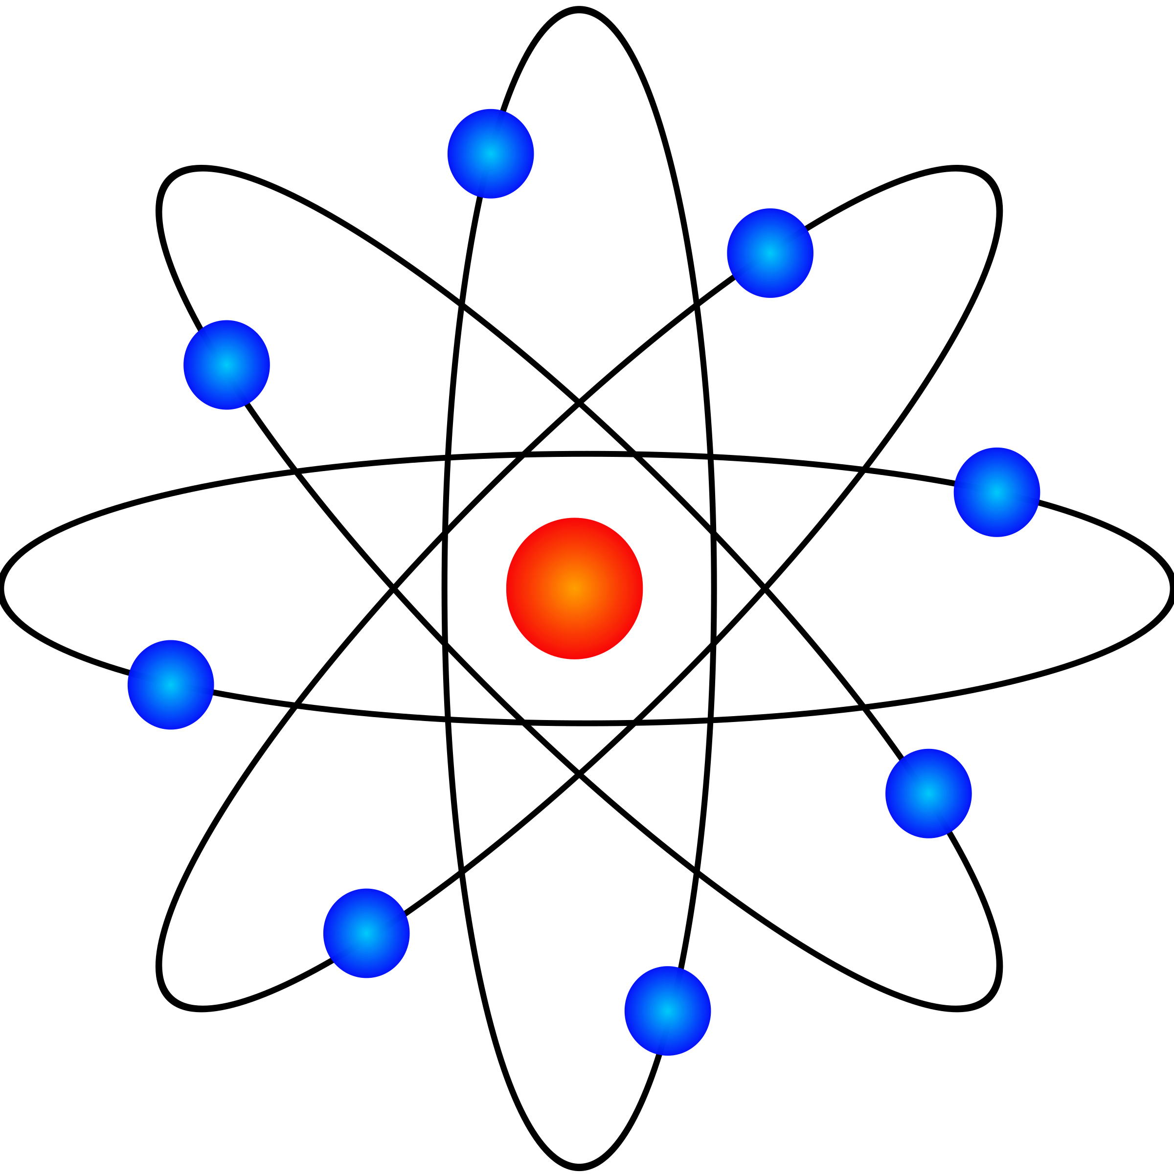
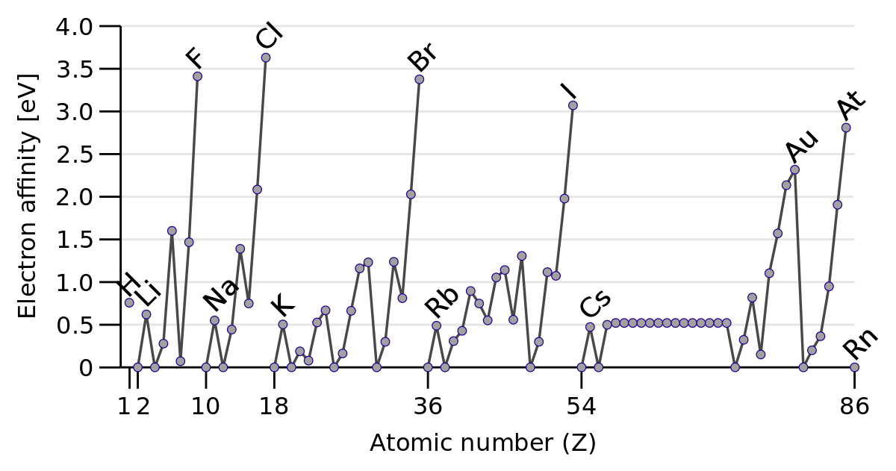
Og is rare but not a gas at room temperature
relativistic (R): B_{e}=1.487 MeV (0.57 MeV in Pb)
nonrelativistic (NR): B_{e}=1.260 MeV (0.53 MeV in Pb)
ΔM_{at}=227 keV (40 keV in Pb)
R
NR
0.064(2) eV for Og!
Qg is predicted to be the first rare gas with positive electron affinity, due to dramatic stabilization effect on the 8s orbital (including significant QED correction of 0.006 eV)

Slide 28
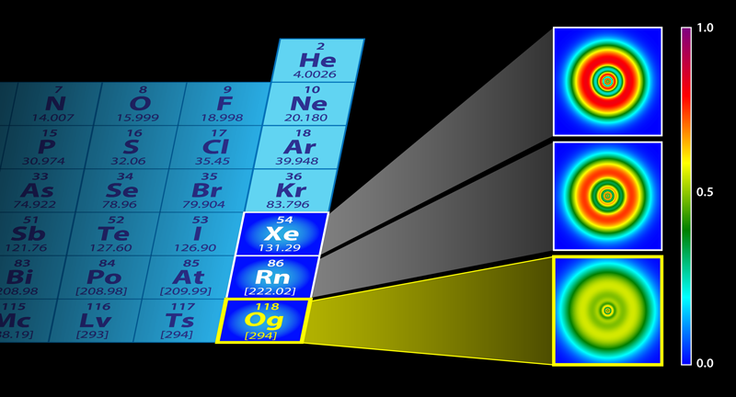
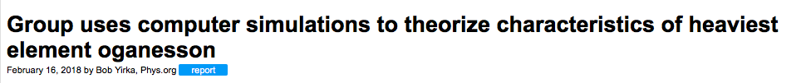
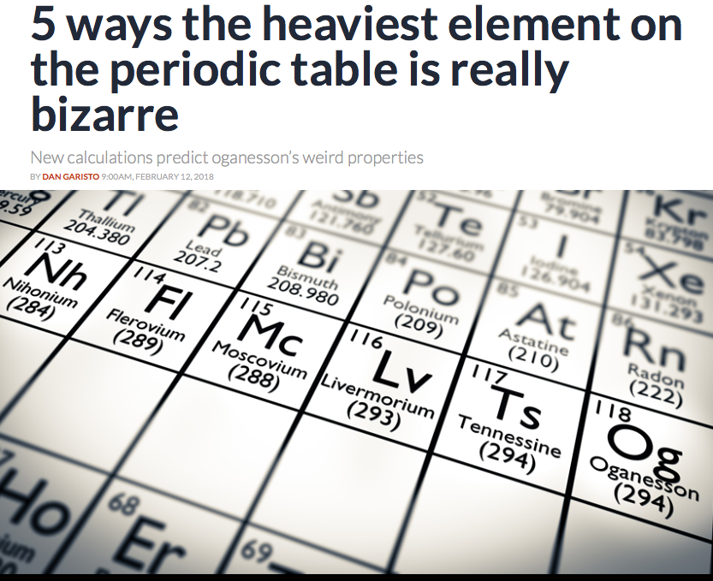
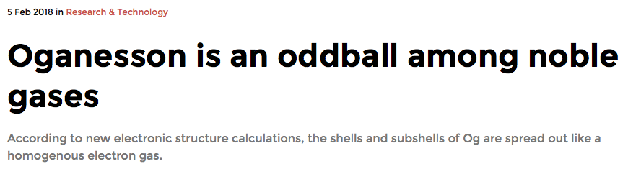
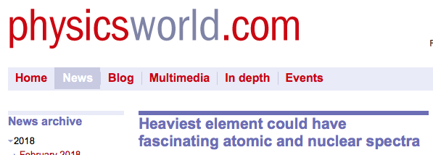

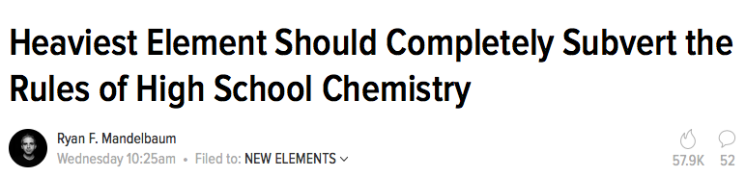
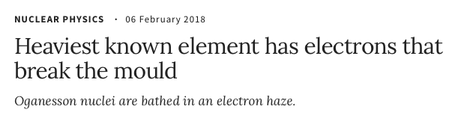

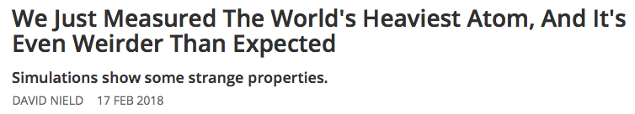
Highlighted by:
Chemistry World
Physics Today
Science News
Nature
Physics.aps.org
Phys.org
Physics Word
ScienceAlert
Gizmodo
…
Physics Viewpoint: Heaviest Element Has Unusual Shell Structure

Slide 29
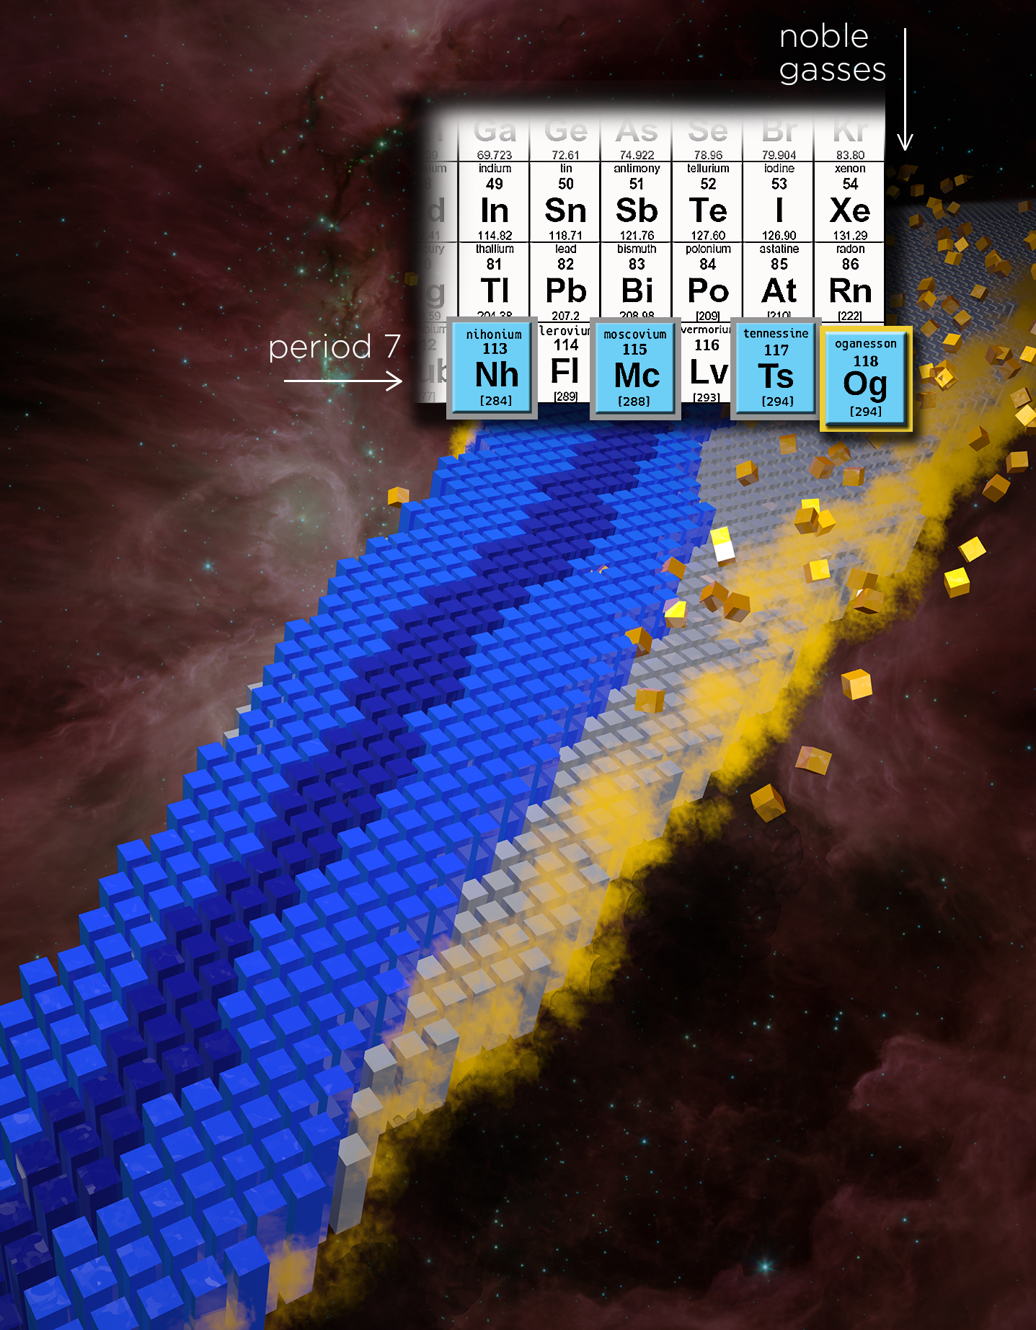
The limits of nuclear mass and charge
Nature Physics 14, 537–541 (2018)

Slide 30
Summary (Iocalization)
Compared to the nucleonic densities, the nucleon localization function has been shown to be an excellent indicator of shell effects and cluster correlations. Its characteristic oscillating pattern, traced back to shell effects, is a clear fingerprint of cluster/fragment configurations.
We have shown that, while the prefragments are formed early in the fission process and change little as the nucleus deforms, there is a large number of nucleons (~30 for ²⁴⁰Pu) that are not localized in the prefragments and are rapidly distributed at scission into the final fragments.
The time-dependent nucleon localization measure is a very good indicator of clusters in complex pre-compound states formed in heavy-ion fusion reactions. The localization reveals the presence of collective vibrations involving cluster structures, which dominate the initial dynamics of the fusing system.
Through electron and nucleon localization functions we show that Og is a rather unusual addition to the Periodic Table and to the Chart of Nuclides. High density of electronic and nucleonic s.p. states, relativistic effects resulting in the strong spin-orbit splitting of electronic levels, and nucleonic polarization effects, make the superheavy atoms, such as Og, quantitatively different from the lighter congeners.

Slide 31
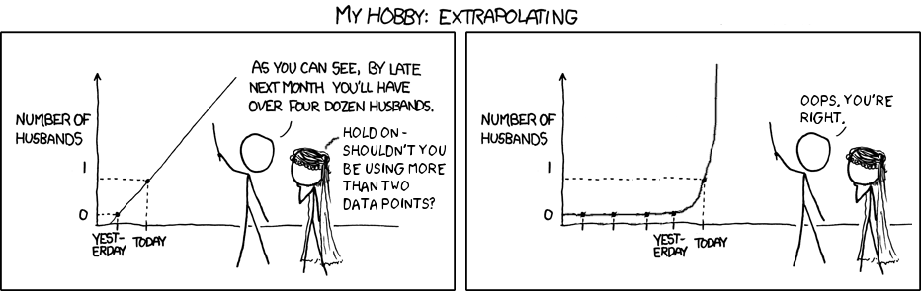
“Remember that all models are wrong; the practical question is how wrong do they have to be to not be useful” (E.P. Box)
In many cases, nuclear input MUST involve massive extrapolations based on predicted quantities. And extrapolations are impossible tough.

Slide 32
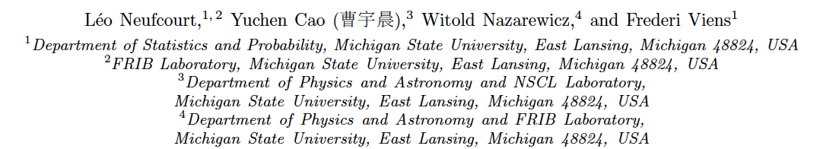
Bayesian approach to model-based extrapolation of nuclear observables
Phys. Rev. C, in press. Editor’s suggestion
In order to improve the quality of model-based predictions of nuclear properties of rare isotopes far from stability, we consider the information contained in the residuals in the regions where the experimental information exist. As a case in point, we discuss two-neutron separation energies S_{2n} of even-even nuclei. Through this observable, we assess the predictive power of global mass models towards more unstable neutron-rich nuclei and provide uncertainty quantification of predictions.
Some recent relevant references…
S. Athanassopoulos, E. Mavrommatis, K. Gernoth, and J. Clark, Nucl. Phys. A 743, 222 (2004).
R. Utama, J. Piekarewicz, and H. B. Prosper, Phys. Rev. C 93, 014311 (2016).
G. F. Bertsch and D. Bingham, Phys. Rev. Lett. 119, 252501 (2017).
H. F. Zhang et al.,J. Phys. G 44, 045110 (2017).
Z. Niu and H. Liang, Phys. Lett. B 778, 48 (2018).
R. Utama and J. Piekarewicz, Phys. Rev. C 97, 014306 (2018).

Slide 33
Separation energy residual:
emulator of residual

Slide 34
We consider 10 global models based on nuclear Density Functional Theory with realistic energy density functionals as well as two more phenomenological mass models.
The emulators of S_{2n} residuals and confidence intervals defining theoretical error bars are constructed using Bayesian Gaussian processes and Bayesian neural networks. We consider a large training dataset pertaining to nuclei whose masses were measured before 2003. For the testing datasets, we considered those exotic nuclei whose masses have been determined after 2003. By establishing statistical methodology and parameters, we carried out extrapolations towards the 2n dripline.
We are not interested in mass formulae: “With four parameters I can fit an elephant, and with five I can make him wiggle his trunk” (John von Neumann)

Slide 35
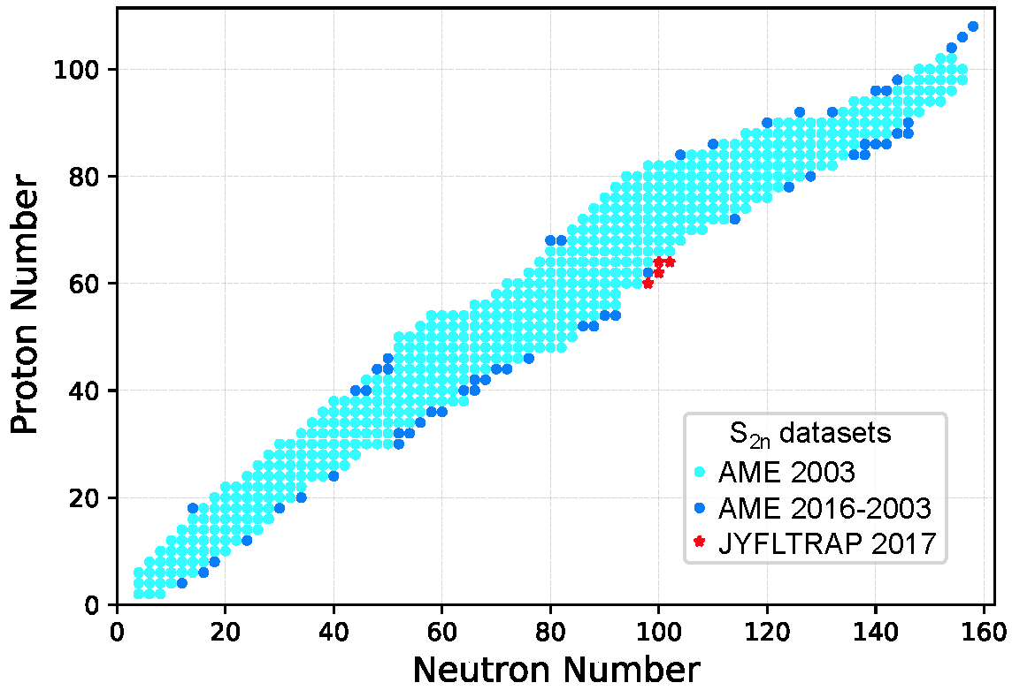
Our objective: extrapolations
Training set:
537 points
Testing sets:
55+4 points

Slide 36
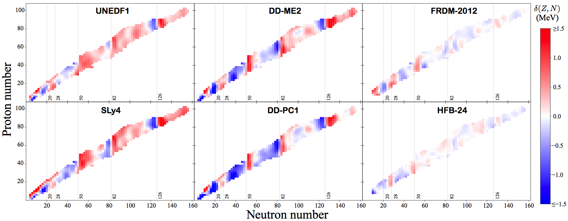
Residuals exhibit local trends
This information can be used to our advantage to improve model-based predictions!

Slide 37
Bayesian approach
residual
(Z,N)_{i}
Bayes’ theorem
Prediction of unknown observable y* given known data y
Two statistical models used:
Gaussian process (3 parameters)
Bayesian neural network with sigmoid function (30 neurons, 1 layer; 181 parameters)
100,000 iterations of an ergodic Markov chain produced by the Metropolis-Hastings algorithm
Some refinements added based on our knowledge of trends

Slide 38
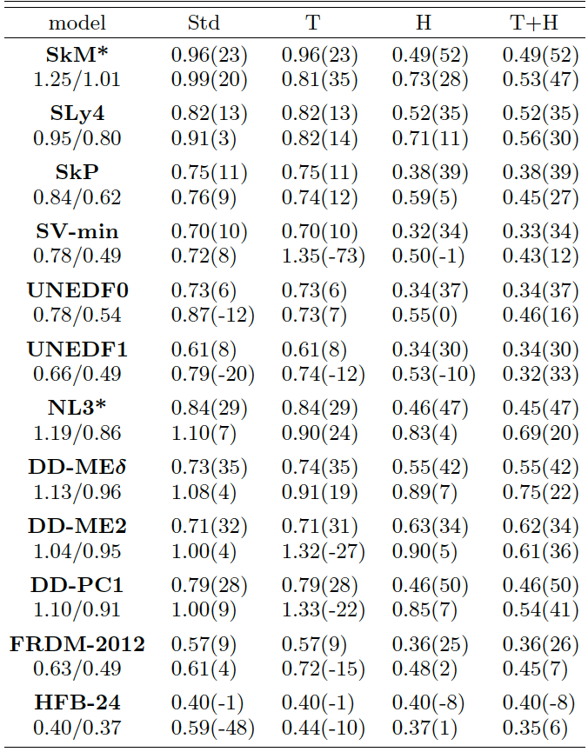
GP
BNN
training dataset: AME2003
testing dataset: AME2016-AME2003
Overall, for the testing dataset AME2016-2003, the rms deviation from experimental S_{2n} values is 400-500 keV in the GP variant for all theoretical models employed in our study, which suggests that our statistical methods capture most of the residual structure.
BUT the predicted mean value is certainly not the whole story!

Slide 39
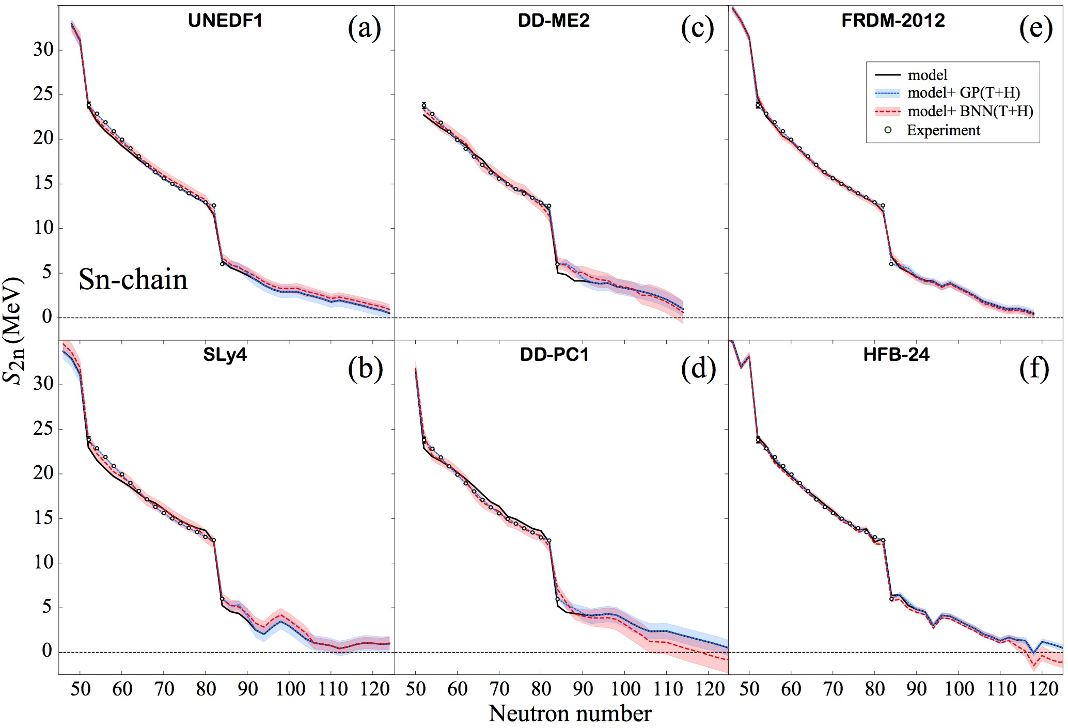
Extrapolations

Slide 40
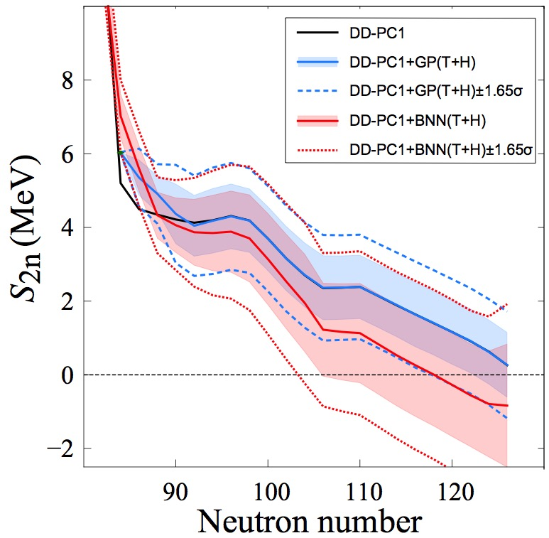
model: N*=126
model+GP: N*=126 (N*=122 at 1σ and N*=118 at 1.65σ one-sided/credibility 95%)
model+BNN: N*=118 (N*=104 at 1σ and N*=102 at 1.65σ)
Can one say: “DD-PC1 predicts the 2n dripline at N=126” ?

Slide 41
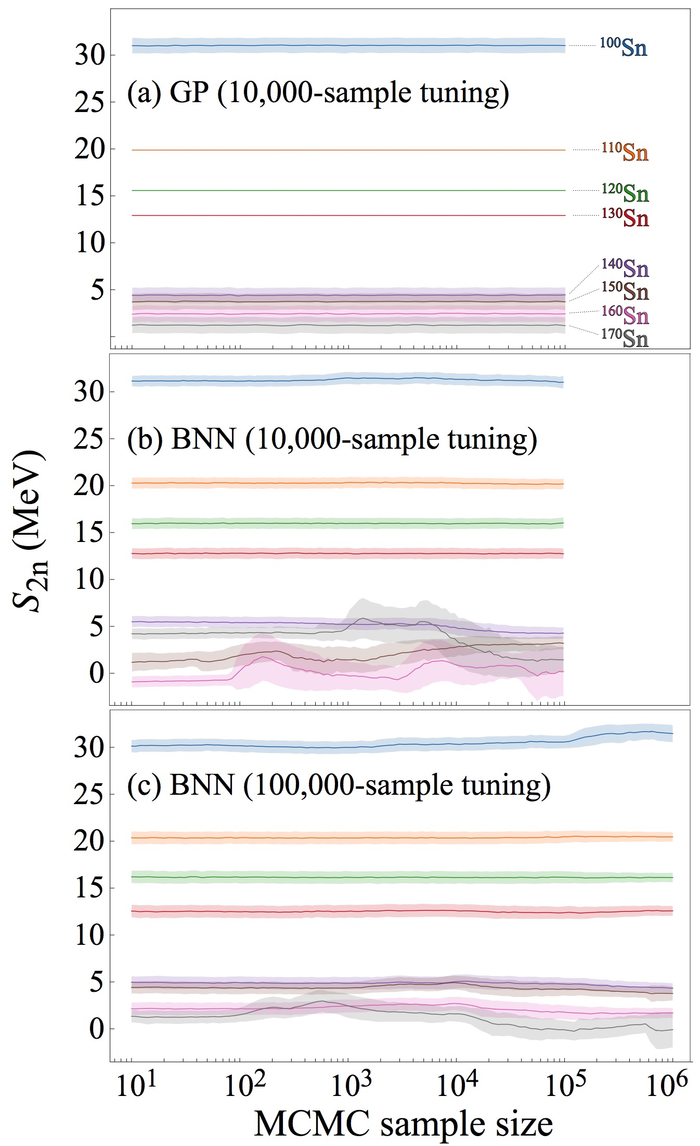
Massive MCMC runs: BNN shows convergence issues!

Slide 42
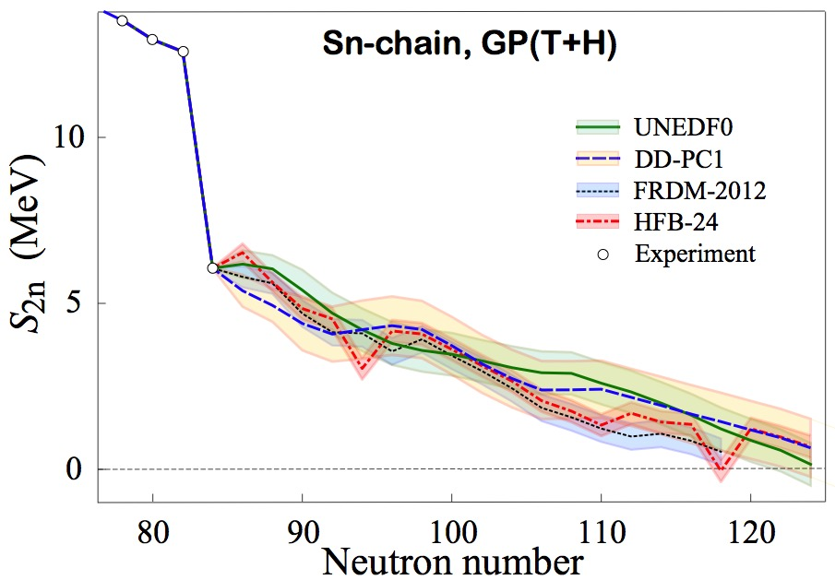

Slide 43
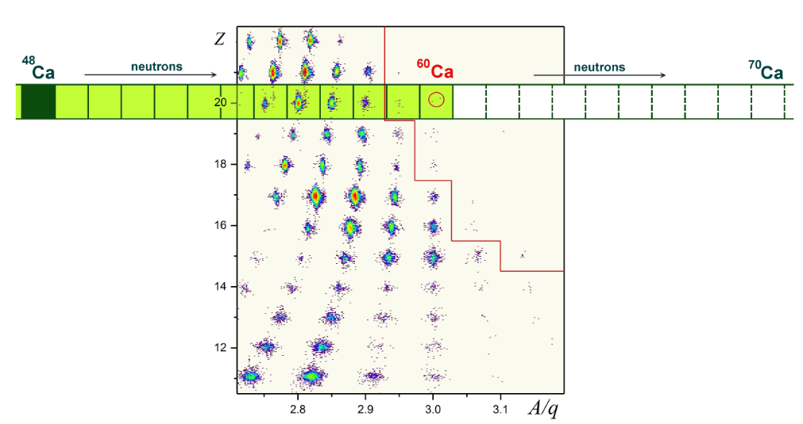
Discovery of ⁶⁰Ca
O.B. Tarasov et al. Phys. Rev. Lett. (2018)
⁵⁹K ?
The eight new neutron-rich nuclei discovered, ⁴⁷P, ⁴⁹S, ⁵²Cl, ⁵⁴Ar, ⁵⁷K, ^{59,60}Ca, and ⁶²Sc, are the most neutron-rich isotopes of the respective elements. In addition, one event consistent with ⁵⁹K was registered.

Slide 44
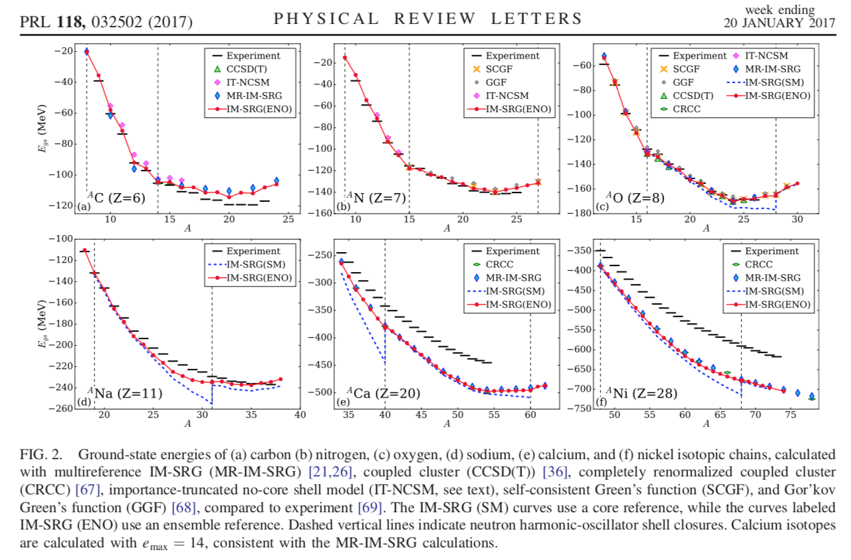
S. R. Stroberg et al.

Slide 45
Phys. Scripta 2013, 014022 (2013)

Slide 46
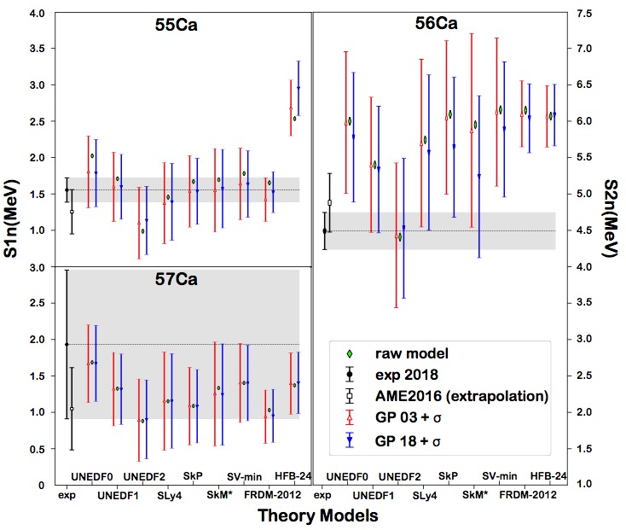
Validation: new masses of ⁵⁵⁻⁵⁷Ca
S. Michimasa, et al., PRL (2018)

Slide 47
Probability of existence
We introduce the posterior probability p_{ex}(Z,N) of the predicted separation energy S_{1n/2n}(Z,N) being positive:
*

Slide 49
Bayesian model mixing
Our model mixing calculations were done by averaging posteriors obtained with individual models. In the first averaging variant, we assumed model-independent prior weights. In the second posterior averaging variant, the weights were obtained as the Bayesian posterior probabilities that a model M_{k} predicts the existence of the key nuclei ⁵²Cl, ⁵³Ar, and ⁴⁹S, namely:

Slide 51
Summary (extrapolations)
While both Gaussian processes and Bayesian neural networks reduce the rms deviation from experiment significantly, GP offers a better and more stable performance. The increase in the predictive power of DFT models aided by the statistical treatment is quite astonishing: the resulting rms deviations from experiment on the testing dataset are similar to those of more phenomenological models.
The estimated confidence intervals on predictions make it possible to evaluate predictive power of individual models, and also use groups of models to make quantified predictions.
The proposed robust statistical approach to extrapolation of nuclear model results can be useful for assessing the impact of current and future experiments in the context of model developments. The new Bayesian capability to evaluate residuals is also expected to impact research in the domains where experiments are currently impossible, for instance in r-process simulations.

Slide 52
Thank you!

