Slide 1
Double beta decay of ¹³⁶Xe: nEXO plans and status
A. Piepke, University of Alabama
For the nEXO Collaboration

Slide 2
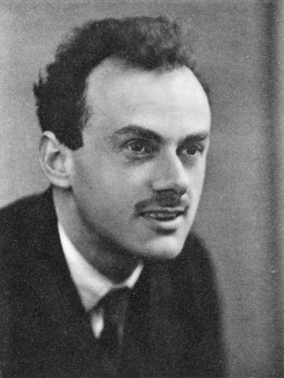
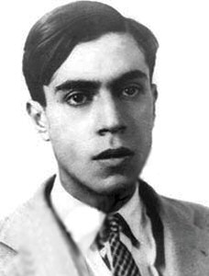
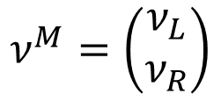
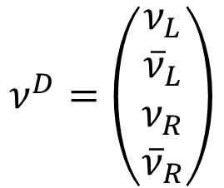
Introduction
Assuming that the previous speakers introduced what we hope to learn from the study of double beta decay I will be VERY brief on the basics.
Neutrinos carry no electrical charge. Particle and anti-particle can not be distinguished by their charge.
Since the 1930-ies the question has been: how to describe them?
Dirac four spinor:
Majorana two spinor:
$$ν^{D}=\left(\begin{matrix}ν_{L} \\ {\overline{ν}}_{L} \\ ν_{R} \\ {\overline{ν}}_{R}\end{matrix}\right)$$
$$ν^{M}=\left(\begin{matrix}ν_{L} \\ ν_{R}\end{matrix}\right)$$
More efficient but results in Lepton number violation. Does it exist?
Familiar but, perhaps, containing redundant states.

Slide 3

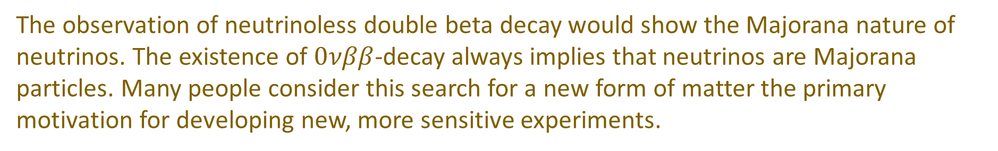
Introduction
Are neutrinos Majorana particles? This question needs to be answered by experiment.
The observation of neutrinoless double beta decay would show the Majorana nature of neutrinos. The existence of $0νββ$-decay always implies that neutrinos are Majorana particles. Many people consider this search for a new form of matter the primary motivation for developing new, more sensitive experiments.
I am not talking about that: allowed two neutrino decay and many other hypothetical neutrinoless modes requiring new physics.
e⁻
e⁻
Added to this possibility of discovering a novel aspect of nature is the capability to determine the value of the neutrino mass. This utilizes one particular decay mechanism: the exchange of light neutrinos. It offers a convenient way of comparing results from different nuclides with each other.
u
u
u
ν_{e}
u
ν_{e}
e⁻
e⁻
ν_{e}
W
W
W
W
ββ2ν
d
d
$$0νββ$$
d
d

Slide 4
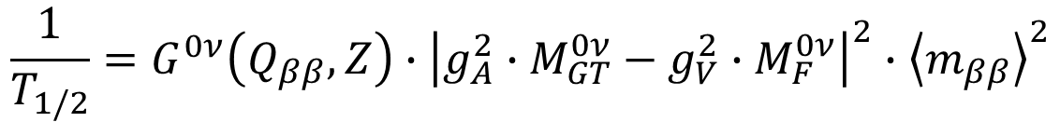
Introduction
The half-life is inversely proportional to the square of the average neutrino mass $\left\langle m_{ββ}\right\rangle$.
$$\frac{1}{T_{1/2}}=G^{0ν}\left(Q_{ββ},Z\right)∙{\left|g_{A}^{2}∙M_{GT}^{0ν}−g_{V}^{2}∙M_{F}^{0ν}\right|}^{2}∙{\left\langle m_{ββ}\right\rangle }^{2}$$
Phase space: decay energy and nuclear charge dependent. Obtained by solving Dirac equation for electron travelling from edge of nucleus to infinity.
Nuclear matrix elements: obtained from approximate solutions of the nuclear many-body problem
Axial vector coupling constant: expresses the modification of the strength of the weak force due the presence of the strong force. Comes from neutron β-decays.
Problematic
Calculable
Problematic
Light neutrino exchange: one possible decay mechanism of many
Needs nuclear models to connect data with the physics, here neutrino mass
Allows to quantify results in terms of a quantity of scientific interest AND allows to compare experiments utilizing different nuclides with each other.

Slide 5
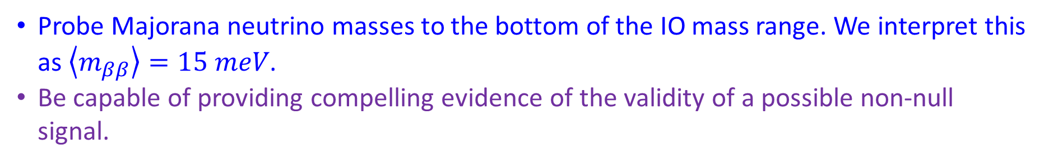
Community Scientific Goals
The 2015 US Long Range Plan for Nuclear Science listed a ton scale double beta decay experiment as its highest construction priority.
Late 2018 DOE issued a Critical Decision 0, stating mission need for an experiment.
Summer 2021 DOE performed a portfolio review. The agency intends to build an international program based on LEGEND-1000 (⁷⁶Ge), nEXO (¹³⁶Xe) and CUPID (¹⁰⁰Mo).
Probe Majorana neutrino masses to the bottom of the IO mass range. We interpret this as $\left\langle m_{ββ}\right\rangle =15 meV$.
Be capable of providing compelling evidence of the validity of a possible non-null signal.
A new detailed quantitative nEXO sensitivity estimate was published (JPG Nucl. Part. Phys. 49 (2022) 015104) in time for the review. It shows how nEXO plans to meet this challenge.

Slide 6
Introduction
These scientific 0νββ-goals require half-life sensitivity in excess of 10²⁸ yr.
To achieve high sensitivity one needs:
Ton-amounts of decaying substance or there are no decays in human time scales,
good energy resolution to discriminate 0νββ-decay events from 2νββ-events,
sufficiently low background so the signal isn’t lost in the fluctuations of uninteresting things. This is achieved by reducing the radioactivity content of all experiment components (passive approach) and active distinction between signal and background events.

Slide 7
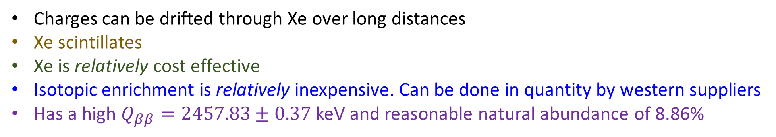
0νββ-decay with ¹³⁶Xe and nEXO
Charges can be drifted through Xe over long distances
Xe scintillates
Xe is relatively cost effective
Isotopic enrichment is relatively inexpensive. Can be done in quantity by western suppliers
Has a high $Q_{ββ}=2457.83±0.37$ keV and reasonable natural abundance of 8.86%
Large $ββ$-detectors are feasible, both technically and fiscally (hopefully).
World xenon production in 2022: about 75 tons. Ukraine is one of the world’s largest suppliers of noble gases. The war there results in high xenon prices. China is an alternative. As an example, much of the xenon of the LZ experiment was purchased from China.

Slide 8
The nEXO Approach
Use 5 tons of isotopically enriched xenon (90% in ¹³⁶Xe) and a single phase liquid Xe TPC.
Exploit 4 observables to separate 0νββ-decay events from background:
Event energy: detect charge and scintillation light for good resolution, discriminate $0νββ$-peak, from $2νββ$-decay and other energy deposits.
Event multiplicity: discriminate dominantly single-site $β$-like signal events from mostly multi-site, $γ$-induced background events.
Distance from boundaries: for large homogeneous position sensitive detectors, discriminate exponentially falling external $γ$-background from uniform $ββ$-events
Discriminate $α$-induced from e⁻/$γ$ events via their characteristic ratios of charge and scintillation signal.
In case of observation: a control experiment with natural or depleted xenon is possible.

Slide 9
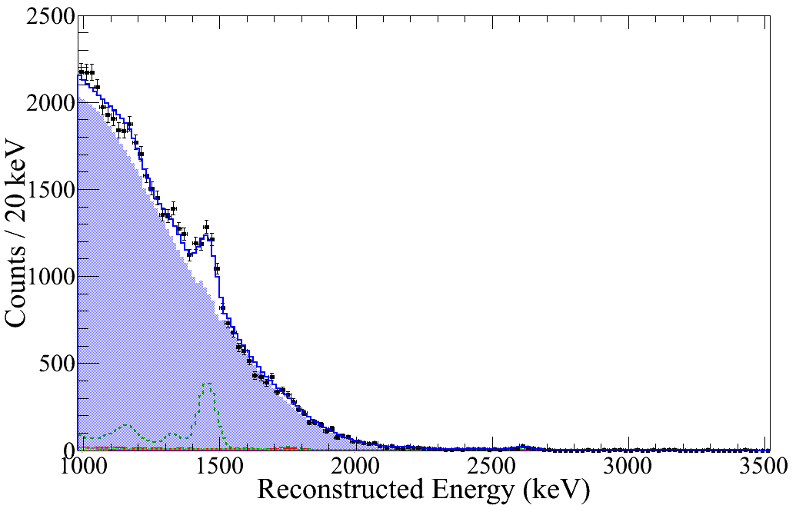
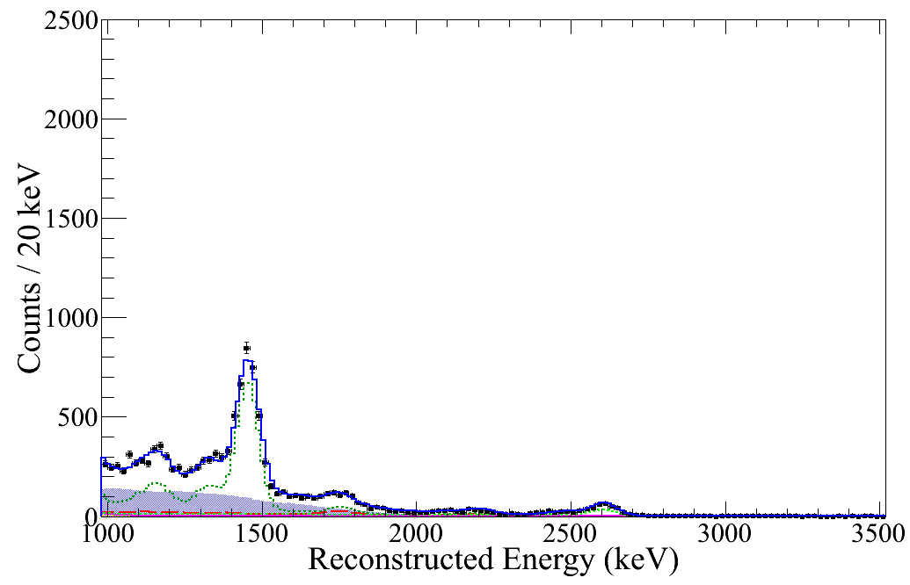
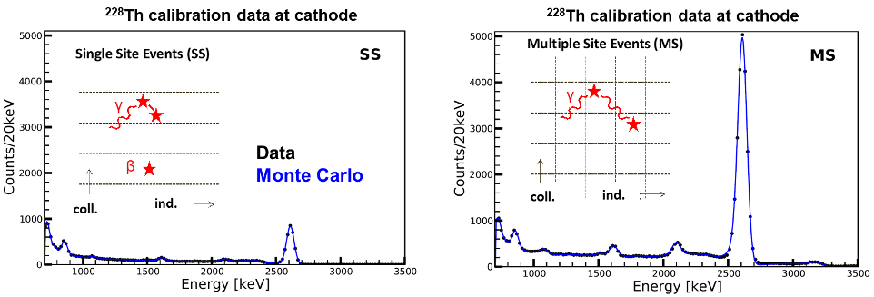
Tracking and Background Suppression
EXO-200 data
Single-site
Multi-site
Low background
data
2νββ
²²⁸Th calibration
source

Slide 10
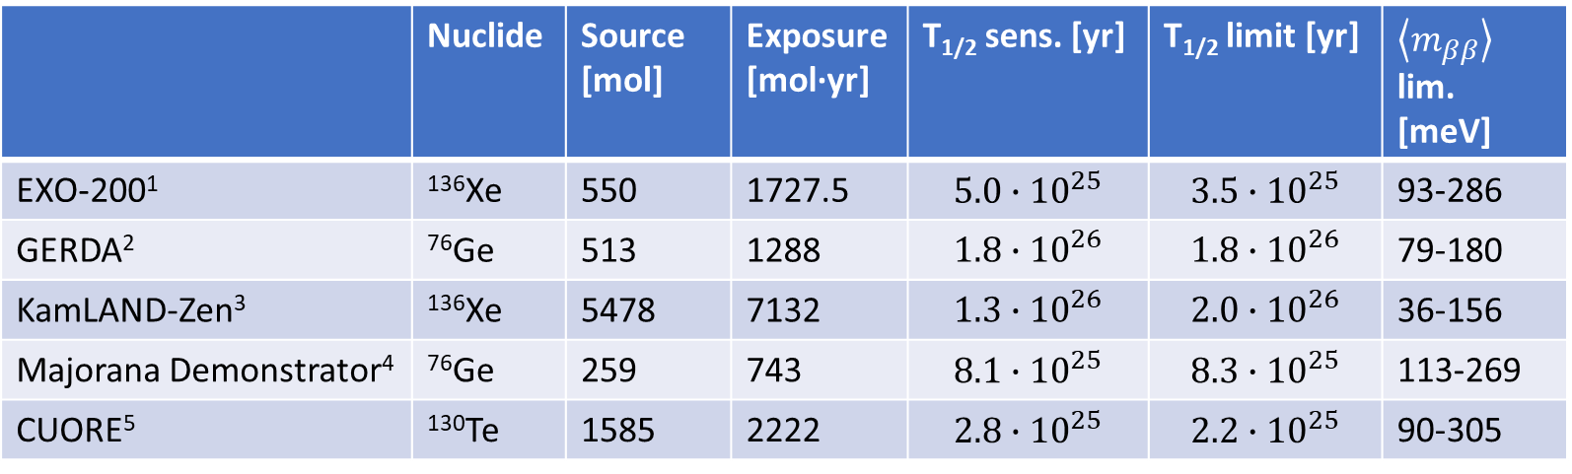
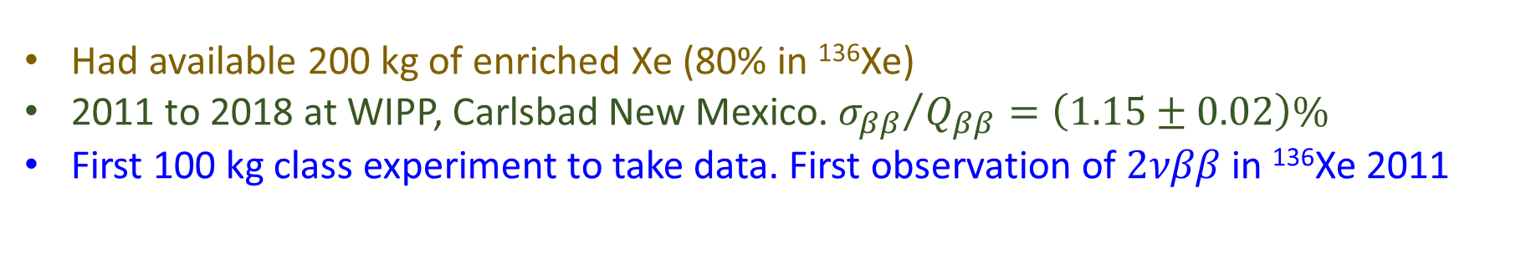
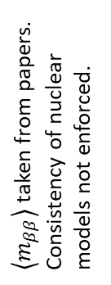
0νββ-decay with ¹³⁶Xe and EXO-200
The approach was demonstrated: substantial fraction of the nEXO collaboration has experience from the predecessor experiment EXO-200.
Had available 200 kg of enriched Xe (80% in ¹³⁶Xe)
2011 to 2018 at WIPP, Carlsbad New Mexico. ${σ_{ββ}}/{Q_{ββ}}=\left(1.15±0.02\right)\%$
First 100 kg class experiment to take data. First observation of $2νββ$ in ¹³⁶Xe 2011
 | Nuclide | Source [mol] | Exposure [mol·yr] | T_{1/2} sens. [yr] | T_{1/2} limit [yr] | $\left\langle m_{ββ}\right\rangle$ lim. [meV]
EXO-200¹ | ¹³⁶Xe | 550 | 1727.5 | $$5.0∙{10}^{25}$$ | $$3.5∙{10}^{25}$$ | 93-286
GERDA² | ⁷⁶Ge | 513 | 1288 | $$1.8∙{10}^{26}$$ | $$1.8∙{10}^{26}$$ | 79-180
KamLAND-Zen³ | ¹³⁶Xe | 5478 | 7132 | $$1.3∙{10}^{26}$$ | $$2.0∙{10}^{26}$$ | 36-156
Majorana Demonstrator⁴ | ⁷⁶Ge | 259 | 743 | $$8.1∙{10}^{25}$$ | $$8.3∙{10}^{25}$$ | 113-269
CUORE⁵ | ¹³⁰Te | 1585 | 2222 | $$2.8∙{10}^{25}$$ | $$2.2∙{10}^{25}$$ | 90-305
$\left\langle m_{ββ}\right\rangle$ taken from papers. Consistency of nuclear models not enforced.
EXO-200 was a competitive experiment in terms of $\left\langle m_{ββ}\right\rangle$ reach.

Slide 11
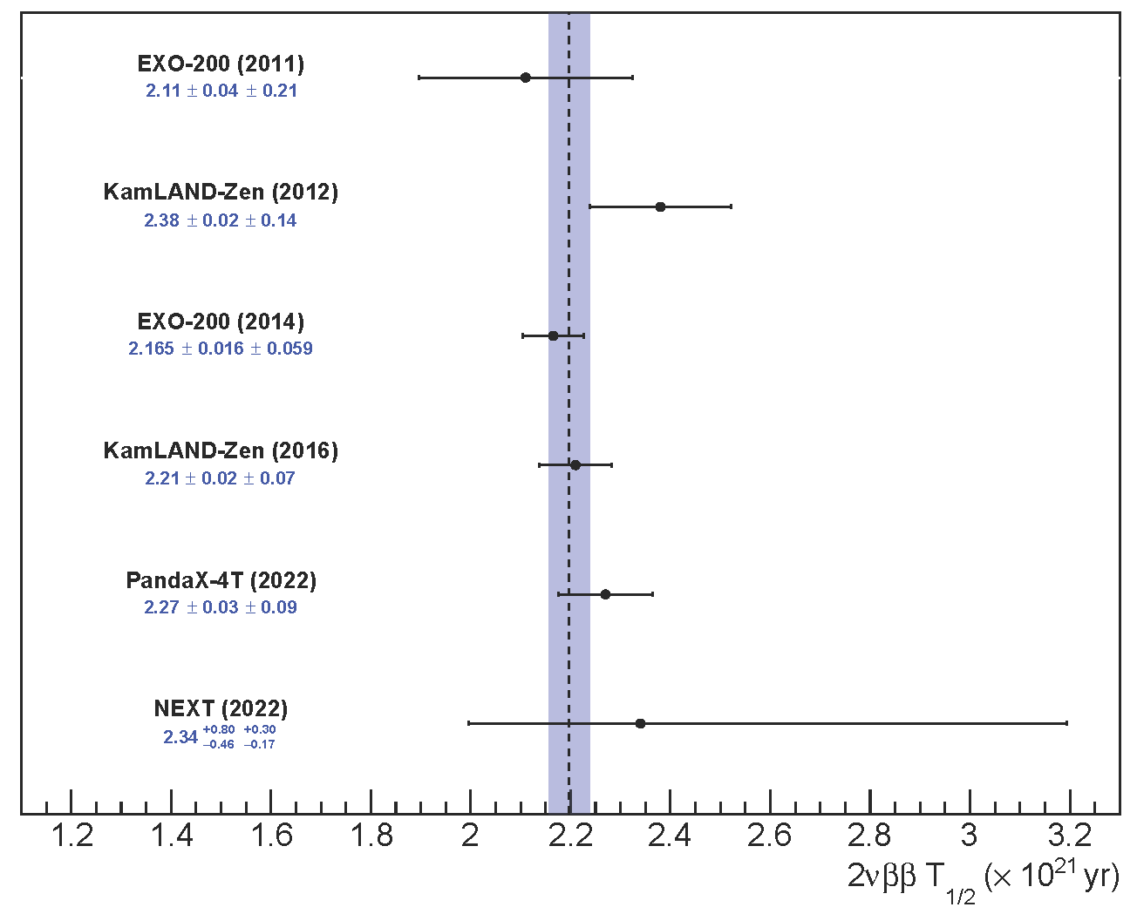
2νββ-decay with EXO-200
PRL 107 (2011) 212501
In 2011 EXO-200 made the first observation of 2νββ-decay of ¹³⁶Xe.
For a while it was the most accurately measured 2νββ half-life.
PRC 85 (2012) 045504
PRC 89 (2014) 015502
PRL 117 (2016) 082503
arXiv:2205.12809 (2022)
PRC 105 (2022) 055501
Variance-weighted mean: (2.197±0.041)·10²¹ yr
Notes:
First KamLAND-Zen measurement not included in average to remove data depency.

Slide 12
EXO-200 Background
Rigorous radioactivity testing program (>300 measurements) utilizing
  ICPMS / GDMS
  NAA
  Ge counting
  Rn atom counting
Coordination with the Monte Carlo, formulate acceptance criteria for all components.
Detector design and construction decisions were governed by these criteria.
Method | ²³²Th cnts in Q_{ββ}±2·σ_{ββ} | ²³⁸U cnts in Q_{ββ}±2·σ_{ββ}
EXO-200 data | 10.3-13.9 | 5.3-7.1
EXO-200 radioassay | 0.5-7.7 | 2.0-9.5
Pre-data prediction | 0.9-10.3 | 6.3-26.8
This approach works and we have shown it with an experiment as complex as EXO-200.
For nEXO we plan to use the same approach.
Leonard et al., NIMA 591 (2008) 490
Leonard et al., NIMA 871 (2017) 169
Albert et al., PRC 92 (2015) 015503
Albert et al. JCAP04 (2016) 029

Slide 13
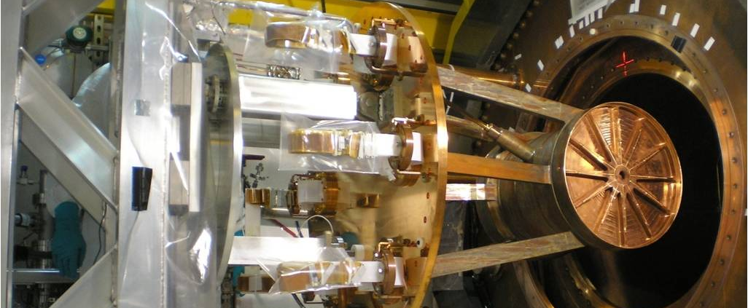
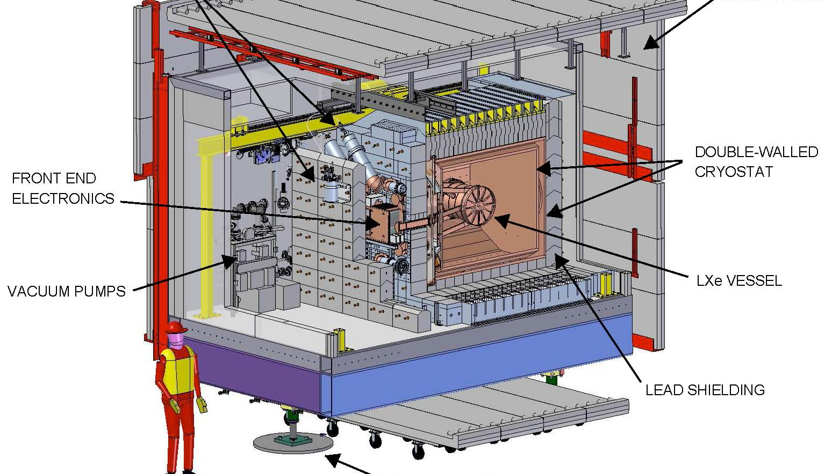
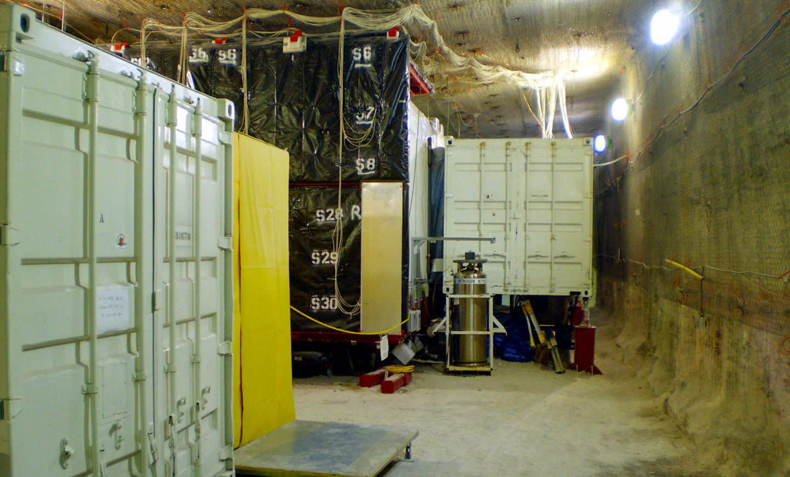
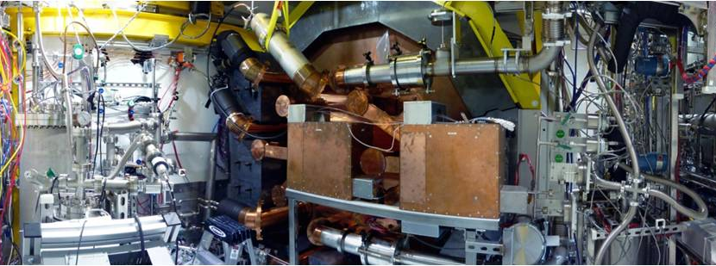

Slide 14
What could be the next step for the liquid xenon TPC approach?

Slide 15
Monolithic versus Segmented
nEXO has large linear dimensions compared to scattering length of 2.5 MeV γs (8.7 cm).
External γ-radiation will exhibit exponential attenuation when moving inward.
No internal materials: quantify remaining γ-ray background events not identified by DNN.
A large homogeneous detector is optimal for exploiting the size argument.
5 kg
(d=13 cm, ~size of a
Ge crystal)
5000 kg
(d=130 cm, nEXO)
150 kg
(d=40 cm, ~EXO-200)

Slide 16
The nEXO Project
DoE project structure has been developed. LLNL is the lead lab to organize this large and complex enterprise. This includes a Work Breakdown Structure (defining the scope of work and schedule), a budget and the management structures.
WBS | Scope
1.01 | Management, Project Controls, QA and ES&H
1.02 | System Engineering and System Integration and Commissioning
1.03 | Time Projection Chamber
1.04 | Photon Detector
1.05 | Time Projection Chamber Support Systems
1.06 | Electronics (Photon Readout and Charge readout)
1.07 | Radioactive background Control
1.08 | Computing, Controls and Software
1.09 | Xenon
1.10 | Outer Detector
1.11 | Facilities
First project funding received in Jan. 2022
A construction decision (CD-1 milestone in DoE language) has not yet been made. The same is true for the other ββ-projects.

Slide 17
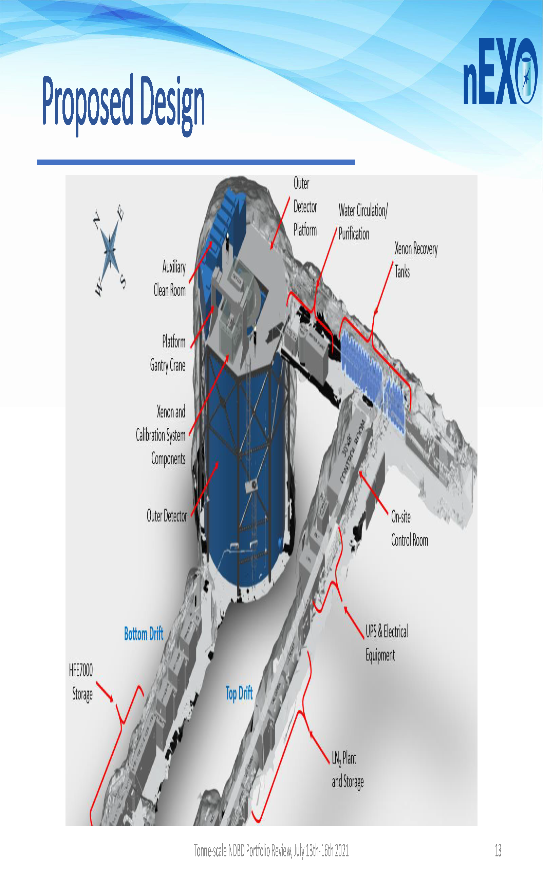
nEXO Detector Design
The baseline site: the SNOLAB cryopit.
Estimates show cosmogenic backgrounds to be negligible there.
The plan is to use a large water shield, instrumented with PMTs to tag remaining muons.
Substantial engineering effort by SNOLAB to lay out the nEXO experiment.

Slide 18
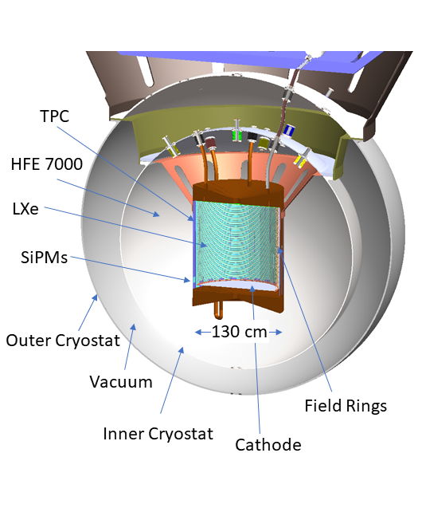
nEXO Detector Design
 | EXO-200: | nEXO: | Improvements:
Vessel and cryostat | Thin-walled commercia Cu w/HFE | Thin-walled electroformed Cu w/HFE | Lower background
High voltage | Max voltage: 25 kV (end-of-run) | Operating voltage: 50 kV | Full scale parts tested in LXe prior to installation to minimize risk
Cables | Cu clad polyimide (analog) | Cu clad polyimide (digital) | Same cable/feedthrough technology, R&D identified 10x lower bkg substrate and demonstrated digital signal transmission
e⁻ lifetime | 3-5 ms | 5 ms (req.), 10 ms (goal) | Minimal plastics (no PTFE reflector), lower surface to volume ratio, detailed materials screening program
Charge collection | Crossed wires | Gridless modular tiles | R&D performed to demonstrate charge collection with tiles in LXe, detailed simulation developed
Light collection | APDs + PTFE reflector | SiPMs around TPC barrel | SiPMs avoid readout noise, R&D demonstrated prototypes from two vendors
Energy resolution | 1.2% | 1.2% (req.), 0.8% (goal) | Improved resolution due to SiPMs (negligible readout noise in light channels)
Electronics | Conventional room temp. | In LXe ASIC-based design | Minimize readout noise for light and charge channels, nEXO prototypes demonstrated in R&D and follow from LAr TPC lineage
Background control | Measurement of all materials | Measurement of all materials | RBC program follows successful strategy demonstrated in EXO-200
Large size | >2 atten. length at center | >7 atten. length at center | Exponential attenuation of external gammas and more fully contained Comptons

Slide 19
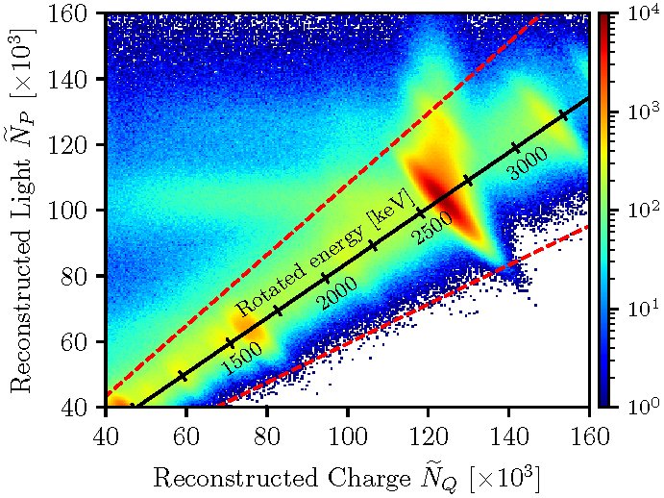
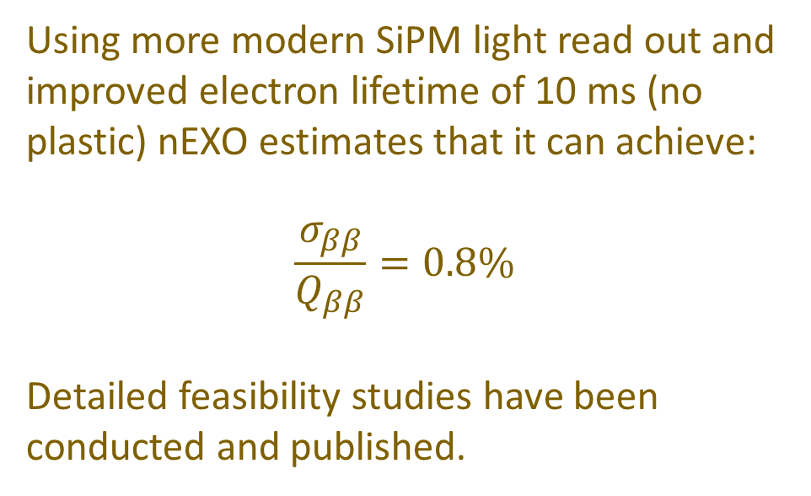
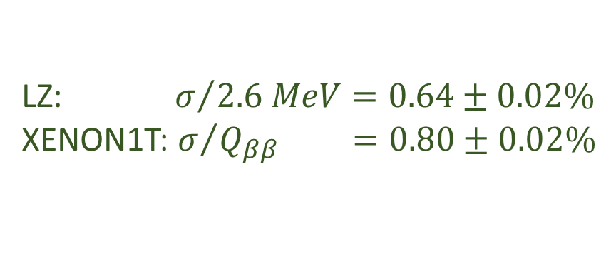
nEXO Energy Resolution
Sufficient energy resolution is obtained by combining ionization and scintillation signals, as demonstrated by EXO-200 (with APD light read out).
Using more modern SiPM light read out and improved electron lifetime of 10 ms (no plastic) nEXO estimates that it can achieve:
$$\frac{σ_{ββ}}{Q_{ββ}}=0.8\%$$
Detailed feasibility studies have been conducted and published.
LZ: $σ/{2.6 MeV}=0.64±0.02\%$
XENON1T: $σ/{Q_{ββ}} =0.80±0.02\%$

Slide 20
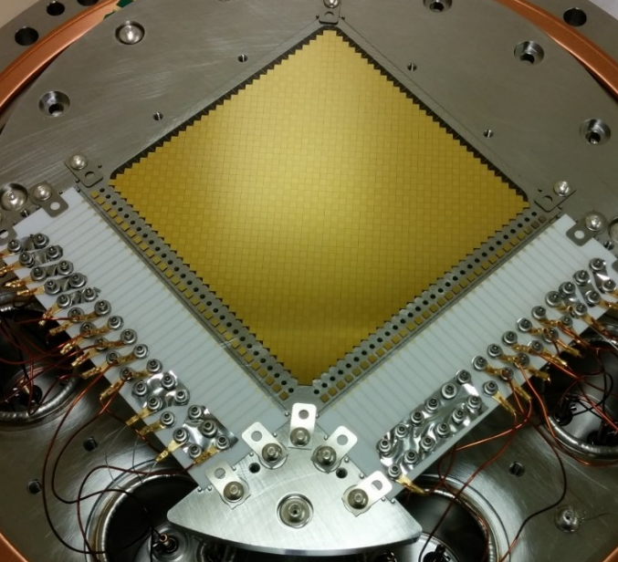
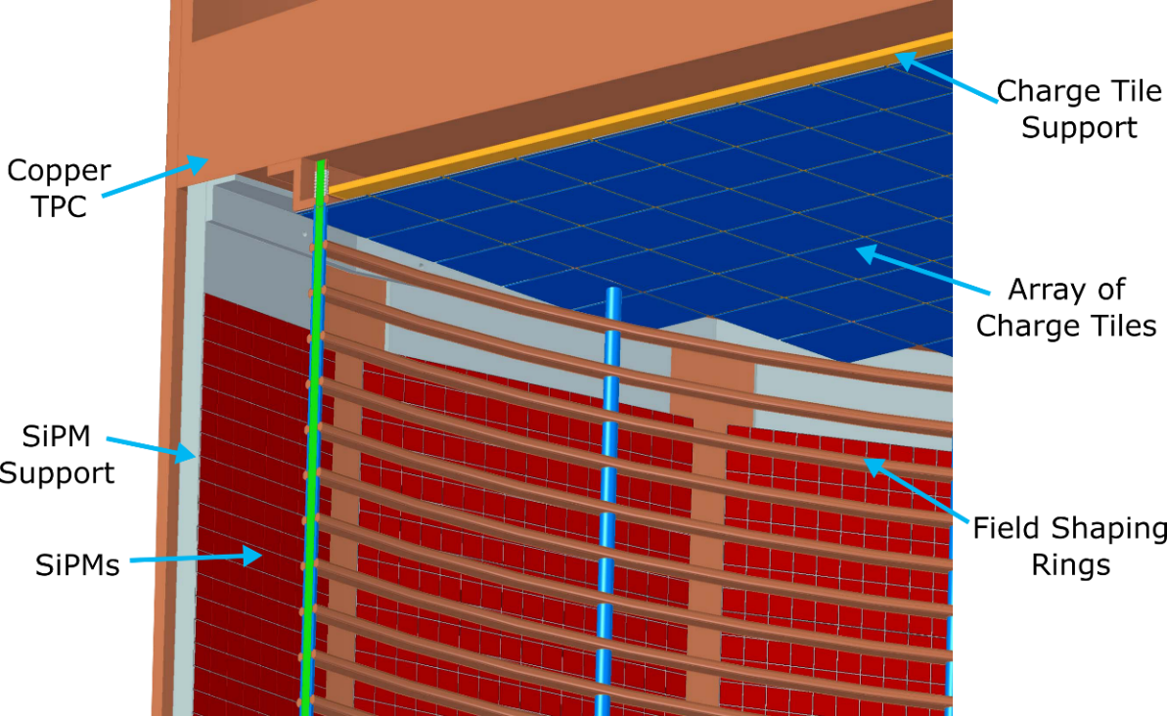
nEXO Detector Design
Prototype charge collection tile
Use metalized fused silica tiles for charge collection, SiPMs for light measurements.
FBK and Hamamatsu SiPMs were found to be acceptable.
10cm
~16 cm
Prototype VUV SiPM array (FBK)

Slide 21
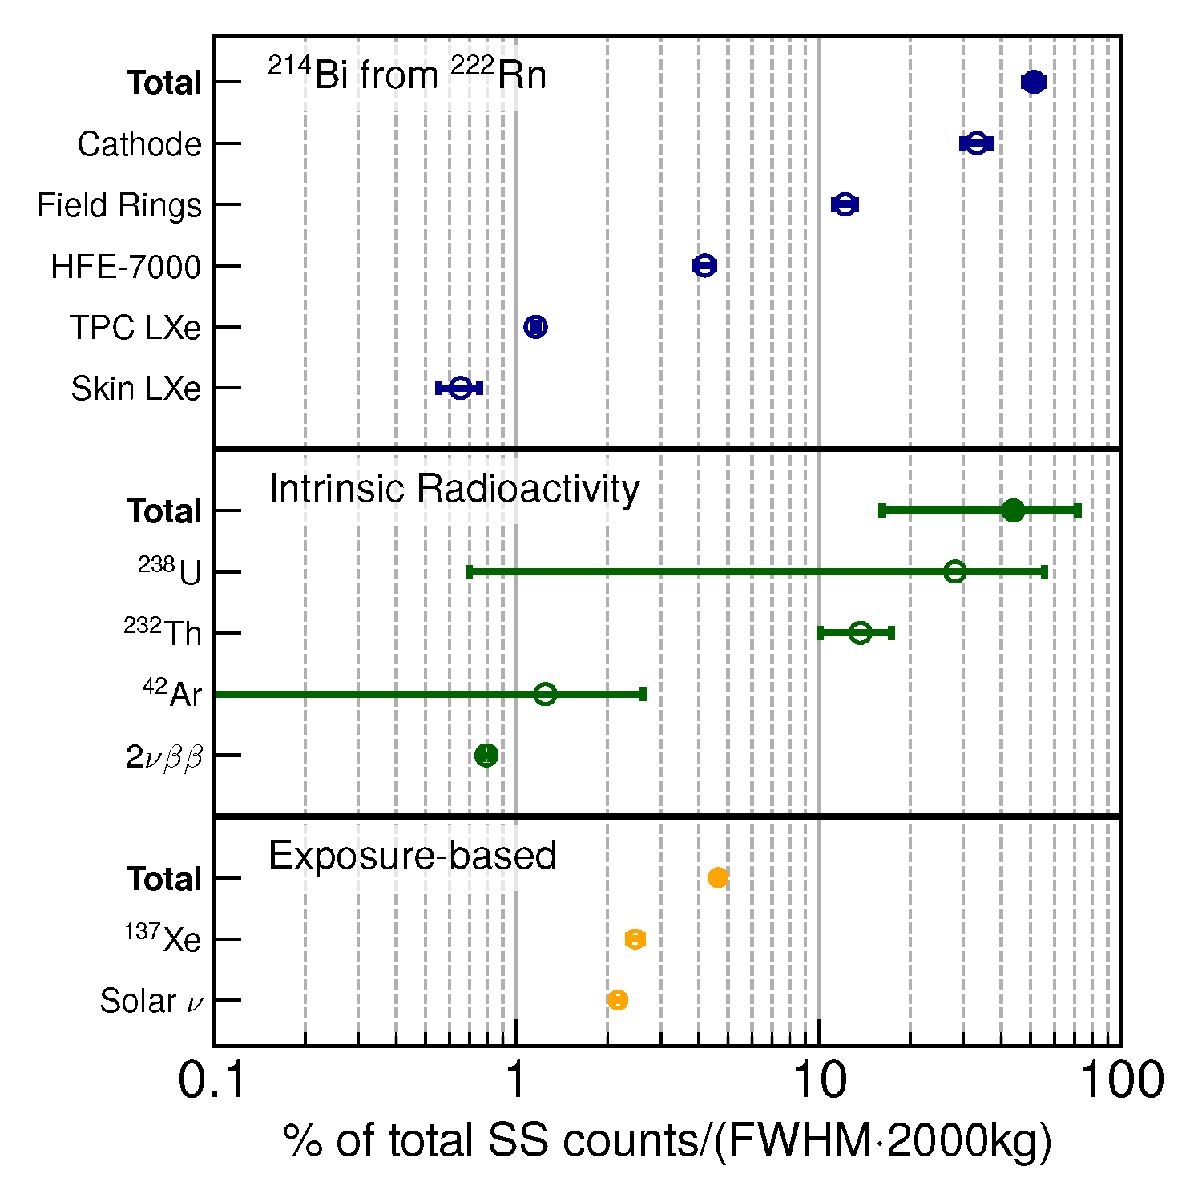
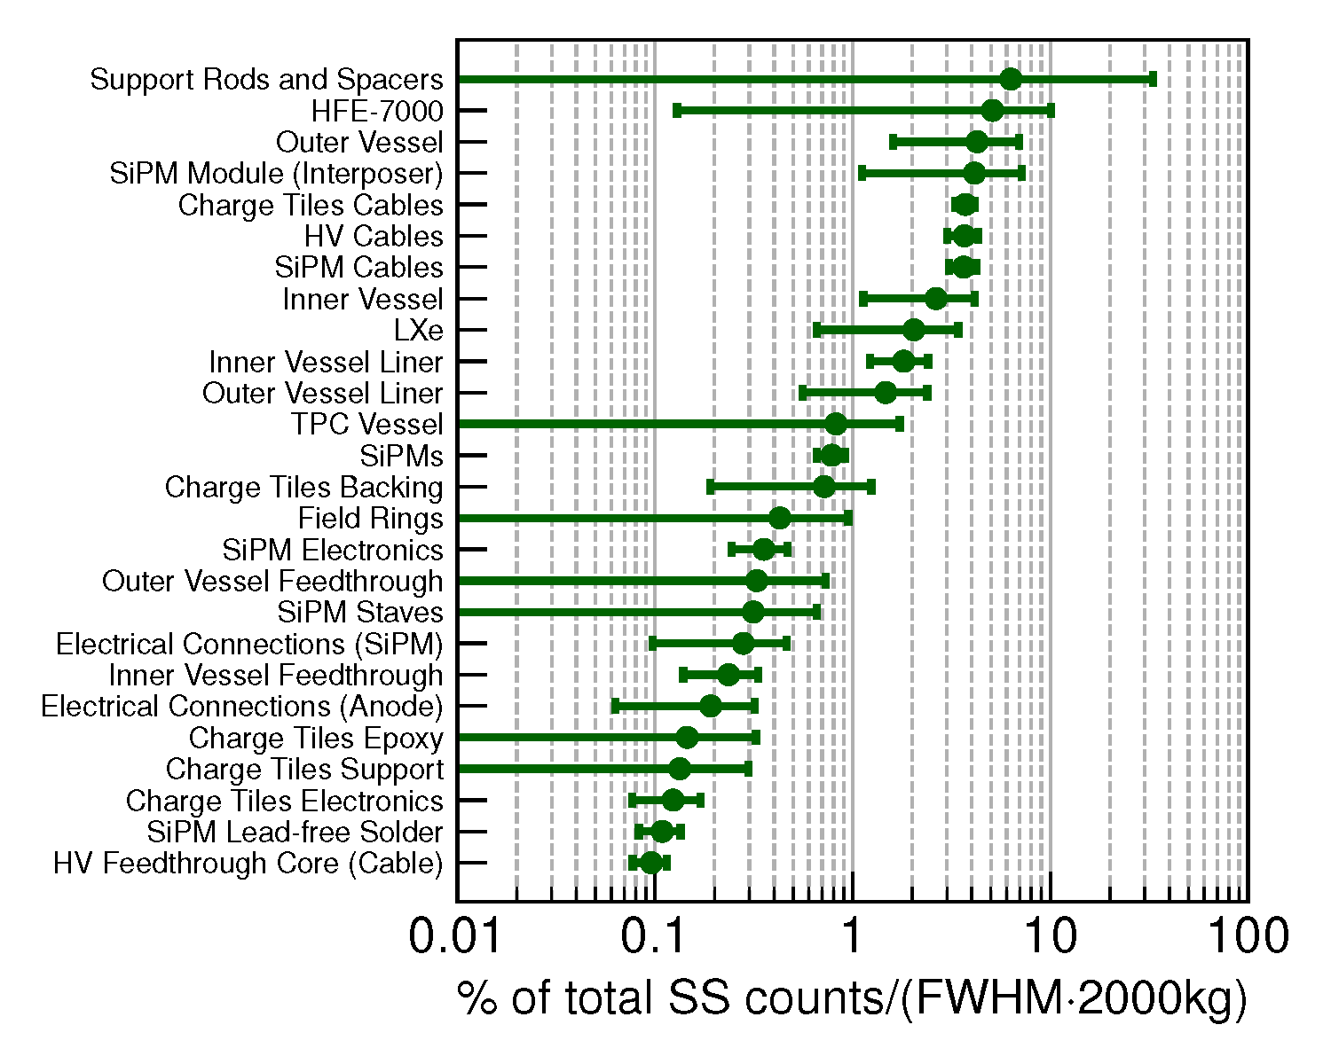
nEXO Background Control
There is no single component dominating the background budget.
The assay program assigns analysis priorities according to the importance ranking of the background contribution.

Slide 22
nEXO Scientific Reach
nEXO is modelled by Monte Carlo simulation, taking into account all knowledge of the signal processing chain and measured background decay rates. Use:
event energy
topological event structure (single sitedness of each event)
event distance from the nearest boundary (standoff distance)
Is based on a likelihood-profile, allowing the simultaneous analysis of above variables. It is not a one-dimensional peak search in an energy spectrum.
Signal and background are distinguished in more than one dimension simultaneously. The energy resolution, while still important, does not play an all deciding role. Whether or not you can see a peak by eye in this one event dimension “energy” is not a good measure for the reliability of a discovery.

Slide 23
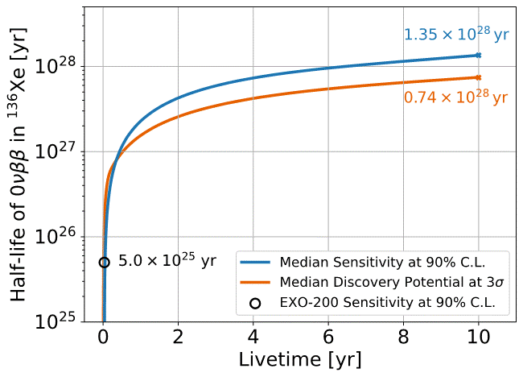
nEXO Scientific Reach
nEXO’s sensitivity estimates are robust and built from a bottom-up approach based on measured radioactivity data.
nEXO half-life sensitivity reaches 10²⁸ yr in 6.5 yr.
Adhikari et al., JPG Nucl. Part. Phys. 49 (2022) 015104

Slide 24
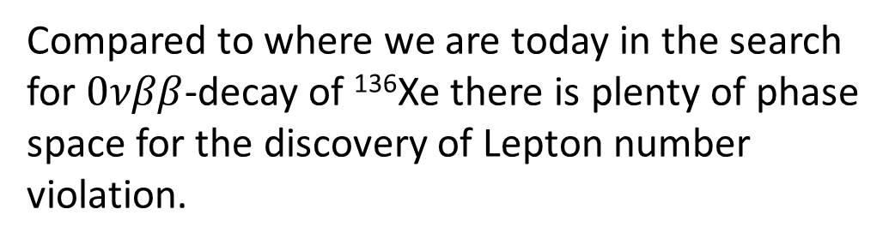
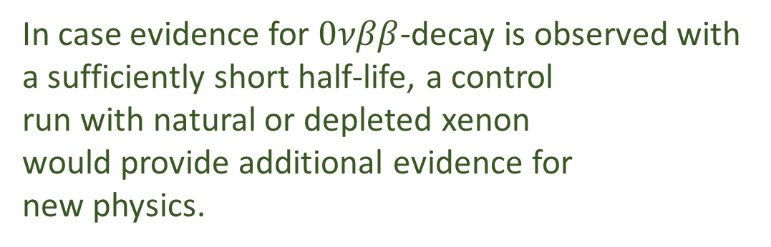
nEXO Scientific Reach
Compared to where we are today in the search for $0νββ$-decay of ¹³⁶Xe there is plenty of phase space for the discovery of Lepton number violation.
In terms of 90% CL sensitivity there are about two orders of magnitude room for improvement.
In case evidence for $0νββ$-decay is observed with a sufficiently short half-life, a control
run with natural or depleted xenon
would provide additional evidence for
new physics.
EXO-200 (limit) | 3.5·10²⁵ yr | PRL 123 (2019) 161802
KamLAND-Zen (limit) | 1.07·10²⁶ yr | PRL 117 (2016) 082503
nEXO (limit) | 1.35·10²⁸ yr | JPG 49 (2022) 015104
nEXO (discovery) | 0.38·10²⁸ yr (5σ) 0.74·10²⁸ yr (3σ)

Slide 25
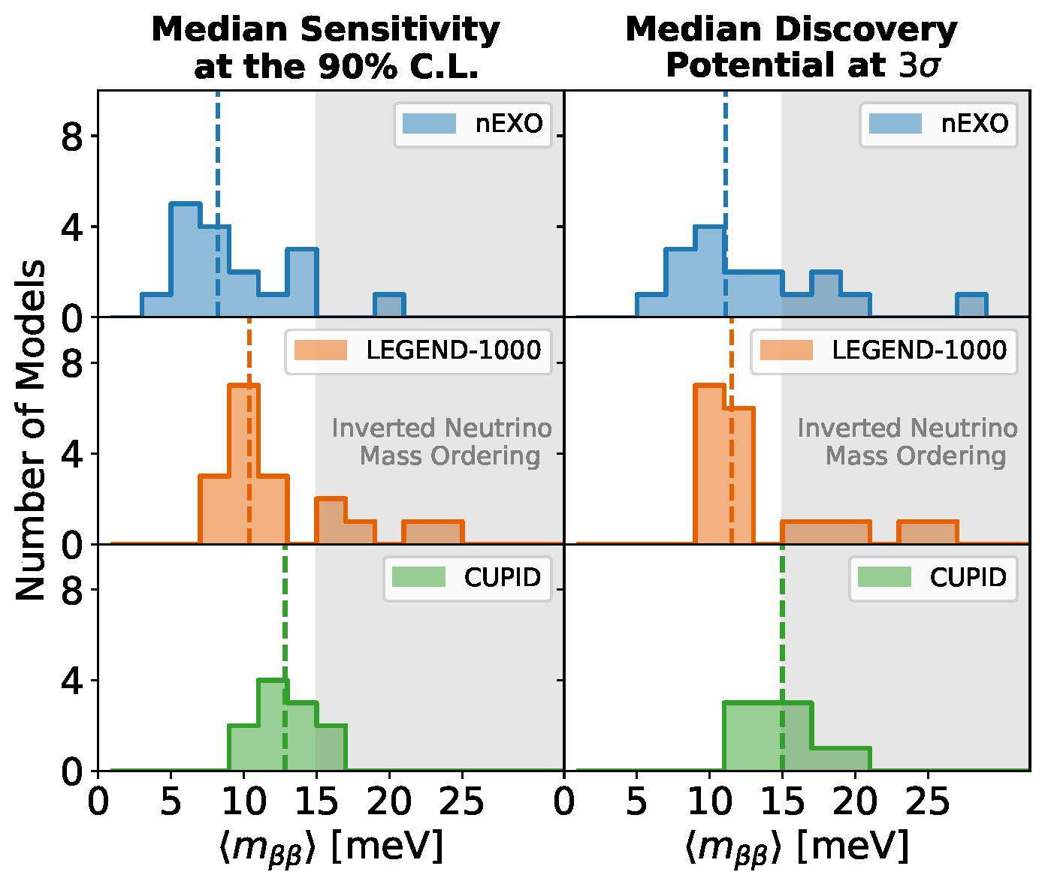
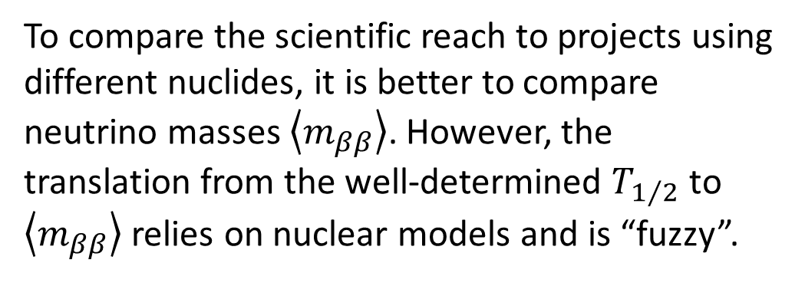
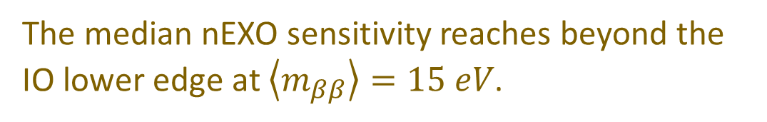
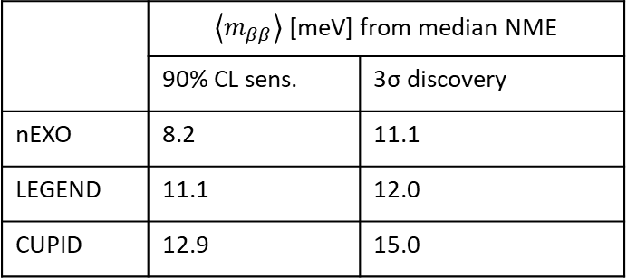
nEXO Scientific Reach
To compare the scientific reach to projects using different nuclides, it is better to compare neutrino masses $\left\langle m_{ββ}\right\rangle$. However, the translation from the well-determined $T_{1/2}$ to $\left\langle m_{ββ}\right\rangle$ relies on nuclear models and is “fuzzy”.
The median nEXO sensitivity reaches beyond the IO lower edge at $\left\langle m_{ββ}\right\rangle =15 eV$.
Deeper physics reach
 | $\left\langle m_{ββ}\right\rangle$ [meV] from median NME
 | 90% CL sens. | 3σ discovery
nEXO | 8.2 | 11.1
LEGEND | 11.1 | 12.0
CUPID | 12.9 | 15.0
Given the high variability of this parameter translation: all three new projects have comparable reach.

Slide 26
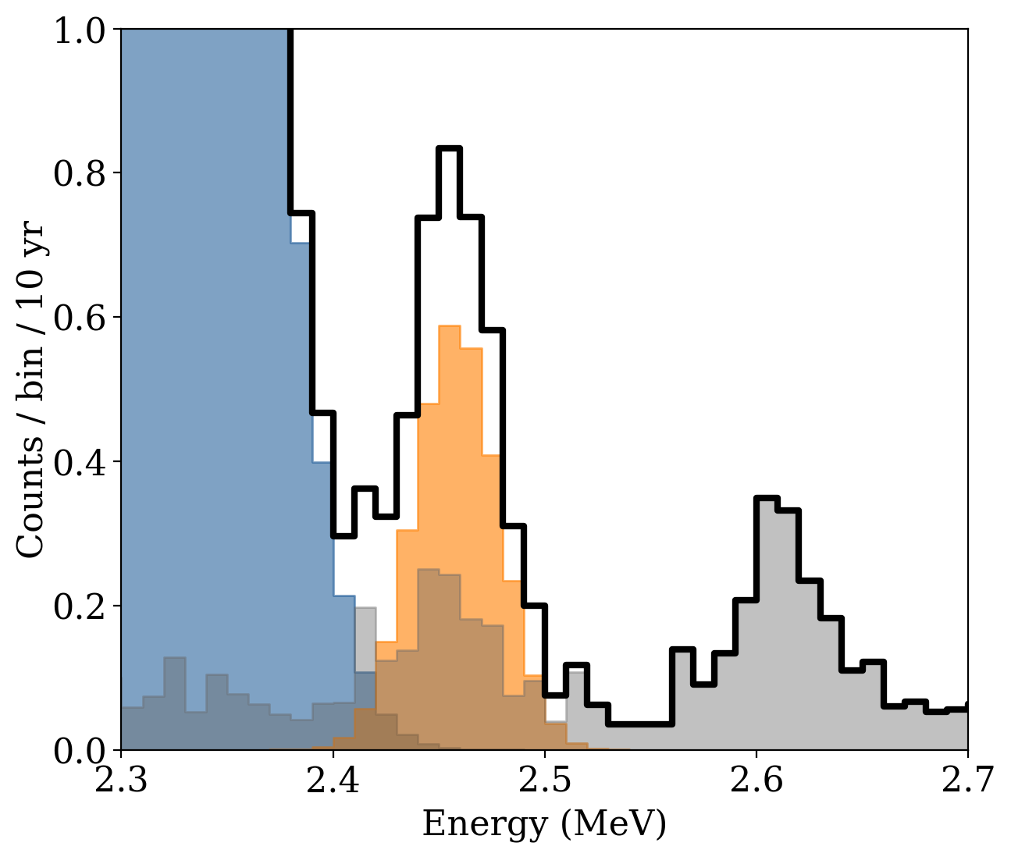
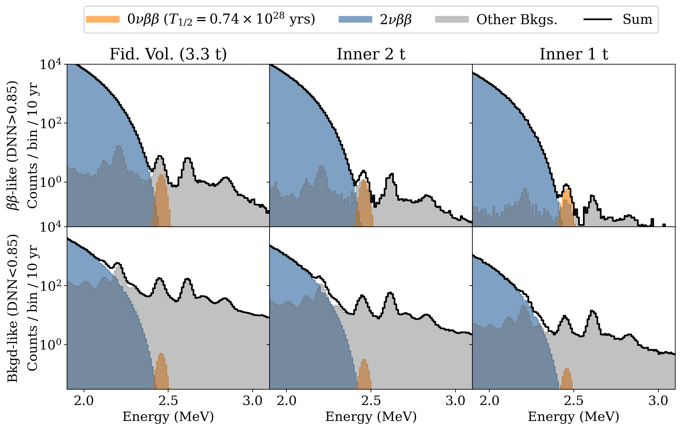
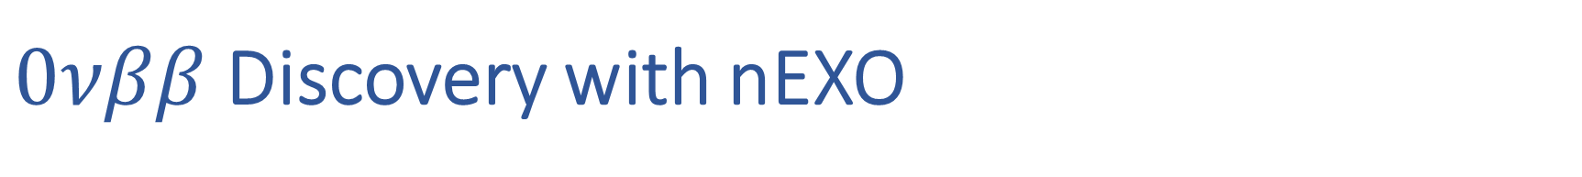
$0νββ$ Discovery with nEXO
PDF at the discovery limit and for 10 yr live time: an event excess is visible in the energy spectrum in the inner part of the detector.

Slide 27
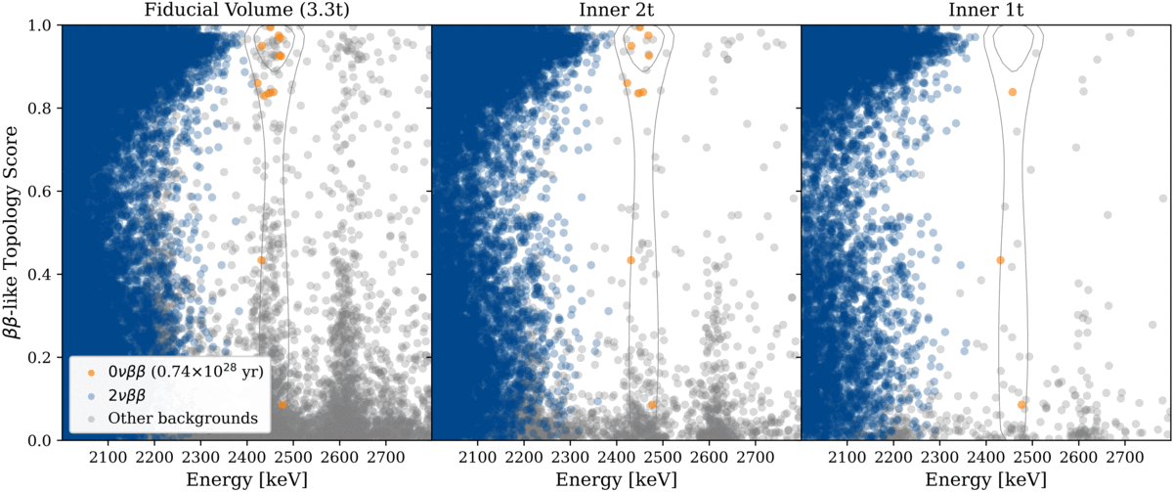
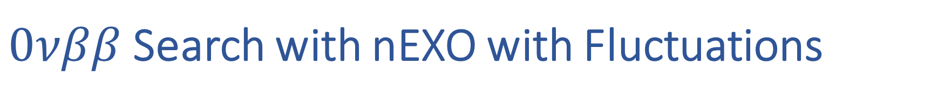
$0νββ$ Search with nEXO with Fluctuations
Repeated toy experiments visualize what we might observe at the limit of discovery (T_{1/2} = 0.74·10²⁸ yr, 3σ), in 10 years of data taking.

Slide 28
Conclusion
The development and construction of next-generation double beta decay experiments is a scientific priority.
Several projects have crystalized out of a large number of ideas.
The nEXO project aims at using 5000 kg of isotopically enriched xenon and a single phase TPC to meet this challenge.
The simultaneous measurement of electron energy, event single sitedness and event position allows to achieve a sensitivity of T_{1/2} > 1.35·10²⁸ yr in 10 yr of data taking.
The collaboration has shown this to be possible by means of a likelihood profile analysis, simultaneously utilizing all event dimensions in the presence of the background derived from the nEXO materials assay program.
A construction decision has not yet been made for nEXO or the other projects.

Slide 29
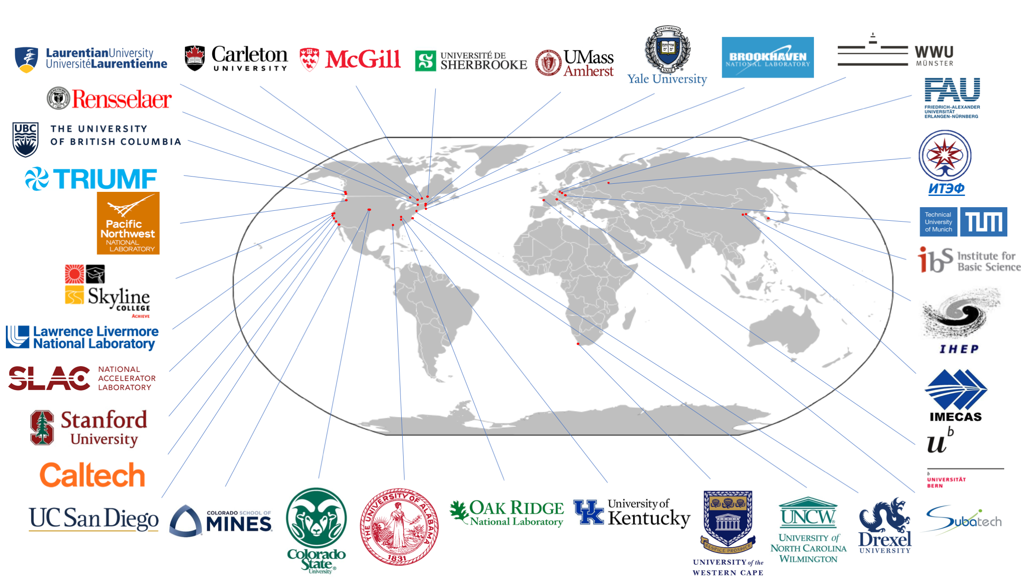

Slide 30
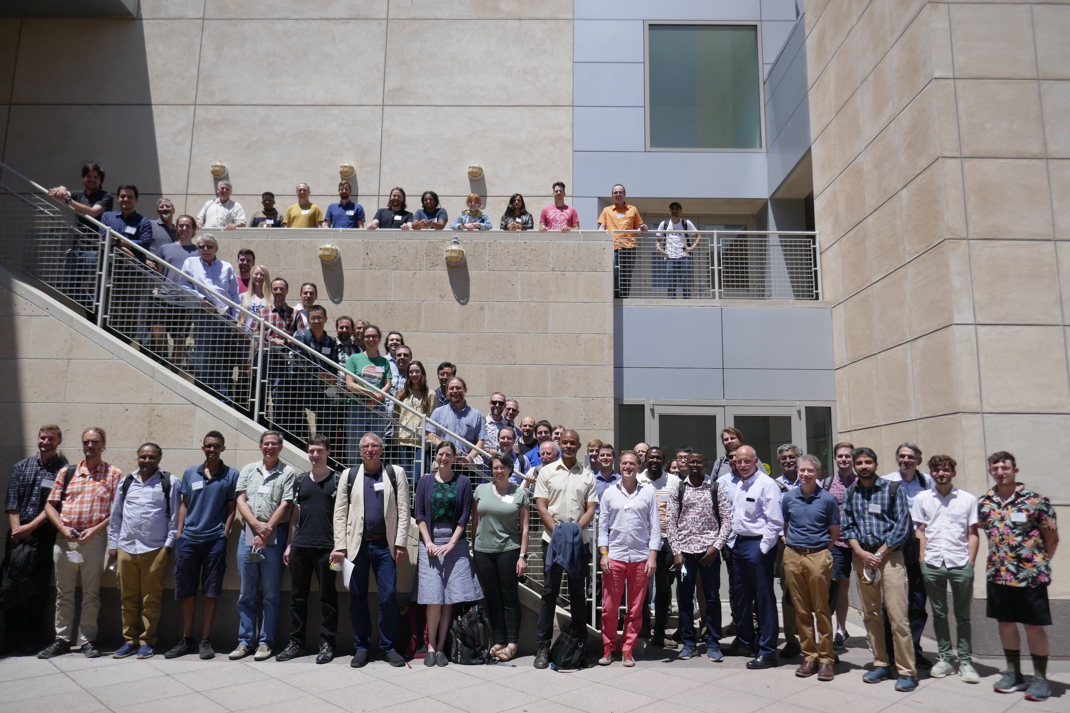
nEXO Collaboration Meeting, Stanford University, July 2022

