Slide 1
A new (secret) Icecube Astronomy (?) D.Fargion, P.G.Lucentini M.Khlopov, see also: D.Fargion, M.Khlopov, P.Oliva, P.G.Lucentini talk 291, 25 February 2021-Venice: Astrophysical or Atmospheric prompt neutrinos in Icecube? AND Also
See: https://pos.sissa.it/331/007/
2019
charming ICECUBE discover?

Slide 2
Flavor revolution ? https://doi.org/10.1016/j.nima.2014.03.006 The cascades must overcome 3 times the tracks: not just the observed 1.6 times the tracks

Slide 3
2013-Flavor revolution→2014 Why not any tau double bang ..yet?

Slide 4
The rare unique HESE neutrino track
Halzen-February 2022
The unique
downward track

Slide 5
HESE FLAVOR ASYMMETRY: DOWN-UP. 17 Shower/1 Track Down ←→ 5/3 Up
The unique
downward track

Slide 6
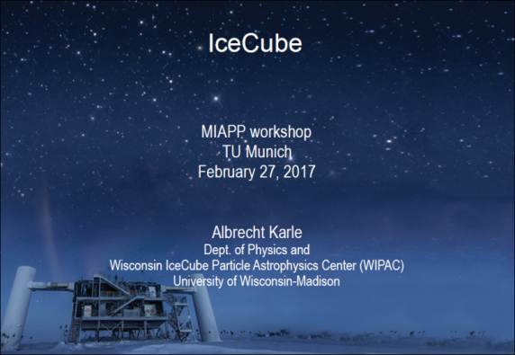
Munich 27 February 2017, Albrecht Karle,
2015
2017
Prompt neutrino (with tau negligible term)
Conventional Atmospheric neutrinos

Slide 7
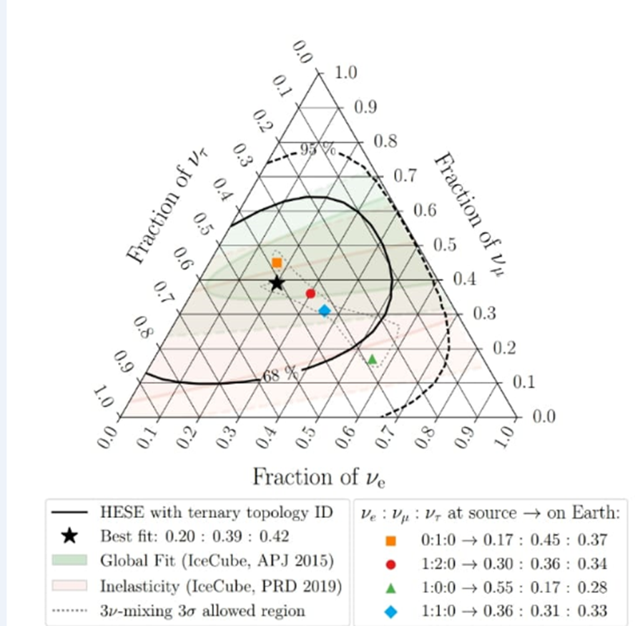
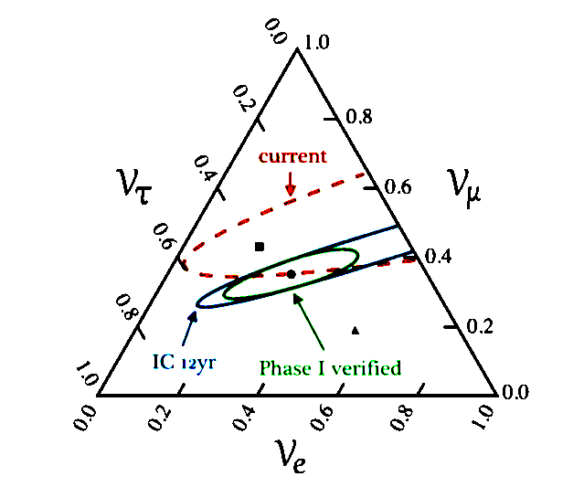
EARLY AND NEW UPWARD FLAVORS
1,1,0 AS THE Atmospheric Charmed
NEW. UP AND DOWNWARD
UNPHYSICAL AND PUZZLING_

Slide 8
Open questions and note to Icecube
After a decade of Highest Energy Neutrino records at several tens TeV in Icecube we had observed among hundreds of events,
(exept an unique delayed neutrino-gamma 2017 flare:
TX0S06+056):
1-YES , an early electro=muon nu flavor presence→ atmospheric charm
2-NO any sharp correlated brightest gamma-neutrino source event.
3-No brightest GRBs or SGRs .
4-NO significant multi-plet clustering among HESE or highest muons.
5-NO Icecube any galactic plane signature.
6-NO Icecube low energy clustering along HESE ones
7-No significant tau double bangs.
All these almost missing imprint for any astrophysics are pointing to the main discover of the atmospheric charm neutrino signature able to rule and hide the underline lower astrophysical one.

Slide 9
The Earliest, the brightest gamma sources: All absent in ICECUBE

Slide 10
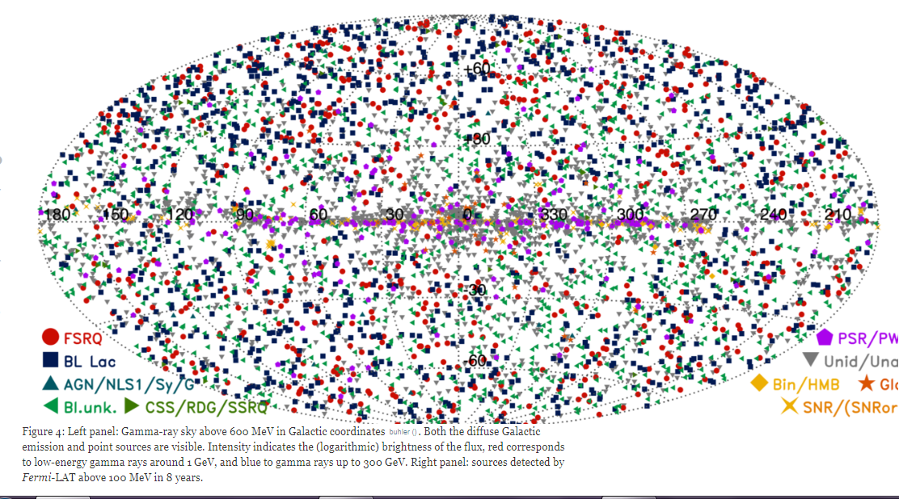
All GRBs in cosmic map, none are correlated in space-time with Icecube

Slide 11
Brightest AGN event 2009 were no correlated to any Icecube tracks: 3 C 454.3

Slide 12
The 2 long days (at tens GeV ) brightest flare by 3C279 :it was absent in june 2015 Icecube

Slide 13
The same 3C 279 flare in AGILE 15-16 June was bright as Vela , but was absent in Icecube

Slide 14
The very sharp Hawc galactic plane signature at tens TeV energy: it is absent in ICECUBE

Slide 15
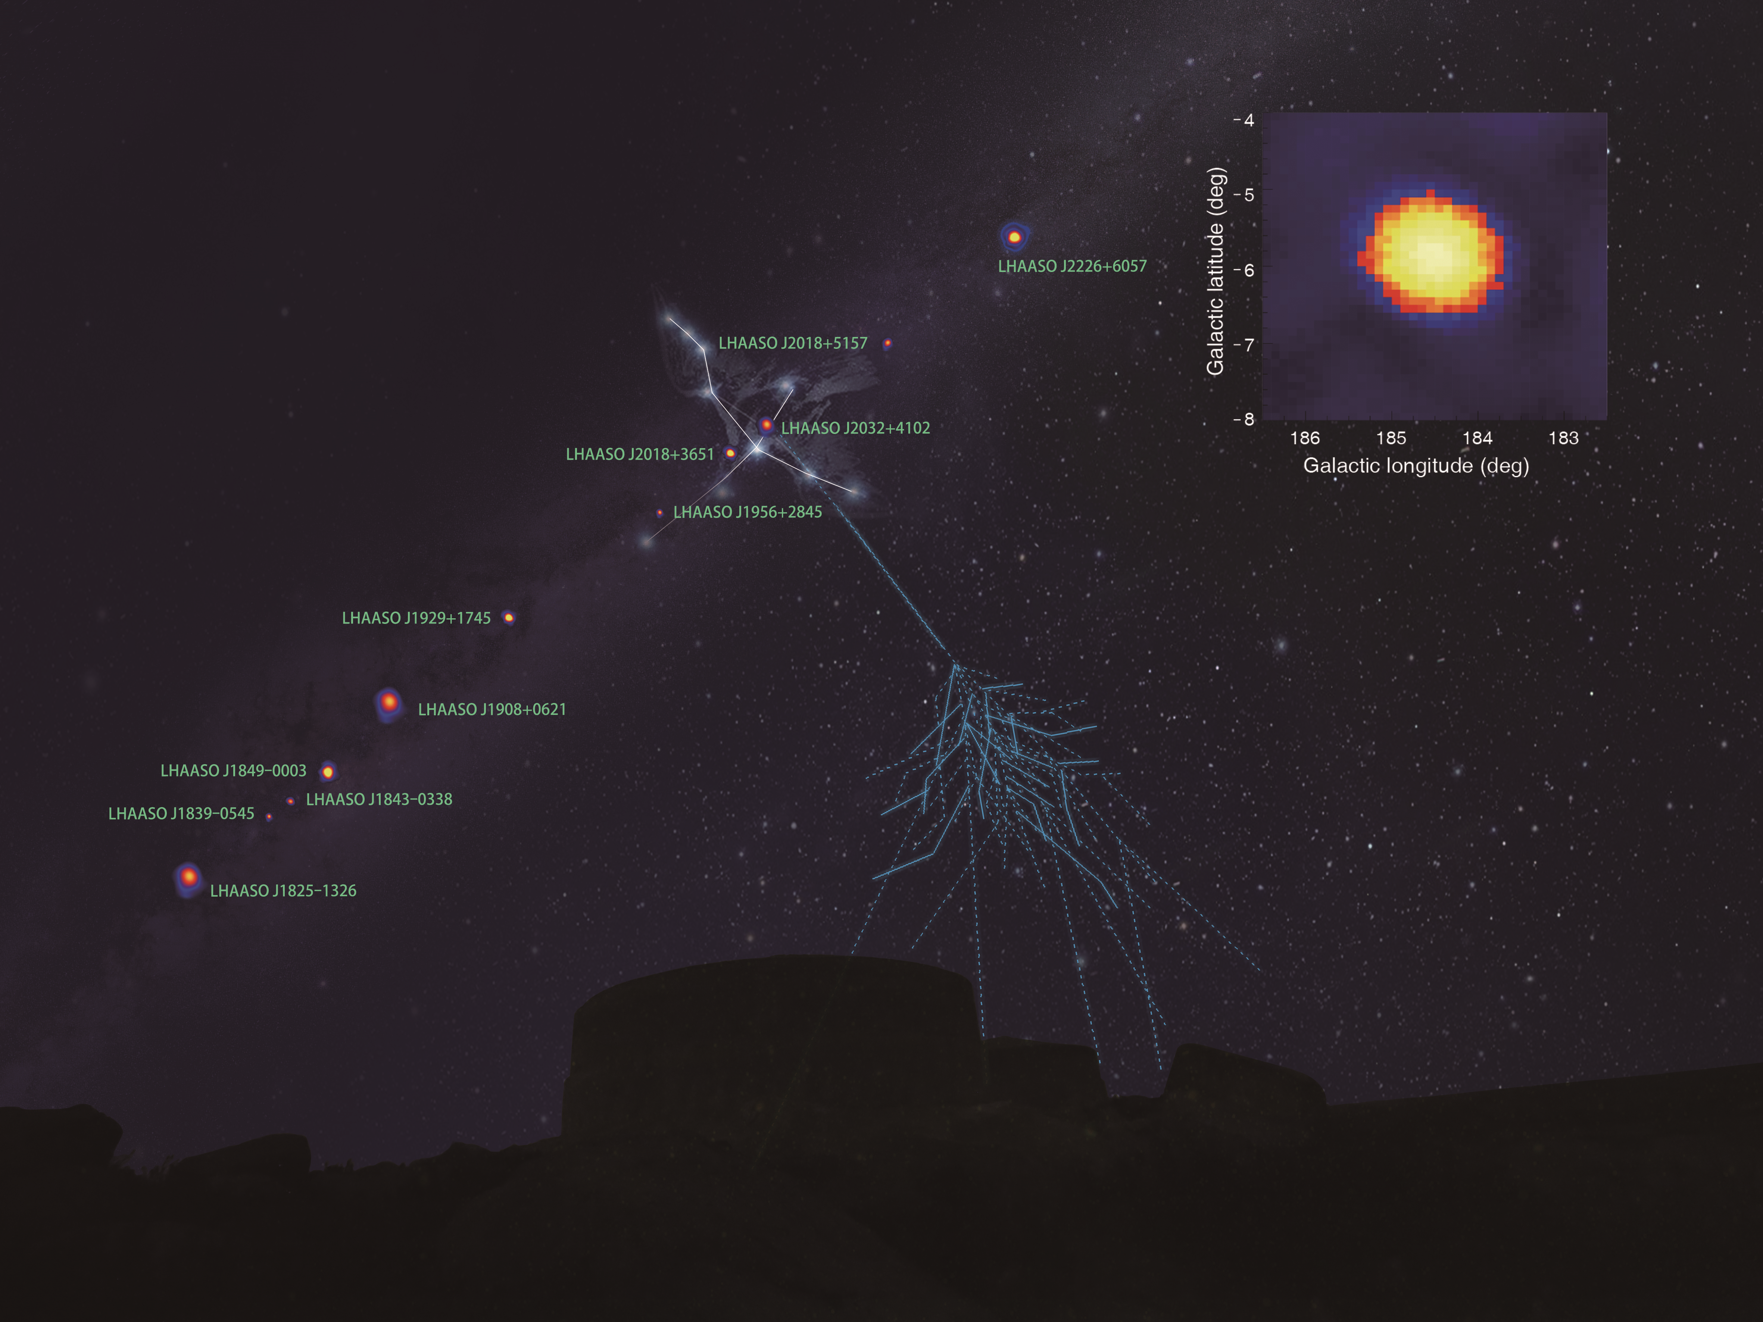
LHAASO galactic PeV sources have not been observed in ICECUBE
Cygnus X
Three brightest
PeVatrons
No trend of cut-off
in SED of γ–ray sources
Updates using newer data show continuous extension to higher energies
1.4 PeV
LHAASO, Nature, 594, p.33-36, 2021

Slide 16
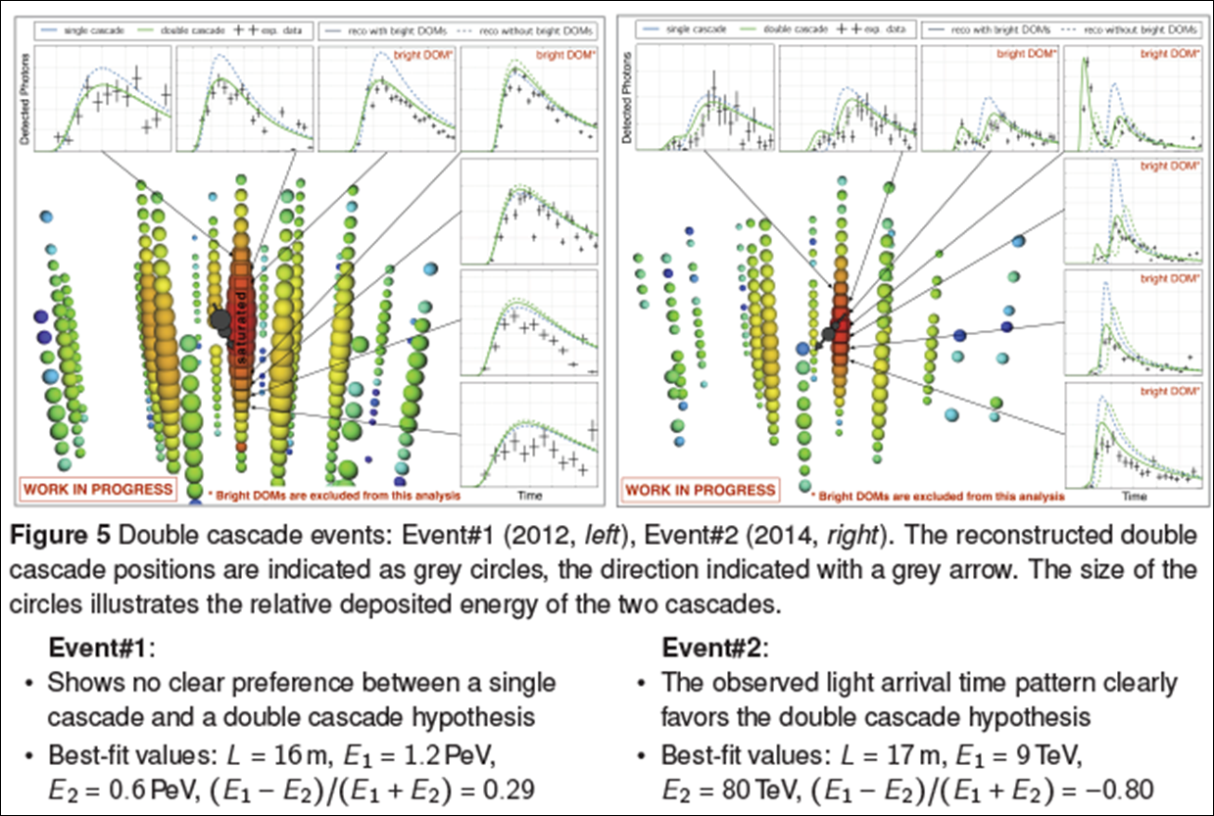
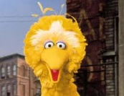
A two rare, puzzling, tau (?) discovered among 36 SHOWERs !!
The brightest is NON CONSISTENT, the weakest, is TOO NOISY
BIG BIRD 2 PeV from 2012 ? OPPOSITE SIGNALS AND SHORT TRACK
The best candidate is the most noise one
And opposite long respect its energy

Slide 17
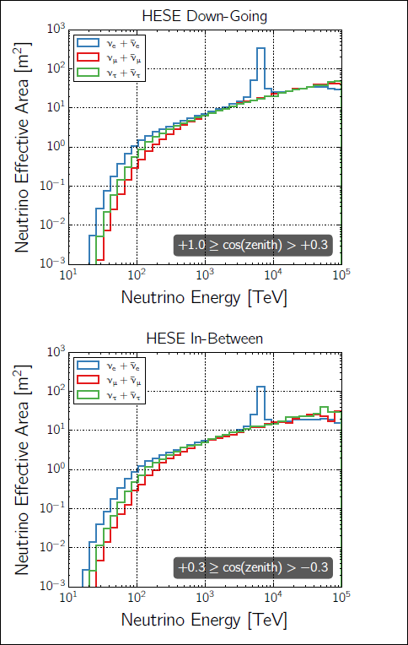
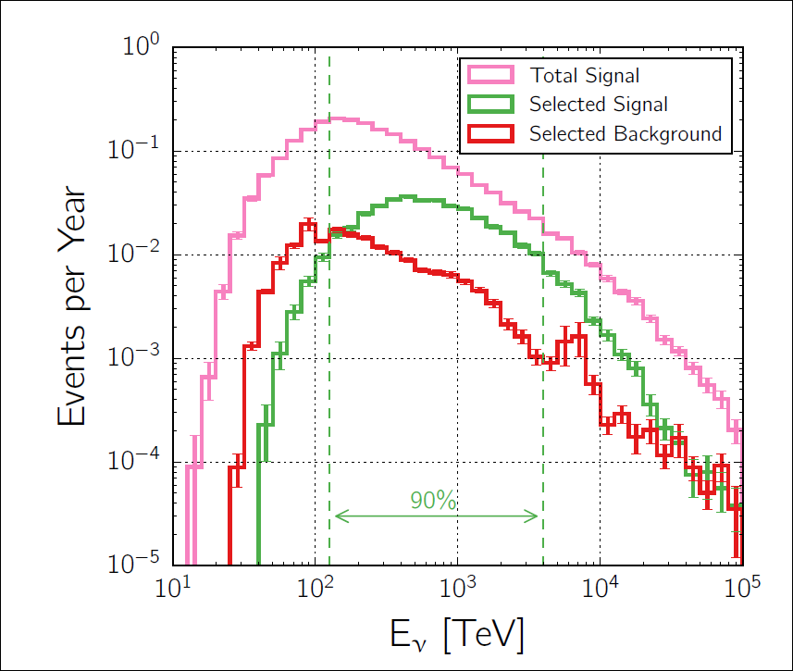
The tau best efficent energy detection: in the center, not ( as observed) at the energy edges

Slide 18
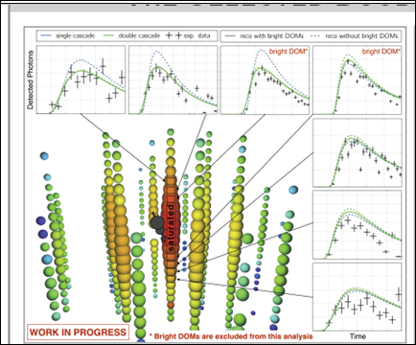
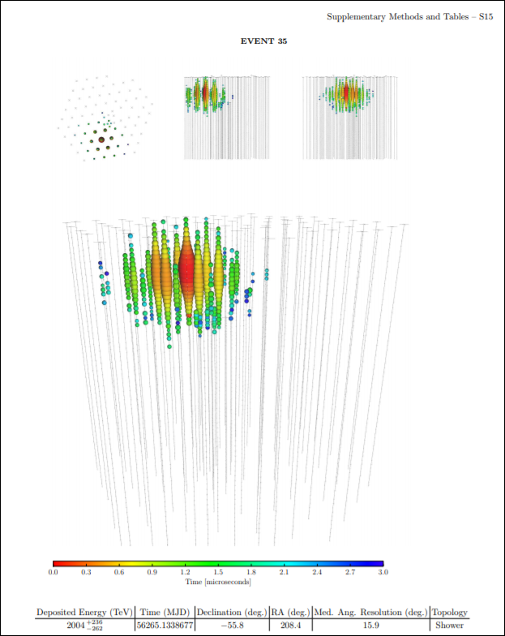
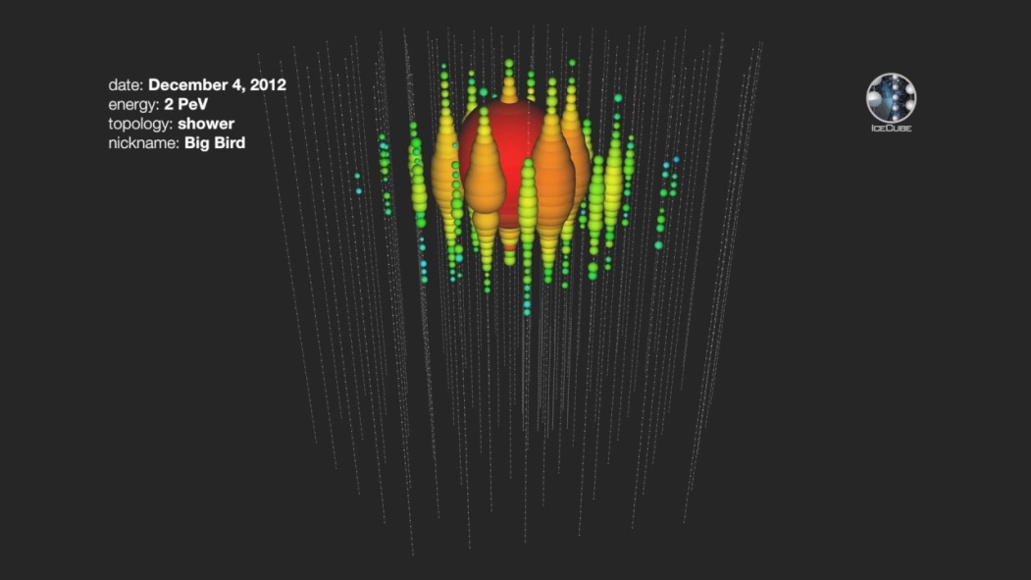
The 2 tau events: The Historic
Evento n.35 : Big Bird 2 PeV..Since
2012---6 years long to claim a tau?
So far there have only been three neutrinos powerful enough to receive the full Sesame Street treatment, with Big Bird joining Bert, 2011, and Ernie, 2012.

Slide 19
Big-Bird: 2 PeV tau (?) candidate pointing no-where: no correlation with known sources, no galactic plane

Slide 20
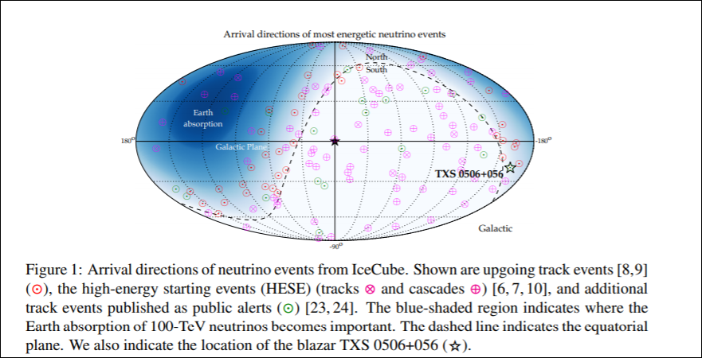
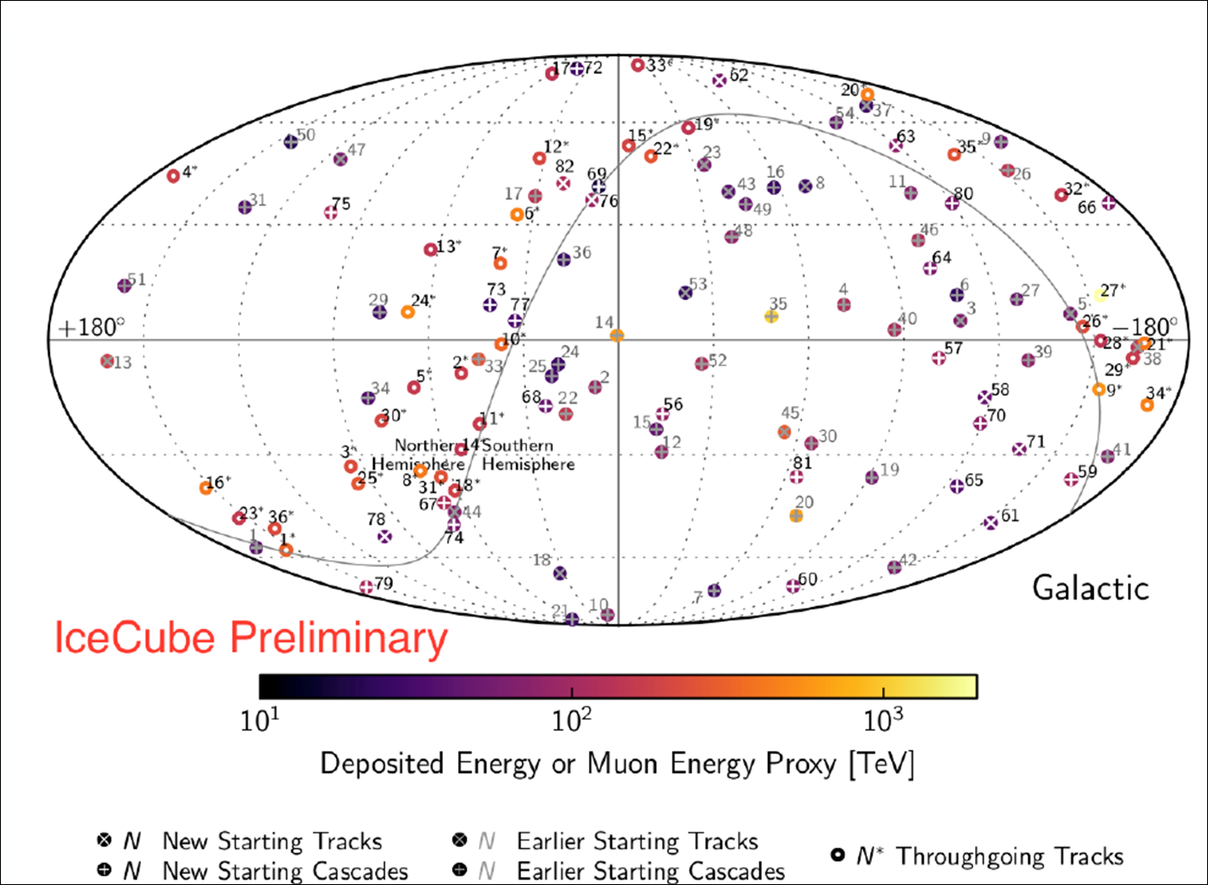
The absence of GALACTIC PLANE in the neutrino HESE and the through going muons
ABSENCE OF HESE MULTIPLETS

Slide 21
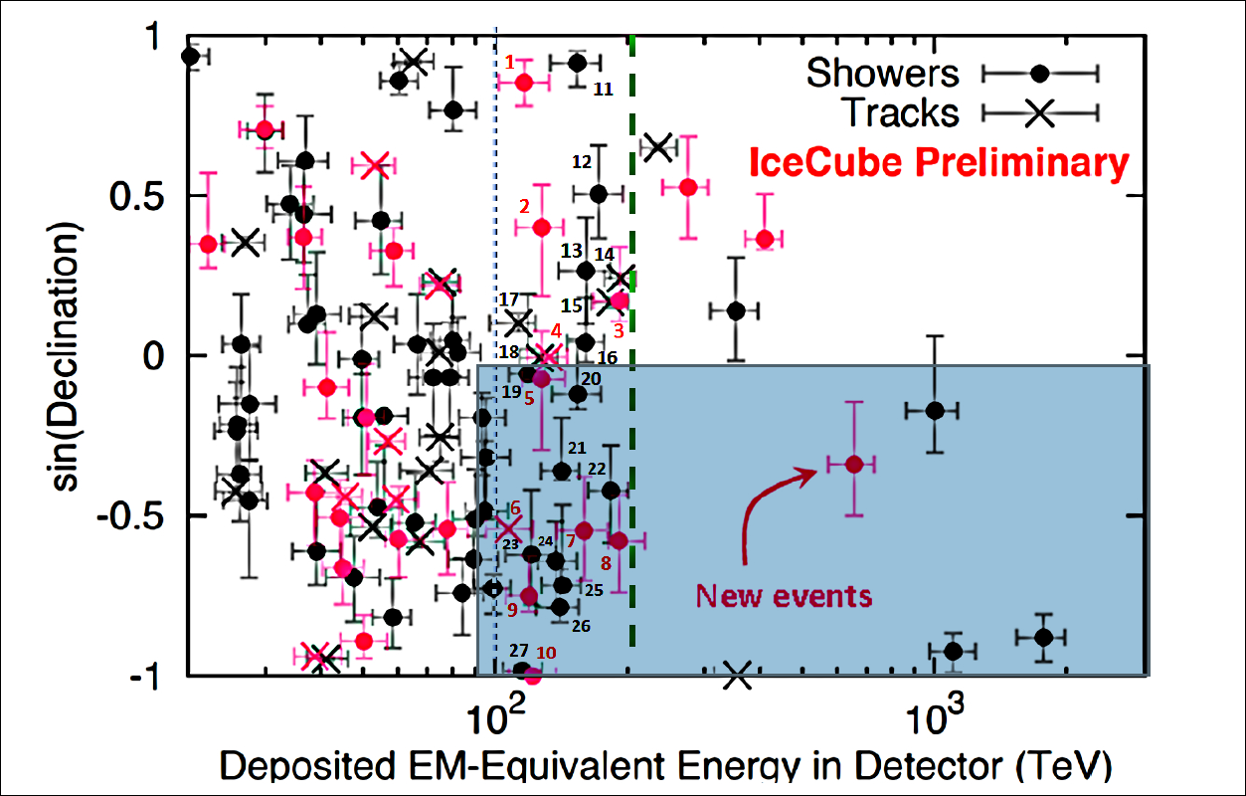
Only Two Taus found above hundred TeV energies? There were 36 cascades-> versus only 2 tau! Too few!! Upgoing above 90 TeVs: 10 cascades-6 tracks = charm ones

Slide 22
The Flavor puzzle in ICECUBE
Any cosmic Neutrino should be democratic in 3 flavors because cosmic mixing: 1:1:1 = >
ASTROPHYSICS WAIT FOR :
3 cascade and 1 Tracks
BUT First 6 years Icecube are CORRESPONDING to: 1.6 cascade+1 track = 1:1:0…. (as prompt neutrinos)
Multiply by 6→ one may expect 10 cascades,6 tracks
AS OBSERVED FOR UPWARD HESE EVENTS
AS FOR CHARMED ATMOSPHERIC ONES

Slide 23
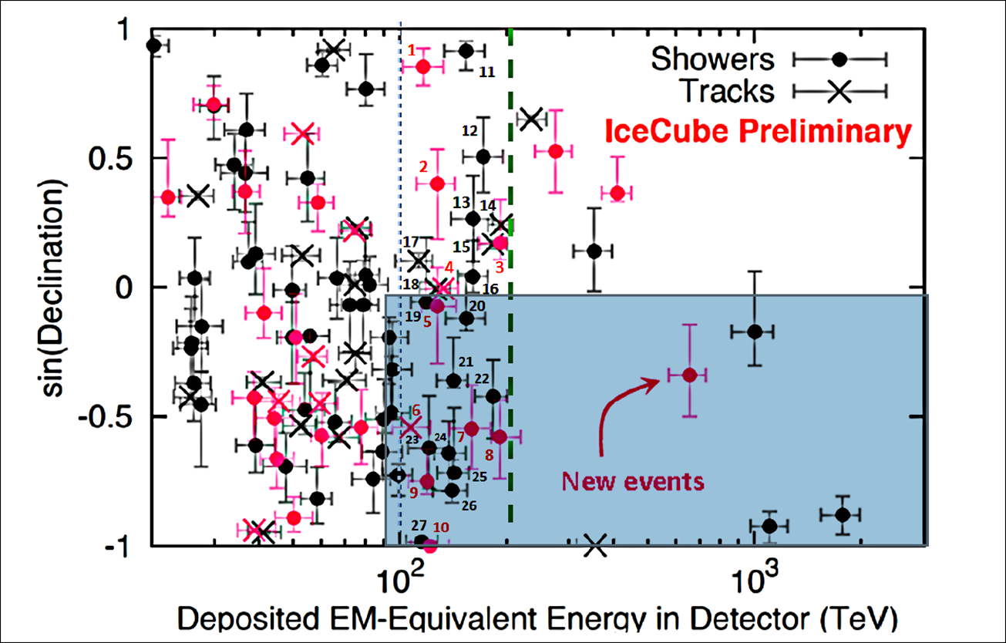
1: Such a ratio,10/6 = 1.6, imply a 1:1:0 (neutrino e:muon:tau) for neutrino flavor signature, as the atmospheric charmed ones. 2.BUT NOTE→Why downward cascades (24) above 100 TeV are overabundant versus (2) tracks!!! Because track directionality is better tracing their usual «prompt» atmospheric airshowers, that is recognized and filtered.

Slide 24
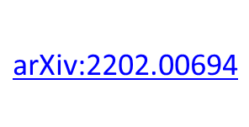
same ratio: HESE FLAVOR ASYMMETRY: DOWN-UP ones- Many DOWN: 17 Shower/1 Track ←→ Up : 5 shower/3 track: The 5/3 is pointing to a Charmed prompt atmospheric flavor: AS EARLY RESULTS OF ICECUBE

Slide 25
Munich 27 February 2017, Albrecht Karle,
Prompt neutrino
(with no tau term)
2015
2017
Conventional
Atmospheric neutrinos
Last 2020-2022-a new puzzling fit
0.2, 0.39, 0.42

Slide 26
HOW CHARMED atmospheric HESE signal may solve these highest UP-DOWN flavor asymmetry puzzle?
Downward Electron air shower at altitudes looses IN late CASCADE THEIR directionality , escaping most veto.
DOWN WARD Muon track and its charm muon neutrino track , reaching at FEW tens Tevs are separated by hundred meters, WELL SEPARATED sometimes with no muon companion inside the ICECUBE.
But their twin Opening angle between MUON and its twin neutrino, IS reduced as the
inverse square of neutrino energy :
above hundred TeVs the twin lepton charmed pair (muon and their neutrinos) are more and more collimated and are mostly overlaping.
MUON TRACK MAY HIDE ITS parallel HESE track making a VETO.
EXLAINING THE DOWNWARD HESE MUON ABSENCE.

Slide 27
1:Bad News , but also Good News for ICECUBE
First, Most tens TeVs up Hundreds TeV neutrinos are mainly noisy atmospheric
The absence of Galactic Plane anisotropy, Tau neutrino presence, the main isotropy are obvious consequences as CR secondaries.
The eventual TOTAL PRESENCE of CHARMED NOISY MUST IMPLY a nearly absence ( 1 over tens thousand) of Muon neutrino Track…BUT..we do observed one downward track!
The presence of at least a downward track at few hundreds TeVs imply a first HIDDEN , BUT REAL, FILTERED NEUTRINO ASTRONOMY, BASED ON DOWNWARD MUON TRACK:
A GUARANTEED NEW NEUTRINO ASTRONOMY

Slide 28
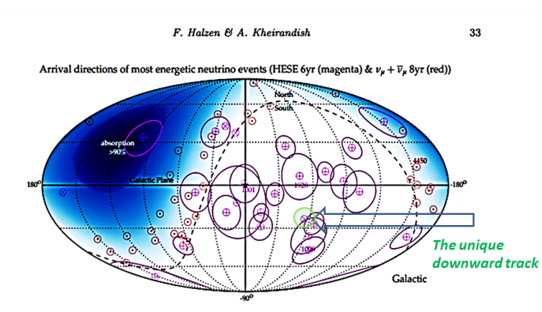
2:SHORT Conclusions (bad and good)
The present ICECUBE astronomy is only at 1-3% of the flux assumed , a flux comparable with the observed TeVs-tens TeV gamma sky.
The downward muon HESE neutrino track are new
Unnoticed or secret, but guaranteed,
astrophysical currier to look for.
The presence of just one downward HESE
neutrino track gives hope and
success to ICECUBE effords.
Additional of such HESE downward tracks
will better probe and confirm
this new filtered astronomy.

Slide 29
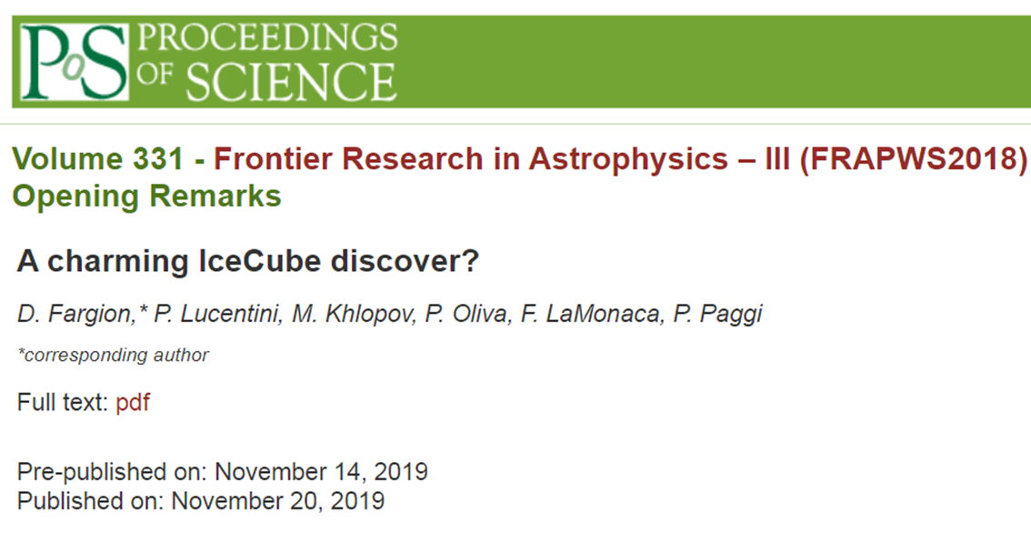
3:Conclusions
Even if Astrophysical neutrino is the desired result, the possible discover of a charm dominant atmospheric signal deserve by itself our
greatest congratulations to Icecube team.

Slide 31
Thank you
ADDITIONAL SLIDES:

Slide 35
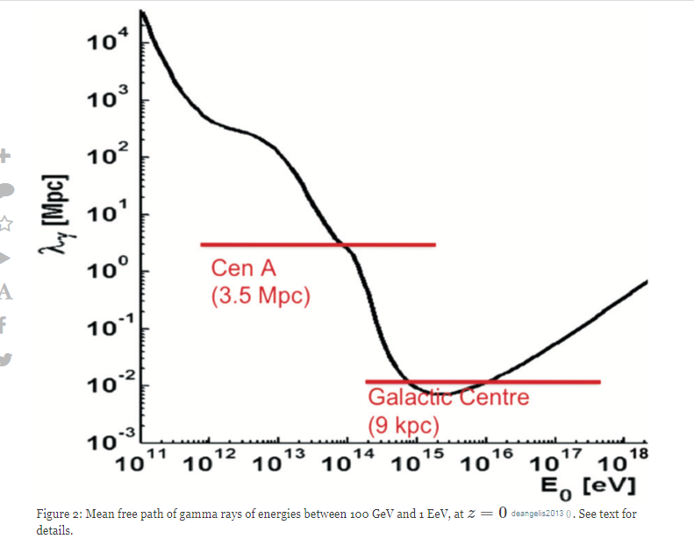
IR opacity at TeVs gamma sky

Slide 36
….Maybe TeVs photon opacity by cosmic IR allows the rise of cosmic TeVs-PeVs neutrinos?
NO much relevant :
Because the tens TeV gamma, their IR hit and their decay it will shine at tens GeVs, transparent to cosmic IR …Therefore the Galactic plane should be the dominant final signal as in Fermi sky
( but not yet observed in Icecube)

Slide 37
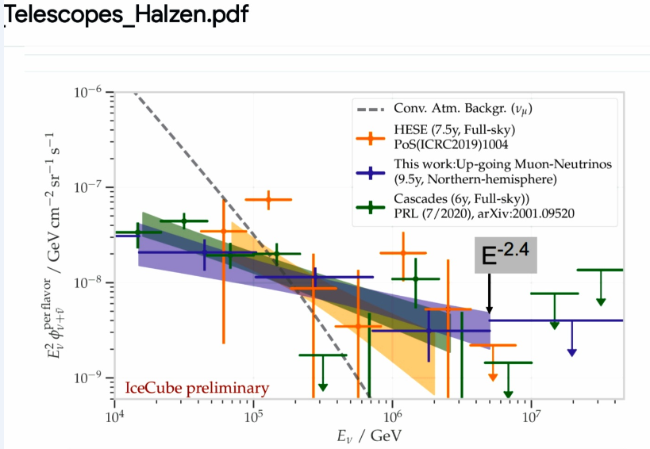
The HESE versus Cascades does show almost a CR (-2.7) spectra not a flat (-2) FERMI one

Slide 39
The smeared homogeneous Icecube sky with no clustering HESE

Slide 40
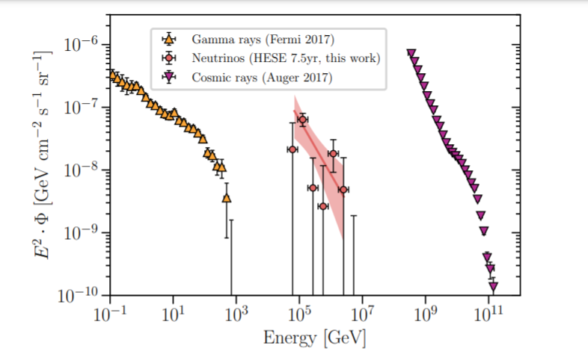
A spectra index = -2 (astrophysics) or , -3 (Charm-CR) ?

Slide 41
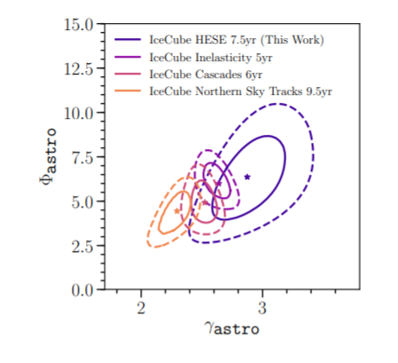
The evolved index spectra from -2 to -3

Slide 42
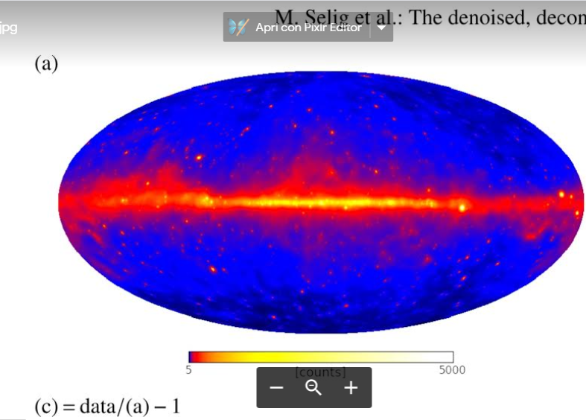
Fermi map : galactic plane. No traces of TeVs secondaries by IR opacity

Slide 43
Indeed the TeVs gamma, their decay, should shower into GeV sky: still much ruled by Galactic plane

Slide 44
Recent Nature March 2021: The detection of a partial Glashow cascades is not any definitive probe to neutrino Astrophysics; also charmed signals may lead to PeVs antineutrino electrons with -3 index and a natural suppression: An astrophysical spectra will need a spectra -2 requiring a sudden unnatural cut-off. Moreover the Glashow event had not been correlated with any known source

Slide 45
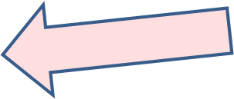
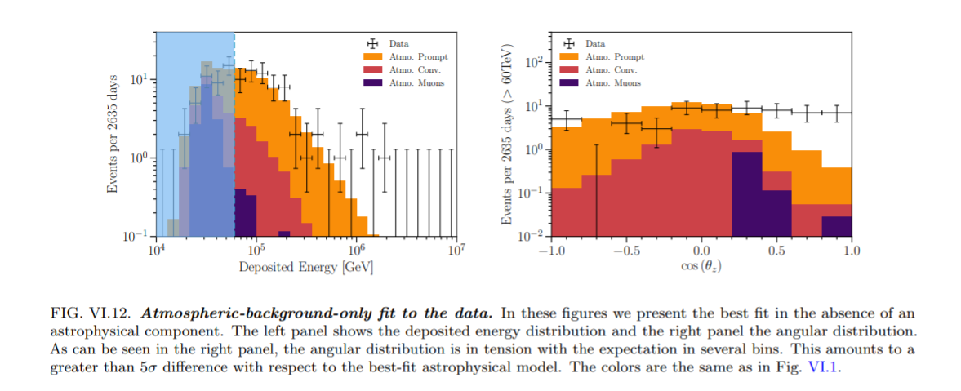
Atmospheric Charm may fit the icecube data
Possible fit with charm atmospheric noise (icecube)
Apparent disagreement for downward events
(mostly cascades) whose directionality may be very unprecise and inclined , hiding their undetected but correlated atmospheric downward airshowers

Slide 46
