Slide 1


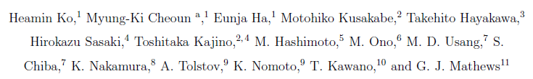
Comprehensive analysis of
Neutrino-process in Core-collapsing supernova explosion (CCSN)
Myung-Ki Cheoun
(Soongsil University, OMEG Institute, Seoul, Korea)
In collaboration with
Refs: PRL 121, 102701 (2018), Acta Phys. Pol. B, 50, 385(2019),
ApJL 891, L24 (2020), ApJ 894, 1 (2020), ApJ in press (2022) …
International School of Nuclear Physics, 43rd Course Neutrinos in Cosmology,
in Astro-, Particle- and Nuclear Physics, Erice-Sicily, September 16-22, 2022
Blackett Institute (San Domenico)
Notes:
Today it is my great pleasure to have a seminar at Tohoku University. I tried to have a seminar in person there. But it is a pity that I could not be there.
Next week, I stay at RIKEN and want to go there, if any chances.
I have stayed at Sendai four years about 30 years ago. I had many beautiful memories at Tohoku University. Near future I want to visit there and discuss many physics at Tohoku University.
Anyhow title of today’s talk is the neutrino process. Here are our collaborators for this physics and relevant references. These two persons, Bogoliubov and Pontecorvo, have played key roles of understanding the neutrino-process.

Slide 2
Contents
Motivation
Neutrino Process in Supernova Explosion
Neutrino Oscillation in vacuum and matter, and neutrino Self-Interaction in the Neutrino Process
Neutrino-induced Reactions by QRPA
Dependence on Neutrino Luminosity
Heavy Elements (⁹²Nb,⁹⁸Tc,¹³⁸La,¹⁸⁰Ta …)
Light Elements (⁷Li,¹¹Be…) & Ratios
of ⁷Li/¹¹B and ¹³⁸La/¹¹B
Cosmological origin of ¹⁰Be
Sterile Neutrinos & Shock Effects in Neutrino Process
Summary
O-rich
Core
Core
Si
O-rich
O/C
He/C
Notes:
This is the contents of my talk. After short motivation of this study, I shortly summarize the origin of elements.
Since then, I focus on the neutrino-process and some physics relevant to the neutrino-process.
After that I will discuss the results of the abundances of some specific nuclei which are believed to be produced by the neutrino-process, such as 138La, 11Be et ce.
If I have time enough, I also discuss recent interesting physics, sterile neutrino in the aspect of the neutrino-process.

Slide 3
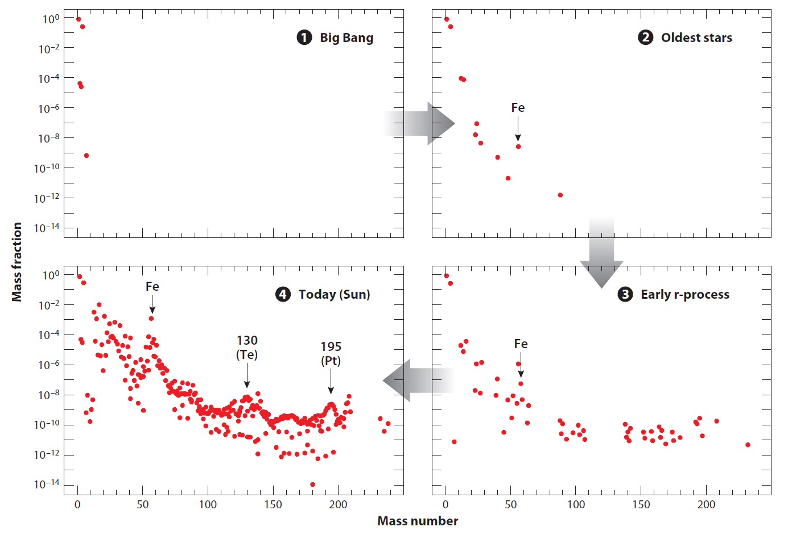
Preliminary
Evolution of Element Abundances in the Universe Evolution
However, …
M. Wiescher et al., Annu. Rev. Astro. Astrophys. (2012)
Notes:
This is the large-scale time evolution of the elements in the solar system since the Big Bang and s- and r-process in the Population III stars.
Heavy elements are increased with the time evolution.
Finally we have the nuclear abundance at present time thanks to lots of efforts from astronomy and meteorite science.
Here you can see famous three peaks in the abundances showing the magic numbers in the nuclear physics.

Slide 4
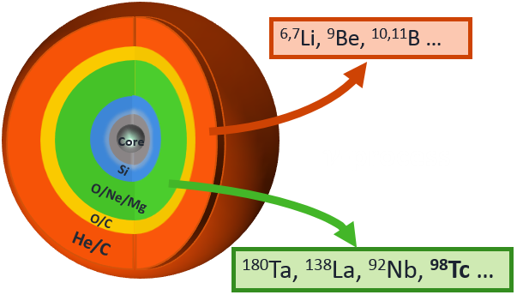






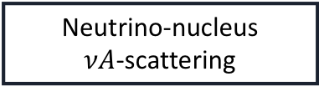


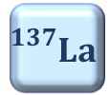



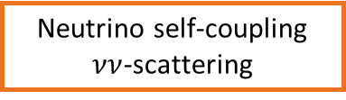




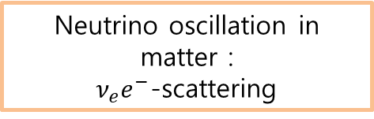


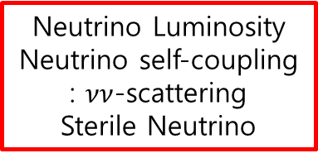



Introduction
Neutrino Process in CCSN Explosion
Why neutrino process in SN?
$${}_{}^{138}{Ce}$$
$${}_{}^{139}{Ce}$$
$${}_{}^{140}{Ce}$$
stable
unstable
$$β^{+}$$
r-process
(rapidly neutron capture)
$${}_{}^{137}{La}$$
$${}_{}^{138}{La}$$
$${}_{}^{139}{La}$$
$${}_{}^{140}{La}$$
$$β^{−}$$
$${}_{}^{136}{Ba}$$
$${}_{}^{137}{Ba}$$
$${}_{}^{138}{Ba}$$
$${}_{}^{139}{Ba}$$
$${}_{}^{140}{Ba}$$
$${}_{}^{138}{Ba\left(ν_{e},e^{−}\right)}{}_{}^{138}La$$
We need to understand the neutrino source and its propagation in SNe ?
Neutrino sphere
Neutrino propagation with momentum $p$
(Not-to-scale)
$$n_{ν}≈{10}^{32}/cm^{3}$$
P
NS
$$p$$
$$e^{−}$$
$$A$$
$$θ_{q}$$
$$q$$
10km
1000km
250000km
Dominant neutrino interactions depend on the neutrino flavor and electron density in the transport.
Neutrino Luminosity
Neutrino self-coupling
: $νν$-scattering
Sterile Neutrino
Neutrino oscillation in matter :
$ν_{e}e^{−}$-scattering
Neutrino-nucleus
$νA$-scattering
Notes:
Here I explain the production mechanism of 138La. As you see, 138La is surrounded by stable nuclei. It means that the nucleus can not be produced by the s- and r-process.
Enter
However, the neutrino-induced reaction can produce the nucleus via NC and CC reactions. Of course, other processes, so to say gamma-process by the photodisintegration and neutron-capture can make the nucleus.
We have to be very careful of those contributions to pin down the information regarding the neutrino process.
Enter 2 times
For understanding the process, we start from the study of the neutrino luminosity emitting from the proto-neutron star or neutrino-sphere. It depends on the SN simulation, which point will be explained later on.
After the neutrino emission, the propagating neutrino interacts with the mater, mainly electrons, and some nuclei
which were already produced in the pre supernova through the s-process for long and long years.
In a nutshell, for the neutrino-process study, we need to understand the neutrino luminosity, oscillation in matter and the neutrino-induced reactions as well as the neutrino-self interaction.

Slide 5
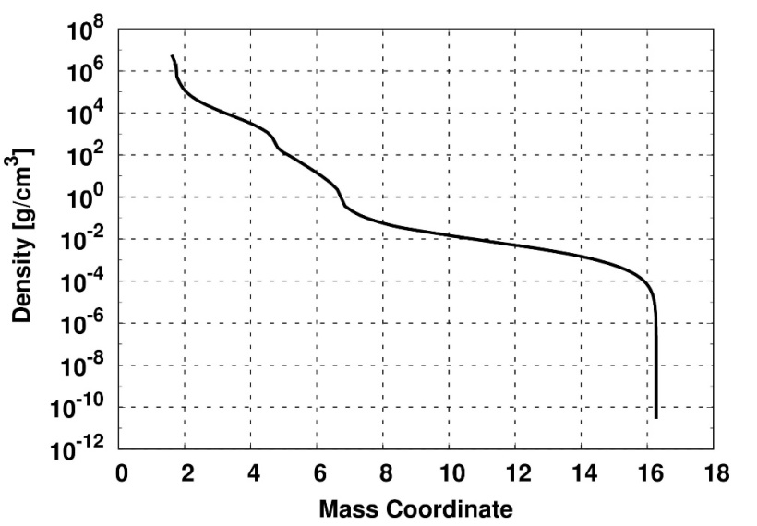
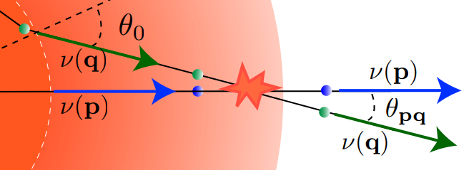
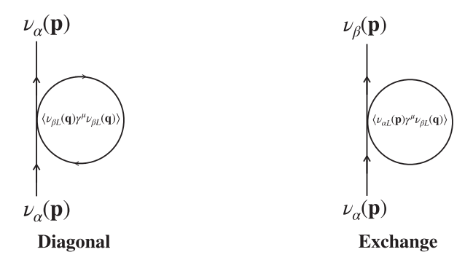
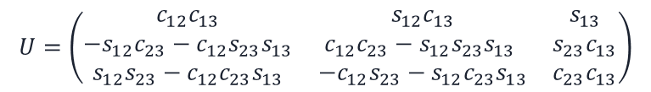
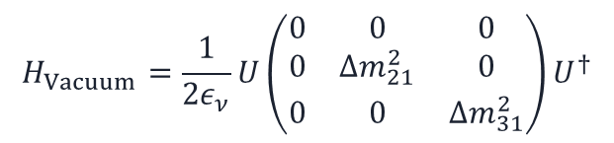
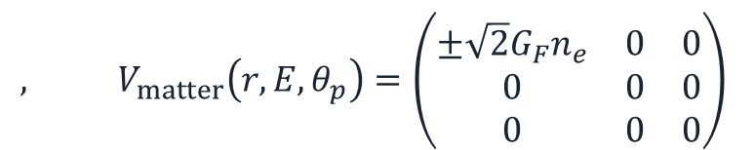


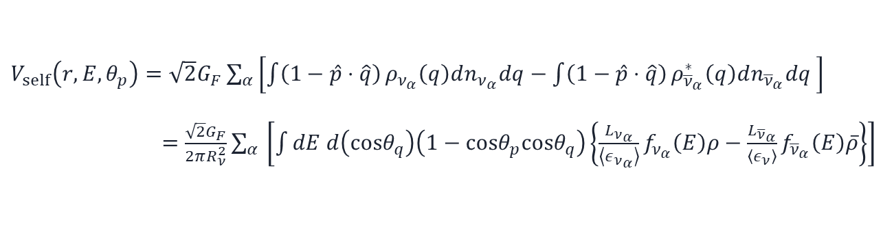
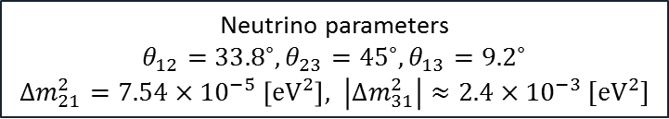
Neutrino process
Neut. Ham. for neutrino density propagation
Total Hamiltonian for neutrino propagation in matter
$$H_{total}=H_{Vacuum}+V_{matter}+V_{self}$$
- Vacuum and matter term
$$H_{Vacuum}=\frac{1}{2ε_{ν}}U\left(\begin{matrix}0 & 0 & 0 \\ 0 & Δm_{21}^{2} & 0 \\ 0 & 0 & Δm_{31}^{2}\end{matrix}\right)U^{†}$$
$$, V_{matter}\left(r,E,θ_{p}\right)=\left(\begin{matrix}±\sqrt{2}G_{F}n_{e} & 0 & 0 \\ 0 & 0 & 0 \\ 0 & 0 & 0\end{matrix}\right)$$
Unitary mixing PMNS matrix
$$n_{e}=ρ_{b}Y_{e}N_{A}$$
$$U=\left(\begin{matrix}c_{12}c_{13} & s_{12}c_{13} & s_{13} \\ −s_{12}c_{23}−c_{12}s_{23}s_{13} & c_{12}c_{23}−s_{12}s_{23}s_{13} & s_{23}c_{13} \\ s_{12}s_{23}−c_{12}c_{23}s_{13} & −c_{12}s_{23}−s_{12}c_{23}s_{13} & c_{23}c_{13}\end{matrix}\right)$$
SN1987, 16.2M_sol
with 6M_sol He core !
Neutrino parameters
$θ_{12}={33.8}^{∘},θ_{23}={45}^{∘},θ_{13}={9.2}^{∘}$
$Δm_{21}^{2}=7.54×{10}^{−5} \left[eV^{2}\right], \left|Δm_{31}^{2}\right|≈2.4×{10}^{−3} [eV^{2}]$
K. A. Olive, et al. [Particle Data Group], Chin. Phys. C 38, 090001 (2014).
- Neutrino self-interaction term
A. Tolstov, in private communication (2017)
$V_{self}\left(r,E,θ_{p}\right)=\sqrt{2}G_{F}\sum_{α}{\left[\int{\left(1−\hat{p}⋅\hat{q}\right)}ρ_{ν_{α}}\left(q\right)dn_{ν_{α}}dq−\int{\left(1−\hat{p}⋅\hat{q}\right)}ρ_{{\overline{ν}}_{α}}^{∗}\left(q\right)dn_{{\overline{ν}}_{α}}dq \right]}$ $=\frac{\sqrt{2}G_{F}}{2πR_{ν}^{2}}\sum_{α }{\left[\int{dE d\left(cosθ_{q}\right)\left(1−cosθ_{p}cosθ_{q}\right)\left\{\frac{L_{ν_{α}}}{\left\langle ε_{ν_{α}}\right\rangle }f_{ν_{α}}\left(E\right)ρ−\frac{L_{{\overline{ν}}_{α}}}{\left\langle ε_{ν}\right\rangle }f_{{\overline{ν}}_{α}}\left(E\right)\overline{ρ}\right\}}\right]}$
H. Sasaki, et al., Phys. Rev. D 96, 043013 (2017)
Heamin KO, et.al, ApJS (2022)
Notes:
Total Hamiltonian is composed of three parts; vacuum oscillation, matter interaction and their self interaction. Each Hamiltonian can be constructed easily with the mixing angles and mass differences. One may use the PDG data for them.
For the self interaction, one can easily calculate lepton-lepton scattering, but we have to use a mean field approximation in the neutrino gas.
Another important ingredient is the electron density in matter which depends on the adopted hydrodynamics.

Slide 6


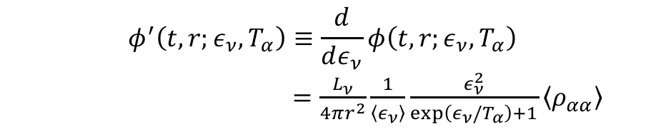

Neutrino process
Self-Interaction effects on the Neutrino Flux
10km
1000km
2000km
250000km
NS
(Not-to-scale)
Inverted mass hierarchy (IH)
$$H_{Vacuum}+V_{matter}+V_{self}$$
The differential neutrino flux with neutrino flavor $α$
$$φ^{′}\left(t,r;ε_{ν},T_{α}\right)≡\frac{d}{dε_{ν}}φ\left(t,r;ε_{ν},T_{α}\right)$$
$=\frac{L_{ν}}{4πr^{2}}\frac{1}{\left\langle ε_{ν}\right\rangle }\frac{ε_{ν}^{2}}{\exp\left(ε_{ν}/T_{α}\right)+1}\left\langle ρ_{αα}\right\rangle$
The neutrino temperatures are
$T_{ν_{e}}=3.2,$ $T_{{\overline{ν}}_{e}}=5$ and $T_{ν_{x}}=6 \left[MeV/k_{B}\right]$
T. Yoshida, et al., Astrophys. J. 686, 448 (2008)
H. Sasaki, et al.(NAOJ) in private communication (2018)
Initially we assume Fermi-Dirac distribution for neutrino spectra (EQ luminosity).
In the case of normal mass hierarchy, the SI effect is suppressed.
For anti-neutrino, similar effects are found.
For the luminosity we use other numerical luminosity by the neutrino transport simulation (NEQ Luminosity).
Notes:
The first point I discuss is the neutrino self interaction (SI) which is thought to occur near the neutrino sphere because the neutrino density is so huge 10^50 per cubic around the neutrino sphere, so the SI becomes significant albeit their weak interactions.
The most important point to notice is the change of the neutrino spectra by the SI. For example, initially we assume the Fermi-Dirac distribution,
but the spectrum of the electro-neutrino is deformed this way by the SI, by which its high energy tail is swollen. But, instead of the increase, the other flavor neutrino loses its high energy tail part. We say, the neutrino spectra are swapped.
However, the SI is suppressed in the normal mass hierarchy.
For anti neutrino case, we also found similar effects.
Since the distortion depends on the neutrino luminosity, we also checked the dependence on the luminosity in the SN simulation.

Slide 7
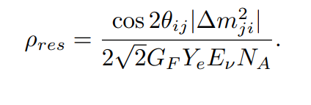
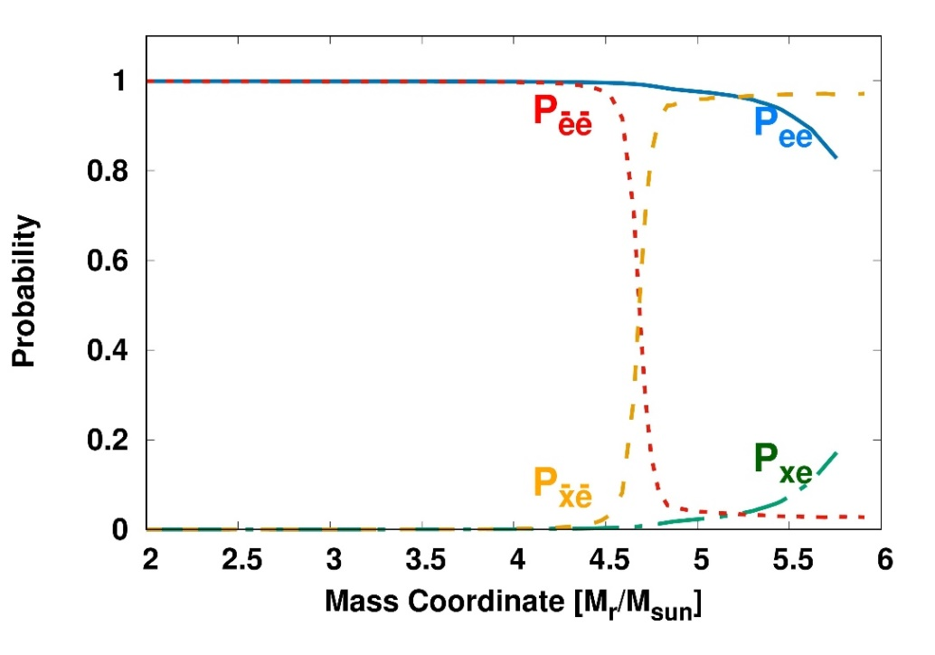

Neutrino process
MSW Effects on the Neutrino Flux (IH)
10km
1000km
2000km
MSW resonance
250000km
NS
(Not-to-scale)
$$H_{Vacuum}+V_{matter}+V_{self}$$
$H_{Vacuum}+V_{matter}$ ( MSW effect)
IH
H. Sasaki, et al.(NAOJ) in private communication (2018)
The differential neutrino flux again including outer region oscillation
$$\frac{d}{dε_{ν}}φ_{α}\left(t,r;ε_{ν},T_{α}\right)=\frac{L_{ν} (t)}{4πr^{2}}\frac{1}{\left\langle ε_{ν}\right\rangle }\frac{ε_{ν}^{2}}{\exp\left(ε_{ν}/T_{α}\right)+1}\left\langle ρ_{αα} (t)\right\rangle ×P_{αβ}\left(ε_{ν}\right)$$
Notes:
The next ingredient is the neutrino oscillation in matter, so to say matter effects or MSW effects. It is nothing but the neutrino interactions with electrons in matter.
Then, as you know, one can find a resonance of the mixing angle at a certain electron density. In the SN1987 model, the resonance region is known to be O-Ne-Mg layer, about 3.7-4.7 solar mass region. Here right side is the outer region of the proto-neutron star.
If we include the mixing angle resonance due to the matter effects, the neutrino flux is drastically changed this way. For example, muon- and tau-neutrino is changed into electro-flavor and also vice verse.
Important consequence of this MSW effects is that the flux of the high energy anti-electro neutrino becomes increased
because the larger temperature of the muon- and tau-neutrino ‘at the time of the emission from the neutrino sphere’ is transferred to electro-neutrino.
This change probability is included in the propagating neutrino flux.

Slide 8
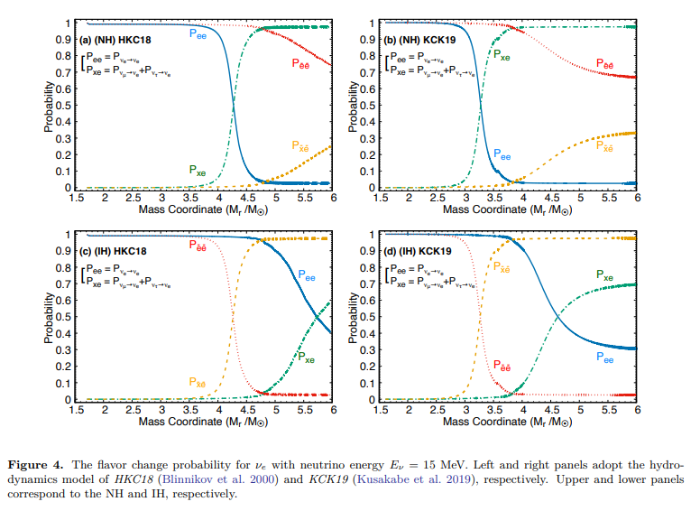
Notes:
Detailed dependence on the mass hierarchy can be found in these figures. The upper part is for NH and the lower part is for IH.
The probability of the high energy electro-neutrino is larger than that for IH case.

Slide 9
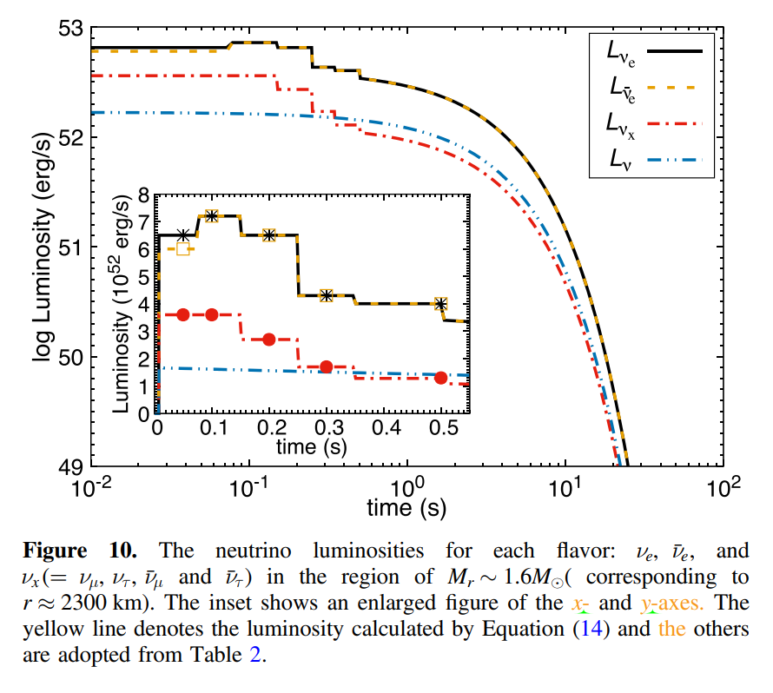
Notes:
Next is the luminosity dependence. In principle, we have to use the luminosity from the neutrino transport model simulation in the SN explosion simulation.
Since it depends on the model and the simulation, we adopted a synthetic model which collected 6 different SN simulation models as shown here.
According to the SN simulation, the neutrino emission is divided in three stages. One is the neutrino emission from the burst, the 2nd is from the accretion phase, and the last one is from the cooling phase.
We considered the accretion and cooling phases because the neutrinos from the burst phase are easily decoupled for a short time interval after the bounce of the core collapse.

Slide 10
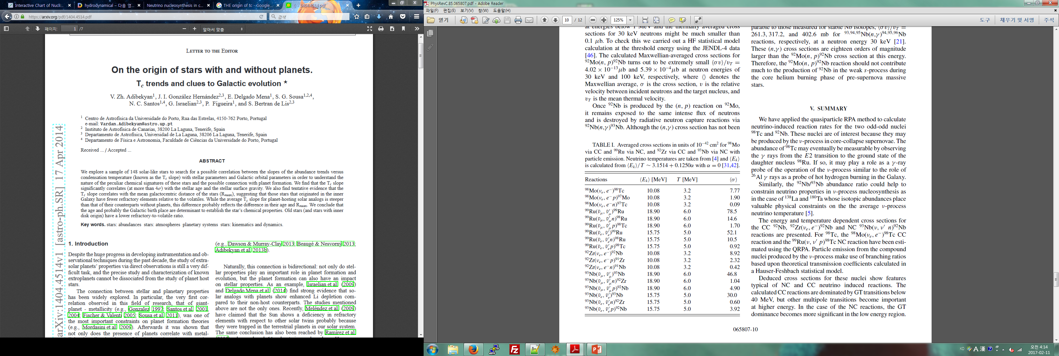
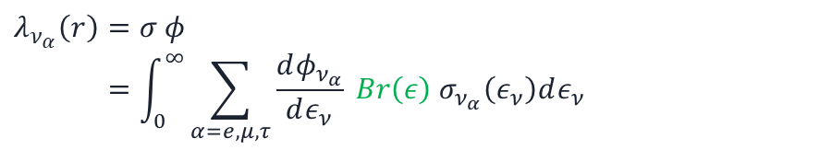

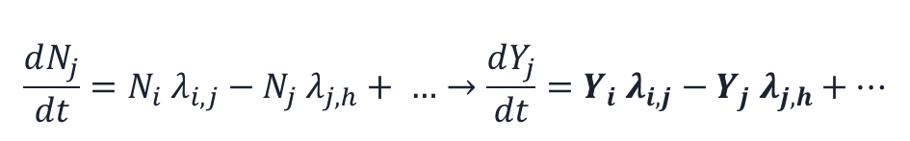
Neutrino process
Neutrino Reactions Rates with Nuclei
Network calculation for nucleosynthesis
$$\frac{dN_{j}}{dt}=N_{i} λ_{i,j}−N_{j} λ_{j,h}+ …→\frac{dY_{j}}{dt}=Y_{i} λ_{i,j}−Y_{j} λ_{j,h}+…$$
$$Y_{j}=\frac{N_{j}}{ρ N_{A}}$$
JINA REACLIB & Los Alamos (n,g) Data !
Kyushu-Tokyo Progenitor Model !
Part for neutrino reaction rates
$λ_{ν_{α}}\left(r\right)=σ φ$
$$=\int_{0}^{∞}{\sum_{α=e,μ,τ}{\frac{dφ_{ν_{α}}}{dε_{ν}} Br\left(ε\right) σ_{ν_{α}}\left(ε_{ν}\right)dε_{ν} } }$$
Cross section data using QRPA
Example: (EQ,IH)
with Neutrino self-interaction
after
MSW resonance
In MSW region, energetic e-neutrino is increased by the P(x-e) neutrino resonance ( w/o SI ).
But it is a bit decreased with the decrease of X-neutrino by the SI.
w/o Neutrino self-interaction
M. K. Cheoun, et al., Phys. Rev. C 85, 065807 (2012)
Notes:
Now we have to perform network calculations including two- and three-body reactions for each nuclear species. We exploited the JINA REACLIB and Los Alamos (n,g) data for the reaction rate.
For the neutrino-induced reaction X-section, we employed the QRPA approach. For the interaction rate, we multiply the branching ratios of the excited state of ‘the compound nuclei produced by the SN neutrino’ as well as the neutrino change probabilities.
One of the example of the change of the reaction rate for 96Mo via CC is presented here. You can find the differences due to the SI and matter effects.

Slide 11
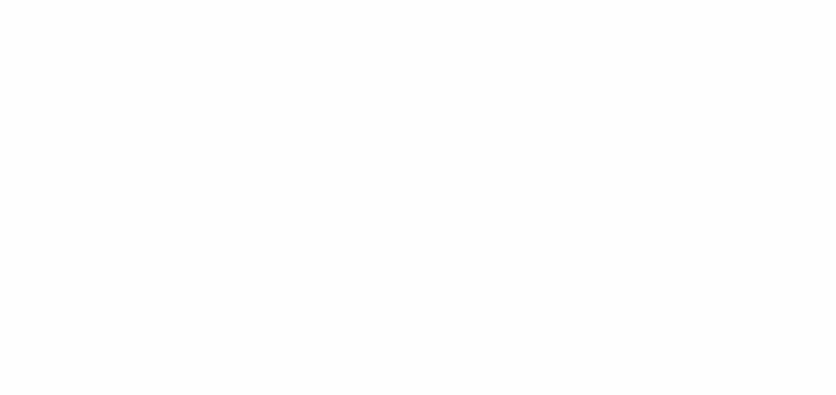
Contents
Motivation
Neutrino Process in Supernova Explosion
Neutrino Oscillation in vacuum and matter, and neutrino Self-Interaction in the Neutrino Process
Neutrino-induced Reactions by QRPA
Dependence on Neutrino Luminosity
Heavy Elements (⁹²Nb,⁹⁸Tc,¹³⁸La,¹⁸⁰Ta …)
Light Elements (⁷Li,¹¹Be…) & Ratios
of ⁷Li/¹¹B and ¹³⁸La/¹¹B
Cosmological origin of ¹⁰Be
Sterile Neutrinos & Shock Effects in Neutrino Process
Summary
O-rich
Core
Core
Si
O-rich
O/C
He/C
Notes:
This is the contents of my talk. After short motivation of this study, I shortly summarize the origin of elements.
Since then, I focus on the neutrino-process and some physics relevant to the neutrino-process.
After that I will discuss the results of the abundances of some specific nuclei which are believed to be produced by the neutrino-process, such as 138La, 11Be et ce.
If I have time enough, I also discuss recent interesting physics, sterile neutrino in the aspect of the neutrino-process.

Slide 12

Phys. Rev. C99, (2019), 064304;
Phys. Rev. C97, (2018), 064322;
Phys. Rev. C97, (2018), 024320;
EPJA 53, (2017), 26 ….
JPG, 46 (2019), 105109
For neutrino-nuclei reactions,
1. We include the transition from 0(+/-) up to 4(+/-) !!!
2. To describe the excitations of compound nuclei, we exploit the (D)QRPA.
3. In the QRPA, the Brueckner G matrix based on the CD Bonn potential and ‘all kinds
of pairing interactions’ in the BCS are included.
4. These (D)QRPA have been successfully tested to reproduce the GT strength distr..
5. For the excitation spectrum of the compound nuclei, we exploit a statistical model
by S. Chiba in TIT.
Notes:
The neutrino-induced X-section is composed of Coulomb, electro-magnetic and longitudinal transitions. Detailed calculation are done in these references.
Just a few points I want to notice are …

Slide 13
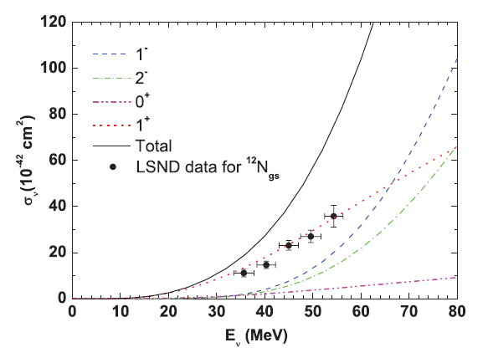
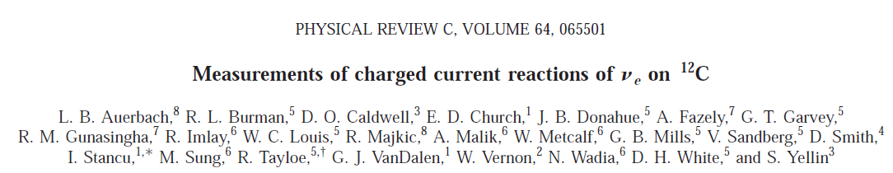
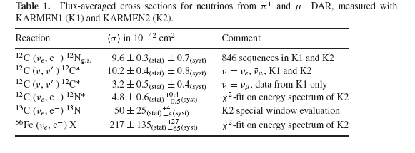
ν-reaction (2 step)
Data in Low E. region: KARMEN/LSND/CC and NC
Cheoun, Phys. Rev. C 81, 028501 (2010)
LSND : ν_{e}¹²C -> e- + ¹²N*
(1⁺⁾
More data from
JSNS² at JPARC ?
Notes:
Before the explanation, I want to show the result of the reaction for 12C target. LSND presented one valuable data for the X-section about 20 years ago.
They measured the neutrino X-section exclusively for the 1^+ excited state in 12N up to about 55 MeV. In fact, this the only available data we can get up to the present.
Since the 1^+ state corresponds to the GT excitation, we calculated the GT transition contribution in the X-section and compared to the data. We obtained reasonable results as shown here. SM calculations were also done by Suzuki san and showed a good agreement with the data.
There are other data from KARMEN and other old experiments. But most of them are averaged data by the neutrino flux.
Now the JSNS2 project is in progress. We expect lots of valuable data for these neutrino-induced reactions.

Slide 14
Contents
Motivation
Neutrino Process in Supernova Explosion
Neutrino Oscillation in vacuum and matter, and neutrino Self-Interaction in the Neutrino Process
Neutrino-induced Reactions by QRPA
Dependence on Neutrino Luminosity
Heavy Elements (⁹²Nb,⁹⁸Tc,¹³⁸La,¹⁸⁰Ta …)
Light Elements (⁷Li,¹¹Be…) & Ratios
of ⁷Li/¹¹B and ¹³⁸La/¹¹B
Cosmological origin of ¹⁰Be
Sterile Neutrinos & Shock Effects in Neutrino Process
Summary
O-rich
Core
Core
Si
O-rich
O/C
He/C
Notes:
This is the contents of my talk. After short motivation of this study, I shortly summarize the origin of elements.
Since then, I focus on the neutrino-process and some physics relevant to the neutrino-process.
After that I will discuss the results of the abundances of some specific nuclei which are believed to be produced by the neutrino-process, such as 138La, 11Be et ce.
If I have time enough, I also discuss recent interesting physics, sterile neutrino in the aspect of the neutrino-process.

Slide 15
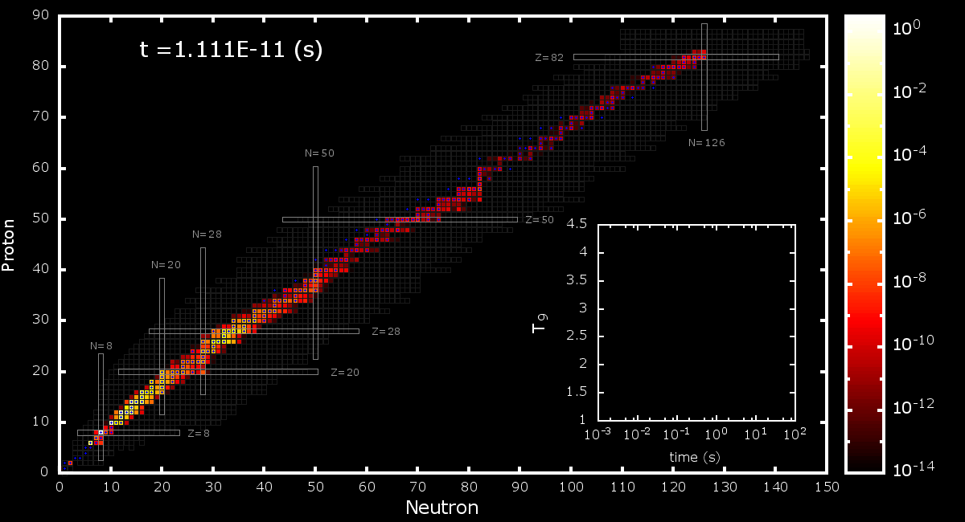
Numerical results for elements abundances
JINA REALIB
Modified (n,g) Reactions
QRPA & Branching Ratios
1987 SN model
Pre-supernova Model
Hydrodynamics Model: HCK18, KCK19
Modified Neutrino Flux by Self-interaction : w/ and w.o/
Neutrino Luminosity : EQ and NEQ
Mass Hierarchy : NH and IH
Notes:
Before the results, I present the database used for the calculation. These are the data bases for the thermal nuclear reactions.
Others are related to SN simulation. We exploited 1987SN model, pre-supernova model from Kyushu and Tokyo group, and two different hydrodynamics.
These models are crucial to these physics …

Slide 16
w/o SI
NEQ & IH
w/ SI
Notes:
Now I will show one of the numerical results, which are for 98Tc and 92Nb cases.
These figures show the abundances in terms of the mass coordinate, wher we used a simple luminosity for grasping the physics.
Since the seed heavy nuclei were inside of the pre-SN, heavy nuclei are mainly produced at inner part by the neutrino process.
First, we can check the SI effect. If we allow the SI interaction, the abundances of 92Nb and 98Tc are decreased because of the decrease of the electro-neutrino flux. Integration of the mass fractions give us these numbers and show the change by the neutrino SI.

Slide 17
#. Extra – Ta180
Neutrino process
Results for Light Elements II
S_p = 0.6
S_p = -0.31
S_n = 3.14
S_n = -1.6
For 7Li, the main reactions are
both e- and anti-e- neutrino reactions via CC
which are larger than NC.
And e-CC reactions through 3He and 7Be
from 4He are larger than anti-e due to MSW.
=> Sensitive on the nu-SI.
But for 11B both electro-
and antielectron-neutrinos via CC and NC work.
=> Insensitive to the nu-SI.
Notes:
Another example is the light nuclei for 7Li and 11B. Light nuclei are mainly produced in the outer side. Therefore, they are very sensitive on the MSW effects of the propagating neutrinos.
These flow charts show the main neutrino reactions for producing 11B and 7Li. We can investigate roles of each neutrino reaction as well as the other nuclear reactions.
I will skip detailed explanations. But at the last of this talk, l will show one example of the importance of each nuclear reaction channel.

Slide 18
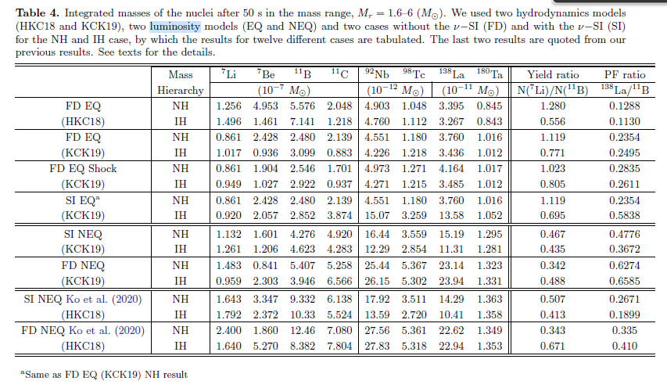
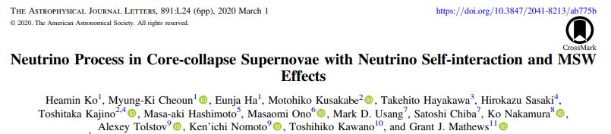
Hydrodynamics : HKC18 and KCK19
Luminosity : EQ and NEQ
Neutrino Self Interaction : FD and SI
Mass Hierarchy : NH and IH
Notes:
Here we summarize the results. These are the results for the 18 cases. The lowest two rows are the results published in ApJL 2020.
The blue box is recent calculation.

Slide 19
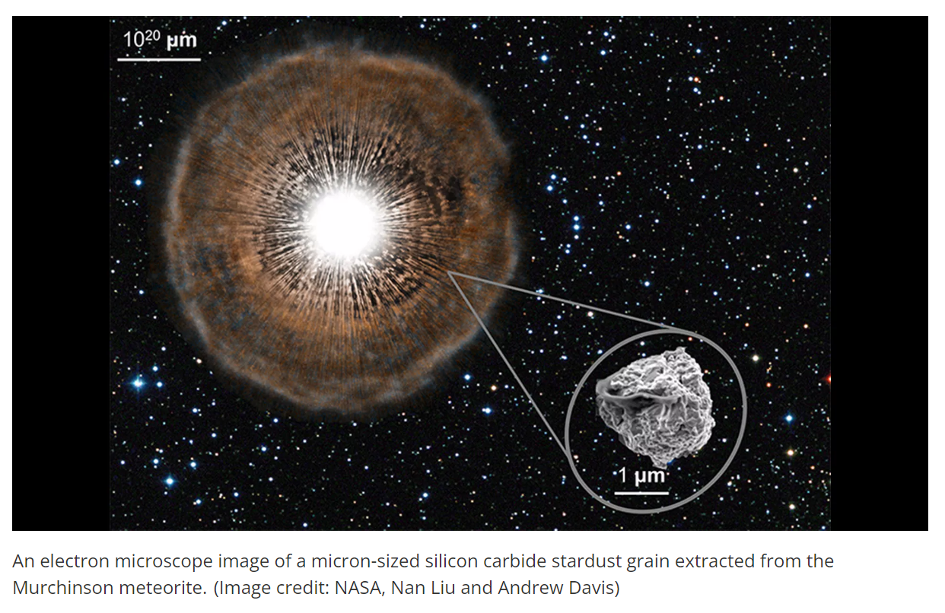
Meteorite Analysis : Analysis of SiC in stardust grain (Pre-solar grain)
from Murchinson meteorite

Slide 20
Mass Fraction ratio of 7Li/11B and PF ration of 138La/11B
The yield ratio of [7Li/11B]
<0.53 (2 sigma)
Spectra | FD | +SI | FD | +SI
Mass Hierarchy | IH | IH | NH | NH
Yield Ratio | 0.671(0.488) | 0.413(0.435) | 0.343(0.342) | 0.507(0.467)
The production factor ratio of [138La/11B]
> 0.41 (lower limit)
Spectra | FD | +SI | FD | +SI
Mass Hierarchy | IH | IH | NH | NH
PF ratio | 0.410(0.6585) | 0.1899(0.3672) | 0.335(0.6274) | 0.2671(0.4776)
Notes:
Here I shortly discuss the meaning of these simulations of the network calculations. These are detailed numbers obtained in the present calculation. Results in the parentheses are the recent KCK results.
Detailed comparison with the available data from meteorite analysis are done here.
First is the ratio of 7Li/11B, which observational data are taken from the meteorite analysis of SiC grains which are -0.31 +- 0.42 and the upper limit is 0.53 within 2 sigma level.
NH is favored for the case including the SI if you compare red arrows. Both hydrodynamics are favored.
Furthermore, the ratio of 138La/11B is critical, which shows the lowest minimum value 0.41. The results by the SI with NEQ is favored for the NH.
In conclusion, the NH is favored if we include the SI and the realistic luminosity.

Slide 21
NH is favored !!!
However, is this the last story ? but the least ??? Other effects ?
Sterile Neutrino,
Magnetic field,
Polarized Electron Density
Neutrino Fast Oscillation..

Slide 22
Contents
Motivation
Neutrino Process in Supernova Explosion
Neutrino Oscillation in vacuum and matter, and neutrino Self-Interaction in the Neutrino Process
Neutrino-induced Reactions by QRPA
Dependence on Neutrino Luminosity
Heavy Elements (⁹²Nb,⁹⁸Tc,¹³⁸La,¹⁸⁰Ta …)
Light Elements (⁷Li,¹¹Be…) & Ratio of ¹¹B/¹³⁸La
Cosmological origin of ¹⁰Be
Sterile Neutrinos & Shock Effects in Neutrino Process
Summary
O-rich
Core
Core
Si
O-rich
O/C
He/C
Notes:
Now let me go the main topic, neutrino process.

Slide 23
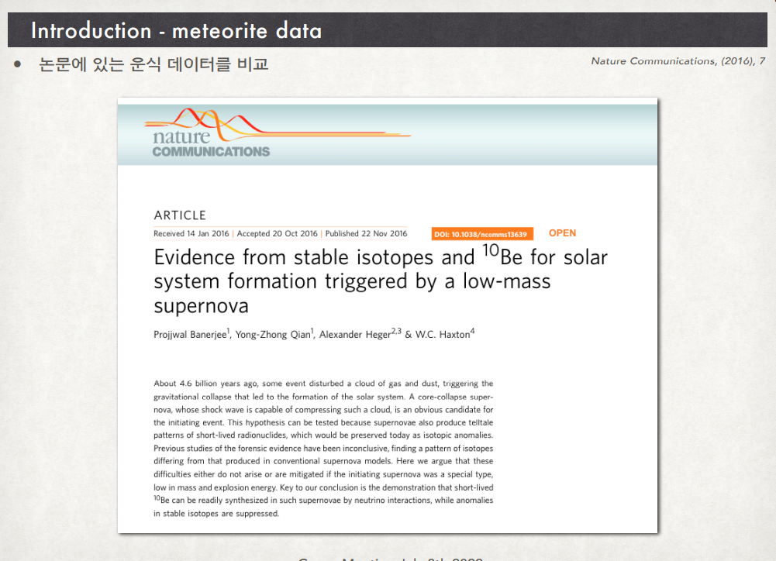
10Be can produced from the SN !
Notes:
Here we have one Nature communication paper. They reported that 10Be can be produced by the SN neutrino-process.

Slide 24
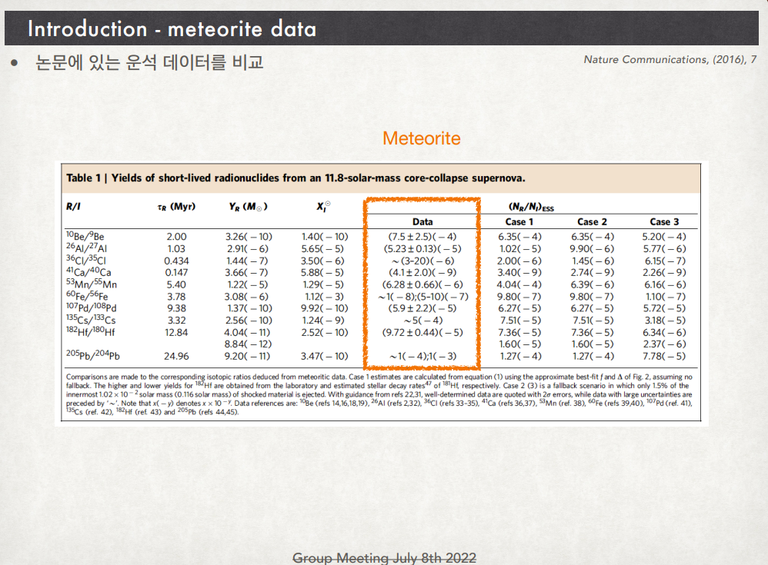
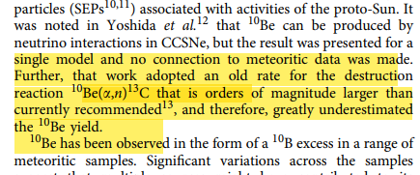
They reported that the data of the ratio 10Be/9Be was obtained from the meteorite analysis.
Note that 10Be is unstable and 9Be is stable.
But previous calculation predicted that 10Be cannot be produced by the neutrino-process
because the destruction channel 10Be(a,n)13C was overestimated i.e. 10Be was destructed fully.
Notes:
They reported that the data of the ratio 10Be/9Be was obtained from the meteorite analysis.
Note that 10Be is unstable and 9Be is stable.
But previous calculation predicted that 10Be cannot be produced by the neutrino-process
because the destruction channel 10Be(a,n)13C was overestimated. That is 10Be was fully destructed by this (a,n) reaction.

Slide 25
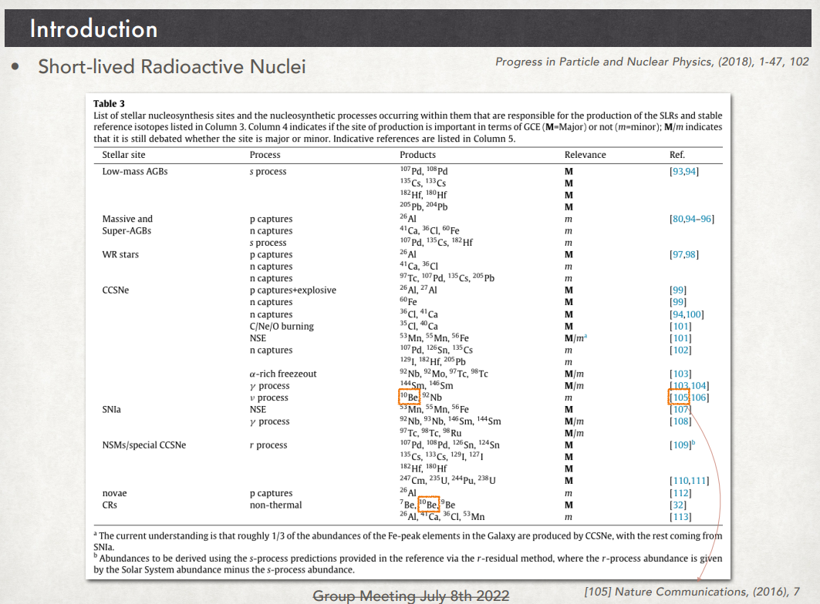
But, even if we use the correct rate for the (a,n) reaction,
the production rate is smaller than the production by the cosmic ray, which
is a kind of the spallation by cosmic rays.
That is the reason why the main mechanism is the spallation by the CR. Is it true?
Notes:
But, even if we use the correct rate for the (a,n) reaction,
the production rate is smaller than the production by the cosmic ray, which
is a kind of the spallation by cosmic rays.
That is the reason why the main mechanism is the spallation by the CR in the Nature paper. But we have one question. Is it true?

Slide 26
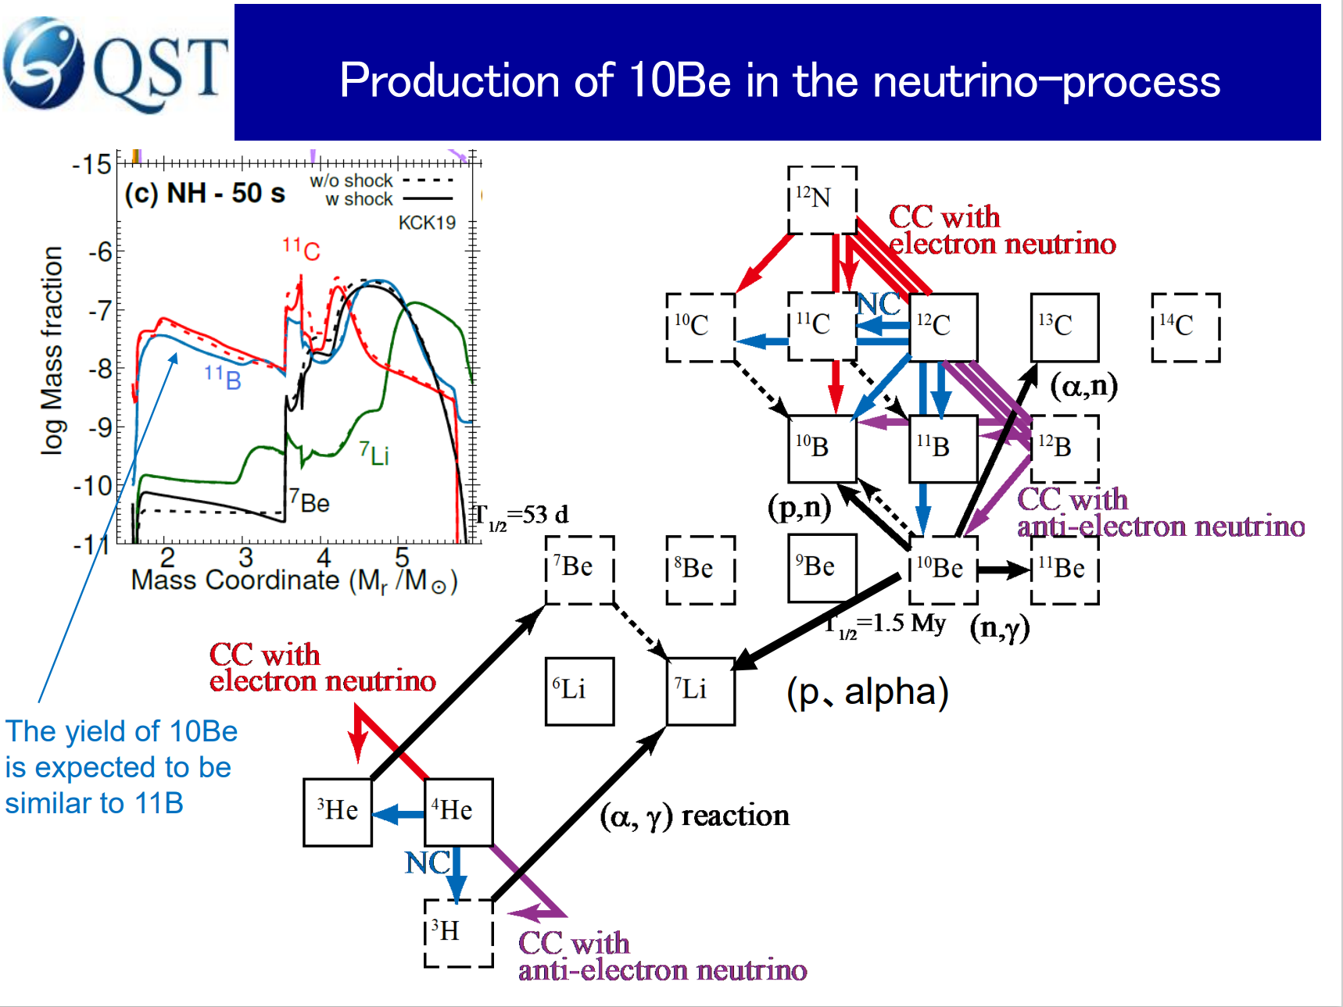
Destruction Reactions (a,n) and (p,a) are fixed
by data and new calculations.
But the problem remained is the (p,n) reaction
and its inverse reactions,
because we do not have data and
theoretical calculations are still questionable.

Slide 27
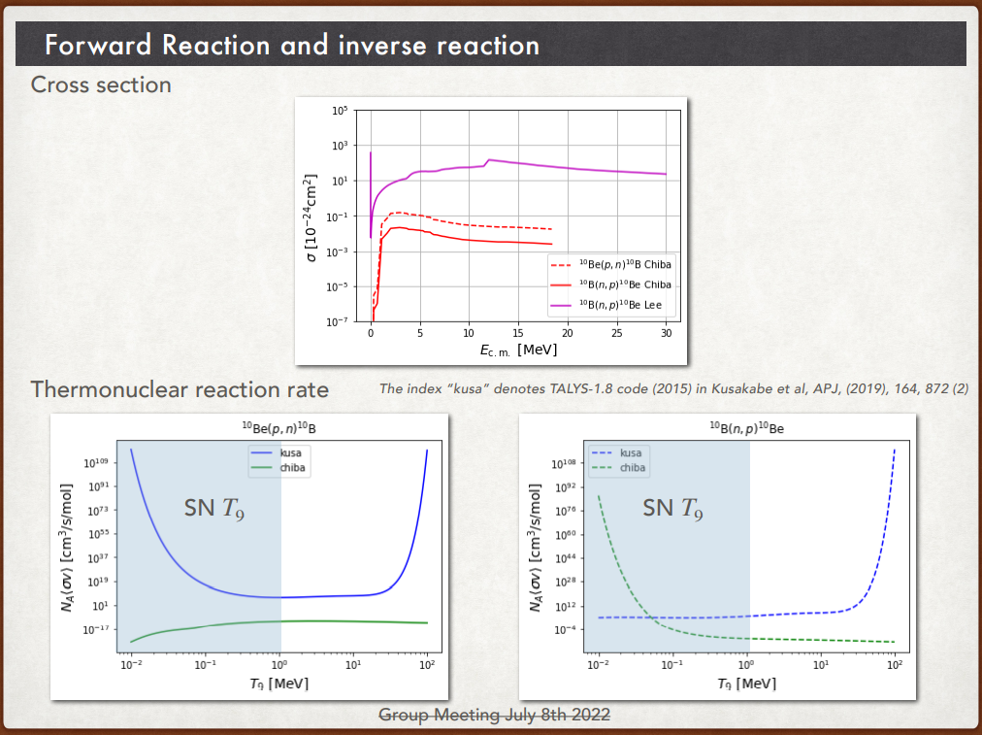
If we use the new data for the (n,p) and (p,n) reactions deduced from JENDL data,
The destruction becomes small, and the construction is larger than those by the Talys. Be10 abundance is up !!
Notes:
These figures show the difference of those reactions from Talys and from JENDL data, respectively.
If we use the new data for the (n,p) and (p,n) reactions deduced from JENDL data,
The destruction becomes small, and the construction is larger than those by the Talys. Be10 abundance is up !!

Slide 28
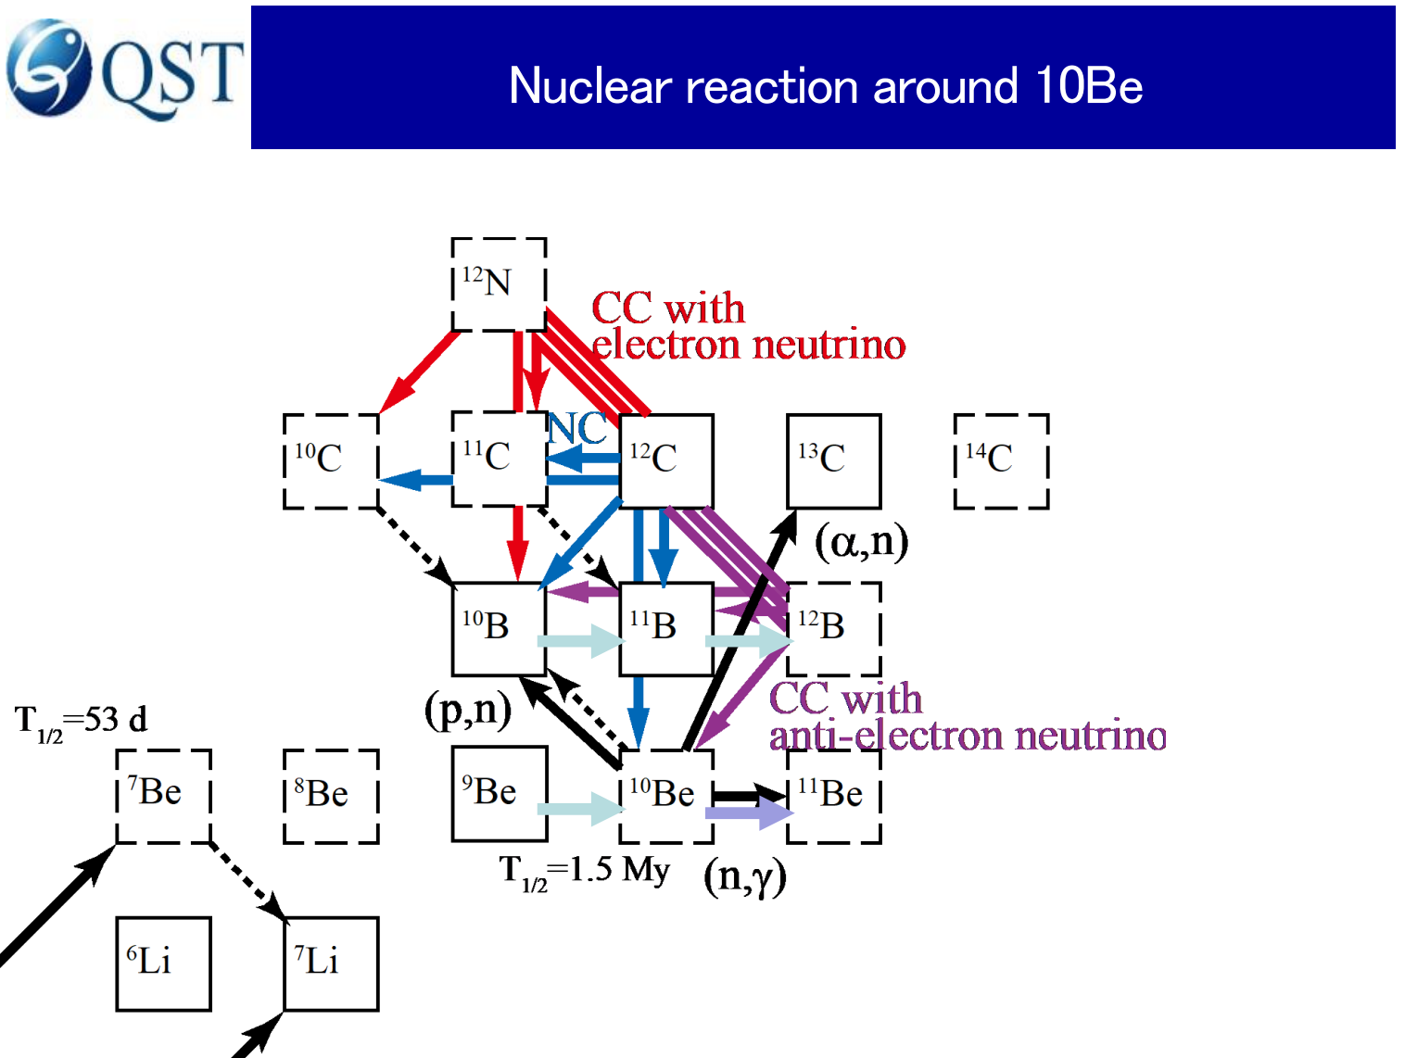
However, there are other production channels
from Be and B, for example, 11Be(g,n)10Be….

Slide 29
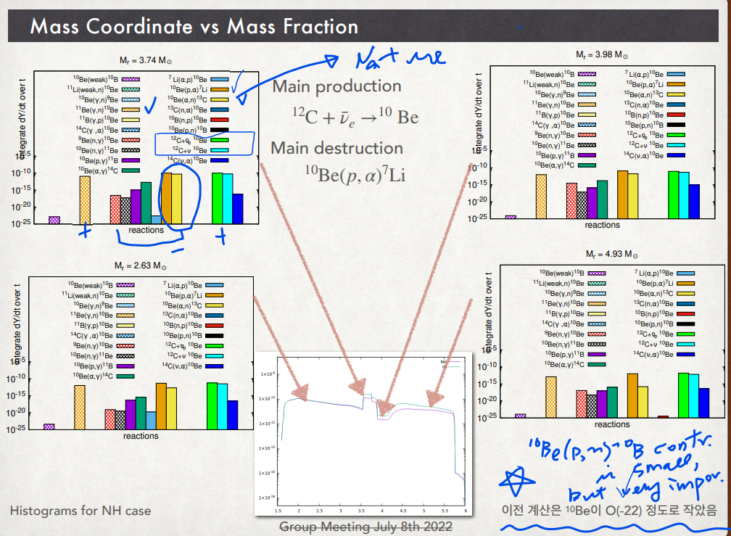
Notes:
These figures show the main nuclear reactions for the production of 10Be. Main productions come from the neutrino reactions, as I told you.
But there are destruction mechanisms by (a,n) and (p,a) from 10Be. They are compete with each other. Moreover the (p,n) and (n,p) reactions are also important because it is related to the change of the seed nuclei in the pre-supernova model.

Slide 30
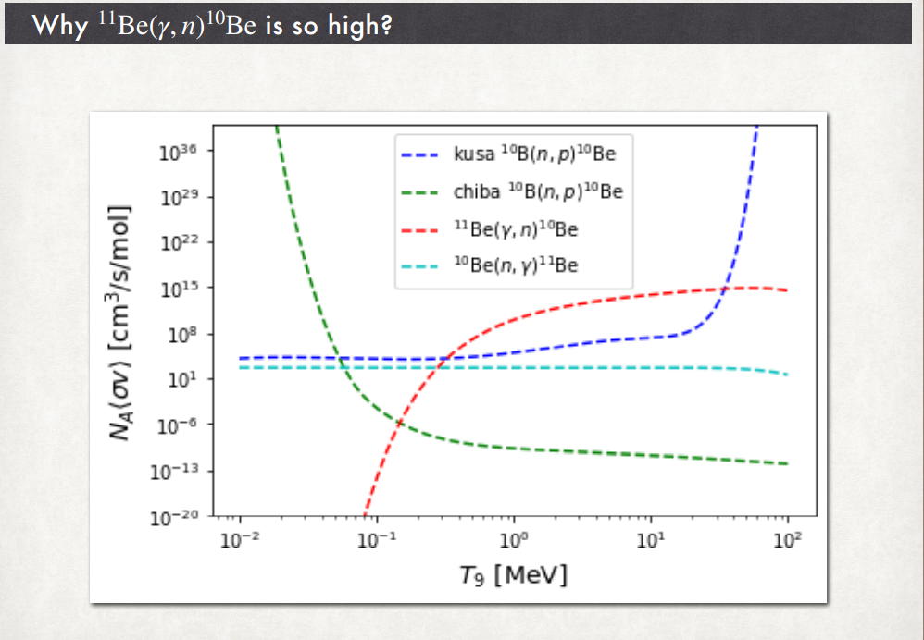
We used the (n,g) data from NNDC and calculated reverse reaction by the balance equation.
The contribution turns out to be critical for the 10Be production process.
Of course, we need experimental data to justify these reactions.
Notes:
We used the (n,g) data from NNDC and calculated reverse reaction by the balance equation.
The contribution turns out to be critical for the 10Be production process.
Of course, we need experimental data to justify these reactions.
Please remember that 11Be is a typical one neutron halo nucleus.
We expect the large effects by the photo disintegration of 11Be, which will affect largely the production of 10Be.

Slide 31
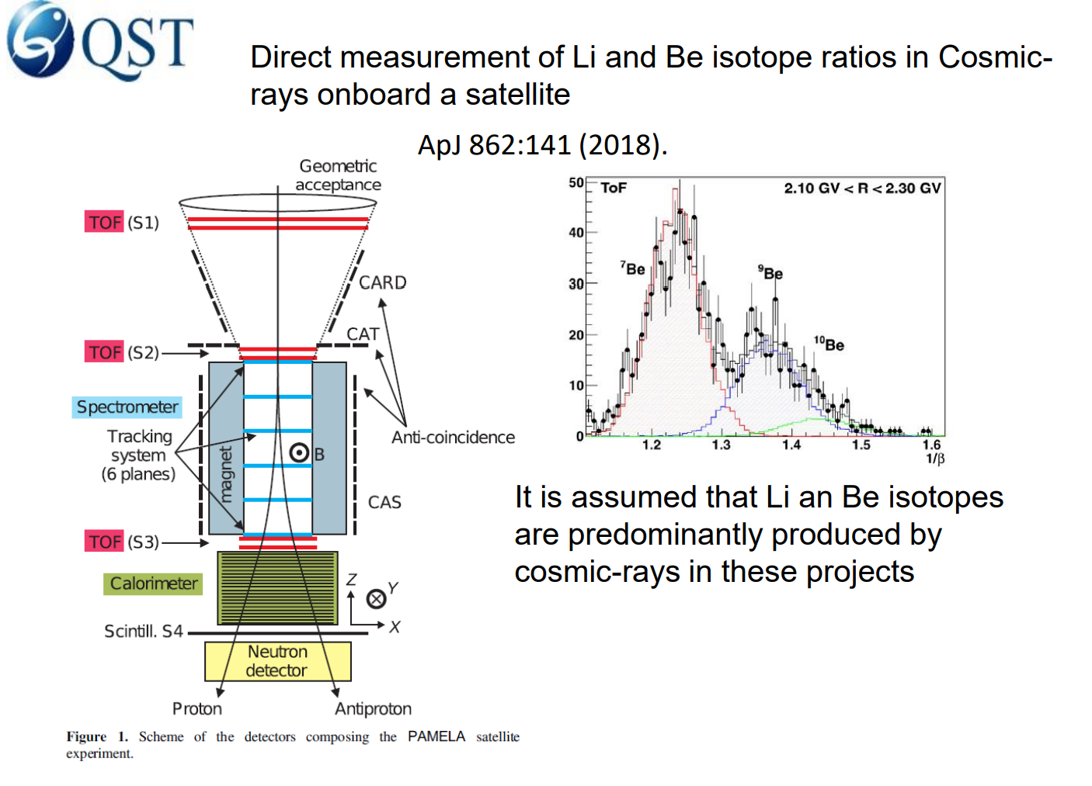
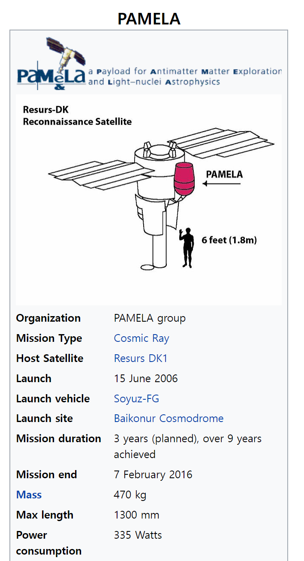

Slide 32
Contents
Neutrino Process in Supernova Explosion
Neutrino Oscillation in vacuum and matter, and neutrino Self-Interaction in the Neutrino Process
Neutrino-induced Reactions by QRPA
Dependence on Neutrino Luminosity
Heavy Elements (⁹²Nb,⁹⁸Tc,¹³⁸La,¹⁸⁰Ta …)
Light Elements (⁷Li,¹¹Be…) & Ratio of ¹¹B/¹³⁸La
Sterile Neutrinos & Shock Effects in Neutrino Process
Summary
O-rich
Core
Core
Si
O-rich
O/C
He/C

Slide 33
Dependence of the Neutrino Process on the Shock Effects

Slide 34
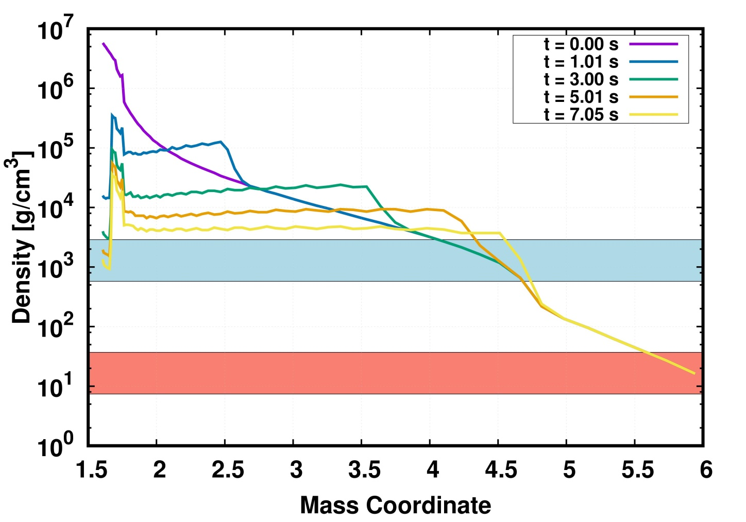
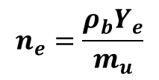
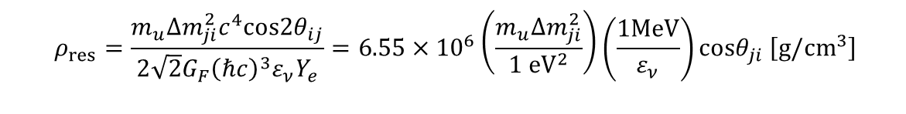


Neutrino process
MSW Effects by Shock W. & Hydrodynamics
Flavor change resonance density [Yoshida et. al. APJ (2006)]
$$n_{e}=\frac{ρ_{b}Y_{e}}{m_{u}}$$
$$ρ_{res}=\frac{m_{u}Δm_{ji}^{2}c^{4}cos2θ_{ij}}{\begin{aligned}2\sqrt{2}G_{F}{\left(ℏc\right)}^{3}ε_{ν}Y_{e} \\ \end{aligned}}=6.55×{10}^{6}\left(\frac{m_{u}Δm_{ji}^{2}}{1 {eV}^{2}}\right)\left(\frac{1MeV}{ε_{ν}}\right)cosθ_{ji} \left[g/cm^{3}\right]$$
Hydrodynamics by A. Tolstov
HKC18
resonance
$$ε_{ν}=10 MeV$$
$$ε_{ν}=50 MeV$$
KCK18

Slide 35
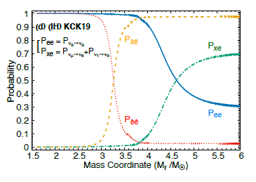
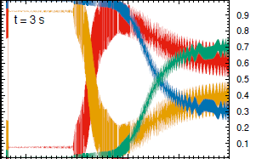
Landau-Zener crossing formula
= Adiabatic parameter
KCK19
In NH, nu_e has a resonance giving high energy nu_e.
In IH, nu_bar_e has a resonance.
But the shock effects
reverse the trend !!

Slide 36
Neutrino Process and
Sterile Neutrino

Slide 37
We found that there is a resonance
for s- and e-neutrino around 1.6 M_sol.
This provides the energetic e-neutrino
which may affect the neutrino reaction
rate.
But it depends on the scenario
of sterile neutrino luminosity.
The 1st scenario is zero luminosity of
sterile neutrino only with mixing.
The 2nd is equivalent luminosity with
the mixing. But the s-neutrino may
decouple by the s-neutrino interactions
with electrons.

Slide 38
1. Sterile neutrino (3+1 model) decreases heavy elements production in the inner region makes them depend on the mass hierarchy.
2. Light elements are produced in the inner region and depend on the MH through the MSW effect.
3. 7Li is produced by e-neutrino which is increased in NH, but 11B is affected by both neutrinos.
4. In the 1st scenario, only IH is allowed in 3 sigma level for 3 model. The 3+1 model is excluded.
1st scenario (zero luminosity) but with
the mixing
2nd scenario (equi-luminosity) with
the mixing
O.K.
????
????

Slide 39
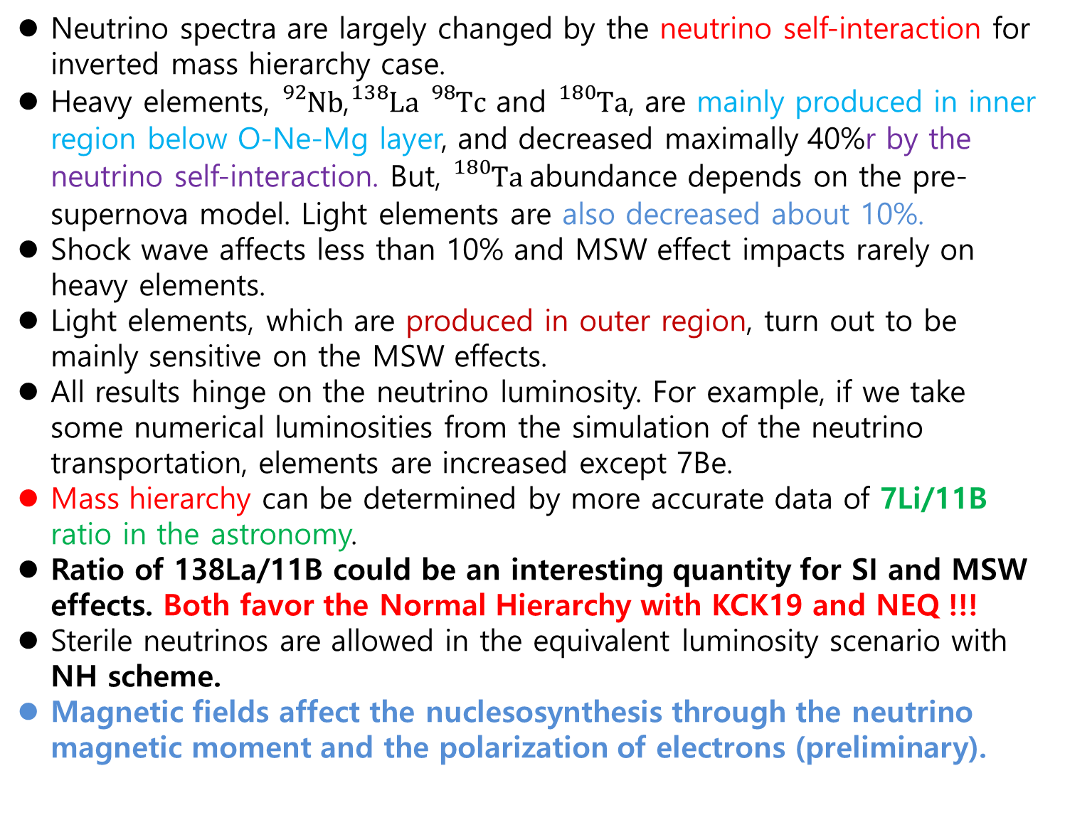
#. Extra – Ta180
Summary
Neutrino process
Summary
Neutrino spectra are largely changed by the neutrino self-interaction for inverted mass hierarchy case.
Heavy elements, ${}_{}^{92}{Nb}$,${}_{}^{138}La$ ${}_{}^{98}Tc$ and ${}_{}^{180}Ta$, are mainly produced in inner region below O-Ne-Mg layer, and decreased maximally 40%r by the neutrino self-interaction. But, ${}_{}^{180}Ta$abundance depends on the pre-supernova model. Light elements are also decreased about 10%.
Shock wave affects less than 10% and MSW effect impacts rarely on heavy elements.
Light elements, which are produced in outer region, turn out to be mainly sensitive on the MSW effects.
All results hinge on the neutrino luminosity. For example, if we take some numerical luminosities from the simulation of the neutrino transportation, elements are increased except 7Be.
Mass hierarchy can be determined by more accurate data of 7Li/11B ratio in the astronomy.
Ratio of 138La/11B could be an interesting quantity for SI and MSW effects. Both favor the Normal Hierarchy with KCK19 and NEQ !!!
Sterile neutrinos are allowed in the equivalent luminosity scenario with NH scheme.
Magnetic fields affect the nuclesosynthesis through the neutrino magnetic moment and the polarization of electrons (preliminary).

Slide 40
Thanks
for
your
attention !

