Slide 1
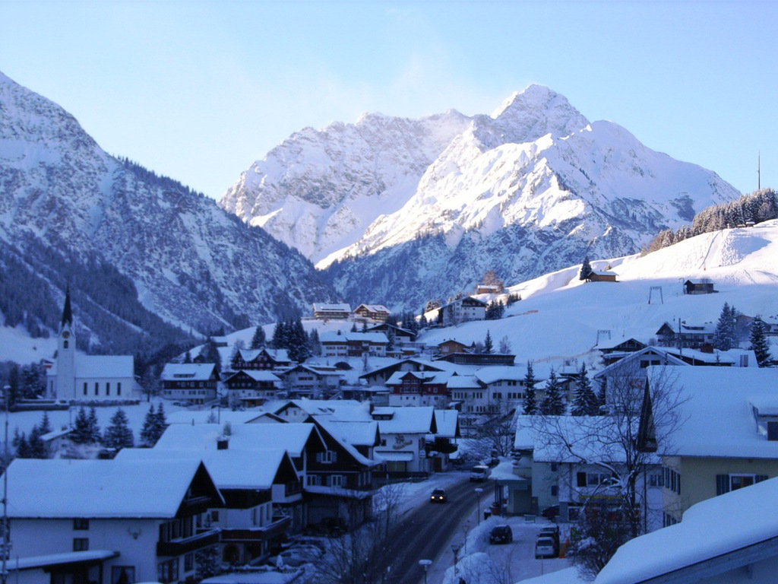
Two non-equilibrium problems in heavy-ion collisions:
Critical dynamics & Sphaleron transitions
Raju Venugopalan
BNL/Heidelberg
Hirschegg 2016, January 17-22, 2016

Slide 2
Outline
Non-equilibrium dynamics of two situations of interest in heavy-ion collisions:
Real time dynamics of critical fluctuations in the vicinity of a critical point
– relevant for a Beam Energy Scan of the QCD phase diagram
(with Swagato Mukherjee and Yi Yin)
Sphaleron transitions in an overoccupied non-Abelian plasma (the Glasma)
– relevant for searches for the Chiral Magnetic Effect
(with Mark Mace and Soeren Schlichting)

Slide 3
Non-equilibrium dynamics in vicinity of critical point
In HI collisions, trajectories close
to a critical point experience large
fluctuations in moments of the order
parameter
Depending on the static universality
class, these moments (and conserved
charges they couple to) can display
non-monotonic behavior across the CP

Slide 4
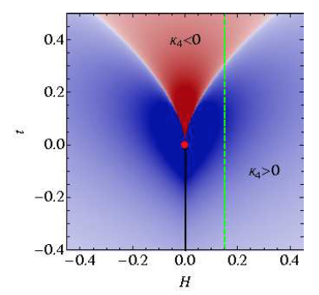
Non-equilibrium dynamics in vicinity of critical point
Example: sign of kurtosis, in the universality
class of the 3-D Ising model in the crossover
regime
Stephanov,arXiv:1104.1627

Slide 5
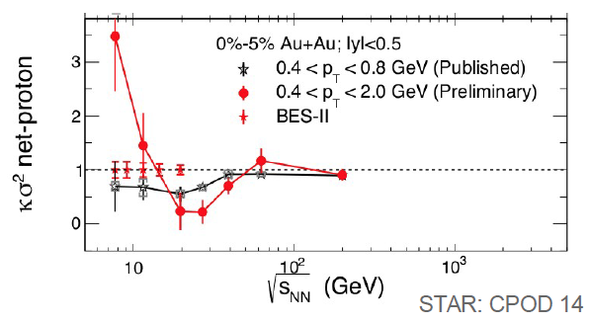
Non-equilibrium dynamics in vicinity of critical point
Hints seen in HI experiments
-strong motivation for BES II
However: close to the CP, systems
experience critical slowing down
τ_{eff ~} ξ ^{z}
z represents a dynamical universality class
HH -> Hohenberg,Halperin, Rev.Mod.Phys. 49, 435 (1977)
For QCD, ``model H” in HH classification scheme,
z =3 – strong dependence on ξ
Son,Stephanov, hep-ph/0401052
Fujii, hep-ph/0302167
Moments of critical field in trajectories close to the CP will deviate significantly
from equilibrium expectations -- what can we expect ?
Such trajectories will likely retain strong memory effects at freeze-out

Slide 6
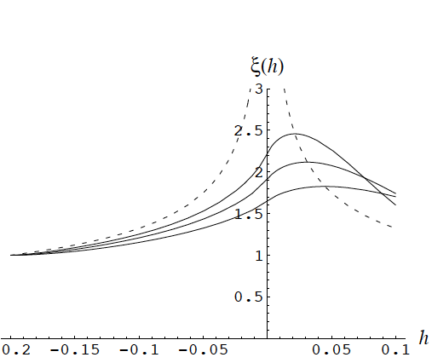
Non-equilibrium dynamics in vicinity of critical point
Previous study:
Berdnikov,Rajagopal,hep-ph/9912274
This expression is reproduced in a Gaussian model for
the effective action for the critical field
-- equilibrium values of higher cumulants are zero
We will consider here a more general formulation that extracts non-trivial
non-equilibrium dynamics of higher cumulants of interest
Mukherjee,Venugopalan,Yin, arXiv:1506.00645, arXiv:1512.08022

Slide 7
Critical fluctuations in equilibrium
Critical fluctuations in equilibrium described by
with
where σ is the zero mode of the critical field , with m_{σ} = ξ⁻¹_{eq}
– linear combination of chiral condensate & baryon density
Son,Stephanov, hep-ph/0401052
Work in regime with expansion parameter
- drop kinetic term σ²/L² << σ²/ξ²_{eq}

Slide 8
Critical fluctuations in equilibrium
Critical fluctuations in equilibrium described by
with
where σ is the zero mode of the critical field , with m_{σ} = ξ⁻¹_{eq}
– linear combination of chiral condensate & baryon density
Son,Stephanov, hep-ph/0401052
Work in regime with expansion parameter
- drop kinetic term σ²/L² << σ²/ξ²_{eq}
Compute cumulants
Magnetization: M_{eq} = σ₀ ~ ξ^{-1/2}_{eq}
Variance: κ₂~ ξ²_{eq}
Non-Gaussian cubic and quartic cumulants: κ₃~ ξ^{9/2}_{eq} , κ₄ ~ ξ⁷_{eq}
Stephanov, hep-ph/0809.3450

Slide 9
Evolution equations for cumulants
Diffusive properties of critical mode can be
described by the Fokker-Planck equation
For ε < 1 can re-express as closed form expressions for cumulants
P_{n} – polynomials of the magnetization and lower (n-1) moments

Slide 10
Evolution equations for cumulants
P_{n} – polynomials of the magnetization and lower (n-1) moments
For Gaussian fluctuations, reproduce Berdnikov-Rajagopal results

Slide 11
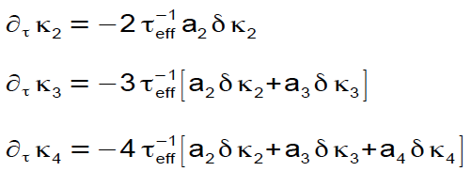
Evolution equations for cumulants
P_{n} – polynomials of the magnetization and lower (n-1) moments
For Gaussian fluctuations, reproduce Berdnikov-Rajagopal results
Near equilibrium: δκ_{n} = κ_{n} - κ_{n}^{eq}
Higher cumulants relax more
slowly to equilibrium…

Slide 12
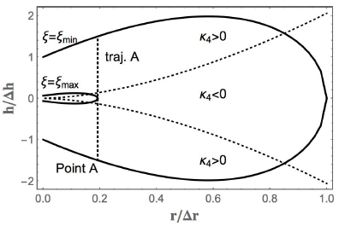
Initial condition: fixing parameters from universality
Fix equilibrium parameters from universality
with 3-D Ising model
Zinn-Justin, hep-th/0002136
r & h are reduced temperature and magnetic
field respectively
τ_{rel} is relaxation time
at outside edge of
critical region
Choose ξ_{max} / ξ_{min} = 3

Slide 13
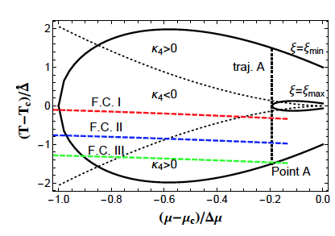
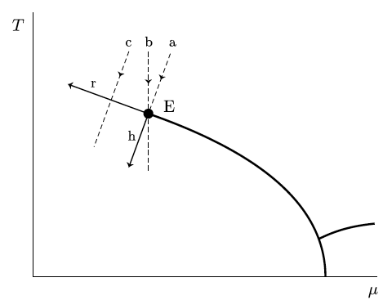
Initial condition: map to QCD critical region
Map to QCD phase diagram: (r,h) ➔ (T,μ)

Slide 14
Initial condition: map to QCD critical region
Map to QCD phase diagram: (r,h) ➔ (T,μ)
Space-time evolution of heavy-ion fireball:
n_{V} =3 for Hubble expansion; also choose c_{s}² = 0.15
τ_{rel} is the relaxation time of the critical mode at the boundary of critical region
τ_{I} is the initial time at which the system enters the
critical region
Reasonable guess: τ_{rel} = 1 fm, τ_{I} = 10 fm
Free parameter τ_{rel} / τ_{I}

Slide 15
Results: memory effects on cumulants
equil.
τ_{rel} / τ_{I} =0.005
F.C I
F.C II
F.C.III
0.02
0.05
0.2
Increasing deviation and even change in magnitude with increasing τ_{rel} / τ_{I}
Freeze-out curves from parametrization of particle ratios
Cleymans,Oeschler,Redlich,Wheaton, hep-ph/0511094

Slide 16
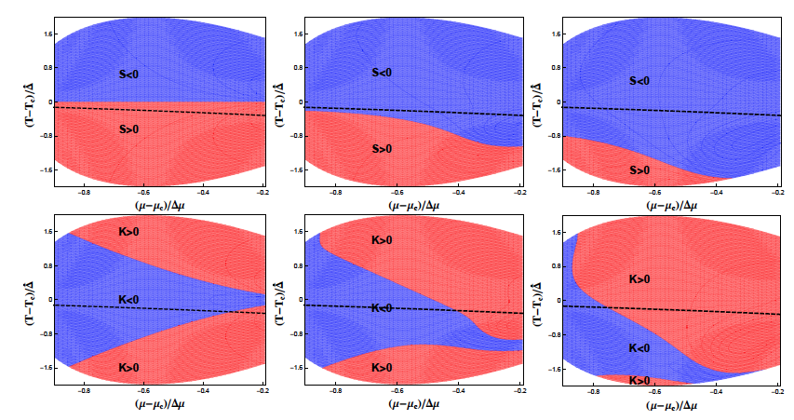
Results: memory effects on cumulants
Equilibrium
τ_{rel} / τ_{I} =0.05
τ_{rel} / τ_{I} =0.2
Skewness (top) and Kurtosis (bottom) can change sign for a given μ
depending on value of τ_{rel} / τ_{I}

Slide 17
Cumulants at fireball freeze-out
Mukherjee,Venugopalan,Yin,1512.08022
Different combination of freeze-out curves and relaxation times
… can give similar results
μ (√s ) ~ 1/√s again from particle ratios at freeze-out
Cleymans,Oeschler,Redlich,Wheaton, hep-ph/0511094

Slide 18
Summary of first study
Critical slowing down suggests that non-equilibrium dynamics and memory effects will play an important role if the width of the critical region is sizeable
Skewness and kurtosis change significantly in magnitude and sign depending on the relaxation time of the diffusive mode, lifetime of system, and freeze-out location relative to the critical point
Comparisons with experiment, in particular inference of critical behaviour,
require theory uncertainties (from lattice simulations to quantitative modeling of fireball trajectories) be nailed down
(BEST Topical Collaboration: co-Pis Swagato Mukherjee + Volker Koch)

Slide 19
Study II: Sphaleron transitions in the Glasma
(with Mark Mace and Soeren Schlichting, to appear this week)
Color Glass
Condensates
Initial
Singularity
Glasma
sQGP -
perfect fluid
Hadron
Gas
Glasma: over-occupied non-equilibrium plasma characterized initially by a large scale Q_{S}

Slide 20
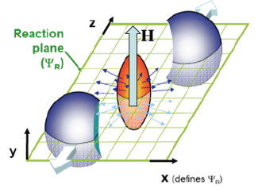
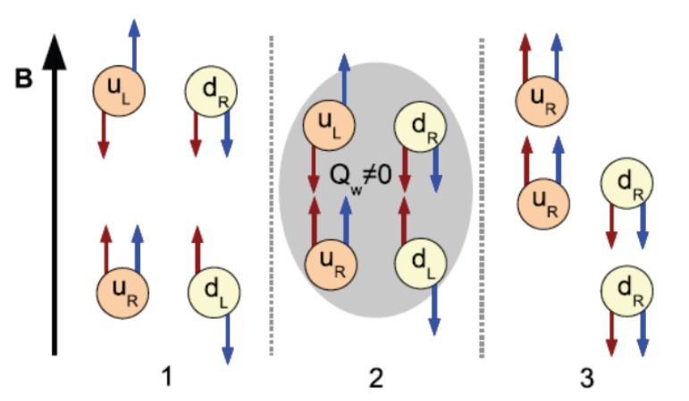
Motivation: the Chiral Magnetic Effect
Original idea: Topological transitions in the presence of an external magnetic field
can generate an induced current with measurable consequences
Kharzeev,McLerran,Warringa, arXiv: 0711.0950
Fukushima,Kharzeev,Warringa, arXiv:1002.2495
Data from STAR, PHENIX and ALICE on opposite charge versus same charge correlations can be interpreted as providing hints of the CME
But no first principles computation…

Slide 21
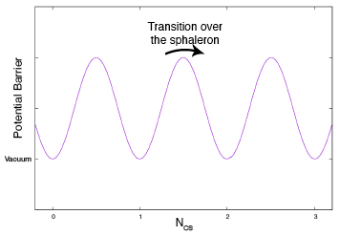
Sphaleron transitions in QCD
Sphaleron: spatially localized, unstable finite energy classical solutions
(σφαλεροs -``ready to fall”)
EW theory: Klinkhamer, Manton, PRD30 (1984) 2212
QCD: McLerran,Shaposhnikov,Turok,Voloshin, PLB256 (1991) 451
Chiral Anomaly:
Chern-Simons current:
Chern-Simons #:
Rate of change of CS #
Key quantity: Sphaleron transition rate

Slide 22
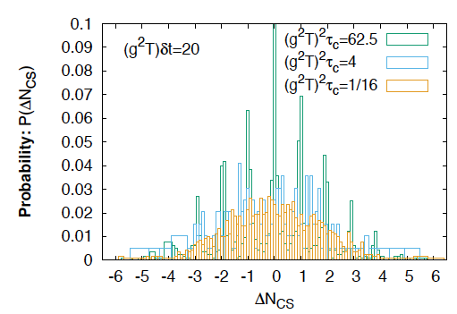
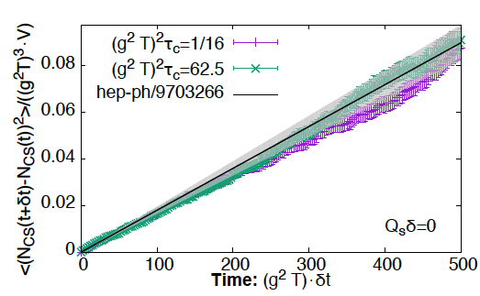
Thermal sphaleron transition rate
Cooled configurations—containing increasingly
soft infrared modes cluster about integer values
of CS #
Reproduce seminal results of Guy D. Moore
Moore, Tassler, arXiv:1011.1167
Parametric form predicted by
Arnold, Son, Yaffe

Slide 23
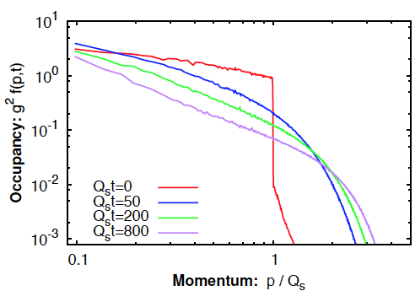
Sphaleron transitions in the Glasma
Large occupancy (for very weak couplings) suggests physics well approximated
by classical-statistical real time simulations of gauge fields
Berges,Scheffler,Sexty,arXiv:0712.3514
Schlichting, atXiv:1207.1450
Kurkela,Moore, arXiv:1207.1663
Berges,Boguslavski,Schlichting,Venugopalan,arXiv:1311.3005
For simplicity, only consider Glasma in a box, and SU(2) gauge theory

Slide 24
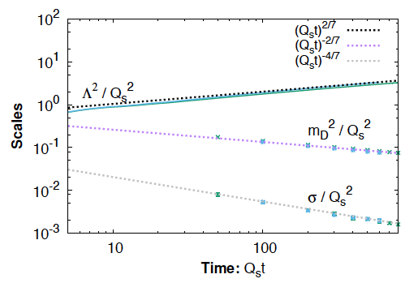
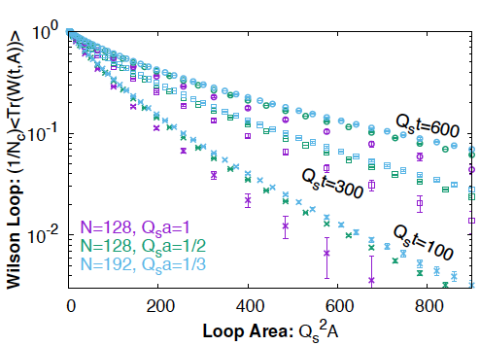
Digression: separation of scales in the Glasma
A (parametrically) one scale Glasma evolves towards the separation of length scales characteristic of a QGP:
T >> gT >> g²T
Trace of spatial Wilson loop obeys area
law – string tension σ sensitive to
Infrared dynamics on magnetic scale

Slide 25
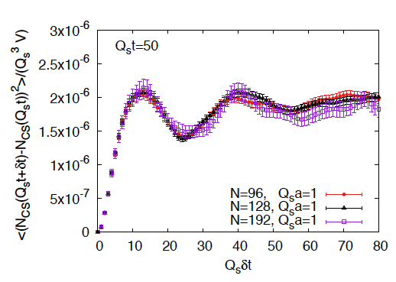
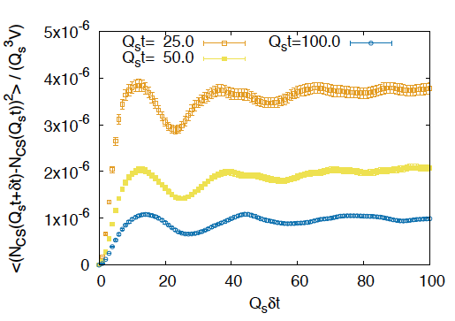
Back to sphaleron transitions
Distinctly un-Markovian behavior at late auto-correlation times…
unlike thermal case

Slide 26
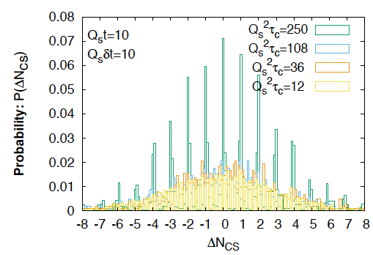
Topology in the Glasma
Clustering around integer valued Chern-Simons number with increased cooling

Slide 27
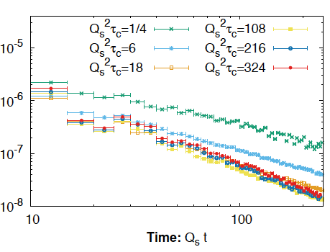
Extracting the non-equil. Sphaleron rate
(Q_{S}t)^{-8/7}

Slide 28
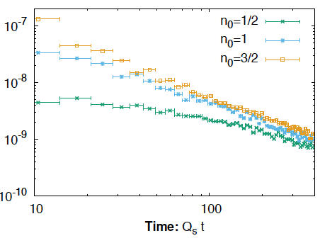
Extracting the non-equil. Sphaleron rate
Independent of occupancy
factor n₀

Slide 29
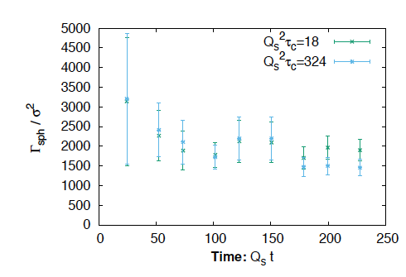
Extracting the non-equil. Sphaleron rate
Γ_{sph} / σ² approximately constant in the Glasma
– closer to the ``naïve” expectations in thermal equilibrium
– unknown if this persists at even later times

Slide 30
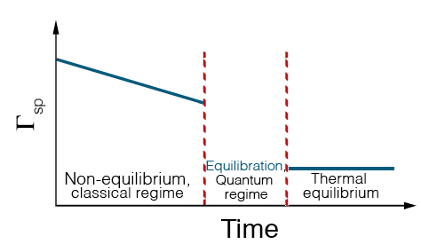
Summary of study II
Topological transitions in the Glasma are large at early times
– parametrically α_{S}⁻⁵ greater than equilibrium rates
Usual problem: extrapolation of rates to larger realistic couplings – computation
provides guidance for such attempts – matching to chiral kinetic theory,
chiral magneto-hydro…?
Technical: SU(3), expanding box, fermions,…, all feasible but manpower and
numerically intensive

