Slide 1
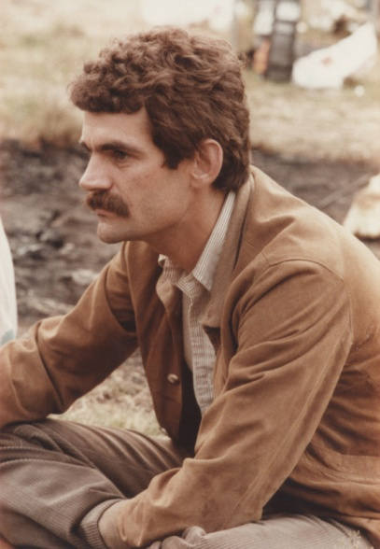
Jochen Wambach Director of ECT* Trento since January first 2016
Studies at Univ. Bonn
1974-79 Dipl. + Ph. D. in Jülich/Bonn
1979-83 Stony Brook
1984-96 Univ. Illinois 1990 Full Prof.
1990-95 Univ. Bonn + Deputy-Director Jülich
1996- Full Prof. TU Darmstadt
2002- 2008 Senat of DFG
2004- Head Theory Group Hadrons +
QCD at GSI.
2015- Academia Europaea
2016- Director of European Centre of Theor.
Physics

Slide 2
Honors and Service of
Jochen Wambach
2003- Fellow of American Phys. Soc.
2002- 2008 Senat of DFG
2007- Editorial B.: European J. of Phys. A
2007- Editorial Board: Phys. Rev. Lett.
2015 elected member of the
Academia Europaea
2016- Director of the ECT* Trento

Slide 3
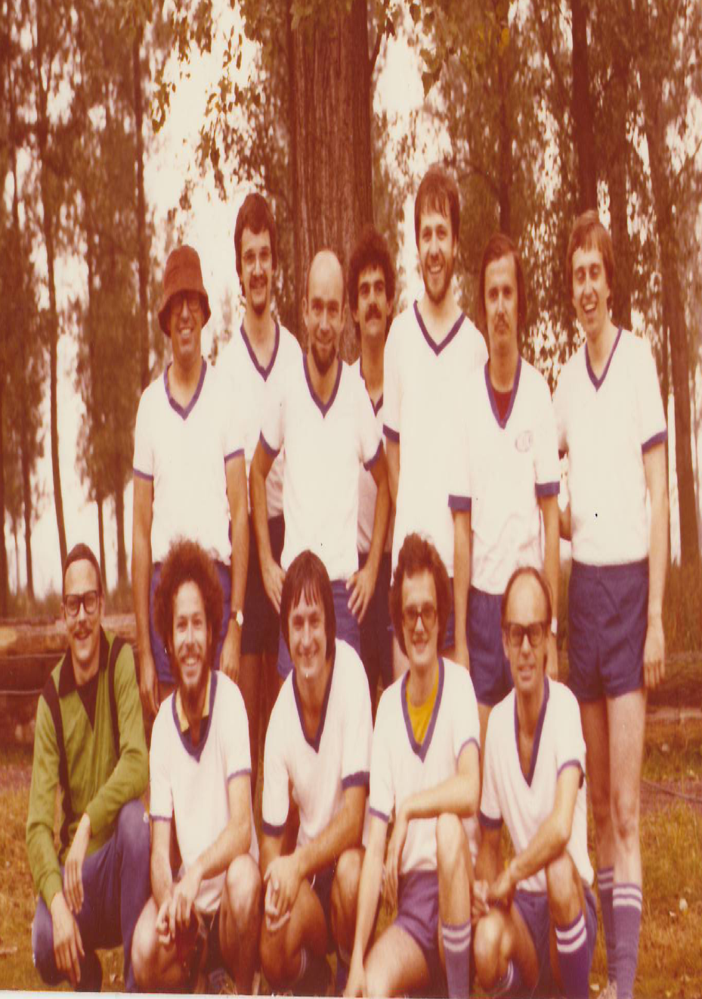
The successful Nuclear Physics Football (Soccer) Team in Jülich-Broich ~1977
Müther, Grümmer
Wambach
Krewald
Faessler
Meyer ter V.
K. W. Schmid
Baur
Osterfeld

Slide 4
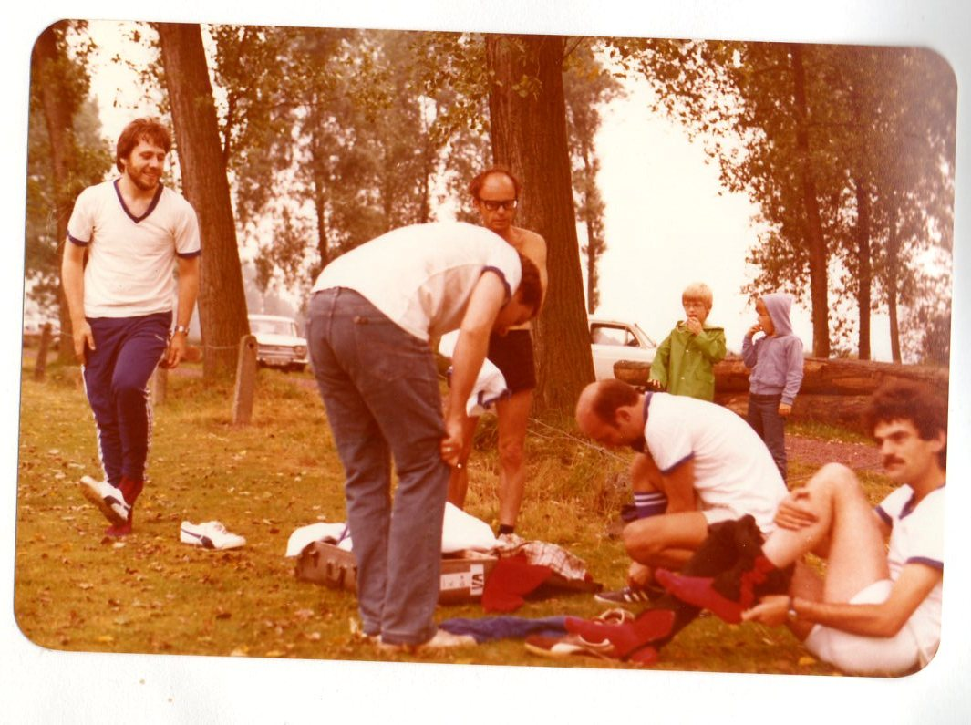
Preparation for the legendary Football
Game in Jülich against Solar Energy ~1977
Müther
Baur
Meyer ter Vehn
Wambach

Slide 5
Search for the Cosmic
Neutrino Background with KATRIN.
Amand Faessler
University of Tuebingen
Germany
Partially based on a common Publication:
Amand Faessler, Rastislav Hodak, Sergey Kovalenko and Fedor Simkovic, J. Physics G, Conf. Ser. 580 (2015) 012040

Slide 6
First: Cosmic Microwave Background Radiation
(Photons in the Maximum 2 mm)
Decoupling of the photons from matter about
300 000 years after the Big Bang, when the electrons are captured by the protons and He4 nuclei and the universe gets neutral. Photons move freely.
Today: ~550 Photons /cm³
(~340 Neutrinos/cm³; 56 left handed electron neutrinos.)

Slide 7
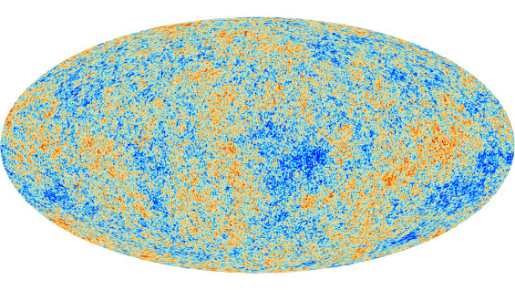
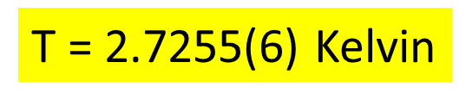
Planck Satellite Temperature Fluctuations
Comic Microwave Background (Release March 21. 2013)
Ε(f) ∝ f³/[exp(hf/k_{B}T)-1][Energy/Volume]

Slide 8
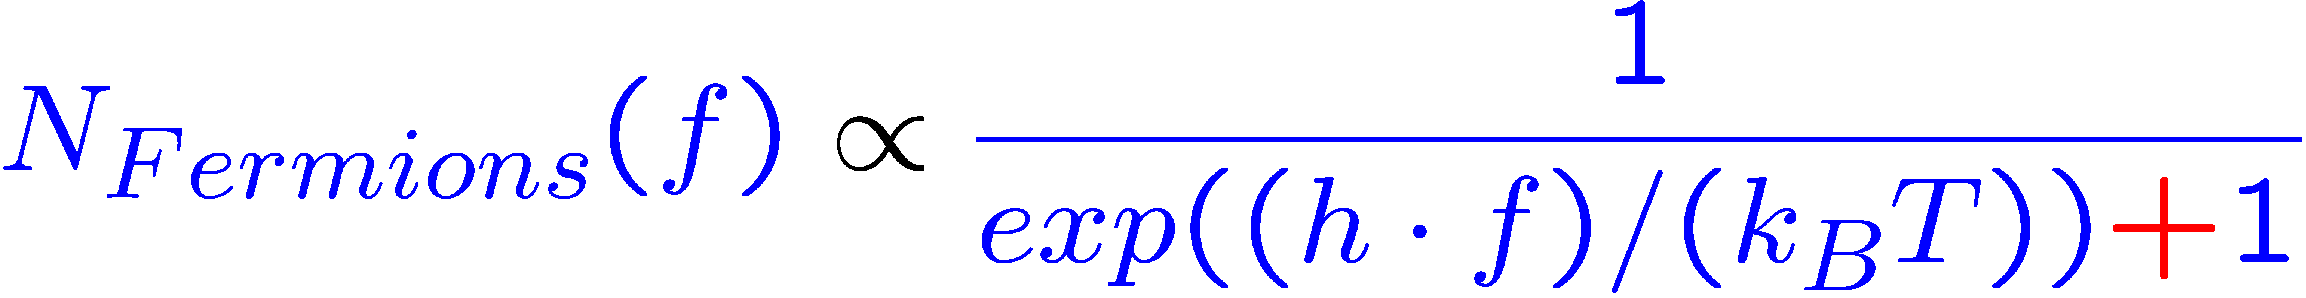
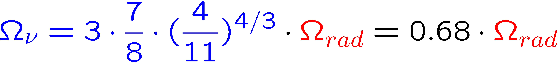
Neutrino Decoupling and
Cosmic Neutrino Background
For massless and massive Neutrinos:
E
Radiation heated up by: e⁺ + e⁻ → γ + γ (Entropy)

Slide 9
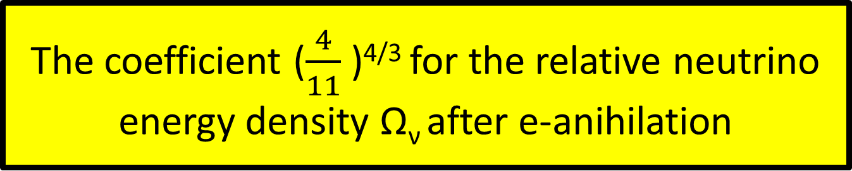
The coefficient ($\frac{4}{11}$ )^{4/3} for the relative neutrino energy density Ω_{ν} after e-anihilation
Electron-positron anihilation:
e⁺ + e⁻ → γ + γ ; Temp_{γ} increases
Phase transition conserves the specific Entropy:
σ[e⁺e⁻γγ] = g_{i} Τ_{i}³ = [ 2 + 2x7/8 + 2x7/8]xT_{i}³ =11/2 x T_{i}³
σ[γγ] = g_{f} T_{f}³ = [ 2 ] x T_{f}³
Entropy conserved: σ[e⁺e⁻γγ] = σ[γγ]
T_{i}/T_{f} = [4/11]^{1/3} ; T_{i} = T_{ν} = 1.95 K ; T_{f} = 2.72 K
Stefan Boltzmannn: P ∝ T⁴ → [4/11]^{4/3}

Slide 10
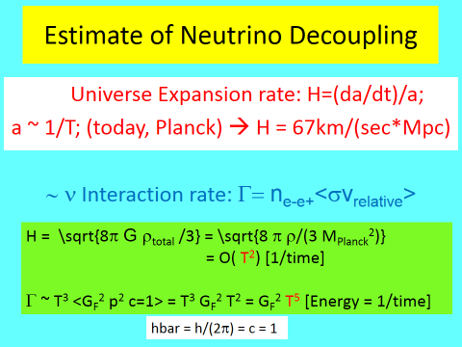
(Friedmann+Stefan-Boltzmann)

Slide 11
Neutrino Decoupling
Γ/H = ( k_{B} T/ 1MeV)³ ~ 1
T(Neutrinos)_{decoupl} ~ 1MeV ~ 10¹⁰ Kelvin;
today: T_{ν} = 1.95 K
Time after Big Bang: 1 Second

Slide 12
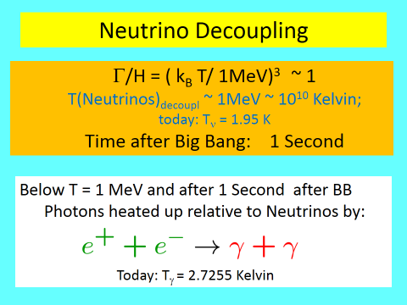


Slide 13
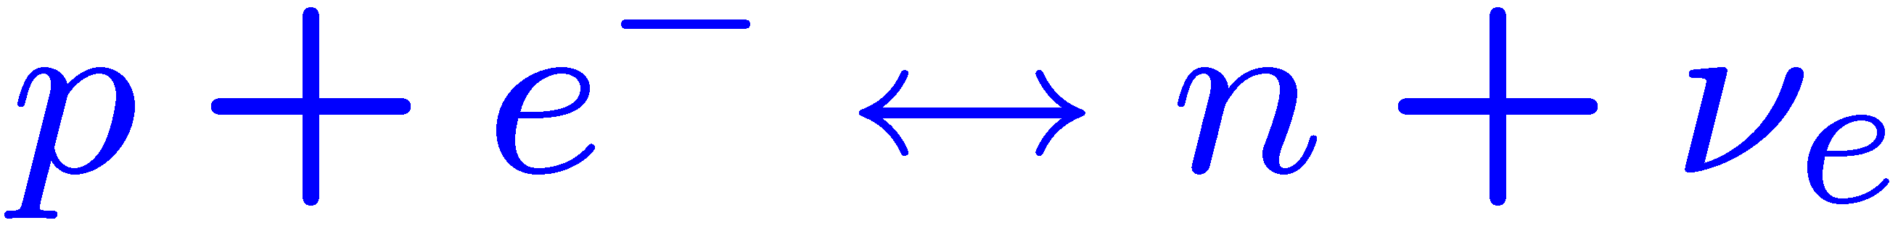
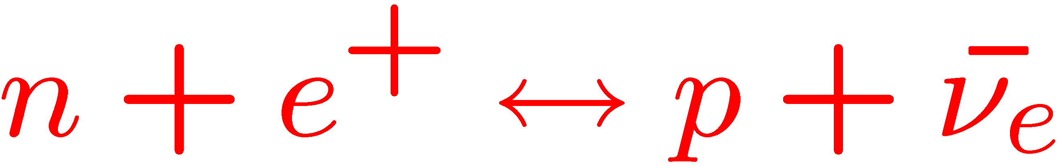
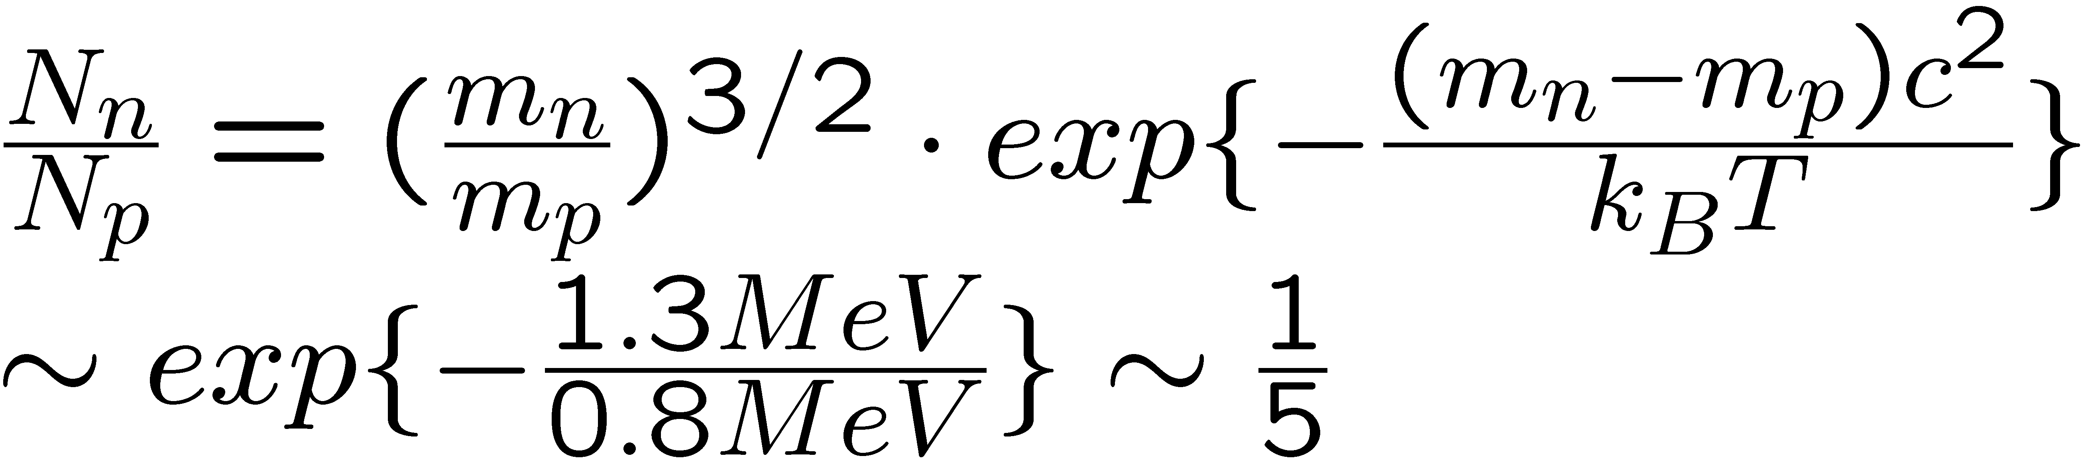
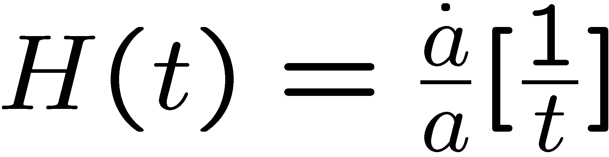
Reaktionsgleichgewicht bei Temp. = T = 0.8 MeV ; Zeit = t =6.25 sec; 3 Families of Neutrinos
→ 1/7 by n-decay
Bei T=0.8 MeV -> Ausfrieren = Freeze out;
Reaktionen/Zeit << Hubble Expansion

Slide 14
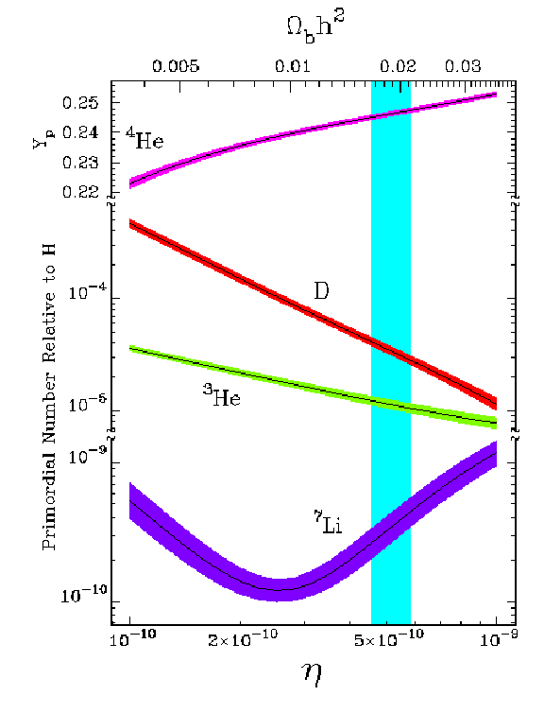
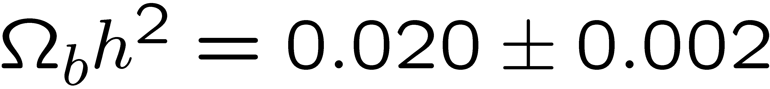
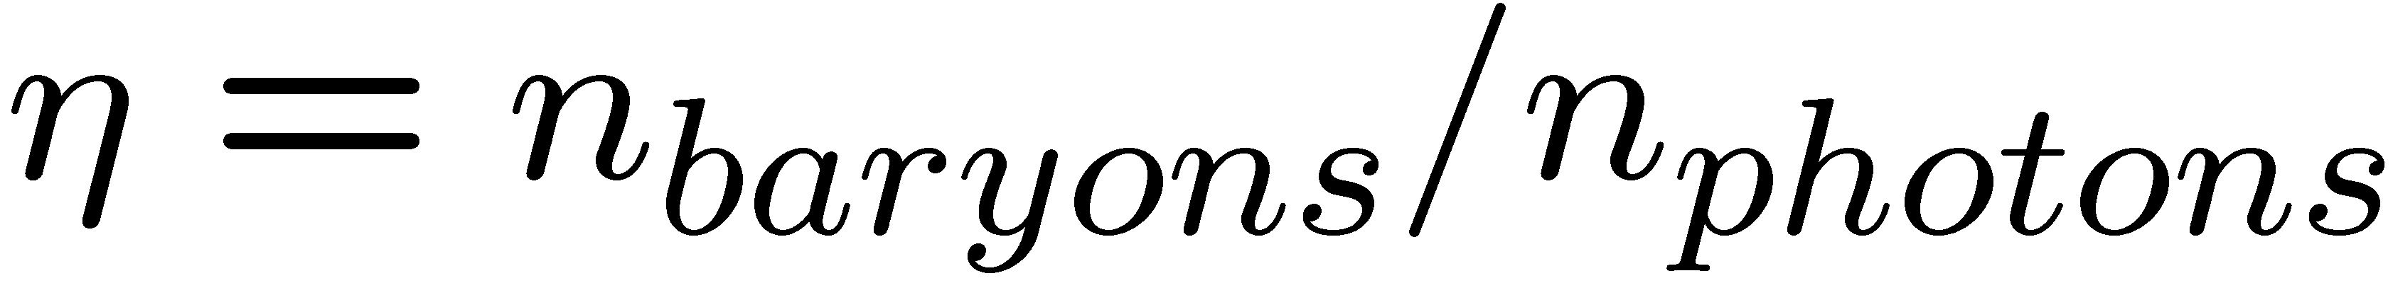
This value of η
Translates into:
= 0.5 Ω_{b}
H = h*100 km/(sec*Mpc)
H = 67 km/(sec*Mps)
Baryons: Ω_{b} ≈ 0.04
Ω_{m} ≈ 0.3; Ω_{lum} < 0.01
N_{ν} = 3.046

Slide 15
Indirect Evidence of the Cosmic Neutrino Background from Planck Data.
Brent Follin, Loyd Knox, Marius and Zen Pan, UC-Davis

Slide 16
(Energy=Mass)-Density of the Universe
Radiation dominated: ρ ~ 1/a⁴ ~ $T4$=Stefan-Boltzmann
log ρ
Matter dominated: ρ ~ 1/a³ ~ T³
Dark Energy
a(t)~1/T
1/Temp
1 MeV
1sec
ν dec.
1 eV
3x10⁴y
3000 K
300 000 y
γ dec.
8x10⁹ y
γ 2.7255 K
ν 1.95 K
today

Slide 17
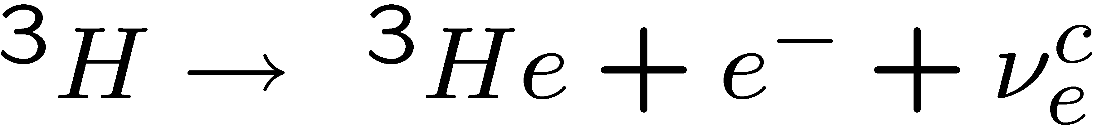
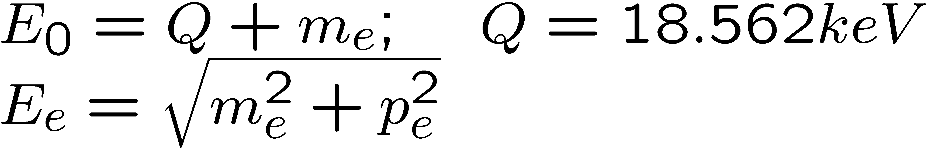
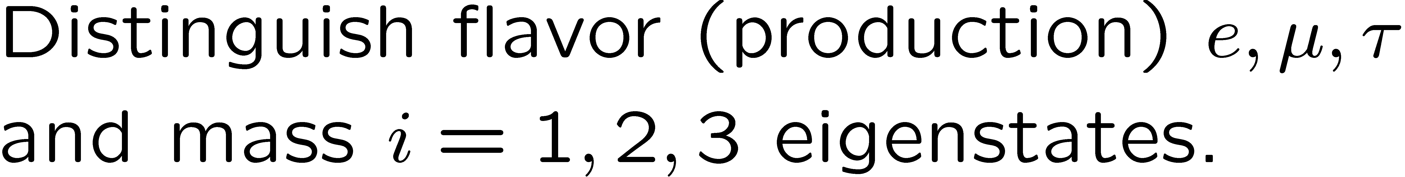
Mass of the Electron Neutrino?
Tritium decay (Mainz + Troisk)
With:

Slide 18
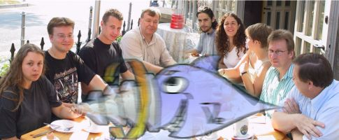
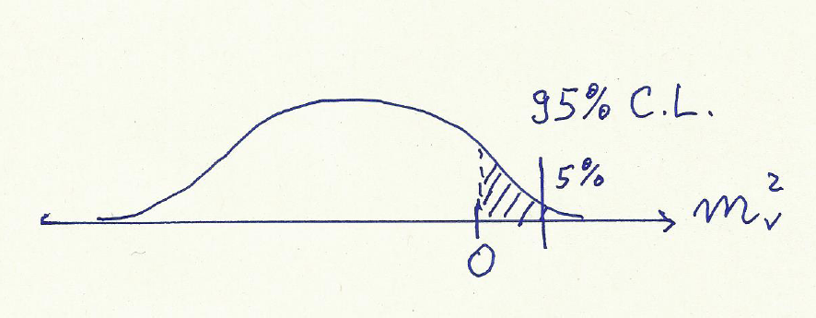
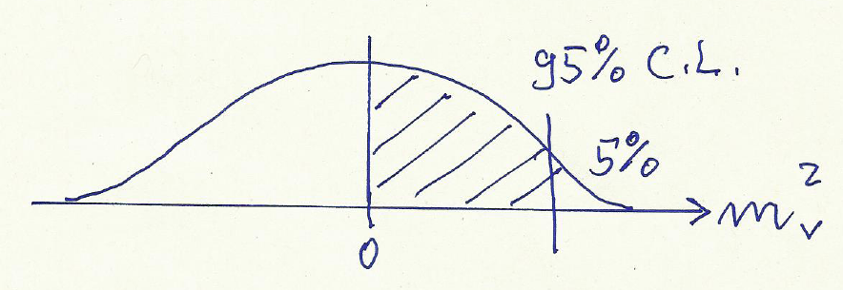
Measurement of the upper Limit of the Neutrino Mass in Mainz by the Triton Beta-Decay: m_{ν} < 2.2 eV 95% C.L.
Kurie-Plot
Eur. Phys. J.
C40 (2005) 447
m_{ν} ²>0
m_{ν}² <0
Electron Energy
Q = 18.562 keV

Slide 19
Measurement of the upper Limit of the Neutrino Mass in Mainz and Troisk by the
Triton Beta-Decay: m_{ν} < 2.2 eV 95% C.L.
Kurie-Plot
Eur. Phys. J.
C40 (2005) 447
³H → ³He + e⁻ + (anti)ν_{e}
m_{ν} ²>0
m_{ν}² <0
Q = 18.562 keV
Electron Energy

Slide 20
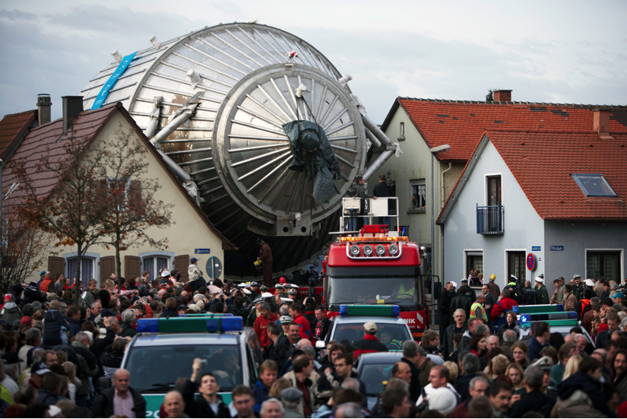
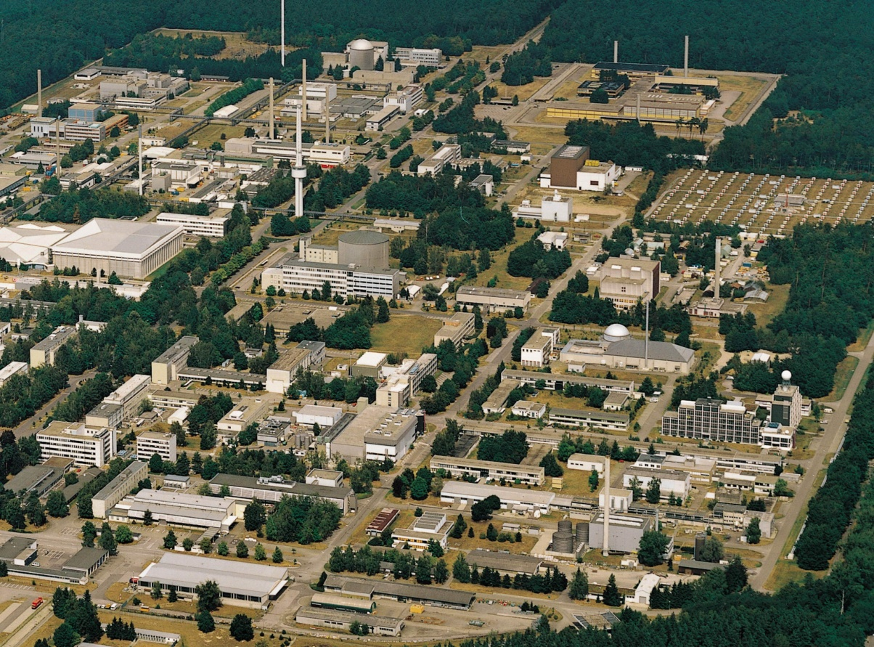
KATRIN-Spectrum in KARSRUHE.

Slide 21
Search for Cosmic Neutrino Background CνB by Beta decay: Tritium
Kurie-Plot of Beta and induced Beta Decay: ν(CB) + ³H(1/2⁺) → ³He (1/2⁺) + e⁻
Infinite good resolution
Q = 18.562 keV
Resolution Mainz: 4 eV
→ m_{ν} < 2.3 eV
Emitted electron
Resolution KATRIN: 0.93 eV
→ m_{ν} < 0.2 eV 90% C. L.
Electron Energy
Fit parameters:
m_{ν}² and Q value meV
Additional fit: only intensity of CνB
2xNeutrino Masses

Slide 22

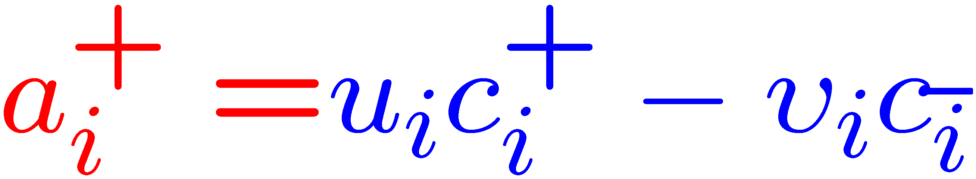
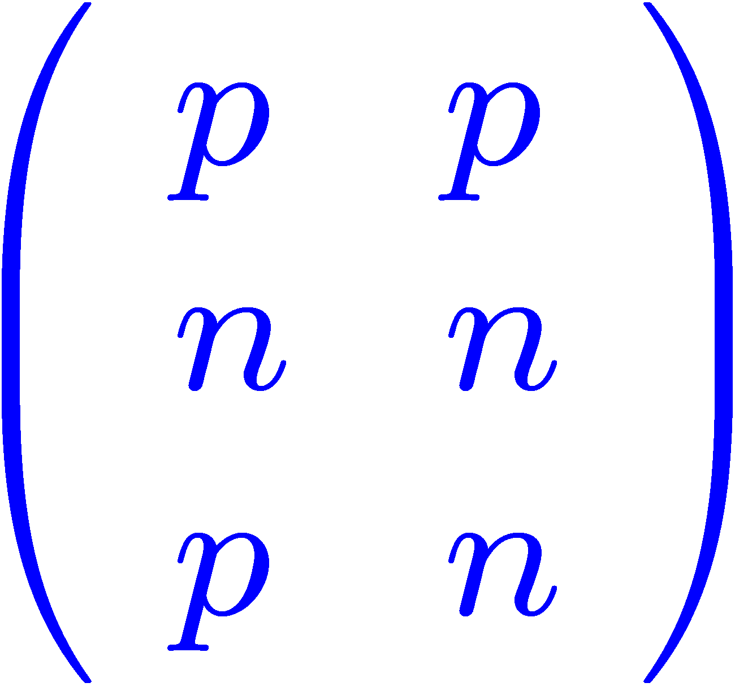
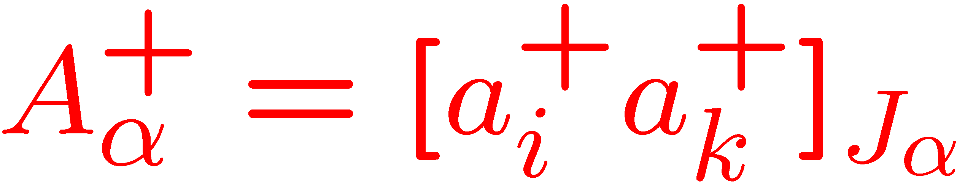
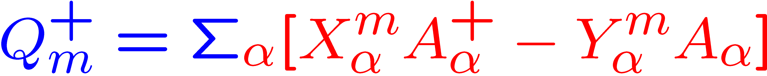
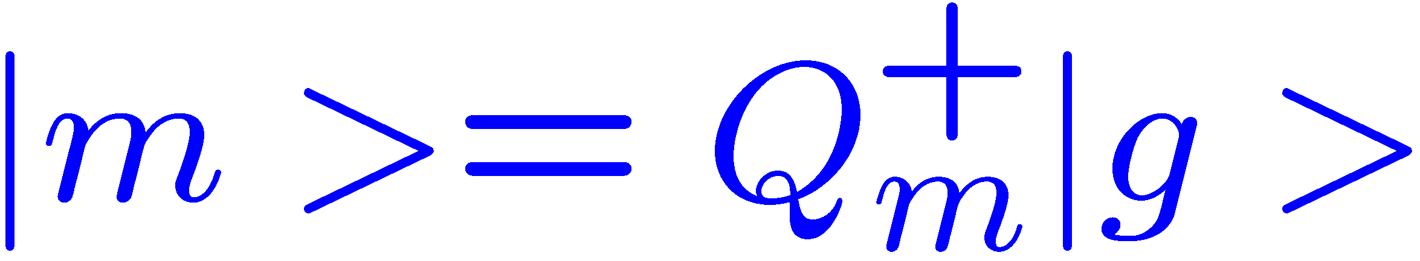
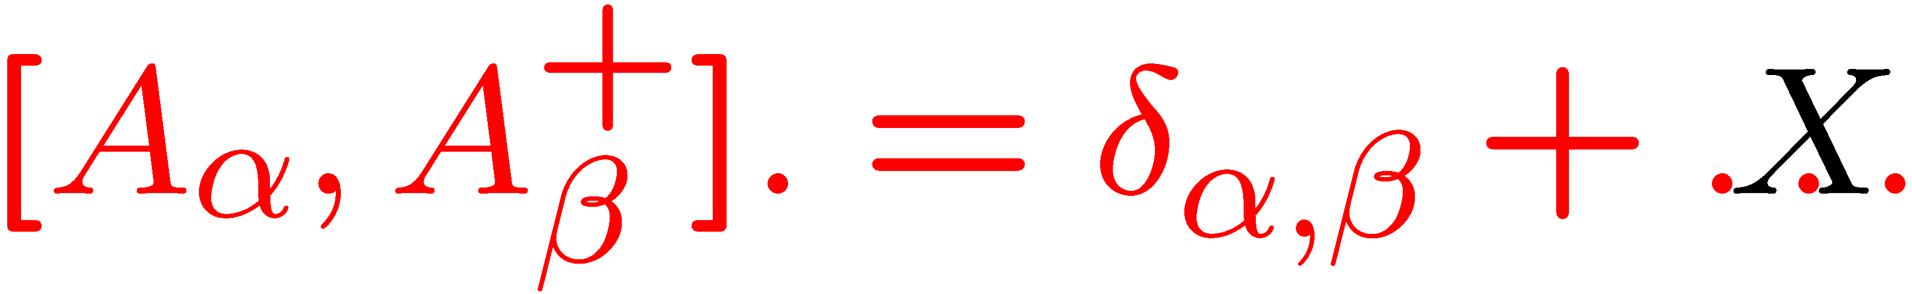
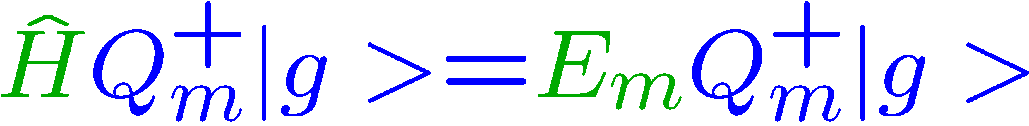

Solution of the Nuclear Structure Problem:
Pairing
Quasi-Boson Approximation

Slide 23
Neutrino Capture: ν(relic) + ³H →³He + e⁻
20 μg(eff) of Tritium → 2x10¹⁸ T₂-Molecules: N_{ν}capture(KATRIN) = 1.7x10⁻⁶ n_{ν}/<n_{ν}> [year⁻¹]
Every 590 000 years a count!! for <n_{ν}> = 56 cm⁻³

Slide 24
Two Problems
Number of Events with average Neutrino Density of n_{νe} = 56 [ Electron-Neutrinos/cm⁻³]
Katrin: 1 Count in 590 000 Years
Gravitational Clustering of Neutrinos!!!???
2. Energy Resolution (KATRIN) ΔE ~ 0.93 eV
Kurie-Plot
Emitted electron
Resolution KATRIN: 0.93 eV
→ m_{ν} < 0.2 eV 90% C.L.
Electron Energy
Fit parameters:
m_{ν}² and Q value meV
Additional fit: only intensity of CνB
2xNeutrino Masses

Slide 25
Gravitational Clustering of Neutrinos
R.Lazauskas,P. Vogel and C.Volpe, J. Phys.g. 35 (2008) 025001;
Light neutrinos: Gravitate only on 50 Mpc (Galaxy Cluster) scale: n_{ν}/<n_{ν}> ~ n_{b}/<n_{b}> ~ 10³ – 10⁴; <n_{b}>= 0.22 10⁻⁶ cm⁻³
A. Ringwald and Y. Wong: Vlasov trajectory simulations. Clustering on Galactic Scale possible (30 kpc to 1 Mpc) n_{ν}/<n_{ν}> = n_{b}/<n_{b}> ~ 10⁶ ; (R = 30 kpc)
N_{ν}capture(KATRIN) = 1.7x10⁻⁶ n_{ν}/<n_{ν}> (year⁻¹)= 1.7 [counts per year]
Effective Tritium Source: 20 microgram → 2 milligram
N_{ν}capture(KATRIN*) = 1.7x10⁻⁴ n_{ν}/<n_{ν}> (year⁻¹)= 170 [counts per year];

Slide 26
Gravitational Clustering of Neutrinos
R.Lazauskas,P. Vogel and C.Volpe, J. Phys.g. 35 (2008) 025001;
Light neutrinos: Gravitate only on 50 Mpc (Galaxy Cluster) scale: n_{ν}/<n_{ν}> ~ n_{b}/<n_{b}> ~ 10³ – 10⁴; <n_{b}>= 0.22 10⁻⁶ cm⁻³
A. Ringwald and Y. Wong: Vlasov trajectory simulations. Clustering on Galactic Scale possible (30 kpc to 1 Mpc) n_{ν}/<n_{ν}> = n_{b}/<n_{b}> ~ 10⁶ ; (R = 30 kpc)
N_{ν}capture(KATRIN) = 1.7x10⁻⁶ n_{ν}/<n_{ν}> (year⁻¹)= 1.7 [counts per year]
Effective Tritium Source: 20 microgram → 2 milligram
N_{ν}capture(KATRIN*) = 1.7x10⁻⁴ n_{ν}/<n_{ν}> (year⁻¹)= 170 [counts per year];
See also: B. Monreal (St. Barbara), J. A. Formaggio (MIT), Phys. Rev.D80 (2009) 051301 „Relativistic cyclotron radiation detection of Tritium decay electrons“
PTOLOMY (Princeton) 100 g Triton: Cosmic Neutrino Background, arXiv: 13074738v2[astro-ph] (Drexlin: Gedankenexperiment)

Slide 27
Requirements:
Maximize the number of detected 18.6 keV
electrons.
2) Conserve angular momentum for the
cyclotron motion of the electrons along
magnetic field lines.
3) Conserve magnetic flux.
4) Focus many 18.6 keV electrons into the
transport channel to the spectrometer.

Slide 28
General Conditions:
1) 18.6 keV Electrons should not scatter to much with the Tritium-Gas. One loses events. Optimum 20 micrograms.
2) Energy resolution of 1 eV requires a low magnetic field at the oposing electric field in the spectrometer. Only 1 eV in perpendicular cyclotron motion: E_{perp}/B = const
3) Magnetic flux conservation limits the source area:
A_{source} (50 cm²)* B_{source} (2 Tesla) =A_{spec} (100 m²; d ~10m)*B_{spec}(1Gauss)
4) A large magnetic field at the source required to focus as many 18.6 keV electrons into forward direction into the transport channel. Large B → large magnetic flux → large perpendicular area of the spectrometer.

Slide 29
PTOLEMY Project at Princeton
100 grams atomic Tritium
Tritium-source: 100 m² planar Graphen-surface with 3x10¹⁵ atomic Tritium‘s at carbon net pro 1 cm² → 1μg/cm² ; 0.2 eV binding;
for 100 grams → 10⁸ cm² = 10 000 m² = 100x100 m² → 100 layers;
18.6 keV electrons scatter wit 3.6 % on one layer of graphen on C.

Slide 30
Problems with Ptolomy
How to obtain 100 m² planar surface for the Tritium source?
How can an electron with 18.6 keV go through 100 graphen layers with 3.6 % probability scattering on one layer?
How to evade the magnetic mirror effect?
How can one handle 100 grams of Tritium?
Guido Drexlin calls it a Gedankenexperiment.

Slide 31
Summary 1
The Cosmic Microwave Background allows to study the Universe
300 000 year after the BB.
The Cosmic Neutrino Background
1 sec after the Big Bang (BB):
T_{ν}(today) = 1.95 Kelvin

Slide 32
Summary 2
Average Density: n_{νe} = 56 [ Electron-Neutrinos/cm⁻³]
Katrin: 1 Count in 590 000 Years
Gravitational Clustering of Neutrinos n_{ν}/<n_{ν}> < 10⁶
→ 1.7 counts per year (2 milligram ³H→ 170 per year)
2. Measure only an upper limit of n_{ν}
Kurie-Plot
Emitted electron
Electron Energy
THE END
2xNeutrino Masses

